Slide 1
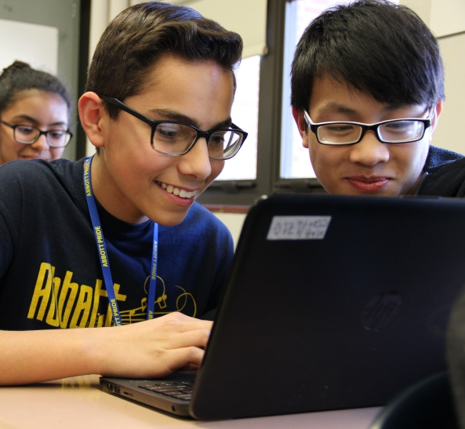
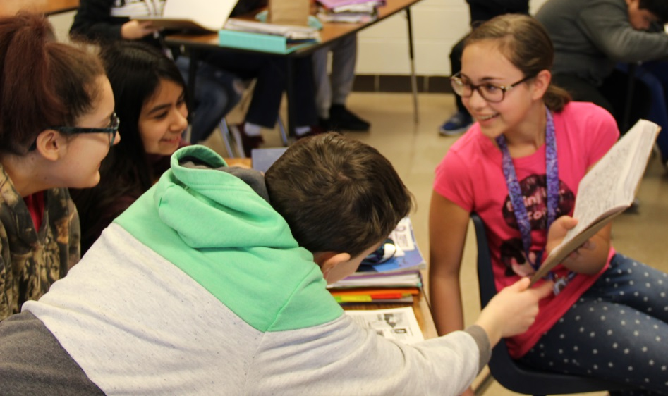
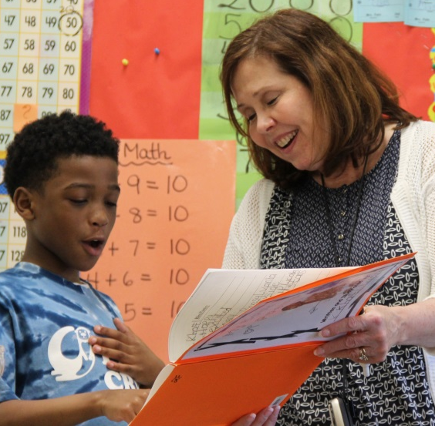
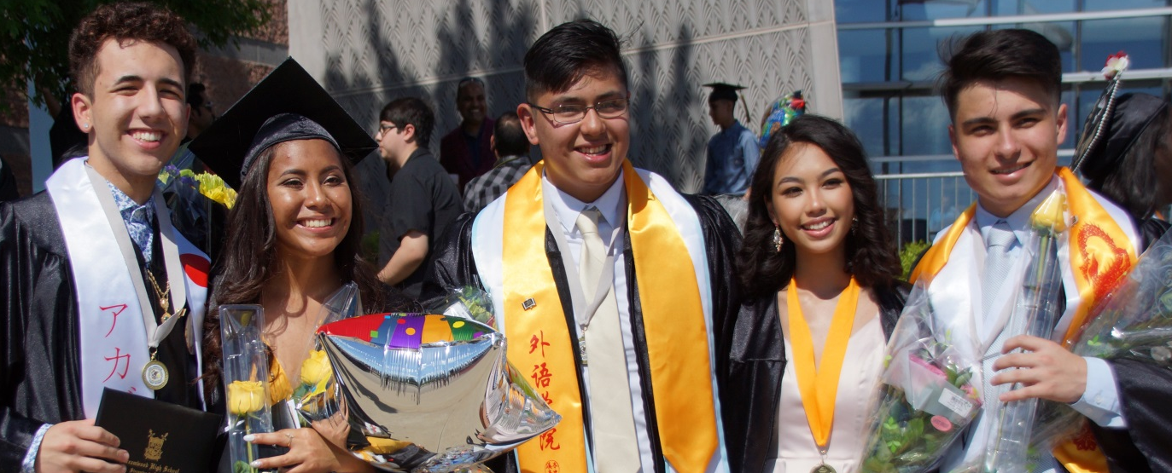
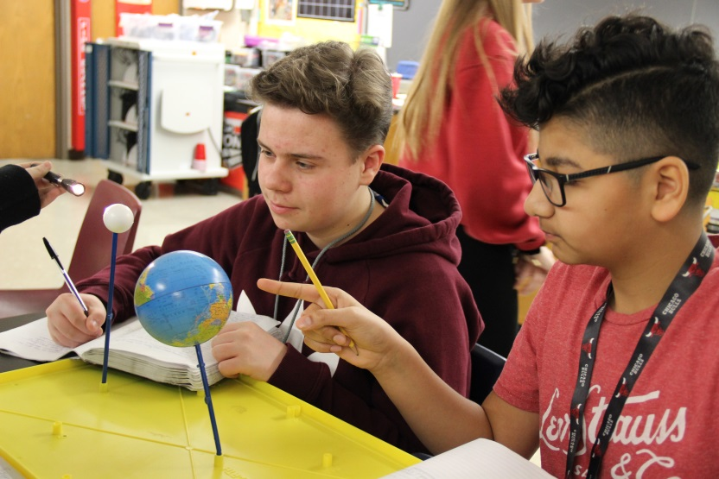

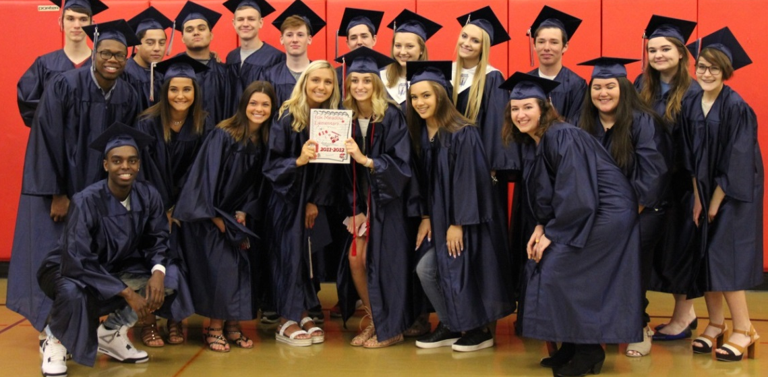

Slide 2

School District U-46
Honors Spanish 4,
Advanced Placement French Language, Advanced Placement Spanish,
and Heritage Spanish Curricular Resources
2026-2027
Board of Education Presentation
Presenters
Celia Banks, Director of Curriculum and Instruction
Jacob VandeMoortel, Coordinator of K-12 Social Studies
and World Languages
April 27, 2026

Slide 3
Purpose
This proposal seeks the adoption and funding of new curriculum and curricular resources for Honors Spanish 4, Advanced Placement French, Advanced Placement Spanish, and Heritage Spanish.

Slide 4



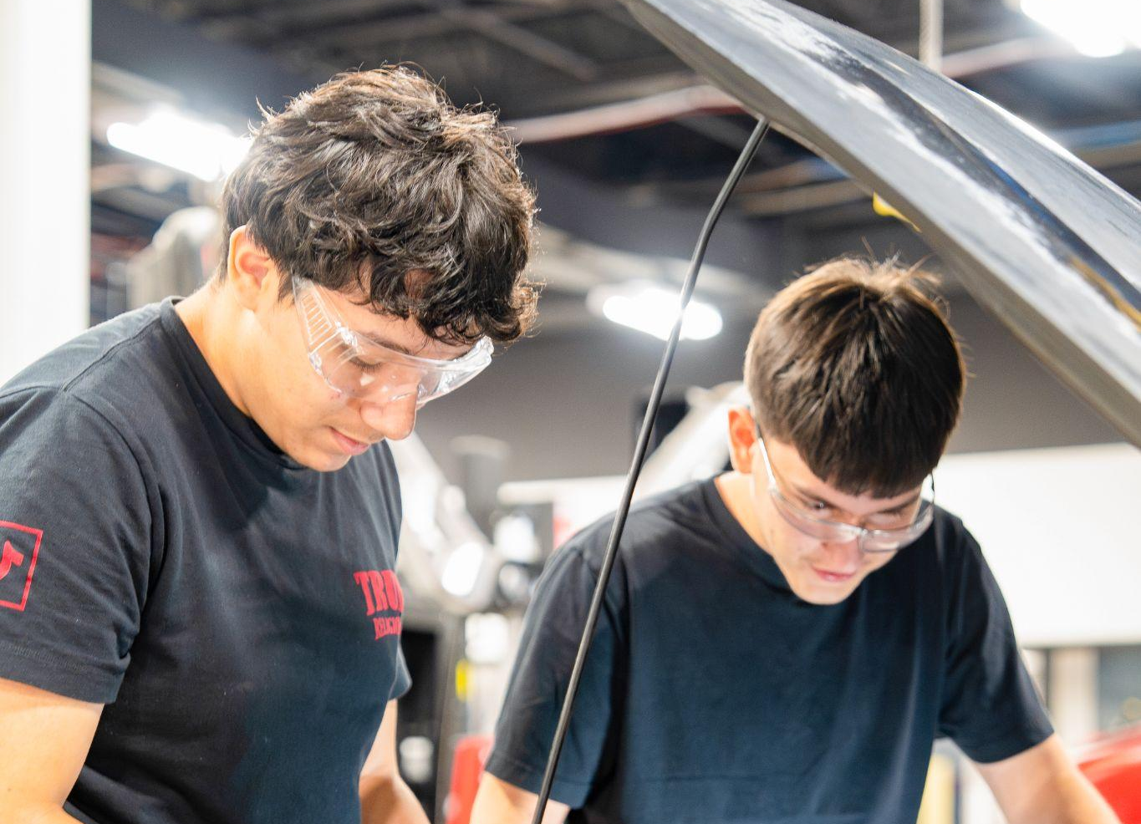




Alignment to Strategic Plan
G O A L # 1
G O A L # 2
G O A L # 3
G O A L # 4
Building
Early Academic
& Social-
Emotional Foundations
Safety,
Sense of Belonging,
& Inclusion
Academic Growth
& Mastery
Ready to Embrace
a Diverse
& Changing World
Notes:
This proposal addresses Goals 2, 3, and 4 the U-46 Strategic Plan.
The proposed curricula will provide our middle school students with exposure to multiple disciplines, such as technology, arts, and life skills, helping them make informed decisions about their future educational and career directions. This flexible system supports holistic development, keeps students motivated, and ensures a well-rounded educational experience that meets the diverse needs of the student population.

Slide 5
Rationale
Complete the transition towards Advanced Placement courses culminating world language pathways.
Create curricular units for Honors Spanish 4 aligned to new resource.
AP® Courses provide opportunities for college credit and Seal of Biliteracy as external validation for students.
With the Advanced Placement Spanish test changing, 1 year renewal bridges to the new edition.
VHL also published Heritage Galeria resources and can be bundled for significant savings.

Slide 6
Committee Members
Spanish 4 teachers collaborated around the curriculum and resource alignment.
APprenons was the universal choice by Advanced Placement French teachers.
Advanced Placement Spanish teachers asked for the 1 year bridge renewal until the new books come out.

Slide 7
Process Timeline
Japanese adds AP Japanese as Terminal course
Japanese curriculum revision moves 4th year Honors to AP and introduces curriculum libraries and cultural experience funds.
Write and adopt Honors Spanish 4 and any needed AP Resources
Select resource and backward design curriculum for Honors Spanish 4 and any AP classes for which resources are not already in place.
SY2024-2025
SY2026-2027
SY2023-2024
SY2025-2026
Propose Shift to AP as terminating course & redesign Honors Spanish 4
Major world language curriculum realignment across all languages and shift to AP as the terminal course for all languages. Retain Honors Spanish 4 with curriculum redesign.
AP options for all languages and Honors Spanish 4
Full implementation of WL programming & Review and adopt new AP Spanish Lang book/Heritage.
Values of the process:
Ensure equity of experience at all sites in all languages.
Elevate the terminal course to an externally validating outcome.
Ensure all teachers had input.
Account for the diverse language experiences of our language learners.

Slide 8



Standards
Illinois State Board of Education
American Council for the Teaching of Foreign Languages
College Board’s Course and Exam Description

Slide 9
Program Overview
French
French 1
French 2
Honors French 3
Advanced Placement® French Language and Culture*
Spanish
MS Spanish 1a/1b
OR
Spanish 1
Spanish 2
Honors Spanish 3
Advanced Placement® Spanish Language and Culture*
OR
Honors Spanish 4*
*new class to begin in SY2026-2027

Slide 10

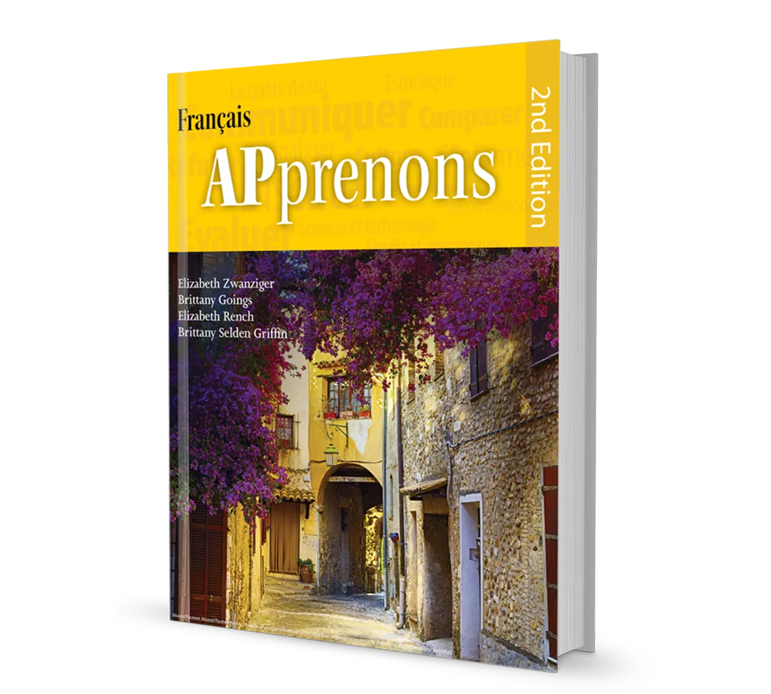
Recommended Resources
EntreCulturas 4 and APprenons from Wayside Publishing
  Industry Leader
  Proficiency and comprehension based, backwards designed
  Includes ACTFL Can-Do proficiency alignment
  Johns Hopkins reviewed and validated
  Cultivates interculturality
  Uses College Board AP Themes
  Responsive and specific professional learning
  Includes formative and summative assessment tools aligned to expected proficiency
Honors Spanish 4
Advanced Placement French

Slide 11


Recommended Resources
Temas and Galeria 1-3 from Vista Higher Learning
  Purposefully designed around ACTFL proficiency guidelines
  Built on authentic, thematically rich content aligned to College Board themes
  Emphasis on interpretive, interpersonal, and presentational communication over isolated grammar drills
  Integration of print and digital resources through online platform
  High-quality audio, video, and reading texts
  Common cartridge allows us to move units to fit our curriculum
Advanced Placement Spanish
Heritage Spanish 1-3

Slide 12
Implementation Plan
2025-2026 | ● Fourth level AP and non-AP Spanish courses listed on course selection sheets ● Write non-AP Spanish fourth level honors course ● Selection of curriculum resources
2026-2027 | ● All languages fourth level AP and non-AP Spanish courses begin ● Utilize common assessment data to determine professional learning ● Utilize resource data usage to ensure effective implementation
2027- 2028 | ● Review new Temas and Galeria for long term adoption ● Data-informed professional learning and new onboard professional learning
2028-2029 | ● Monitoring of new curriculum and resources ● Data-informed professional learning and new onboard professional learning ● Utilize common assessment data for revisions and professional learning

Slide 13
Professional Learning
2.5 hour DCD training for APprenons
2.5 hour DCD training for EntreCulturas 4
2.5 hour DCD refresher for Temas
2.5 hour DCD refresher for Galeria
Wayside Cost: $5,000.00
VHL Cost: $6,000.00
Total Cost: $11,000.00

Slide 14
Cost: Wayside Curriculum Proposal
Item | # of Years of Access | Quantity | Unit Cost | Total Cost
APprenons, 2nd Edition, Hardcover Print and Digital (FlexText + Explorer) (ISBN:9781942400356) | 5 | 36 | $202.83 | $7,301.88
APprenons, 2nd Edition, Hardcover Print and Digital (FlexText + Explorer) (ISBN:9781942400356) | 5 | 10 | $0.00 | $0.00
APprenons, 2nd Edition, Multi-Year Teacher Print and Digital Package (SC TE + Teacher FlexText + Student FlexText + Explorer) (ISBN:9781942400981) | 5 | 5 | $198.70 | $993.50
EntreCulturas - Spanish 4; Copyright 2026, Student Hardcover Print and Digital (ISBN:9781641595049) | 5 | 30 | $186.95 | $5,608.50
EntreCulturas - Spanish 4; Copyright 2026, Student Digital Package (ISBN:9781641595056) | 5 | 88 | $114.26 | $10,054.88
Professional Learning -2.5 hour DCD training for AP French Teachers -2.5 hour DCD training for Spanish 4 teachers |  | 2 | $2,500.00 | $5,000.00
Shipping and Handling |  | 1 | $1,002.40 | $1,002.40
TOTAL |  |  |  | $29,961.16

Slide 15
Cost:
Vista Higher Learning Contract Renewal
Item | # of Years of Access | Total Cost
1 Year Contract Renewal for Textbooks and Licenses | 1 | $84,589.25
Professional Learning | n/a | $6,000.00
Shipping and Handling | n/a | $0.00
TOTAL |  | $90,589.25

Slide 16
Proposed Results
Strategic Plan Goal #2
Increase in levels three and four language courses.
Increase in Panorama Sense of Belonging Scores.
Strategic Plan Goal #3
Increased Alignment to ACTFL Proficiency through District Common Summative Assessments.
Strategic Plan Goal #4
Increase number of students earning the State Seal of Biliteracy.
Increase in Advanced Placement scores.

Slide 17
Evaluation of Change
Strategic Plan Goal #2 - Deliberate Inclusion of Interculturality will manifest in improvement on Panorama scores.
Strategic Plan Goal #3 - Standards aligned, and resource supported common assessments will improve alignment and performance on district common summative assessments.
Strategic Plan Goal #4 -Wayside and VHL assessments aligned to ACTFL Proficiency will allow us to track progress toward Advanced Placement and State Seal of Biliteracy benchmarks.

