Slide 1

College Information Night
Terra Nova HS Counseling Department
April 2026

Slide 2

Counseling Department
Maya Lozowski (she/her)
School Counselor M.A., PPS
Last Names A-La
Anne Carew (she/her)
School Counselor, M.A., PPS
Last Names Le-Z
Diane Spasic (she/her)
College & Career Advisor
Mika Sasaki (she/her)
Wellness Counselor, MSW
Madeline Wilson (she/her)
Wellness Counselor II, MSW, PPS
Michela Christensen (she/her)
Registrar

Slide 3

College & Career Center
Diane Spasic - amazing resource for you and your students!
She assists students with:
Career & College exploration
College applications
Financial aid applications
Scholarships
Work permits
College tours
And much more!

Slide 4
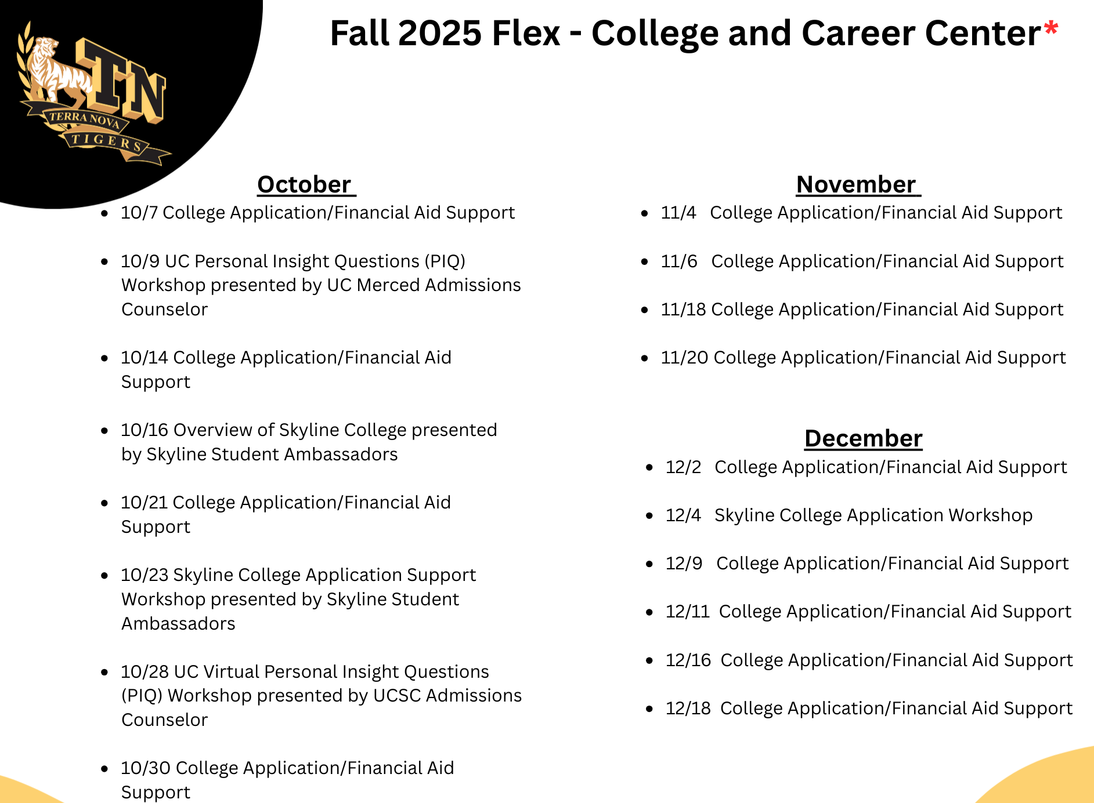
FlexTime
Workshops
WHAT:
Workshops to help navigate
academic goals
WHEN:
Tuesdays & Thursdays during Flex
WHERE:
College & Career Center
HOW:
Sign up w/School Counselors or in College & Career Center
Notes:
Maya

Slide 5


College and Career
Lunch Visits
Notes:
Anne

Slide 6
Grade Level Info
9TH GRADE | 10TH GRADE
Link Crew Transition to High School Building connections Peer Helper class visits Developing positive habits 4-year academic planning | Interest and Career Exploration Career Fair CCGI NCAA Eligibility Extracurricular participation Community involvement

Slide 7

Grade Level Info (continued)
11TH GRADE | 12TH GRADE
Post High School Exploration Resume Building Career and job preparation Volunteer/Internship experience Transcript review College campus tours | Graduation Eligibility Support in post-secondary plans College Applications Financial Aid and Scholarships Post-graduation planning Trade, College, Job, Gap Year

Slide 8

TNHS Graduation Requirements
Earn a total of 225 credits
Pass specific subject requirements
English: 40 credits (4 years)
History/Social Science: 30 credits (3 years)
Math: 30 credits (3 years)
Laboratory Science: 20 credits (2 years)
Physical Science: 10 credits
Life Science: 10 credits
Fine Art or Language Other Than English: 10 credits (1 year)
Career Technical Education (CTE): 10 credits (1 year)
Physical Education: 20 credits (2 years)
Health: 5 credits (1 semester)
Electives: 60 credits

Slide 9

Credits And Grading
Credits:
Students earn 5 credits per class, per semester
Total of 30 credits per semester or 60 credits per year
The only grade that does not provide credits to students is an “F” or “NM” grade
If a student does not receive credits for a class, they must make up the credits before graduation
Grading:
Three grading periods in a semester
Every 6 weeks
Grading is cumulative
Final grades are earned at the end of the semester- December and May
Athletic Eligibility: 2.0 gpa every 6 week grading period

Slide 10

Credit Recovery and Enrichment Courses
If your student is missing credits in certain subjects,
they do have options to recover those credits before graduation.
JUHSD Summer school
APEX (after school credit recovery)
Concurrent Enrollment at Community College
Fee-based programs outside of our district (i.e. Silicon Valley High School)
AP Courses - students may recieve college credits depending on their score and college attended
Notes:
If they don’t get into an AP class here (i.e. AP Psychology), they can take a class at the community college
Mention that students can take classes at any CCC.

Slide 11

Concurrent Enrollment
Terra Nova students can take a course at a community
college and receive college and high school credits.
Examples of courses taken at community colleges:
LOTE- American Sign Language, German, Mandarin
STEM- Human Anatomy, Physiology
Courses related to interested major- Introduction to Business
Students must apply to community college and get permission from parents/guardians and counselor
Courses are free but there might be additional fees (i.e. book fees, course fees, etc).
Notes:
Inclusive access book fee - students will be dropped if not paid by deadline

Slide 12
Concurrent Enrollment
Concurrent Enrollment is a special enrichment program designed to provide current high school students the opportunity to get an “early start” on their college experience. Most courses are CSU and UC transferable and students can earn college credit by taking online or in-person, day or evening, courses held at the CSM campus.
High school students enrolled in 11 units or fewer are not required to pay the Enrollment Fee and Health Fee. Some courses may require payment of a materials fee (See course description in class schedule). Students are expected to purchase their own textbooks as recommended or required for their college courses. This includes any Inclusive Access textbook fees that are required for the class.
Why it’s important to earn college credit while in HS
SMCCD info - Concurrent enrollment steps and Webschedule
CSU and UC recommendations

Slide 13


Middle College
Middle College at Skyline College is an innovative pathway to college and career readiness that integrates high school, college, and career training.
Middle College offers a flexible and supportive environment, allowing students to earn college credits while completing their high school graduation requirements.
Middle College at Skyline College offers:
A mature alternative to the traditional high school environment
A chance to get a head start on your college degree while earning your high school diploma
A transition to college in a flexible, supportive, and academically enriched environment
A refreshing challenge with increased individual attention
FREE Tuition
For more information or questions
please call: 650-738-4403
Notes:
UPDATE

Slide 14
Updates for Class of 2027 and Beyond
Class Ranking Updates
Beginning with the class of 2027, class rank will no longer be included on high school transcripts
No longer calculating class rank or awarding a valedictorian or salutatorian
Academic Honors
Students will no longer be awarded the valedictorian or salutatorian designations for graduation
Students will now be recognized for academic honors based on their graduation status and cumulative gpa
Summa Cum Laude - GPA of 4.0 and above
Magna Cum Laude - GPA of 3.70 - 3.99
Cum Laude - GPA of 3.5 - 3.69

Slide 15
Things to Keep in Mind for Students
Explore your options!
College visits are super important
Find a good fit for your student
Let them fill out their applications!
Context of high school
Holistic student
Finding balance - practicing self-care
Gaining experience for independence and advocacy
Community service
Clubs
Job

Slide 16
UC & CSU Eligibility Requirements (“A-G”)
History/Social Science – 2 years (1 year World History & 1 year U.S. History or 1 semester U.S. History and 1 semester American Government)
English – 4 years
Math – 3 years* (Algebra I, Geometry, Algebra II or MC1, MC2, MC3)
Lab Science – 2 years* (1 year life & 1 year physical)
Language Other Than English – 2 years* (same language)
Visual & Performing Arts – 1 year
Elective – 1 year
*additional years of subject recommended
Must earn a “C” grade or better both semesters and coursework must be CP or higher
**Each campus and/or program has specific gpa requirements
(Minimum 3.0 gpa for UCs and minimum 2.0 gpa for CSUs)
**Applications open on August 1st, 2026**

Slide 17
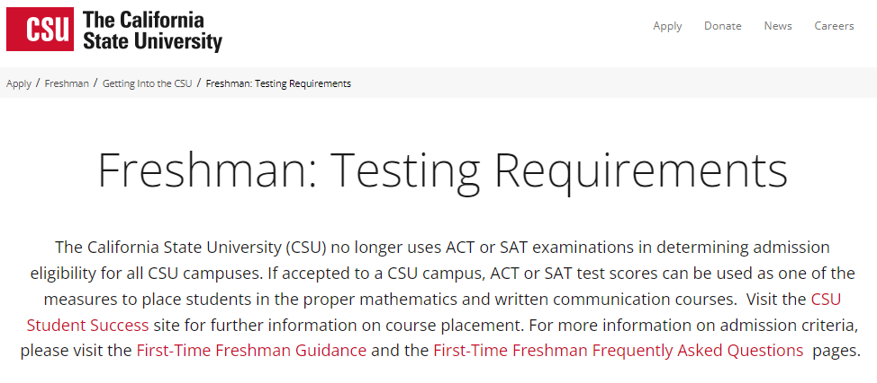
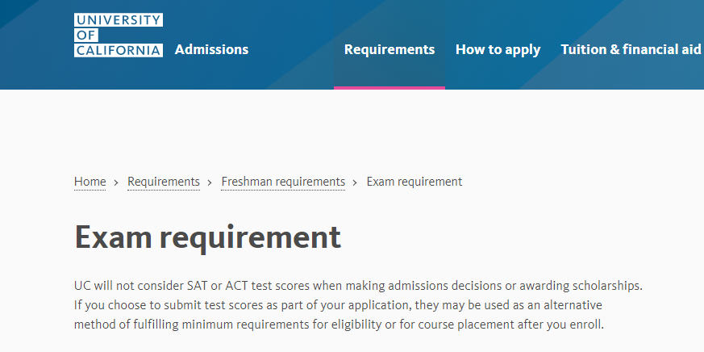
SAT/ACT
Testing
*Private/Out of State colleges and universities testing may vary, it’s encouraged to do research on specific freshmen admission req based on the individual institution.
Notes:
Any test scores sent will only be used for placement purposes only, and will only be reviewed after the student is admitted to the institution

Slide 18
How UC Applications are Reviewed
Personal Insight questions (PIQs)
Academic grade point average in all completed A-G courses, including additional points for completed UC-certified honors courses.
Number of, content of and performance in all A-G subject areas beyond the minimum requirements.
Number of and performance in UC-approved honors, Advanced Placement, International Baccalaureate Higher Level and transferable college courses.
Identification by UC as being ranked in the top 9 percent of your high school class at the end of your junior year (Eligible in the Local Context, or ELC).
Quality of your senior-year program as measured by the type and number of academic courses in any A-G subject area in progress or planned.
Quality of your academic performance relative to the educational opportunities available in your high school.
Outstanding performance in one or more specific subject areas.
Outstanding work in one or more special projects in any academic field of study.

Slide 19
How UC Applications are Reviewed
Recent, marked improvement in academic performance as demonstrated by academic GPA and the quality of coursework completed or in progress.
Special talents, achievements and awards in a particular field, such as visual and performing arts, communication or athletic endeavors; special skills, such as demonstrated written and oral proficiency in other languages
Special interests, such as intensive study and exploration of other cultures
Experiences that demonstrate unusual promise for leadership, such as significant community service or significant participation in student government; or other significant experiences or achievements that demonstrate the student's promise for contributing to the intellectual vitality of a campus.
Completion of special projects undertaken in the context of your high school curriculum or in conjunction with special school events, projects or programs.
Academic accomplishments in light of your life experiences and special circumstances, including but not limited to: disabilities, low family income, first generation to attend college, need to work, disadvantaged social or educational environment, difficult personal and family situations or circumstances, refugee status or veteran status.
Location of your secondary school and residence.

Slide 20
UC Eligibility in the Local Context (ELC)
Eligibility in the Local Context (ELC)
A program by which the University of California identifies top-performing California resident high school students.
ELC draws qualified students from among the top 9 percent of each participating high school.
California resident applicants receive ELC status if they:
Attend an ELC-participating high school,
Have taken a specific pattern of 11 A-G courses prior to the 12th grade
Have a UC-calculated GPA that meets or exceeds the 9 percent benchmark GPA calculated by UC for their high school.

Slide 21
New! CSU Direct Admissions Program
The CSU system has established a statewide CSU Direct Admissions Program. The CSU will make an offer of admissions before a student has even applied if they meet certain academic standards. Students choose if they initiate next steps.
What are the 16 CSUs I have been admitted to?
CSU Bakersfield Cal Poly Humboldt Cal State San Bernardino
CSU Channel Islands Cal State LA Cal State San Marcos
Chico State Cal State Monterey Bay​ San Francisco State
CSU Dominguez Hills CSU Northridge​ Sonoma State
Cal State East Bay Sacramento State Stanislaus State
Fresno State
How will students be informed they have been admitted? The CSU will work with districts and high schools to obtain student information to inform students they are admissible to the CSU. This will occur with the admission cycle of fall 2027.
Do students need to still apply and submit a Cal State Apply application? Yes. In order to receive an official offer of acceptance from a campus, students will still need to submit an application.
Is there a fee to apply? Yes, students will need to still complete an application and pay the $70 application fee/campus. Application fee waivers are automatically calculated in the Cal State Apply application, and if students qualify they can use it for up to four ​CSU campuses.

Slide 22


Community College
Community College
Free tuition to Skyline, College of San Mateo or Cañada College
AA Degree (Cosmetology, EMT, Respiratory, Radiology, etc.)
Vocational Programs
Transfer to 4-year university
Promise Scholar Program

Slide 23



Transfer Programs

Slide 24
Private Schools/Out of State Colleges
Check individual admission requirements
SAT or ACT with Writing (check with individual colleges)
Most require personal statement essays, letters of recommendation, and transcript
May require supplemental information (i.e. portfolio)
Letter of Recommendation packet
Many accept the Common Application
www.commonapp.org
WUE Schools https://www.wiche.edu/tuition-savings/wue/

Slide 25
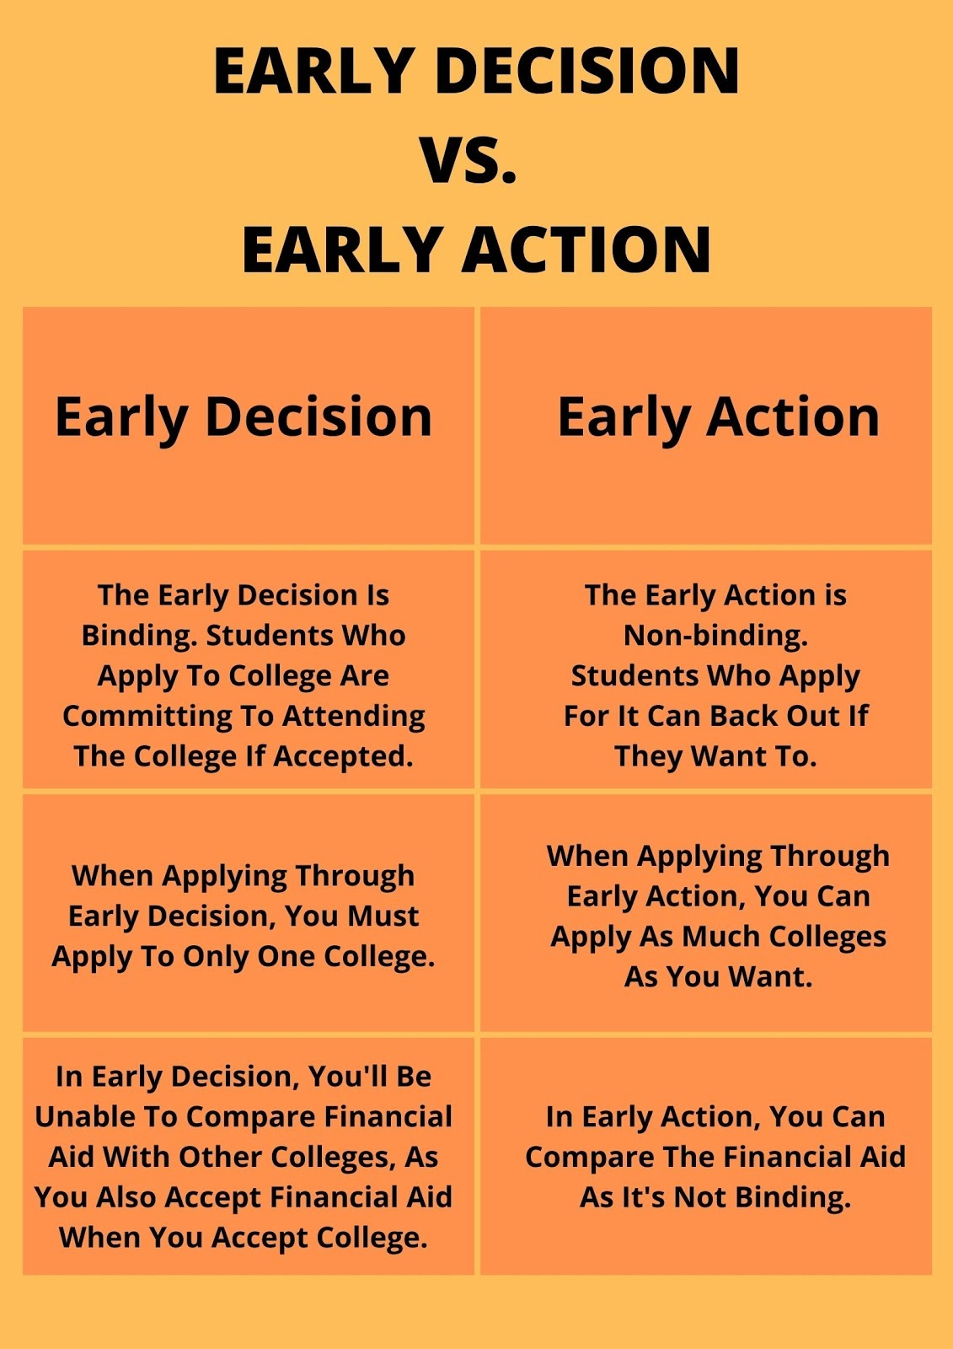

Early Action vs Early Decision
Early Decision (ED) is a binding application where you must attend if accepted, offering higher acceptance rates.
Early Action (EA) is non-binding, allowing you to apply to multiple schools, receive early notifications, and decide by May 1.
ED is for top-choice, certain schools, while EA offers flexibility.

Slide 26

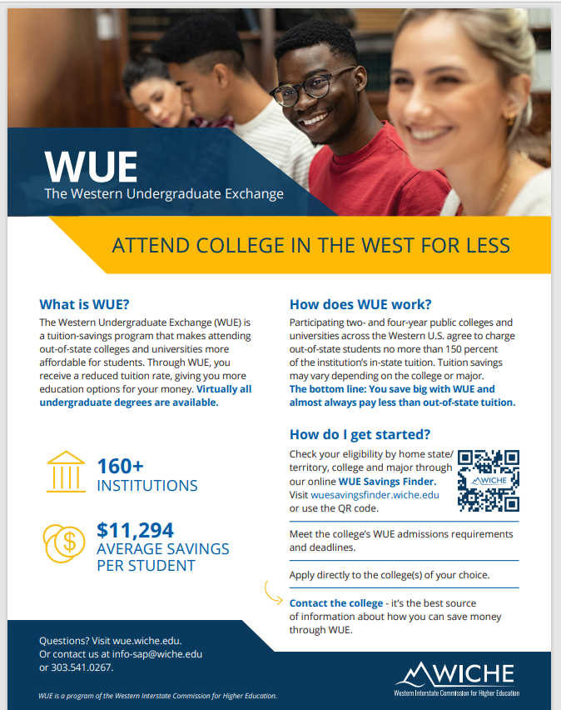
The Western Undergraduate Exchange (WUE) is an agreement among WICHE’s 16 member states and territories, through which 160+ participating public colleges and universities provide steep nonresident tuition savings for Western students.
Through WUE, eligible students can choose from hundreds of undergraduate programs outside their home state, and pay no more than 150 percent of that institution’s resident tuition rate.

Slide 27

National Collegiate Athletic Association (NCAA)
The NCAA is an organization dedicated to providing a pathway to opportunity for college athletes. Over 1,000 colleges and universities are members of the NCAA.
If you want to compete at an NCAA Division I or II school, you must meet academic and amateurism standards set by NCAA members.
As a college-bound student-athlete, you’re responsible for your eligibility — that means planning ahead, taking high school courses seriously and protecting your amateur status. It can be a challenging step, but the benefits of being a student-athlete are worth the effort.
http://fs.ncaa.org/Docs/eligibility_center/Student_Resources/CBSA.pdf

Slide 28

CAASPP Testing- 11th Grade
The Early Assessment Program (EAP) is designed to provide students with an early signal of college academic preparation through California Assessments of Student Performance and Progress (CAASPP/EAP) results.
CAASPP/EAP scores are ONE of the multiple measures the CSU utilizes as an indicator of students’ readiness for college-level coursework in English and mathematics and for placement of first-time freshman in the appropriate General Education (GE) English and mathematics courses once they enroll at the CSU.
Each spring, all grade eleven students in California take the Smarter Balanced Summative Assessments for English language arts/literacy (ELA) and mathematics administered as part of the California Assessment of Student Performance and Progress (CAASPP) System.
The release of the CAASPP results will not affect a student’s application for admission. Results are only used to determine a student’s placement after he or she has been admitted to the CSU. Some, but not all, CCC accept EAP scores. Students may submit a copy of their score report to a CCC if requested.
Notes:
Any test scores sent will only be used for placement purposes only, and will only be reviewed after the student is admitted to the institution

Slide 29

Financial Aid
All seniors must apply for FAFSA or CA Dream Act, unless opted-out
Opt-out form will be available on the district website
Free Application for Federal Student Aid, (FAFSA), Priority Deadline: March 2, 2027
California Dream Act, Deadline: March 2, 2027
CalGrant - Rising 12th grade students -
Promise Scholarship - Free tuition & more at MANY community colleges
Other Scholarships
TN Scholar Awards - Spring semester of senior year
Notes:
Anne

Slide 30

Your Student May Be Eligible for a CalKIDS Scholarship (worth up to $1,500)
Visit CalKIDS.org
As a California public school student, your child may be eligible to receive a CalKIDS Scholarship of $500 to $1,500 for college or career training. Funded by the State of California, a CalKIDS Scholarship can be used for qualified college and career training expenses such as tuition and fees, books and supplies, and computer equipment.
Checking a student’s eligibility and claiming a CalKIDS Scholarship is quick and easy; it only takes a minute. All you need is your child’s 10-digit Statewide Student Identifier (SSID), which can be found through StudentVUE. For more information, to check your child’s eligibility, and claim their scholarship, visit CalKIDS.org.
Notes:
Anne

Slide 31

California College Guidance Initiative (CCGI)
JUHSD has partnered with the California College Guidance Initiative (CCGI) to help your child develop a well-informed college and career plan.
CCGI is a nonprofit that works with school districts throughout California to achieve two major goals:
(1) to ensure that all high school seniors in California graduate with clear postsecondary goals and a plan for how to achieve them, and (
2) that each student’s academic transcript data follows them as they advance across educational systems to reduce information gaps that could otherwise hinder their success.
As a partner with CCGI, JUHSD’s students have access to exclusive tools and resources to support their college and career planning, such as career assessments, student-friendly college and career search tools, quick college application launches, information on scholarships, financial aid, and so much more!

Slide 32
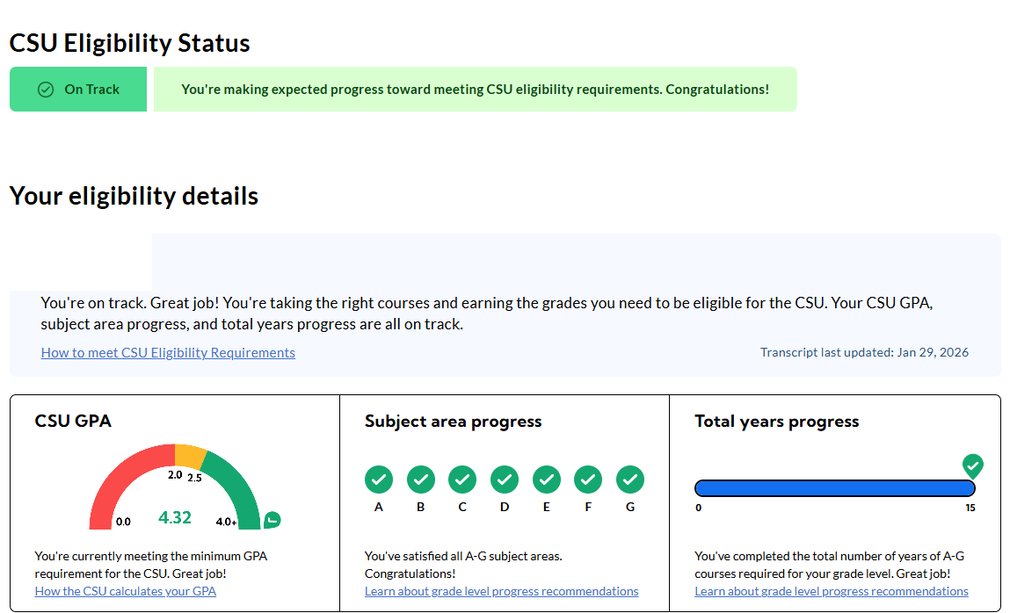
CaliforniaColleges.edu
Find your A-G and GPA progress for UC/CSU

Slide 33
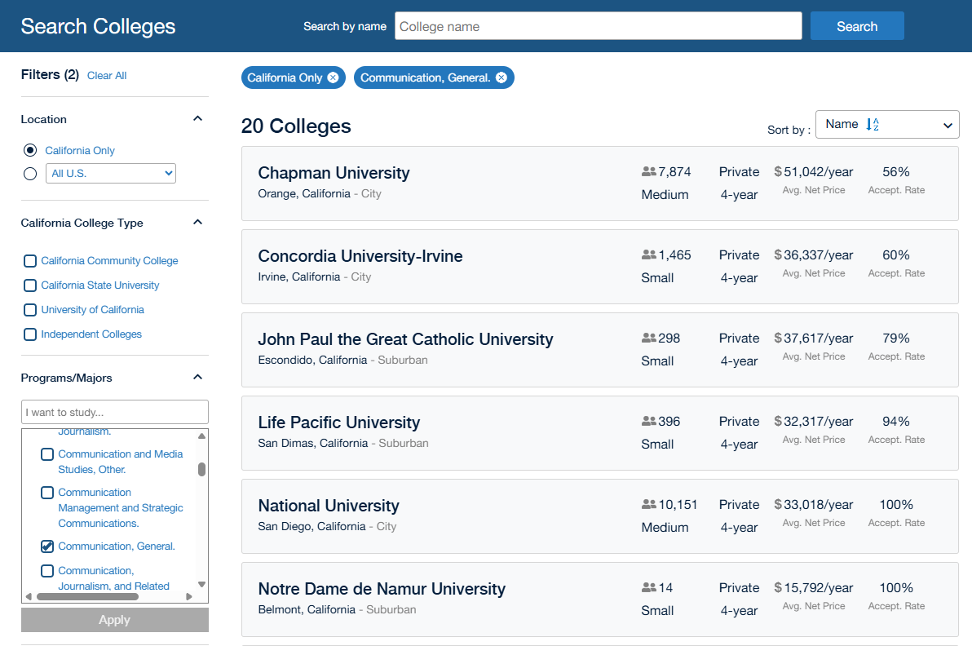
CaliforniaColleges.edu
Search for majors and colleges

Slide 34
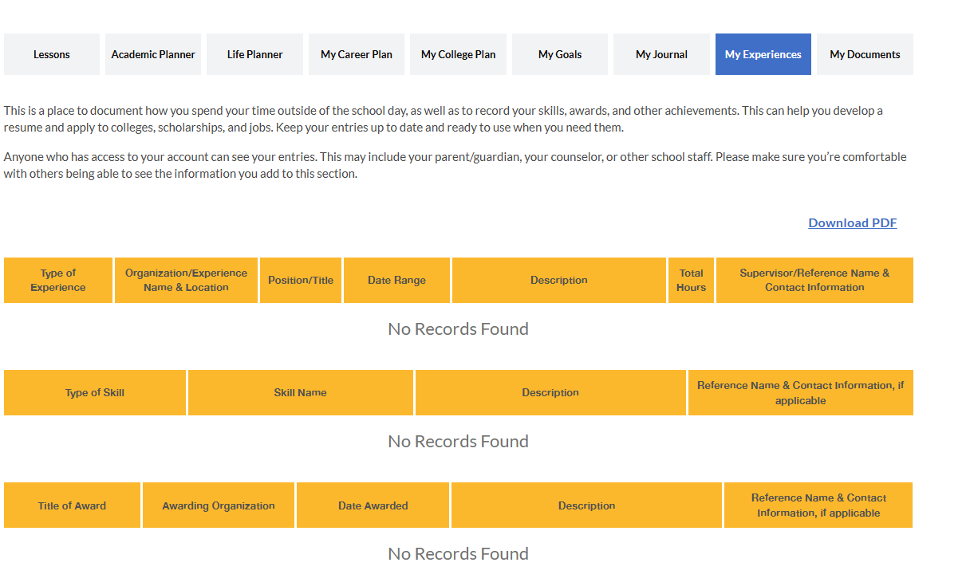
CaliforniaColleges.edu
Track your extracurricular activities: sports, volunteer, clubs, awards, etc

Slide 35

College Admissions Statistics
UCLA admit rate for the class of 2025 was 9%
UC Berkeley admit rate for the class of 2025 was 11.4%
All other UC acceptance rates range from 28% to 87%
Most competitive CSU campuses -
Cal State Fullerton
Cal State Long Beach
Cal Poly Pomona
San Diego State University
San Jose State University
Cal Poly San Luis Obispo
Most competitive majors -
Nursing
Computer Science
Biological Sciences
Engineering majors

Slide 36
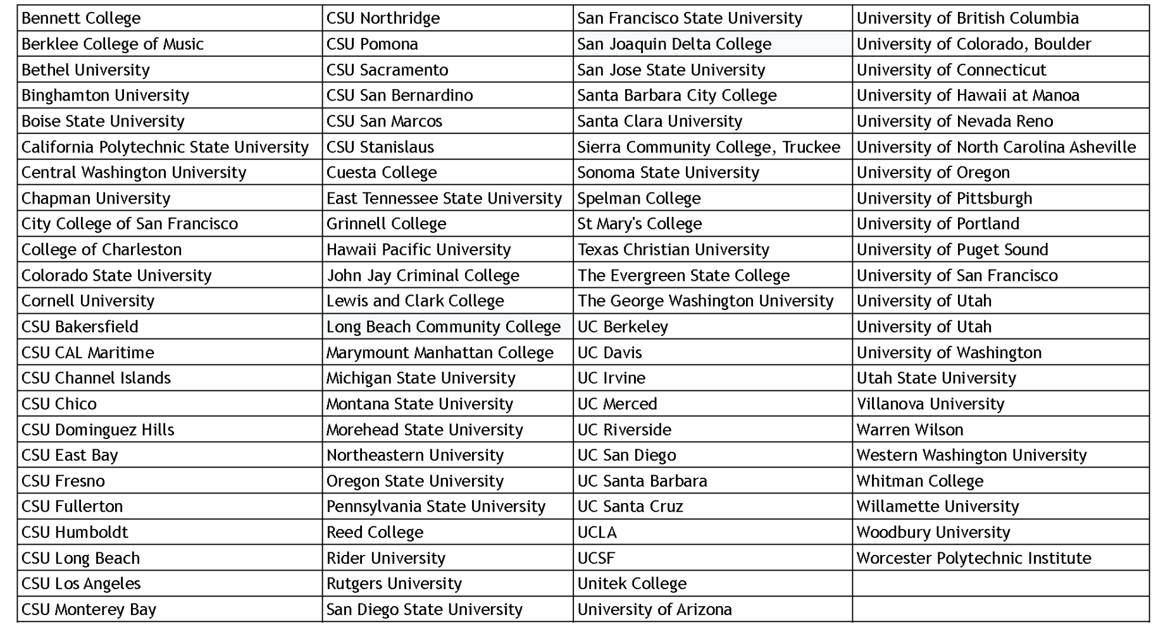
Colleges TN Graduates Attend
Notes:
Maya

Slide 37
Other Post High School Options
It is important for students to understand that most of their post high school options require a high school diploma including, Trade Schools, Unions Programs and the military.
Apprenticeship Programs - Trades (TIPS Program)
Gap Year
Armed Forces
*Math is crucial for any of these options- maybe even the gap year…
Notes:
M

Slide 38


TIPS Program
There are 453 labor/trade unions in the greater bay area.
Most Trade Unions Require (some will require more and some less)
Must be 18 yrs old in CA
A high school diploma or GED certificate (some require a specific grade in Algebra)
A valid driver’s license
Pass an aptitude test
Background check/Drug Test
Birth Certificate/SS Card
Once requirements are met, applicant are placed into a pool for companies to hire. When joining a union applicants start as apprentices with specific required on the job training hours and classes 2-4 hours a week.
State certified joint apprenticeship training program lasting about 20 weeks, with classes twice a week from 6-9pm
The TIP Program includes the following:
4 Certifications: CPR/First Aid card, OSHA 10 card, Trades Intro Program Certificate, National Building Trades Certificate
Blueprint Reading & Technology
Tool Identification and Practical Application
Basic Construction Math
American Labor History
Knowledge of Construction/Build Trades Unions
Presentations from 12+ local building trades
Roles of Building Trades Professionals
Job-site Attitudes and Behaviors
Local Union Code of Conduct
Union Member, Apprentice Roles & Responsibilities
Green Construction
Construction Industry Awareness
Notes:
Michela

Slide 39

Senior Year Sneak Peak…
Parchment - What is it and how to make an account?
Keep an eye out for the fall senior parent meeting
Application deadlines, financial aid, Couseling/C&C parent nights, awards and grade details, graduation day prep
Athletics - Block Jackets/ Senior Nights
Senior activities - School vs. non school and overview of whats coming up
What we need from you…

Slide 40
QUESTIONS?

