Slide 1

Welcome
Title I Annual Public Meeting
August 2025
Notes:
We would like to welcome you to our Annual Public Meeting. The purpose of the Annual Public Meeting is to inform you about our Title I program at…. Thank you for being here and giving us some of your important time.

Slide 2
Welcome Families
Agenda
Title I Program Overview
Read to Achieve Updates
Our Title I Plan for 2025-2026
Title I Staff
Parent and Family Engagement
Student/Teacher/Parent Compact
Parent Resource Center

Slide 3
Title I Program Overview
Title I is a federally funded program under the Every Student Succeeds Act (ESSA) of 2015.
Title I is a federally funded program under the Every Student Succeeds Act (ESSA) of 2015.
It provides funding for high poverty schools to help students who are behind academically or at risk of falling behind to meet our state's academic content and performance standards.
Schools qualify for Title I funds based on poverty level
(Free/Reduced Lunch numbers)

Slide 4
North Carolina Read to Achieve
“The goal of the State is to ensure that every student read at or above grade level by the end of third grade and continue to progress in reading proficiency so that he or she can read, comprehend, integrate, and apply complex text when needed for secondary education and career success.”
Notes:
Read to achieve is something you will hear a lot about this year. Read to achieve is a statewide initiative that will go into effect this school year. It states the following.

Slide 5
North Carolina Read to Achieve
Plan Components
NC Comprehensive Literacy Plan
K-3 Diagnostic Reading Assessment (mClass)
Third graders not performing on grade level
Retention, Summer Reading Camp, Fourth Grade Transitional Classes
Notes:
These are the major components of the read to achieve program.
- NC has had a comprehensive literacy plan in place to ensure proficiency by the end of grade 3
- mClass is our assessment for reading in grades K-3 . We will use mClass to help us know what your students need more help on.
- For third grade students who are unable to meet grade level standards we will have a summer reading camp in place to help them to meet grade level standards
- Students who are unable to meet standards at the end of summer reading camp will be placed into 4th grade transitional classes in order to help them continue to close the gap. More information on these components will be available as the year continues.

Slide 6
Read to Achieve
All teachers will implement the K-5 reading assessments
Parents, staff, and students will be informed about NC Read to Achieve throughout the 2024-2025 school year
Parents will receive mClass reports to explain where their child is reading and suggestions to do at home
Notes:
Here at ….we will be doing everything we can to help your children meet grade level expectations. We will be using new assessments and providing you with a lot of information to help you and your child.

Slide 7
Title I
School-Wide Process
  A needs assessment of the school is conducted and the data analyzed
  The needs assessment guides the development of our School Improvement Plan in collaboration with administrators, faculty, parents, students, and community
  Students performing below standard receive differentiated instruction by highly qualified intervention specialists in addition to classroom instruction
  Collaboration about curriculum strategies occurs between the intervention specialist and classroom teacher. Data-driven dialogue supports and monitors student progress
Notes:
Each year …completes surveys and this data is analyzed in order to decide how our Title I money will be spent each year. These surveys are very important so please make sure to send them back. The opinions of staff, students, and parents are taken into account when making decisions. Our goal is to help all of the Students at ___________________ do the best that they can and to help them on their way to graduation. Our staff meets on a continual basis to share data on students and to make decisions about how we can best help your children.

Slide 8
Title I Plan
Our Title I Program for
2025-2026 consists of the following:
ClassDojo: We will utilize ClassDojo as our platform for communication this school year.
Title I Budget:
Full Time Instructional Specialist
Part Time Instructional Specialist
Full Time Instructional Assistant
Part Time Instructional Assistant
Notes:
After completing our surveys and meetings this past year we decided to use our funding to pay for the following things.

Slide 9
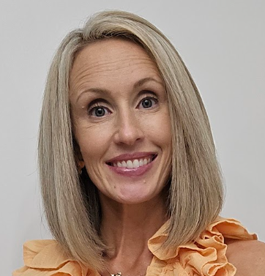
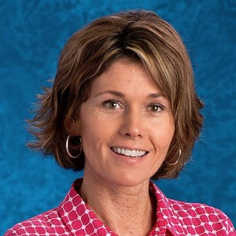
Meet our Title I Staff
Amanda Rich
Instructional Coach
Sharon Cooke
Reading Specialist

Slide 10
Parents Right to Know
Title I schools must meet federal regulations related to teacher qualifications and state assessments as defined in the ESEA (Elementary and Secondary Education Act) and ESSA (Every Student Succeeds Act).
Parents have a right to know:
The qualifications of their child's teacher
Information on the level of achievement of their child
If their child is being taught by someone who is not "highly qualified" and will be in that position for four or more weeks
The school's parent policy and have input in the decisions that make up the school's policy
How your child's school is performing

Slide 11
Ways to Help Your Child at Home
  Be involved
  Attend family nights
  Attend all parent teacher conferences
  Attend PTO events
  Volunteer your time at the school
  Talk to your child about school
  Check homework nightly
  Read to your child
  Check-out Parent Resource Center

Slide 12
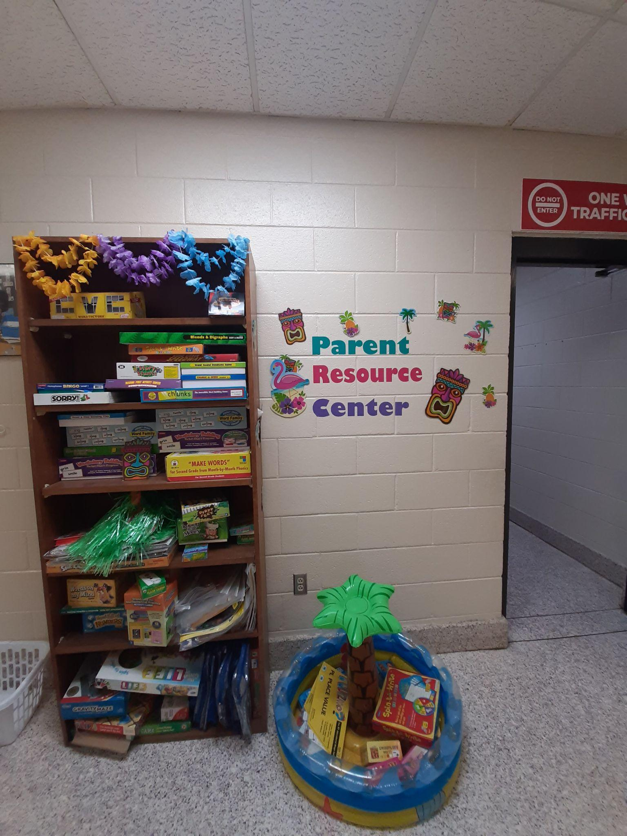
Parent Resource Center
Visit our Parent Resource Center (located beside our cafeteria) to check out educational materials and games that you can take home to practice concepts that your child is learning about at school.
Notes:
Discuss how the resource center can be used to work with students at home. Upload a picture of your resource center.

Slide 13
Parent -Teacher-Student Compact
Everyone has a role and responsibility in ensuring the success of all students.
Parent Compacts outline how the school and families will work together to ensure your child’s success.

Slide 14
Upcoming Events
October: Literacy Lunch and Learn
February/March: Math Event
*Actual dates for these events will be sent out closer to the event.

Slide 15
Questions
Thank you for coming!
Notes:
Make sure you have a sign in sheet

