Slide 1
Day 1: Project Overview & Mythbusters

Slide 2
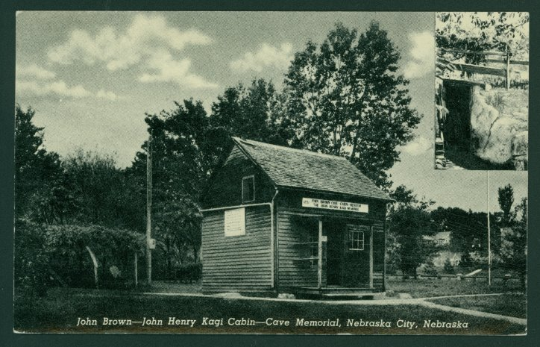
Our Research Project
Omaha Public School 8th grade students will learn about the Nebraska territory's role in slavery and the Underground Railroad from 1854 to 1861. ​​
Projects will uncover and share the history of Nebraska’s Underground Railroad sites, Nebraska’s abolitionists, Nebraska’s slave owners and its Freedom Seekers.

Slide 3
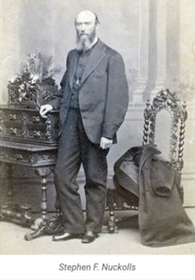
How are we gonna do it?
Learning how to access Nebraska’s Territorial Newspapers and History Nebraska’s Journals to uncover the stories of Freedom Seekers, the Underground Railroad and slavery in Nebraska. ​
​
Working in pairs to select a Nebraska abolitionist, Freedom Seeker or slave owner to research and present a final project

Slide 4
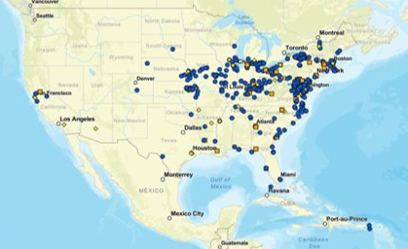
Your final projects
Work with UGRR scholars and teachers to create a final project. ​
​
Final maps produced by you will show the locations of Nebraska and Western Iowa’s UGRR sites. ​

Slide 5
MIHV Website Scavenger Hunt
GOAL: Explore past MIHV projects to understand your role this summer.
Let’s find out what previous student projects have looked like
With a partner, scan the QR code at the top of each page
Answer the questions on that page
Do as many as you can in 10 minutes! It’s fine if you don’t finish them all

Slide 6

What do we know about slavery?
GOAL: Activate our memories of what we already know about slavery in the United States.
Movement: Move from poster to poster at your own speed. Try not to make a huge clump in front of a poster so others can participate.
Voice: CHALLENGE! Can you do this without talking?
Participation: write names of people or laws, ideas, or facts you think you know about each topic on its own sticky note and add it to the poster. If you aren’t 100% sure, write it anyway!

Slide 7
Slavery: Myth vs. Fact
GOAL: Decide what is real and what is a myth about slavery in the United States
Slavery was mainly a problem in the South.
Many supporters of slavery or enslavers didn’t know better; it was a different time.
Though many enslaved people suffered, many others were treated well and content.
Most enslaved people had no power to resist slavery.
The Civil War was mostly fought about issues like states’ rights and taxes.
While slavery was obviously horrible, Black people have had legal freedom for most of America’s history.
In the United States, only Black people were enslaved.
The Civil War and 13th Amendment completely ended slavery in the United States.

Slide 8
Mythbusters: American Slavery
GOAL: Use your history detective skills to bust one myth about slavery in the United States
With your group, pre-read the questions on the back of your article. This will help you know what to focus on in the reading
Then, read the article as a group. Pause after every paragraph and ask yourself: what question could this information help me answer?
As you read, answer the questions in your notebook. You can just number them starting with 1.

Slide 9
Exit Ticket
On your notecard, fill in these blanks.
Your name
Some people think this about enslavement:______________
That’s a myth! The truth is: _______________________

