Slide 1

A Name Is Not Just A Name
MIHV

Slide 2

Race
“the fact of dividing people, or of people being divided, into such groups”

Slide 3

Ethnic
“of or relating to large groups of people classed
according to common racial, national, tribal,
religious, linguistic, or cultural origin or background”

Slide 4

Interactive Sites:
Measuring Race and Ethnicity Across the Decades: 1790-2010
https://www.census.gov/data-tools/demo/race/MREAD_1790_2010.html

Slide 5

Slave
“a person who is forced to work for and obey another and is considered to be their property; an enslaved person.”
This term was predominately used from 1619-1865.
The establishment of the 13th Amendment changed how society named this new population of freedmen, an emancipated slave.

Slide 6
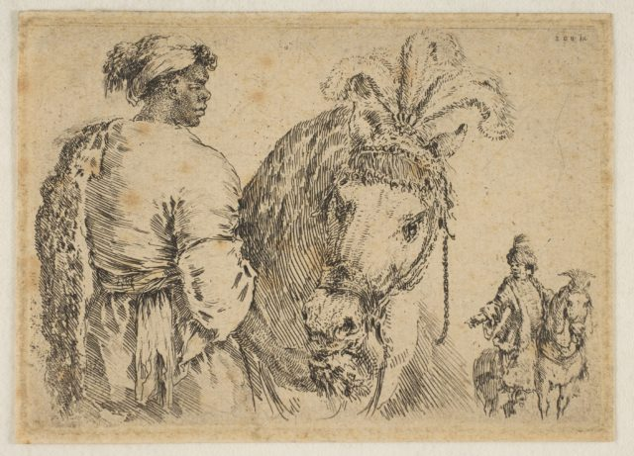
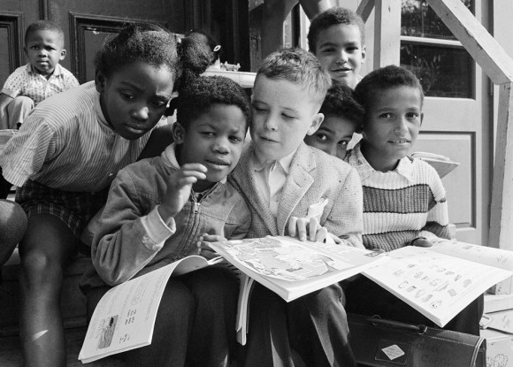
Negro -
dated, often offensive : a person of Black African ancestry
dated, often offensive : a member of a group of people formerly considered to constitute a race of humans having African ancestry and classified according to physical traits (such as dark skin pigmentation)
*Notice the note mentioning that this term and definition are coined as being “dated, often offensive”
This Photo by Unknown Author is licensed under CC BY-NC-ND

Slide 7
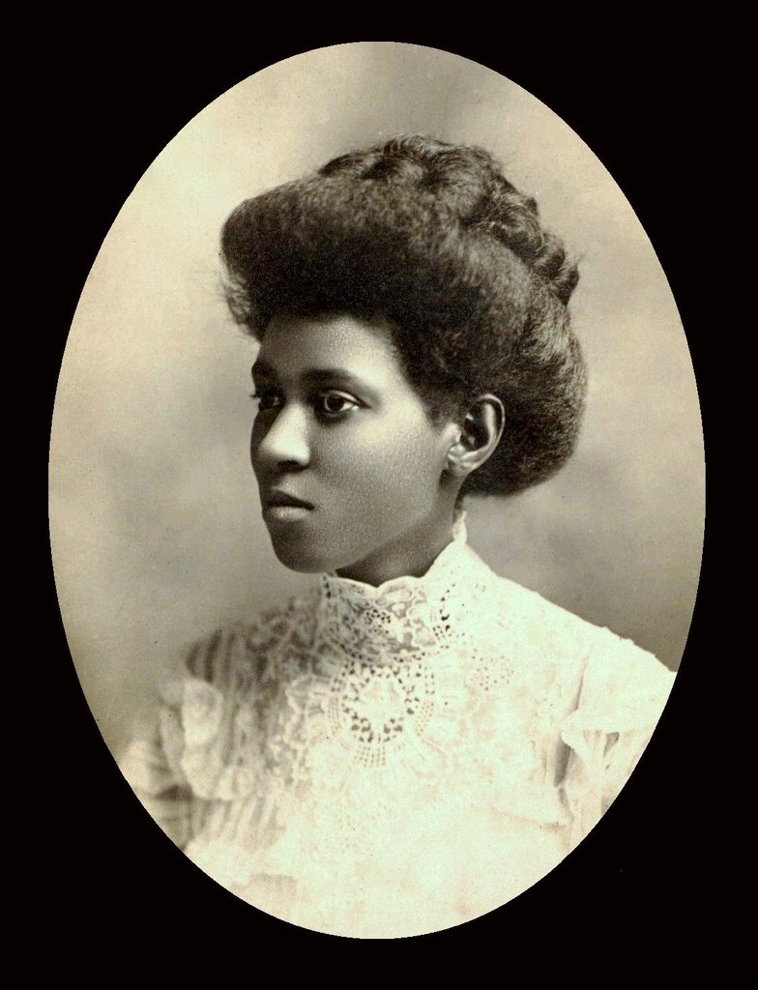
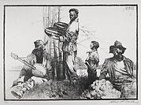
Negro -
“The terms Negro and, to a lesser extent, Negress were formerly in common use, but began to fall out of favor in the 1960s, and by the 1980s had largely been replaced in nonhistorical contexts by Black and African American.”
This Photo by Unknown Author is licensed under CC BY-SA-NC

Slide 8

Colored
“The adjective meanings of colored relating to race were formerly in common and widespread use well into the 20th century, although attitudes toward them had changed by the 1960s. In most nonhistorical contexts, these uses of colored are now considered unacceptable; the terms Black and African American are preferred.”

Slide 9

Exceptions for the terms
“Negro” and “Colored”
“A few organizations continue to use Negro in their names, reflecting the historical preference for the term: the full name of the UNCF, a philanthropic education organization founded in the mid-20th century, is the United Negro College Fund, also called the United Fund; and the Negro League Baseball Museum, which documents the Black baseball leagues active largely between 1920 and the late 1940s, continues to carry the name used by those leagues. The use of Negro in these contexts and others like them is not regarded as offensive.”

Slide 10
Exceptions for the terms
“Negro” and “Colored”
“The adjective colored remains in the full name of the NAACP (the National Association for the Advancement of Colored People), a civil rights organization founded in the early 20th century. The use of colored in this name is not regarded as offensive. The adjective colored is also occasionally still used in self-reference by Black people, but its use by others is offensive.”

Slide 11
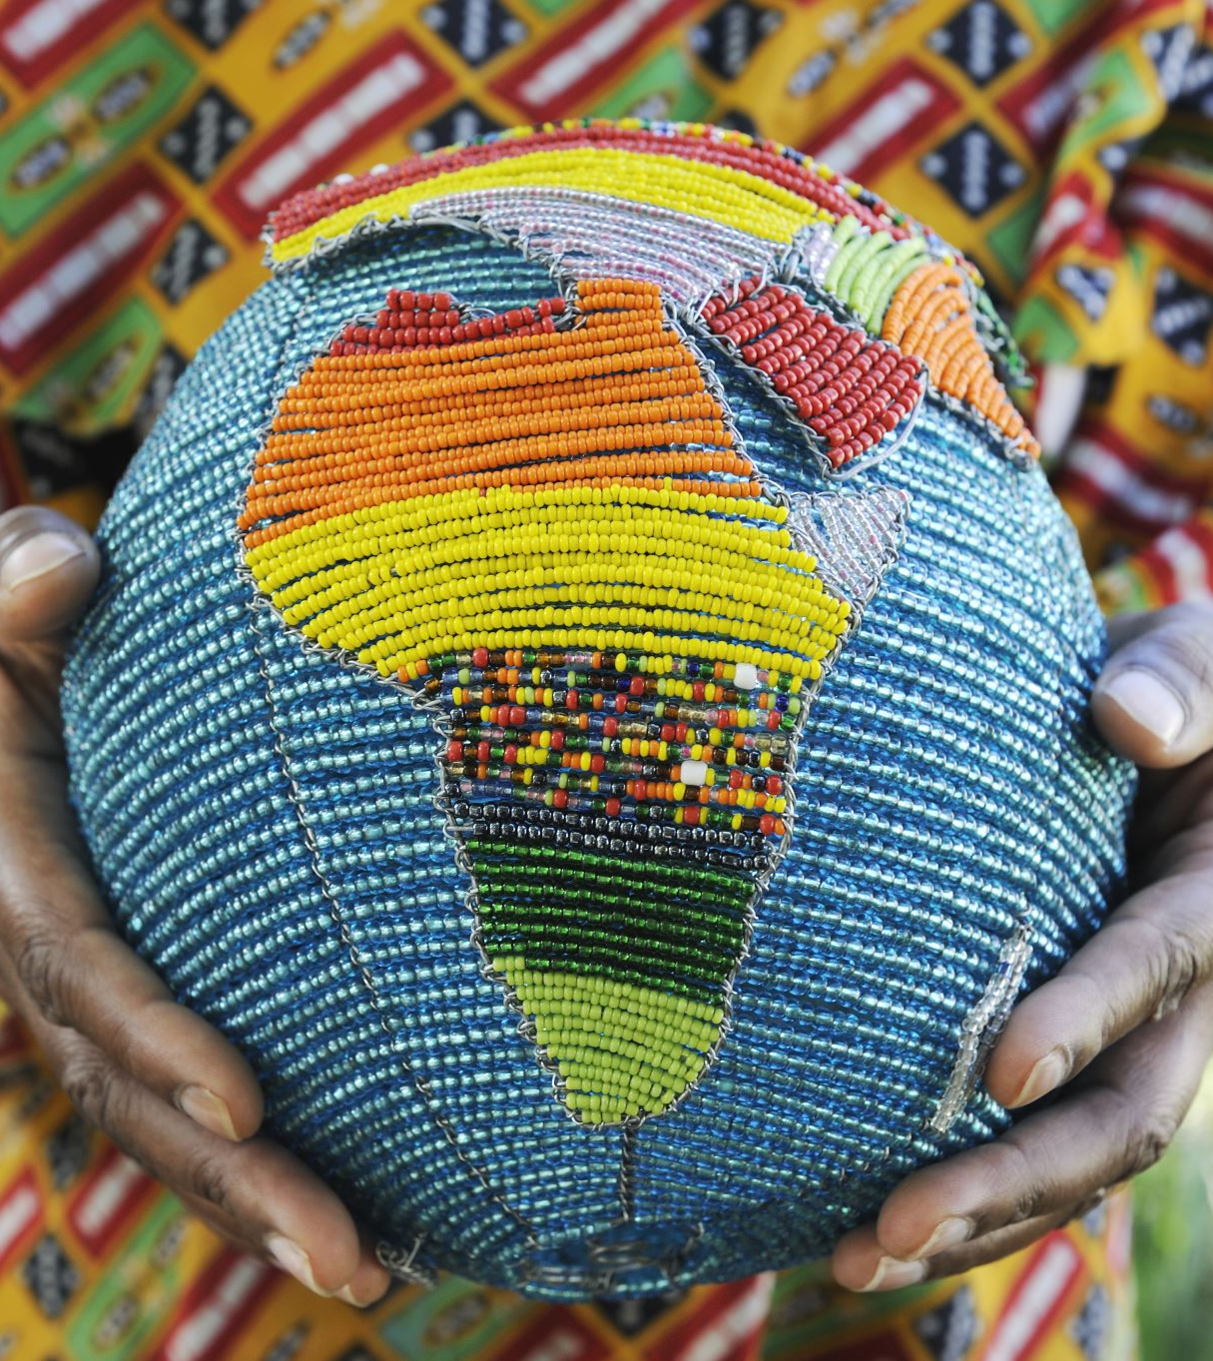
Black
“of or relating to any of various population groups of especially African ancestry often considered as having dark pigmentation of the skin but in fact having a wide range of skin colors”
“a racialized classification of people, usually a political and skin color-based category for specific populations with a mid to dark brown complexion.”

Slide 12
Black
“Young Black activists in the United States started using "Black" in the 1960s when referring to descendants of slaves as a way to leave the term "Negro" and the Jim Crow era behind, says Keith Mayes, associate professor of African American and African Studies at the University of Minnesota.”

Slide 13
African American
"African American" caught on in the US in the 1980s
as a more “particular and historical” term than the generic
"Black,“ Keith Mayes says.
Said to be coined term by Rev. Jesse Jackson

Slide 14
People of Color
"People of color" was originally meant to be a synonym of "Black," but its meaning has expanded to accommodate Latinos, Asians, Native Americans and other non-white groups, says Efren Perez, a professor of political science and psychology at the University of California Los Angeles.”

Slide 15
Sources
https://www.pewresearch.org/short-reads/2020/02/25/the-changing-categories-the-u-s-has-used-to-measure-race/
https://www.merriam-webster.com
https://www.uah.edu/diversity/news/15567-which-is-the-correct-terminology-black-african-american-or-people-of-color#:~:text=Young%20Black%20activists%20in%20the,at%20the%20University%20of%20Minnesota

