Slide 1
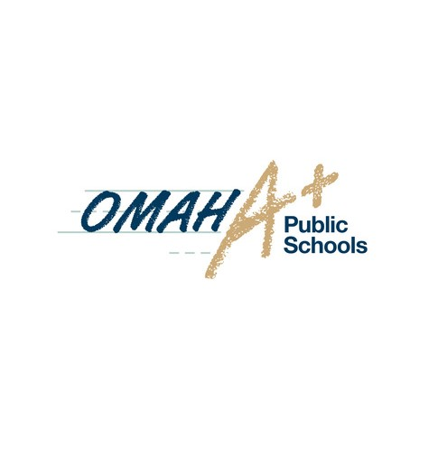
Rooted in Excellence 160 Years of Omaha Public Schools
Omaha Public Schools began in 1859 with the goal of inspiring excellence as the first public school system in Douglas County. Its goal is to prepare students for life in a world where understanding and appreciating diversity are essential.
Throughout the past 160 years, Omaha Public Schools has remained dedicated to its mission of preparing all students to excel in college, career and life. The district has grown to consist of 62 elementary schools, 12 middle schools, seven high schools, one virtual school, and 13 alternative programs. The school district is set to open five new schools (two elementary schools, one middle school and two high schools) between 2022 and 2023.

Slide 2
What makes our history?
Brainstorm: What might be included in an OPS timeline? What would we want to know to understand our history?
Notes:
Start by having students individually brainstorm. Then have students share ideas with a partner or small group to learn from others and expand on their answers.

Slide 3
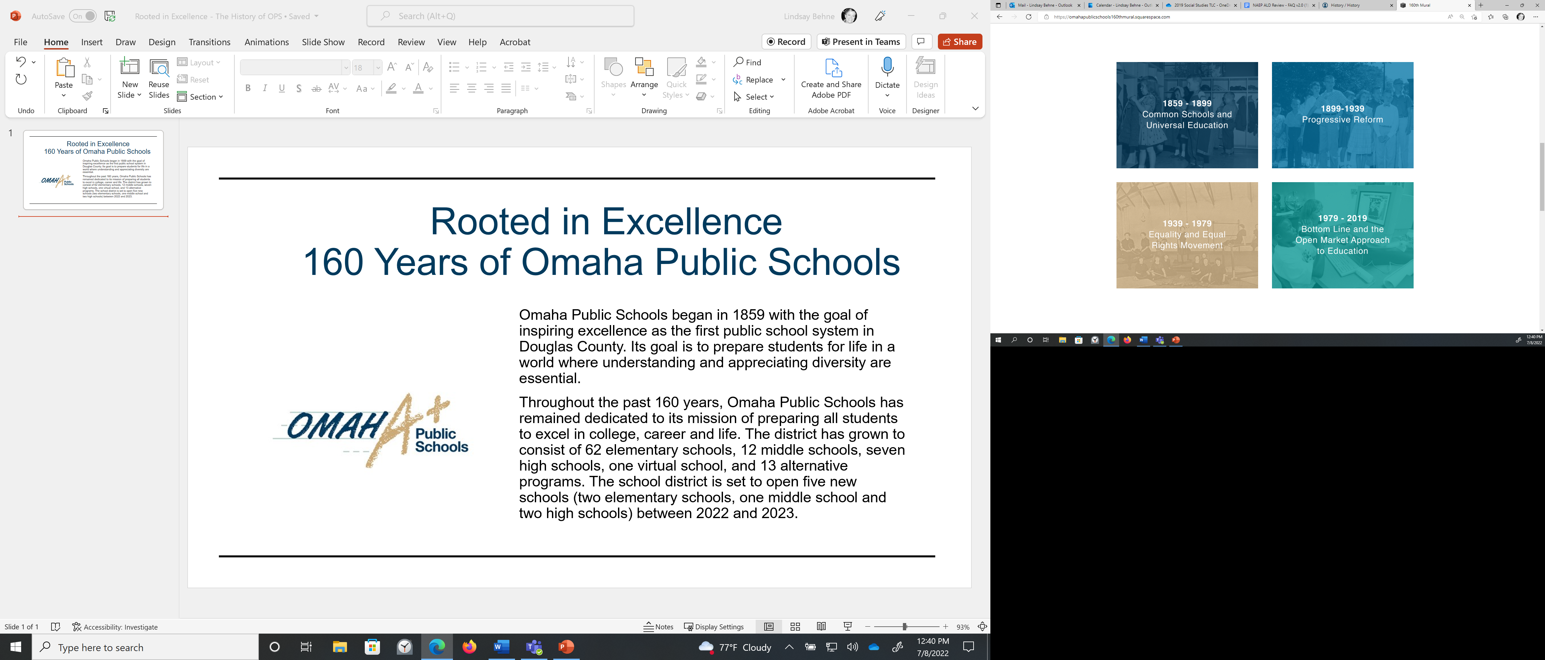
Notes:
Teacher Prep: This is designed to be a small group activity. You will need a set of timeline cards and era placards/mats for each group. Prior to this lesson: 1) Cut apart the events from the Timeline Cards (separate document)
2) Create placards/era mats with the date ranges from each era on them.
3) Have students spread out so that they can place the placards on a flat surface.

Slide 4
OPS History Game
Materials:
Timeline Cards
Education Eras Mats
Fact Checker
Directions:
When time begins, open your Timeline Cards envelope
Review and sort the event cards to the correct Era Mat
Keep your answers hidden/secret as best as possible…it is a game with prizes!
When time is called, place any unsorted cards back in the envelope

Slide 5
Let’s Check!
Notes:
Use slides 6 – 9 to have students check their answers.

Slide 6
1862 | Union Pacific Railroad established
1879 | Lake School Opens
1895 & 1896 | Gamble and Overall
1896 | Sight and Hearing Tests
1896 | Plessy vs. Ferguson

Slide 7
1900 | Night School
1911 | First Female High School Principals
1919 | OPS Allows Female Teachers to Marry
1921 | OPS National Firsts: Safety Patrol & National Honor Society
1937 | Alfonzo Davis – First Black Military Aviator from Omaha

Slide 8
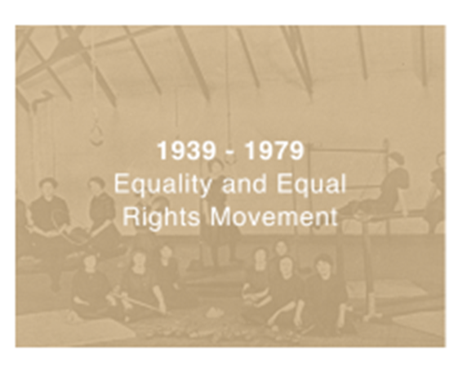
1941-43 | Kindergarten in all OPS Schools
1943 | OPS Victory Gardens
1947 | First African American Principal
1954 | Brown vs. Board of Education
1962 | Libraries in Every OPS School

Slide 9
1980 | Arts Education in OPS
1990s | Native Indigenous-Centered Education
1994 | Block Scheduling in OPS
1999 | Return to Neighborhood Schools
2010 | Making Invisible Histories Visible Begins

Slide 10
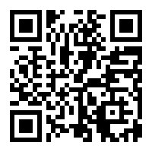
Rooted in Excellence 160 Years of Omaha Public Schools
Notes:
Using Part 1 of the graphic organizer, students will explore the OPS mural website identifying and recording 3 – 5 additional events from the eras that they find interesting.
Then using Part 2 of the graphic organizer, students will complete the Claim-Support-Question processing activity.

