Slide 1
Title 1 Annual Review Meeting
Presented by: Tyna Morrison
April 8, 2026

Slide 2
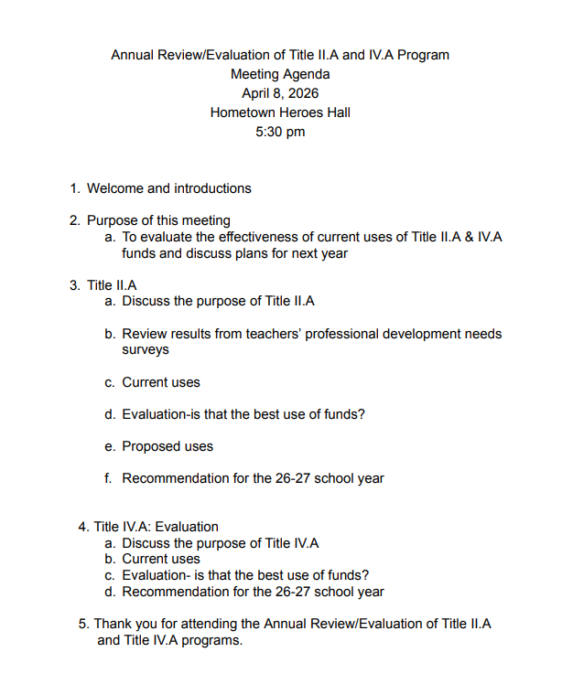

Slide 3

Schoolwide Program
Our school participates in Title I.A
The school receives an allocation from the state (which is given by the federal government) based on census poverty and population of children 5-17, children in neglected/delinquent institutions and foster children.
The district decides which building to serve with the allocation.

Slide 4

Schoolwide Program Student Selection
A schoolwide program is not required
to identify particular children as
eligible for Title I services.

Slide 5

Growth and how we measure it:
Unit tests
STAR
IXL

Slide 6
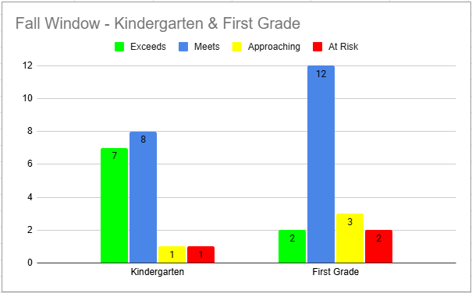
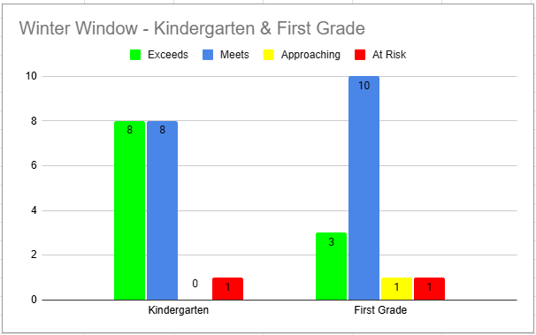
2025-2026 STAR EARLY LITERACY TESTING DATA

Slide 7
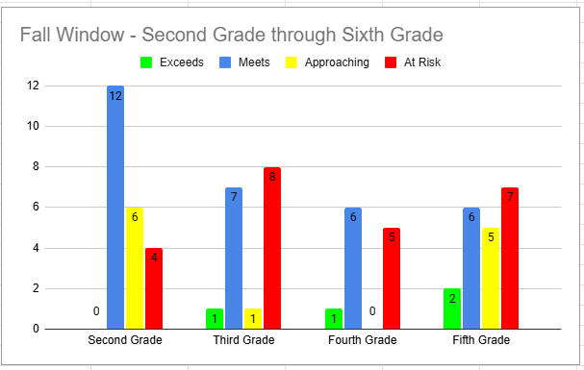
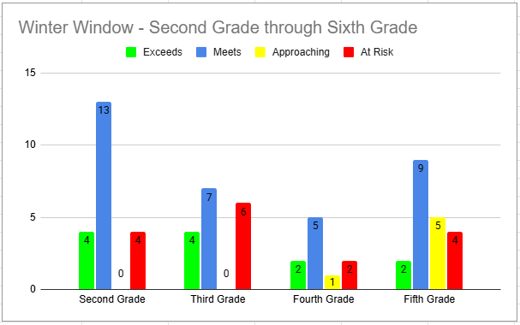
2025-2026 STAR READING TESTING DATA 3rd Grade - 6th Grade

Slide 8
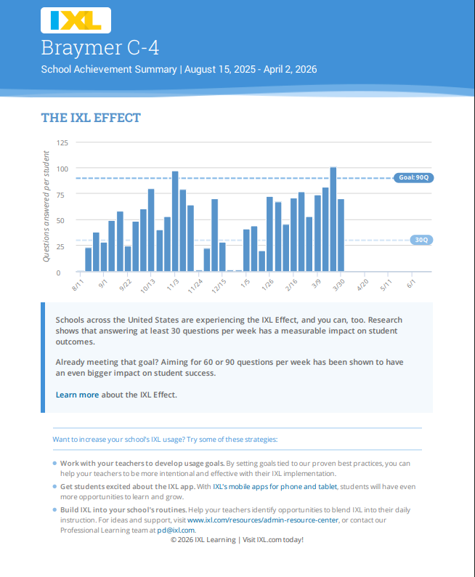

Slide 9
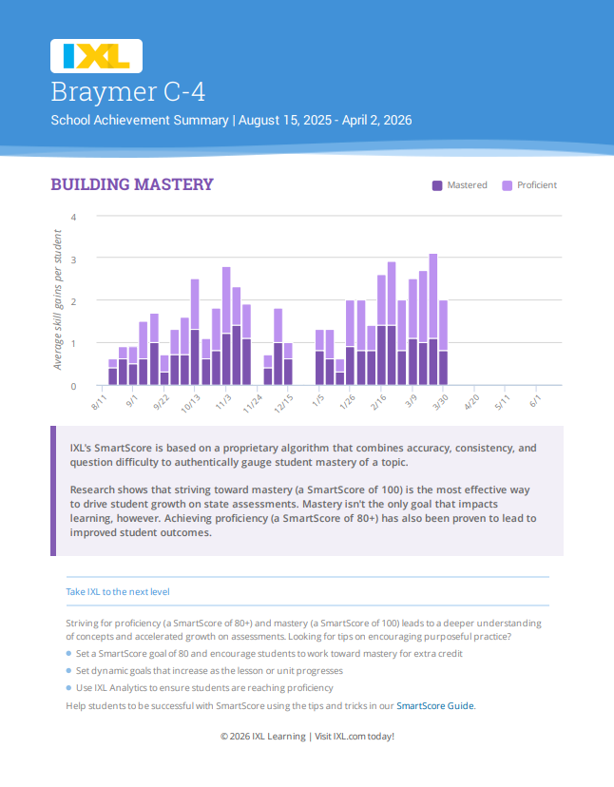

Slide 10
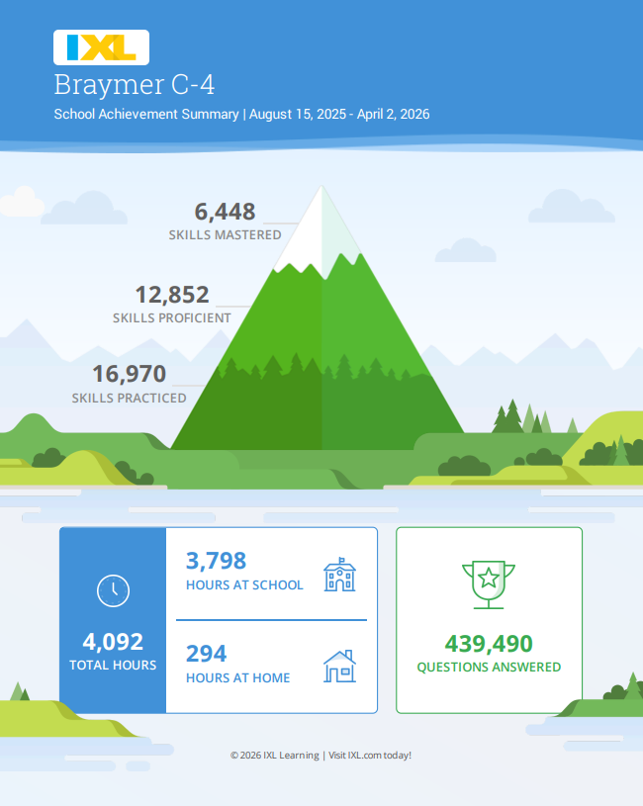

Slide 11
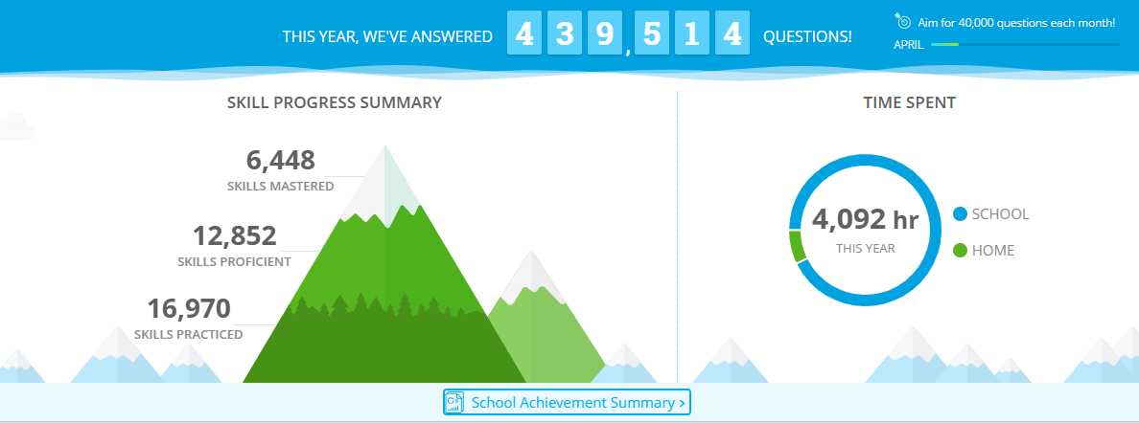

Slide 12
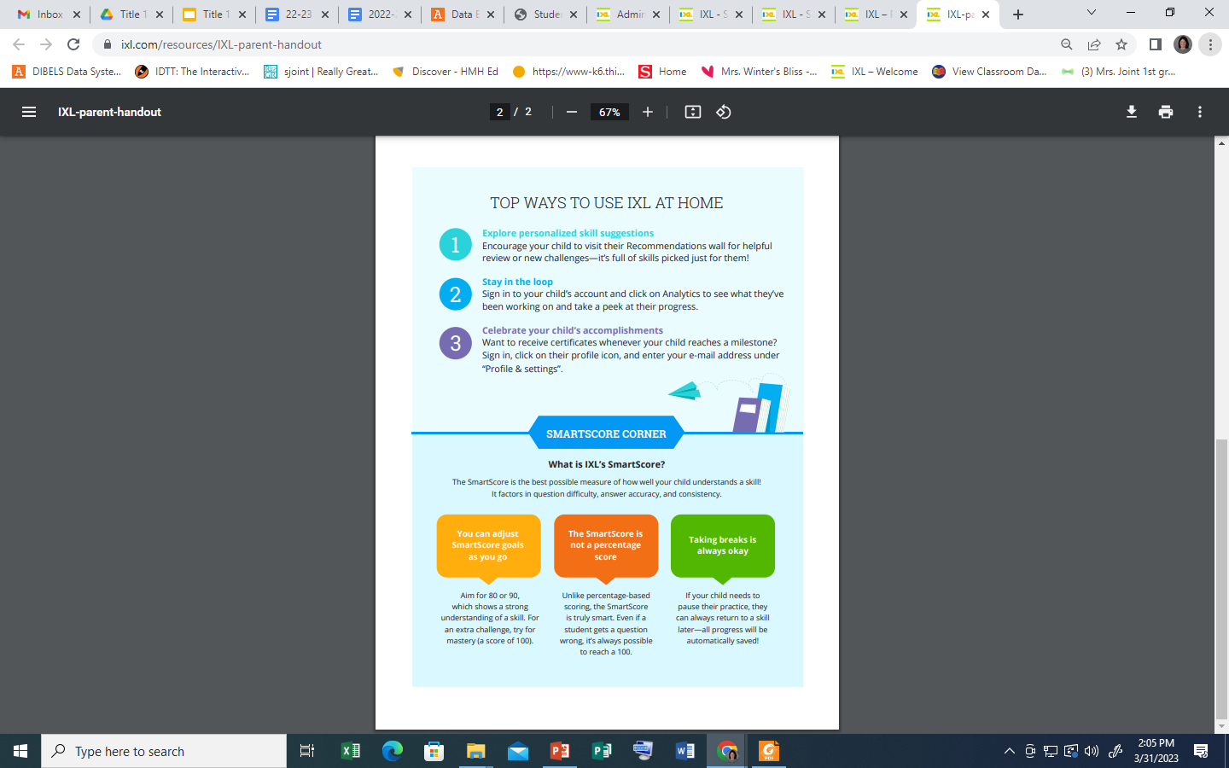


Slide 13

Review the follow items
School, Parent and Family Engagement Policy
Schoolwide Program Plan
School Parent-Student Learning Compact

Slide 14

Parent Involvement
Parents are a vital part of the Title I Reading Program. Parents will be invited to participate in their child’s education through the following activities:
❏ Annual Meeting
❏ Surveys
❏ Participate in various meetings-open house, and/or Literacy nights

Slide 15
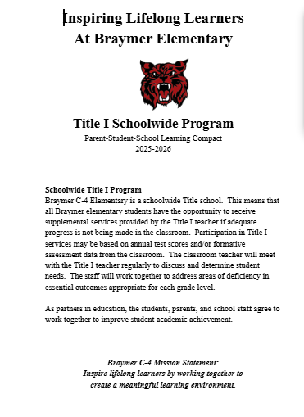
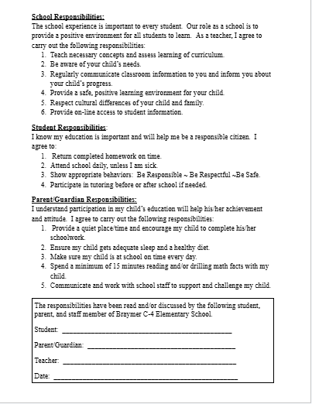

Slide 16



We have several resources to help reinforce reading skills at home.
Items available for check-out include: board games, electronic games, flash cards, books, as well as other materials.
Some items will be sent home with students. Suggestions for additional resources…
Parent Resource Center

Slide 17

Thank you for coming.
Contact information:
Tyna Morrison
tmorrison@braymerc4.net
660-645-2284

