Slide 1
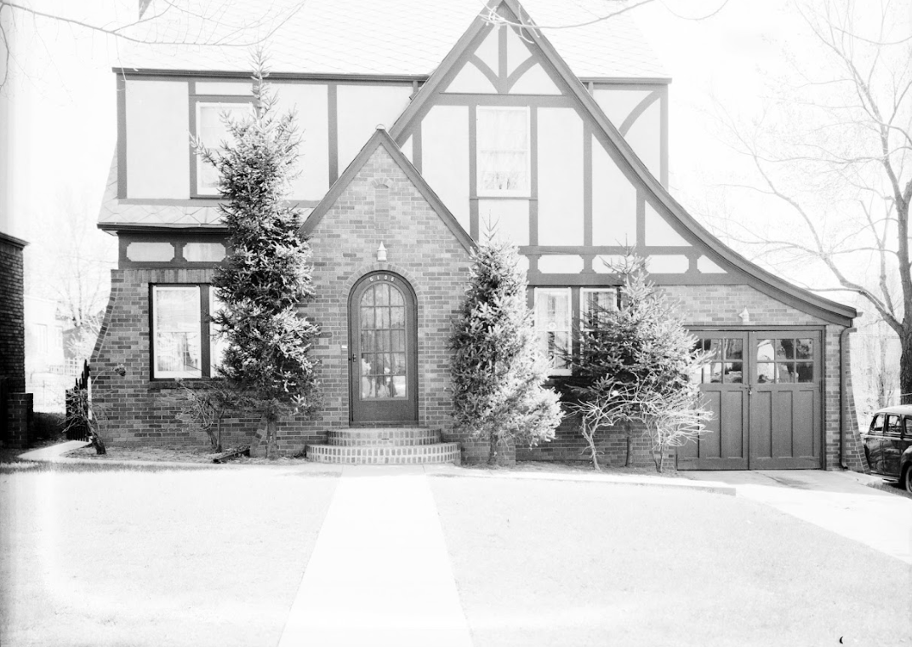
Discovering the History
of Your Home

Slide 2
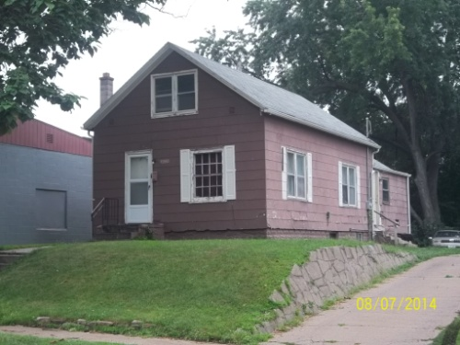
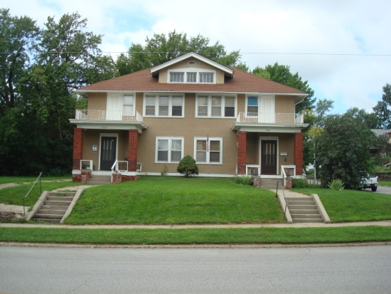
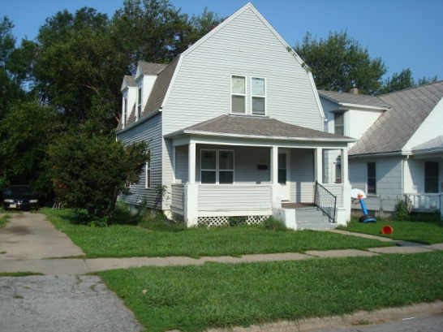

Why is Researching the History of Properties Important?

Slide 3
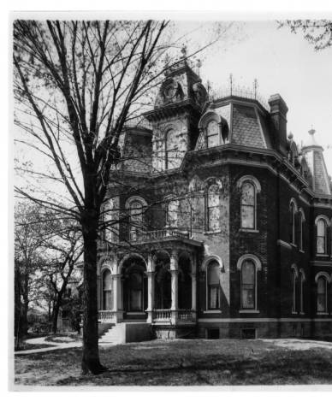
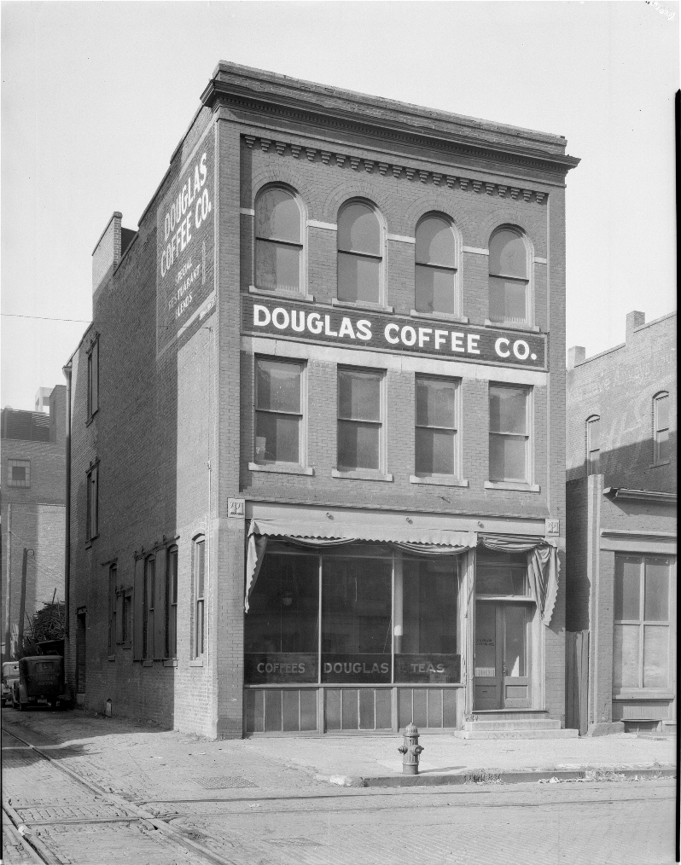
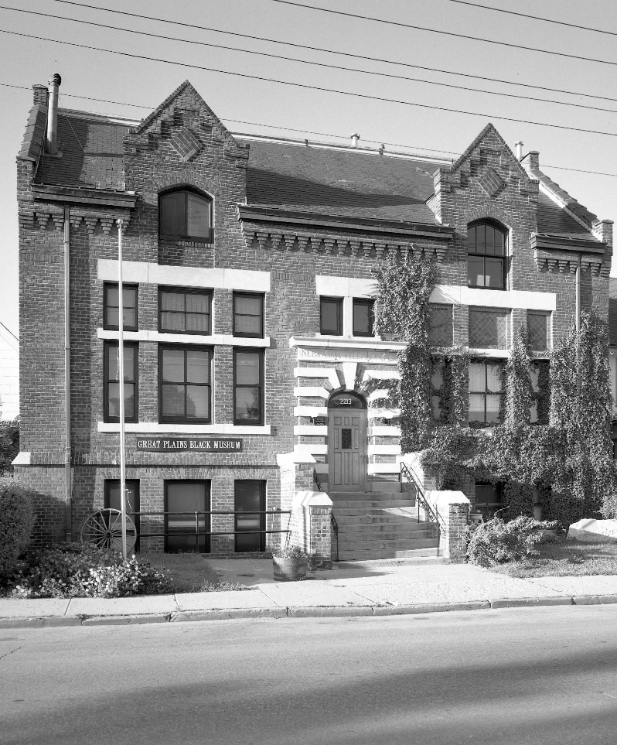
Every property has a story.
Knowing that story can help you appreciate and promote what makes it unique.
Notes:
Telling a buildings story can help save it!

Slide 4

Where to Begin?

Slide 5
Douglas County GIS Site https://maps.dogis.org/
Approximate Year Property Built
Addition Name, Lot and Block
Section, Township and Range
Materials Property Made Out Of
Historic Aerials and Historically Significant Identification

Slide 6
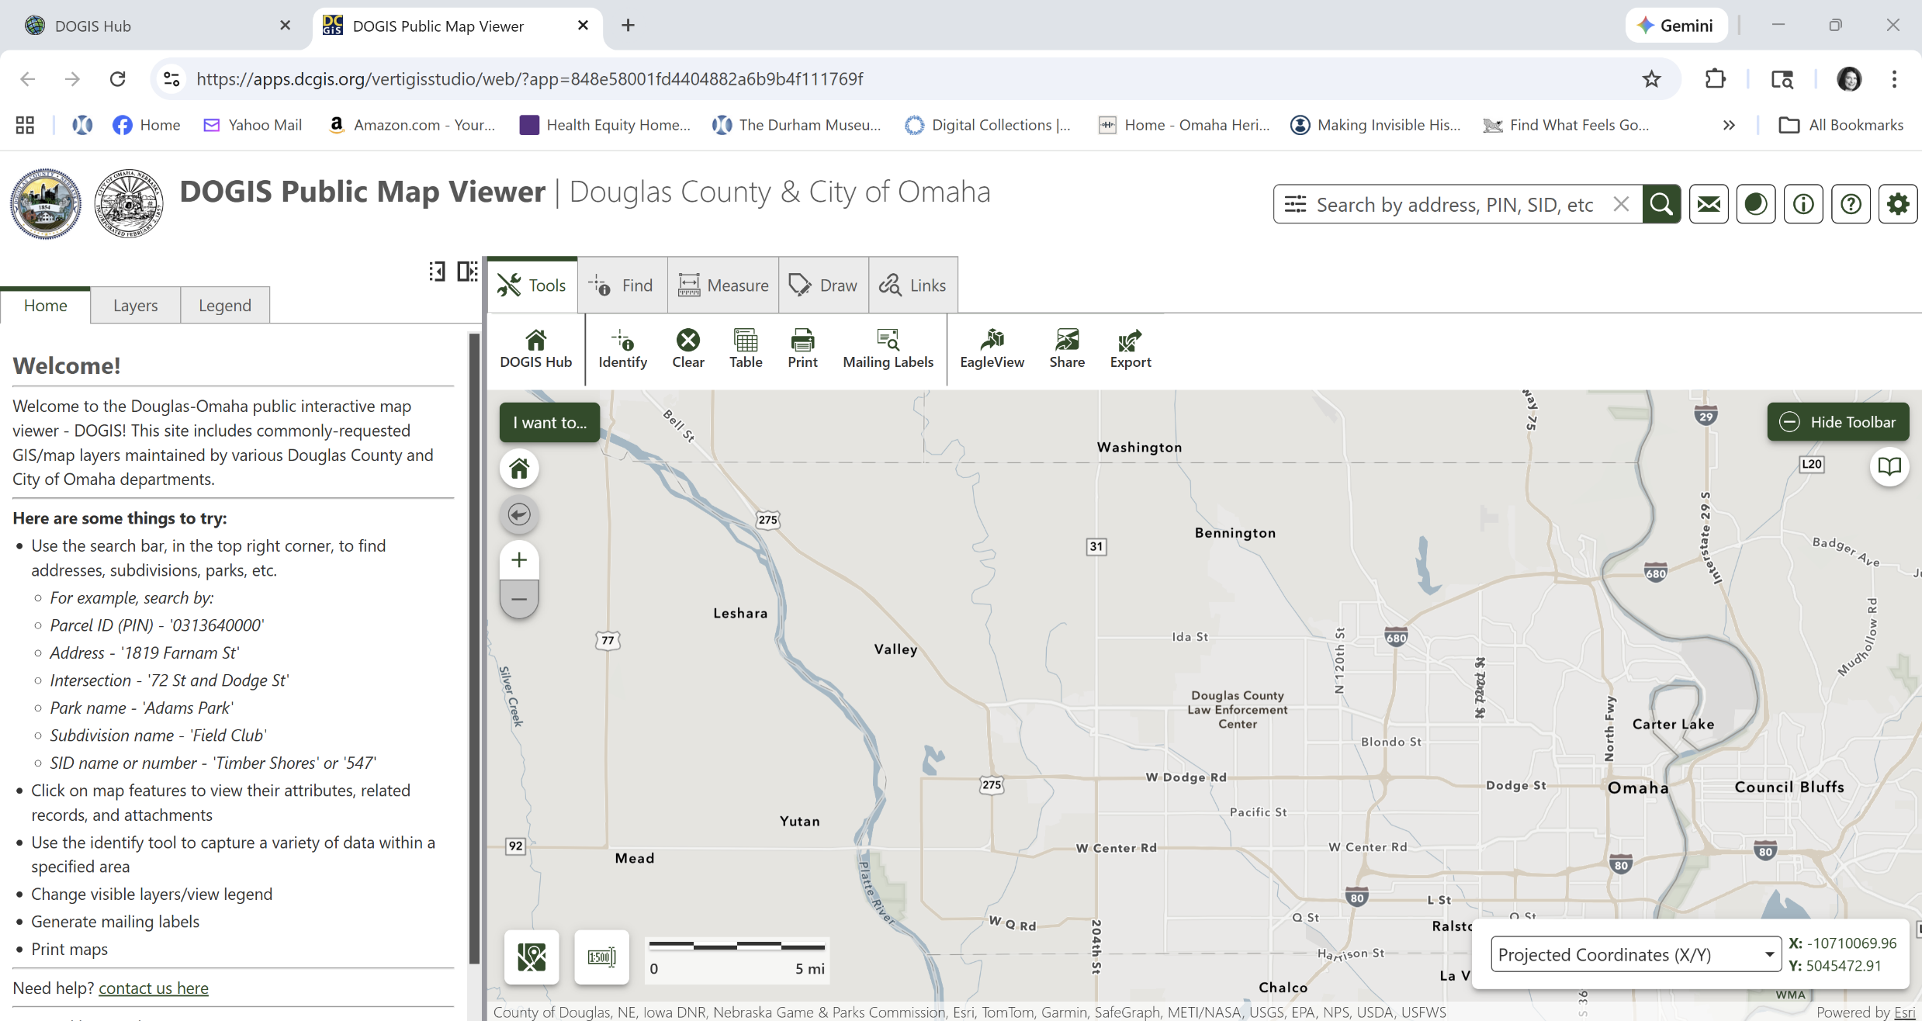
https://maps.dogis.org/
Notes:
Search address. Click on address once found to access Assessors Report on the left hand side. Through accessors report can find approximate year built, what made out of, house/building floor plan. Click on Historic Preservation Layer to find out if it is on the National Register or Locally Landmarked meaning research has already been done on this property and is available at City of Omaha’s Preservation site. Write down block, township, section and range to find the original plat (next slide).

Slide 7
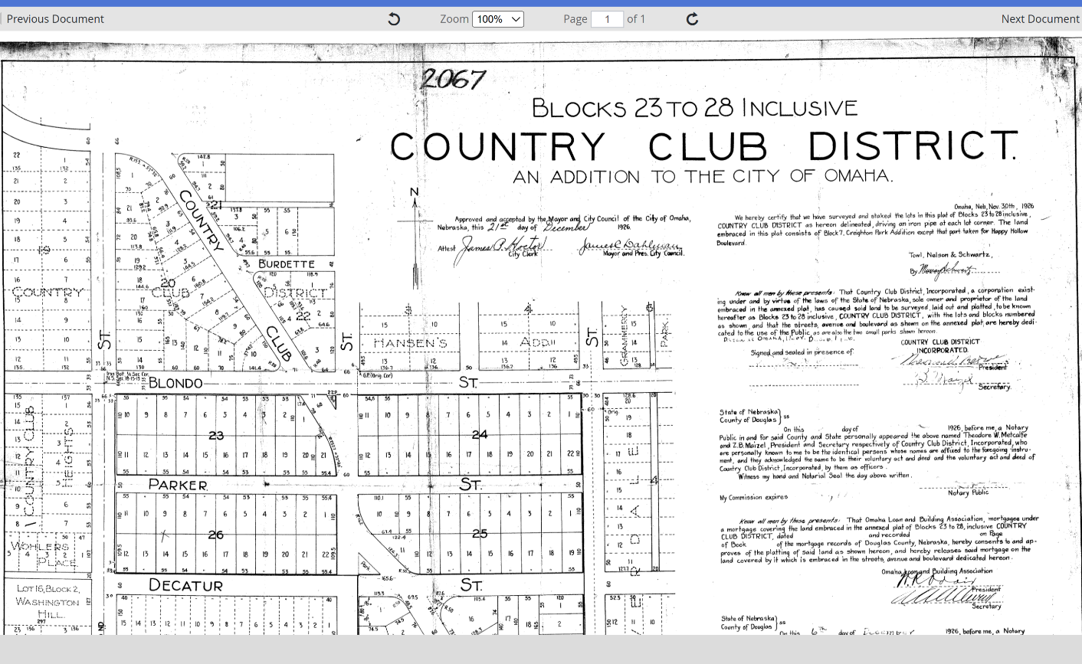
Douglas County Engineer Site Plat and Survey Research
https://www.dcengineer.org/land-survey-records
Notes:
Plug in Township, Section, Range information to find original plat maps for the land.

Slide 8
City of Omaha Landmarks Heritage Preservation Commission http://landmark.cityofomaha.org/
Reconnaissance Surveys
Local and Nationally Registered properties in Douglas County.
Image Collection & GIS Preservation Map
Architectural plans
Notes:
Great site to find architectural plans, images and Reconnaissance Surveys showing information about Omaha’s neighbhorhoods. Plus if a property or neighborhood is Locally Landmarked or on the National Register you can find the nomination here.

Slide 9
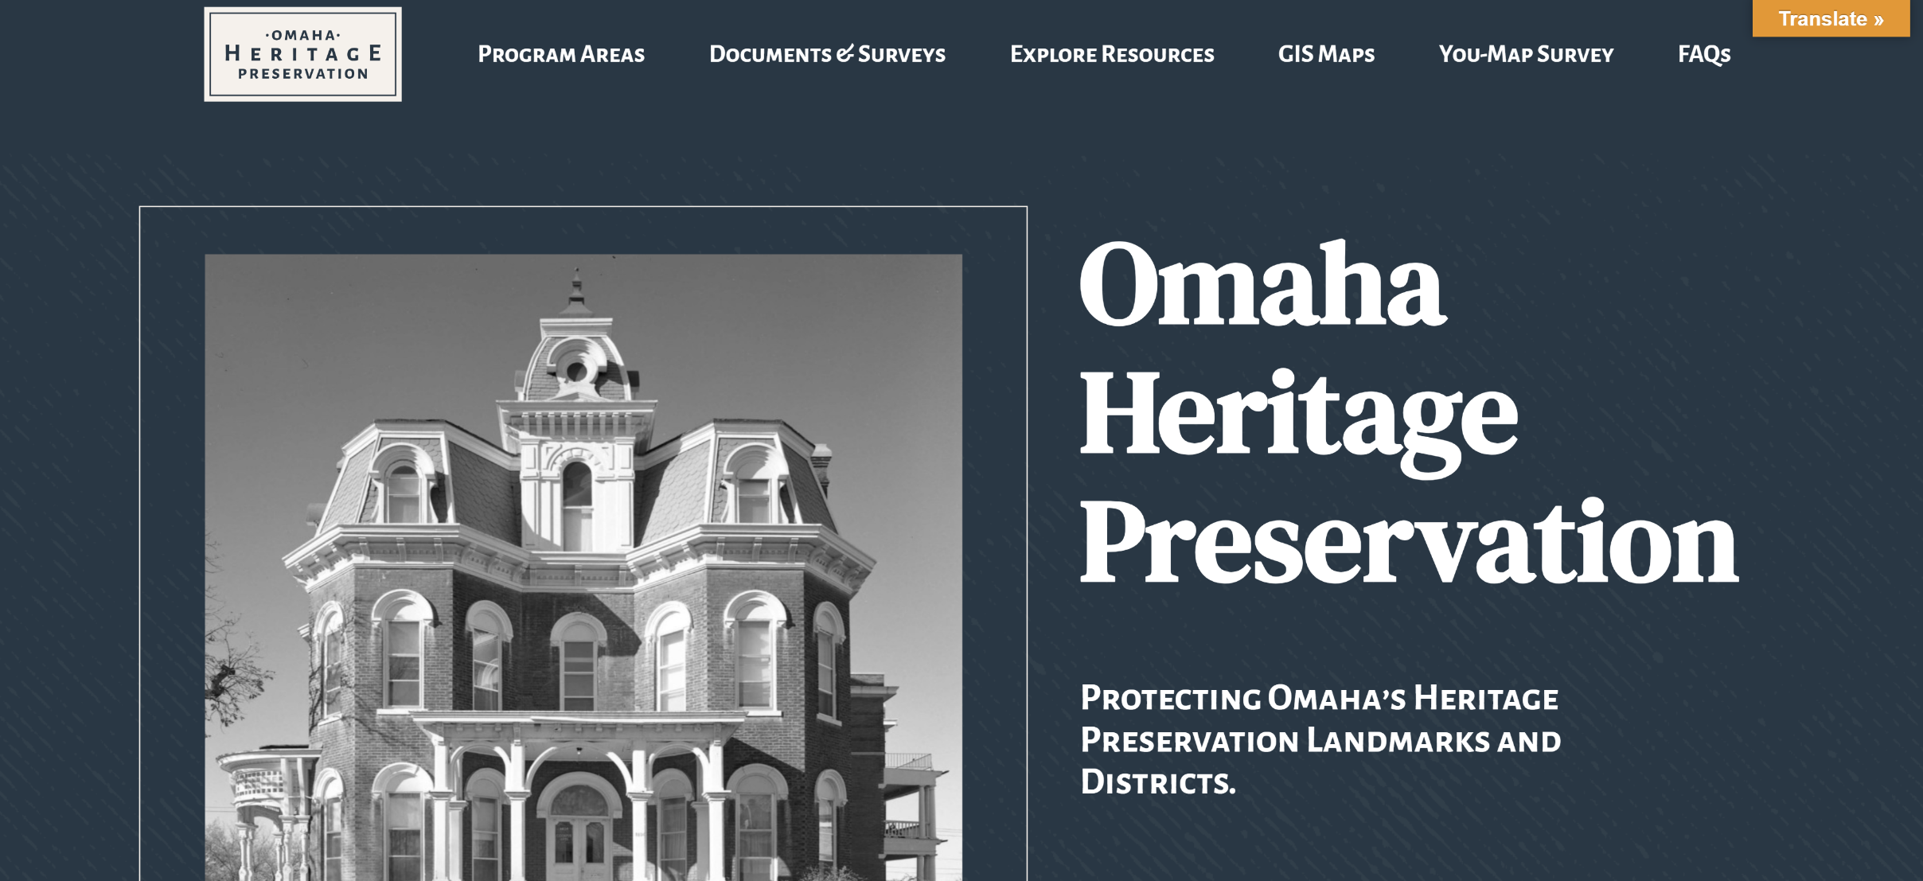
http://landmark.cityofomaha.org/
Notes:
City of Omaha Presevation Site

Slide 10
Omaha Public Library OmahaLibrary.org > Resources
Digital Historic & Current Omaha World-Herald, 1878-Present
Digital Omaha Star 1938-2011
Digital Catholic Voice
Newspapers.com
Fold3 Military Records
City Directories
Fire Insurance Sanborn Maps 1887-1962
Heritage Library Addition – Census, Marriage Records, Birth Records.
Special Collections
Early photographs, postcards, albums, stereo views and maps
Notes:
To access these sites must have an Omaha Public Library card which is available for free.

Slide 11
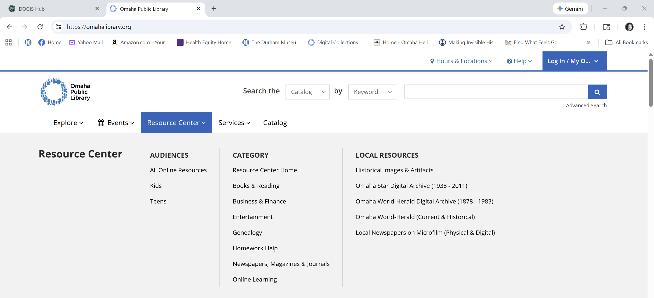
www.OmahaLibrary.org

Slide 12
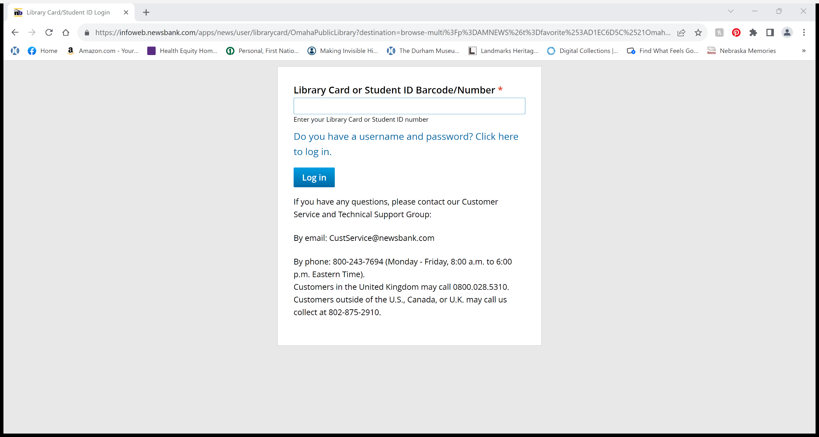

Slide 13
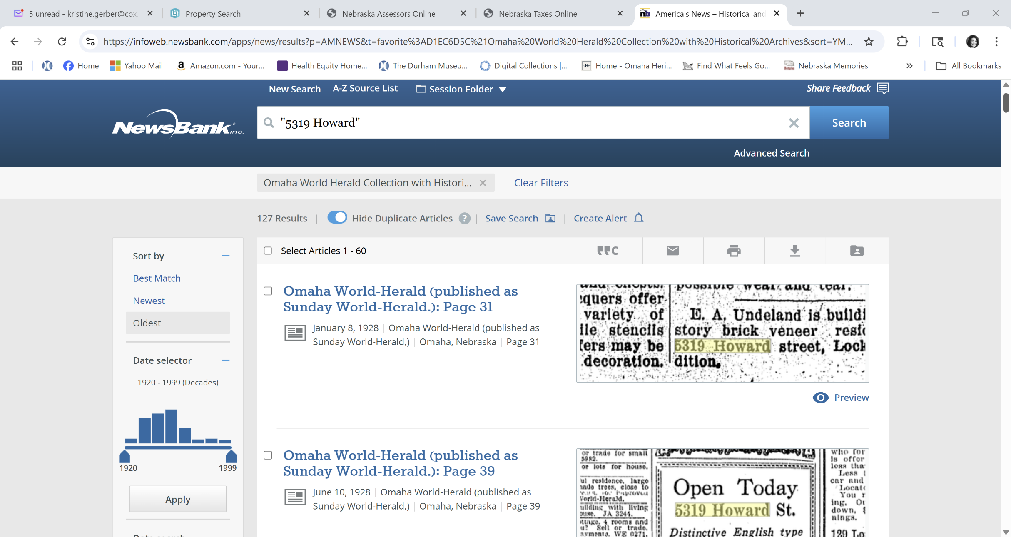
Omaha World-Herald Current and Historical
Notes:
Tips when searching addresses … spell out Directions or Numbers. Example 235 North Fourteenth Street. This was how they used to publish addresses in the early day. But also try 235 N. 14th. Make sure and put quotation marks around the address “235 North 14th” You can clip and save the articles in a pdf or jpg format.

Slide 14
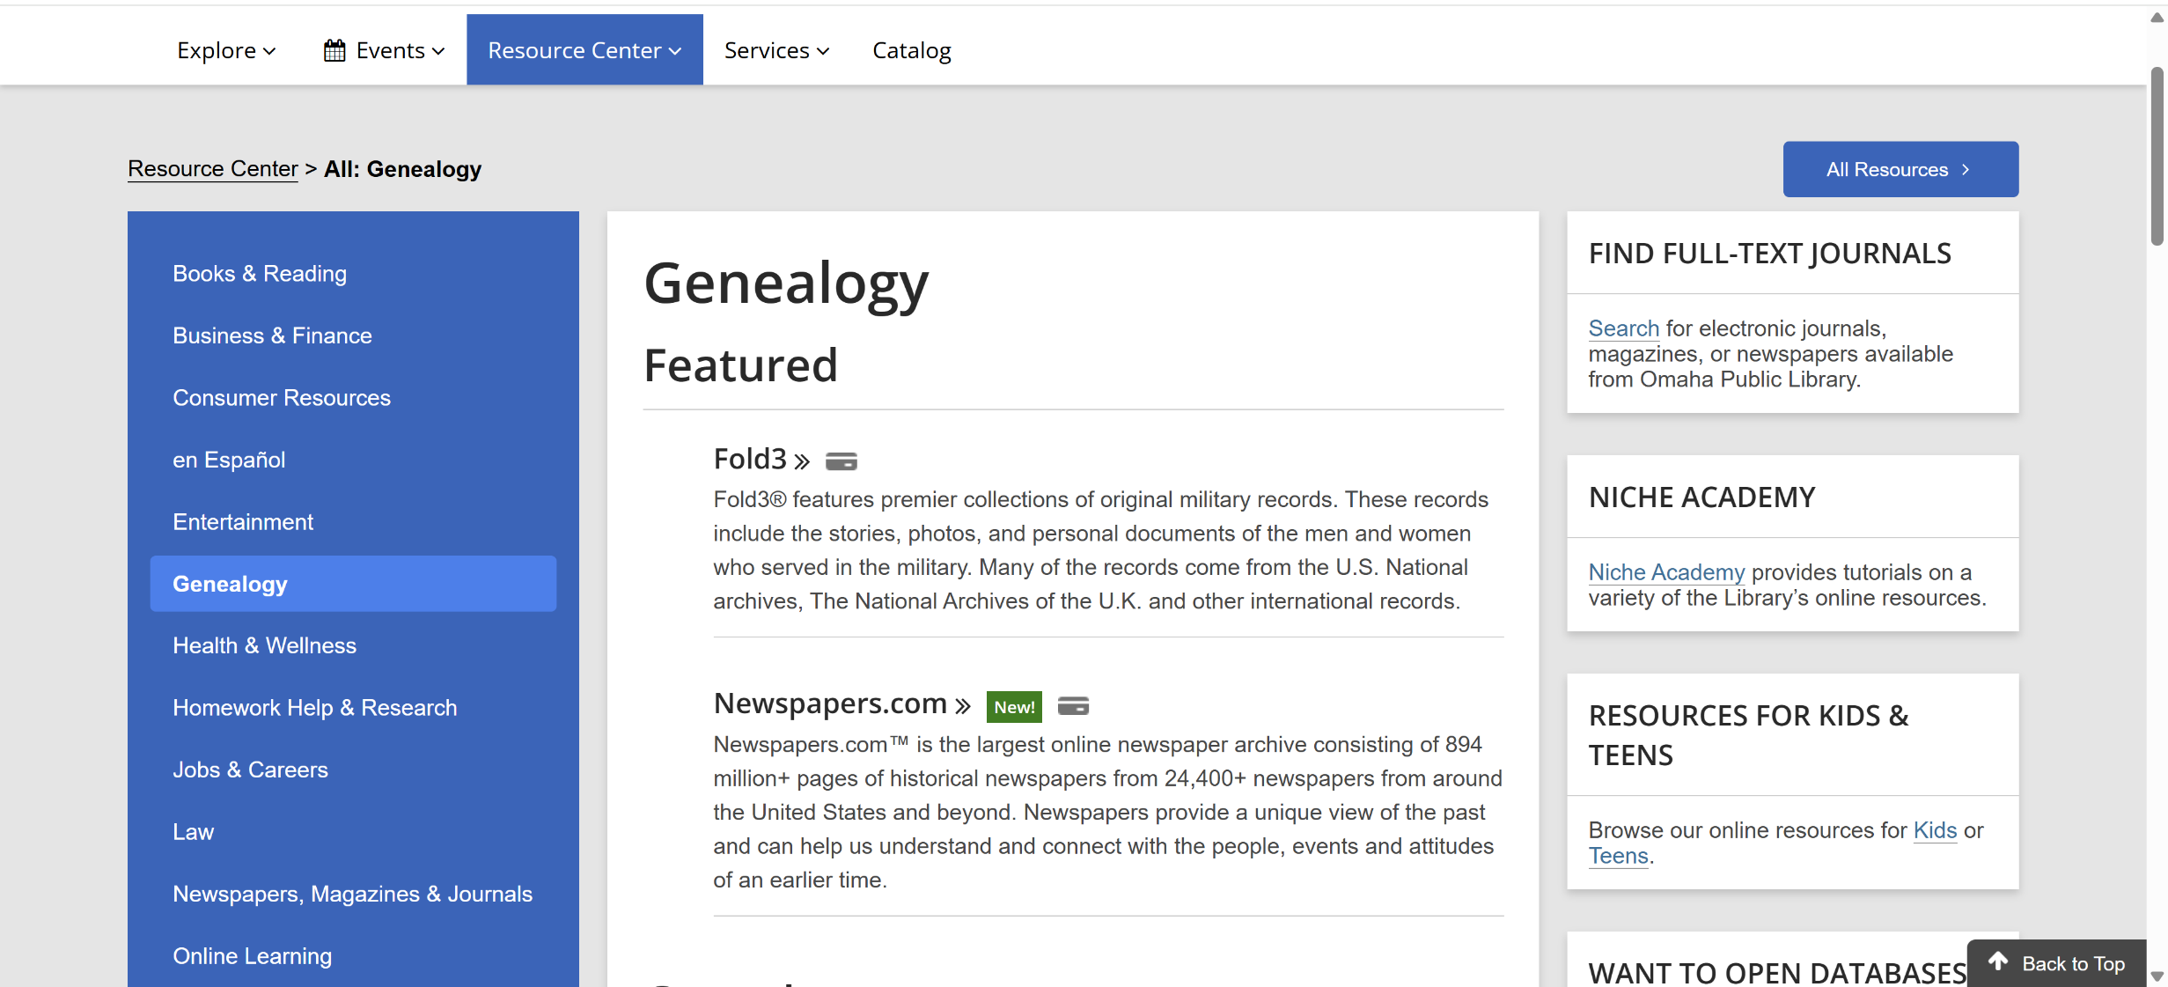
https://omahalibrary.org/resources/genealogy/
Notes:
Under Geneology is where you can find Newspapers.com that has free access to newspapers throughout Omaha and Nebraska and across the nation. Many early newspapers that are no longer in business are located here.

Slide 15
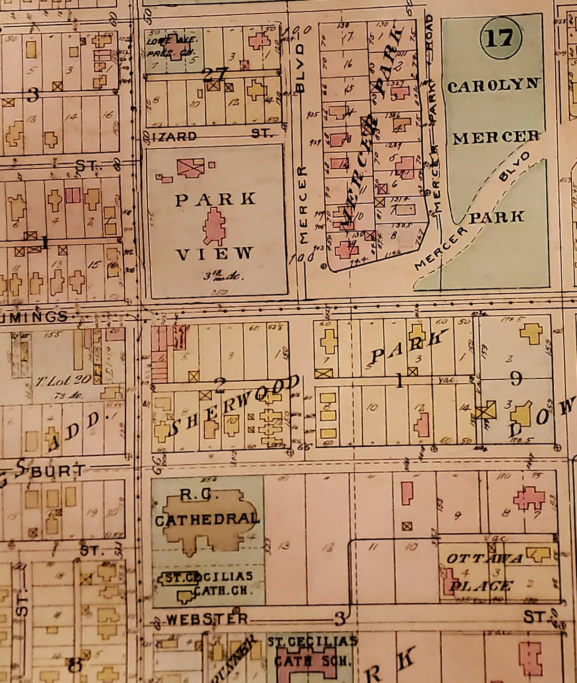
Digital Sanborn Maps
Produced by a Fire Insurance Company to determine insurance rates for properties.
Digital and printed copy versions available at the Omaha Public Library or in City Planning.
For Omaha maps start in 1880’s and go through 1962.
Notes:
Great place to see how a city has grown and changed.

Slide 16
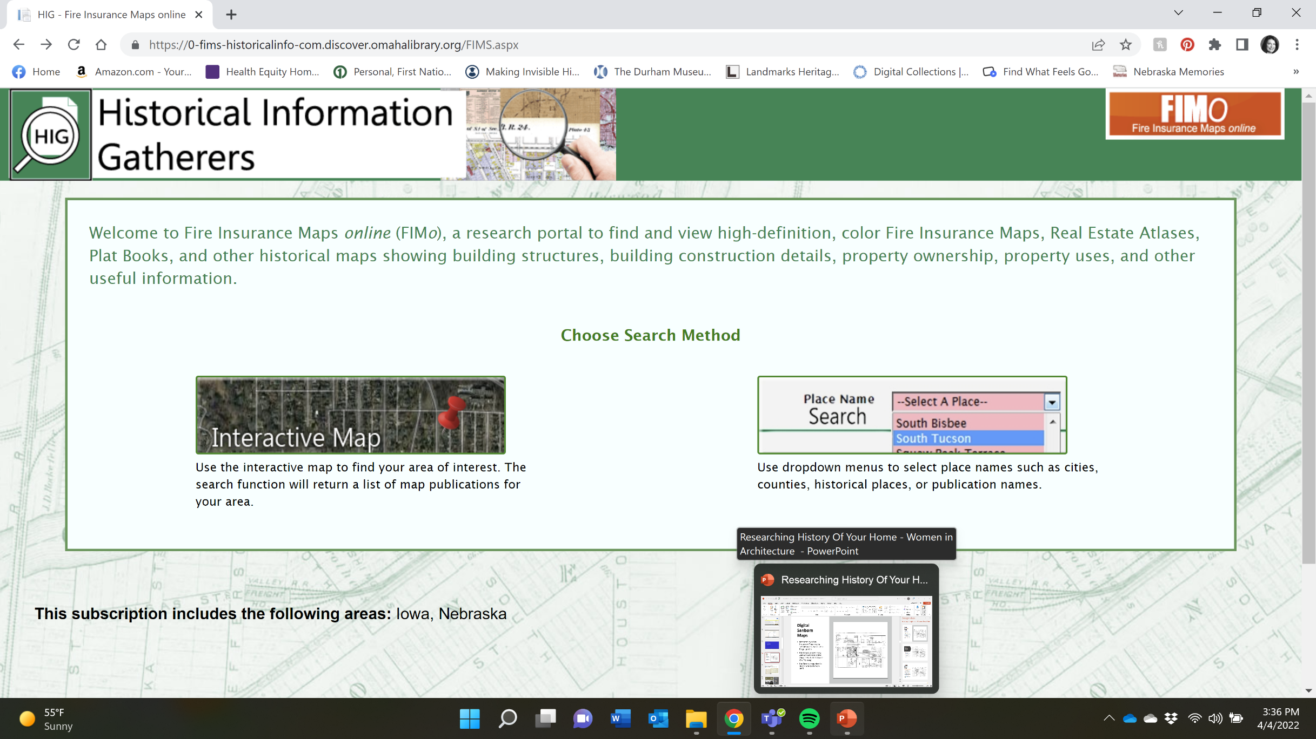
Notes:
Click on Interactive Map and type in the address and city.

Slide 17
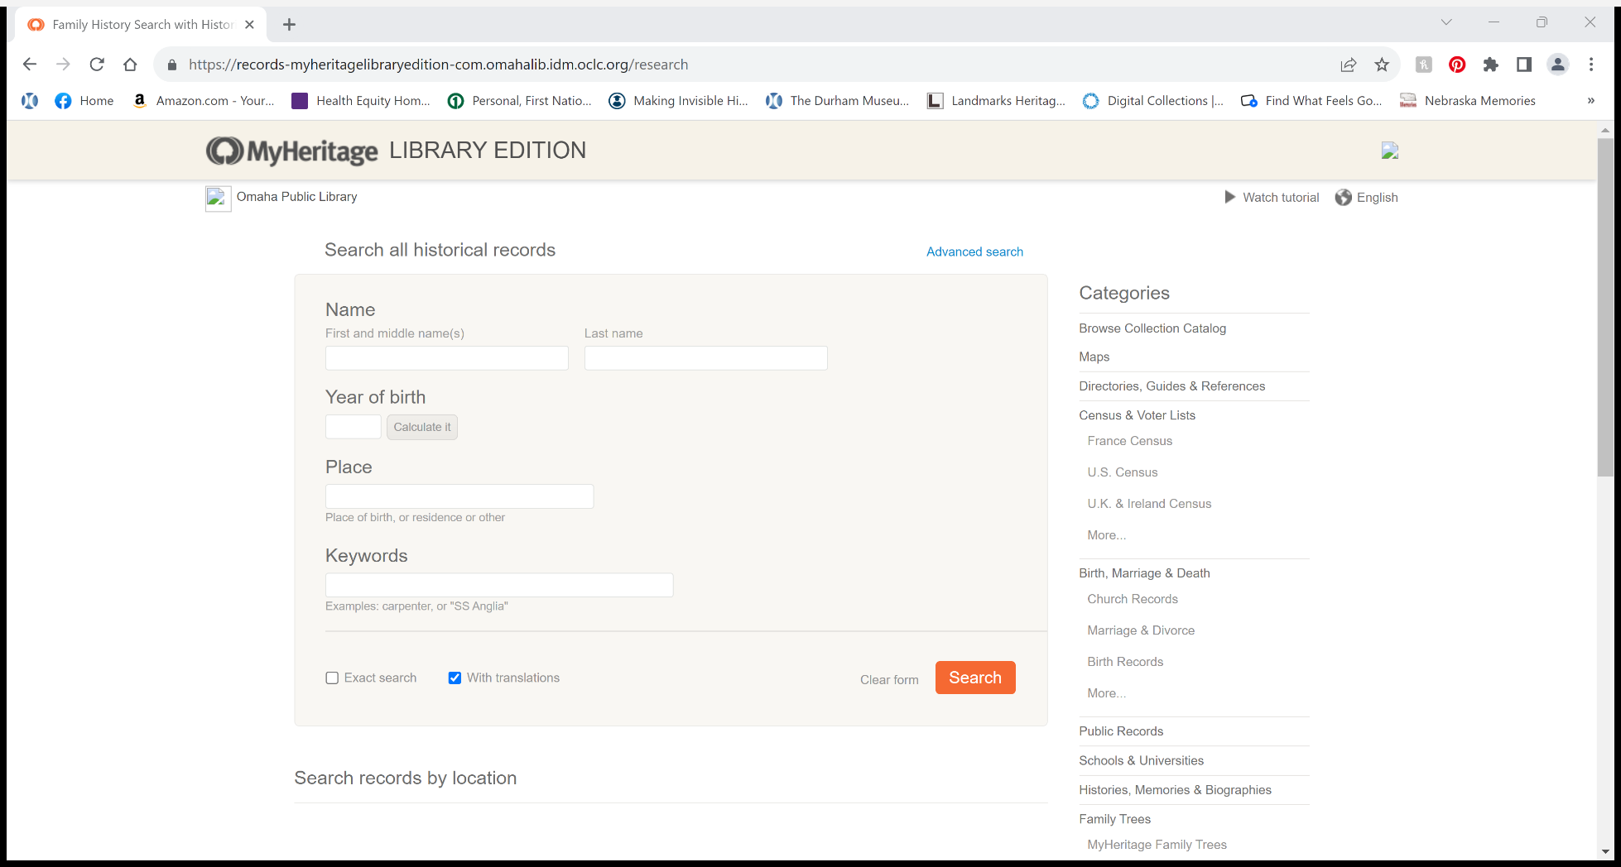
My Heritage Library Edition
Census Data, Birth, Marriage, Death Records and More
Notes:
Excellent place to research the history of a person. Links you to their listings in City Directories, Census Records and Military Records.

Slide 18
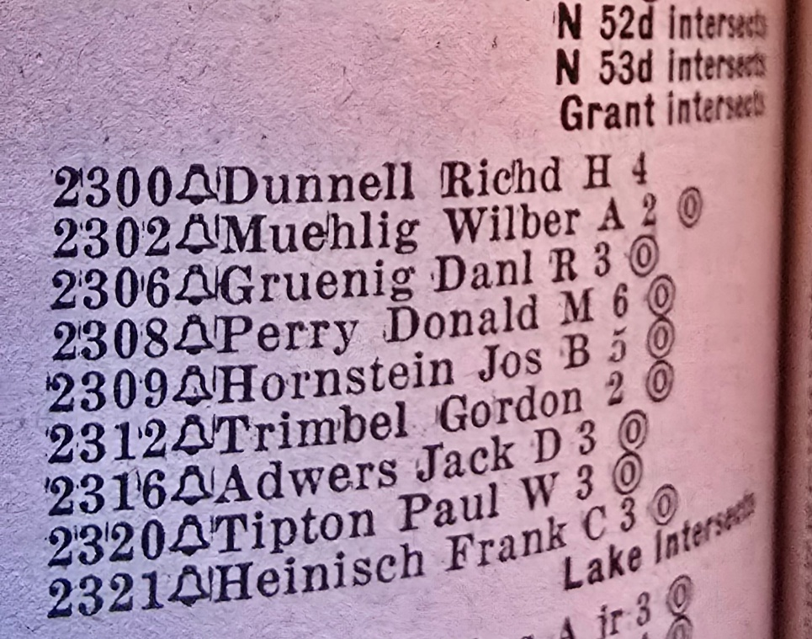
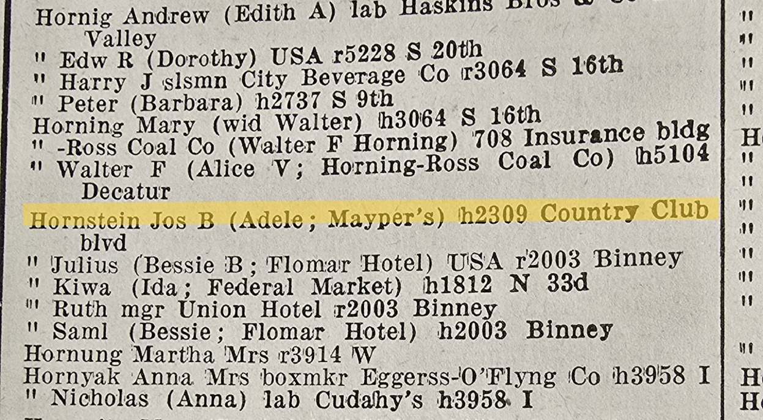
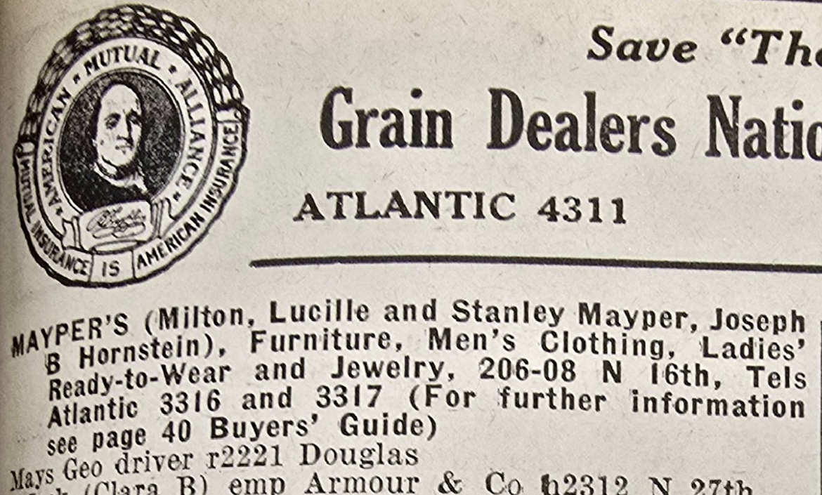
City Directory Research 1945
Notes:
City Directories are located in Omaha’s new Central Library

Slide 19
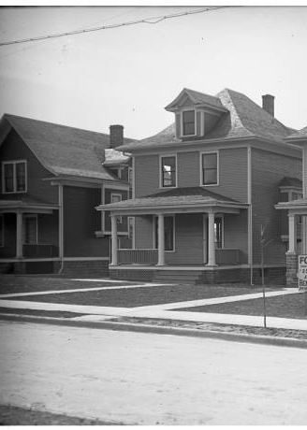
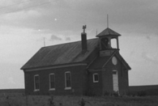

The Durham Museum
Archive contains more than 1 million images spanning from the 1860s to the 1990s.
Search Online first
Or open by appointment - Tuesday-Friday 10:30-3:30, or the first Saturday of the month.
Policies
https://durhammuseum.org/exhibits-collections/photo-archive/
Photoarchive @durhammuseum.org
Notes:
Can search photos online.

Slide 20
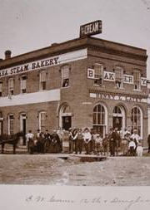
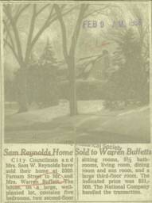
Douglas County Historical Society
Bound Newspapers
Clipping Files
City Directories
County Records – Birth, Death, Marriage, Naturalization
Images – 30,000
William Wentworth Collection
William Henry Jackson
Benson Historical Society
Notes:
Can search photos online.

Slide 21
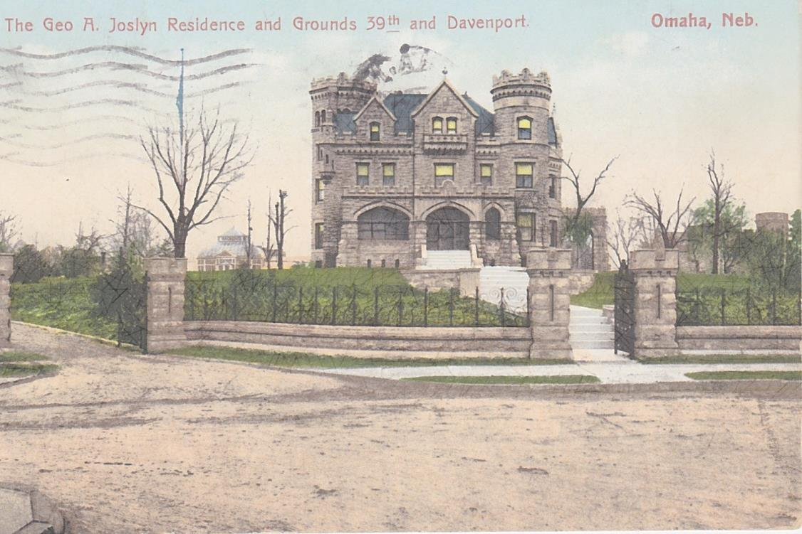
Postcards
Postcards of past and present, local and distant sites.
Classic postcards of businesses, residences, parks, schools and city street scenes from a century ago. 1890s to 1960s.
Brad & Gina Stephens, Omaha Postcard and Collectibles Show, omahapostcards@gmail.com
March and August shows in Omaha. Next one is March 20-21 at Westside Community Center.

Slide 22
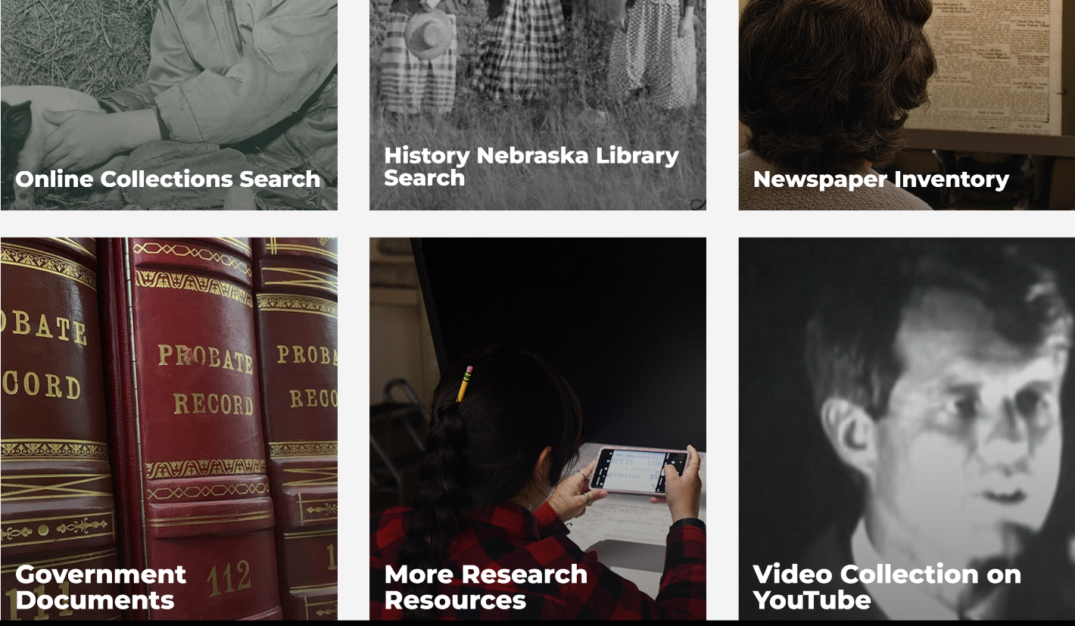
Nebraska State Historical Society
Online Collections Search
Newspaper Inventory
History Nebraska Library Search
Video Collection on YouTube
Government Documents
Architects and Their Work
https://history.nebraska.gov/collections/
https://history.nebraska.gov/collections/

Slide 23
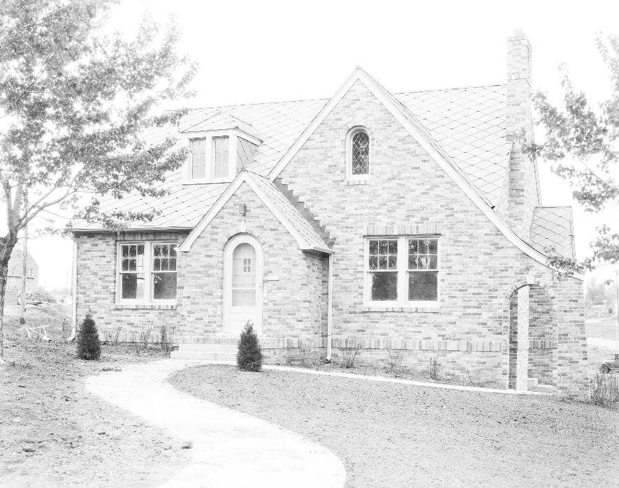
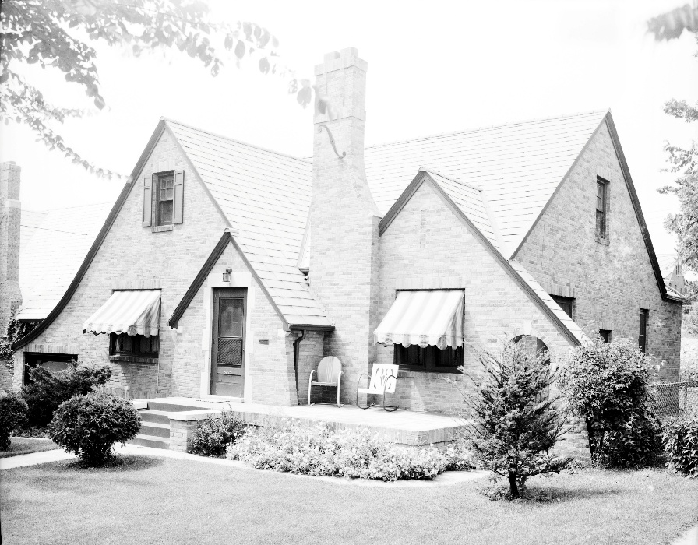
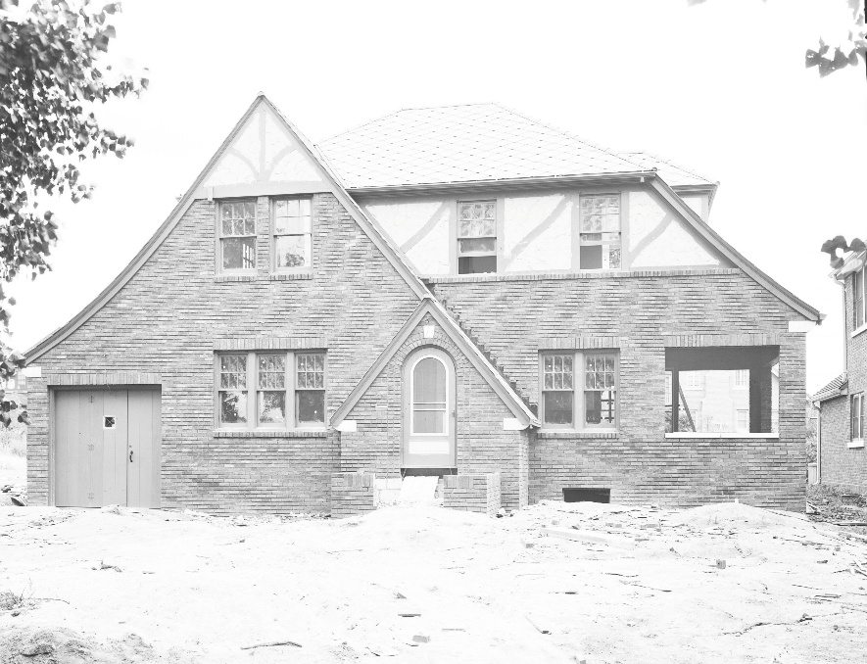
5104 Decatur Street
5012 Parker Street
Nathaniel Dewell Collection
at the Nebraska State Historical Society
2507 N. 56th Street
Notes:
Was an architectural photographer who took pictures of many of Omaha’s homes in the 1920s through 1940s.

Slide 24

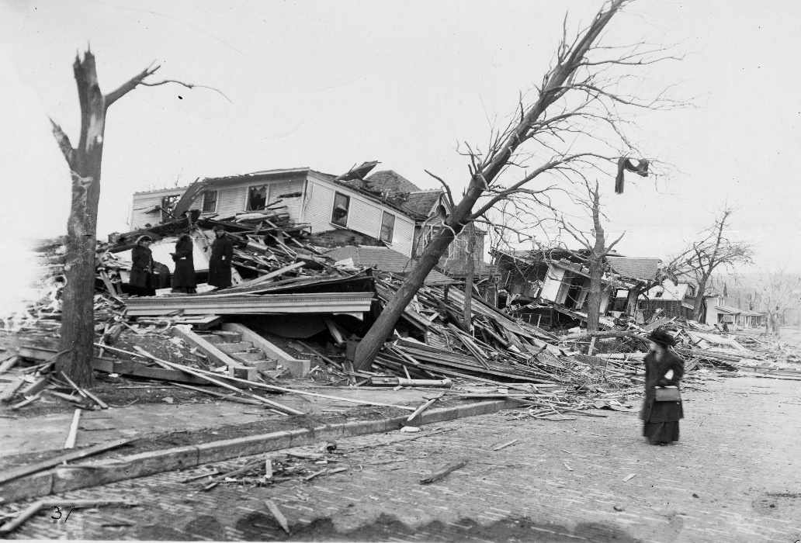
More than 500,000 photos housed in the
World-Herald Library (1900 - 1997)
Negatives from May 1991 - December 1997
Digital Archive 1997 – present
Photographs before 1997 filed by name or subject
March 23, 1913 Easter Sunday Tornado.
42nd & Farnam, South Side of Street

Slide 25
Other Photo Resources
National Archives Catalog
https://www.archives.gov/research/catalog
Library of Congress
https://www.loc.gov/photos/ > Search Omaha
Local Ethnic Organizations – German American Society, Czech Museum, Great Plains Black History Museum, Sons of Italy, Nebraska Jewish Historical Society
Omaha History Books – i.e. Omaha Times Remembered

Slide 26
U.S. Census Data
Available for free through Ancestry.com (1940 and 1950), FamilySearch or National Archives. I like Ancestry.com best.
Can gather property owners name, others living in the home, ethnic group/race, where born, education level, where they work.
Reports are easy to download.
Available every 10 years up to 1950.

Slide 27
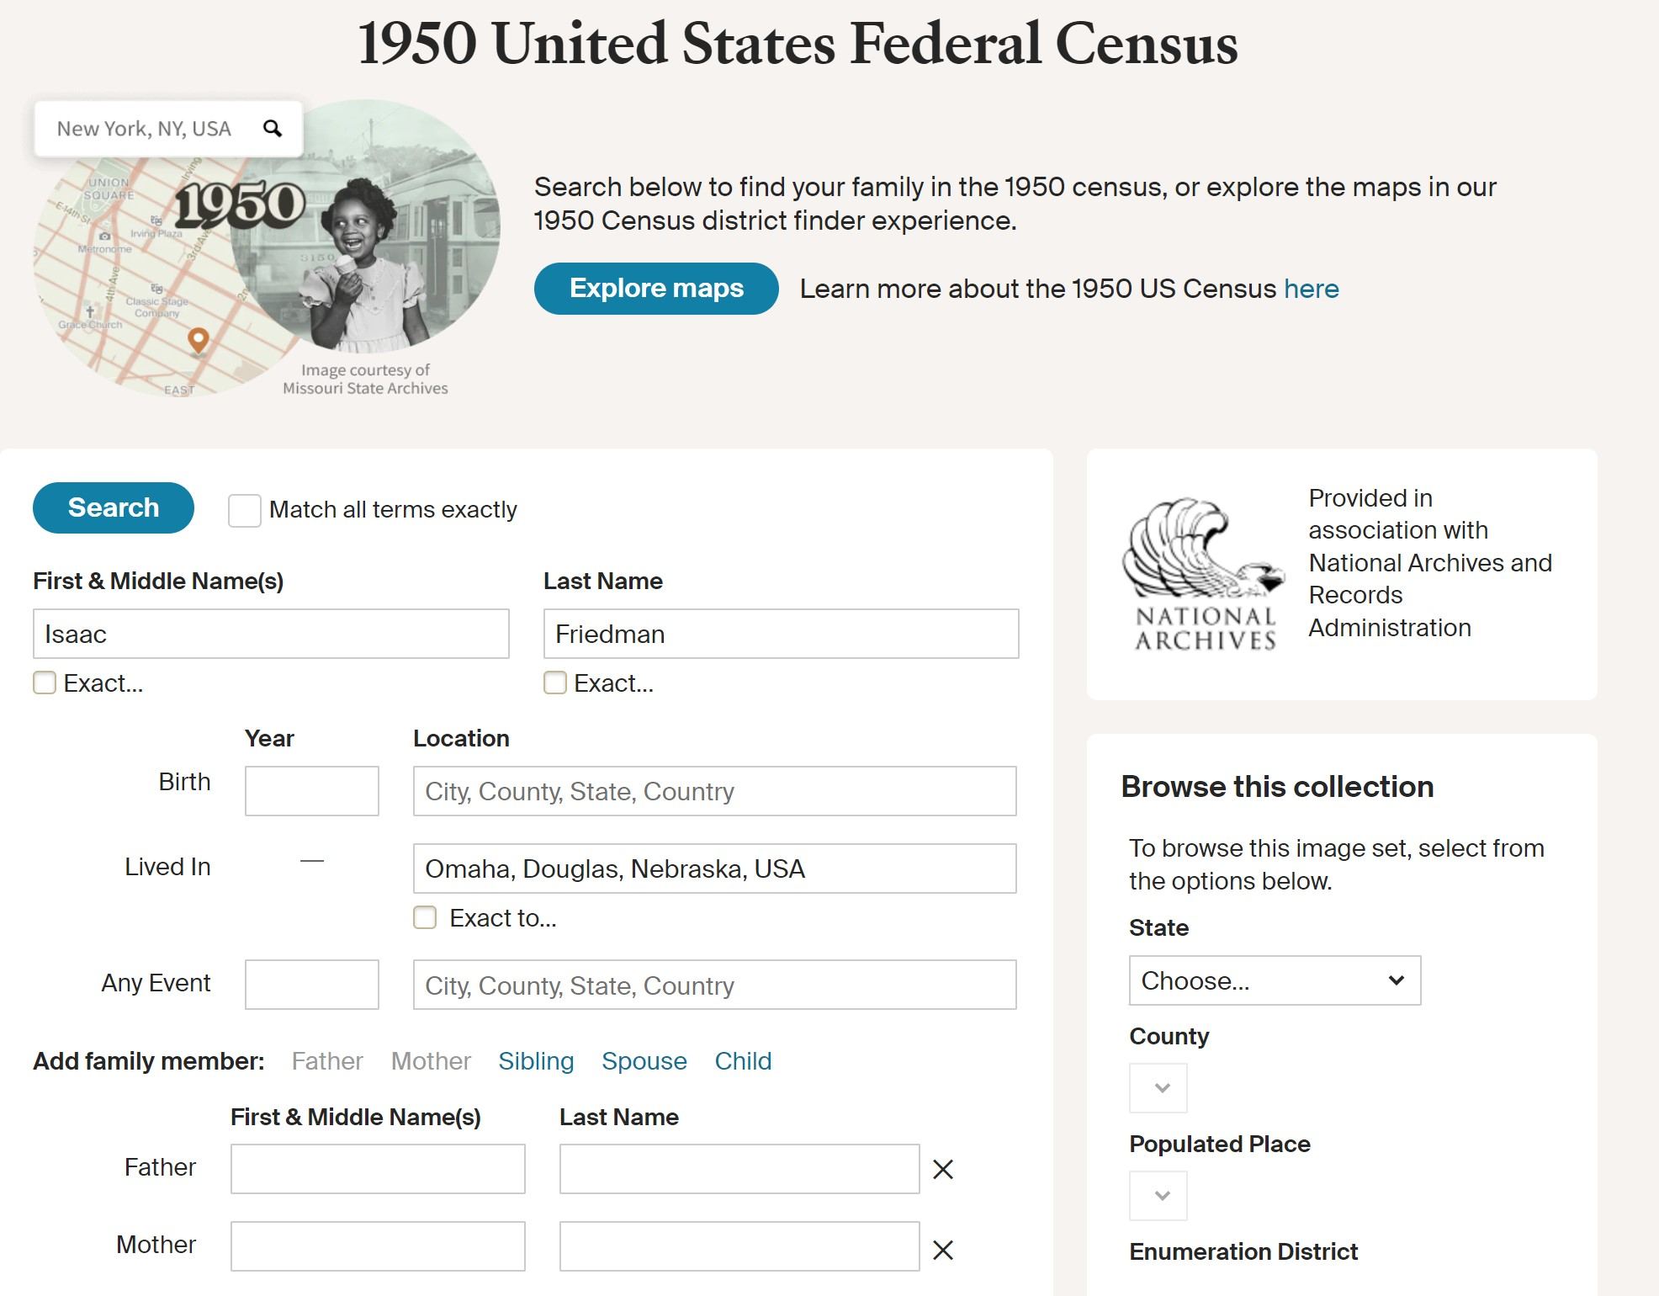

Slide 28
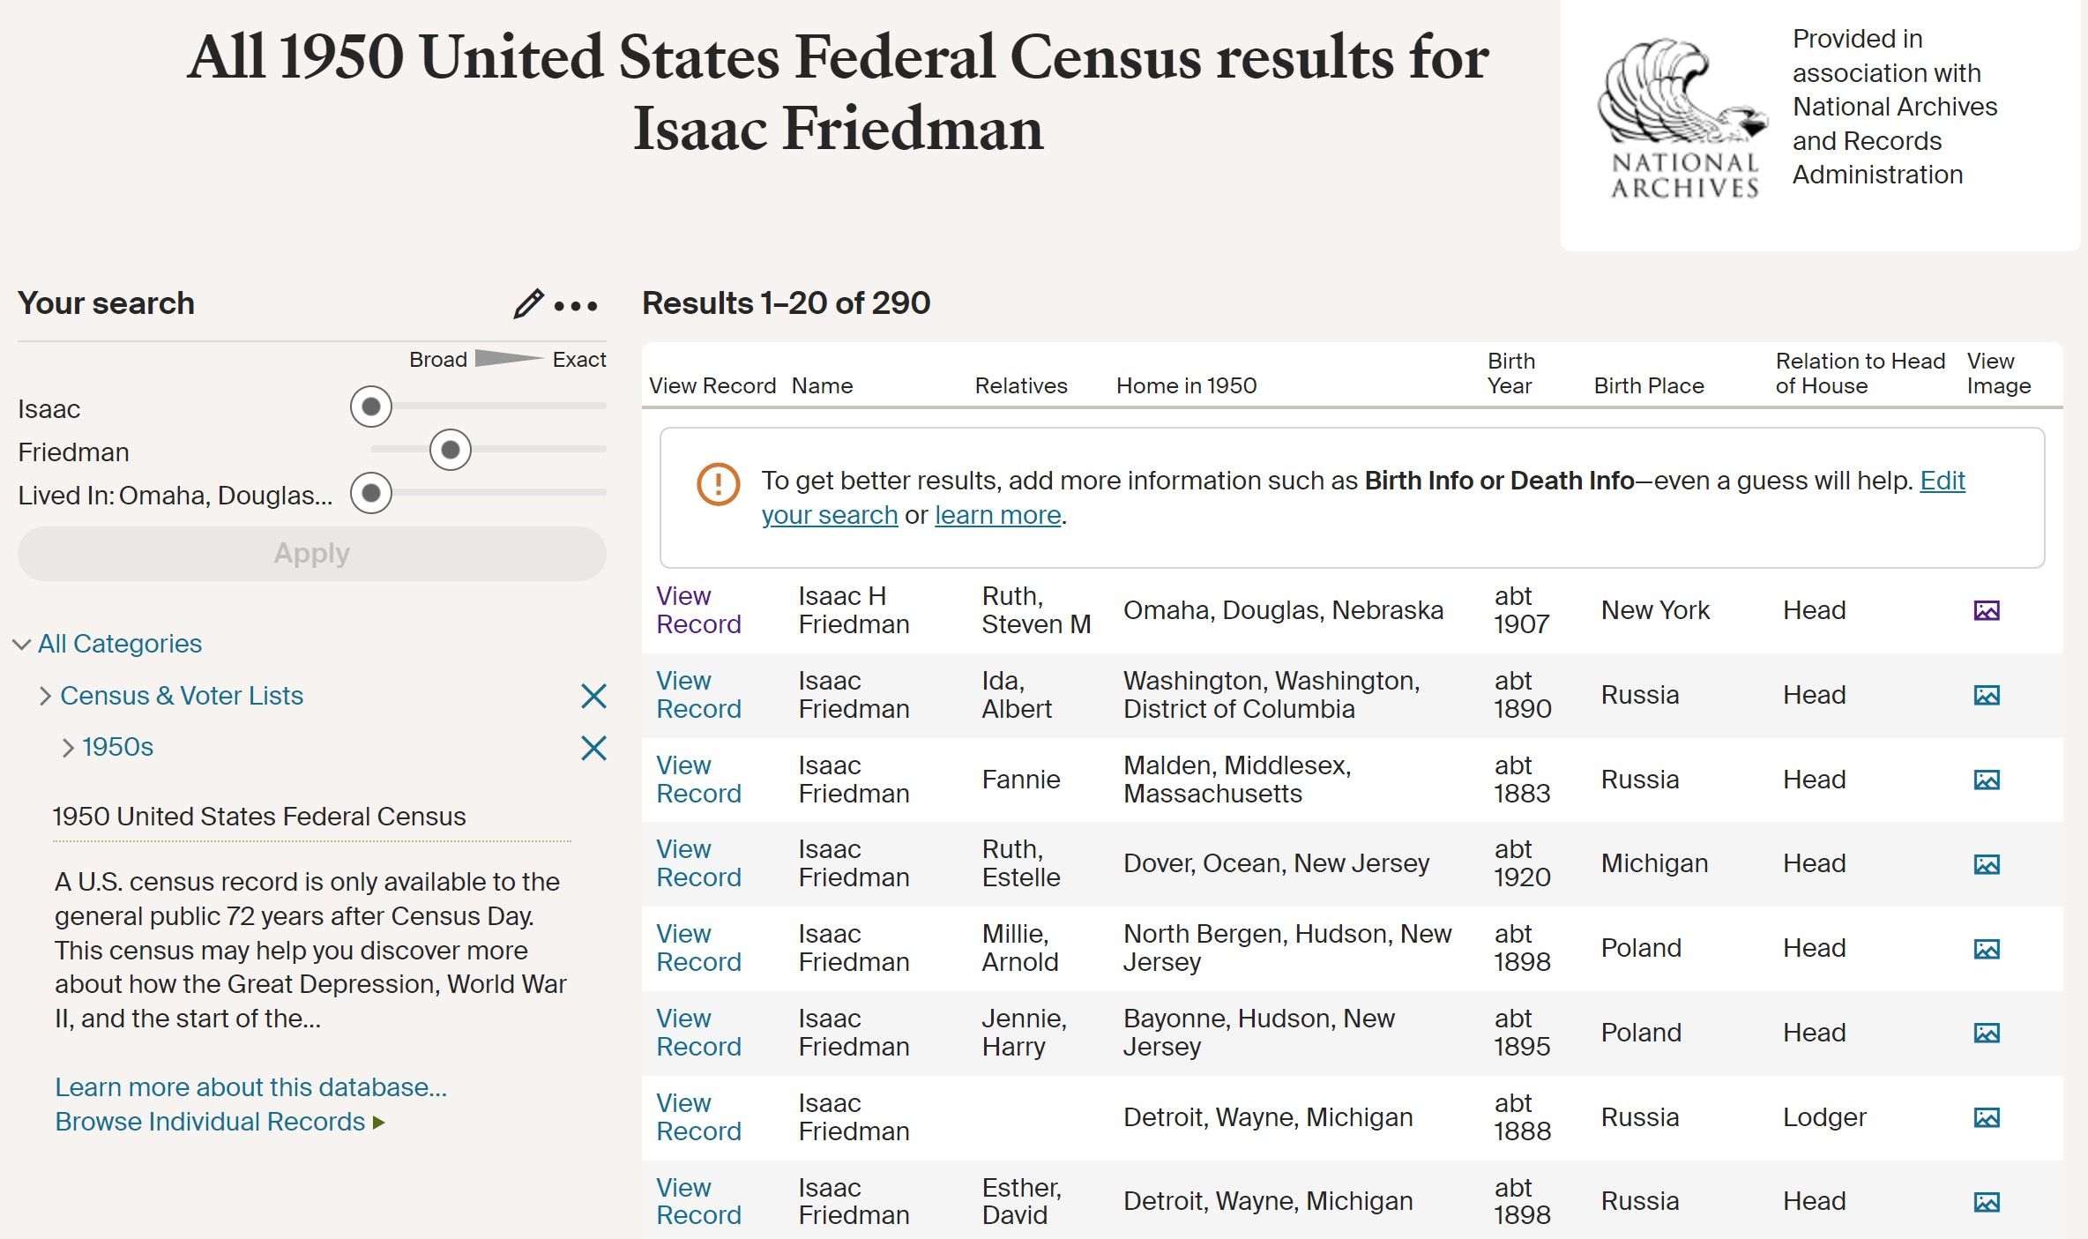

Slide 29
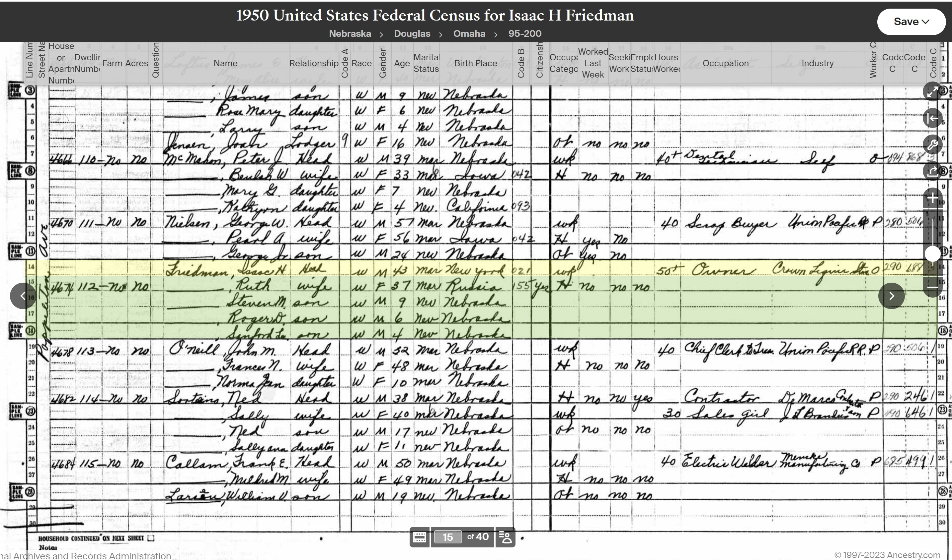

Slide 30
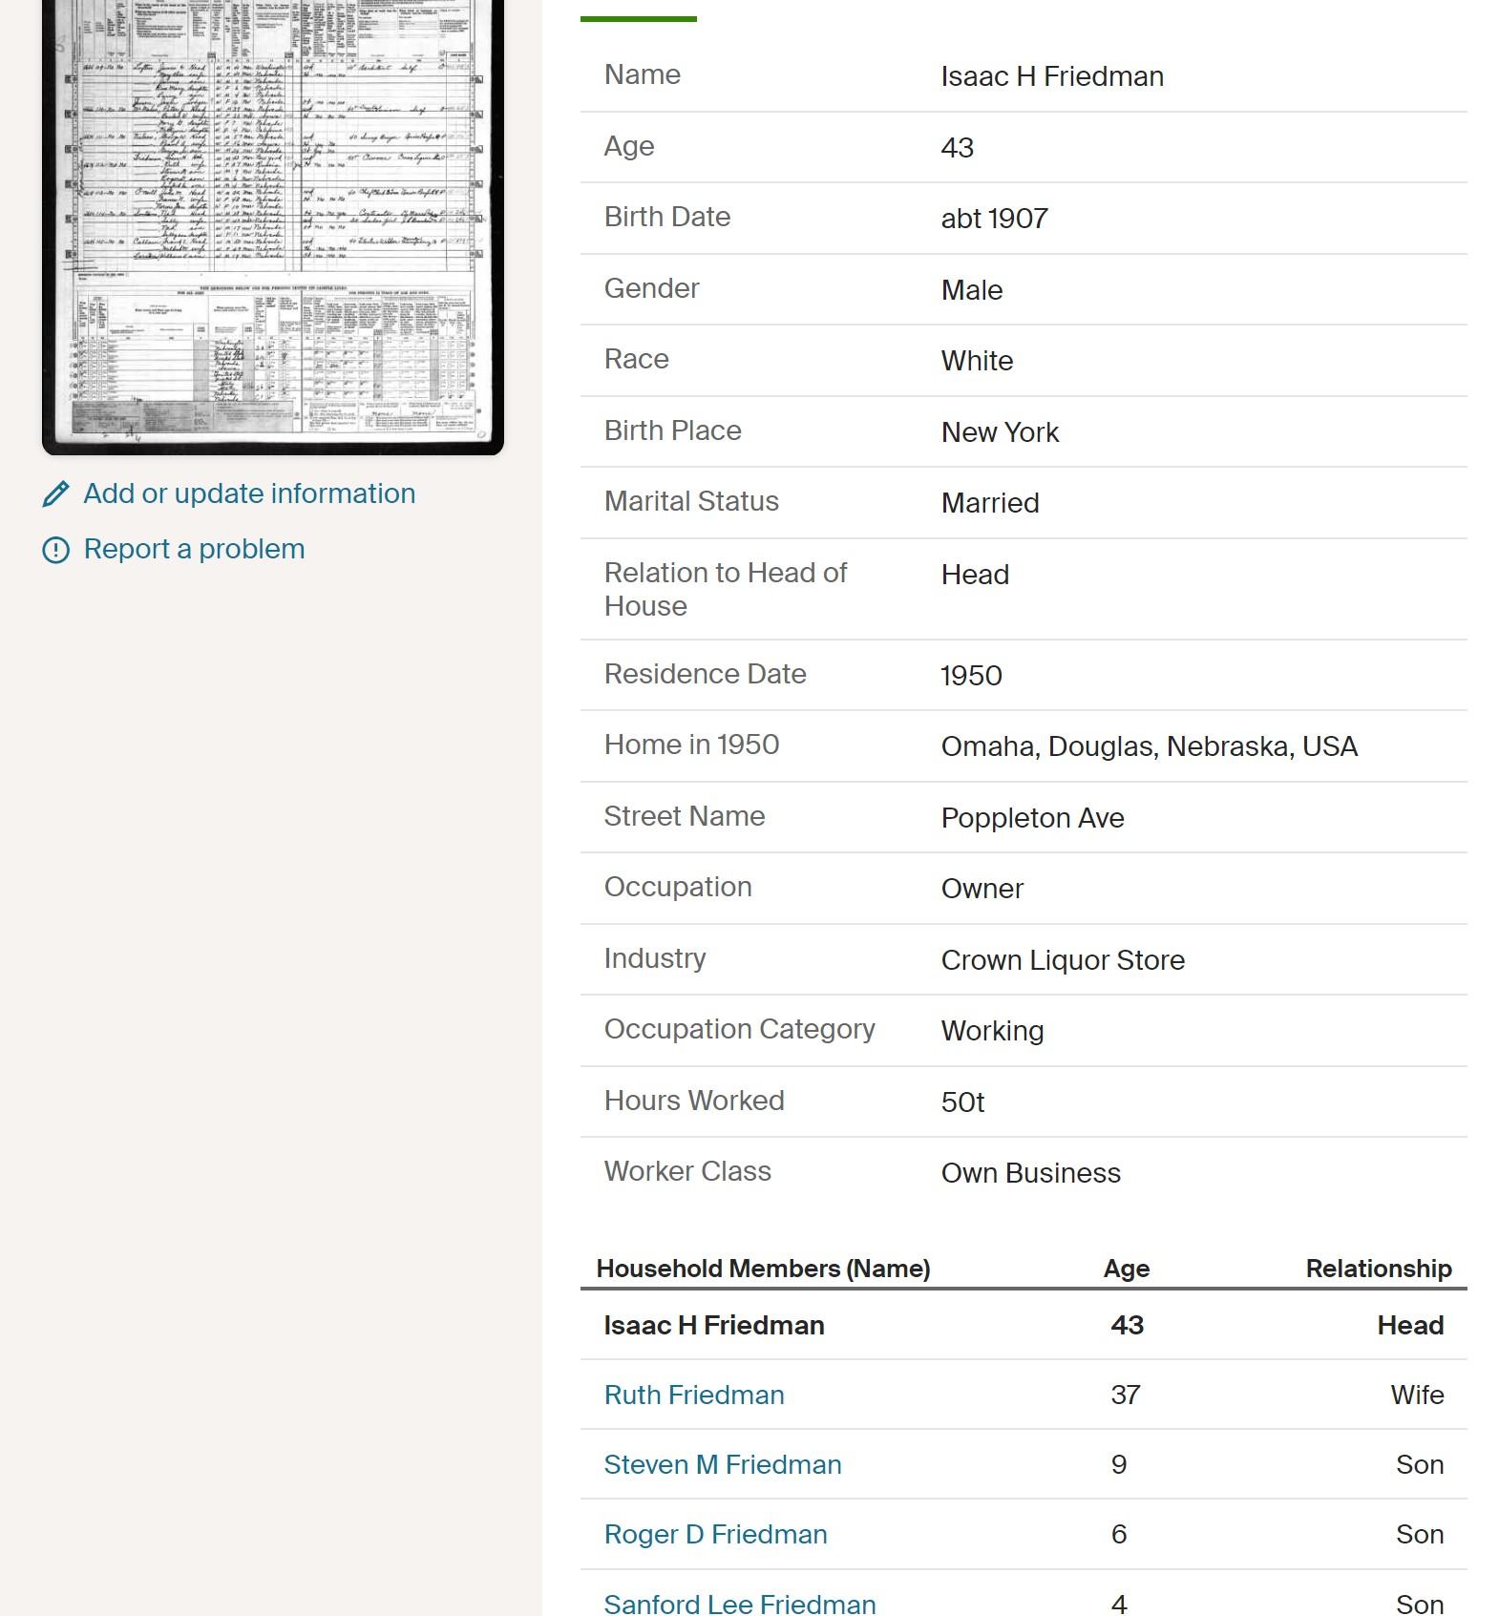

Slide 31
Other Sources
Facebook Sites - Omaha History Club, Omaha Exploration and North Omaha History Blog, My Omaha Obsession
Google Books books.google.com
Hathitrust.org – Digital library. Western Architect, Improvement Bulletin.
Old Tour Books – Neighborhood Tours done in the past.
Bureau of Land Management Glorecords.blm.gov Access to more than five million Federal land title records issued between 1788 and the present. Includes images of land patents, survey plats and field notes and land status records.

Slide 32
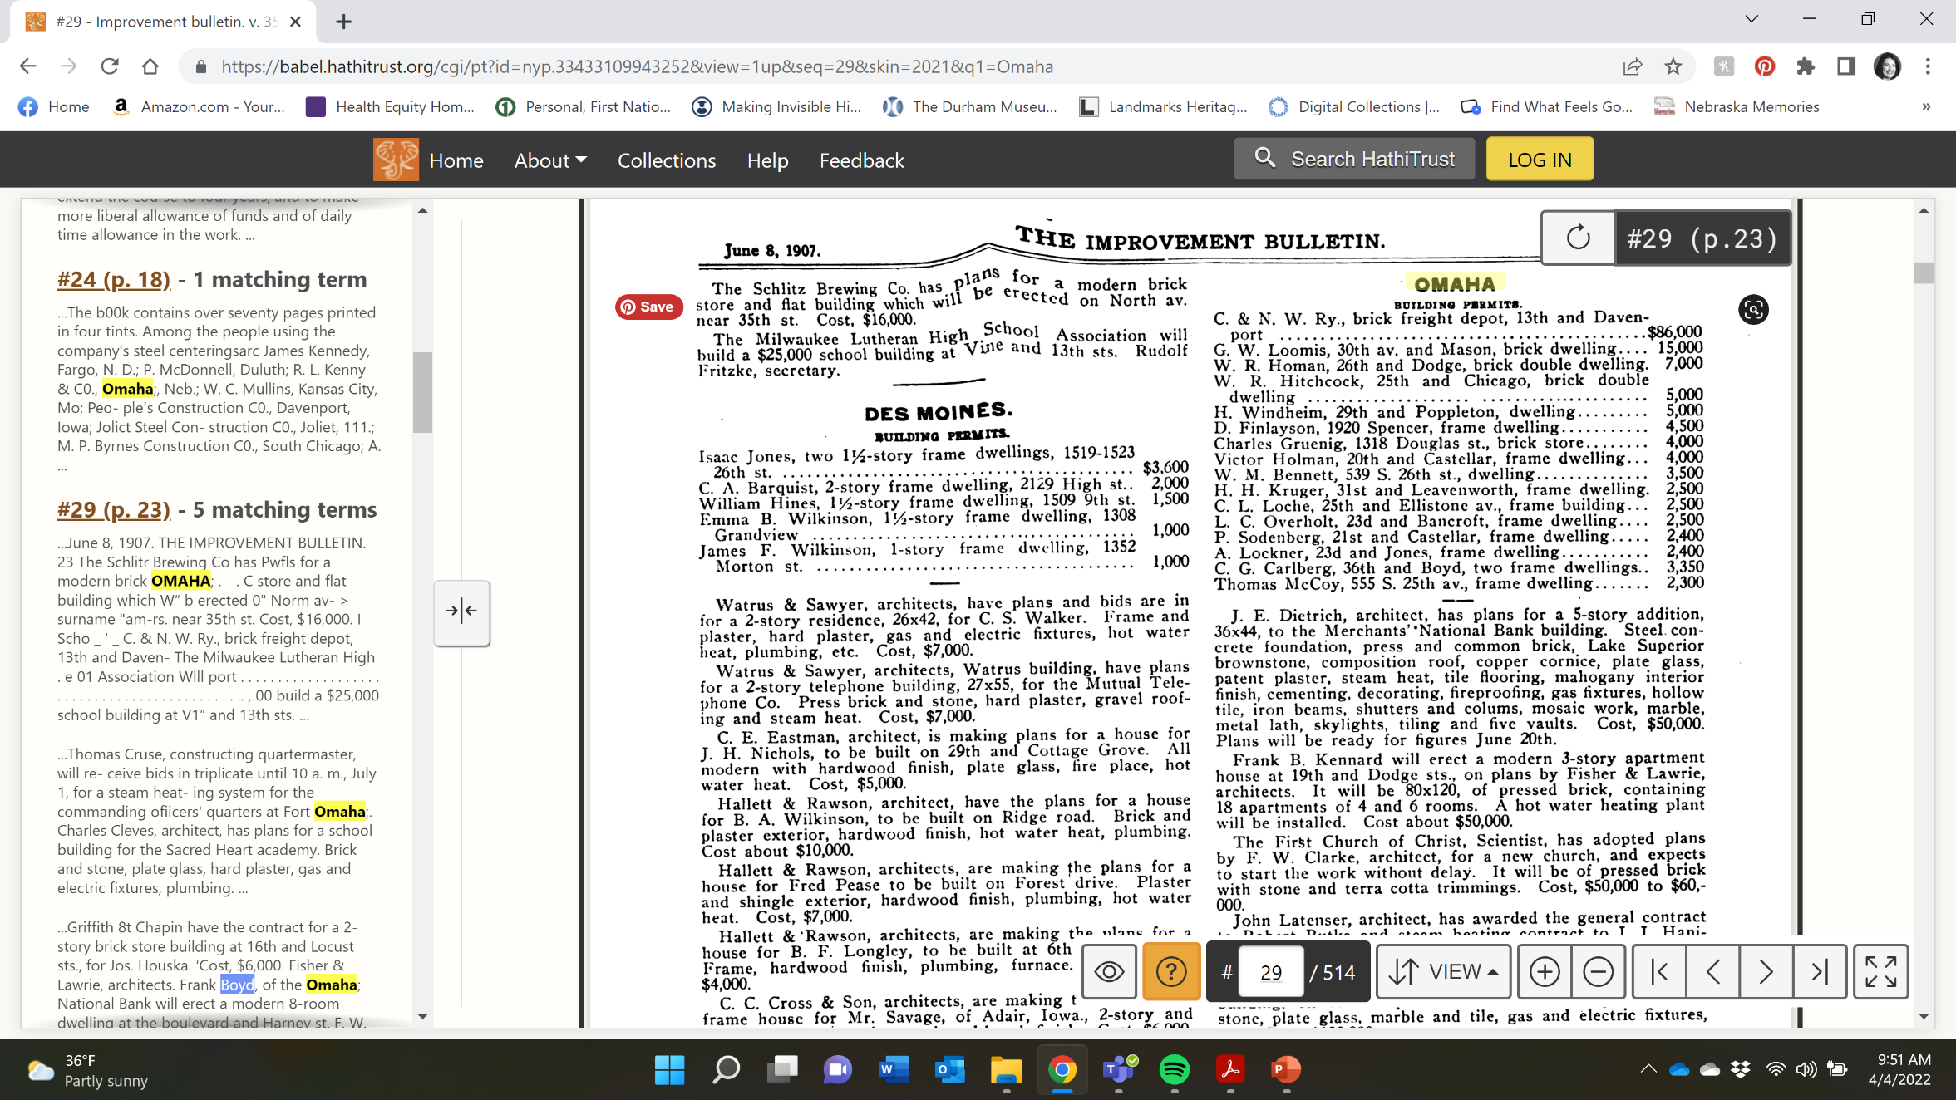

Slide 33
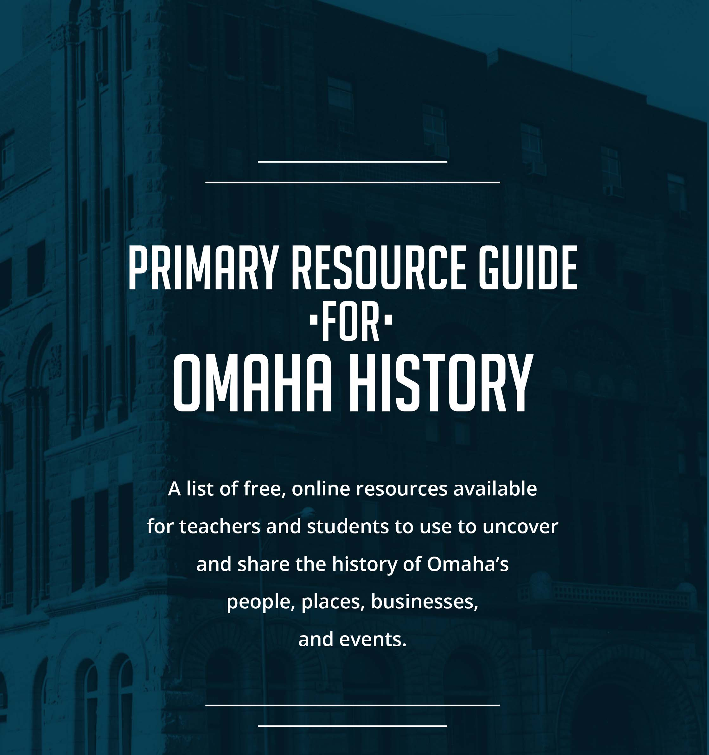
www.ops.org/InvisibleHistory
Lesson Plans Tab

Slide 34
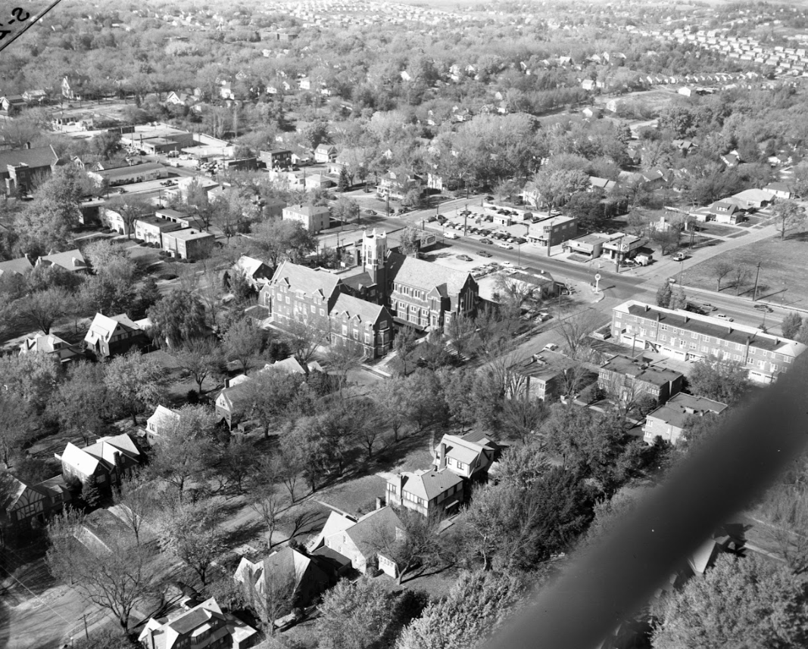
No Go Out and Share Omaha’s Stories

