Slide 1



What was the
Trans-Mississippi exposition?

Slide 2
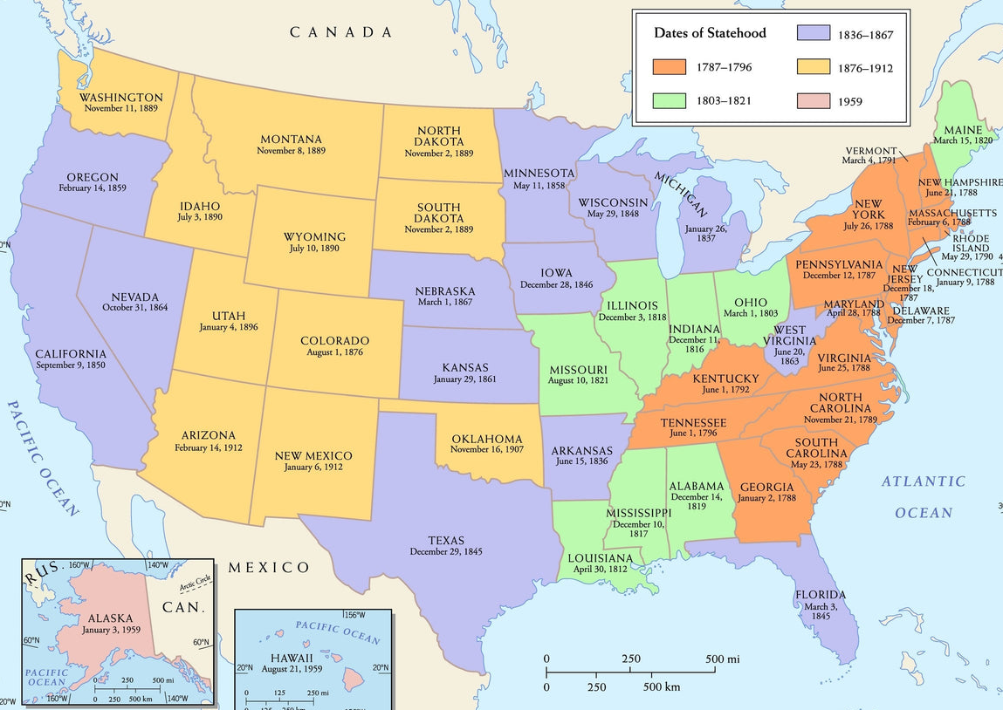

How did the event get its name?
What smaller words/prefixes do you see in these big words?
Trans-Mississippi
Exposition
Across, beyond, through
A public event to EXPOSE people to new items or ideas
The Mississippi River

Slide 3

What was the Trans-Miss?
GOAL: Infer what visitors to the Trans-Miss might have experienced
Together, we are going to watch a video introducing us to the Trans-Miss. The video will play twice so you have time to take notes!
As we watch, answer the 5W questions in your notes:
WHO: How many people visited the Trans-Miss?
WHAT: What did visitors see or experience?
WHEN: When did the Trans-Miss take place?
WHERE: Where within Omaha did the fair take place?
WHY: Why was the fair important? What new technology or important people were involved?
Notes:
Notes:
Who: How many people visited? 2.5 million people
What: What might have visitors seen or experienced at the Trans-Miss?
When: When did the Trans-Miss take place?
Where: Where specifically within Omaha did the fair take place?
Why: Why was the fair important? What new technology or important people were involved?

Slide 4
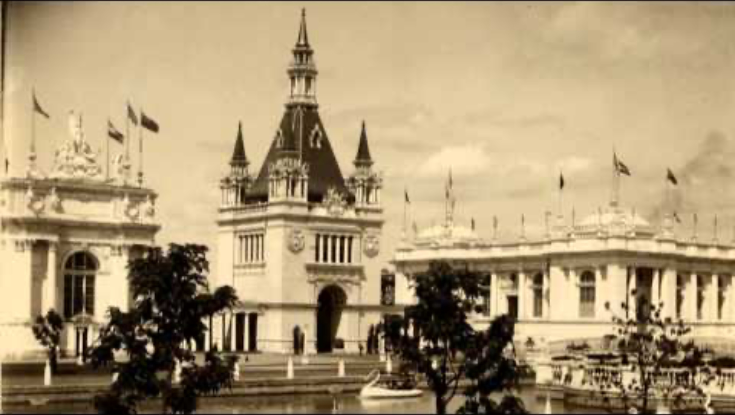
https://youtu.be/KPOEZadMJ5Y?si=KhqzKzEc50mDIiV3
Notes:
Play the video twice.

Slide 5

Understanding the Trans-Miss
GOAL: Read to understand the goals and impacts of the Trans-Mississippi Exposition
Read the question for Section 1. Then, read Section 1. When you find information that relates to the question, STOP! Answer the question! Then keep reading.
Repeat the process for Section 2 and Section 3

Slide 6
Field trip
Kountze Park and Neighborhood
Walk the site of the Grand Court with a map and images from the Trans-Miss (in lesson plan folder)
The Durham Museum
View the Trans-Mississippi and Early Omaha Exhibits
Video Preview of The Durham’s Exhibit
https://www.cspan.org/program/american-history-tv/
1898-trans-mississippi-and-international-exposition/403487
Notes:
Review Details of Field Trip. Map, tour script and images are in the lesson plan folder. In advance, show an 8-minute video of Carrie Meyer at The Durham talking about their Trans-Miss exhibit. https://www.cnspan.org/program/american-history-tv/1898-trans-mississippi-and-international-exposition/403487

Slide 7
Architecture

Slide 8
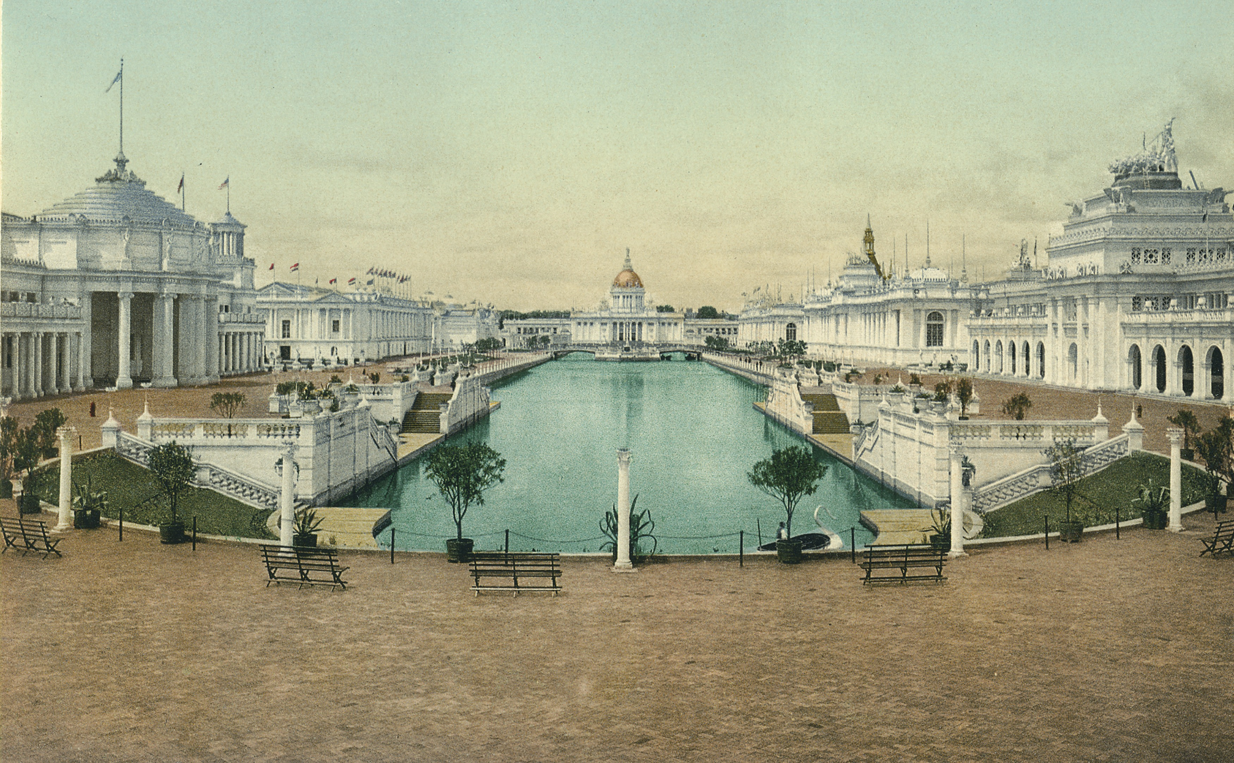
Attendance question
What are two adjectives or connections that come to mind when you see this picture?
This reminds me of…
This looks like…
I would describe this place as…
I would describe these buildings as…
Notes:
Give kids 5 minutes, then randomly choose 3 to share what they wrote.

Slide 9
What is the Beaux-Arts Style?
GOAL: Identify elements of the Beaux-Arts style.
On the next slide, we’ll look at a famous example of the Beaux-Arts style: the San Francisco City Hall
Use the slide to label your picture on your notes
When we’re done, you’ll identify Beaux Arts elements in Trans-Miss exposition buildings

Slide 10
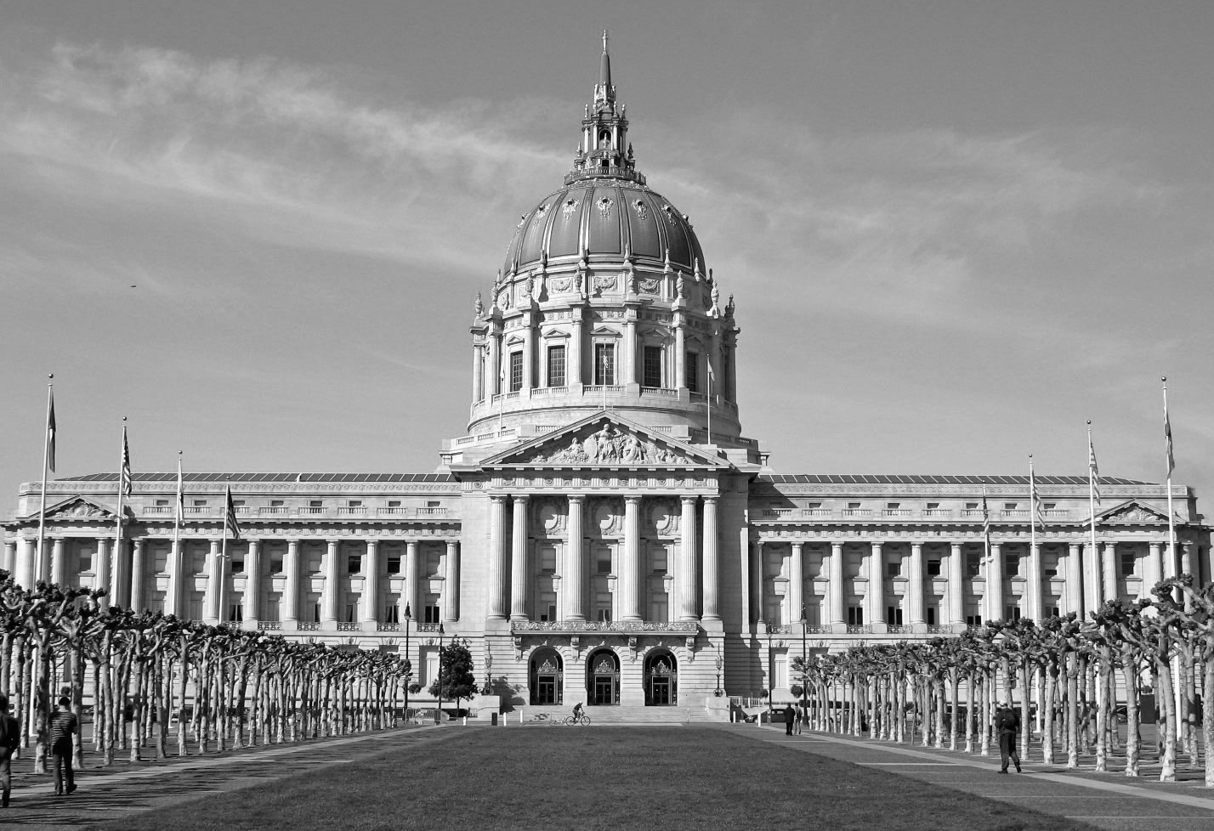
Symmetrical
Domed/Triangular roof
Sculptures
Beaux-Arts Style
Beaux-Arts Style
Archways
Columns

Slide 11
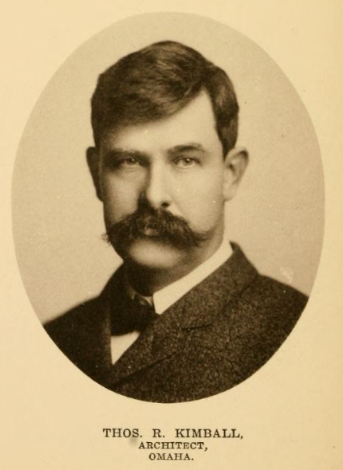
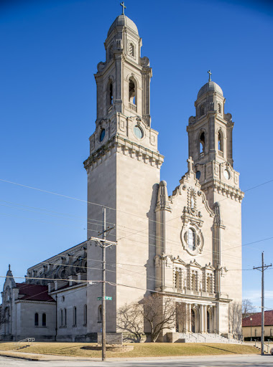
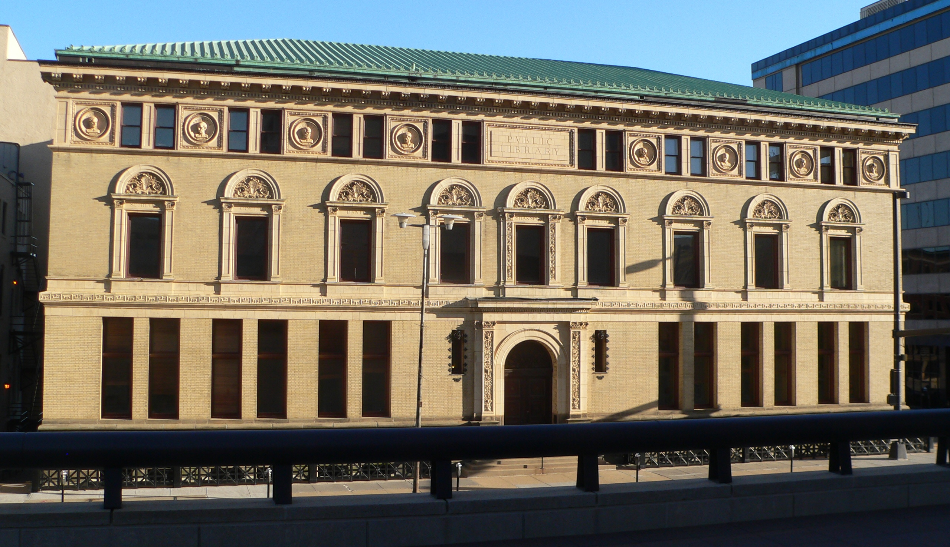
Who was the Chief Architect?
The lead architect of the Trans-Miss Exposition was Thomas Kimball
He was trained in the Beaux Arts style in Paris
He helped design the Exposition’s Grand Court, a symmetrical arrangement of buildings in the Beaux Arts style
After the Exposition, he continued shaping Omaha’s architecture, designing buildings like St. Cecilia’s Cathedral and the original Omaha Public Library

Slide 12

Architecture Gallery Walk
GOAL: Compare buildings designed for the Exposition and identify elements of the Beaux Arts style
Use each image to answer the questions on your graphic organizer
MOVEMENT: Move at your own pace. Try not to clump up around pictures – keep it moving!
VOICE: We should not be able to hear you from across the room
PARTICIPATION: Work by yourself or with one partner
Notes:
Worksheet done
Gallery walk done

Slide 13
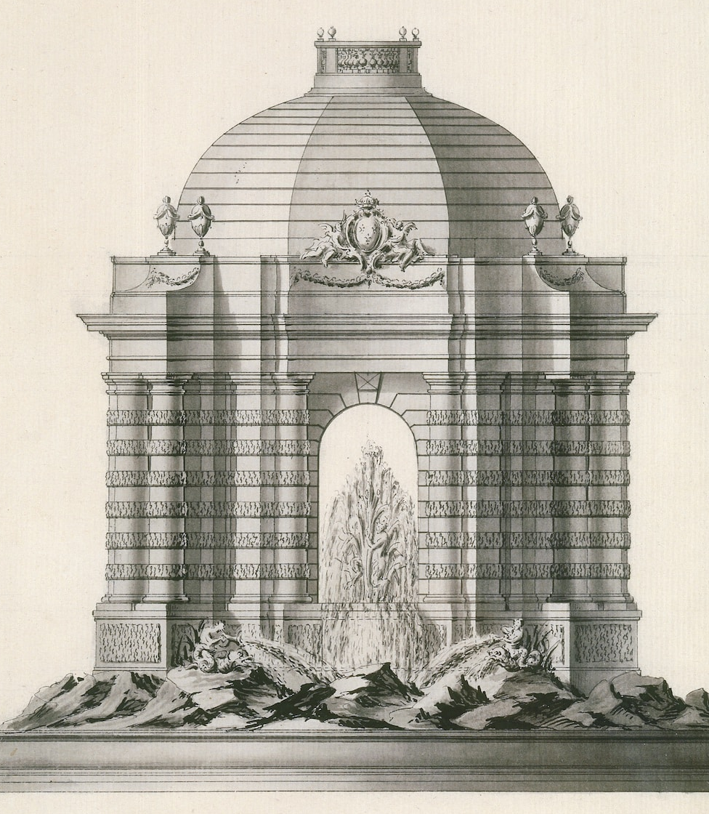

Design Challenge
Symmetrical
GOAL: Put your Beaux Arts design knowledge to the test!
It’s your turn to be the designer!
Design a building in the Beaux Arts style to honor someone or something you love!
Grand Palace of Roblox
Magnificent Court of Kendrick
Use two Beaux Arts design elements. Label them in your design
Draw by hand or use Canva on your iPad.
Domed roof

Slide 14
Visitor Experience

Slide 15

Attendance question
What rides or games do you like to play or ride at a fair or carnival? What’s your favorite carnival food? (Think of the tilt-a-whirl, roller coaster, haunted house, giant slide, ring toss, funnel cakes, cotton candy)
Notes:
Give students 5 minutes, then randomly choose 3 to share.

Slide 16
Imagine it’s 1898. You’re in Omaha, Nebraska, and you’ve come to visit the Trans-Mississippi Exposition.
Visiting the Exposition
Imagine it’s 1898. You’re in Omaha, Nebraska, and you’ve come to visit the Trans-Mississippi Exposition.
How would you have gotten to Omaha and to the Exposition grounds?
Where would you have stayed?
What would you expect to see, hear, and experience?
Notes:
Train to Burlington Station, which was built to accommodate the expected visitors. Now where KETV broadcasts from. Took Streetcars to the grounds.

Slide 17
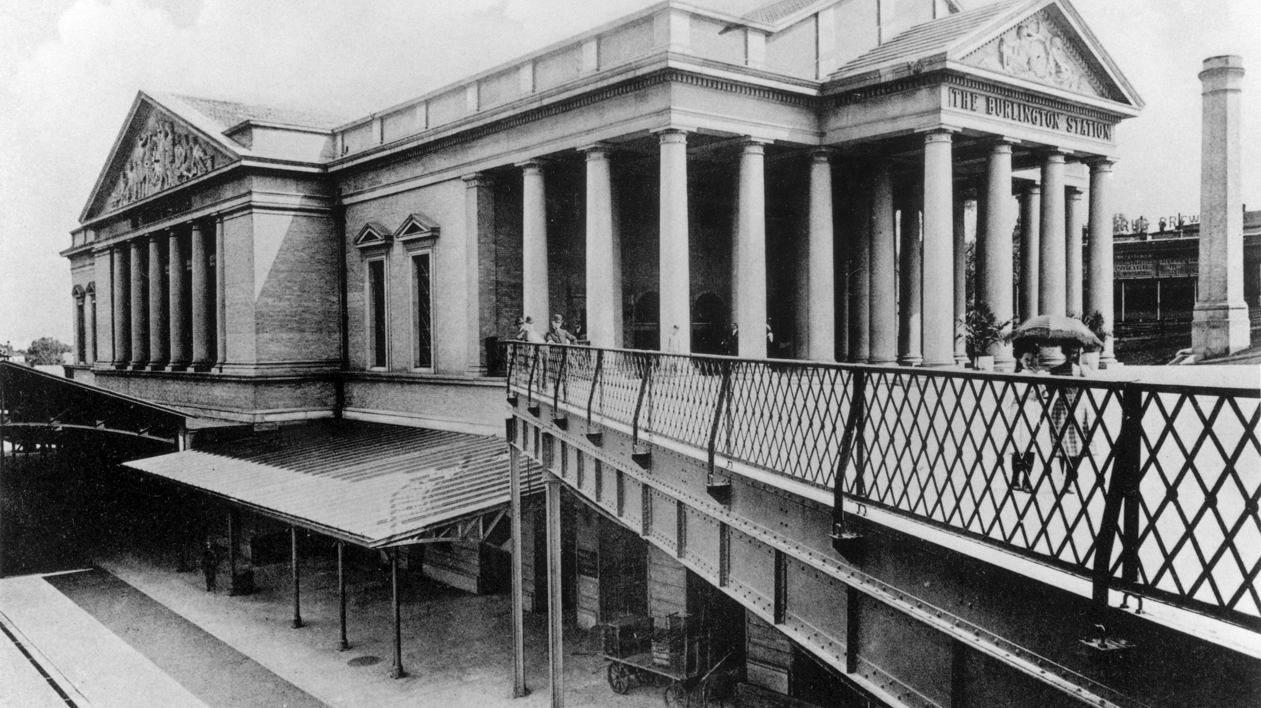
Notes:
Burlington Station. Designed by Thomas Kimball. Opened July 4, 1898. Note columns are no longer on the building. In 1930 they remodeled the building and took them off. The columnis are now standing on the east side of UNL’s Memorial Stadium.

Slide 18
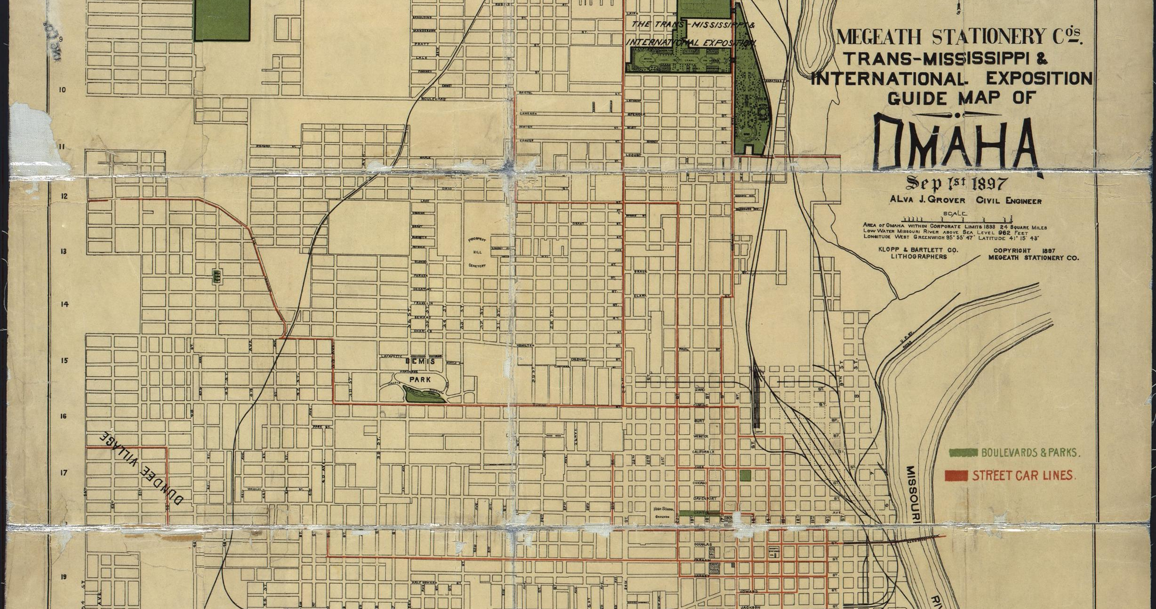
Notes:
Red Lines – Streetcar routes. Three streetcars would take travelers to the exposition on 24th, 16th or 20th Street.

Slide 19
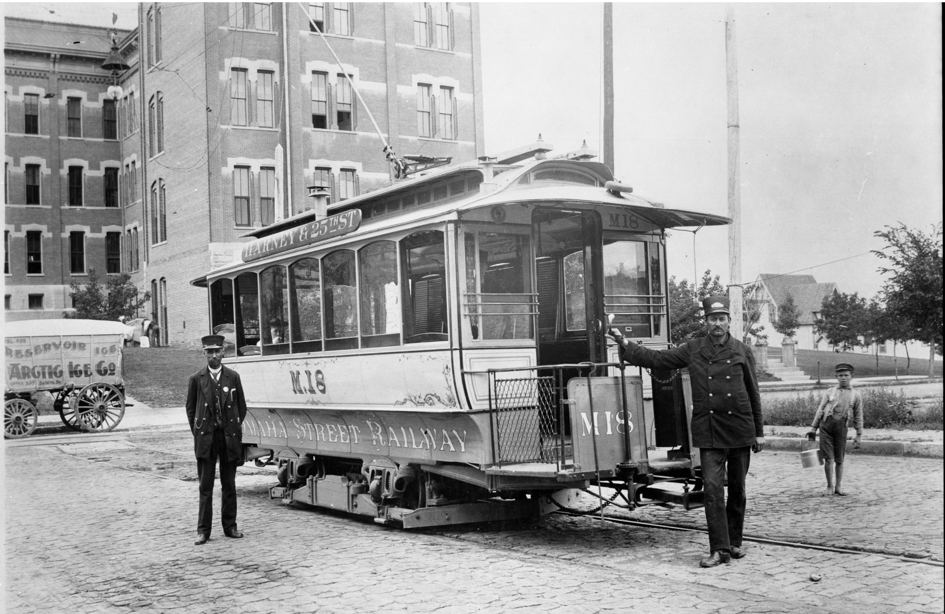
Notes:
What Streetcars would have looked like in 1898. They ran on electricity.

Slide 20
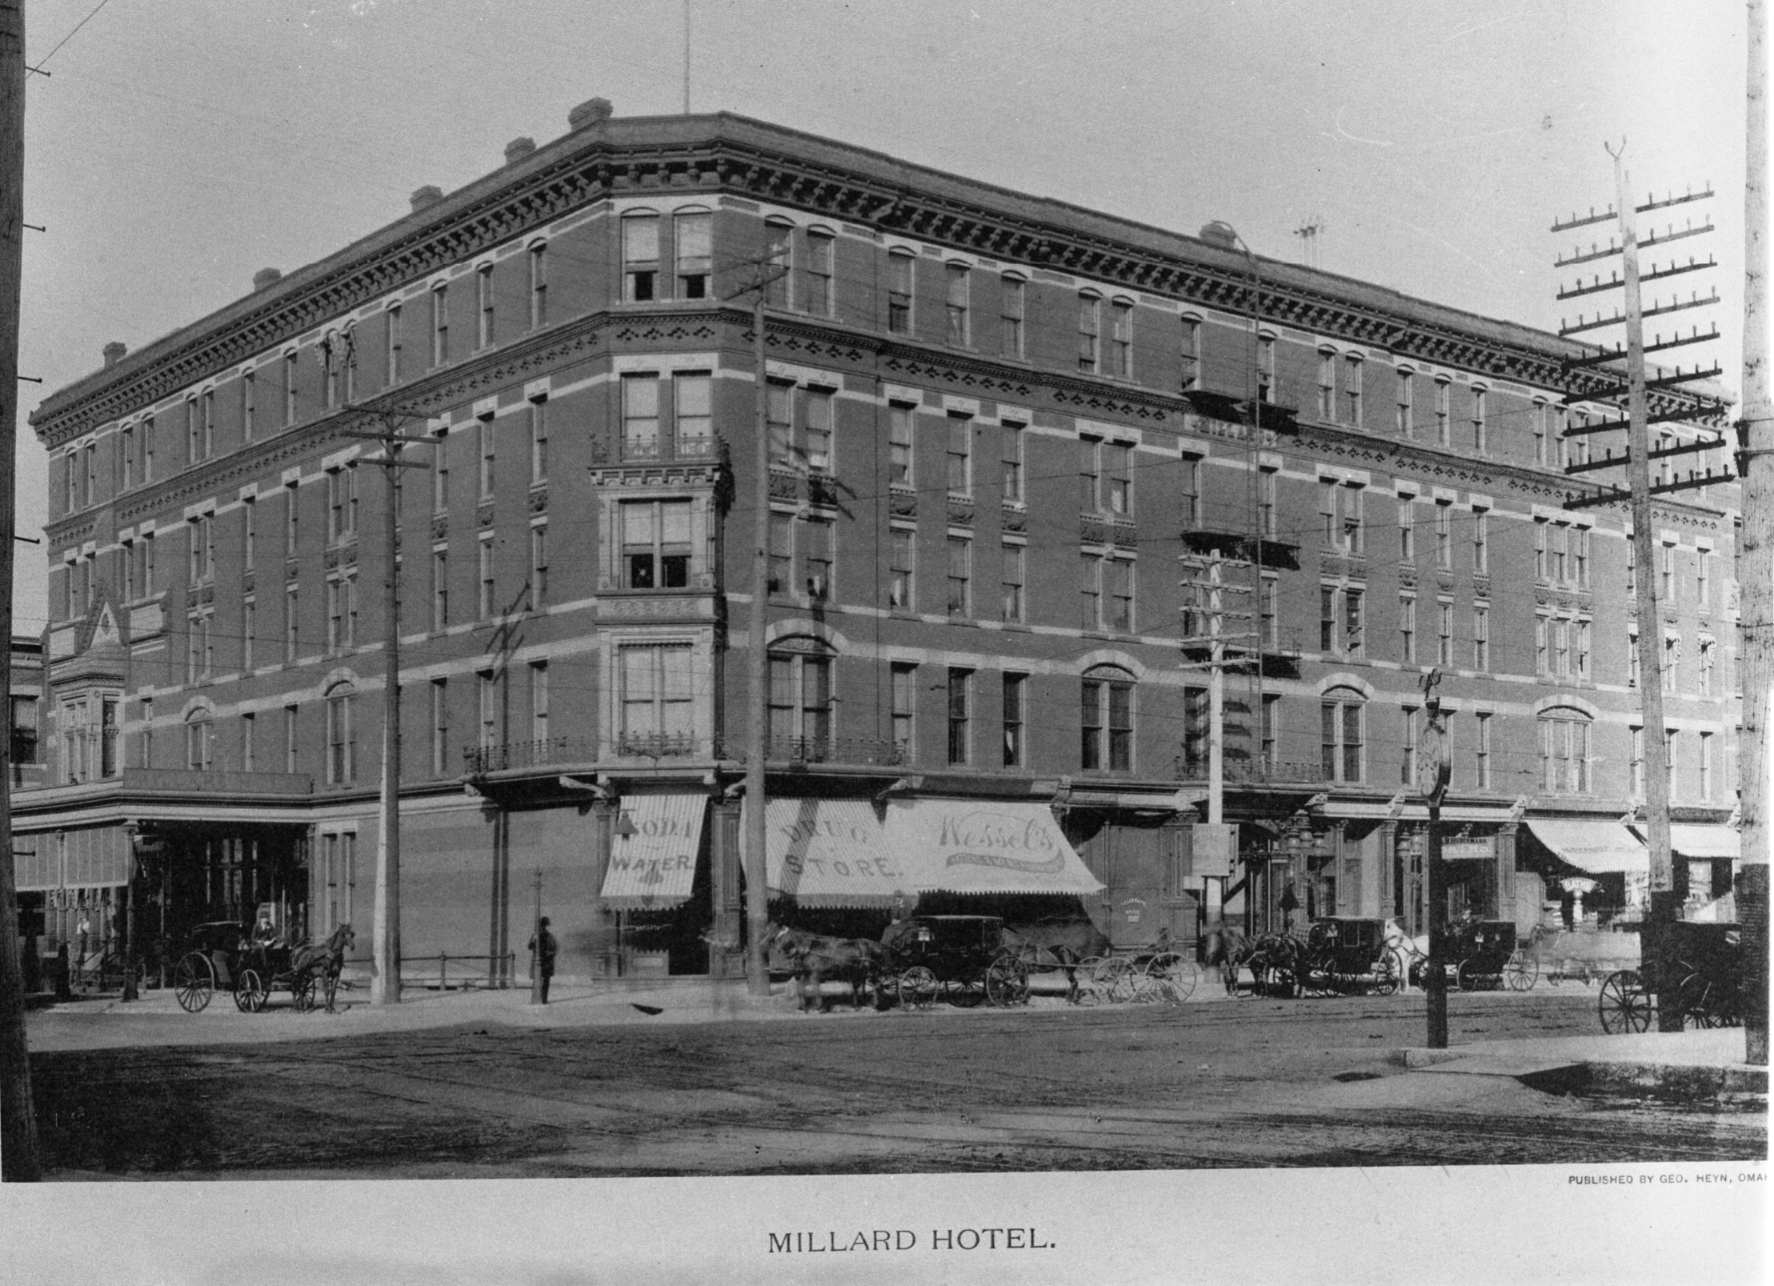
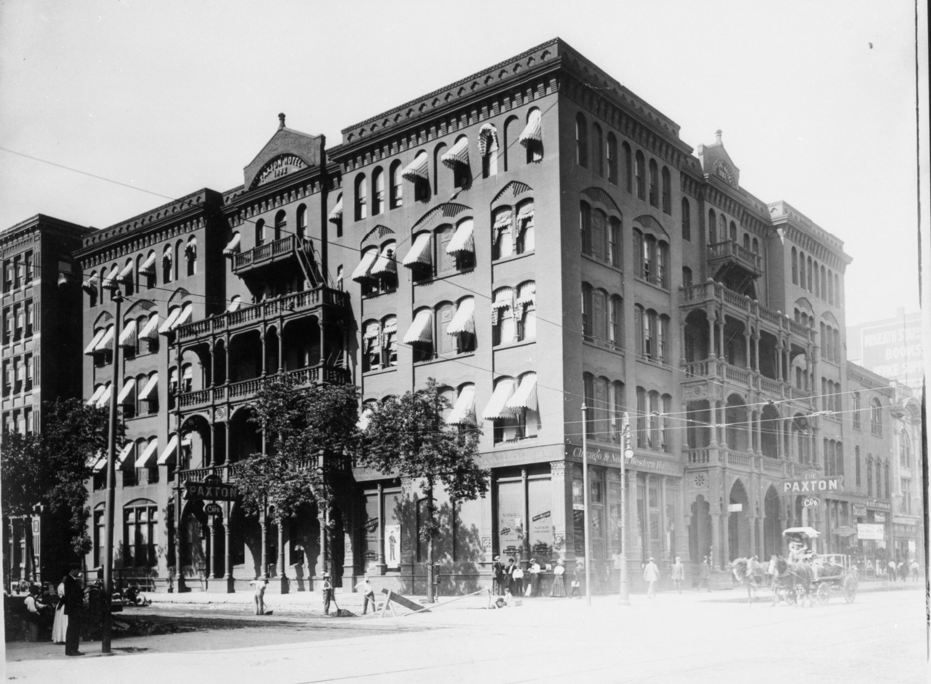
Millard Hotel 13th and Douglas and the Paxton Hotel at 14th and Farnam Streets
Notes:
You may have stayed at the Millard Hotel or the Paxton Hotel in Downtown Omaha. Or at a Boarding House – explain what a boarding house was.

Slide 21
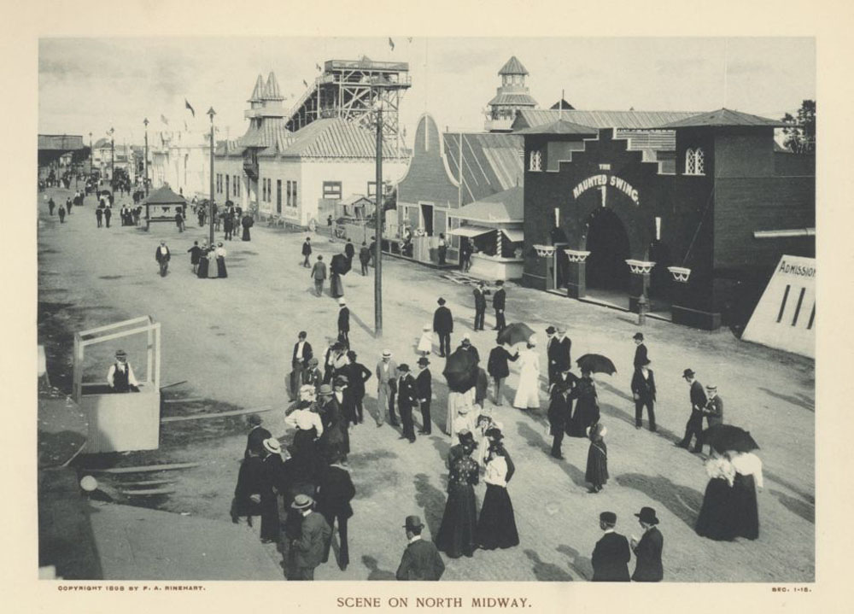
Notes:
What would visitors see, hear, feel and taste?

Slide 22

Visitor Experiences
More than 2.6 million people came through the doors of the Trans-Mississippi Eposition.
Visitors could explore many different shows, restaurants, rides, and other experiences.
Read the card with your experience on it and look at the picture
Then, look at the categories on your notes. Notice which category your experience fits into – it might fit into more than one!
DON’T write anything down yet! Just become the expert on your experience.
Notes:
Give each student a card with a picture and explanation on it. They take 3 minutes to read it. Tell them to look at the prompts on the bottom to make sure they know which category or categories they fit into.

Slide 23
Visitor Experiences Meet & Greet
GOAL: Collect experiences in each category
MOVEMENT: Move around the room at your own pace. When you’re done talking to someone, move on to another person – don’t just stand around!
VOICE: We shouldn’t be able to hear you from across the room, but you should speak loud enough for your partner to hear you
PARTICIPATION: Find people whose experiences fit into each category. NO REPEATS! For each experience category, answer all the questions.
Notes:
Students move around the room on their own to find experiences that fit into each category by interviewing each other.

Slide 24
Midway

Slide 25
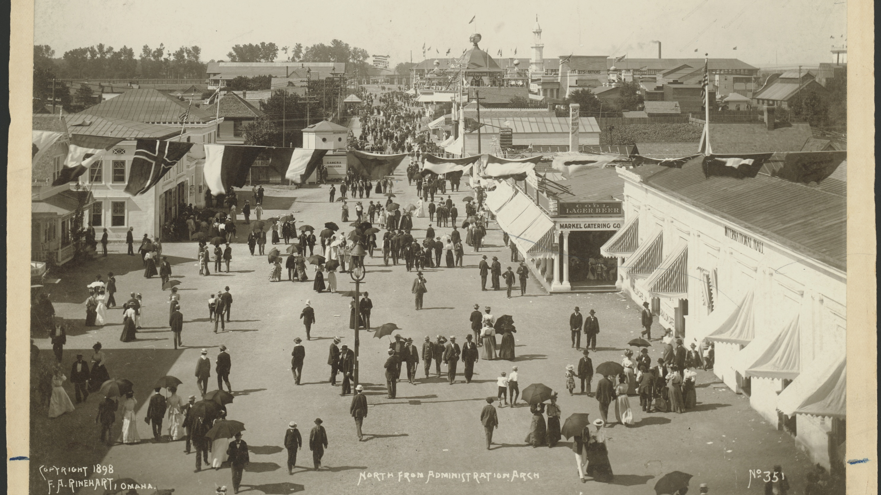

Slide 26
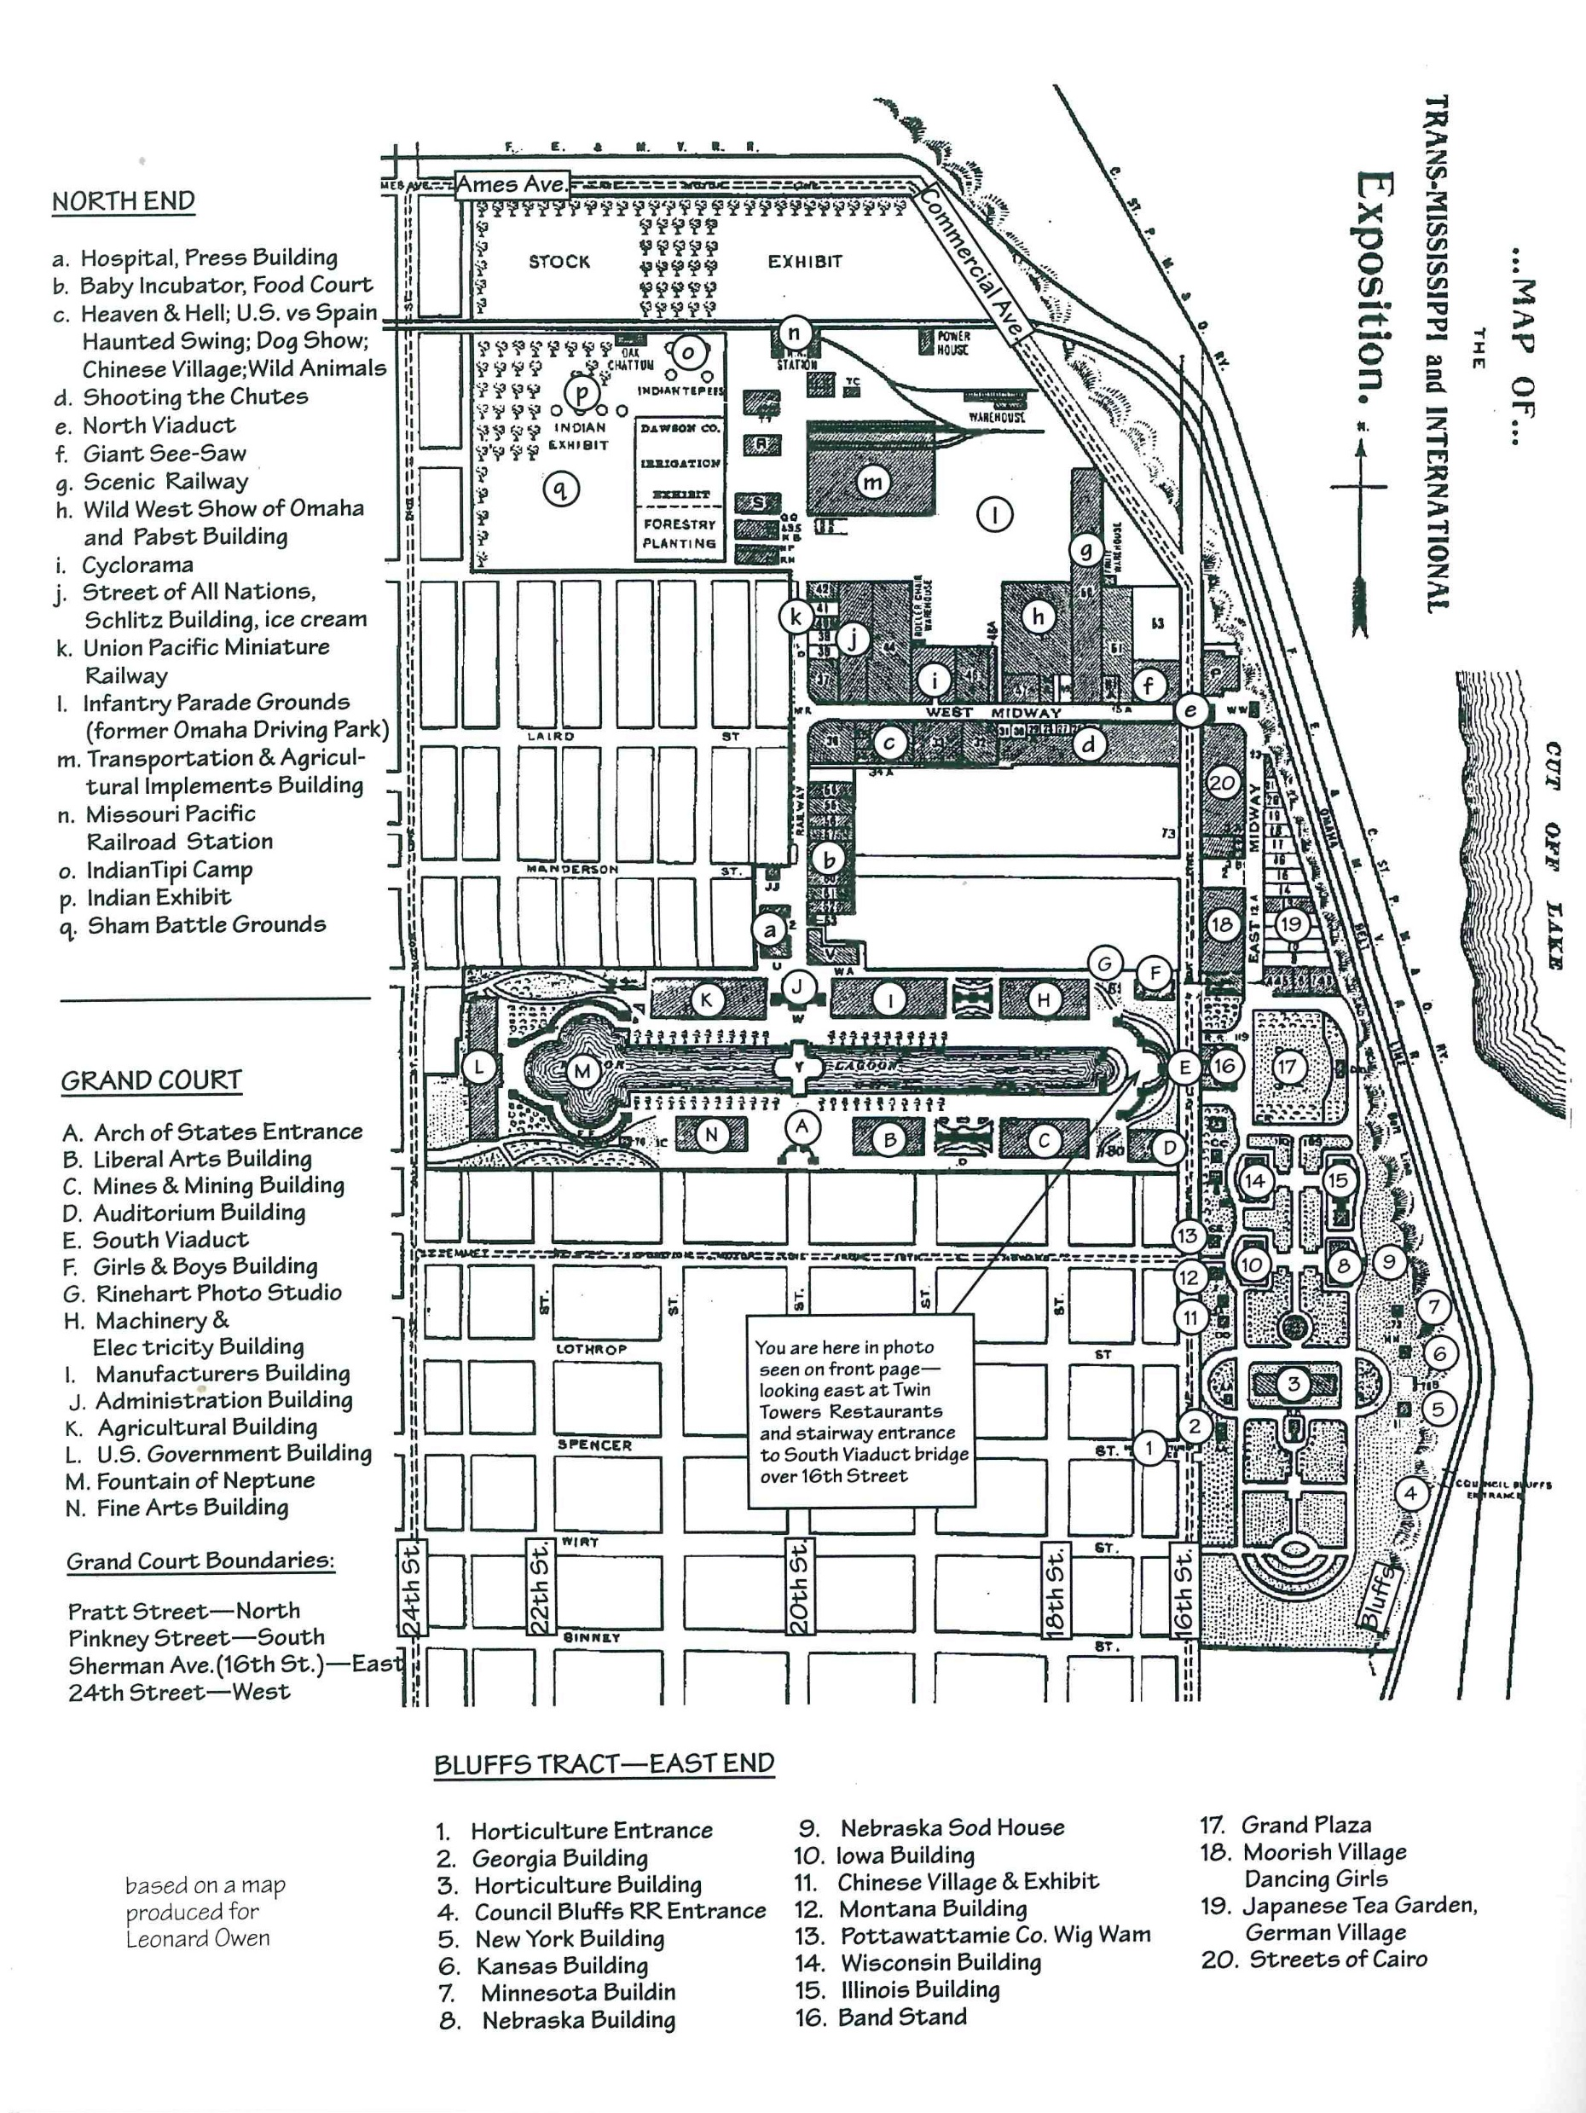
Notes:
Point out where Midway Rides Were – West Midway, top arrow, Bluffs Tract-East Midway, bottom arrow.

Slide 27
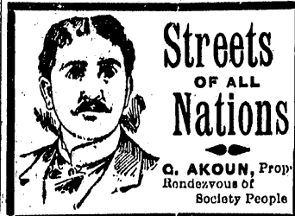
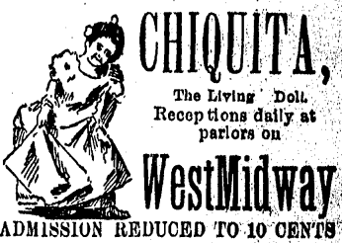
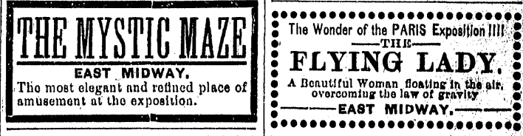


Five Senses on the Midway
GOAL: Predict what people saw, heard, smelled, and felt while walking down the Midway
Look at the pictures on the right. Pick ONE midway attraction to focus on
Imagine what it would be like to experience the attraction. In your notebook, fill in these sentences:
I would see…
I would hear…
I would smell…
I would feel…
I would taste…
Notes:
Teachers – walk around the room as kids write their senses reflection. Pick one student per ad and have them explain what they wrote and why – what about the ad made them predict these things?

Slide 28
Research an attraction!
GOAL: Collaborate with a partner to find the most important details from a primary source and communicate your learning to others.
Spin for your Midway Topic: https://wheelofnames.com/yqp-q2u
With your partner, find and read the primary source about your Midway attraction
On your notes, fill in the three questions about your Midway attraction
What would you feel, hear, smell, taste, and feel at this attraction?
How does this show either progress/technology of 1898 OR the way marginalized groups –for example, people of different races or people with disabilities – were treated in the 1890s?
Do you think people want to visit this kind of attraction today? Why or why not?
3. Create a poster with the name of your attraction and the information you found. You and your partners handwriting should be on the poster!

Slide 29
Midway Gallery Walk
GOAL: Compare events that were included in the midway
Pick three other Midway attractions around the room to take notes on
Answer the questions on your notes about the attraction
MOVEMENT: Move at your own pace. Try not to clump up around pictures – keep it moving!
VOICE: We should not be able to hear you from across the room
PARTICIPATION: Work by yourself or with one partner

Slide 30
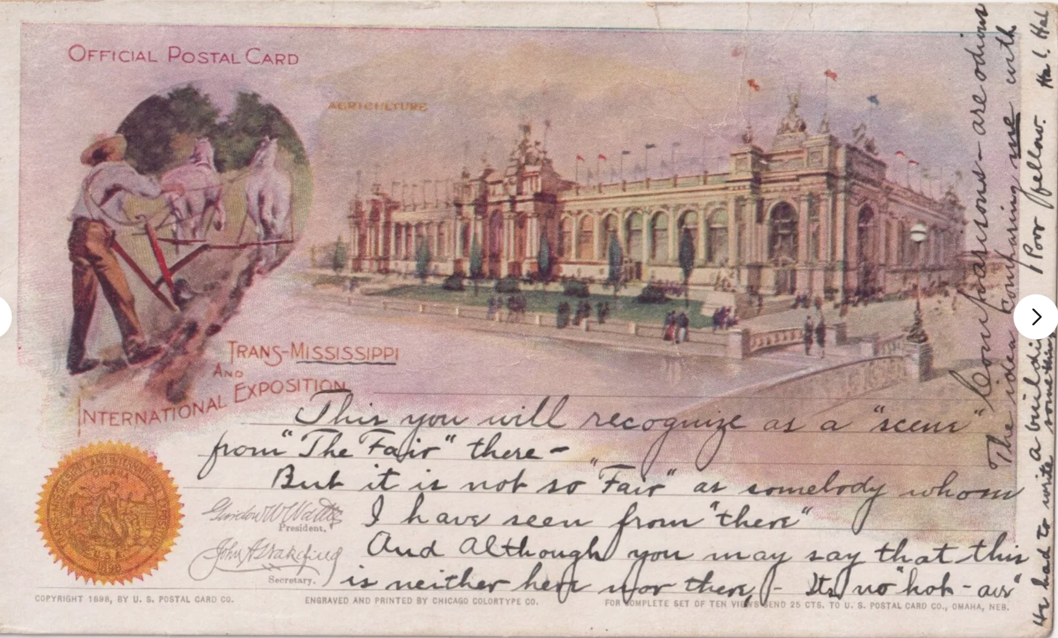
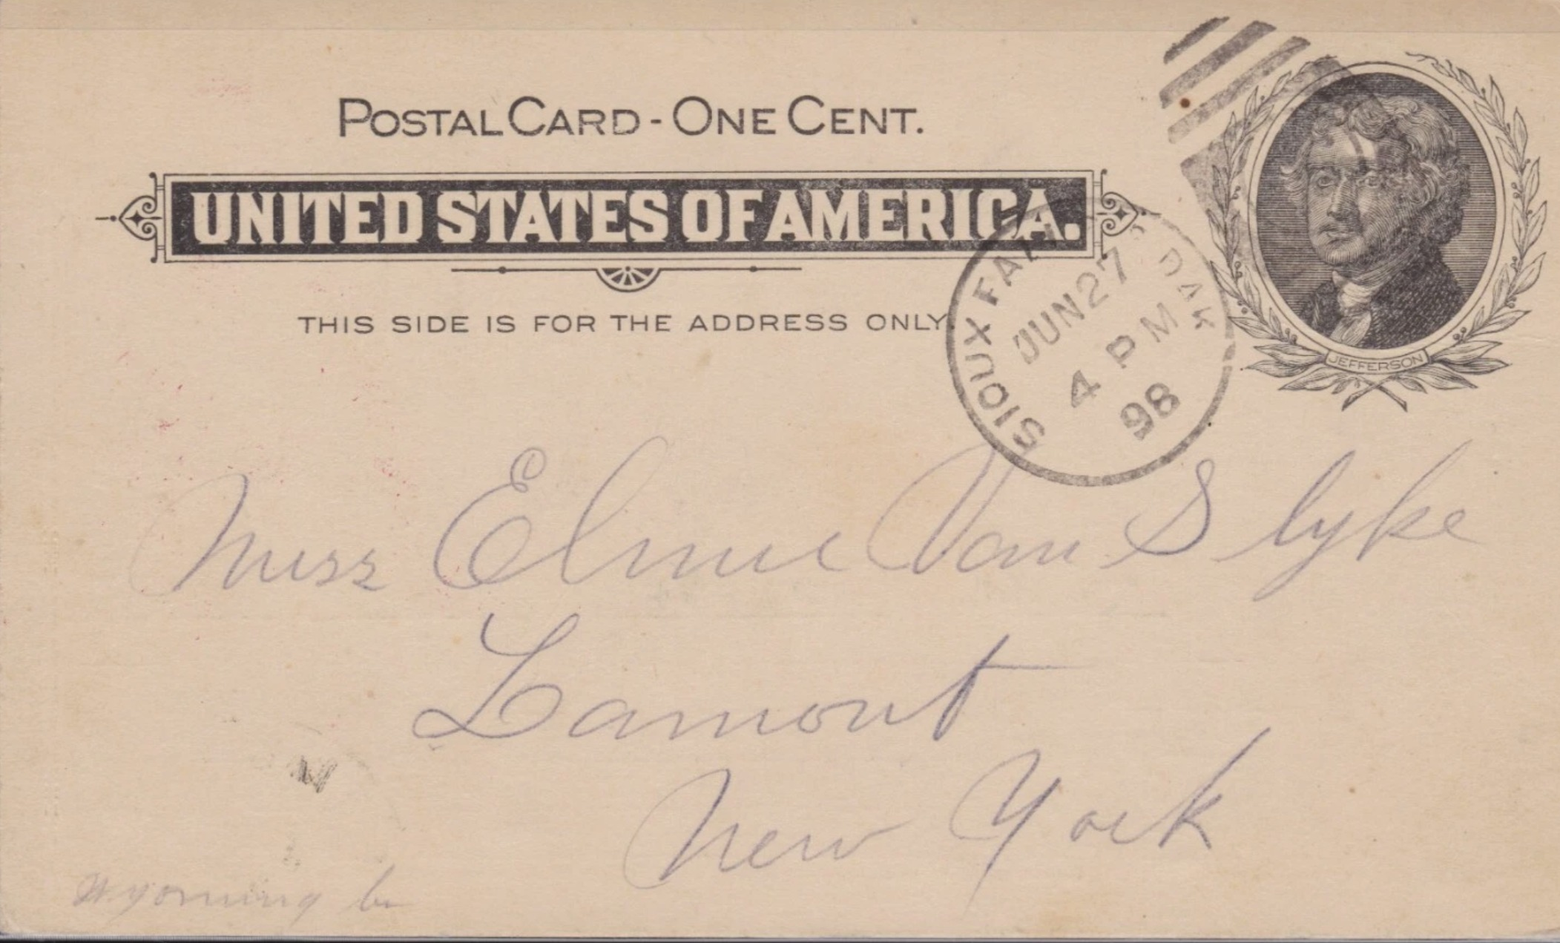
Trans-Miss Postcard
Notes:
Here’s an actual postcard sent from the Trans-Mississippi Exposition. What date is it postmarked? Where were they sending it? Notice Address. Not a lot of details.

Slide 31
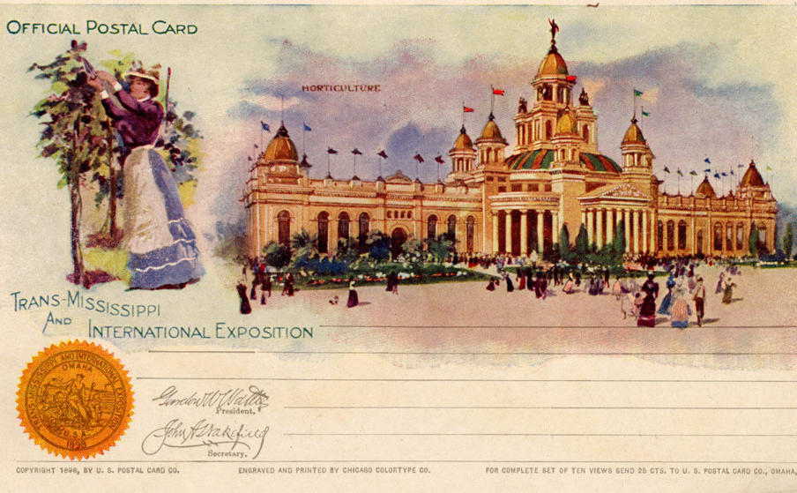
Write Your Own Postcard
Use everything you learned today to write a postcard to a friend or family member bragging about the AMAZING experience you’re having at the Trans-Mississippi Exposition!
Read instructions on your
notes carefully!

Slide 32
The Indian Congress

Slide 33
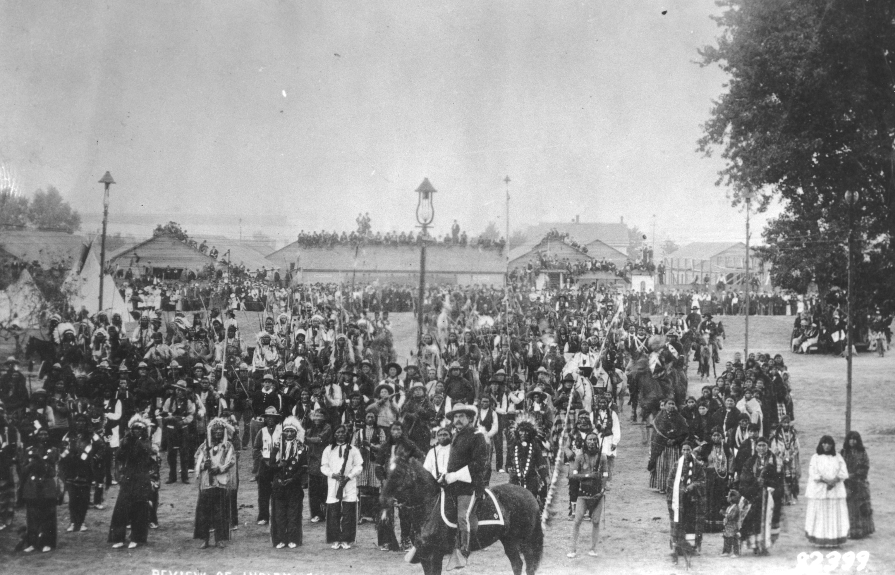
Attendance question
Look at the picture.
Write down:
one thing you SEE,
one thing you PREDICT,
and one thing you WONDER about what’s happening this picture.
Look closely at the details. How can they help you make a prediction?
Notes:
Give students 5 minutes, then have 3 share for EACH category (nine students total). Ask kids to point at the picture to back up their observations/predictions and give them ownership of their answers.

Slide 34
What was the Indian Congress?
Use this information to answer the questions on your notes.
The Indian Congress at the Exposition was the largest gathering of Native leaders in US history. More than 545 Native people from 35 different tribal nations attended
The U.S. Government gave $40,000 to create the Indian Congress. James Mooney at Smithsonian helped organize.
The purpose was to ”highlight Native history and traditions. The goal was to gather different tribes to display their way of life, including their customs, clothing, and homes.” Many White people were convinced that this may be the last time they could ”glimpse a culture very different from their own,” as Native people were being pushed off their land and assimilated into White culture by the US Government
The official guidebook said the Indian Congress showed Native people in the “utmost state of savagery,” and the final report said that visitors to the Exposition were “most interested in traditional aspects, like tepees, dances, and ceremonies, rather than modern, educated Native Americans”

Slide 35
What was the Indian Congress?
Together, we will watch a video created by past Omaha Public Schools Making Invisible Histories Visible students about the Indian Congress.
Read the questions on your notes so you know what to look for in the video
As the video plays, write down answers to your questions as you hear them

Slide 36
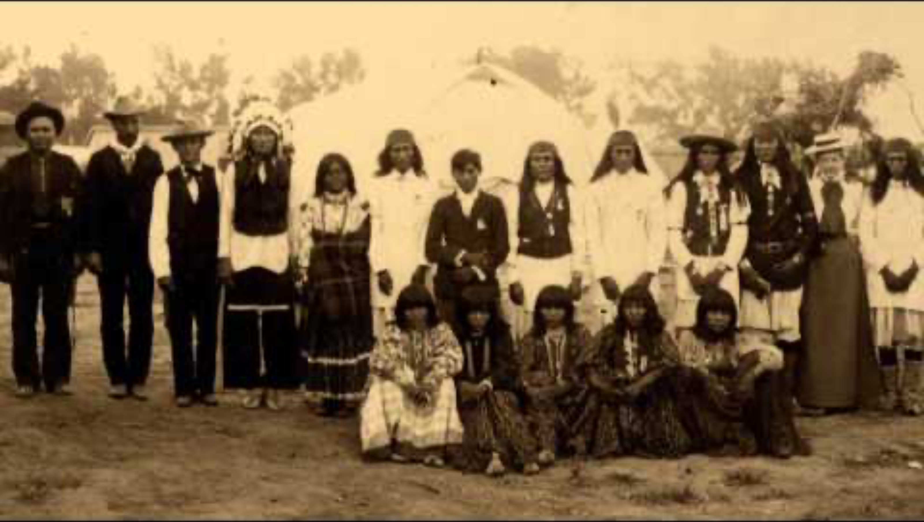
https://youtu.be/qyGNGH8qX1M?si=vrER-rhIiJqQjflw

Slide 37

Indian Congress Stations
GOAL: Determine the attitudes toward Native people featured at the Indian Congress
MOVEMENT: Every 5 minutes, the timer will go off and you will go to a new station. Do NOT move on your own time
VOICE: Feel free to read and discuss with the people at your station. We shouldn’t hear you from across the room
PARTICIPATION: Read the text and look at the images at your station to help you answer the questions. Make sure you know which station you’re visiting!
Notes:
Cox’s repor

Slide 38
The Role of Women
at the Trans-Miss

Slide 39
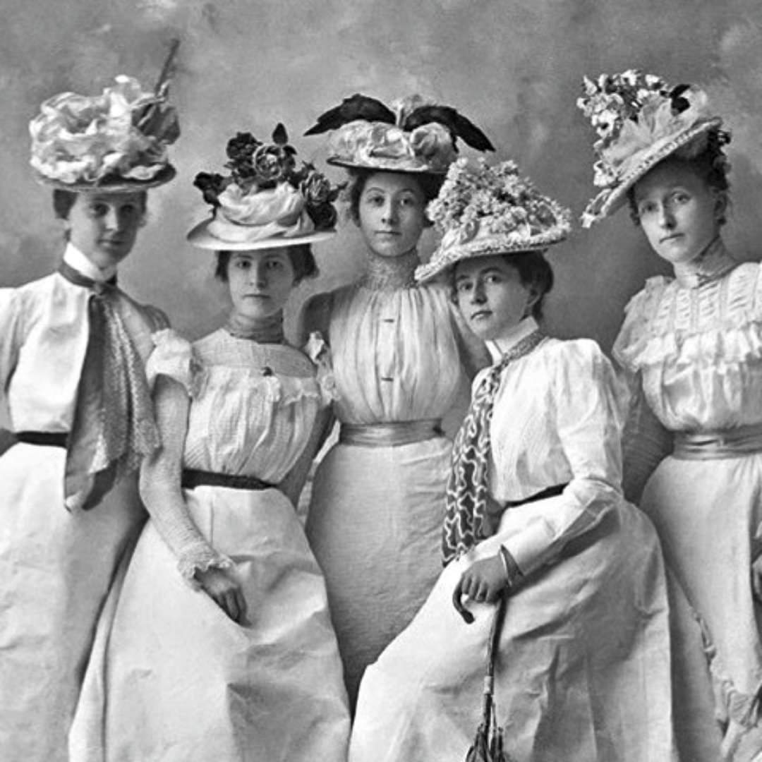
Attendance question
Good morning! Answer this question in your notebook. We will share our answers in five minutes.
What do you know about the role of women in American society in the 1890s? Were they able to vote and go to college? What kinds of jobs were common for women?

Slide 40
Women’s Work at the Expo
The Women’s Club of Omaha desired that women should have a role in the Exposition.
Led by Mrs. Lillian Resler Harford, they were put in charge of the Bureau of Education. 27 women were elected from throughout Nebraska to help with the organizational efforts. Two women from each state outside of Nebraska served on an advisory council.
Women were tasked with organizing exhibits and events in four categories:
Educational Exhibits – Collective and Individual
Women’s Work
Congresses
The Girls’ and Boys’ Building
With your partner, read the section about your category. Then, answer the questions about your section on the back of your presentation notes.
Notes:
Give groups of two one of the four readings about what women oversaw at the Exposition. Use the reading to answer the questions on their notes. Readings can be handed out at random.

Slide 41
The Role of Blacks
at the Trans-Miss

Slide 42
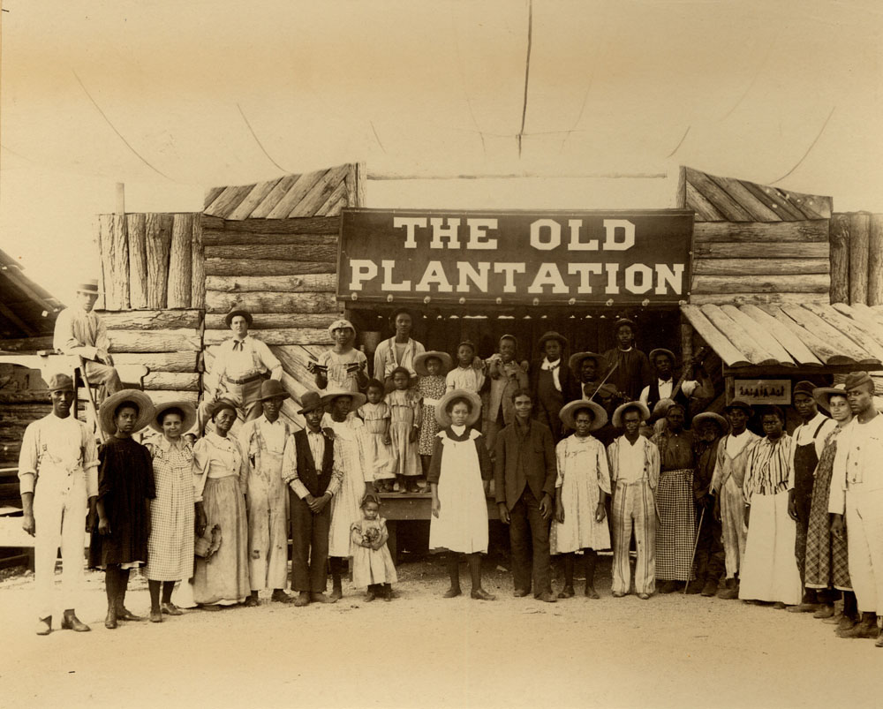
Black Involvement
So Much More than The Old Plantation
Notes:
When you hear about the African American experience you often hear about The Old Plantation. But the Trans-Mississippi Exposition held three important gatherings of African Americans led by Omaha organizers – Edwin Overall and Cyrus Bell.

Slide 43
Gathering Context
CONTEXT helps us understand the background information for an event.
For example, if there is a fight in the cafeteria, the context might be the relationship between the kids involved, any words exchanged or actions between them, etc.
Together, we will watch a video to understand the context of the formation of a new group at the Trans-Mississippi Exposition. This group was called the Representative White & Colored American Association of the United States.
Use the video to answer the questions about Jim Crow laws and other important context for this group.

Slide 44

https://youtu.be/gGHf3gTaJyg?si=tKtOucph66YsKxSw
Notes:
What was the purpose of Jim Crow Laws?
Where does the name "Jim Crow" come from?
What argument did the Supreme Court make stating that segregation was legal as long as this existed?
What organization was founded in 1909 to protect the rights of African Americans?
Why do you believe the Supreme Court upheld and defended clearly unjust laws that discriminated against African Americans?

Slide 45
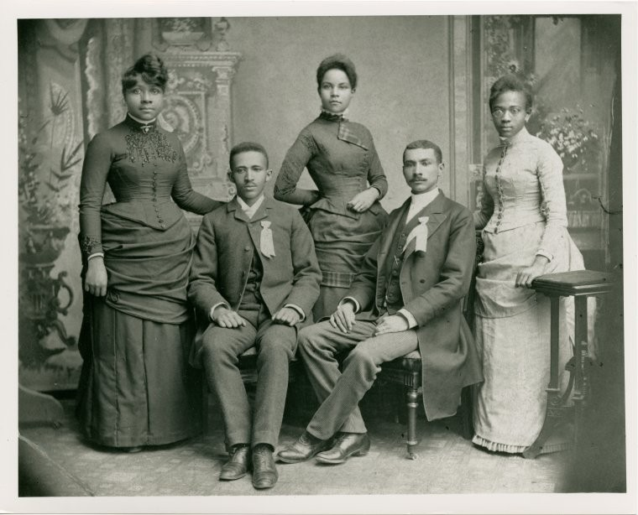
Black Involvement
Under the leadership of Omahans Edwin Overall and Cyrus Bell, the Trans-Mississippi Exposition held two meetings on August 17-19, 1898, bringing together Black and White People from across the United States.
The Congress of White & *Colored Americans
The *Colored National Personal Liberty League
Note: Colored was the predominant and preferred term for African Americans in the mid- to late 19th century in part because it was accepted by both White and Black Americans as more inclusive, covering those of mixed-race ancestry.
Notes:
In 1880, there were 811 Blacks living in Omaha. In 1890 the number had grown to 4,566. The majority of Blacks lived in Ward 3.

Slide 46

What was the Association?
GOAL: Understand the goals and ideas behind the integrated congress and its leaders. Compare and contrast the congress with other representations of Black folks at the Trans-Mississippi Exposition.
Preview the questions and prompts on your notes. Notice what information you will need to pay special attention to as you read.
Read the article. Pause when you find information to help you answer the questions on your notes.

Slide 47
Exit Ticket
Answer the question below. We will share our answers in five minutes.
Based on what you read today, how did the Trans-Miss show BOTH racial progress AND racist ideas that still existed in the 1890s?
Example answer: The Trans-Miss showed racial progress because…However, the Trans-Miss also showed racist ideas because…
Notes:
Have kids share their answers. Direct them to the reading if they are struggling. Use key words in the reading (in contrast, however…) to spot the differences.

Slide 48
Technological Innovations

Slide 49

Attendance question
What technology do you see in this picture that might have been exciting or new to people in 1898?
Notes:
Give students 5 minutes, then ask 3 to share. Start with one; then ask ”who had something different?” for the next 2.

Slide 50


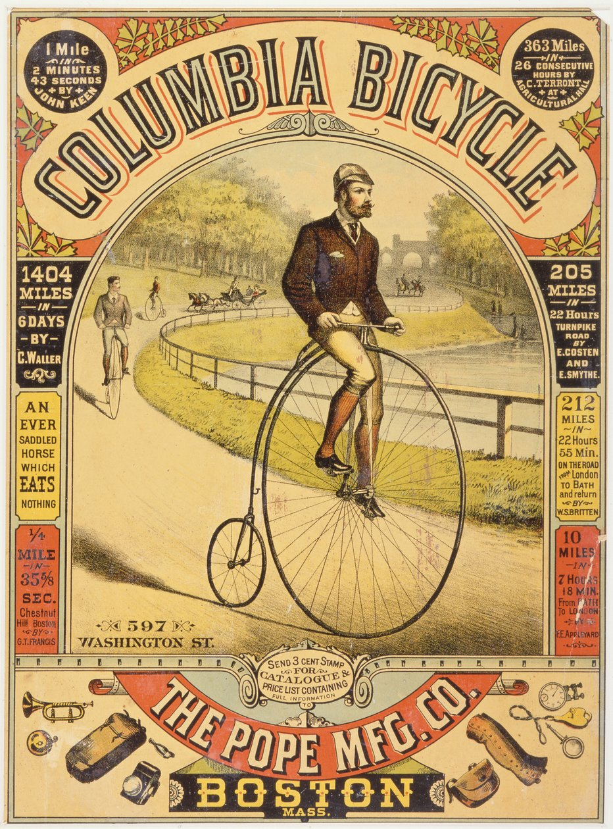
Advertisements from the 1890s
What do these advertisements from the 1890s have in common?
Notes:
Ask students to spend 1 minute thinking about what these advertisements have in common, then ask 4-5 to share what they notice (pictures, colorful, a few key words, why people should buy the thing)

Slide 51

Advertising new technology!
Part of the purpose of the Trans-Mississippi Exposition was to show off new technology, especially technology that had been created in western states.
GOAL: an advertisement for one of the new technologies
being showcased at the Trans-Miss!
STEP ONE: Read the source about your technology
STEP TWO: Create an advertisement for your technology. Convince people it’s AMAZING, and they should come check it out at the Trans-Mississippi Exposition!
Your advertisement should include:
The name of the technology
What problems will this technology solve for people?
How will this make a positive impact on peoples’ daily lives?
Hang your advertisement poster up somewhere on the wall when it’s done!
Notes:
Randomly assign technology. Can work alone or with a partner. Hand out blank pieces of printer paper for kids to create their advertisements; provide colored pencils/crayons/markers
Kids should hang these up around the room when they are finished.

Slide 52
Technology scavenger hunt
GOAL: Make connections between new technologies that were showcased at the Trans-Miss!
Your CHALLENGE is to find new technology that fits in each category on your notes. You can only use each technology ONCE! No repeats!
MOVEMENT: Move at your own pace. Try not to clump up around pictures – keep it moving!
VOICE: We should not be able to hear you from across the room
PARTICIPATION: Work by yourself or with one partner

