Slide 1
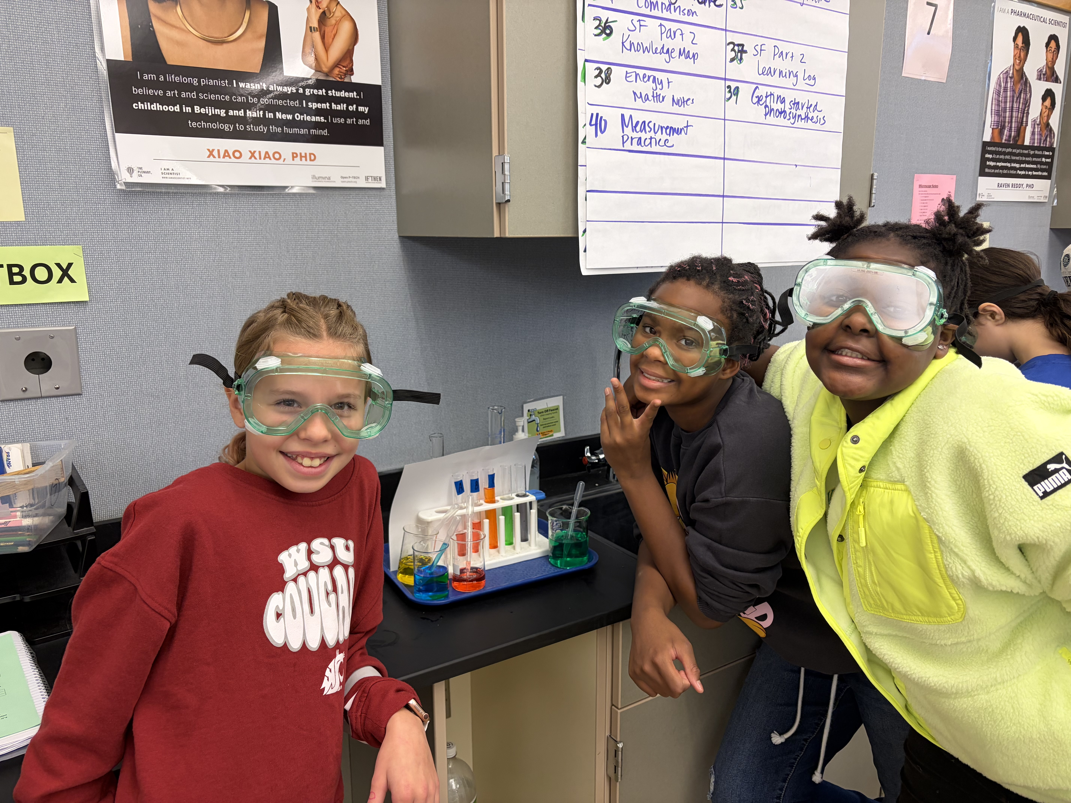


Welcome to 5th Grade Parent Night!
Exploring Science Pathways

Slide 2
Science Pathways Overview
Grade Level | MS Science Standard Path | MS Science Alternate Path
6th | Life Science | Earth and Space Science
7th | Earth and Space Science | Physical Science
8th | Physical Science | High School Biology

Slide 3
MS Science Standard Path
Most Common Pathway for Incoming 6th Graders
6th Grade: Life Science
7th Grade: Earth Science
8th Grade: Physical Science
Benefit: A rigorous lab-based science path designed to support all students

Slide 4
MS Science Standard Path
Smooth Transition to Middle School Science
  First lab-based class
  Three units of study: Structure and Function, Genetics, and Ecosystems
  Science everyday with at least three hands-on labs per week
  Letter grades and summative assessments

Slide 5
MS Standard Path- Life Science Units of Study
Structure and Function includes:
  Microscope use including live organisms
  Photosynthesis and Cellular Respiration investigations
  Structures of cells, tissues, and organs and their function for survival
Genes and Molecular Machines includes:
  Reproduction – flowering plants, fish and microorganisms
  Reproduction cellular level - genes and mitosis
  Inheritance of traits and Punnett Squares
Ecosystems and Their Interaction includes:
  Use class ponds as lens for ecosystems work
  Natural and artificial selection
  Changes over time, data table analysis and graphing

Slide 6
MS Science Standard Path
Skills Development in 6th Grade
Lab safety
Independent navigation of Canvas
Maintaining a science notebook
Homework management and test preparation
Collaboration, initiative, good work habits
Provides a strong foundation for all future science classes

Slide 7
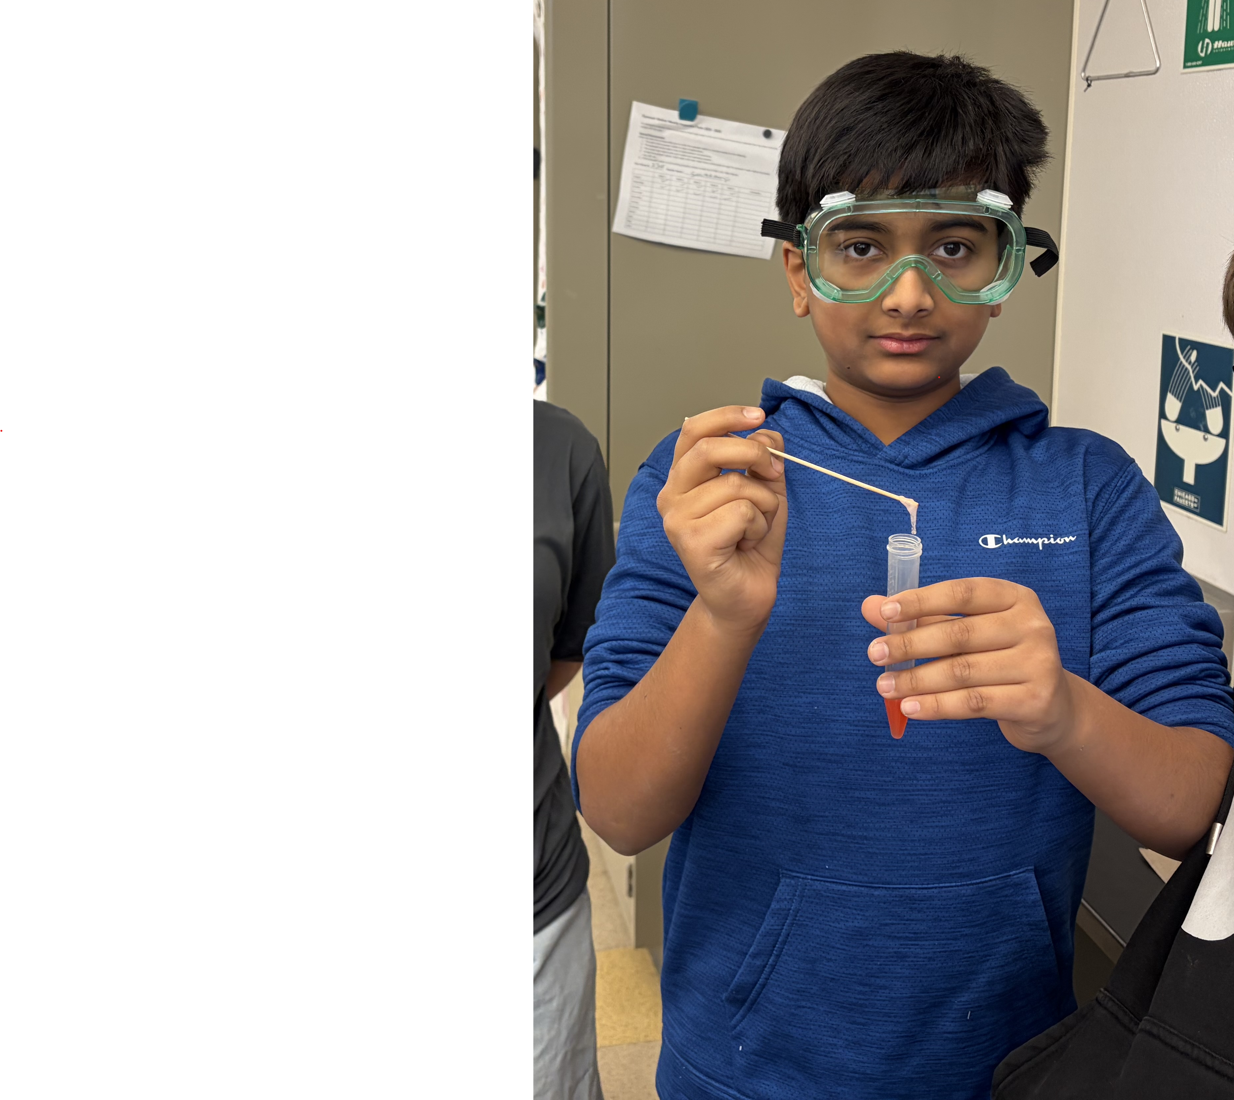
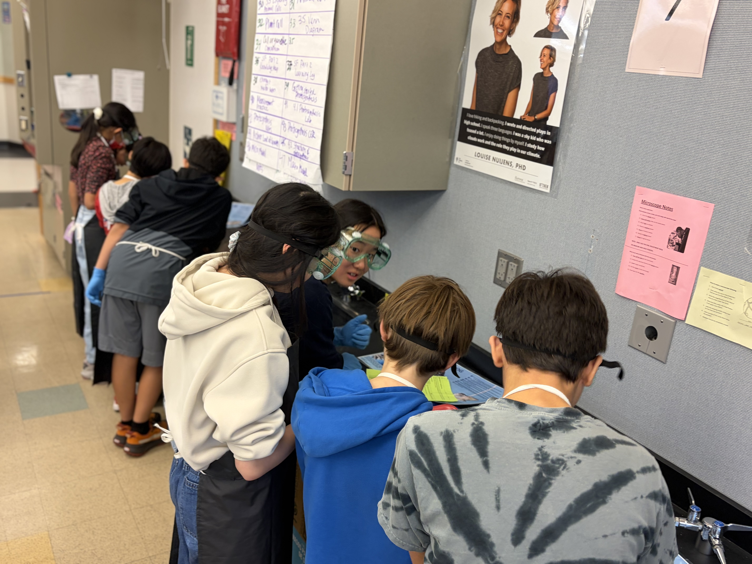
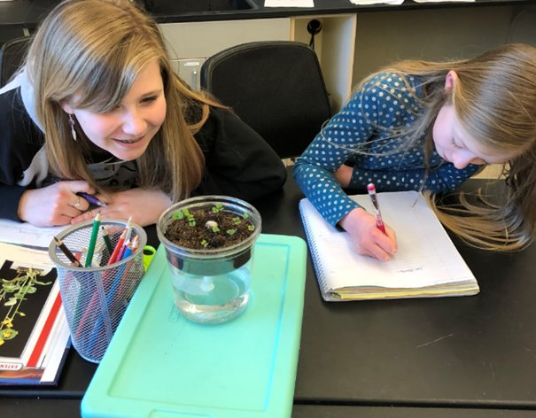
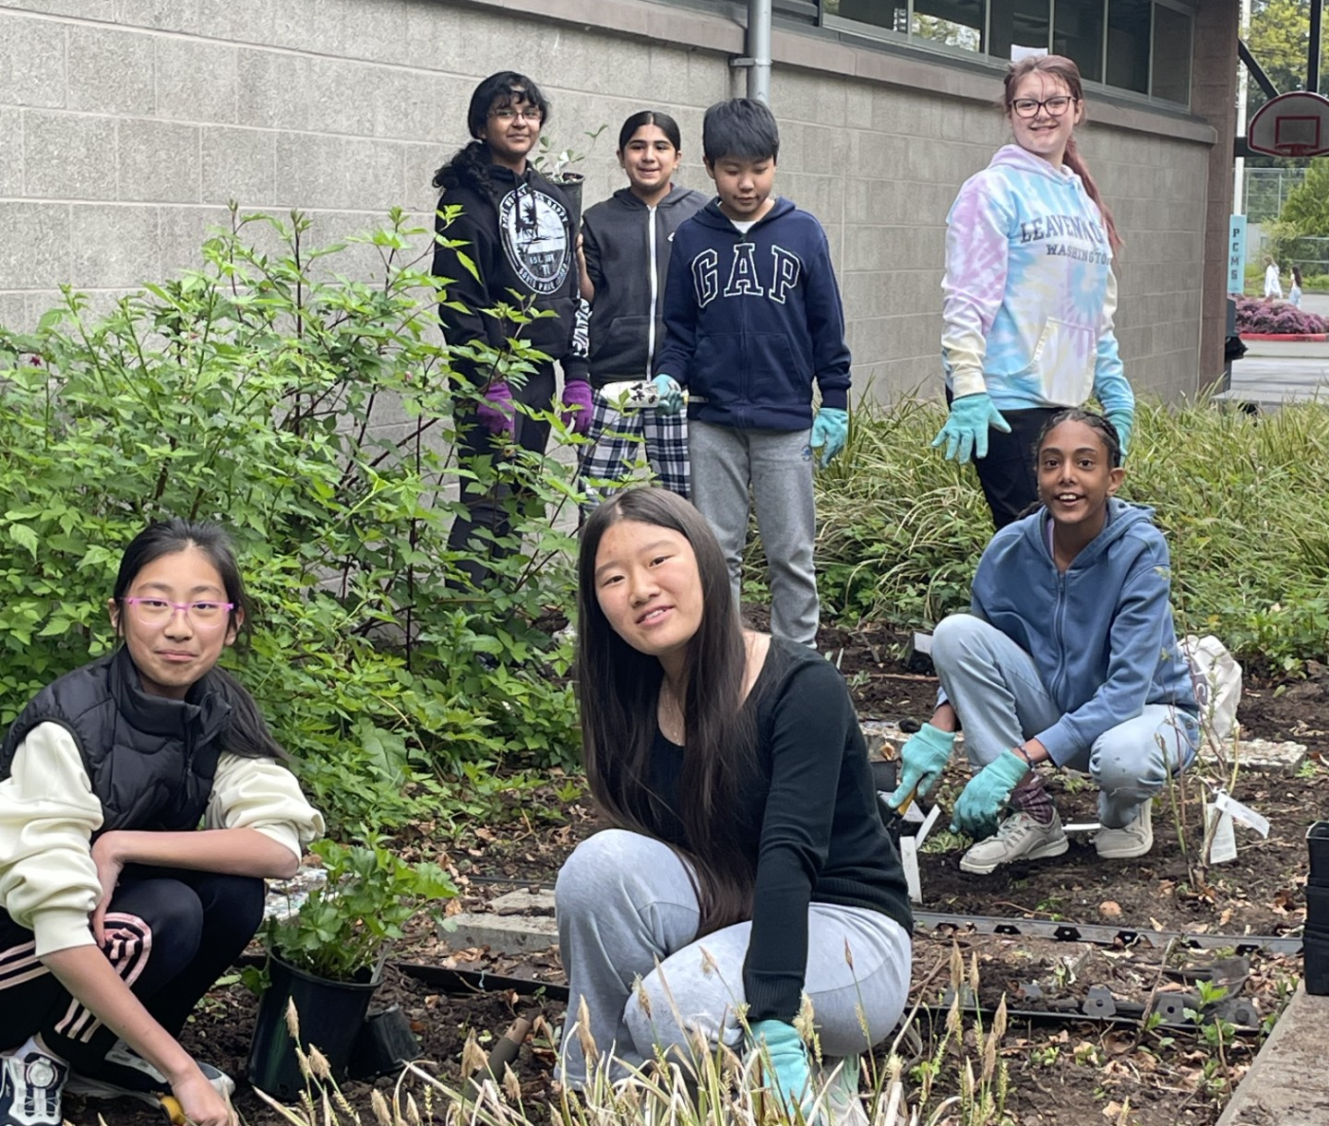
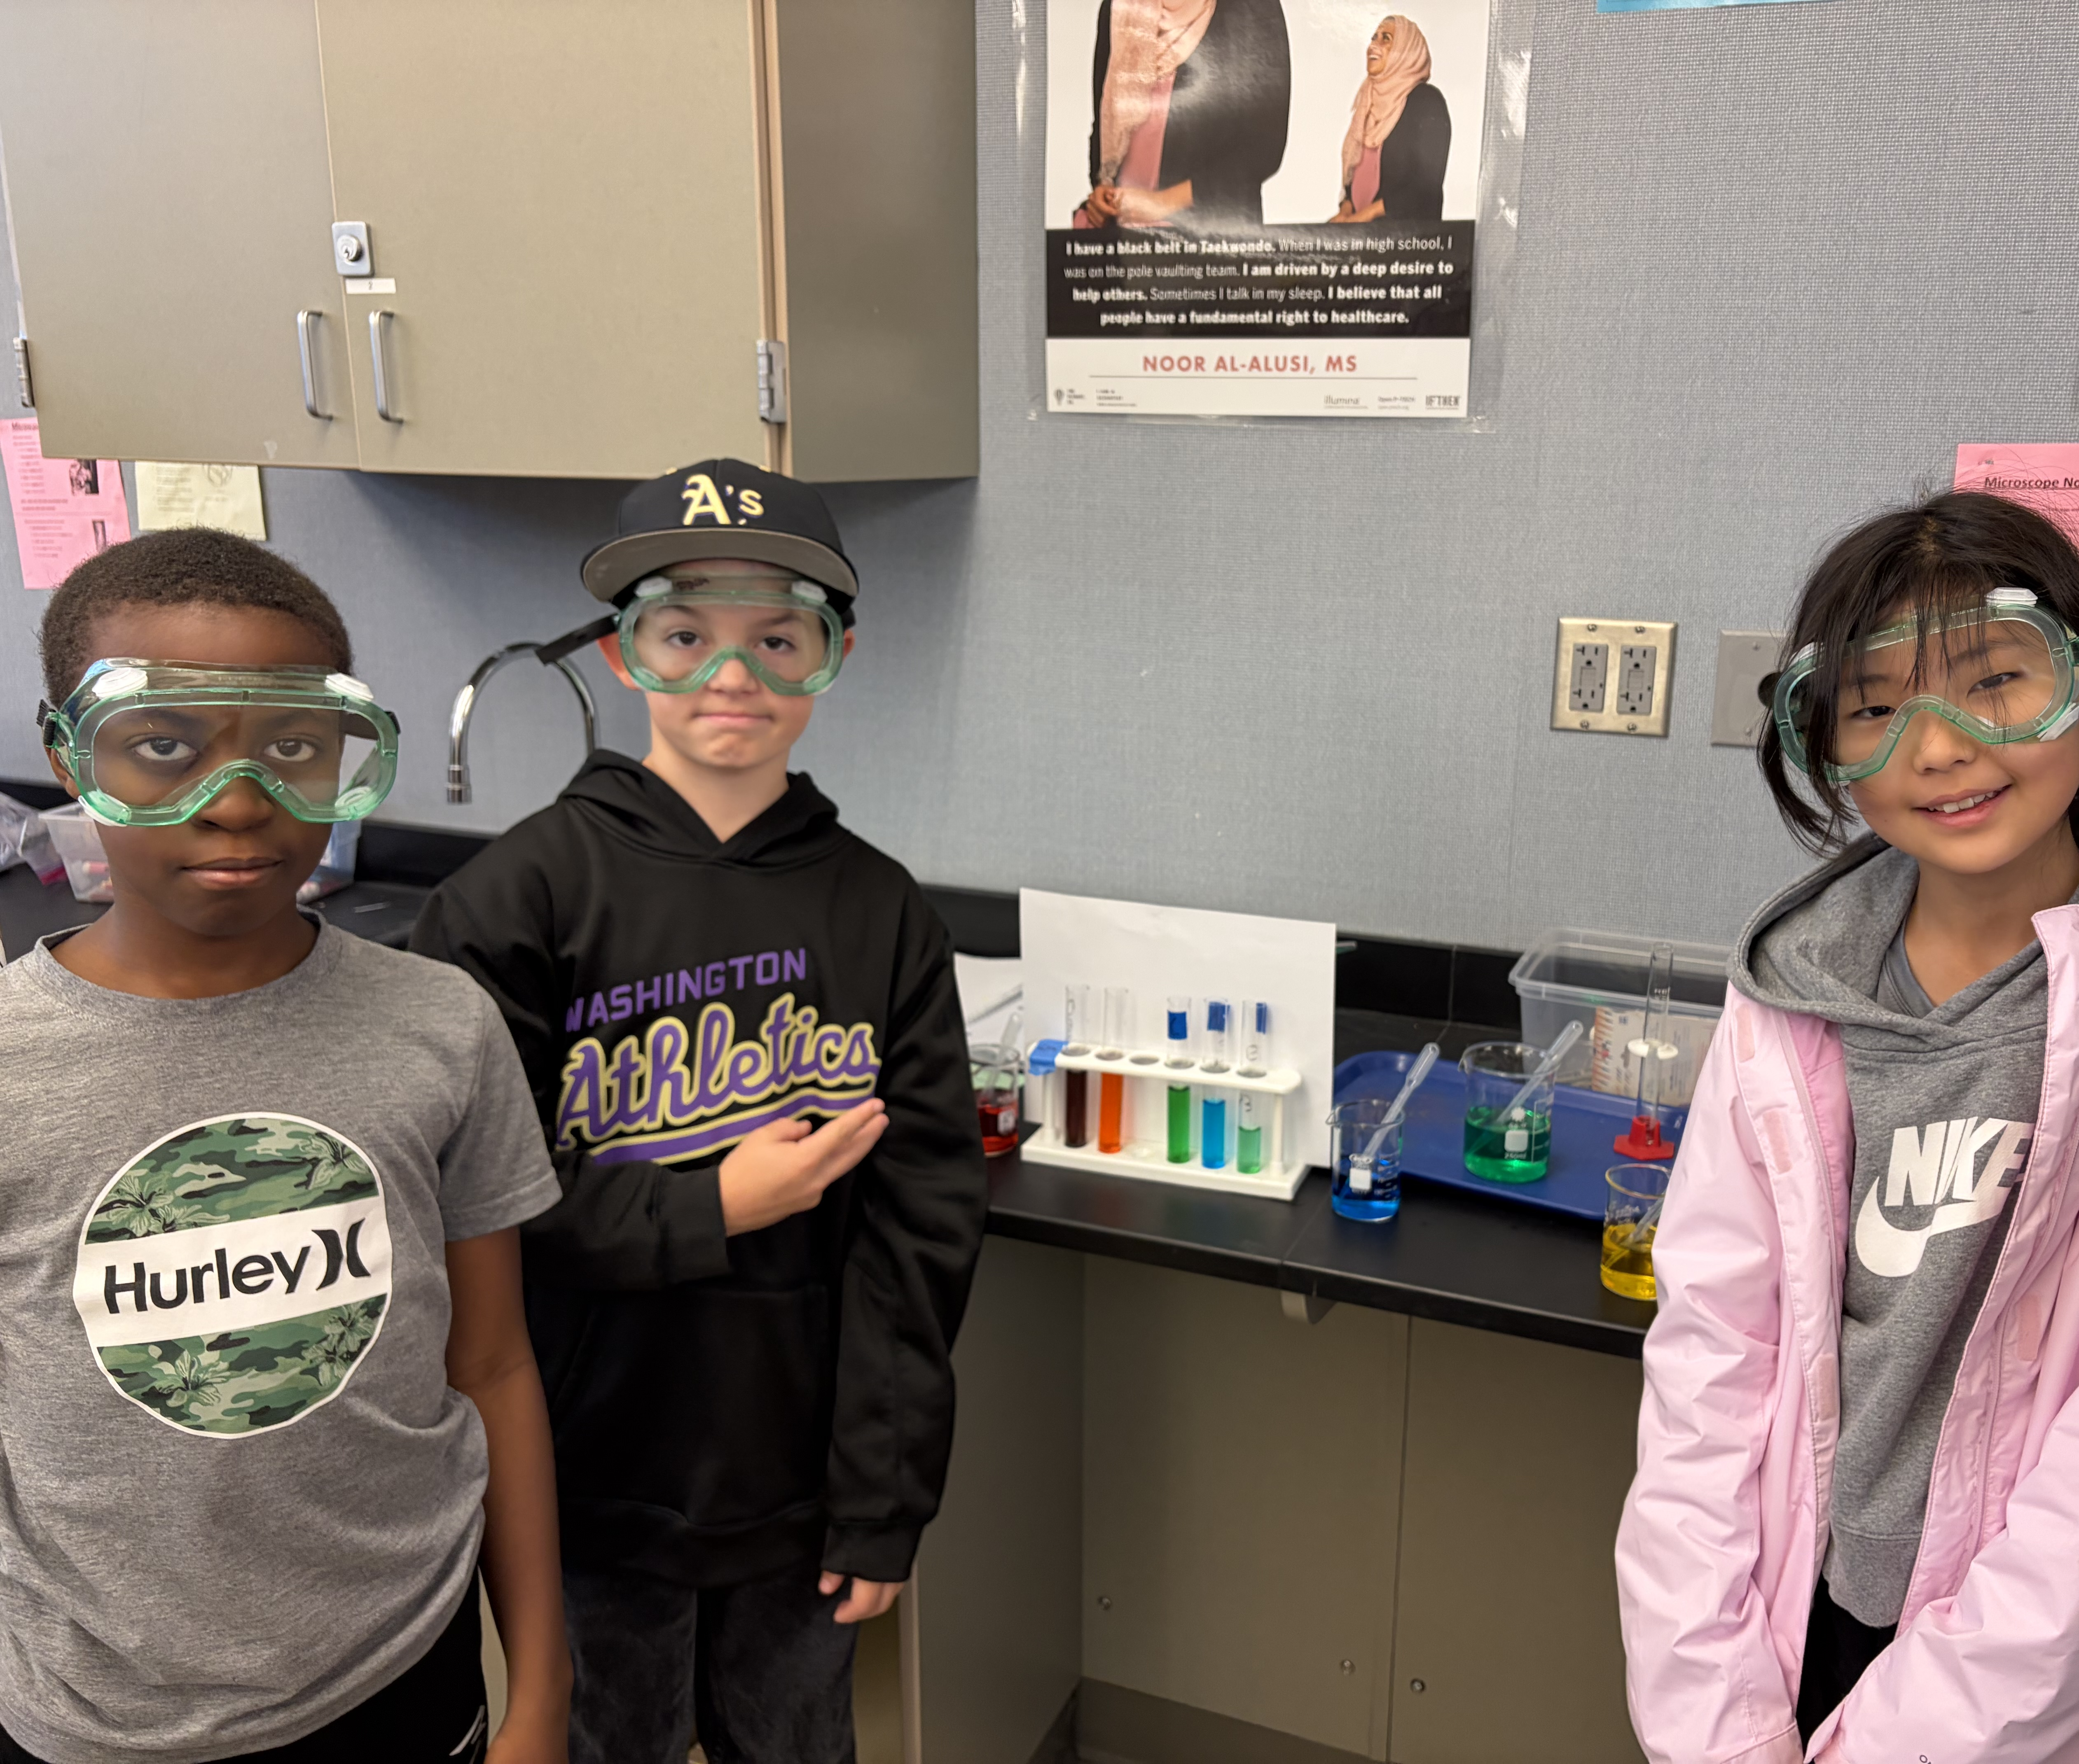
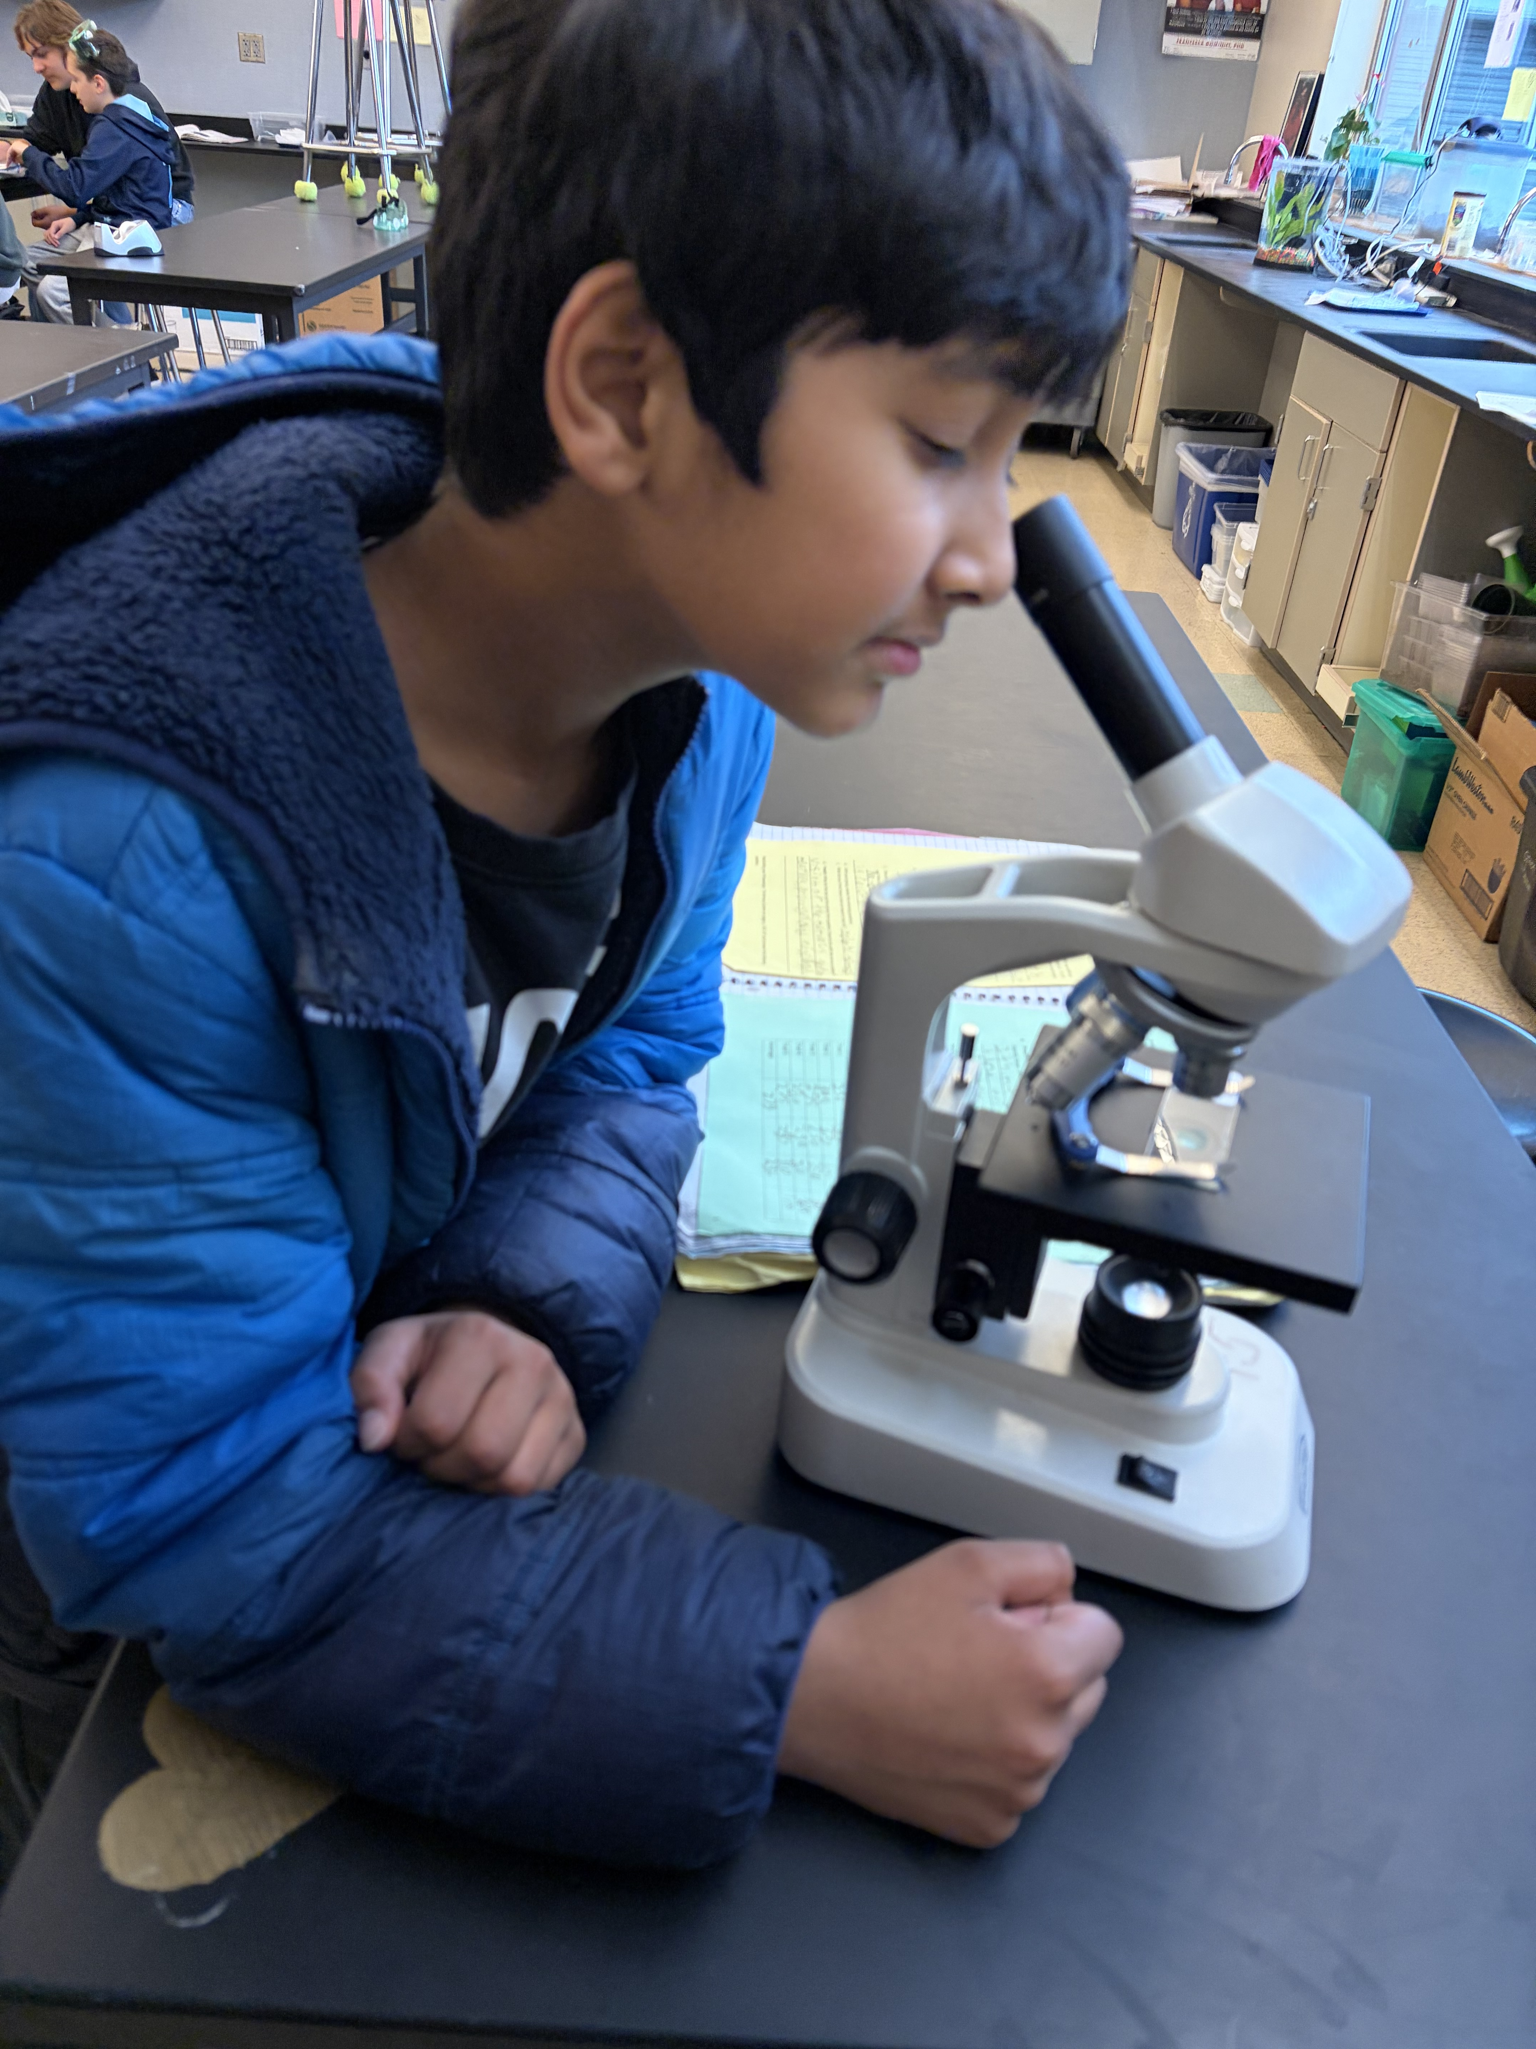
Standard Path
6th Grade
Life Science

Slide 8
MS Science Alternate Path
Less Common Pathway- Skips Life Science
6th Grade: 7th Grade Earth & Space Science
7th Grade: 8th Grade Physical Science
8th Grade: HS Biology
Class Composition: 6th grader in a 7th Grade
general education class with mostly
7th graders

Slide 9
MS Science Alternate Path
Less Common Pathway- Skips Life Science
:
ISD Recommends for this pathway:
Students should be at least one grade level ahead in their math and reading skills. (Level 4 grades in math and reading on i-Ready and SBA assessments)
Enrollment in Math 1/2 or higher as 6th grader
Suggested Background: Strong foundation in Life Science
https://www.isd411.org/2025-2026/ms-course-guide/science

Slide 10
MS Science Alternate Path
Less Common Pathway- Skips Life Science
:
Students entering 7th grade science as a 6th grader should:
  Be able to keep an organized and well maintained science notebook
  Be ready to independently manage homework and classwork initiation and completion
  Collaborate well with older students
Challenge: Students can not move paths. Once Life Science is skipped it cannot be taken later.

Slide 11
Questions?

Slide 12
Conclusion and Resources
Consider your own student and what is the best fit for them.
For more information: ISD Science Course Guide
https://www.isd411.org/2025-2026/ms-course-guide/science
Email 6th Grade Life Science Teacher:
Christie Santodomingo santodomingoc@issaquah.wednet.edu
Science Lead:
Ashley Potter pottera@issaquah.wednet.edu

