Slide 1
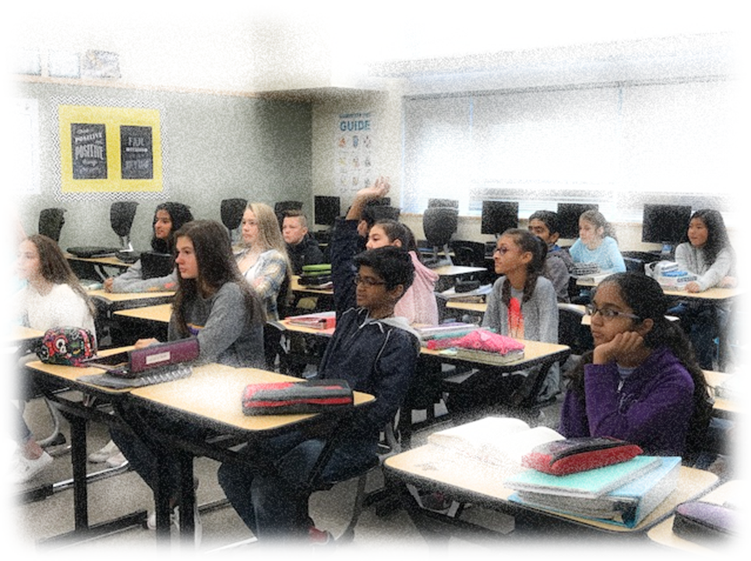

Language Arts & Elective choices for 6th grade 2026-27

Slide 2

THREE
PATHWAYS:
6th Grade Language Arts + Elective
260606
On-Level Language Arts +
Yearlong Music
Band
Orchestra
Choir
Trimester Electives
        Skills for Success
        Film Appreciation
        Computer Science
OR
Advanced Language Arts +
Yearlong Music
Band
Orchestra
Choir
Trimester Electives
        Skills for Success
        Film Appreciation
        Computer Science
OR

Slide 3
Community Microschool open to Adv ELA & On-Level ELA
Language Arts and The Arts
Integrated block class (100 mins)
Yearlong ELA + Visual Arts elective
Visual Arts + Creative Writing and Drama
Extra time and flexibility to delve into engaging hands-on projects that fosters creativity and critical thinking
Differentiated Learning – follows the same ELA curriculum as other 6ELA classes; ISD is currently in the process of adopting new ELA curriculum
Microschool Pathway continues in 7th & 8th grades: Language Arts and Leadership with Heidi Fielden and Annie Kurtenbach
New Pathway

Slide 4
Language Arts and The Arts
Daily/Weekly Routines:
        Sketchbook along with Writing Notebook
        Fine Art Analysis (tone, symbolism, theme)
        Elements of Art along with Elements of Literature
        Possible Projects:
        Trimester 1: Visual Arts – Personal Narrative
        Torn paper self portraits; Important Object and Important Place Warm & Cool project
        Trimester 2: Creative Writing –Young Wonders novels
        Illustrated Poetry Notebook; 3D Room Project
        Trimester 3: Drama- Hero’s Journey
        Create your own HJ shadow puppet play, Greek myth plays, The Odyssey – class play
New Pathway

Slide 5
How is Advanced Language Arts (ELA+) Different?
Advanced Language Arts has:
Added rigor and assignment requirements
A higher level of sophistication and depth
An emphasis on higher level thinking skills
More self-advocacy – taking responsibility for your own learning.
More project-based assignments

Slide 6
General Guidance for Choosing AdvELA
The following statements should correlate with you (the student) as a learner:
I like to read and write, and am eager to grow
I can express my ideas effectively in writing
I can revise my writing to make it stronger
I enjoy academic challenges
In addition, incoming 6th Graders should have:
Grade of 4 in 5th grade Writing and Reading; SBA scores Level 4

Slide 7
General Guidance for Choosing
Language Arts and The Arts Microschool
The following statements should correlate with you (the student) as a learner:
I like art, creative writing, and drama
I enjoy hands-on projects that are creative and challenging
I like to read and write, and am eager to grow
I can express my ideas effectively in writing
I enjoy academic challenges

