Slide 1

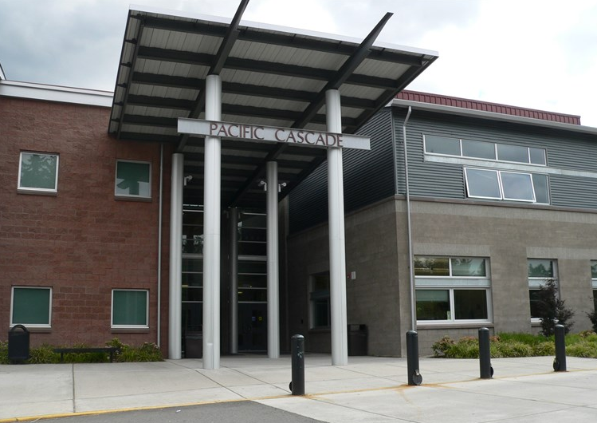
Pacific Cascade Middle School
Health
Excellence
Relationships
Opportunities
Equality
Safety

Slide 2

PCMS STUDENTS ARE
RESPECTFUL
  Of others
RESPONSIBLE
  For themselves
SAFE
  To learn

Slide 3
In the Office
Principal: Jeff McGowan (L-Z)
Assistant Principal: Casey Stookey (A-K)
Assistant to the Principal: Marie Werbel
Counselors:
  Laura Meserole (A-K)
  Miranda Williams (L-Z)
Attendance: Kaitlyn Probst
Bookkeeper: Jennifer Christiansen
Registrar: Rhonda Kurtenbach

Slide 4

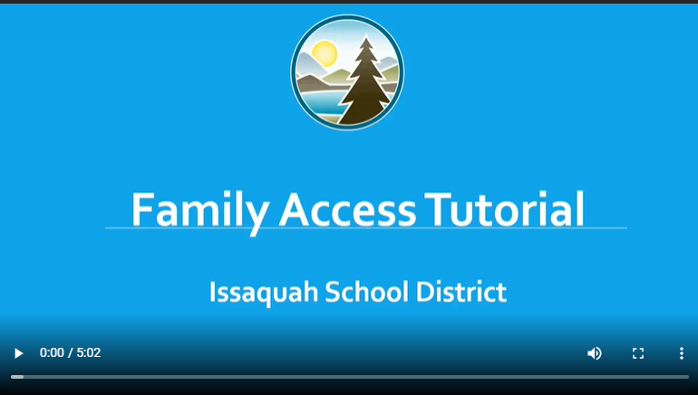
School Communication
All electronic (weekly bulletin), please sign up on our home page
Family Access
(online grade book, attendance)
Canvas – ISD’s learning management system. Students can access coursework, turn in assignments, and connect with teachers and classmates
www.isd411.org

Slide 5


PCMS School Counselors:
Ms. Meserole -A-K
Ms. Williams L-Z
The Role of School Counselors:​
Provide support for academic, social/emotional and career-oriented needs​
Individual student academic planning​
Classroom guidance lessons​ (all 3 grades)
Small group counseling activities​
Short-term counseling support​
Referral to SBMH Counselor for long-term support​
Collaboration with stakeholders for student success​
Advocacy for all students

Slide 6
Course Selection Quick Overview
Enter in Student Access NOT Family Access
Core Classes:
  Language Arts – Grade Level or Advanced
  Science – Life Science (grade level) or Earth & Space - advanced
  Math – One of the 3 pathways
  Social Studies – everyone takes the same
Everyone takes PE/Health
Yearlong Electives – (music, support class, LA/Art microschool)
*OR*
3 Trimester Elective Strand: Film Appreciation, Skills for Success, Computer Science
Choosing Adv. Classes:
  Please see the learning recommendations on the Middle School Course Guide.
  Note: These recommendations have been updated and based from extensive data regarding student outcomes.

Slide 7
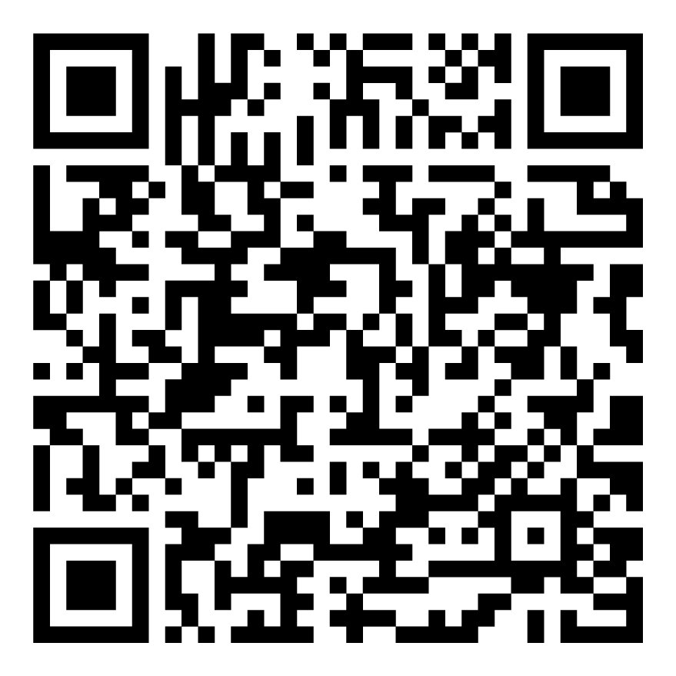
Pacific Cascade PTSA
President:
Kasey Trefethen
What We Do
  Provide volunteers and other support for PCMS and ASB activities
  Sponsor all-school events such as the Back to School Social and Celebration of Cultures Night
  Provide parent education opportunities throughout the year
  Fall and spring school enrichment grants to support as many students and staff as possible

Slide 8
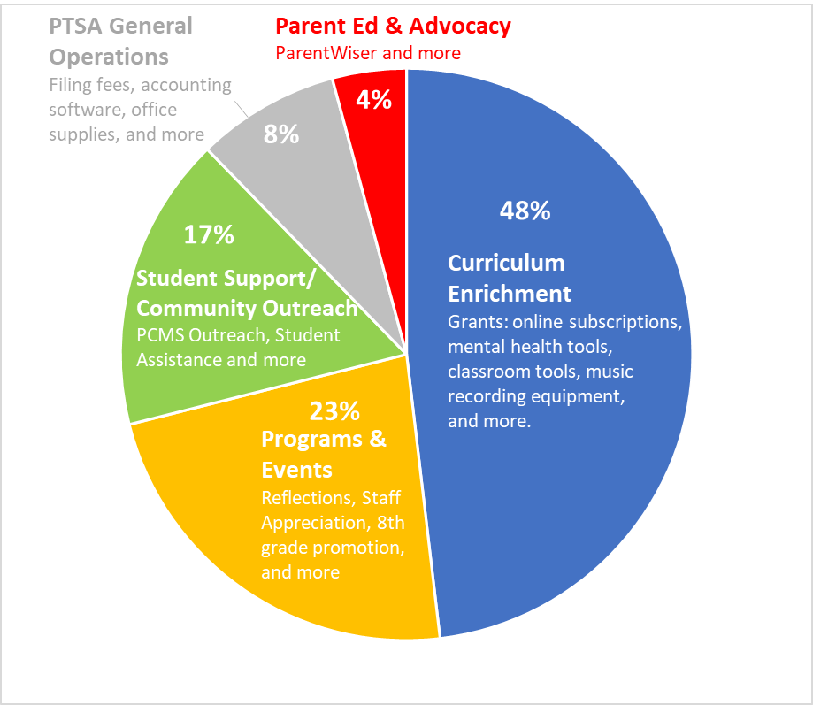

Slide 9

Issaquah Schools Foundation
At PCMS, the Foundation funds:
Fine Arts Program Support
Books for School Library
After school academic support
Robotics program
VOICE mentor program
Cultural Bridges –supporting relationships between families
Tools4School – supplies for students in need
ParentWiser – parent education series
Food Support for Hungry Students
Nurses Fund
Student Intervention Services

Slide 10
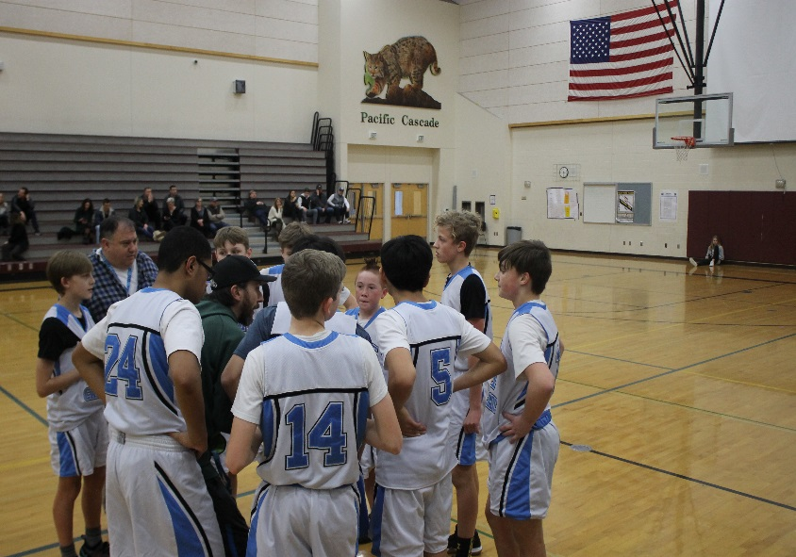
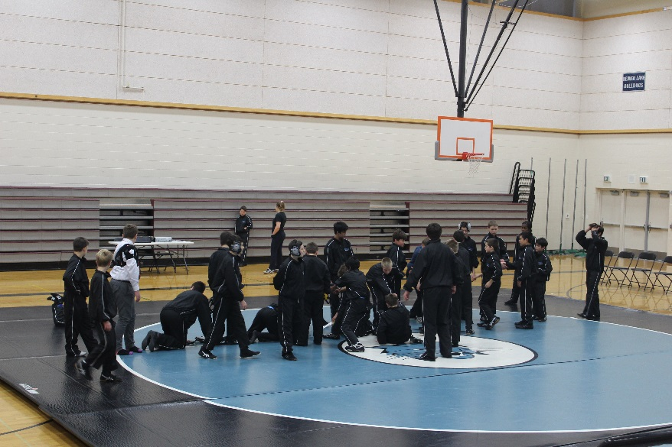
Middle School Experience: Sports
Fall (Sept – Oct)
Winter 1 (Nov – Jan)
Cross Country(Co-ed)
Volleyball (Girls)
Soccer (Boys)
Wrestling (Co-ed)
Basketball (Girls)

Slide 11
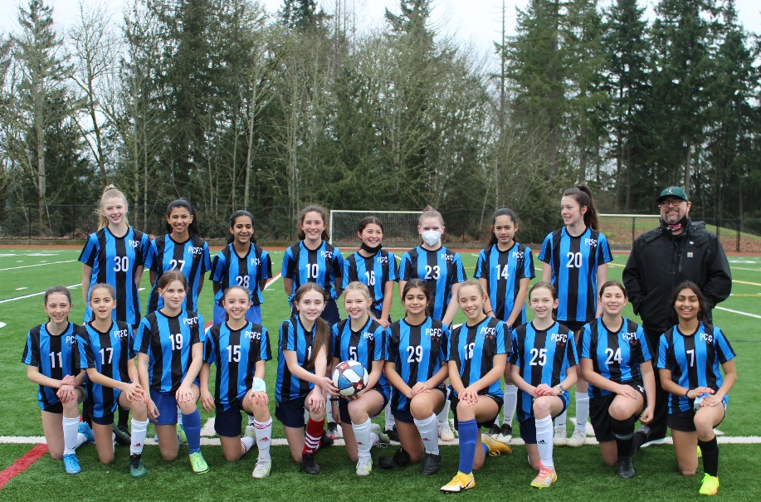
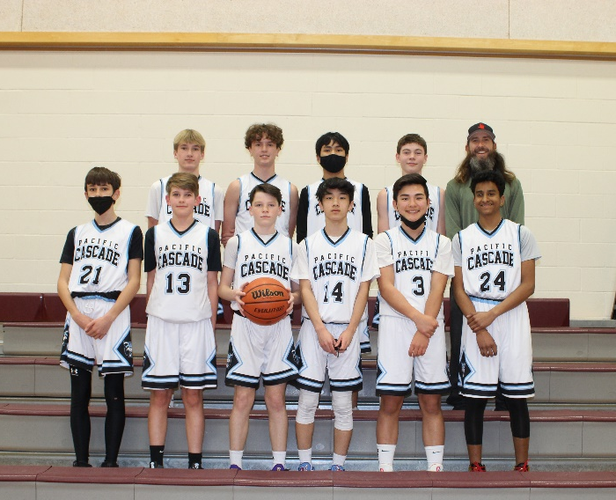
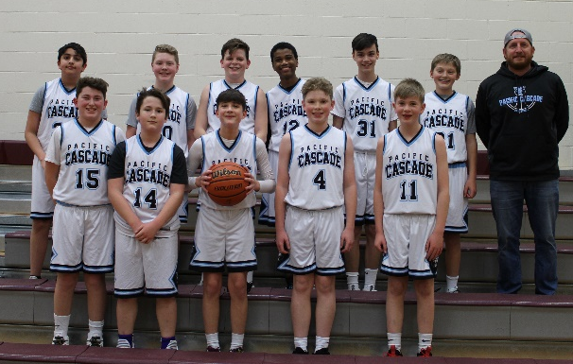
Middle School Experience: Sports
Winter 2 (Jan – Mar)
Spring (Apr – Jun)
Basketball (Boys)
Soccer (Girls)
Track (Co-ed)

Slide 12
Athletics Details
Paperwork and registration completed through Final Forms on our website
Students entering 6th grade are required to have a physical dated after June 1. A physical date in the summer is valid for the entire school year.
$50.00 per sport (4th sport is free!)
Intermural $20.00
Students must have an ASB card ($35.00) to
participate in sports

Slide 13
Middle School Experience: Clubs
PCMS has a variety of afterschool clubs (and we’d like more!)
Ideas for clubs include:
  Jazz Band
  A to Z Club
  Robotics Club
  Dungeons and Dragons Club
  Board Game Club
  Honor Society
  Art Club
  Pokemon/Rubics Cube
Teachers and students will plan and launch clubs in the fall working together with Associated Student Body (ASB)

Slide 14

W.E.B.
Where Everybody Belongs
8th WEB Leaders link with 6th graders
Activity Day in August
Fun and energetic activities
Build relationships
Tour of the school in June and August
More activities throughout the year

Slide 15
Breakout Session Rotations:
A-G
  Rm. 1307 LA
  Rm. 2308 Science
  Commons Math
H-N
  Commons Math
  Rm. 1307 LA
  Rm. 2308 Science
O-Z
  Rm. 2308 Science
  Commons Math
  Rm. 1307 LA

Slide 16
Welcome!
6th Grade Science Options
Christie Santodomingo and Ashley Potter
Notes:
Welcome!
Our goal today is to give you an overview of the Common Core State Standards in Mathematics and our middle school math options.

Slide 17
6th Grade Science Options
Note: Most students take Science Path I – 6th Grade Life Science
Grade Level | MS Science Path I | MS Science Path II
6th | Life Science | Earth and Space Science
7th | Earth and Space Science | Physical Science
8th | Physical Science | High School Biology

Slide 18
Life Science Units of Study
Structure and Function includes:
  Microscope use including live organisms
  Photosynthesis and Cellular Respiration investigations
  Detailed observation and communication skills
Genes and Molecular Machines includes:
  Reproduction – flowering plants, fish and microorganisms
  Reproduction cellular level - genes and mitosis
  Inheritance of traits and Punnett Squares
Ecosystems and Their Interaction includes:
  Use class ponds as lens for ecosystems work
  Natural and artificial selection
  Changes over time, data table analysis and graphing

Slide 19
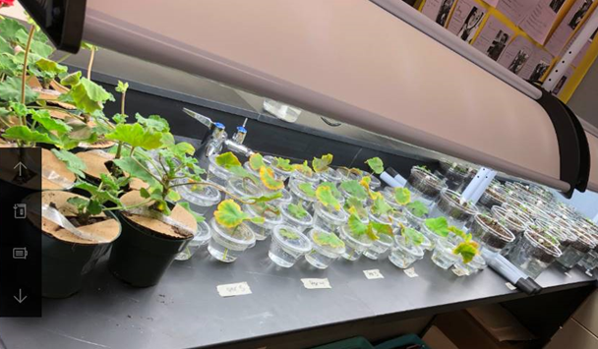
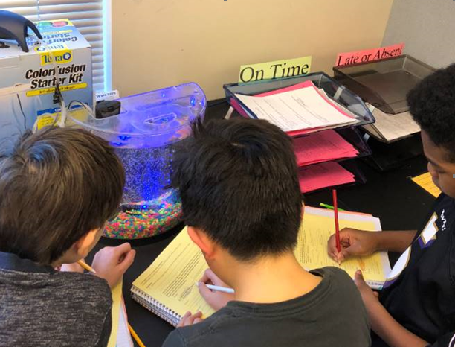
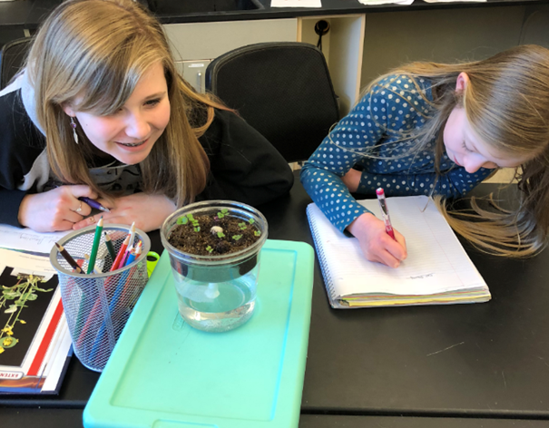
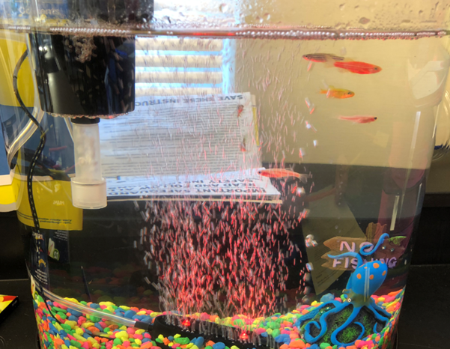

Slide 20
Considering Science Path II? Readiness Recommendations include
History of Report Cards at Level 4
Prior exposure to Life Science concepts
Enrolled in advanced math pathway
 | 4th Grade SBA ELA | 4th Grade SBA Math | iReady Scores
Recommended Score | Level 4 | Level 4 | Level 4

Slide 21
6th Grade Math Alignment
Choose your math placement 1st based on math readiness.
Grade | Math You Picked | Best Science Choices
6th | Math 1 | Life Science
6th | Math 1/2 | Life Science
6th | Math 2/3 | Life Science OR Earth and Space Science
6th Rare Choice | Algebra (These students take 8th grade math classes at the High School) | Life Science OR Earth and Space Science
Notes:
What is important to note is that in order to be successful in courses such as Chemistry and Physics, a student needs to have already completed Algebra I. This is why it is important to consider the relationship between your child’s Science Path and Math Pacing.

Slide 22
Math Alignment
 | Science | Math
 | Life Science | Math 1/2 (Math 1 is ok)
 | Earth and Space Science | Math 2/3
 | Physical Science | Algebra
 | HS Biology | Geometry
 | HS Chemistry | Completion of Geometry recommended before enrolling in Chemistry.
Notes:
What is important to note is that in order to be successful in courses such as Chemistry and Physics, a student needs to have already completed Algebra I. This is why it is important to consider the relationship between your child’s Science Path and Math Pacing.

Slide 23
Additional Science Path II Considerations
Student in Science Path II will be in class with 7th graders.
There will be additional homework every night.
Consider outside interests, commitments, and school work load.
Consider planned absences outside of illness

Slide 24
6th Grade Science Options
Note: Most students take Science Path I – 6th Grade Life Science
Grade Level | MS Science Path I | MS Science Path II
6th | Life Science | Earth and Space Science
7th | Earth and Space Science | Physical Science
8th | Physical Science | High School Biology

Slide 25
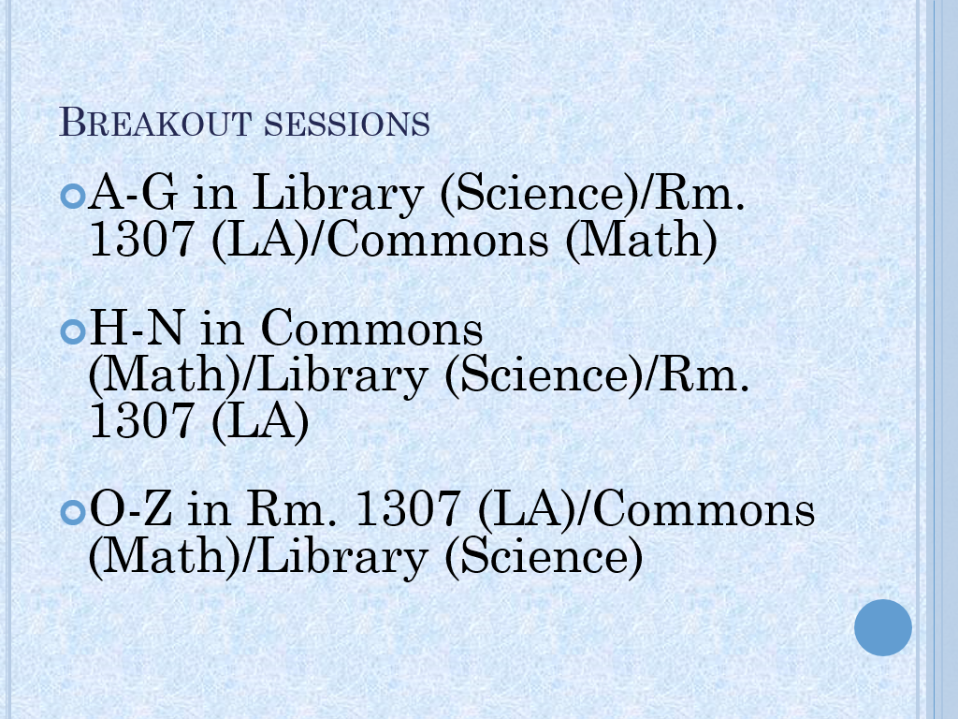

Commons goes to Library, Library to 1307 and 1307 to Commons.

Slide 26
Questions?
K-12 Science Information
Your child’s 5th grade teacher
Lena Jones, Secondary Science Specialist
jonesl@issaquah.wednet.edu
Dawn Wallace, Director of Teaching & Learning
wallaced@Issaquah.wednet.edu

Slide 27
Fifth Grade Parent Night
February 12, 2024
Heather Weider
6th grade math teacher
Options for Middle School Math

Slide 28
Washington State Standards
Math Content
Math Practices
6th | 7th | 8th
Ratios and Proportional Relationships |  | Functions
Expression and Equations
The Number System
Statistics and Probability
 | Geometry
1. Make sense of problems and persevere in solving them.
2. Reason abstractly and quantitatively.
3. Construct viable arguments and critique the reasoning of others.
4. Model with mathematics.
5. Use appropriate tools strategically.
6. Attend to precision.
7. Look for and make use of structure.
8. Look for and express regularity in repeated reasoning.
Focus  Coherence  Rigor
Notes:
The Washington State content standards for math delineate what students need to know and be able to do in math at each grade level, from kindergarten through high school.
This slide shows the “domains” in middle school math which represent the major work of each grade and the Standards for Mathematical Practice which are habits of mind we want students to develop as mathematicians.
These standards are focused, coherent, and rigorous. Rigor in the standards refers to a balance of procedural skill and fluency, conceptual understanding, and application to real-world problem solving.
In Grade 6, instructional time focuses on four areas:
connecting ratio and rate to whole number multiplication and division and using concepts of ratio and rate to solve problems;
completing understanding of division of fractions and extending the notion of number to the system of rational numbers, which includes negative numbers;
writing, interpreting, and using expressions and equations;
developing understanding of statistical thinking.
Ratios and Proportional Relationships
Understand ratio concepts and use ratio reasoning to solve problems.
The Number System
Apply and extend previous understandings of multiplication and division to divide fractions by fractions.
Compute fluently with multi-digit numbers and find common factors and multiples.
Apply and extend previous understandings of numbers to the system of rational numbers.
Expressions and Equations
Apply and extend previous understandings of arithmetic to algebraic expressions.
Reason about and solve one-variable equations and inequalities.
Represent and analyze quantitative relationships between dependent and independent variables.
Geometry
Solve real-world and mathematical problems involving area, surface area, and volume. Statistics and Probability
Develop understanding of statistical variability.
Summarize and describe distributions.
Statistics and Probability
Develop understanding of statistical variability.
Summarize and describe distributions.
Mathematical Practices
Make sense of problems and persevere in solving them
Reason abstractly and quantitatively
Construct viable arguments and critique the reasoning of others
Model with mathematics
Use appropriate tools strategically
Attend to precision
Look for and make use of structure
Look for and express regularity in repeated reasoning

Slide 29
Middle School Math Options
Option A
6th grade:
Math 1
7th grade:
Math 2
8th grade:
Math 3
Option B
6th grade:
Math 1-2
7th grade:
Math 2-3
8th grade:
Algebra
Option C
6th grade:
Math 2-3
7th grade:
Algebra I
8th grade:
Geometry
Notes:
There are three math pathways for students to choose from when registering.
How do you know what pathway is right for me?
The following slides will explain each pathway in more detail.
Pathway A sequencing with standard pacing
Pathway B sequencing with compacted pacing-concepts taught at a faster pace, a year and a half standards taught in one year
Pathway C sequencing with skipping content and compacted pacing

Slide 30
Math Option A
In 6th Grade register for... | Middle School | Common High School Path
MS Math 1 | 6th grade: MS Math 1 7th grade: MS Math 2 8th grade: MS Math 3 | 9th grade: Algebra 10th grade: Geometry 11th grade: Algebra 2 12th grade: Pre-Calculus/Choice
PACING MATCHES THE WASHINGTON STATE STANDARDS
Notes:
Math 1 (KM601)
Learning Recommendations: 5th Grade Math, enrolled in 6th grade.
Description: This course addresses the State Standards for Mathematics for Grade 6 by developing students’ abilities to problem solve, reason and communicate mathematics through the Standards for Math Practice. Student learning focuses on conceptual understanding and fluency in adding and subtracting, multiplying and dividing fractions and decimal numbers; rational numbers including negative numbers, connecting ratios and unit to proportional relationships, writing and interpreting expressions and equations and inequalities. Students that take Math 1 in 6th grade commonly take Algebra in 9th grade and Pre-Calculus in 12th grade. This course supports a wide range of career and college entry requirements.
How do I know if this is the right Middle School path for me?
Students choosing this pathway will focus on depth and proficiency of grade level standards. Pacing of new concepts will match recommendations in the Washington State Standards.
This pathway maximizes support for math learning. Students choosing this pathway may prefer to take time on a topic to develop depth of understanding and practice skills for mastery with support from their teacher.

Slide 31
Math Option B
In 6th Grade register for... | Middle School | Common High School Path
MS Math 1-2 | 6th grade: MS Math 1-2 7th grade: MS Math 2-3 8th grade: Algebra | 9th grade: Geometry 10th grade: Algebra 2 11th grade: Pre-Calculus* 12th grade: Calculus*
COMPACTS MS MATH 1 THROUGH MS MATH 3 INTO TWO YEARS
* The calculus series is the most common pathways choice on this path. See the high school course guide for more options.
Notes:
Math 1-2 (KM602)
Learning Recommendations: Level 3 and 4 grades in Math, Level 3 or 4 on i-Ready and SBA assessments, enrolled in 6th grade.
Description: This course starts in the same place as Math 1, but is taught at a faster pace, introducing new concepts quickly, it covers all of the standards in Math 1 as well as the first half of Math 2. This course focuses on the Grade 6 and selected Grade 7 State Standards for Mathematics by developing students’ abilities to problem solve, reason and communicate mathematics through the Standards for Math Practice. The main topics of this course are proportional relationships, operations with rational numbers, linear equations, scale drawings and geometric constructions as well as statistical sampling. Students that take Math 1-2 in 6th grade commonly take Algebra in 8th grade and Calculus in 12th grade. Students considering a future a math-based career such as sciences, technology, or engineering should consider taking this course in 6th grade.
How do I know if this is the right Middle School path for me?
Students choosing this pathway will receive a compacted curriculum for MS Math 1 through MS Math 3. Compacting is designed to focus on the development, depth and proficiency of pre-algebra skills to ensure readiness for Algebra.
This pathway provides a more challenging pace of learning new concepts and applications. Students choosing this pathway should have a strong understanding of 5th grade math content. Receiving 3's (meeting expectation or standard) on past report cards, the state assessment (SBA) and/or i-Ready Math would indicate a strong understanding of math standards.
Additionally, students choosing Math Pathway B should have an interest in a challenging math course, and be ready to work hard, persisting when encountering difficult math tasks.
Emphasize a full year of algebra in 8th grade-Algebra foundational for upper level math courses, especially Algebra II

Slide 32
Math Option C
In 6th Grade register for... | Middle School | Common High School Path*
Math 2-3 | 6th grade: Math 2-3 7th grade: Algebra 8th grade: Geometry | 9th grade: Algebra 2 10th grade: Pre-Calculus* 11th grade: Calculus AB* 12th grade: Calculus BC*
SKIPS 6TH GRADE MATH and Compacts 7th and 8th grade
* The calculus series is the most common pathways choice on this path. See the high school course guide for more options and specifics for attending the IB program at Skyline.
Notes:
Course description
Math 2-3
Learning Recommendations: 5th grade math grade of 4, Winter i-Ready Math score of 4.17or higher.
Description: This course covers the second half of Math 2 and all of the standards taught in Math 3. This course focuses on selected Grade 7 State Standards and all of the State Standards for Grade 8. Student learning focuses on systems of linear equations, functions, and relationships, 2D and 3D space, and the Pythagorean Theorem. Sixth grade students that take this course skip the content taught in Math 1-2 and are taught at a faster pace, introducing new concepts quickly. Students that take Math 2-3 in 6th grade commonly take Geometry in 8th grade and Algebra II in 9th grade and two years of Calculus in 11th and 12th grade. Students considering a future a math-based career such as sciences, technology, or engineering should consider taking this course in 6th grade.
How do I know if this is the right Middle School path for me?T
This pathway SKIPS 6th grade math and joins 7th grade students who took 6th grade math at their middle school. Students choosing this pathway should have a strong understanding of 6th grade math content including the following:
Mentally (without paper) multiply numbers between 0 and 12, quickly and accurately
Mentally add, subtract and divide most single and double-digit numbers, positive and negative
Divide multi-digit numbers without a calculator
Plot ordered pairs on the coordinate plane in all four quadrants
Divide two fractions
Quickly and easily reduce fractions, convert mixed numbers to improper fractions, and convert improper fractions to mixed numbers
Solve ratio and rate problems
One indicator for readiness for pathway C is that the student is working or scoring at the 7th grade level, or scoring above a 4.17 in i-Ready math and each math domain or topic.

Slide 33
Learning Recommendations
Math Option C Math 2-3 Math Readiness Criteria (skipping content and compacted pacing)
2022 SBA Math score: Level 4 or higher
Report Card Grades in Math: 4
iReady math score above 4.07 and working at a 7th grade level
Students choosing advanced/accelerated courses should:
Reflect student's interest and aspirations in that course of study
have excellent study habits and organizational skills.
have strong communication and reading skills for engaging with rigorous material.
demonstrate motivation, maturity, perseverance and stamina for learning challenging material.
be active participants in all aspects of the classroom, including discussions, group or individual projects, and labs.
consider the increased time commitment to studies outside of the school day. Please consider all responsibilities, including sports, music and club affiliations.
consider the possibility that grades could be lower than if students took the typical course sequence(s).
consider the possibility that by skipping courses in math and science your student may have some gaps in content knowledge.
Notes:
Course description
Math 2-3
Learning Recommendations: 5th grade math grade of 4, Winter i-Ready Math score of 4.17or higher.
Description: This course covers the second half of Math 2 and all of the standards taught in Math 3. This course focuses on selected Grade 7 State Standards and all of the State Standards for Grade 8. Student learning focuses on systems of linear equations, functions, and relationships, 2D and 3D space, and the Pythagorean Theorem. Sixth grade students that take this course skip the content taught in Math 1-2 and are taught at a faster pace, introducing new concepts quickly. Students that take Math 2-3 in 6th grade commonly take Geometry in 8th grade and Algebra II in 9th grade and two years of Calculus in 11th and 12th grade. Students considering a future a math-based career such as sciences, technology, or engineering should consider taking this course in 6th grade.
Since this pathway both skips content and is accelerated we want families to carefully consider the learning recommendations and readiness criteria.

Slide 34
Math Option D
In 6th Grade register for... | Middle School | Common High School Path*
CC 8 / Algebra | 6th grade: CC8/Algebra 7th grade: Geometry 8th grade: Algebra 2 | 9th grade: Pre-Calculus 10th grade: Calculus AB 11th grade: Calculus BC 12th grade: Choice
Math Option D
PLACEMENT TEST REQUIRED
* The calculus series is the most common pathways choice on this path.
Students attending Skyline with interest in the International Baccalaureate (IB) program would create a "gap year" in math their freshman year if they choose this pathway.
Students interested in this option should register for Option C, placement test will be held in the Spring, families will be notified via E-news.
Notes:
Course description
CC8/Algebra 1 (MT980)
Learning Requirement: Sixth grade students cannot register for this course. Sixth grade students must pass a placement test. The placement test will be given May/June. Information regarding testing will be shared though district news in the spring.
Description: This course is a high school level course. Sixth grade students that take CC8/Algebra 1 skip the content taught in Math 1, Math 2 and are taught at a compacted pace, this course covers the second half of Math 3 and all of the standards for Algebra 1. This course focuses on equations, linear and exponential relationships, descriptive statistics and quadratic functions. Students that take this course in 6th grade commonly take Algebra 2 in 8th grade. This also may result in a gap year when taking Calculus.
Transportation to high school in 8th grade: You must provide transportation to the nearest high school for CC Algebra 2 for the entire 8th grade year.
Skyline High School coursework: If your child is planning to pursue an International Baccalaureate (IB) diploma at Skyline High School, they will have to find an alternate math course (Statistics is recommended) in 9th grade as students are not allowed to enter the IB math pathway until grade 10.
How do I know if this is the right Middle School path for me?
To register for this pathway a student must take and pass a placement test. Learn more on our Placement Test webpage.
Reminder: Placement test is scheduled in the spring after registration. If you are interested in this pathway register for pathways A-C and then your schedule will be changed is your score is proficient on the placement test. Notice regarding the placement test will be sent via enews in Spring, testing is end of May beginning of June.

Slide 35
What if you want to change pathways or need support?
Your math teacher and school counselor are available to advise math choices and pathway changes.
Notes:
We want to let families know if they choose an option that is too challenging or not challenging enough it may be possible to change. We want them to see their counselor if they want to make a change. The counselors would like to talk with the families since each situation is unique. Emphasize SEE YOUR COUNSELOR
Sometimes students decide they want to get further in math or pursue more math options. Here are ways to advance your math pathways.
Summer jump from MS Math 1 to MS Math 2/3. IReady available through the summer, need to speak with counselor and math teacher
Concurrent Geometry-Algebra 2. All of our high schools have a 7-period day allowing for more electives. Students wanting to speed up their math path have the option of taking Geometry and Algebra 2 during the same school year.
Sometimes students want more time to solidify their learning or receive support in their learning to ensure long-term success. Here are some ways to get support or adjust your pathway.
Take a lab class or study skills class when offered. In middle school a study skills class may be offered to provide support with math classes. In high school, this support may be offered through a math lab class.
Adjust the pathway after MS Math 1/2. Students finding the pace of Math 1/2 does not match their needs could take MS Math 2 in 7th grade.
Take Pre-Algebra. High schools may offer incoming 9th grade students who did not master the skills taught in MS Math 3 in 8th grade the opportunity to take Pre-Algebra for an elective credit. Pre-Algebra does not count as a math credit for graduation. This course supports success in the Algebra-Geometry-Algebra 2 sequence.
Take Advanced Algebra & Trigonometry. After Algebra 2 students can continue preparing for advance math course in college by taking Pre-Calculus or can take Advanced Algebra & Trigonometry then Pre-Calculus in high school or college. Having a strong grasp of the skills taught in these courses are important for success in Calculus.
Summer School, Grade Improvement and Credit Recovery. If you find that you finished a course and either did not receive credit, received a poor grade or are not confident that you left the class ready for success in the next class, consider summer school learning opportunities and credit recovery options (high school only) to boost your math skills for success. Ask your school counselor for more information.

Slide 36
Questions?
For more detailed information please visit the ISD website:
Middle School Course Guide (https://www.isd411.org/academics/middle-school-curriculum-pathways/course-guide

Slide 37
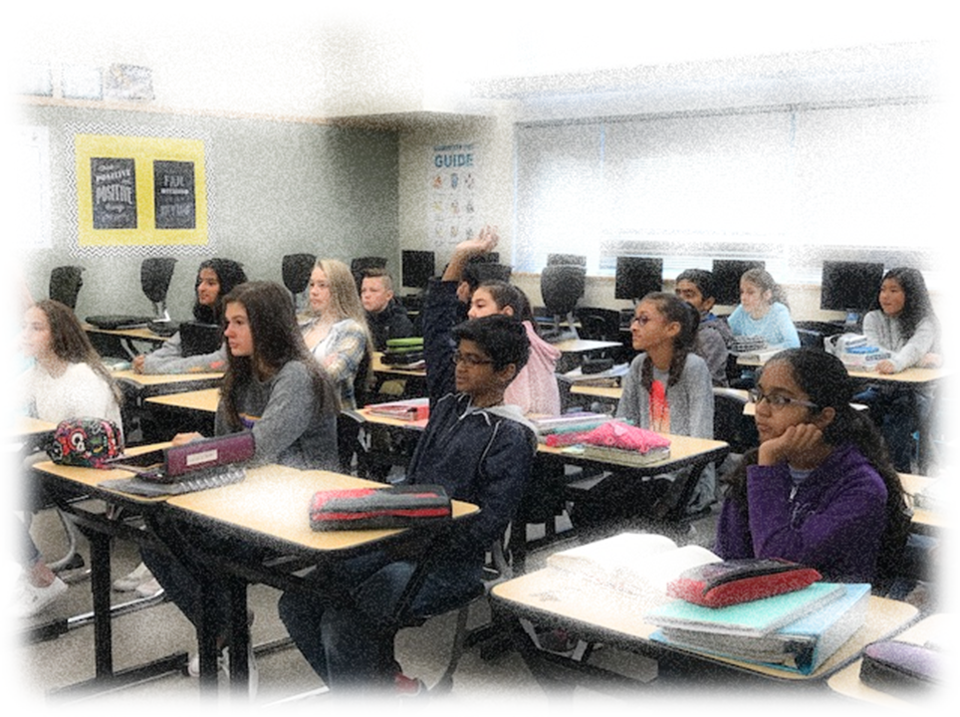
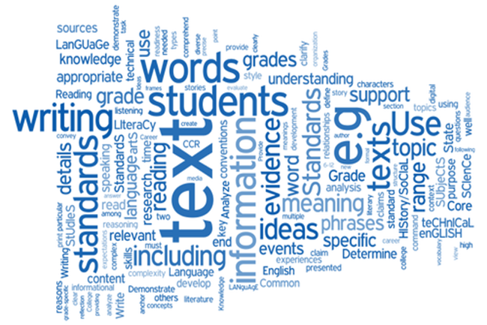
6th Grade Language Arts

Slide 38

6th Grade Language Arts Content
Regular Language Arts
Novel: Freak the Mighty
Reader’s Workshop Units:
  Identity
  Hero’s Journey
Scope Magazine
Writing Fundamentals
Personal Narrative
Informative - Feature Article
Argumentative
Advanced Language Arts
Great Books Roundtable
Novel: Freak the Mighty
Reader’s Workshop Units:
  Young Wonders
  Hero’s Journey
Scope Magazine
Writing Fundamentals
Personal Narrative
Informative – Podcast
Argumentative - Debate

Slide 39
How is Advanced Language Arts (ELA+) Different?
Advanced Language Arts has:
Added rigor and assignment requirements
A higher level of sophistication and depth
An emphasis on higher level thinking skills
More project-based assignment
An accelerated pace
More work done outside of class

Slide 40
General Guidance for Choosing ELA+
The following statements should correlate with you (the student) as a learner:
I like to read and write, and am eager to grow
I can express my ideas effectively in writing
I can revise my writing to make it stronger
I enjoy academic challenges
In addition, incoming 6th Graders should have:
Level X on Fountas and Pinnell reading assessment
Grade of 4 in 5th grade Writing and Reading

