Slide 1
TIMBERLANE REGIONAL SCHOOL DISTRICT
Serving the communities of Atkinson, Danville, Plaistow and Sandown
The mission of the Timberlane Regional School District is to engage all students in challenging and relevant learning opportunities, emphasizing high aspirations and personal growth.
Overview of
2013-14 Budget
Public Hearing on the Budget
January 10, 2013
Performing Arts Center
40 Greenough Road, Plaistow, NH

Slide 2

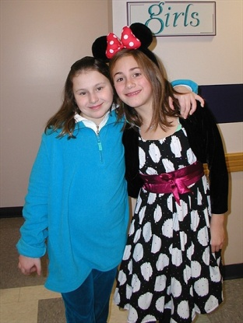



Presentation Agenda
2013-2014 BUDGET HEARING
Process
The Budget
  Summary
  Budget Drivers
Default Budget
  Definition
  Items not covered
Warrant (presented by School Board Chairman)
  Article 3: Capital Reserve addressed by Mr. Stokinger
  Article 4: Collective Bargaining Agreement/Mr. Collins
  Article 5: Authorization for Special Meeting/Mr. Collins
  Article 6: Fund Balance Retention/Mr. Stokinger
  Article 7: General Acceptance of Reports/Mr. Collins
  Article 8: Citizen’s Petition on SAU Budget

Slide 3

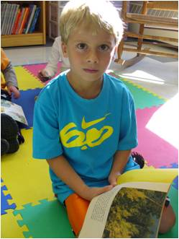
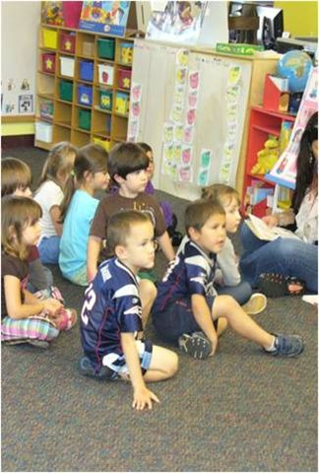
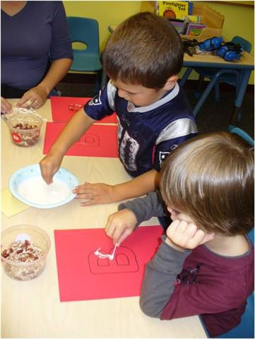
Budget Process
2013-2014 BUDGET HEARING
Building Level Needs
  Building Administrators
  Directors
Superintendent’s Budget
Review & Recommendation
  School Board
  Budget Committee
Public Deliberation
Vote

Slide 4
Need Based Budget Requests
Total 2012-2013 Budget: $63,021,817
Administrative Requests
Increase of: $1,694,151 2.69%
Committee & Board Adjustments
Decrease of: ($443,550)
Proposed Budget Summary
Increase of: $1,250,601 1.98%
Total 2013-2014 Proposed Budget
$64,272,418

Slide 5
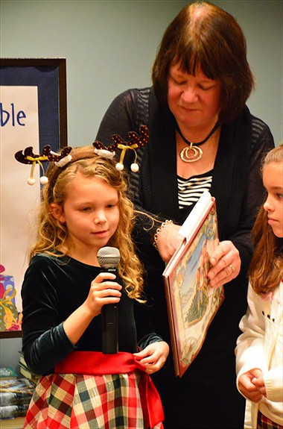

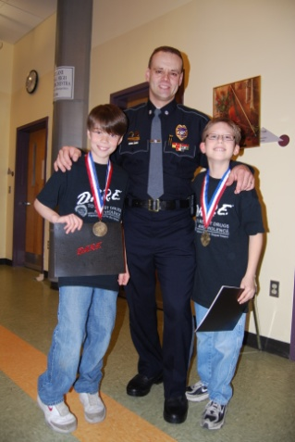

Budget Drivers
2013-2014 BUDGET HEARING
The major budget drivers affecting most
of the change:
Employee Salaries ($190,282)
  Teacher Contract Separate Warrant Article
  Staff Reductions as Appropriate
Employee Benefits
  NH State Retirement $819,267
  Employee Insurance $513,026
  Other Benefits ($2,788)

Slide 6
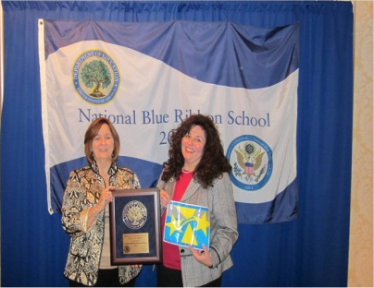
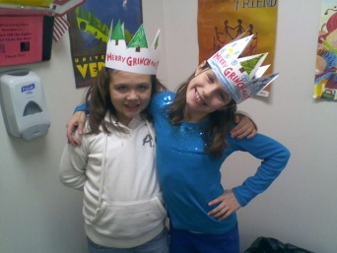

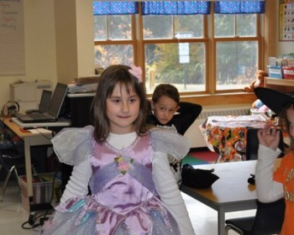


Budget Drivers
2013-2014 BUDGET HEARING
Instruction Related
  Professional Services $96,535
  Books, Supplies and Equipment $310,418
  SAU $37,265
  Transportation $61,959
Other
  Bond Interest ($84,000)
  Capital Reserve ($200,000)
  Reduction of Federal Grants ($110,000)

Slide 7
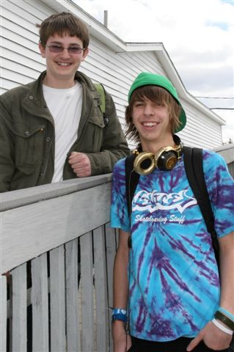
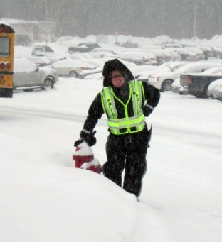

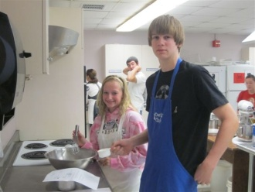
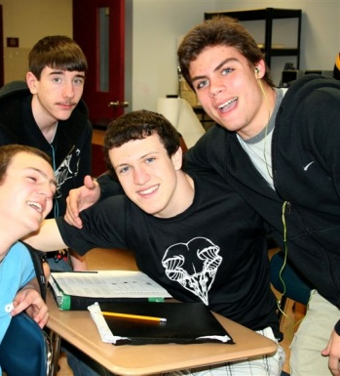
Highlights –Inc/(Dec) by Function
2013-2014 BUDGET HEARING
1100 Regular Education ($180,470)
1200 Special Education $81,024
1420 Athletics $27,610
1600 Evening Division $13,434
21xx Support Services - Students ($61,130)
221x Support Services - Staff & Admin $132,224
222x Library/Media Services ($20,226)
2320 SAU 55 $37,265
2410 Office of the Principal $183,229
26xx Operation & Maintenance of Plant $28,149
272x Transportation $61,959
2840 Information Management $8,003
2900 Support Services - Benefits $1,324,005
51xx Bond Principal & Interest ($84,000)
5250 Capital Reserve & Federal Grants ($310,000)
2013-2014 Budget Increase $1,250,601

Slide 8
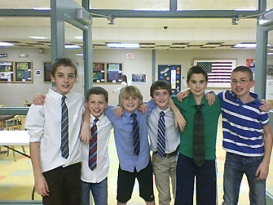

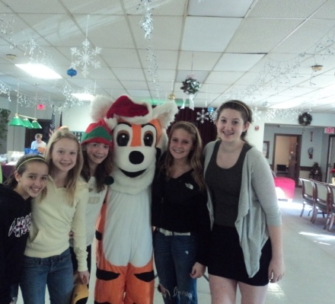
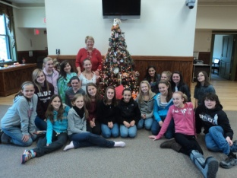


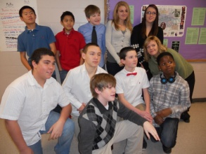
Default Budget
2013-2014 BUDGET HEARING
Should the proposed budget be defeated,
the Default Budget would be: $64,418,761
Default: $64,418,761
Proposed: $64,272,418
Difference: ($146,343)

Slide 9
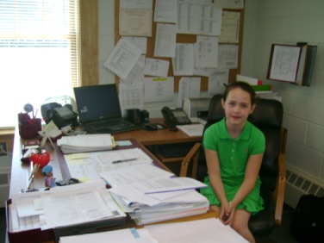
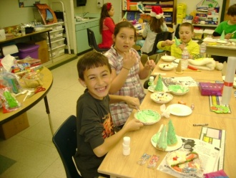


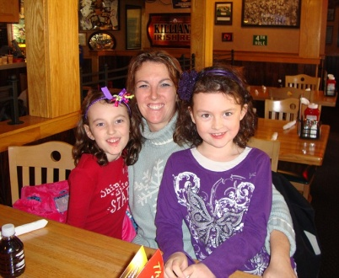

2013-2014 BUDGET HEARING
The items not covered by the
default budget are:
  Staff Reductions
  Equipment

Slide 10
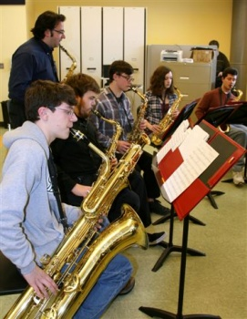
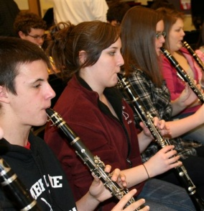

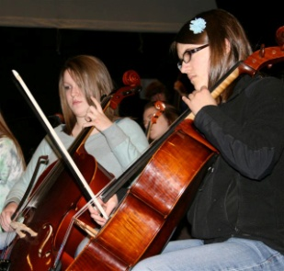
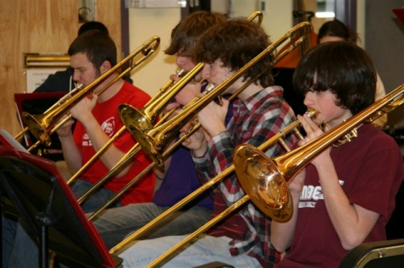
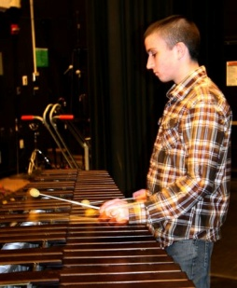
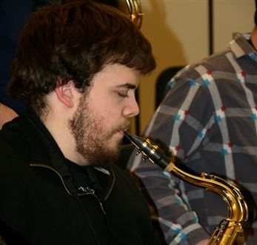
Article 3
Capital Reserve Fund
Shall the Timberlane Regional School District raise and appropriate up to $200,000 to be placed in the School Building Construction, Reconstruction, Capital Improvement and Land Purchase Capital Reserve Fund established in 1996, with such amount to be transferred from the June 30, 2013 undesignated fund balance (surplus) available for transfer on July 1 of this year? (MAJORITY VOTE REQUIRED)
2013-2014 BUDGET HEARING

Slide 11
Article 4
Collective Bargaining Agreement
Shall the Timberlane Regional School District approve the cost items included in a three-year collective bargaining agreement reached between the Timberlane Teachers’ Association and the Timberlane Regional School Board which calls for an increase in salaries and benefits at current staffing levels:
Year 2013-2014 $398,203
Year 2014-2015 $718,281
Year 2015-2016 $684,321
and to further raise and appropriate the sum of $398,203 for the upcoming fiscal year, such sum representing the increase in salaries and benefits required by the new agreement over those that would be paid at current staffing levels over the amount paid in the prior fiscal year? (MAJORITY VOTE REQUIRED)

Slide 12
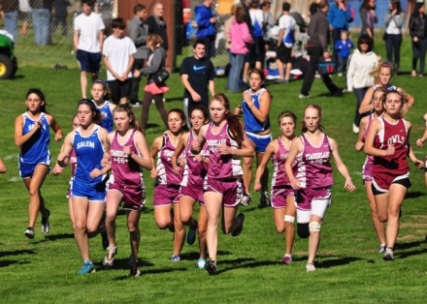
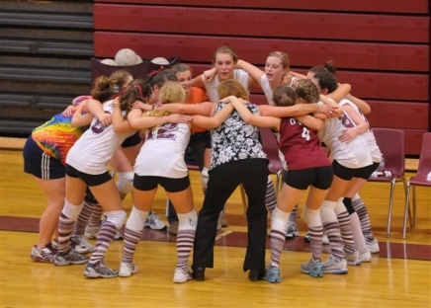
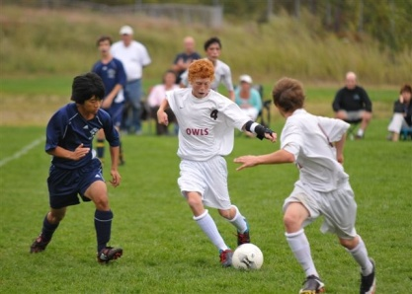


Article 5
Authorization for Special Meeting on Cost Items
Shall the Timberlane Regional School , if Article 4 is defeated, authorize the Timberlane Regional School Board to call one special meeting, at its option, to address Article 4 cost items only? (MAJORITY VOTE REQUIRED)
(Without this Article the District would have to petition Superior Court for a special School District meeting. This saves the District the expense of attorney fees and court costs.)
2013-2014 BUDGET HEARING

Slide 13
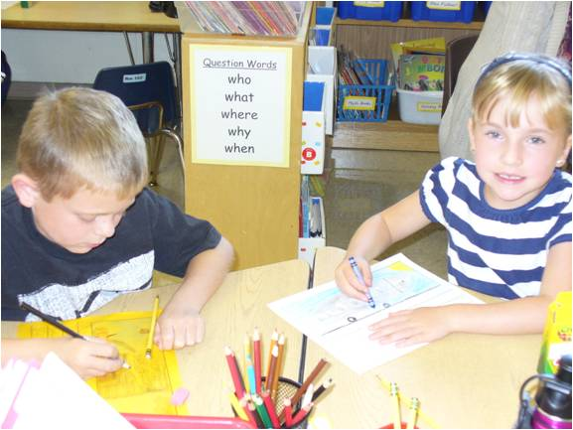


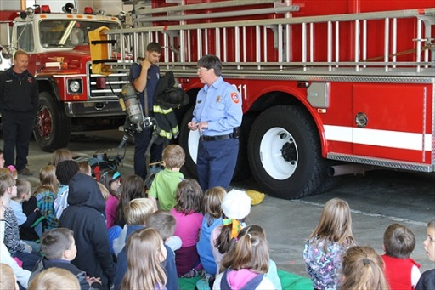
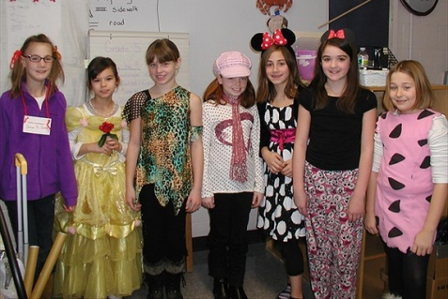
Article 6
Fund Balance Retention (Surplus)
Shall the Timberlane Regional School District vote to authorize, indefinitely until rescinded, the retention of year-end unassigned general funds in an amount not to exceed, in any fiscal year, 2.5 percent of the current fiscal year’s net assessment, for the purpose of having funds on hand to use as a revenue source for emergency expenditures and over-expenditures under RSA 32:11, or to be used as a revenue source to reduce the tax rate, all in accordance with RSA 198:4-b, II? (MAJORITY VOTE REQUIRED)
2013-2014 BUDGET HEARING

Slide 14
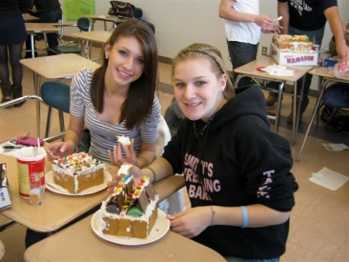
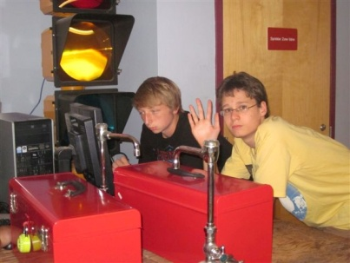
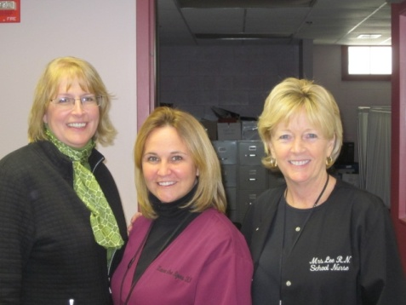
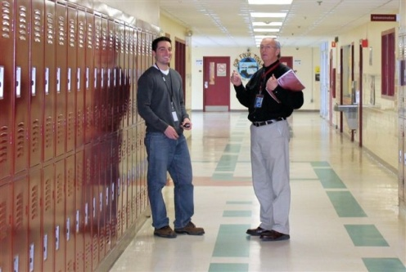
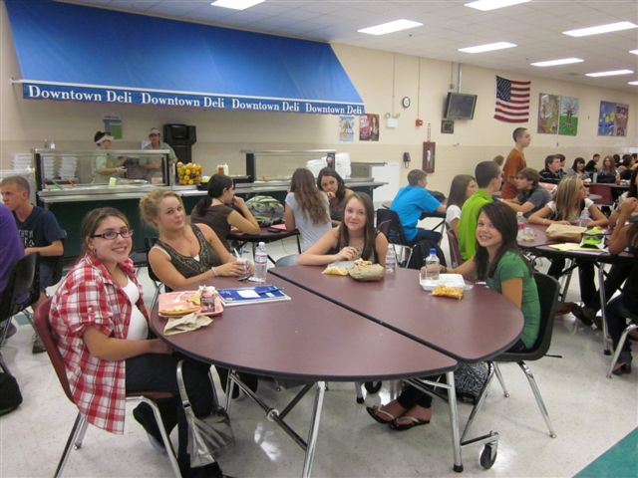
Article 7
General Acceptance of Reports
Shall the Timberlane Regional School District accept reports of agents, auditors, and committees as written in the 2012 Annual Report? (MAJORITY VOTE REQUIRED)
2013-2014 BUDGET HEARING

Slide 15
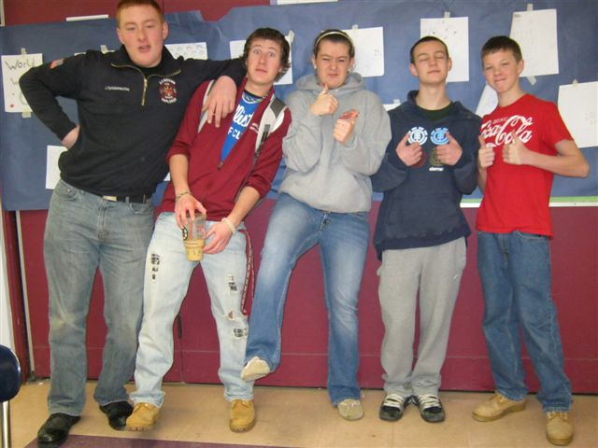
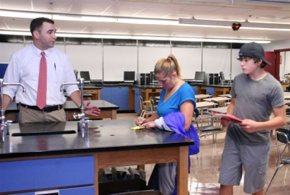
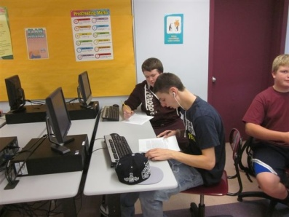
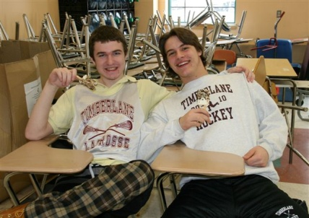

Article 8
SAU Budget As Separate Warrant Article – Petition by Donna Green et al
2013-2014 BUDGET HEARING
Shall the voters of the Timberlane Regional School District within School Administrative Unit number 55 adopt the provisions of RSA 194-C:9-b to allow for insertion of the school administrative unit budget as a separate warrant article at annual school district meetings? MAJORITY VOTE REQUIRED

Slide 16
Deliberative Session
Thursday, February 7, 2013
7:00 PM at the Performing Arts Center

Slide 17
Thank You

Slide 18
DEFAULT BUDGET OF THE SCHOOL
OF: Timberlane Regional School District, NH
Fiscal Year From July 1, 2012 to June 30, 2013
RSA 40:13, IX (b) "Default budget" as used in this subdivision means the amount of the same appropriations as contained in the operating budget authorized for the previous year, reduced and increased, as the case may be, by debt service, contracts, and other obligations previously incurred or mandated by law, and reduced by one-time expenditures contained in the operating budget. For the purposes of this paragraph, one-time expenditures shall be appropriations not likely to recur in the succeeding budget, as determined by the governing body, unless the provisions of RSA 40:14-b are adopted, of the local political subdivision.
 |  | Prior Year | Reductions & Increases | Minus
 | PURPOSE OF APPROPRIATIONS | Adopted |  | 1-Time | DEFAULT BUDGET
Acct.# | (RSA 32:3,V) | Operating Budget |  | Appropriations
 | INSTRUCTION
1100-1199 | Regular Programs | 19,361,265 | (105,183) |  | 19,256,082

