Slide 1
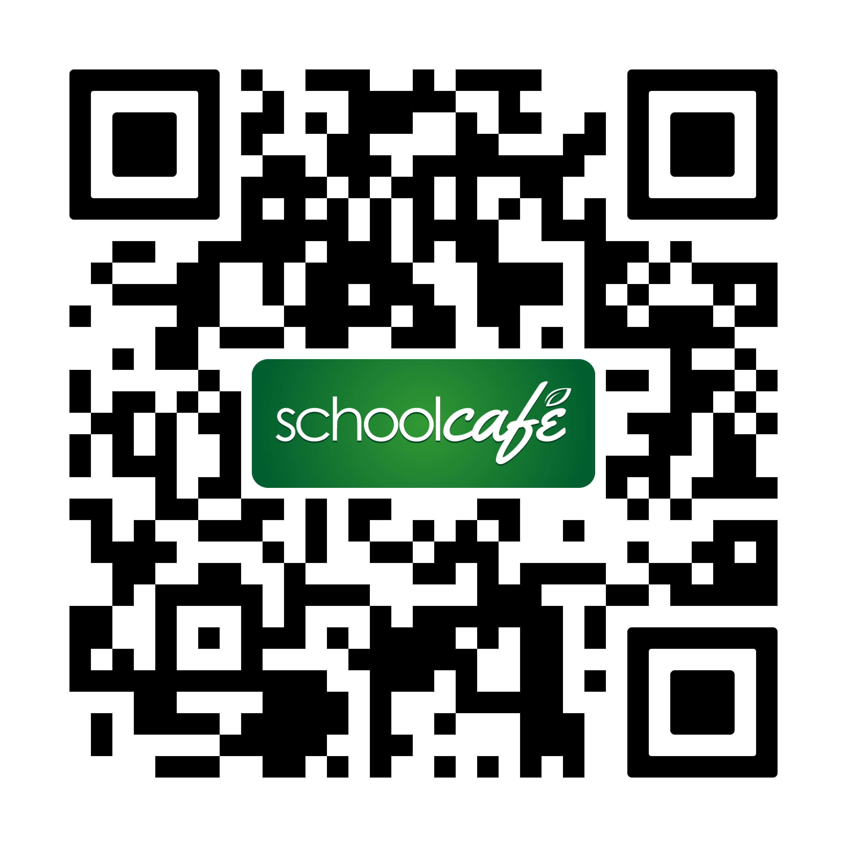
Pine Grove Area School District
Breakfast Menu
What is a Meal?
Students must choose at least 3 of the 4 components available for the school breakfast price.
- Choice of Whole Grain
- Choice of Protein
- Choice of Fruit or Vegetable
- Choice of Milk
A minimum ½ cup serving of fruit or vegetable must accompany a reimbursable breakfast.
Whole Grain Cereals
(served with graham crackers)
Cinnamon Toast Crunch, Trix, Cocoa Puffs, Lucky Charms, Froot Loops, Cheerios
Choice of Fruit
Seasonal fresh fruits, canned fruit in light syrup, 100% fruit juice
Choice of Milk
1% white, fat-free white, fat-free chocolate, fat-free vanilla, fat-free strawberry
 |  | 1 | 2 | 3
 |  | Chocolate Chip French Toast | No School | No School
 |  | Assorted Cereals or Cereal Bar
6 | 7 | 8 | 9 | 10
No School | Breakfast Bagel | Egg Wrap | Waffles | Breakfast Pizza
 | Assorted Cereals or Cereal Bar | Assorted Cereals or Cereal Bar | Assorted Cereals or Cereal Bar | Assorted Cereals or Cereal Bar
13 | 14 | 15 | 16 | 17
Croissant Sandwich | Breakfast Bagel | Mini Cinni Rolls | Pancakes | Breakfast Pizza
Assorted Cereals or Cereal Bar | Assorted Cereals or Cereal Bar | Assorted Cereals or Cereal Bar | Assorted Cereals or Cereal Bar | Assorted Cereals or Cereal Bar
20 | 21 | 22 | 23 | 24
Maple Flatbread Sandwich | Breakfast Bagel | Egg Wrap | French Toast Sticks | Breakfast Pizza
Assorted Cereals or Cereal Bar | Assorted Cereals or Cereal Bar | Assorted Cereals or Cereal Bar | Assorted Cereals or Cereal Bar | Assorted Cereals or Cereal Bar
27 | 28 | 29 | 30
Croissant Sandwich | Breakfast Bagel | Mini Cinni Roll | Waffles
Assorted Cereals or Cereal Bar | Assorted Cereals or Cereal Bar | Assorted Cereals or Cereal Bar | Assorted Cereals or Cereal Bar
(V) Vegetarian
These items do not contain meat, poultry, or seafood, but may contain dairy and/or egg
(VG) Vegan
These items do not contain any animal products
Your Team
Bernie Kelly, General Manager
570.345.2731 ext. 357
ma1116@metzcorp.com
Meal Prices
Student Breakfast $0.00
Reduced Breakfast $0.00
Faculty Breakfast $2.85
Notes:
Use “Arial” font size 7 for all text except headings. Use the TAB key to move between days for each week. CLICK next row to move to following week.

