Slide 1
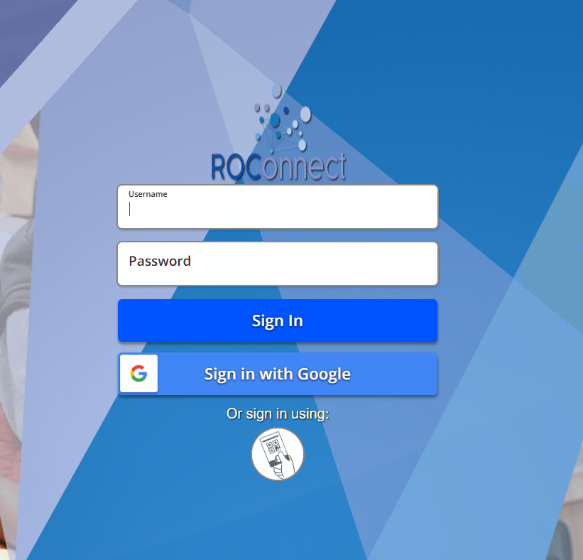

SchooLinks
How to Access School Links
Login ROConnect DashBoard - Link
Click on SchooLinks Icon

Slide 2
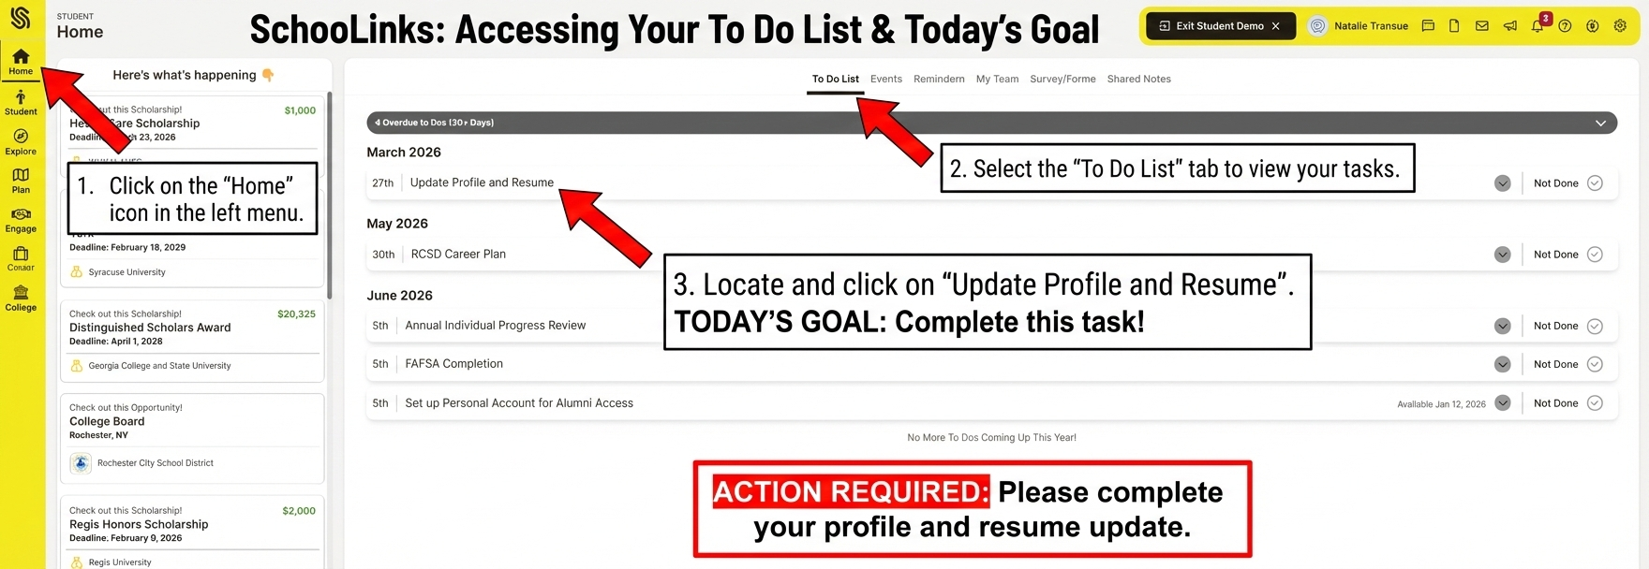
SchooLinks Profile and Resume

Slide 3
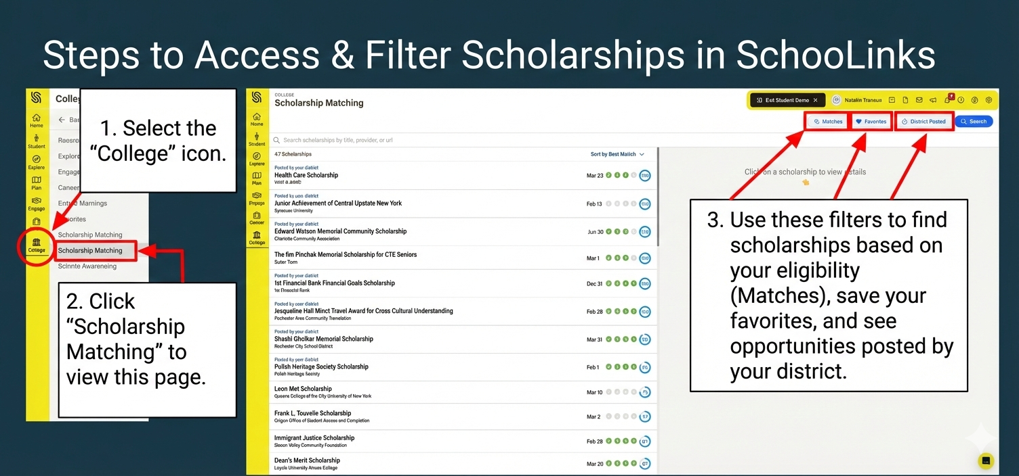
SchooLinks Scholarships

