Slide 1

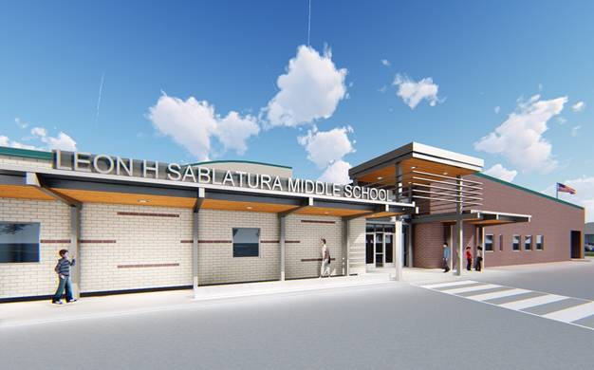
Class of 2034 Grizzlies
Education is for improving the lives of others and for leaving your community and world better than you found it. ~Marian Wright Edelman

Slide 2

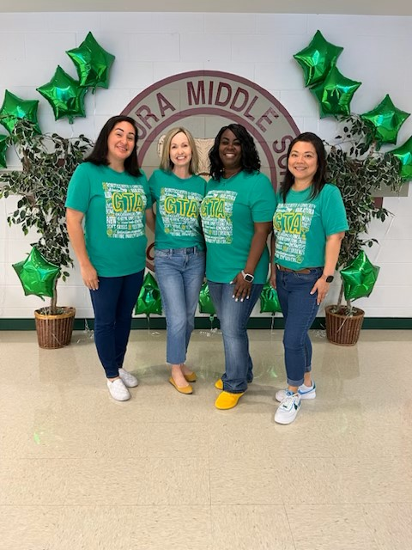

Sablatura Administration
Verna Tipton—Principal
Liza Guajardo—Assistant Principal—5th
Patricia Robinson—Assistant Principal—6th
Stacy Mueller –GT Academy Specialist
Krystal Zakharov—5th Grade Counselor
Erica Alvarez—6th Grade Counselor
Stacy Elliott— Registered Nurse
Morgan Roblyer---Communities In Schools

Slide 3


Our Mission
Our mission is to work collaboratively with the students and parents of the Sablatura Middle School community to develop all aspects of the student. Our goal is to provide an enriching academic curriculum with high standards of learning. It is our responsibility to create a safe learning environment that empowers students to become contributing members of a racially and culturally diverse world.
Sablatura Middle School……
Learning Today, Leading Tomorrow

Slide 4
Curriculum Statement for T1 Campuses:
Pearland ISD is committed to develop students’ appreciation for education and support students in becoming independent life-long learners who can apply critical thinking skills and graduate to become successful, productive adults in society.
In all subjects, Pearland ISD uses the Texas Essential Knowledge and Skills (TEKS) as the foundation for all classroom curriculum. Classroom lessons are designed around the TEKS and the individual learning needs of students.

Slide 5
Ringing Into Success: Bell Schedule
Math and Reading: Each will have a 90-minute instructional block to enhance learning and engagement.
Science and Social Studies: These subjects will be taught by the same teacher within a
90-minute instructional block, fostering deeper connections between the two areas.
Electives: Elective courses will continue to be taught in a 45-minute instructional block.
• Courses: Due to SB 2124, all 5th-grade courses will be general education. Because SB
2124 identifies 6th grade as the official starting point for advanced math across the state,
Pearland ISD will begin offering advanced classes in all subjects starting in 6th grade to
align with state expectations.
GT Academy Program: All core courses will be PAP to challenge and inspire our
gifted learners.
Dual Language Program: For Dual Language focus on language and content development.

Slide 6

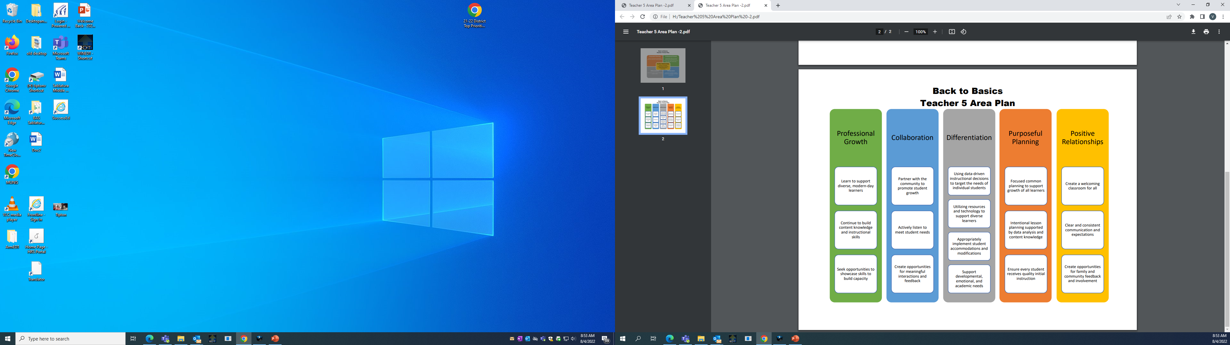


We provide rigorous, innovative, engaging, and relevant learning opportunities to ensure every student achieves growth.

Slide 7














Technology & Instruction

Slide 8


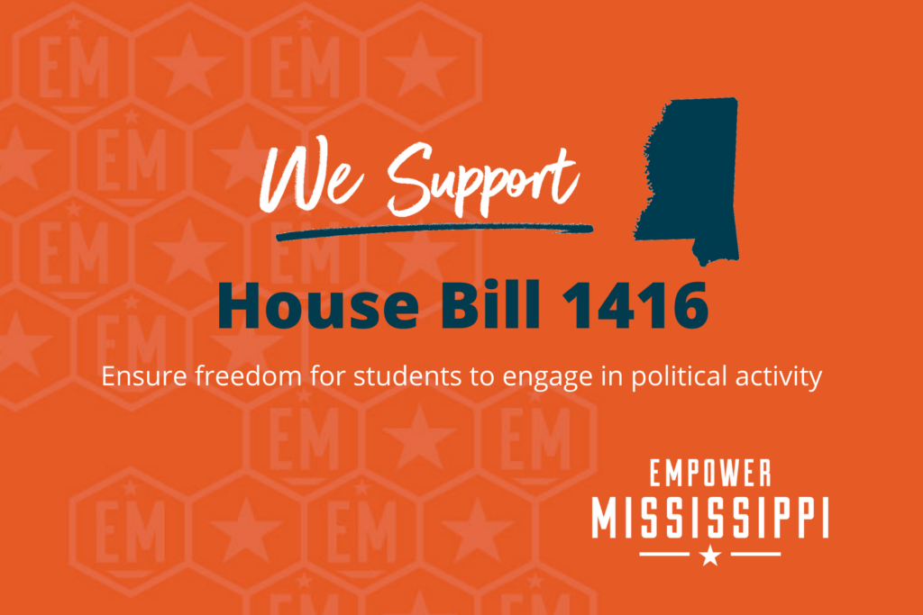
GRADE 5 Reading
GRADE 5 Mathematics
GRADE 5 Science
STAAR tests are designed to measure what students are learning in each grade and whether or not they are ready for the next grade. The goal is to ensure that all students receive what they need to be academically successful. Meeting these individual student needs depends greatly on schools, parents, and community members working together.

Slide 9

A Day Without Enthusiasm is Like A Day Without Sunshine!
School Day:
8:35-3:55
Doors open:
7:30 a.m.

Slide 10
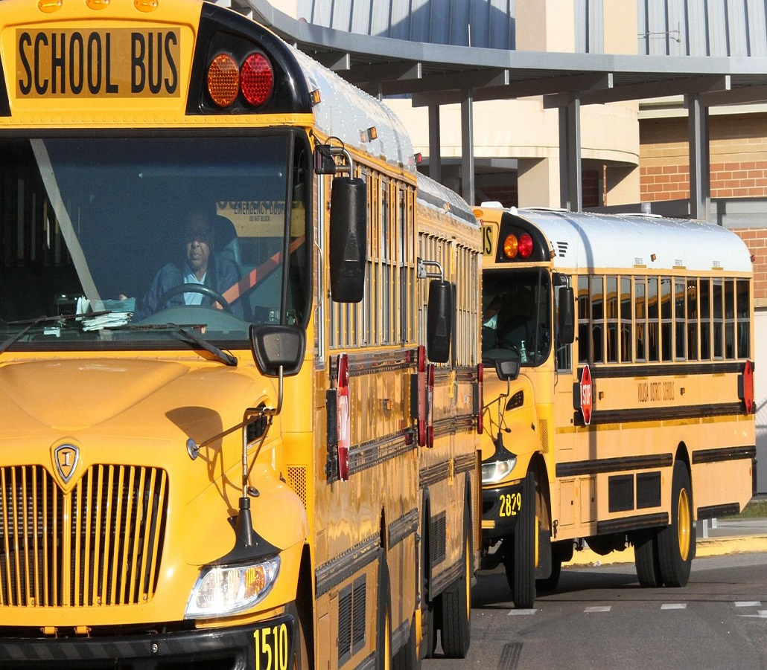
School Bus/School Day
Procedures & Times
Arrival
Dismissal
Check Out

Slide 11







Cafeteria
Dress Code
Lockers
Cell Phones/Smart Devices
Skyward—Grades
Classroom Referrals
Progress Reports/ Report Cards
Parent Volunteers—PTA, GTA Dual Language Booster Club

Slide 12








Staying Connected
Skyward Parent Portal
Monthly Newsletter
Email
Campus Website
Announcements in Canvas
Weekly Folder
Please make sure your phone number and email address are correct in Skyward to receive news and important information.

Slide 13




Attendance
Classroom Expectations & Campus Commitment
Camp Grizzly
Campus Discipline
Bully Policy & Prevention
School and Community Safety

Slide 14
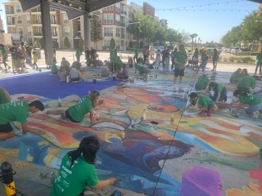

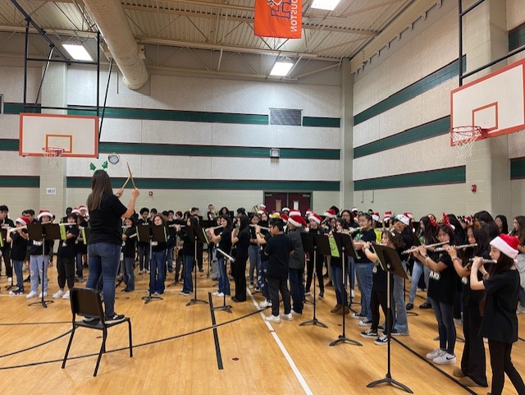
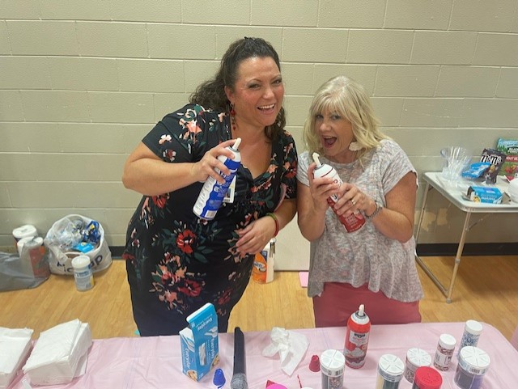
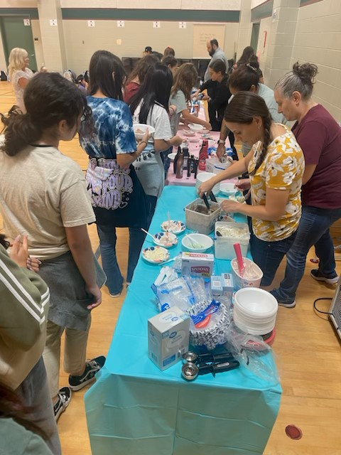
Electives
Band
Art
Physical Education
Choir/Music
Spanish-Dual Language Program

Slide 15
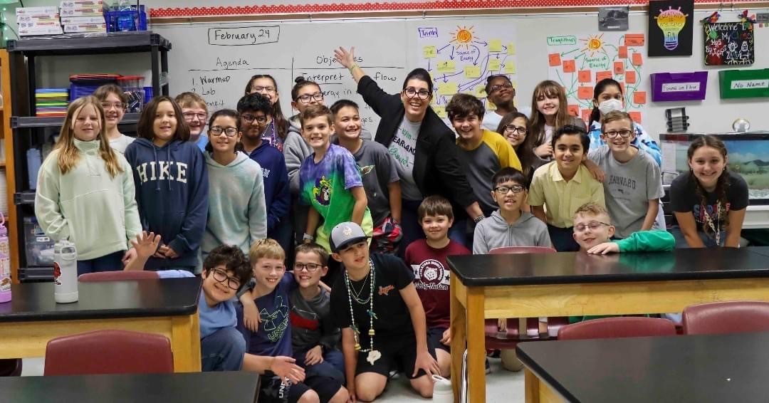



Student Support
Tutorials
Parent & Teacher Conferences
School Counselors
Communities In Schools
Title I Math & Read 180
GT Academy
Dual Language-ESL Support
Rise Mentors
T-Chat Virtual Counseling Services

Slide 16


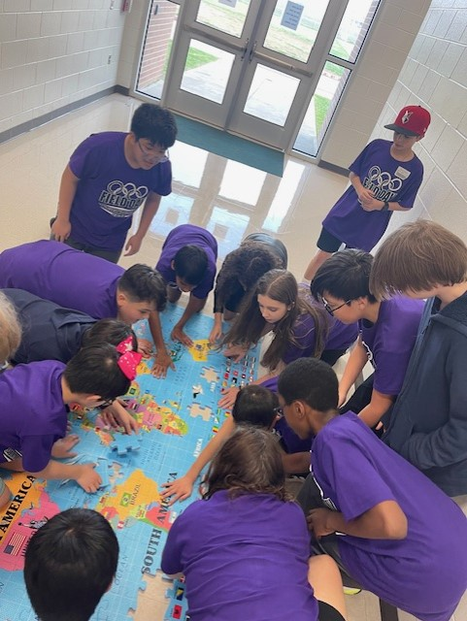
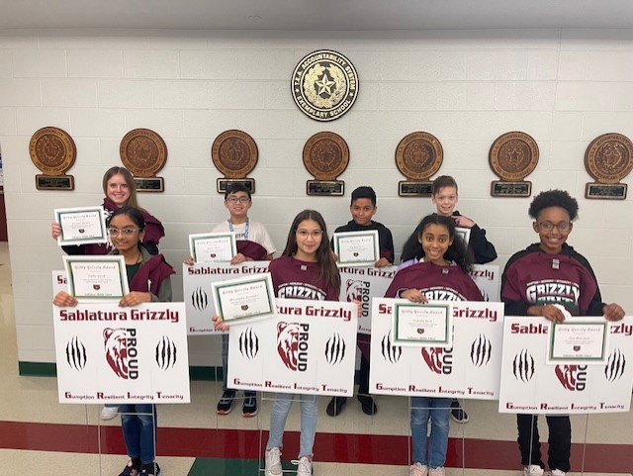
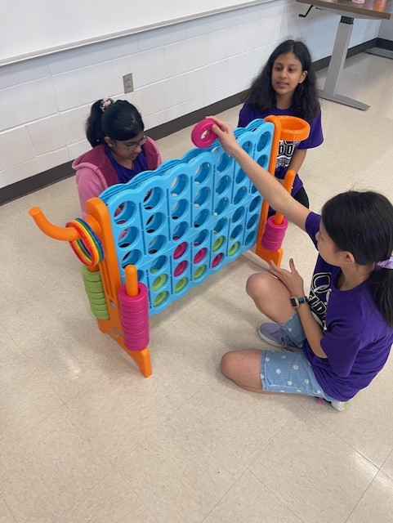
Incentive Programs
PAWS & Applause
Field Trips
Special Events/Theme Days
Character Luncheons
Gritty Grizzly Award

Slide 17


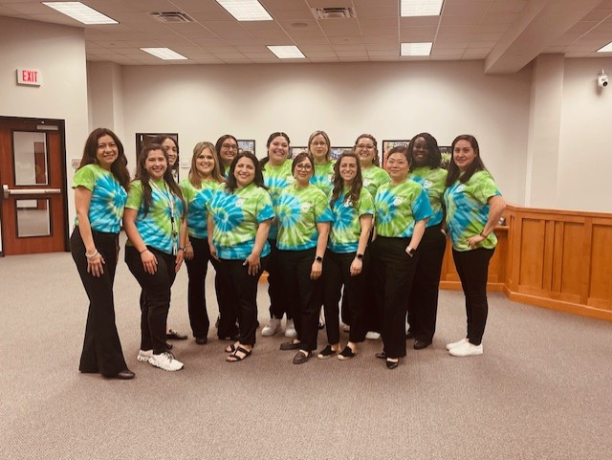
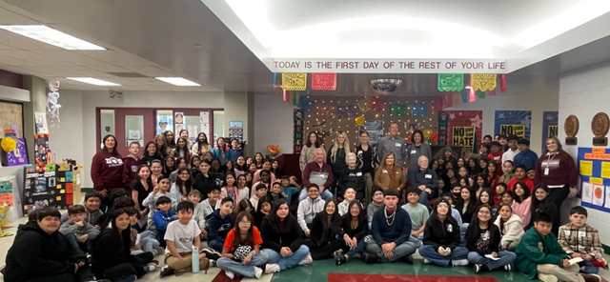
Curriculum/Currículo
Spanish/Español
Language Arts/Artes del Lenguaje
English/Inglés
Language Arts/Artes del Lenguaje
Social Studies/Estudios Sociales
LOTE/Lengua extranjera (español)
Math/Matemáticas
Science/Ciencias

Slide 18
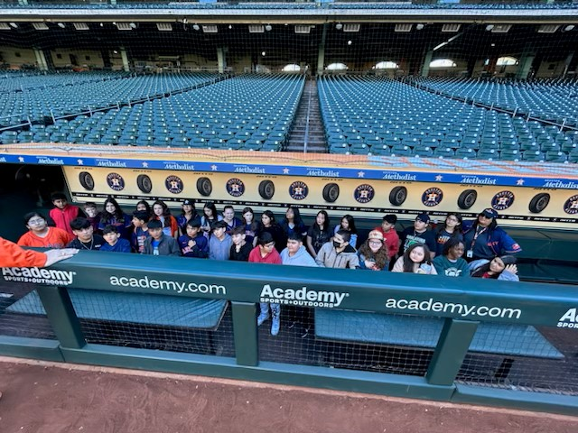
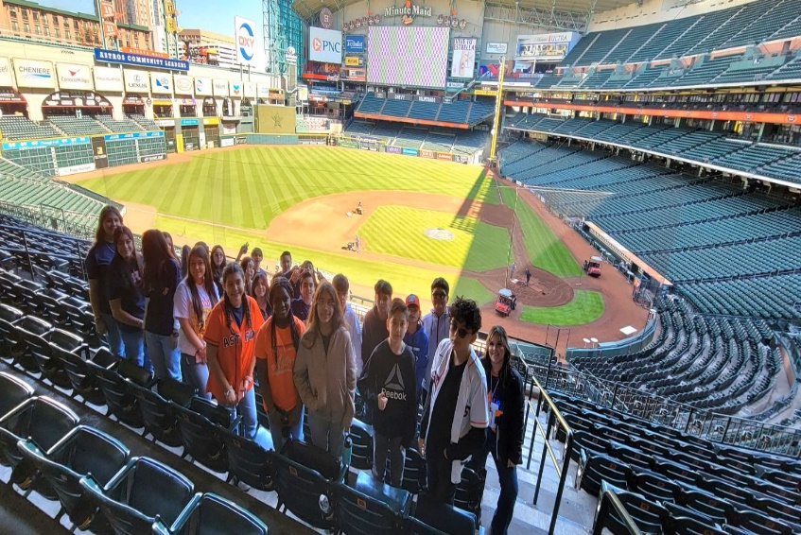
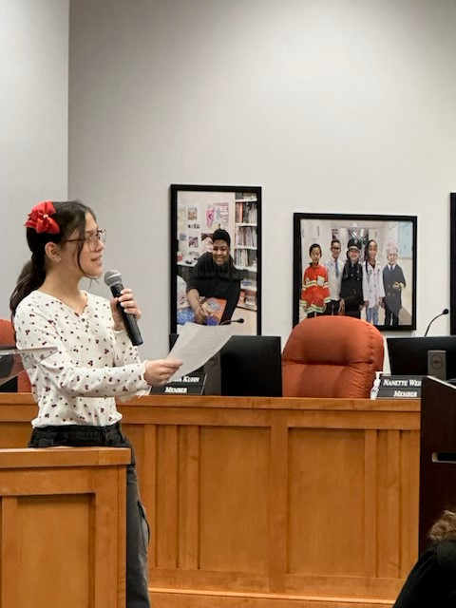
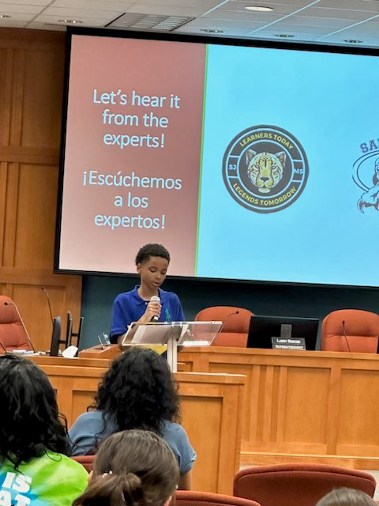
Dual Language students will have the opportunity to learn how being bilingual positively impacts our community. They will be able to practice both languages in our planned endeavors.
Visiting businesses that make global impacts
Touring colleges and universities
Meeting with speakers such as authors and leaders
Participate in community outreach
We ask for your support! Be prepared to participate in fundraising and active volunteering!

Slide 19




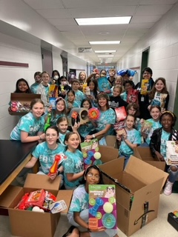
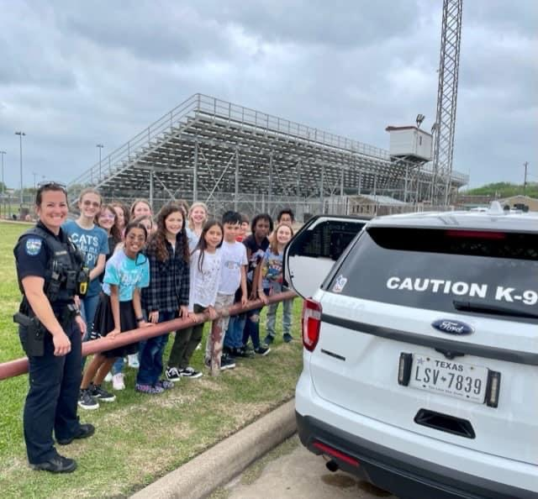
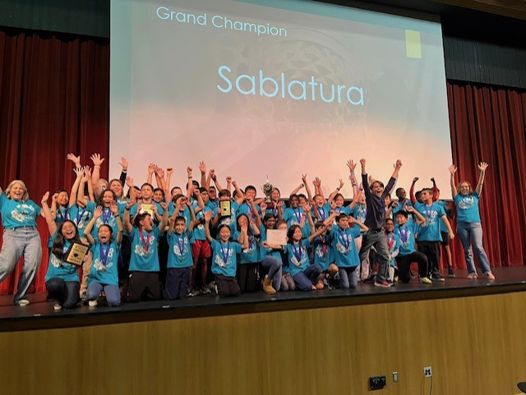
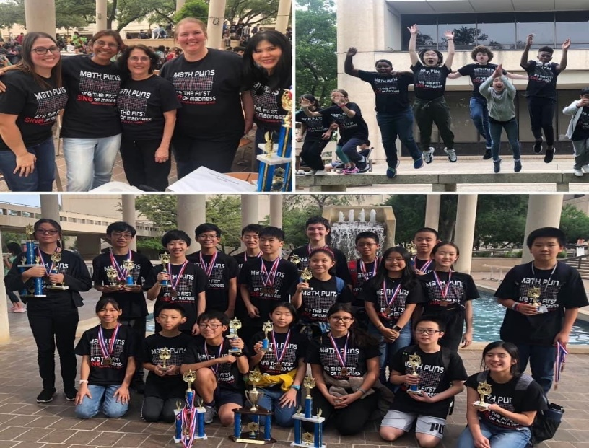
Student Council
Future Problem Solvers
PAWS
Math Club
Yearbook
Chess Club
Book Club
Robotics
Quiz Bowl
Running Club
CITY

Slide 20

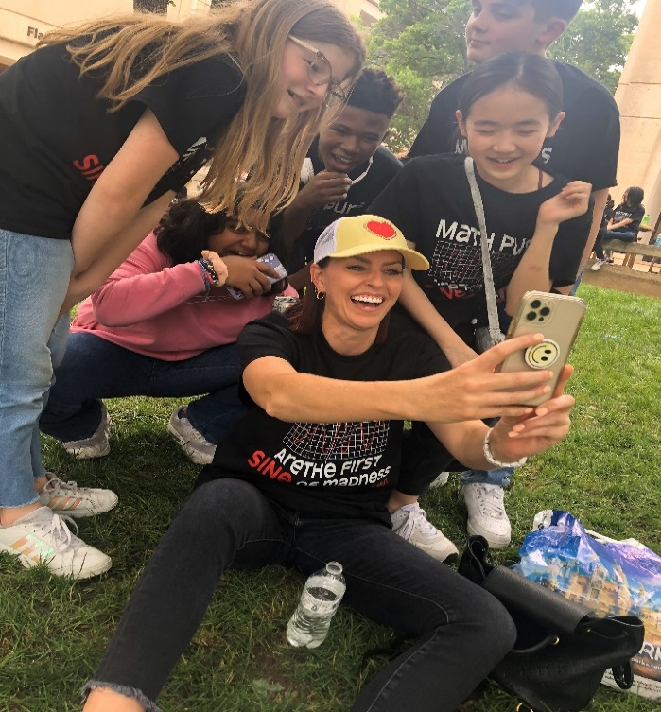
Support Academic Skills
Application of Research & Writing
Mini Courses
Social & Emotional Support
Soft Skills (Perfectionism, Time Management, Group Dynamics, etc.)
Opportunity for Math Acceleration

Slide 21

Six Components For All Students:
Academic Support
College and Career Readiness
Enrichment Activities
Health and Human Services
Parent and Family Involvement
Supportive Guidance and Counseling

Slide 22


We Welcome……
Class of 2034 Grizzlies
Grizzly Den Day
August 6th
12pm-4:30pm
August 19th
First Day of School

