Slide 1
Timberlane School
Field Restoration Project
Middle School
Freshman
JV

Slide 2
Tonight
To review JV/ Middle School Baseball Field proposed renovation donation:
  Dugouts
  Batting cages
  General Field Improvements
  Long term Goals
Proposed value
    Phase one: $19,369.25
    Phase two: $20,366.00

Slide 3
Quick update
What we’ve accomplished so far!

Slide 4
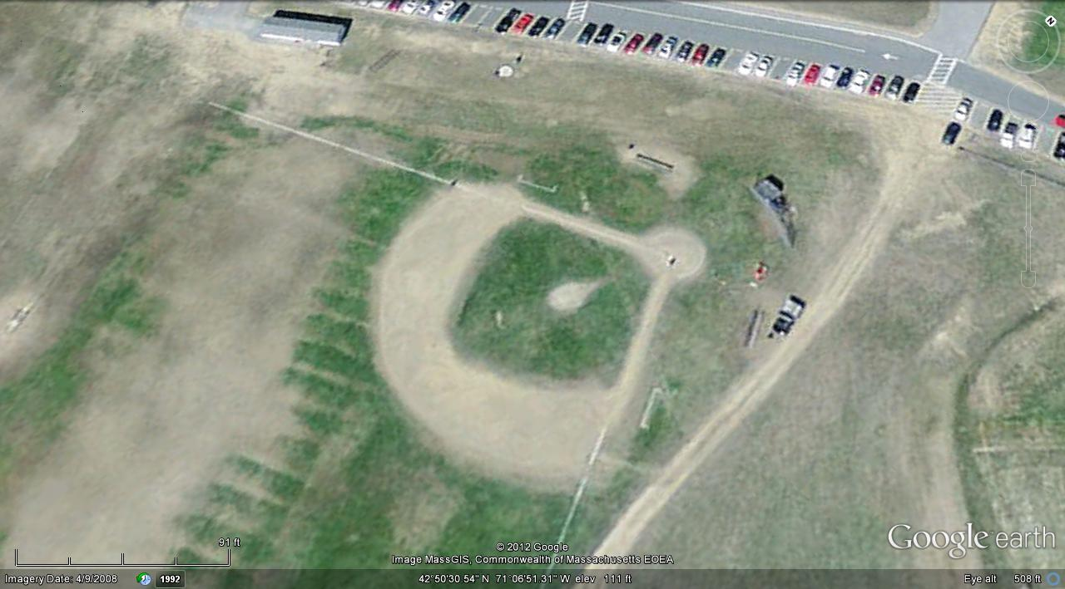
Where We Started

Slide 5
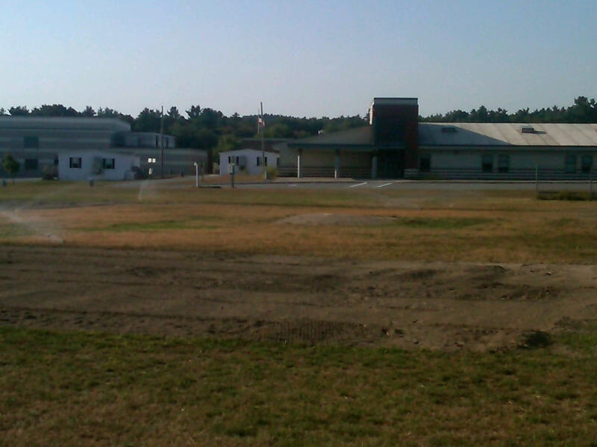
Day 1 irrigation

Slide 6
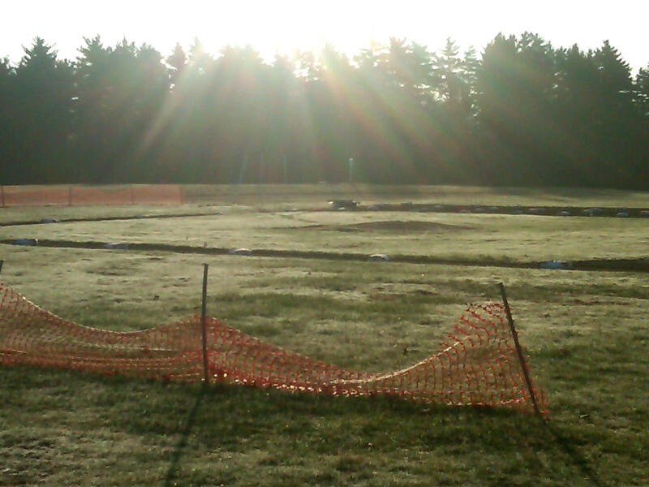
Shine on me!

Slide 7

Phase 1
Two 9’ x 50’ dugouts
Construction to be supervised by Jim Hughes and Angelo Fantasia
Construction
2 X 6 stick Construction
8’ CMU three courses high
Reinforced Concrete Pads
Proposed Cost $19,369.25

Slide 8
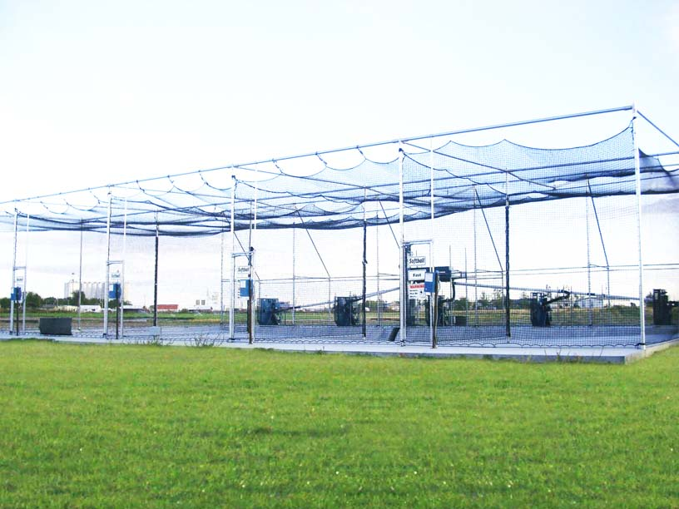
Phase 2 Batting Cages
Two 70’ X 16’ x12’ Batting Cages
Internal Net to fit inside cages
Increased value at practices
Access from dug out directly into batting cage
Proposed Cost $20,366.00
Saves on existing infrastructure

Slide 9
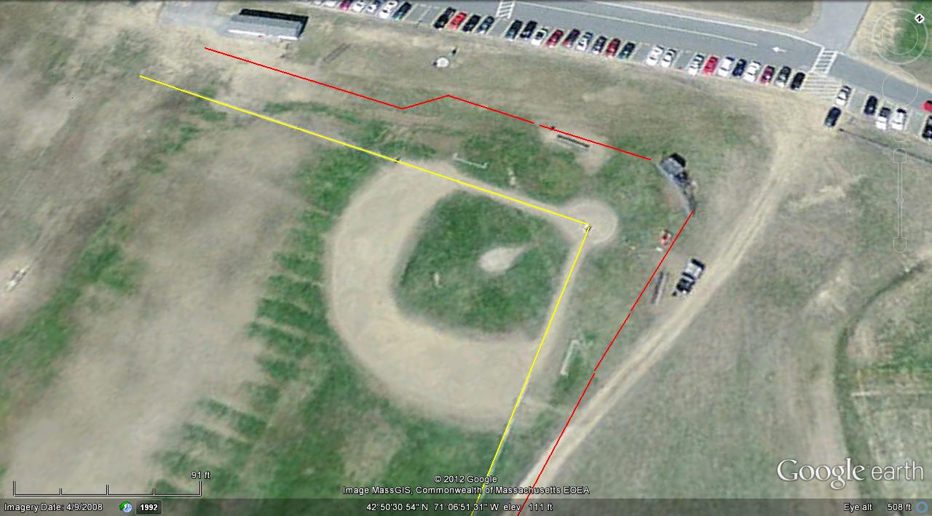






310’
Seats
Dugout
Batting Cage
T
Batting Cage
Dugout
Seats
350’

Slide 10
Design Advantages
Batting Cages:
Extensions of backstop
Used as on deck circle and bullpen
Increase efficiency of practice time
Dugouts:
Provides a dry and sheltered area for players
Adds separation from students and fans

Slide 11
Field Needs
Long Term Project
Bleachers
Outfield fence
Lights

Slide 12
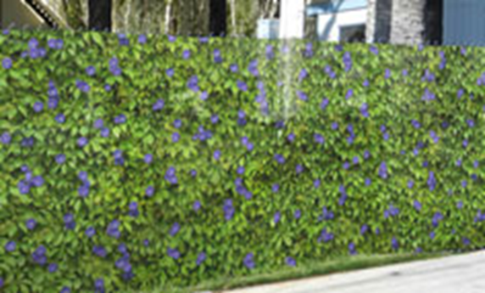
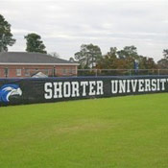
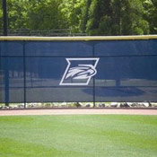
Proposed Screening
Serves three purposes
Privacy from Batting cages and other fields.
Mode of corporate donations
Team logo

Slide 13
Proposed Value

Slide 14
Master Plan
Parent Participation
Communications
Donations
Corporate Sponsorships
Short Term Field Plan
Team Building projects
Participation
Long Term Plan
Fund Raising
Fund raising activities
Sign of recognition
Donation acknowledgement
Corporate involvement

Slide 15
Value vs. Cost
Batting cages
  Cost to contract = $20,366.00
  Material Cost:
    Fence $ 1000.00
    Misc. $ 200.00
    Net $ 650.00
    Labor $ 0.00
    ____________
    Total cost $1850.00

