Slide 1
Eagle Scout Project
Patrick Radford
Troop 18, Plaistow, NH

Slide 2
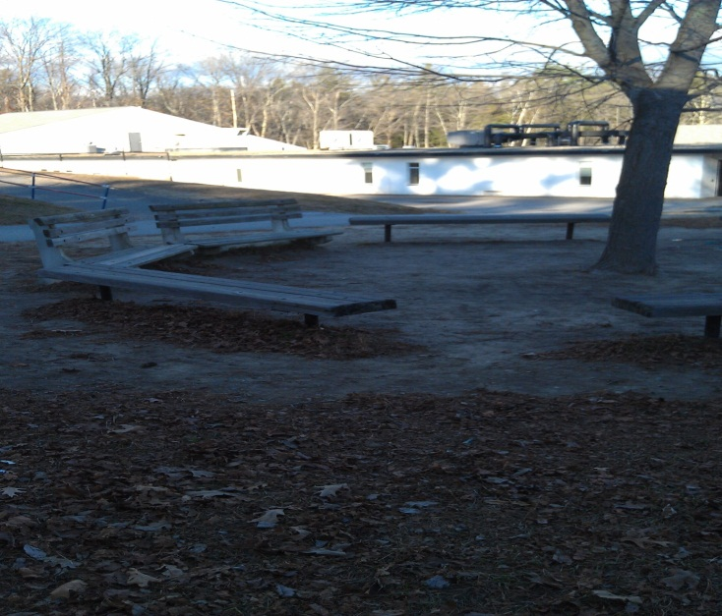
Project
Build a teaching circle for Pollard Elementary school.
A teaching circle is an area where students can gather and sit down in a circle, while the teacher instructs as the focal point in the center of the circle.

Slide 3
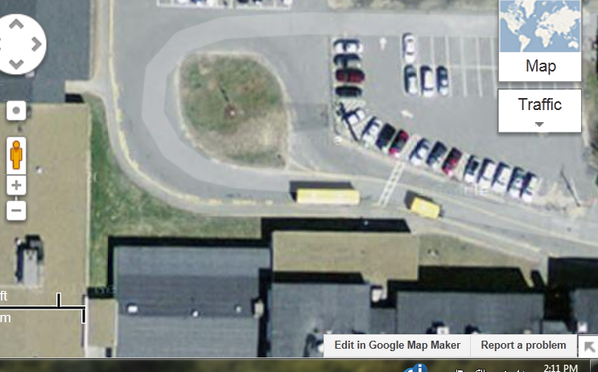
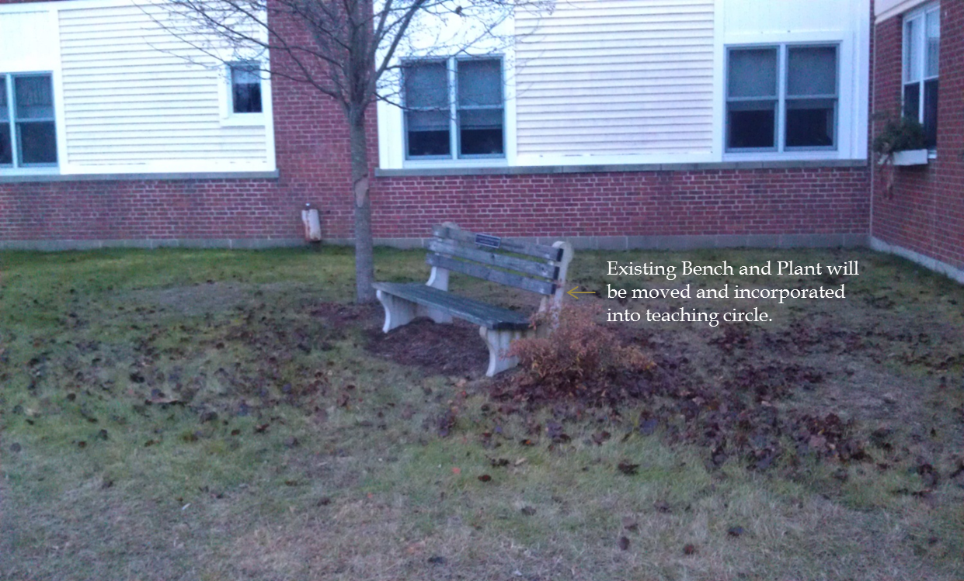
Site Location: on side of Pollard School

Slide 4
Benches
Nine benches seating 3 - 4 people per bench
Height: 15 – 17 inches
Length: approximately 96 inches
Easy to maintain
Natural look
Secure with cement
Still researching bench options, will present to Mrs. Gaydos and Mrs. Toscano for selection
Total Costs:
  $450.00- $3,600 for wooden/composite benches
  $3,600- $8,100 for metal benches

Slide 5
Fundraising/ Schedule
Fundraising
  Pollard School Jeans Day: Held February 22nd, money school raised will be put towards the project
  Home Depot/Lowes grants
  Donations
Schedule
  Expect a couple days work offsite to prepare/assemble the benches
  Onsite- expect one to two days for installation
  Expect to complete project by late Spring to mid-Summer 2013 depending on fundraising

Slide 6
Project Work Outline
Day 1:
Meet at site with tools, equipment and materials
Layout Benches
Move plant
Install benches into ground with cement as required and let it dry overnight
Lunch
Complete any remaining tasks and cleanup
Day 2
Finishing touches

Slide 7
Next Steps
Obtain School Committee approval
Present Eagle Project Plan to Yankee Clipper Council for approval
Finalize bench options
Check with the town to see if any permits are necessary
Secure Donations/Fundraising
Order Benches/Materials
Assemble Crew
Install Benches
Inspection by Mrs. Gaydos and Mrs. Toscano

