Slide 1
TRHS Observatory
Nick Bealo Proposed Eagle Scout Project

Slide 2
Summary
Eagle Project from Plaistow Troop 18
Proposed 10’ by 10’ observatory
Cost for the school district $0.00
  Boy Scouts will be raising all funds
    TRSD responsible for any electrical work if they decide it is useful
Timberlane HS will be the owners of the observatory once it is complete

Slide 3
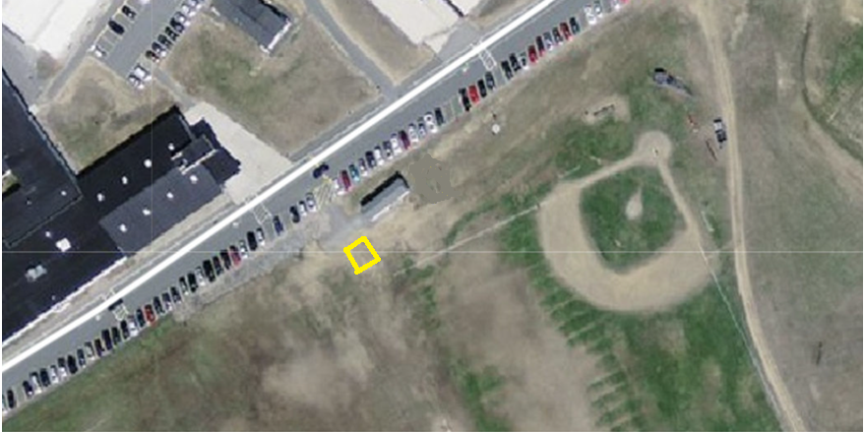
Where
Mr. Hughes will determine exact location

Slide 4
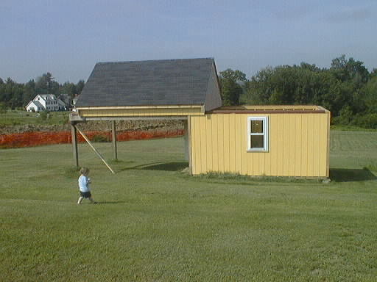
What It Will Look Like
This is Sweet Hill Observatory owned by Peter Bealo (my dad)
  A 12’ by 16’ observatory
The Proposed design would look much like this design with a roll off roof
The observatory will be built with the roof rolling off to the north
Capable of holding TRHS’s current telescopes

Slide 5
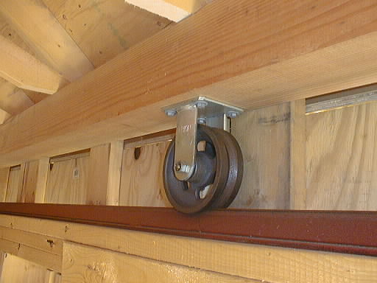
The Roof (because everyone asks)
Each side of roof rolls on 3 V-grooved iron wheels
Wheels ride on angle iron tracks
Tracks are on 6X12" wooden beams
  TRHS version would use smaller beams due to roof having <1/4 the weight
Posts holding end of beams are 6X6“

Slide 6
Unique Requirements
TRSD Requirements
  Mr. Hughes to approve final drawings
  No windows, for security
General Observatory Requirements
  Roof rolls off to the north
    Obstructs fewest number of interesting celestial objects
  No insulation or heat source inside to keep it at ambient temperature
  Part of floor that telescope sits on is isolated from where people walk to avoid vibrations

Slide 7

Steps
Approval by High School
Find school liaison – Mr. Hughes
Approval From School Board
Approval From Boy Scout Yankee Clipper Council
Estimated Completion Time: End of Summer of 2013
  In Time For The Beginning Of The 2013-2014 School year and to see Comet ISON due on December!
Estimated cost:
  If stick built (worst case): ~$4,000

Slide 8
Construction/Fundraising
If basic shed is donated by shed supplier: modify roof, add tracks, install
If wall units donated by shed supplier: assemble, assemble roof and track system
If stick built: assemble floor, walls, roof, install in place
Material/ Tradesman needs
  Shed, wall units or lumber, concrete for sonotube foundation
  Welder willing to tack weld several 20’ angle iron runs

Slide 9
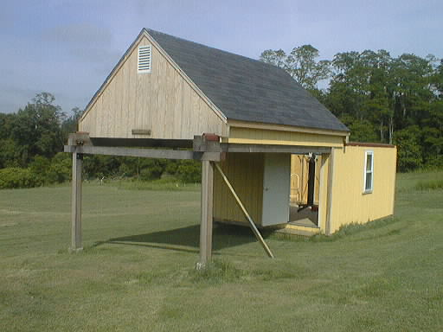
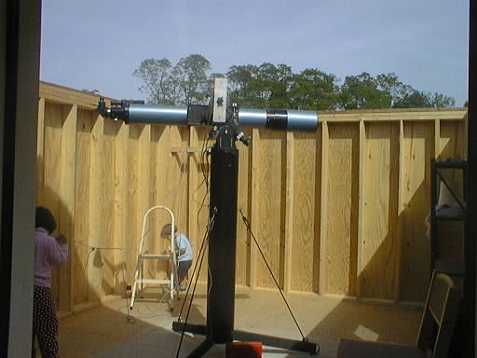
Questions???
Interior
The roof rolled off

