Slide 1
The Pollard Greenhouse
Bryce Whittaker’s Eagle Community Service Project

Slide 2
Specifications of Final Product
Manufactured by SunGlo. This kit is TOP of the line.
  Manufactured in USA (Seattle)
  17.5 feet by 7.5 feet, approximately 8 feet tall
  12 Year Factory Warranty
  All panels are double layer, acrylic/polycarbonate and will not yellow over the years!
  Snow Load and Wind Sheer Rated… And Baseball Proof!
Construction…
  Start…..FIRST day of April Vacation
  Finish – LAST day of April Vacation
  This timeline was critical as we did not want an open construction site when school reopened.
  Greenhouse took approximately150 man hours to build!

Slide 3
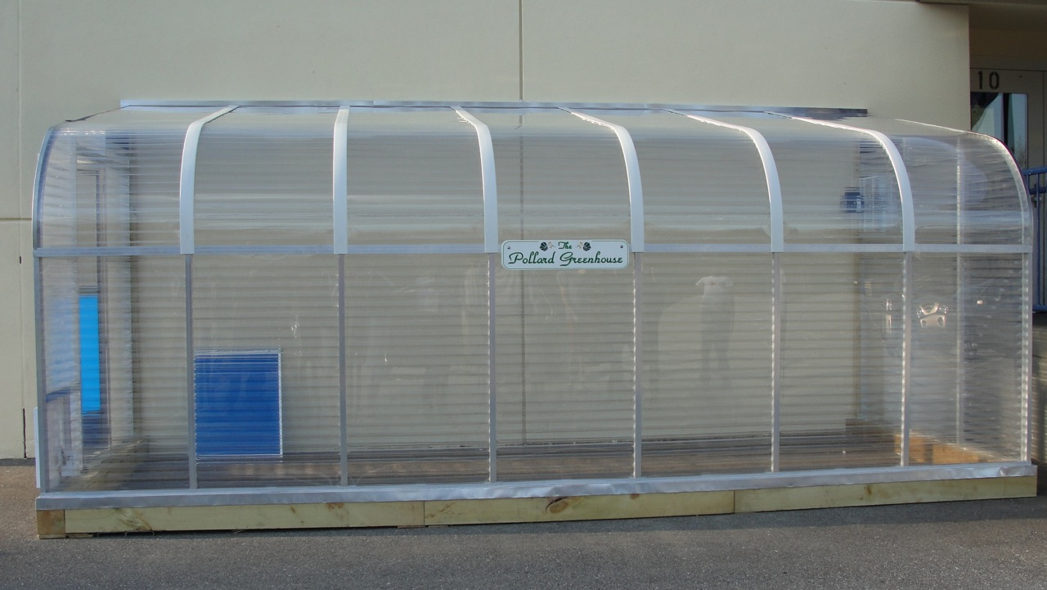
Competed, and Perfect!

Slide 4
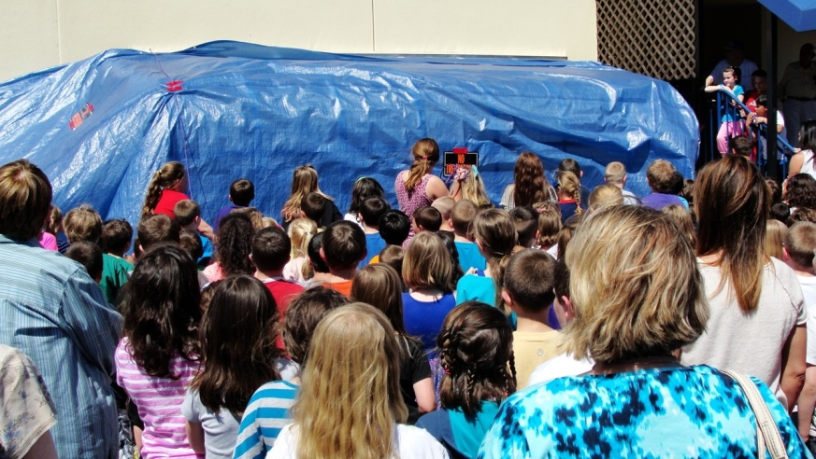
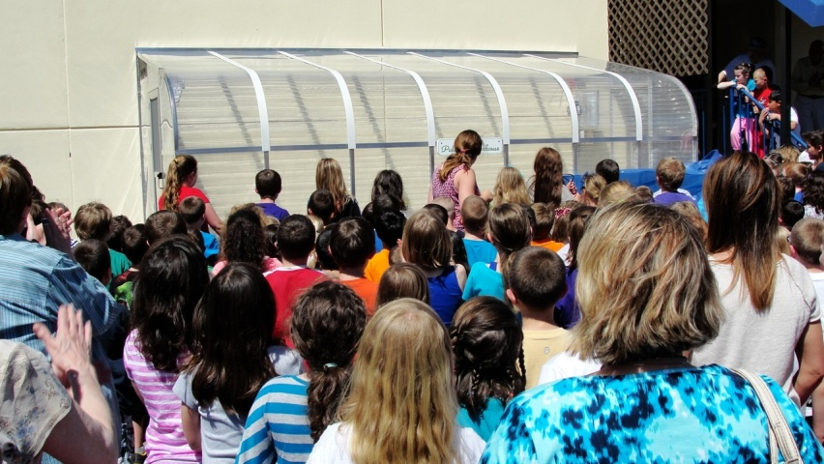
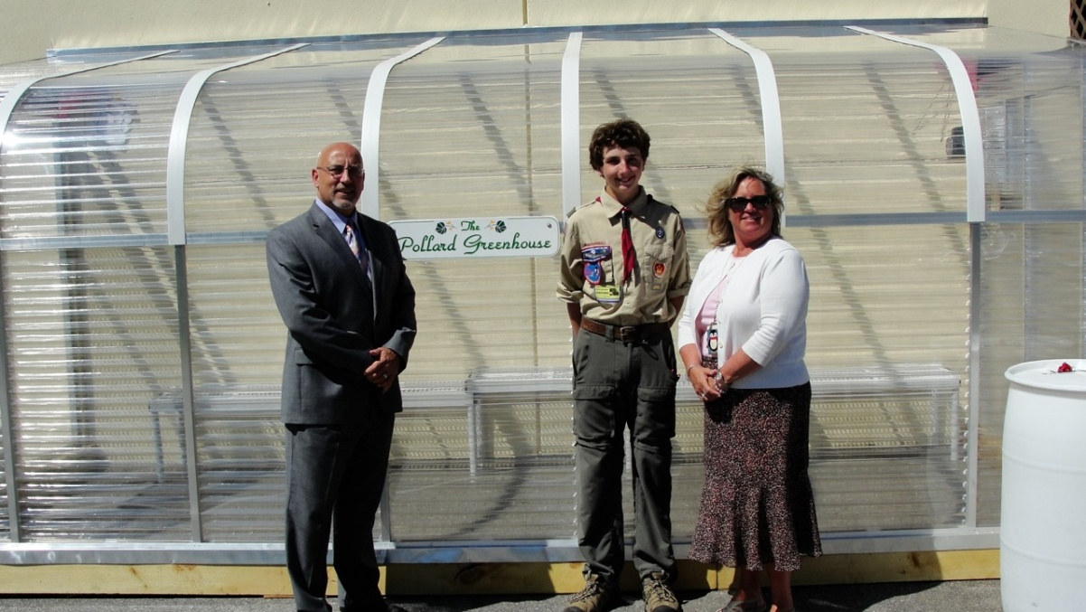
Officially Unveiled and Turned Over to Pollard School on May 7!

Slide 5
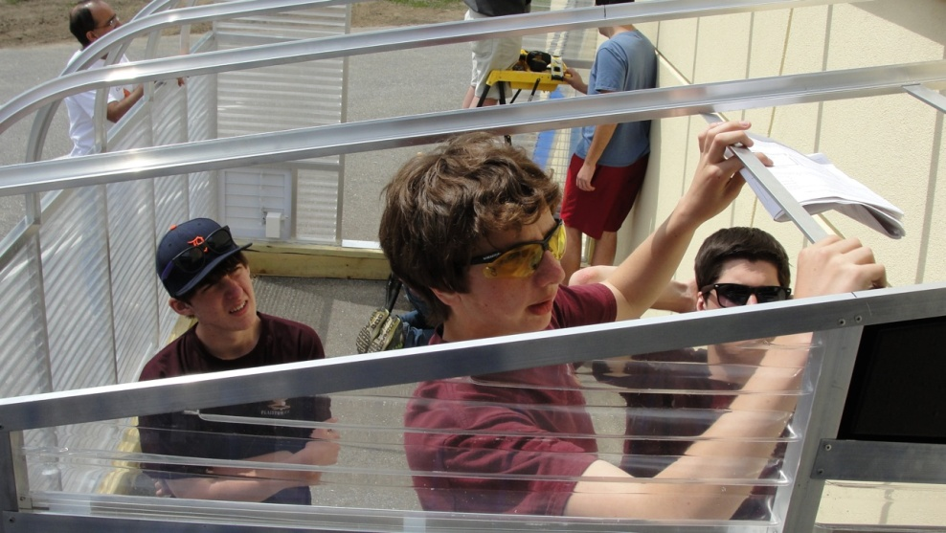
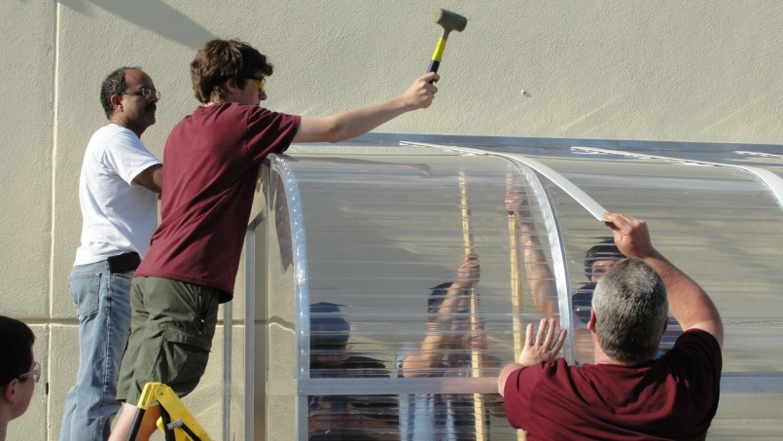
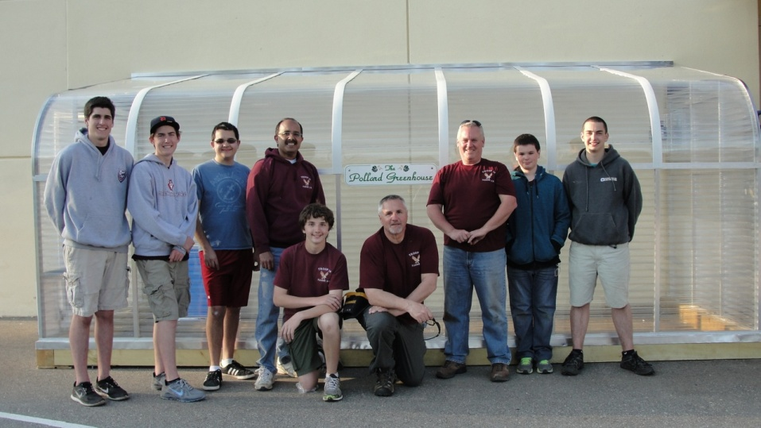
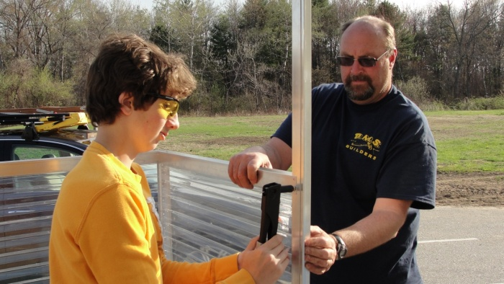
Photos Along The Way
There were some long days, but the helpers were GREAT!

Slide 6
Fund Raising Efforts
I was able to raise over $5,0000 thanks to some very generous people and organizations!
    Flamingo Drive – grossed $1,326.00!
    Pollard Yard Sale brought in $1,067.18!
    The Pollard PTA contributed $1,000.00!
    Pollard Teachers Jeans Days added $897.00
    Presentation to Lions Club added $500.00
    Presentation to K of C added $300.00
    Home Depot contributed building supplies valued at $200.00 or more

Slide 7
Budget
Originally budgeted for $3,500. After learning about snow load concerns, a new budget for $5,000 was developed as we needed a different class of greenhouse.
I came in very close to budget. I was able to raise $5,115.18, against a final cost of $5,388.68 (includes everything)
The majority of the overage was due to an emergency shipping charge from the factory. This was needed in order to ensure the construction was complete before April vacation ended.

Slide 8
Budget - continued
On my last visit in August, this board approved the project, and told me that if I needed help with funding, bring in the exact amount needed to a future meeting for consideration, and here I am!
I am hoping that this board might agree to help fund the remainder of this project to zero out my balance sheet.
I am asking for $288.50, this is money that had to be spent at the last minute to guarantee completion on time
I have a balance sheet slide next, and will also pass out a copy of the project balance sheet for your records.

Slide 9
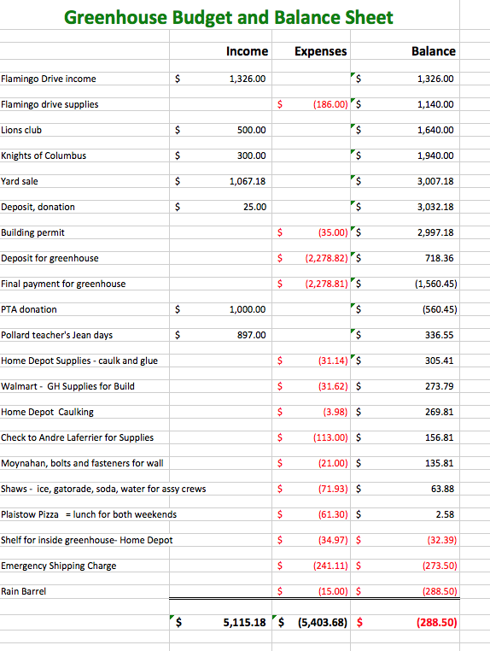
The Balance Sheet

Slide 10
Thank You!
This was a wonderful learning experience for me, and I thank EVERYONE who was involved for their support and confidence in me!

