Slide 1
6-12 Articulation Report
June 6th, 2013

Slide 2
5 Areas of Focus
  Design of the Report Card
  Curriculum Alignment
  Homework Policy
  Re-Learning/Re-Take Procedure
  Consistency of Rubric Language

Slide 3
DESIGN OF REPORTCARD
The Middle and High School Report Cards will have a similar design
Middle School Report Card will have a Cover Page that will reflect this
For Parents who would like more information about their child's academic progress towards the standards, the full standards based report card will also be available

Slide 4
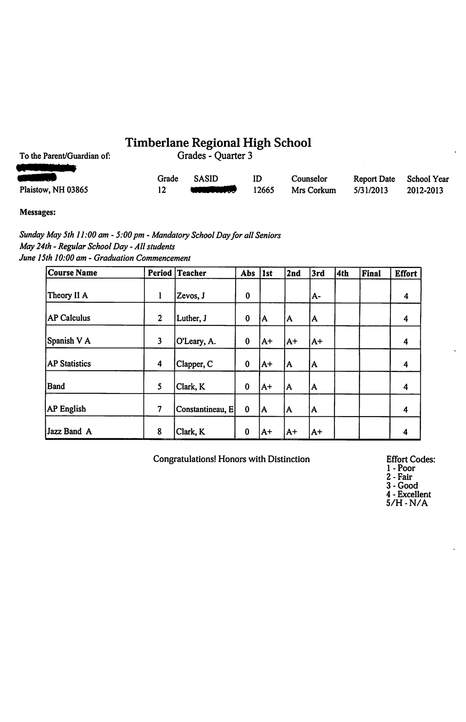
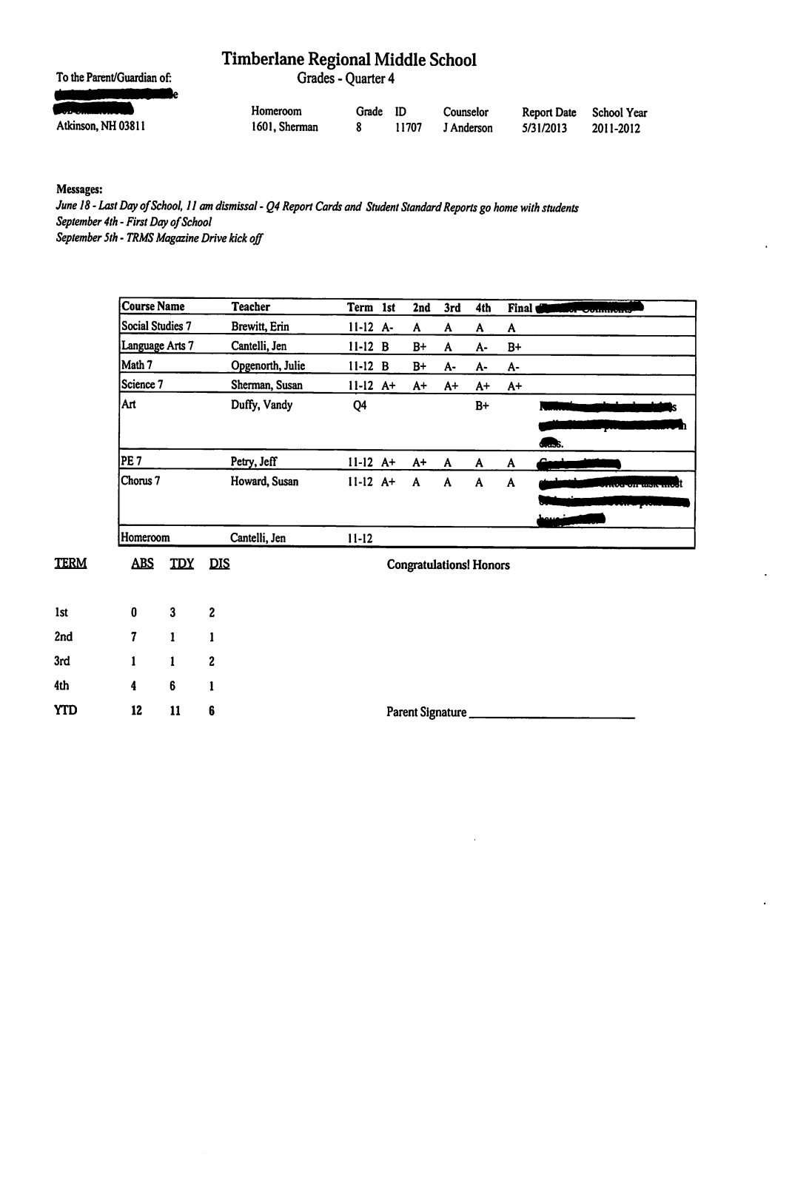

Slide 5
CURRICULUM ALIGNMENT
Academic Deans and Middle School Curriculum Coordinator will begin setting regular meetings starting July 1st
District will begin Understanding By Design Professional Development for uniform curriculum development language
Common Core work will continue

Slide 6
HOMEWORK POLICY
In grades 6-12 the weight of homework will be capped at 10% (this has been the procedure at the high school for three years).
Homework is considered an out-of-class assignment to support learning and is formative in nature.
For continuity across all disciplines, at the Middle School each grade level/content area and at the High School each course will have the same agreed upon weight for homework.

Slide 7
RE-LEARNING PROCEDURE
Relearning the standards, learning goals and competencies where the student was not demonstrating an adequate level of proficiency.
The student must agree to a contract of terms which shows their goals and commitment of how they will relearn material prior to any reassessment
The contract for re-learning will be consistent across each grade level and will be developmentally appropriate.

Slide 8
CONSISTENCY OF RUBRIC LANGUAGE
Rubric Development will be a major part of the Understanding By Design Professional Development Plan.
Curriculum Coordinators , Academic Deans and Administrators will complete a thorough walk-through and alignment of all rubrics for consistency and developmental appropriateness.
The “Path to 4” will be clear and consistent.

Slide 9
MOVING FORWARD
Remove the “Pilot” from the Report Card
Allow the newly proposed Report Card, which includes standards based reporting and will be derived from a 100 point scale when appropriate, to move forward
Allow the current 6-12 Alignment Team to continue to work on and refine the five areas described
Allow the 6-12 Alignment Team to report progress to the School Board in the 2013/14 school year

