Slide 1
TIMBERLANE REGIONAL SCHOOL DISTRICT
Serving the communities of Atkinson, Danville, Plaistow and Sandown
Deliberative Session
Steve Ranlett, Moderator
February 6, 2014
Performing Arts Center
40 Greenough Road, Plaistow, NH
The mission of the Timberlane Regional School District is to engage all students in challenging and relevant learning opportunities, emphasizing high aspirations and personal growth.

Slide 2
Budget Committee Members
ATKINSON | PLAISTOW
Jason Grosky (2014) Gregory Spero, Chair (2015) | Dennis Heffernan (2016) Diane Rothwell (2014) Barry Weymouth (2014)
DANVILLE | SANDOWN
Dennis Francoeur (2014) Michelle O’Neil, Vice Chair (2016) | Cathleen Gorman (2016) Donna Green (2015)
SCHOOL BOARD REPRESENTATIVE
Rick Blair
2014 DELIBERATIVE SESSION

Slide 3
School Board Members
ATKINSON | PLAISTOW
Kate Delfino (2015) Michael Mascola (2014) | Peter Bealo (2014) Rick Blair (2016) Susan Sherman (2014)
DANVILLE | SANDOWN
Rob Collins (2014) Nancy Steenson (2016) | Joe Morris (2014) Kelly Ward 2016)
2014 DELIBERATIVE SESSION

Slide 4
Dr. Earl Metzler
Superintendent of Schools

Slide 5

What do you see?

Slide 6

Delicate Balance
POLITICS
PEDAGOGY

Slide 7
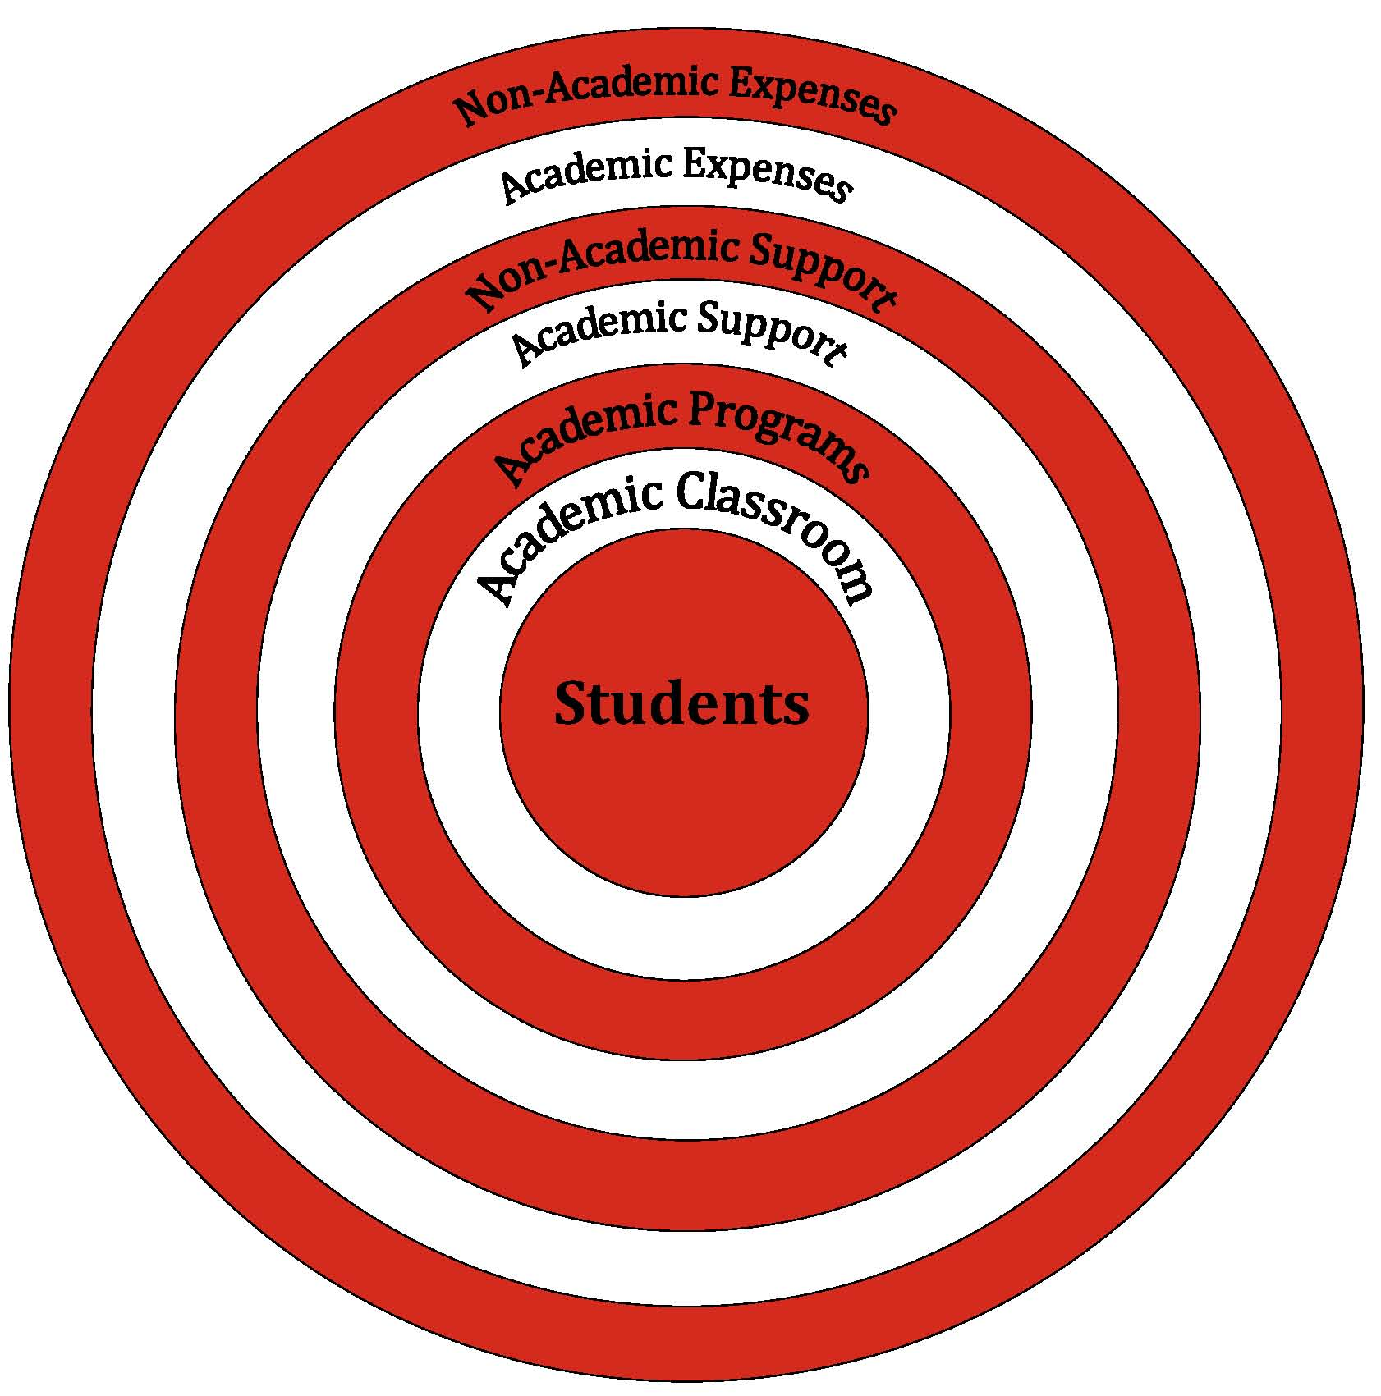
Budget Philosophy

Slide 8
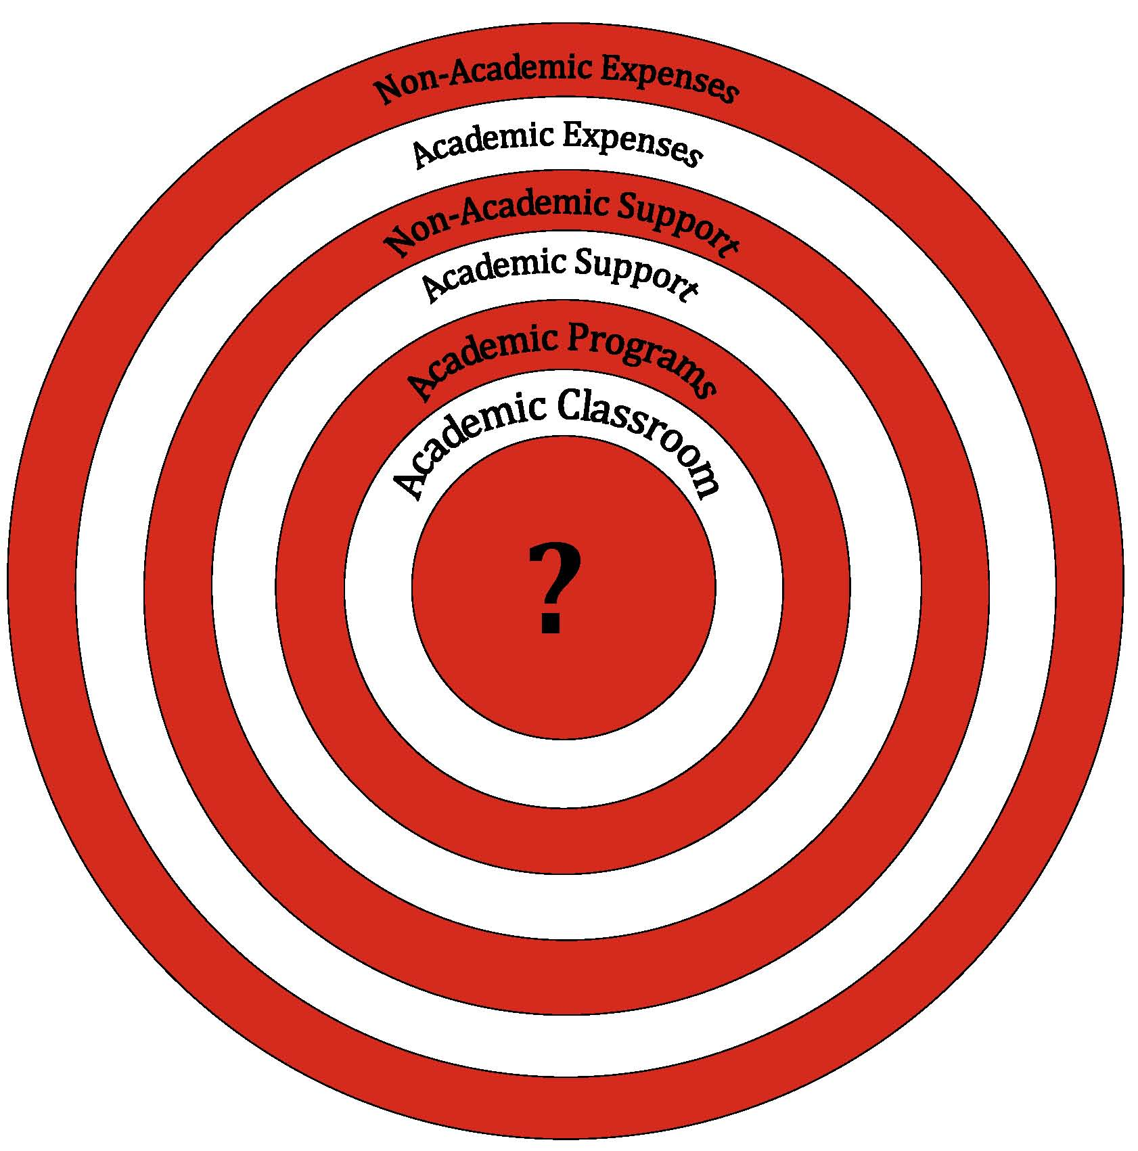

Budget Considerations
Students

Slide 9
Inside Out or Outside In?

Slide 10


Slide 11
First Session of Annual Meeting
First Session of Annual Meeting (Deliberative)
This first session of the Annual Meeting is being held at the Timberlane Performing Arts Center, Greenough Road, Plaistow, New Hampshire. Today’s date is February 6, 2014. This session shall consist of explanation, discussion, and debate of warrant articles number 2 through number 9. Warrant articles may be amended subject to the following limitations: (a) warrant articles whose wording is prescribed by law shall not be amended, (b) warrant articles that are amended shall be placed on the official ballot for a final vote on the main motion, as amended, and (c) no warrant article shall be amended to eliminate the subject matter of the article.
2014 DELIBERATIVE SESSION

Slide 12
Second Session of Annual Meeting
Second Session of Annual Meeting (Voting)
Voting on warrant articles number 1 through number 9 will be conducted by official ballot to be held in conjunction with town meeting voting to be held on Tuesday, the 11th day of March, 2014, at the Town election polls in Atkinson, Danville, Plaistow, and Sandown, New Hampshire.
Atkinson will vote at the Atkinson Community Center 7am-8pm
Danville will vote at the Danville Community Center 8am-7pm
Plaistow will vote at Pollard School 7am-8pm
Sandown will vote at the Sandown Town Hall 8am-8pm
2014 DELIBERATIVE SESSION

Slide 13
Article 1 – Election of Officers
To choose the following school district officers:
Atkinson Voters School Board Member 3-year Term
Danville Voters School Board Member 3-Year Term
Plaistow Voters School Board Member 1-Year Term
Plaistow Voters School Board Member 3-year Term
Sandown Voters School Board Member 1-Year Term
____________________________________________________________________________________________
Atkinson Voters Budget Committee Member 3-Year Term
Danville Voters Budget Committee Member 3-Year Term
Plaistow Voters Budget Committee Member 1-Year Term
Plaistow Voters Budget Committee Member 3-Year Term
2014 DELIBERATIVE SESSION

Slide 14
Article 2 – Operating Budget
Shall the voters of the Timberlane Regional School District raise and appropriate as an operating budget, not including appropriations by special warrant articles and other appropriations voted separately, the amounts set forth on the budget posted with the warrant or as amended by vote of the first session, for the purposes set forth therein, totaling $66,452,054? Should this article be defeated, the operating budget shall be $65,974,014 which is the same as last year, with certain adjustments required by previous action of the Timberlane Regional School District or by law; or the governing body may hold one special meeting, in accordance with RSA 40:13, X and XVI, to take up the issue of a revised operating budget only. Note: Warrant Article 2 (the operating budget) does not include appropriations proposed under any other warrant articles. (MAJORITY VOTE REQUIRED)
Recommended by the School Board 8-0
Recommended by the Budget Committee 8-1
2014 DELIBERATIVE SESSION

Slide 15
Budget Process
Building Level Needs
  Building Administrators
  Directors
Review & Recommendation
  School Board
  Budget Committee
Public Deliberation
Vote
2014 DELIBERATIVE SESSION

Slide 16
Need Based Budget Requests
Total 2013-2014 Budget: $65,020,621
Administrative Requests
Increase of: $2,603,496 4.00%
Committee & Board Adjustments
Decrease of: ($1,172,063)
Proposed Budget Summary
Increase of: $1,431,433 2.20%
Total 2014-2015 Proposed Budget
$66,452,054
2014 DELIBERATIVE SESSION

Slide 17
Operating Budget
2013-2014 to 2014-2015
2014-2015 Proposed* | $66,452,054
2013-2014 Budget | $65,020,621
Change | $1,431,433
Percent | 2.2%
*Does not include SAU Operating Budget
Recommended by both the School Board and Budget Committee
2014 DELIBERATIVE SESSION

Slide 18
Historical Budget
Total Budget
Adjusted for prior year warrant articles
2014 DELIBERATIVE SESSION

Slide 19
Increases in Operating Budget
Salaries | $1,093,588
Employee Insurance | 667,023
Transportation | 187,436
Retirement | 172,496
Equipment | 109,033
FICA | 101,065
Professional Services | 92,145
Books and Info Resources/Software | 79,898
Tuition | 75,510
Facilities Projects/Bldg Lease/Repairs | 125,433
Other | 84,446
TOTAL INCREASE | $2,788,073
2014 DELIBERATIVE SESSION

Slide 20
Decreases in Operating Budget
SAU 55 (separate warrant article) | ($1,028,131)
Capital Reserve | (200,000)
Bond Interest | (84,000)
Supplies | (44,509)
TOTAL DECREASE | ($1,356,640)
2014 DELIBERATIVE SESSION

Slide 21
Major Budget Factors
2014 DELIBERATIVE SESSION

Slide 22
Changes By Major Category
2013-2014 to 2014-2015
Salaries and Benefits | $2,048,133
Instruction Related | 460,777
Facilities Related | (92,275)
Other | (985,202)
TOTAL INCREASE | $1,431,433
Recommended by both the School Board and Budget Committee
2014 DELIBERATIVE SESSION

Slide 23
Salaries and Benefits
Salaries | $1,093,588
Insurance | 667,023
NH Retirement | 172,496
FICA | 101,065
Work Comp/ Unemployment | 13,961
TOTAL | $2,048,133
2014 DELIBERATIVE SESSION

Slide 24
Instruction Related
Tuition (Special Ed & Vocational) | $75,510
Equipment | 109,033
Professional Services | 92,145
Books/Software | 79,898
Supplies | 75,491
Travel/Workshops | 28,700
TOTAL | $460,777
2014 DELIBERATIVE SESSION

Slide 25
Facilities
Renovation & Repair | $76,940
Supplies | (120,000)
Building Lease (Modulars) | 34,785
Bond Interest | (84,000)
TOTAL | ($92,275)
2014 DELIBERATIVE SESSION

Slide 26
Other
Transportation Contracts | $187,436
School Administrative Unit 55 | (1,028,131)
Capital Reserve | (200,000)
Other | 55,493
TOTAL | ($985,202)
2014 DELIBERATIVE SESSION

Slide 27
Recommended vs. Default
Recommended Budget | $66,452,054
Default Budget | $65,974,014
Difference | $478,040
Percentage | 0.72
2014 DELIBERATIVE SESSION

Slide 28
DEFAULT BUDGET OF THE SCHOOL
OF: Timberlane Regional School District, NH
Fiscal Year From July 1, 2012 to June 30, 2013
RSA 40:13, IX (b) "Default budget" as used in this subdivision means the amount of the same appropriations as contained in the operating budget authorized for the previous year, reduced and increased, as the case may be, by debt service, contracts, and other obligations previously incurred or mandated by law, and reduced by one-time expenditures contained in the operating budget. For the purposes of this paragraph, one-time expenditures shall be appropriations not likely to recur in the succeeding budget, as determined by the governing body, unless the provisions of RSA 40:14-b are adopted, of the local political subdivision.
 |  | Prior Year | Reductions & Increases | Minus
 | PURPOSE OF APPROPRIATIONS | Adopted |  | 1-Time | DEFAULT BUDGET
Acct.# | (RSA 32:3,V) | Operating Budget |  | Appropriations
 | INSTRUCTION
1100-1199 | Regular Programs | 19,361,265 | (105,183) |  | 19,256,082
2014 DELIBERATIVE SESSION

Slide 29
Estimated Tax Rate Impact*
 | 2013 | Recommended | Default
ATKINSON | $15.29 | $15.02 | $14.89
DANVILLE | $22.17 | $23.50 | $23.22
PLAISTOW | $18.14 | $18.39 | $18.21
SANDOWN | $20.90 | $22.02 | $21.76
* Combined local and state school rate
2014 DELIBERATIVE SESSION

Slide 30
Cost per Pupil 2012-2013 *
State Average | $13,459
Timberlane | $13,329
45 districts spend less
115 districts spend more
* Most recent data published by the NH Dept. of Education
2014 DELIBERATIVE SESSION

Slide 31
Article 3 – SAU Budget
Shall the voters of the Timberlane Regional School District adopt a school administrative unit budget of $1,487,025 for the forthcoming fiscal year in which $1,137,741 is assigned to the school budget of this school district? This year's adjusted (default) budget of $1,455,409, with $1,113,221 assigned to the school budget of this school district, will be adopted if the article does not receive a majority vote of all the school district voters voting in this school administrative unit. (MAJORITY VOTE OF BOTH DISTRICTS REQUIRED)
Recommended by the School Board 8-0
Recommended by the Budget Committee 8-1
2014 DELIBERATIVE SESSION

Slide 32
Article 4 - Capital Reserve Fund
Shall the Timberlane Regional School District raise and appropriate up to $350,000 to be placed in the School Building Construction, Reconstruction, Capital Improvement and Land Purchase Capital Reserve Fund established in 1996, with such amount to be transferred from the June 30, 2014 undesignated fund balance (surplus) available for transfer on July 1 of this year? (MAJORITY VOTE REQUIRED)
Recommended by the School Board 8-0
Recommended by the Budget Committee 8-1
2014 DELIBERATIVE SESSION

Slide 33
Article 5 – Sandown Central Kitchen Renovation
Shall the voters of the Timberlane Regional School District raise and appropriate the sum of $385,412 to renovate the kitchen at Sandown Central Elementary School and to authorize the District to withdraw up to the sum of $335,412 from the existing School Building Construction, Reconstruction, Capital Improvements and Land Purchase Capital Reserve Fund with remaining funds ($50,000) to come from the 2014-15 operating budget? (MAJORITY VOTE REQUIRED)
Recommended by the School Board 8-0
Recommended by the Budget Committee 8-1
2014 DELIBERATIVE SESSION

Slide 34

Article 6 – One Year Collective Bargaining Agreement (TSSU)
Shall the voters of the Timberlane Regional School District approve the cost items included in the collective bargaining agreement reached between the Timberlane Support Staff Union and the Timberlane Regional School Board, which calls for the following increases in salaries at the current staffing levels over the amount paid in the prior fiscal year:
Cost Distribution | 2014-15
Salaries | $49,969.92
FICA | 3,822.70
NH Retirement | 5,104.16
Insurance | 189,550.62
TOTAL | $248,447.40
2014 DELIBERATIVE SESSION

Slide 35
Article 6 – One Year Collective Bargaining Agreement (TSSU)
AND…
further to raise and appropriate the sum of $248,447.40 for the 2014-15 fiscal year, such sum representing the additional costs attributable to the increase in salaries and benefits required by the new agreement over those that would be paid at the current staffing levels? (MAJORITY VOTE REQUIRED)
Recommended by the School Board 8-0
Recommended by the Budget Committee 8-1
2014 DELIBERATIVE SESSION

Slide 36
Article 7 - Authorization for Special Meeting on Cost Items
Shall the Timberlane Regional School District, if Article 6 is defeated, authorize the Timberlane Regional School Board to call one special meeting, at its option, to address Article 6 cost items only? (MAJORITY VOTE REQUIRED) (Without this Article the District would have to petition Superior Court for a special School District meeting. This saves the District the expense of attorney fees and court costs.)
Recommended by the School Board 8-0
Recommended by the Budget Committee 8-1
2014 DELIBERATIVE SESSION

Slide 37
Article 8 - Acceptance of Reports
Shall the Timberlane Regional School District accept reports of agents, auditors, and committees as written in the 2013 Annual Report? (MAJORITY VOTE REQUIRED)
Recommended by the School Board 8-0
2014 DELIBERATIVE SESSION

Slide 38
Article 9- Rescind SAU Budget on Warrant Petition by Julie Knight et al
Shall the voters of the Timberlane Regional School District within School Administrative Unit Number 55 rescind the adoption of RSA 194-C:9-b, relative to the alternative school administrative unit budget adoption procedure, and adopt the provisions of RSA 194-C:9 as the method for governing the adoption of the school administrative unit budget? (MAJORITY VOTE OF BOTH DISTRICTS REQUIRED)
Recommended by the School Board 8-0
2014 DELIBERATIVE SESSION

Slide 39

MARCH 11, 2014
Atkinson: Atkinson Community Center 7am-8pm
Danville: Danville Community Center 8am-7pm
Plaistow: Pollard School 7am-8pm
Sandown: Sandown Town Hall 8am-8pm
VOTE
2014 DELIBERATIVE SESSION

