Slide 1

Benefits of a Pre-engineering program at TRHS.

Slide 2
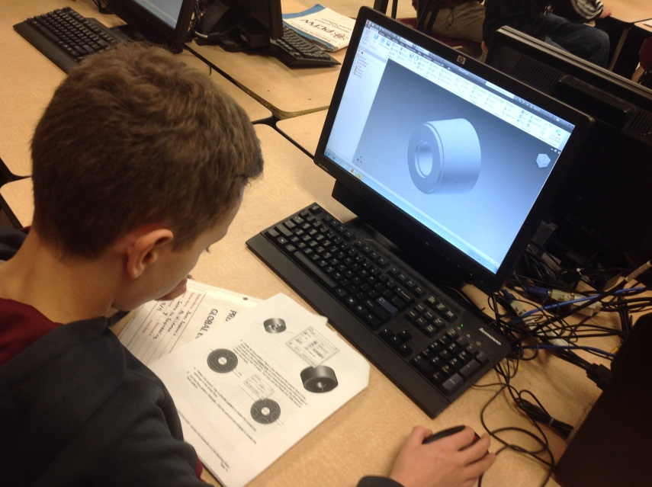
PLTW at a Glance
Pre-engineering program
Full curriculum
Teacher training program
Industry software, industry training
College and industry partnerships
Notes:
IED, POE, DE, CIM, BE, AE, EDD CEA 8 courses expand down to middle school (gateway) biomedical engineering (4 courses), elementary program
Written curriculum for all of the courses
Instructors must be trained by PLTW
Industry CAD software

Slide 3
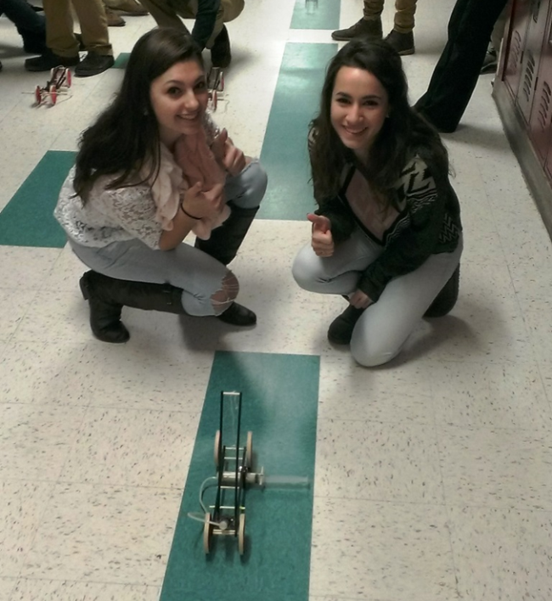
PLTW Timeline at TRHS
Started 2004-2005
June of 2011 dedicated engineering teacher was hired.
Expand program offerings
September of 2012 initiated the certification process.
Expand program offerings
June 2013 formally certified
Expand program offerings

Slide 4
PLTW Courses
IED: Introduction to Engineering Design
POE: Principles of Engineering
DE: Digital Electronics
CIM: Computer Integrated Manufacturing
AERO: Aerospace Engineering
BE: Biotech Engineering
CEA: Civil Engineering and Architecture
EDD: Engineering Design and Development

Slide 5
Number of students served
Year | IED | POE | DE | CIM | AERO | BE | CEA | EDD | Total
04-05 | 33 | 0 | 0 | 0 | 0 | 0 | 0 | 0 | 33
05-06 | 32 | 7 | 0 | 0 | 0 | 0 | 0 | 0 | 39
06-07 | 18 | 0 | 17 | 0 | 0 | 0 | 0 | 0 | 35
07-08 | 16 | 16 | 0 | 5 | 0 | 0 | 0 | 0 | 37
08-09 | 12 | 12 | 4 | 9 | 0 | 0 | 0 | 0 | 36
09-10 | 15 | 30 | 5 | 4 | 0 | 0 | 0 | 0 | 54
10-11 | 15 | 36 | 4 | 2 | 0 | 0 | 0 | 0 | 57
11-12 | 33 | 54 | 8 | 0 | 0 | 0 | 0 | 0 | 95
12-13 | 31 | 65 | 8 | 8 | 0 | 0 | 0 | 0 | 112
13-14 | 45 | 18 | 0 | 0 | 6 | 19 | 0 | 10 | 98
14-15 | 46 | 28 | 2 | 0 | 5 | 14 | 11 | 4 | 110

Slide 6
Benefits of ‘Certification’
Students in IED, POE, DE and CIM can apply for Dual Enrollment credit through NHTI
Students in the program can get college admission and scholarship preference as well as potential course credit
Advisory board improves community relations, increases student opportunities

Slide 7
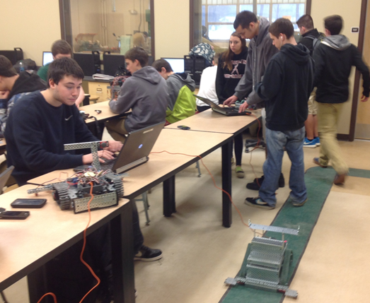
Highlights to date
Program has grown to capacity
Graduates going on to success
EDD students working with industry mentors to design and develop practical inventions.
Notes:
Jonathan Travers (‘08) became an mechanical engineer at UNH competing for EPA grants for innovative wind turbine designs
Ryan Tingley (‘13) used knowledge gained in PLTW classes to invent a Pizeoelectric Energy Harvester (Patent Pending #61928067).

Slide 8
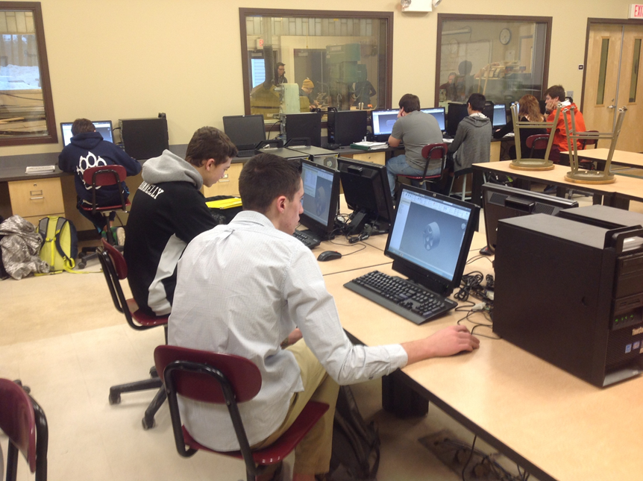
Plans for Moving Forward
Continued expansion of course offerings to include all potential courses.
Increase number of PLTW certified teachers
Increase membership on the advisory board
Increase number of opportunities for students

