Slide 1
Eagle Scout Proposal
By: Jake Chaput

Slide 2
What I am doing
I will be replacing the current message sign at Sandown Central with a new one. It will be in a new location. I will also be adding lights that will be on a timer so the sign can be seen in the dark.

Slide 3
Why it is needed
First the current sign is in a hard to see location and is very warn down. Being moved and adding lighting will make it more visible so parents can read easier. Also the current has no lock system so letters can be stolen but the new one will be locked.

Slide 4
Budget
To buy and install the sign should be around five to six thousand dollars. Once I have all designs and dimensions of the sign then I’ll be able to get an exact quote.

Slide 5
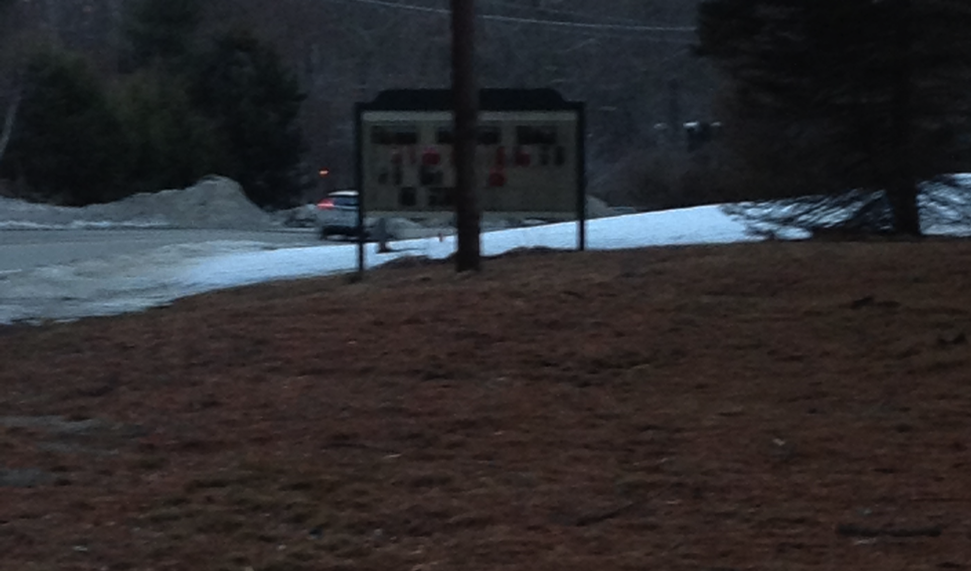
Current Sign

Slide 6


New sign design Ideas

Slide 7
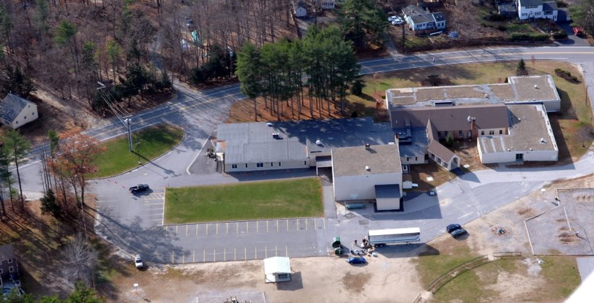
Location

Slide 8
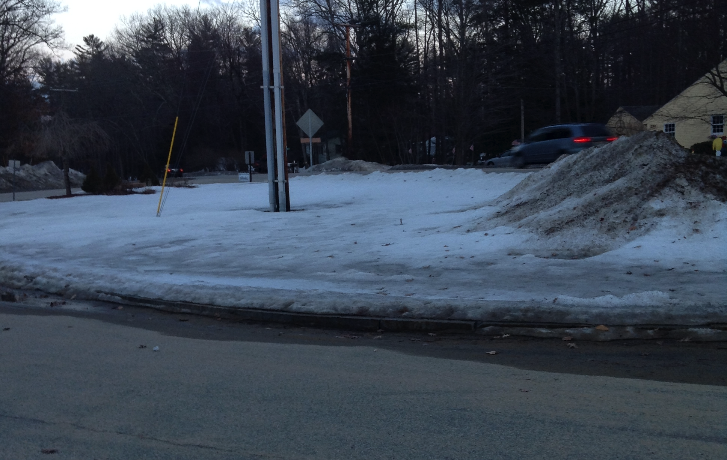
Location

