Slide 1
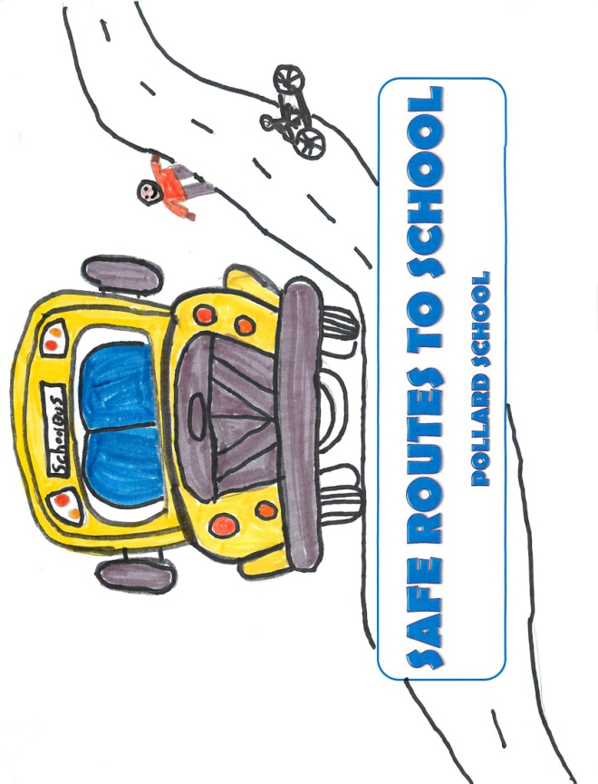
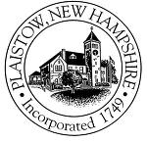
SAFE ROUTES TO SCHOOL
The Town of Plaistow and the
Pollard Elementary School
Presentation to the TRSD School Board
April 17, 2014
Michael Hollow, Grade 5

Slide 2

Why all the excitement about Safe
Routes to School?!
In 2013, the Town of Plaistow and Pollard Elementary School applied for and received a grant totaling $249,170 through the NHDOT’s Safe Routes to School (SRTS) program. In addition, in July 2013, the Town of Plaistow Board of Selectmen pledged an additional $100,000 in supplemental funding.
These funds are now being used for infrastructure and non-infrastructure projects at or in the vicinity of the Pollard Elementary School and Town Hall.

Slide 3

The Goal of the Pollard School SRTS Program:
To allow for and encourage the safe walking and/or biking of students.

Slide 4
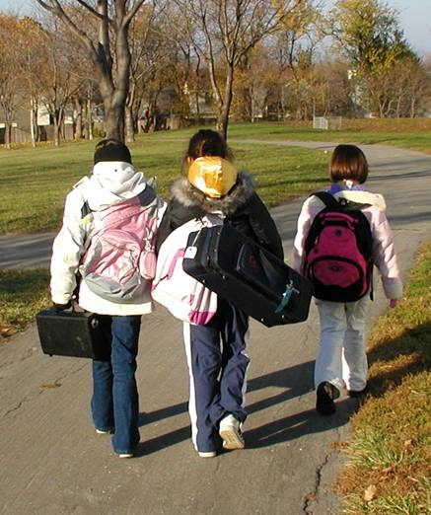
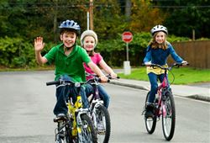
Pollard School SRTS Program – Outcomes:
Increased bicycle, pedestrian and
traffic safety.
More children walking and bicycling to
and from schools.
Improved childhood health and active
lifestyles.
Improved partnerships among
schools, local municipalities, parents
and other community groups.

Slide 5
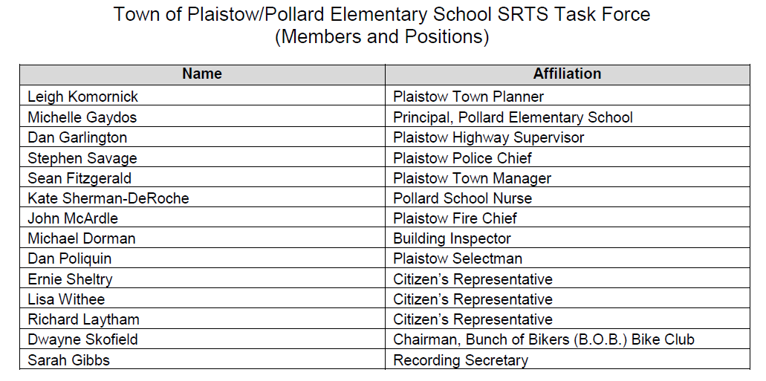
SRTS Task Force

Slide 6
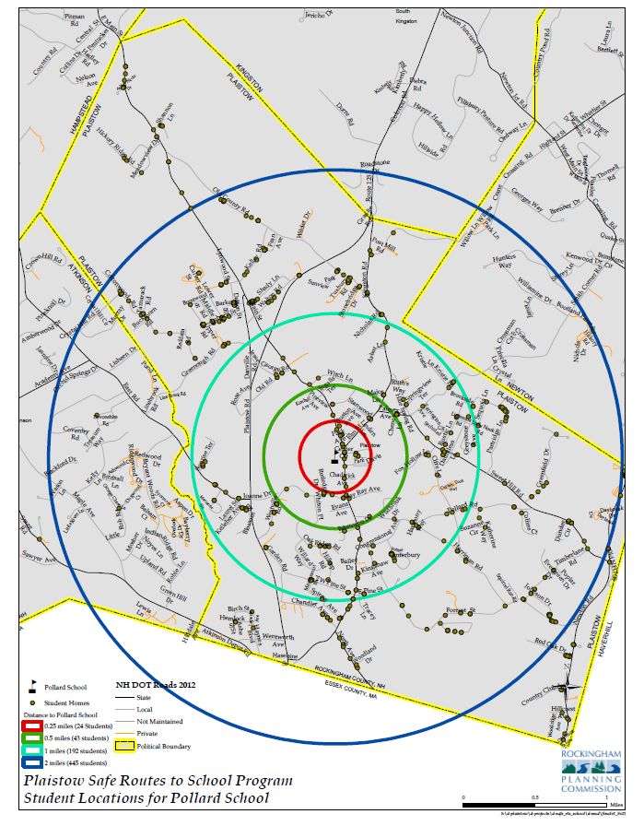

Pollard School
Student Location Mapping

Slide 7
Student and Parent Surveys
Surveys about walking and biking to school were completed in September 2012.

Slide 8
Student Mapping/Surveys Showed:
63% of the students live within 2 miles of the school.
37% of the students live within 1 mile of the school.
7% of the total students walk or bike to school.
In 1969, 80% of the students who lived within 1 mile of school walked or biked to school!!

Slide 9
The Surveys Also Showed:
68% of the students ride to school by bus.
25% of the students are dropped off and/or picked up by family vehicles.
The remaining 7% of the students arrive and/or depart by biking or walking.

Slide 10
Why Don’t Parents Allow Their Children to Walk or Bike to School?
Pollard School
The survey results cited SAFETY ISSUES
as the top reason!
Main Street
(Over 11,000 Vehicles Per Day)
Elm Street
( Major Intersection)
Town Hall

Slide 11
Pollard Bike/Walk to School Days

Slide 12
Non-Infrastructure Purchases Will Include:
Helmets
Wave Bicycle Racks
Bike Education & Rodeo Session by Chris Poulos, Inc.
Bike Rodeo Supplies
Crosswalk/Traffic Safety Signs
Traffic Cones
Custom Traffic Cone Signs to Place on Traffic Cones
Total Cost = $10,680

Slide 13
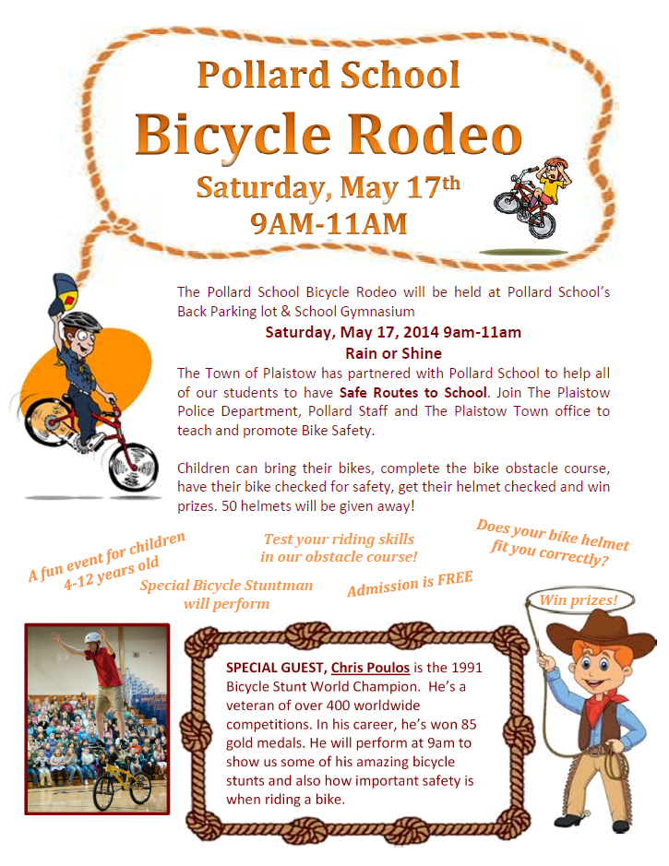
Helmet giveaway
Bike Stunt rider demonstration
Check bike and helmet
for safety
Practice and develop skills

Slide 14
Infrastructure Funds
The $238,438 of infrastructure funds will be utilized for:
Intersection Improvements
The intersection of Main and Elm Streets will be reconfigured including reshaping the existing landscaped traffic island and eliminating the paving in the now-closed slip lane. There is also a need for some additional drainage work.
Sidewalk Improvements
Sidewalk improvements will include the installation of 5’ wide asphalt sidewalks. Additionally, granite curbing will be installed where none exists today. Possible landscaped medians will further isolate the sidewalks from the roadways.
Crosswalk Improvements
Crosswalk improvements will include the installation of 2 new crosswalks.

Slide 15
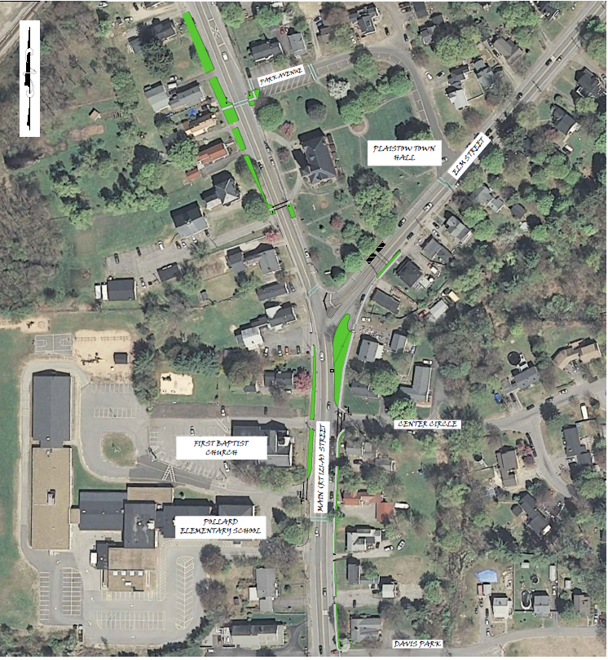
Proposed Infrastructure Improvements:
Sidewalk Improvements
Crosswalk Improvements
Intersection Improvements

Slide 16
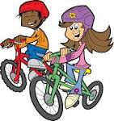
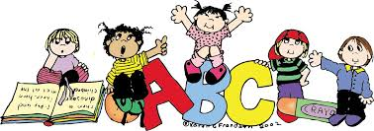
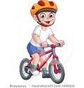

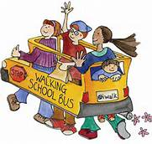
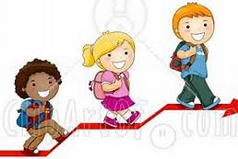
WE DID IT!!

