Slide 1

Freshman Academy Update
May 22, 2014

Slide 2
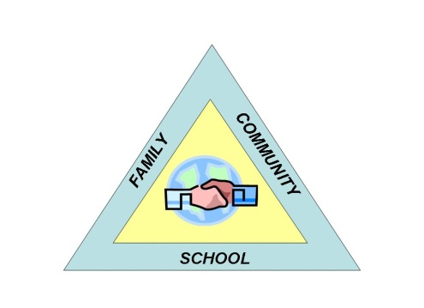
The Program Goals
Personalization
Collaboration
Communication

Slide 3

How are we accomplishing personalization?

Slide 4
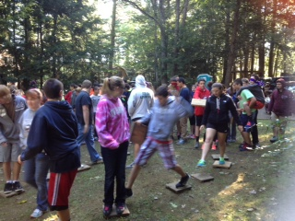
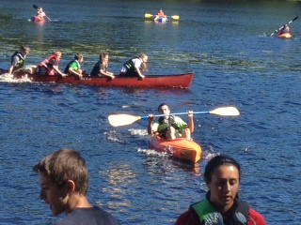
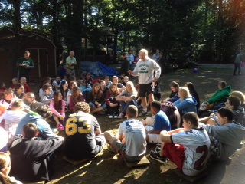
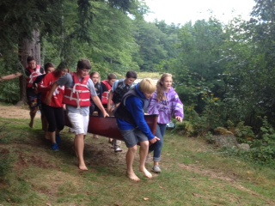
Adventurelore 9/16-19
Both students and teachers took part in team building and risk taking activities to strengthen 21st century skills such as collaboration and problem solving.

Slide 5
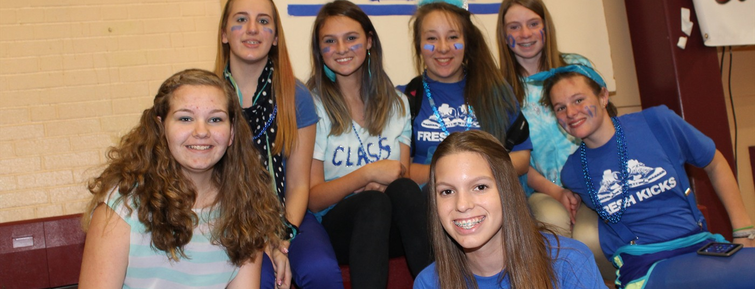
Freshman Advisory
With a revised curriculum, including two study days and a silent reading day, we have merged the academic and social education in the program. Students have taken part in Project X, in helping the school newspaper, and in preparing “come to Timberlane” PSA’s.

Slide 6
How are we encouraging collaboration?

Slide 7
Common planning time- allows for deeper discussion around students and school initiatives.
Team-wide collaboration around vocabulary instruction.
Continued focus on academy-wide study skills- utilizing advisory.
Professional camaraderie and sharing between disciplines and levels

Slide 8
How are we facilitating communication?

Slide 9
Weekly team meetings – increased inclusion of guidance and non-core teachers.
Streamlined communication to parents
Increased use of team/course websites.
Whole academy meetings each month.

Slide 10
How do we know it is working?

Slide 11
Behavioral incidents are down significantly

Slide 12
The number of students who feel a connection to an adult other than their guidance counselor has risen from 77% to 86%.
Semester 1 grade distribution has remained fairly consistent to last year.

Slide 13
What’s ahead for 14-15?

Slide 14
STAR assessment will help ensure appropriate student placement.
Revised advisory program for 14-15 school year.
Academy-wide common vocabulary chart will be finalized.
Streamlined supports for both students needing support and enrichment.
Continued focus on reading and literacy.

