Slide 1
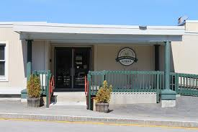
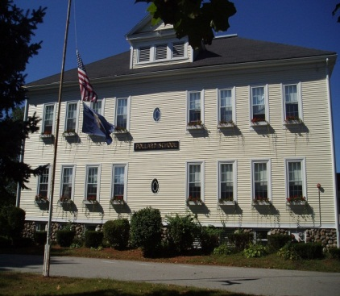
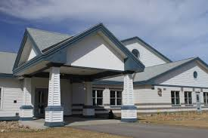
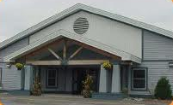
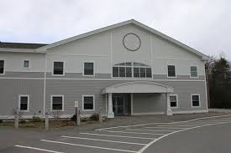
Elementary Schools’ Action Plan Review
June 5, 2014

Slide 2
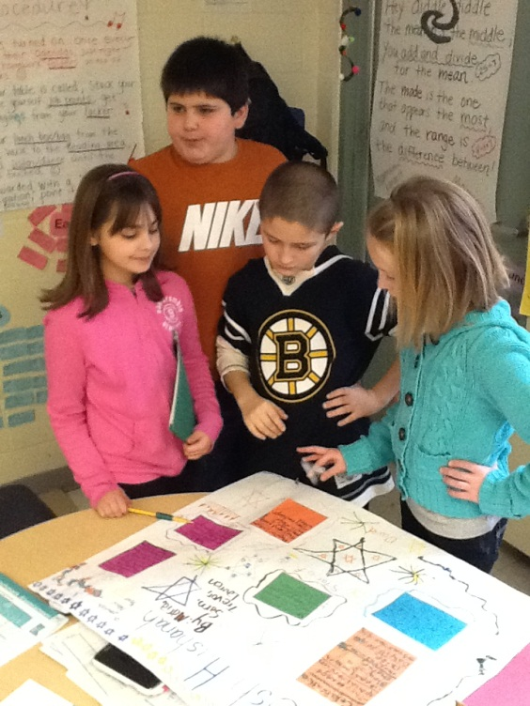
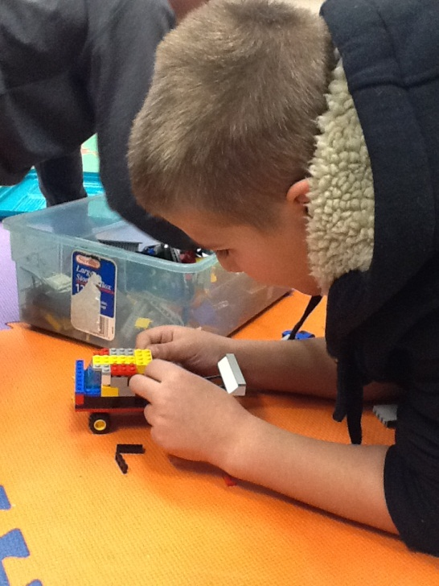
Atkinson Academy’s
Action Plan Updates

Slide 3
Goal 1: Strategic Interventions
In an effort to ensure that no more than 15% of the student population will require strategic intervention all staff will continue working to support students in all grade levels in the area of literacy and mathematics. Student progress will be monitored using end of unit benchmark assessments in both areas throughout the 2013-2014 school-year.
Notes:
Language Arts Measures: Reading Street Benchmark Assessments, DIBELS Next
Math Measures: End-of-Unit Assessments, EasyCBM (DIBELS Math)

Slide 4
Action Steps for Goal 1
Math and Language Arts Tier 2 Groups:
  Just Words
  Fundations
  Spellography
End-of-unit & benchmark assessments have been reviewed throughout the year.
Notes:
Tier 2: began in early September using data collected at the end of the previous school year RESEARCH BASED PROGRAMS
Two enrichment days have been held:
Math Enrichment Day/December 6th
Literacy Enrichment Day/May 22nd
Math/Science Club

Slide 5
Update Goal 1: Met and In Progress
Literacy Tier 2
Grade | Beginning | Middle | End | Met
K | 15% | 5% | 3% | 
1 | 23% | 9% | 9% | 
2 | 6% | 3% | 3% | 
3 | 6% | 3% | 3% | 
4 | 8% | 5% | 3% | 
5 | 6% | 9% | 8% | 
Math Tier 2
Notes:
Star Training-Summer 2014
Staff Training/Champions-Sept. 2014
Math Tier 2: We didn’t have baseline available so we will be tracking math similar to Literacy next year using the end of the year data.

Slide 6
Goal 2: Data Collection
Atkinson Academy will have a systematic data collection process in place by June 2014 that will provide teachers will accurate and reliable information from which instructional decisions can be made.

Slide 7
Action Steps for Goal 2
Staff has had initial SchoolNet Training (software platform initiated by the district to house data)
PLC (Professional Learning Communities) and Data teams have been given assessment data to review
Notes:
An assessment timeline for mathematics and language arts was provided to staff in September.
PLC conversations have been focused on assessment data throughout the year.
DIBELS Next data has been collected 3 times this year.
EasyCBM math data was collected once this spring.
NECAP scores

Slide 8
Update Goal 2: In Progress
Additional staff training in SchoolNet will occur
A data coach will be working with PLC and Data Teams

Slide 9
Goal 3: Behavior Management
Atkinson Academy will develop a systematic behavior management plan do be designed and implemented during the 2013-2014 school-year.

Slide 10
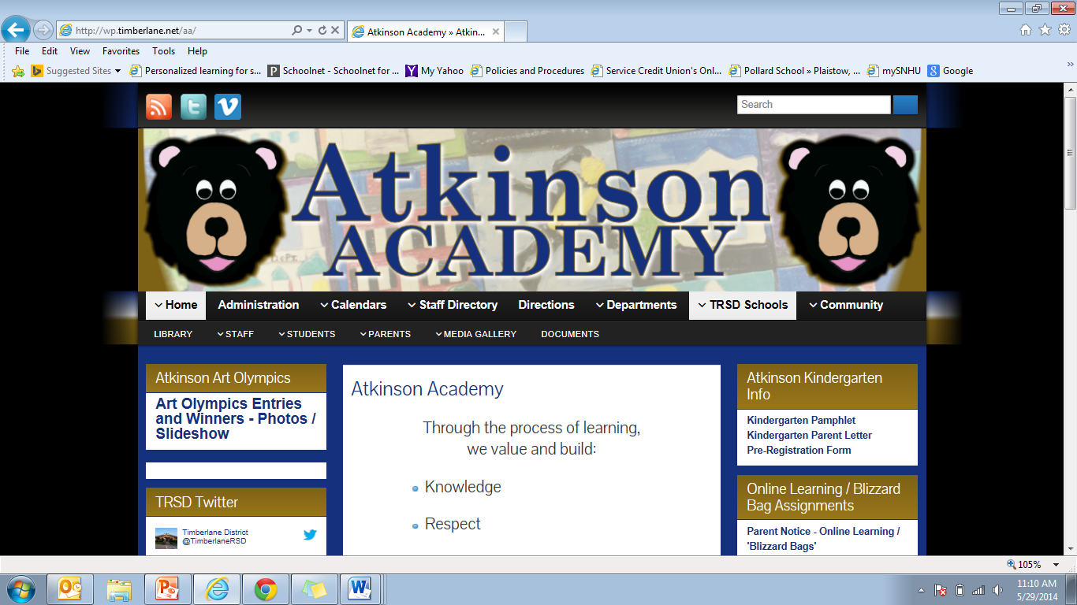
Action Steps for Goal 3
An “ABC Bear Community Team” was formed and includes a cross-section of the staff.
Data was collected on student behavior
Our PBIS consultant (Positive Behavioral Interventions and Supports) worked with the ABC Team to finalize behavior expectations.
SWIS data collection system was introduced (School-Wide Informational System)
Notes:
This team identified a school mascot and prepared three different rollouts throughout the year.
The SWIS data collection system was introduced late spring and will continue to be used in the fall 2014.

Slide 11
Update Goal 3: Met and Ongoing
Met
  The structure is in place and the tools needed to monitor behavior are in place.
Ongoing
  The team is prepared to begin collecting student behavior data in the Fall.
  Continue using SWIS behavior program.
  Continue with ongoing roll-outs.

Slide 12
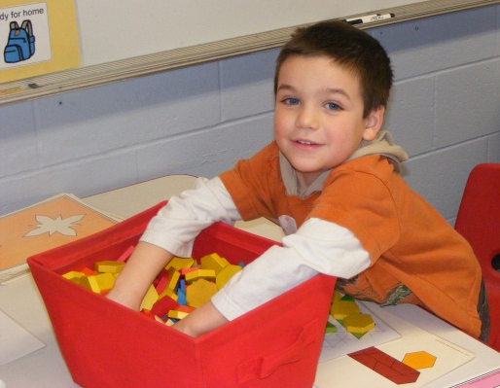
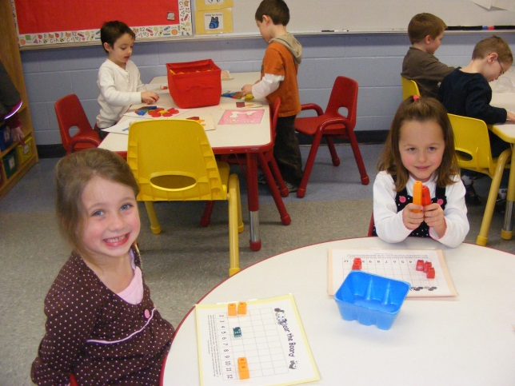
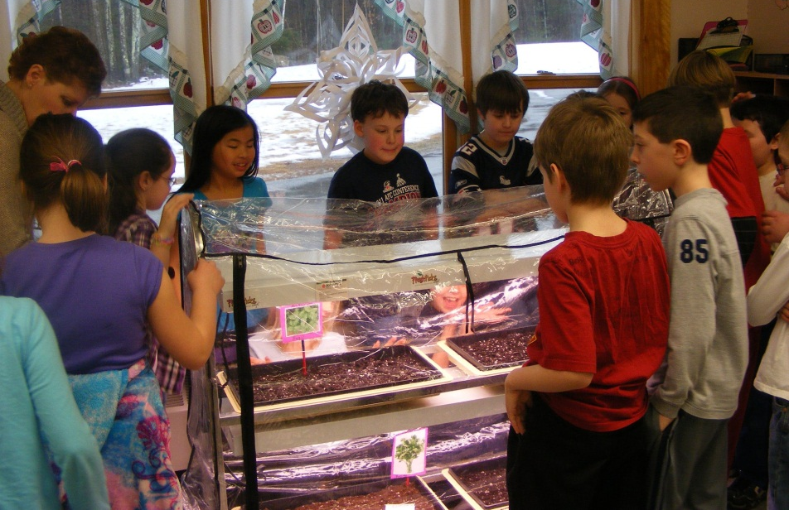
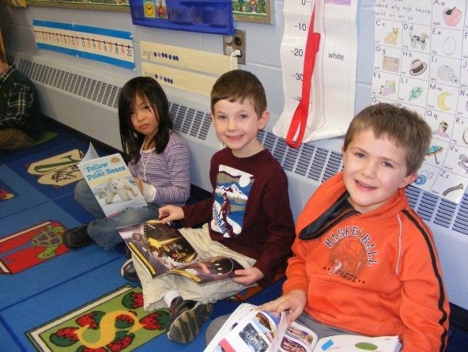
Danville School’s
Action Plan Updates

Slide 13
Goal 1: Differentiated Instruction
During the school year 2013-2014, Danville Staff will explore and develop a plan for differentiated instruction during small group instruction in reading and math to ensure no more than 15% of students participate in tier 2 instruction for remediation.

Slide 14
Action Steps for Goal 1
Weekly Professional Learning Communities (PLC) meetings membership represented from all facets of our instructional team
Weekly Target Team reviewed progress monitoring interventions
Tier 2 instruction is based on need: extension, practice, reteach
Title 1 collaborates with teachers to provide focus lessons to demonstrate application of learned skills
Researched based materials for interventions

Slide 15
Update Goal 1: In Progress
Tier 2 Numbers:
Grade | % Reading Fall | % Reading now |  | % Math Fall | % Math Now
K | 31 | 27 |  | 11 | 11
1 | 37 | 28 |  | 28 | 19
2 | 28 | 34 |  | 26 | 27
3 | 27 | 25 |  | 23 | 17
4 | 46 | 42 |  | 35 | 34
5 | 37 | 27 |  | 35 | 27

Slide 16
Goal 2: Response to Intervention
During the school year 2013-2014, Danville staff will use the data system established to make instructional decisions within our Response To Intervention (RTI) model with at least 5% gains in reading and math

Slide 17
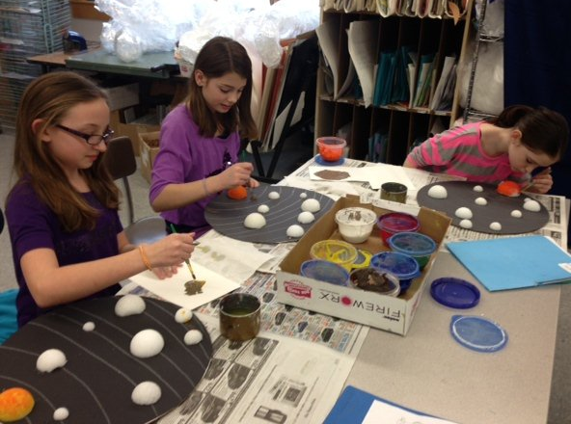
Action Steps for Goal 2
Structured school based Assessment Teams used protocols for reviewing data
Instituted Instructional scaffolding to promote deeper level of learning
Teachers understand instructional shifts of Common Core State Standards: vertical and horizontal articulation

Slide 18
Goal 3: PBIS (Positive Behavioral Interventions and Supports)
During the school year 2013-2014, the Universal Team will create clear behavioral expectations and consistent consequences by designing, facilitating, and evaluating a program of positive behavioral interventions and supports (PBIS) using collected data

Slide 19
Action Steps for Goal 3
Universal team participated in scheduled meetings to plan, teach, and assess behavioral expectations as deemed pertinent by school staff
Use Schoolwide Information Systems (SWIS) data to identify student need for behavioral interventions
Whole school assemblies to communicate behavioral expectations

Slide 20
Update Goal 3: In progress
Continue to review SWIS data to inform instruction around behavioral needs
Continue to teach behavioral expectations as needed
Review reinforcements to maintain student motivation
On-going assessment to assure effectiveness in promoting student growth

Slide 21

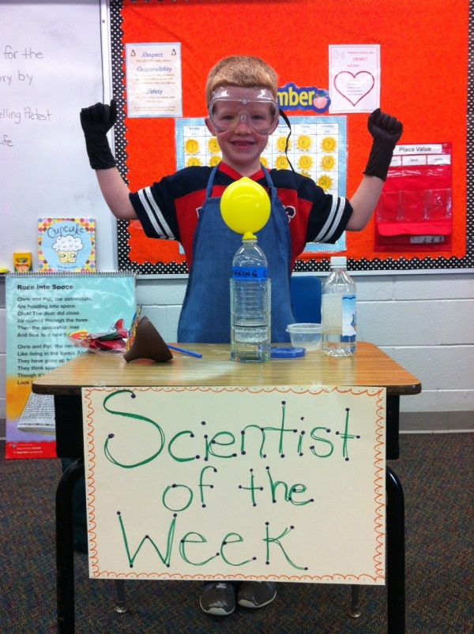
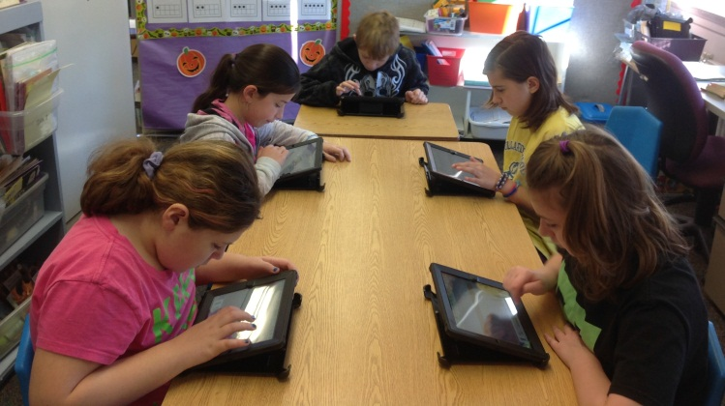
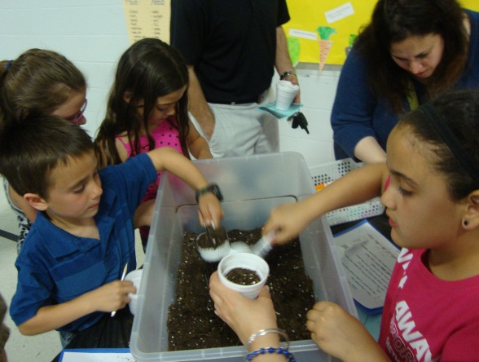
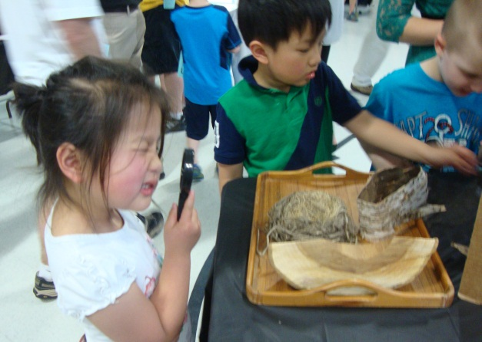
Pollard School’s
Action Plan Updates

Slide 22
Goal 1: Literacy
All students will increase acquired skills critical to literacy development by 5-8% by the end of the 2013-2014 school year as measured by pre- and post-assessments, including emergent literacy checklists for pre-kindergarten and grade level word lists for kindergarten through fifth grade.
Areas of Focus of acquired skills critical to literacy development:
  PreK/K: Emergent-Letter name-alphabetic
  Grade 1: Late emergent- Within word pattern
  Grade 2: Late letter name-Early syllable and affixes
  Grade 3: Within word pattern-Syllables and affixes
  Grade 4: Within word pattern-Syllables and affixes
  Grade 5: syllables and affixes-Derivational relations

Slide 23
Action Steps for Goal 1
A Universal Screening using Words Their Way was given to all students using grade level Words Their Way lists
Tier 2 instruction was provided to all strategic level students
Universal post-assessment administered to all students using grade level Words Their Way lists
Notes:
The Words Their Way Instructional philosophy was utilized as our main resource during Tier 2 instruction for struggling students’ grades K-five. This program improves students’ spelling, their word attack, reading fluency, vocabulary, and comprehension at the word level.
Progress Monitoring completed regularly on strategic Tier 2 students

Slide 24
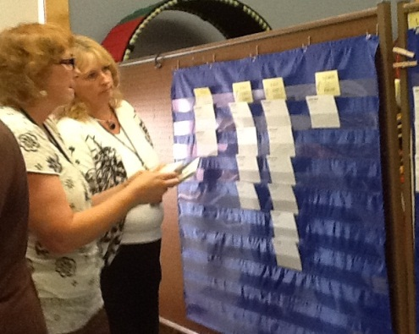
Update Goal 1: Met and in progress
Grade level | Mid-year Assessment % making SMART Goal | Post- Assessment% making SMART Goal | Met 5-8%
Kindergarten | 91% | 100% | 
Grade 1 | 92% | 100% | 
Grade 2 | 85% | 96% | 
Grade 3 | 52% | 89%
Grade 4 | 49% | 62%
Grade 5 | 46% | 83%
Notes:
Letter and Sound ID is the basis for the kindergarten data 52 letters (lower and upper case) and the sounds of the 52 letters
Words Their Way Spelling Inventories are the basis for the grades 1-5 data
Scores used for the action plan were the number of words spelled correctly (grades 1-2: 26 words and grades 3-5: 25 words)
Another way to look at the WTW data is the number of spelling features students were able to spell correctly. Scores looked at through this lense were not reported in the action plan report. They were, however, reported by teachers, discussed at PLCs, used for strategic Tier 2 programming, and discussed at A-Team. Knowledge of spelling features (short and long vowels, digraphs, blends, syllables, base words, affixes...) is the ultimate goal, but not as easily reported on as "words spelled correctly."
Our intent with WTW was to use it with our strategic Tier 2 students, with the assumption that increasing their word knowledge would lead to being more proficient readers.
Grade 4: 62% of the kids meeting the action plan goal of increasing their score at least 5% was accurate. On the spring scores, 32 (out of 83) kids did not make the 5% increase. Of these kids: 3 have an IEP with reading/writing goals, 1 receives Tier 2 instruction from classroom Tchrs, 2 receive Tier 2 instruction, 26 receive no specialized instruction outside the classroom.

Slide 25
Goal 2: Math
All Students, as indicated below, will increase mastery in the “Critical Areas of Focus” based upon the Common Core Standards for their grade level by 5-8% by the end of the 2013-14 school year as measured by pre- and post-assessments.
Critical Areas of Focus:
  PreK/K: Fluency of number sense including demonstration (objects) and ability to compare whole numbers within 20.
  Grade 1: Fluency and understanding of addition facts within 20.
  Grade 2: Fluency and understanding of subtraction facts within 20.
  Grade 3: Fluency and understanding of multiplication facts up to 100.
  Grade 4: Fluency and understanding of division facts up to 100.
  Grade 5: Fluency and understanding with addition and subtraction of fractions bullets as needed

Slide 26
Action Steps for Goal 2
Teachers at each grade level created universal pre- and post- assessment.
Teachers progress monitored struggling students
Midyear assessment was administered
Universal post-assessment of all students was completed mid-May
Notes:
Data was discussed at PLC’s and grade level teachers implement a plan using Tier 2 times based on their class/grade level data.

Slide 27
Update Goal 2: Met and in progress
Grade level | Mid-year Assessment % making SMART Goal | Post- Assessment% making SMART Goal | Met 5-8%
Kindergarten | 96% | 100% | 
Grade 1 | 99% | 100% | 
Grade 2 | 88% | 96% | 
Grade 3 | 90% | 97% | 
Grade 4 | 86% | 99% | 
Grade 5 | 95% | 95%
Grade Level | New Goal/New Assessment for those meeting 1st goal | Met 5-8%
Grade 1 | Students scoring above 80% on mid-year assessment | 69%
Notes:
Grade 5 students not making the 5-8% made 4% growth

Slide 28
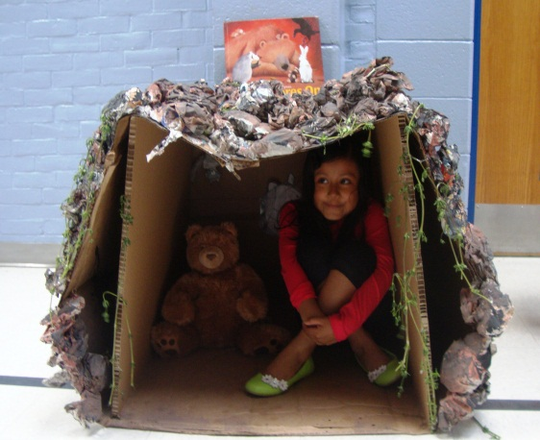
Goal 3: Science
To increase students’ scientific knowledge, critical thinking, habits of mind, vocabulary, writing and use of graphical tools by participating in a grade level scientific research based project. A grade level summative assessment will be used to measure student achievement (process and product will be measured by grade level rubrics). Grade 4 Science NECAP scores will increase of 5-8% in the proficient level in comparison to the spring 2013 results.
Grade level scientific research based project theme:
  PreK/K: The Four Seasons
  Grade 1: The Five Senses
  Grade 2: Plants
  Grade 3: Simple Machines/Motion
  Grade 4: Food Chains and Webs

Slide 29
Action Steps for Goal 3
Grade levels planned scientific research based projects utilizing science curriculum and the Tsunami research reference book during PLC times.
Enrichment Teacher and SSR teacher implemented “Light Bulb Lab”, teaching the scientific Method to each classroom K-5
4th grade completed practice NECAP tests (March-”I Do” and April “We Do”)
Notes:
Purchased “Navigating the Information Tsunami: Engaging Research Projects that meet the Common Core State Standards” for all staff to assist with the creation of their scientific research based projects

Slide 30
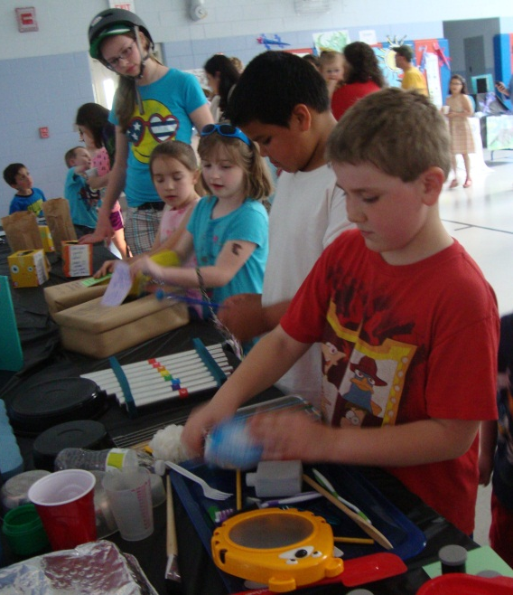
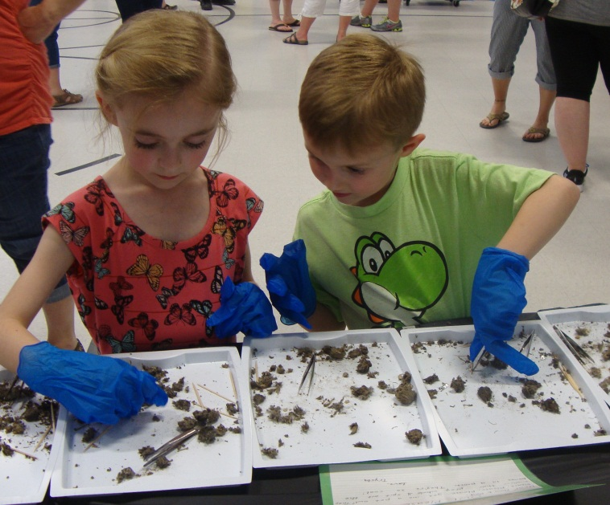
Update Goal 3: Met and In Progress
Pollard Night at The Museum was a HUGE success!
  Awaiting Gr 4 Science NECAP results

Slide 31
Goal 4: Climate
To improve the learning environment and culture of Pollard School, all community members will model our core values and expectations during the 2013-14 school year.
This will be measured by:
  Reviewing student behavior referral forms documented with the School Wide Informational System (SWIS) program
  Pre- and post- staff climate surveys. (Pollard has baseline data from the staff climate surveys taken in the fall and spring of the 2012-13 school year.)

Slide 32
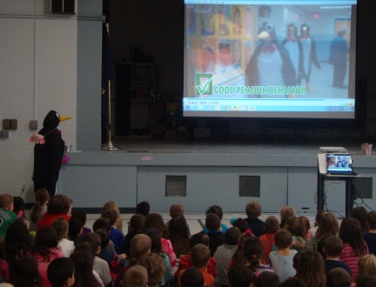
Action Steps for Goal 4
Staff made changes or modifications to Behavior matrix and Behavior Form.
SWIS program for k-5 Instituted (School Wide Information System)
SWIS Data Reports at Universal Team and Staff meetings
Rollouts and celebrations attached to the K-5 “Pollard School has HEART” & “Bucket Filling” themes. (Hallway online)
Notes:
August PD day and a follow-up questionnaire to determine changes or modifications to Behavior matric and Behavior Form.
Informed staff of current behavior procedures and notes based upon a staff feedback. Our School Values, Vision, Mission statement were also discussed.
The Building level Sunshine/Wellness Committee will administered end of year staff survey (similar to 2013’s)
4 Professional staff members trained in Social Thinking
3 Staff Book groups have been completed
Staff Golden Goose is awarded monthly
Staff Literature Luncheons (3)

Slide 33
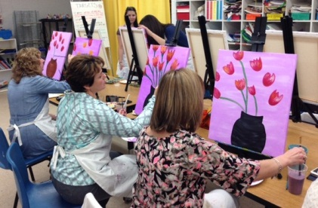
Update Goal 4:
Staff Culture- Met
Culture Indicators | 2013 | 2014
Co-workers display a positive attitude | 74% | 89%
There is a positive feeling of community | 79% | 90%
Gratitude and appreciation are regularly expressed | 82% | 90%
I am satisfied with the amount of support I receive | 82% | 85%
The volume of work I have keeps me from being successful | 57% disagree | 83% disagree
*Data taken from Pollard Climate Survey for 2013 and 2014

Slide 34
Update Goal 4:
Student Behavior Using SWIS Data -In Progress
Continue to review SWIS data
Continue to Roll-out behavioral expectations as determined by SWIS data
Infuse Social Thinking and Zones of Regulation language into all grade level classrooms
Notes:
Continue to review SWIS data to inform our instruction around behavioral needs
Infuse Social Thinking and Zones of Regulation RESEARCH BASED PROGRAM

Slide 35
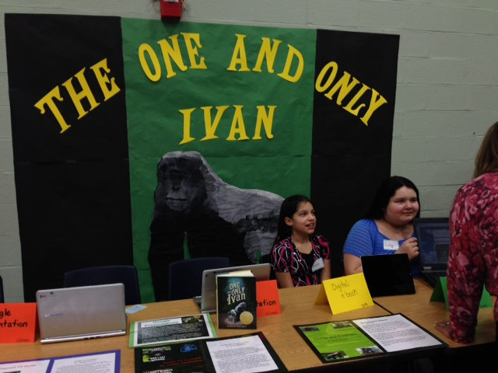
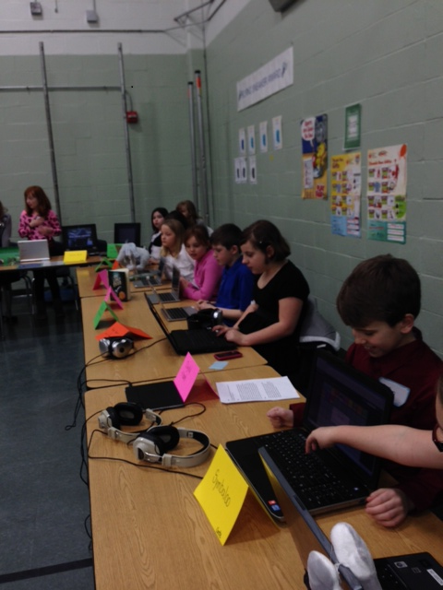
Sandown Central’s
Action Plan Updates

Slide 36

Goal 1
In an effort to promote a captivating learning environment, we will create stimulating units of study and lessons that are varied, integrated, creative, interactive, utilize technology, and provide relevant learning response options. Success will be measured by a 10% increase in the overall results of the next Tripod Survey.
(New Goal – May 2014)

Slide 37
Update Goal 1: In Progress
Creating a “captivating learning environment” is a newly crafted goal for Sandown Central School, and replaces our previous goal of “understanding the Common Core Standards and shifts in grade level progressions by meeting and collaborating with Sandown North”. As the district’s process to realign our curriculum became apparent via district wide committees this past year, it became obvious that the former goal was not viable.

Slide 38
Goal 2
In an effort to improve student achievement in mathematics, we will further develop, extend and refine our RTI framework, by more effectively utilizing data to plan and implement focused group instruction in mathematics. Progress will be measured by increasing the percentage of students at the proficient level on assessments by 3%.

Slide 39
Update Goal 2: Met and in progress
Step #1 Using Everyday Math end-of-unit assessments. (Met)
Step #2 Utilize common core math problems to pre and post assess in tier two to measure growth on specific skills.
(Met)
Step #3 Evaluate the process of steps 1 and 2, and make any necessary changes.
(Met)

Slide 40
Goal 3
In an effort to improve student performance, the data team will assist teachers in the creation of a system by which students are vested in monitoring their own progress. This will be measured by 3% improvement in student achievement in academics over their fourth and fifth grade years.

Slide 41
Update Goal 3: Met and in progress
Step#1 The data team has been formed and is in place. (Met)
Step#2 Our data team uses a spreadsheet which currently stores all current academic information. This data is shared with our data team, and with our PLC’s to analyze and inform all teachers on their students’ progress. (Met)
Step #3 Teachers meet and confer with students individually to set learning objectives, encourage a “growth mindset”, and develop responsibility and investment in learning. (In Progress)

Slide 42

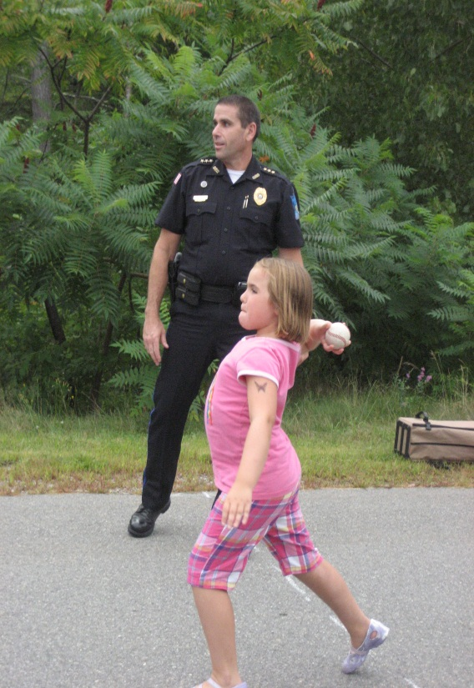
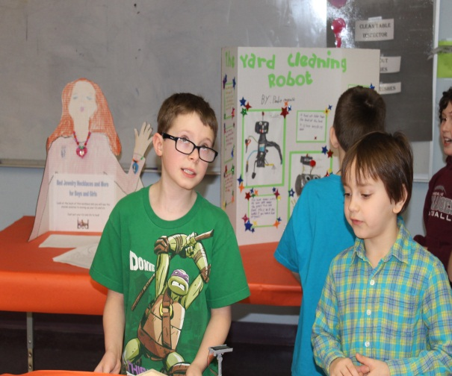
Sandown North’s
Action Plan Updates

Slide 43
Goal 1 Assess and Adapt Instructional Practices
By June 2014, the Leadership Team will implement systems to assess and adapt practices in response to data and educator feedback, as measured by a completed written data collection form.

Slide 44
Update Goal 1: Met or in progress
Met:
  Assessments (tools changing based on district initiatives)
  Benchmarks
  Data Collection Form (Academic/Behavior)
  Student Sorts
  RTI Process
  Create flexible universal schedule
  Pace instruction based on student learning
In Progress:
  Provide STAR assessment training
  Update documents to reflect STAR protocols
  Matching student learning needs to tier II interventions

Slide 45
Goal 2 Communication
By June 2014, we will have established communication norms and procedures to optimize collaboration, as measured by 80% staff consensus.

Slide 46
Update Goal 2: Met or in progress
Met:
  Establish norms of practice guidelines for communication
  PLC Notes
    Google Forms
    User Friendly Notes Template (Leadership Team)
  Outlook
    Appointments
    Data reporting documents
In Progress:
  Expand the use of the User Friendly Notes Template to PLCs and committees
  Implement norms of practice guidelines for communication

Slide 47
Goal 3
By June 2014, educators will be systematically supported in making informed decisions to accelerate student achievement by 5%. Pacing and instruction will be responsive to assessments.

Slide 48
Update Goal 3: Met or in progress
Met
  Created procedures to address academic concerns
  Developed a comprehensive list of our current assessments to establish baselines for interventions
  Designated a data review team to process data and universal trends and a reporting system back to grade level teams
In Progress
  We need to look into STAR to identify what skills are being targeted to meet Common Core Standards
  We will investigate resources to provide intervention supports for teachers
  We will recognize and share innovative and effective teaching practices

Slide 49
Goal 4
By June 2014, students will partake in daily experiences that engage multiple modes of learning, as measured by classroom visits and SWIS data.

Slide 50
Update Goal 4: Met or in progress
Met
  Identified available instructional tools and staff resources
  Provided uninterrupted instructional time for math, literacy, and interventions
  Discussed data at PLC, Leadership, Instructional and Target team meetings
  Established flexibility within the schedule for project based instruction
In Progress
  Implement working document for teachers to input and share lessons that address multiple modes of learning
  Identify and plan for professional development needs to support multimodal learning
  Identify professional development for interpreting data

