Slide 1
Kaulele Pueo flight of the owl
April, 2014

Slide 2
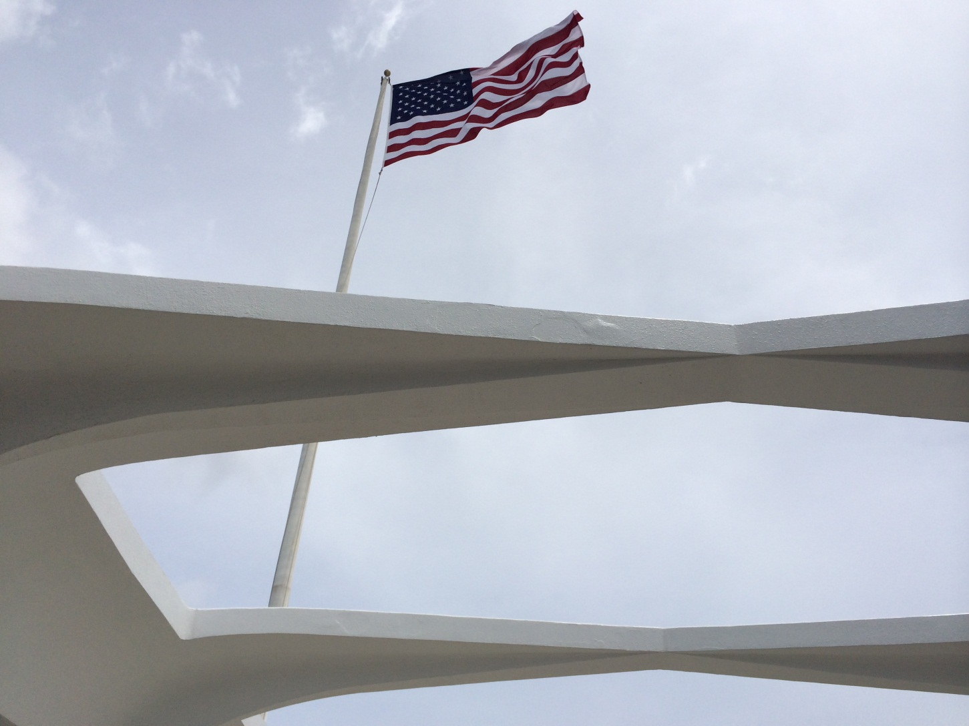
History

Slide 3
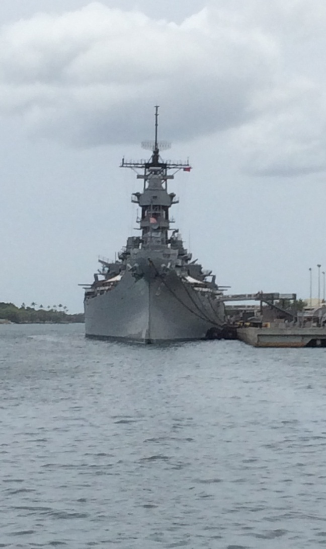
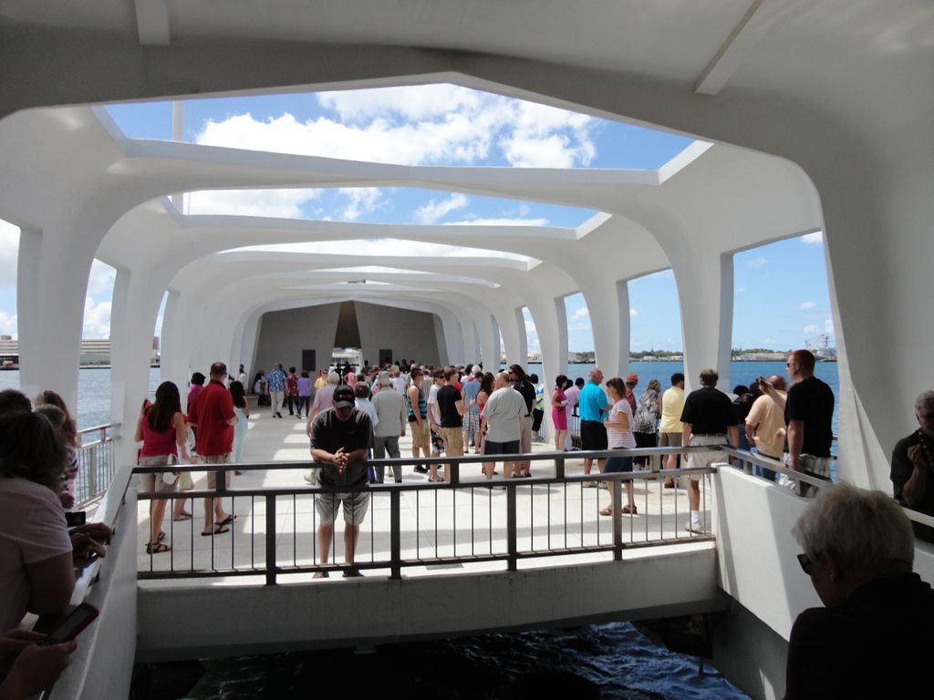
Pearl Harbor USS Missouri

Slide 4
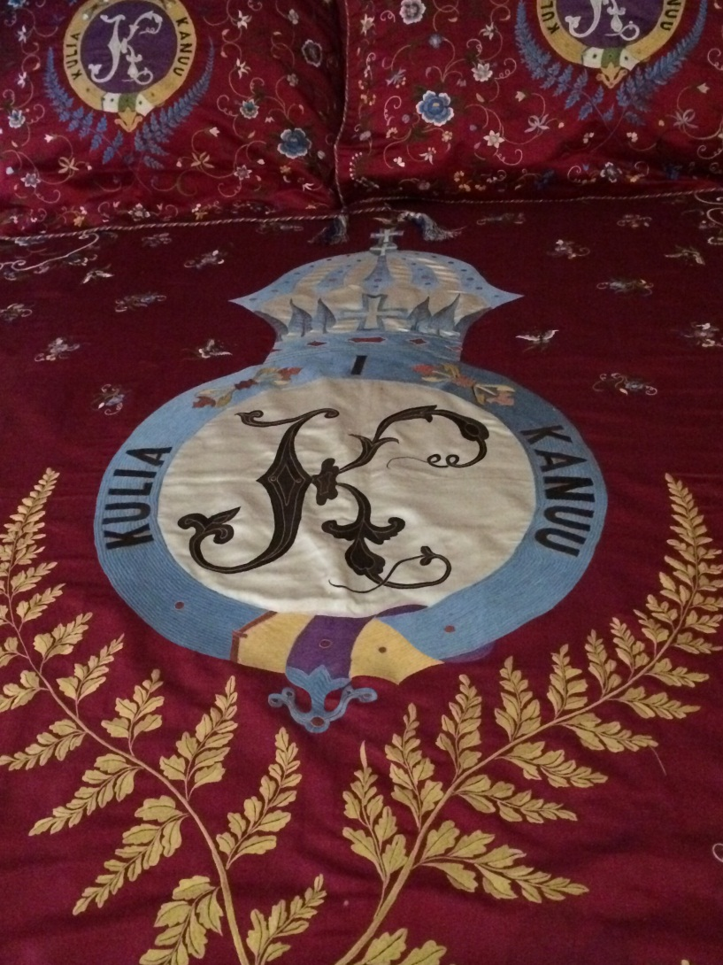
Kaiulani Palace & Bishop Museum
The only palace on US soil
Kingdom of Hawai’i
Usurping of the crown from the Kamehameha line
Bayonet treaty
Territory of Hawai’i
50th state 8/21/1959

Slide 5
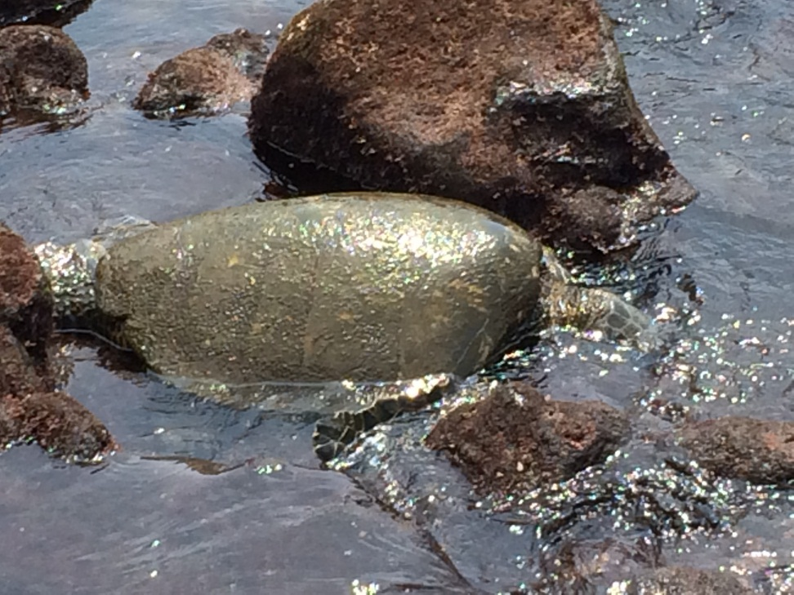
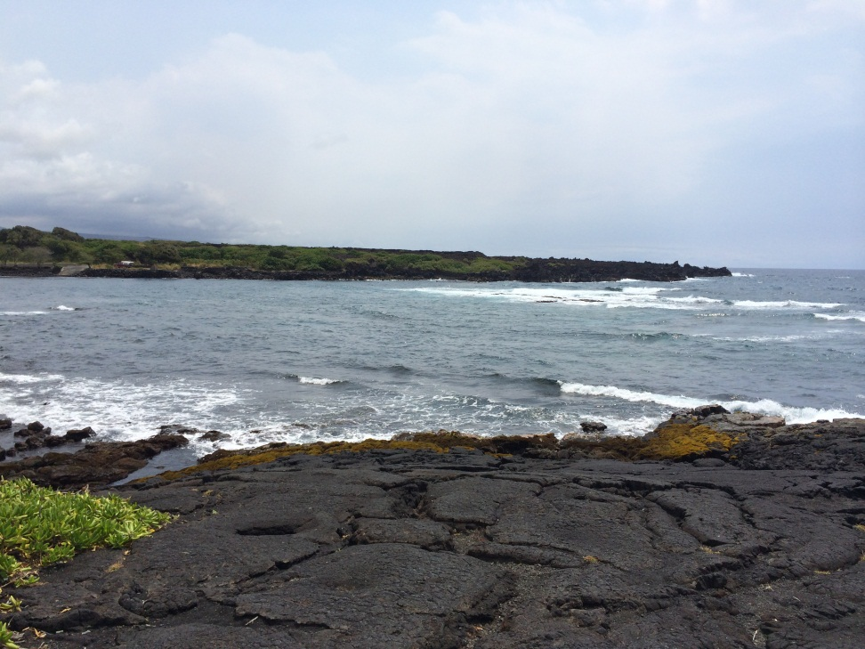
Science
Volcanic sand beach & Turtle nesting area

Slide 6
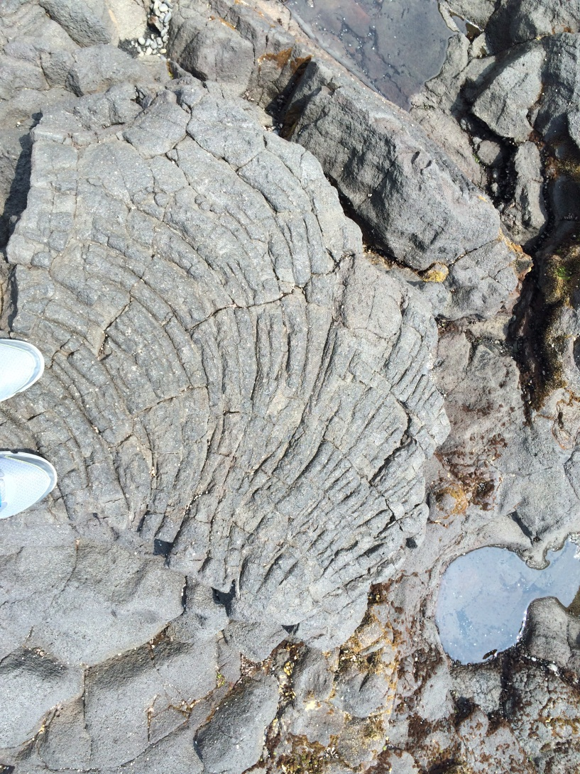
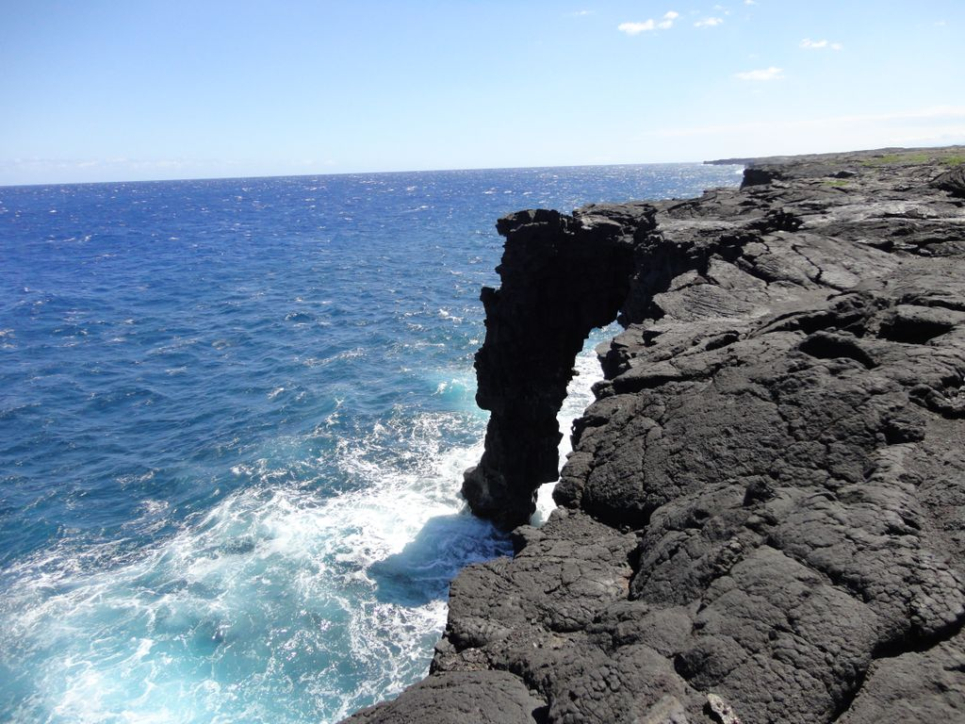
Volcano National Park

Slide 7
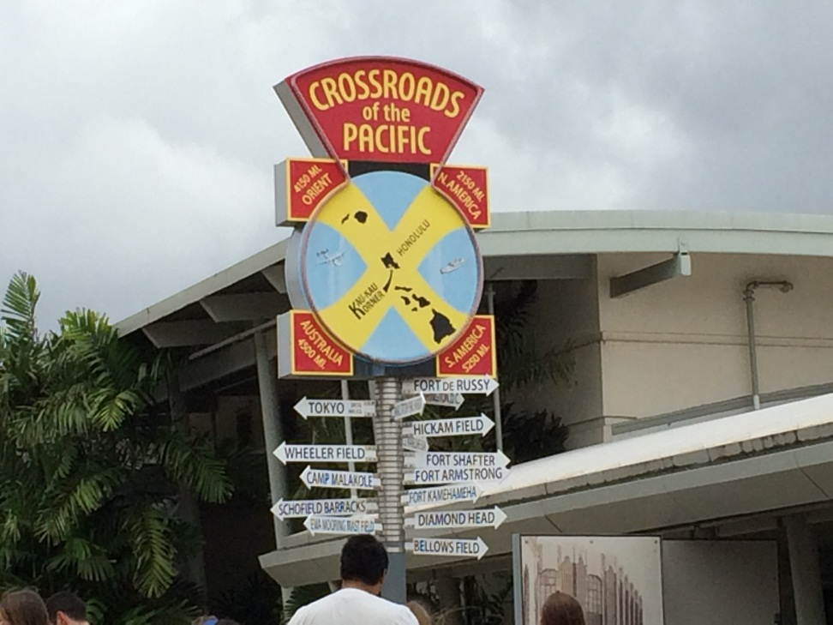
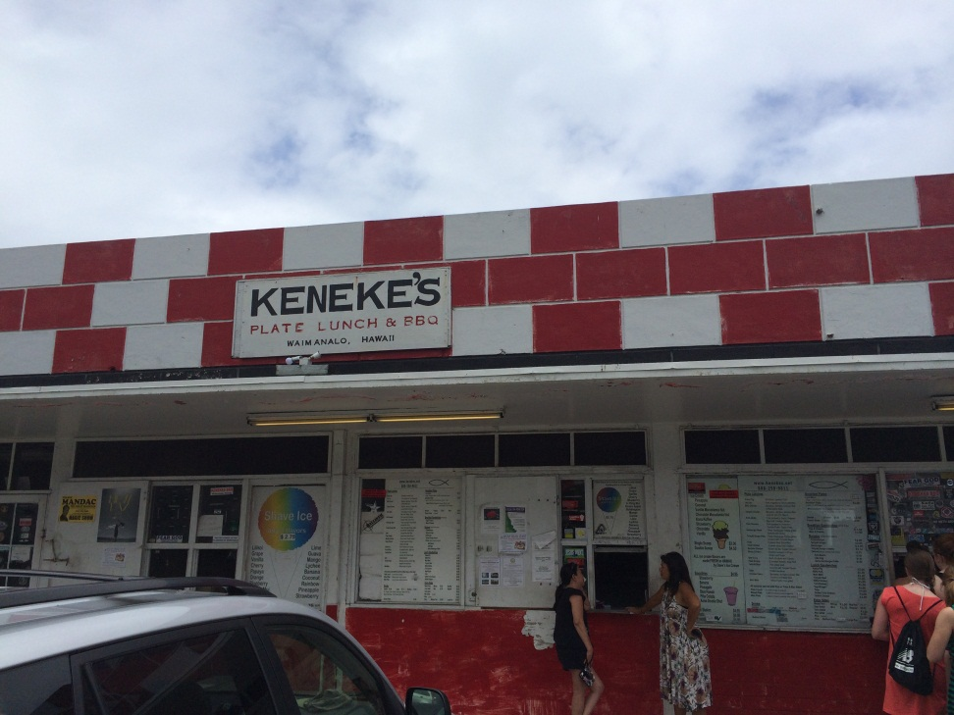
Culture
Waimea Valley –Valley of the Kings
Plate Lunch, Taro, Poi, Musabi

Slide 8
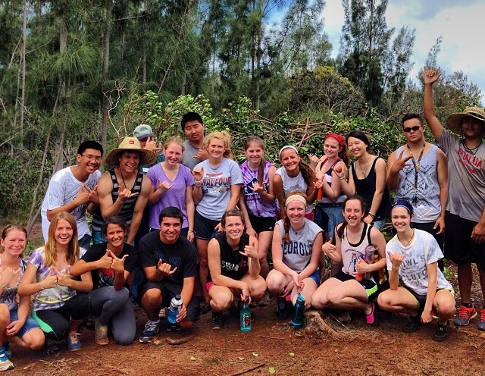
Service – Waimea Valley
Clearing invasive jungle species & replanting 50 native trees

Slide 9
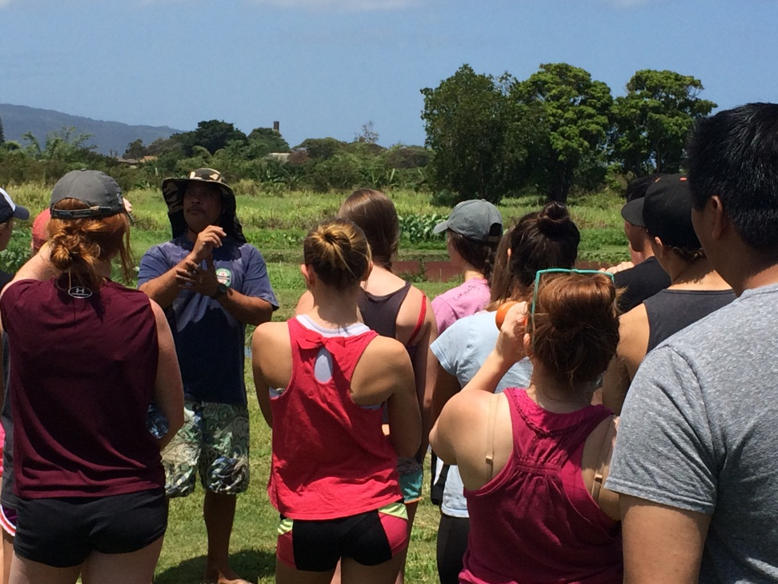
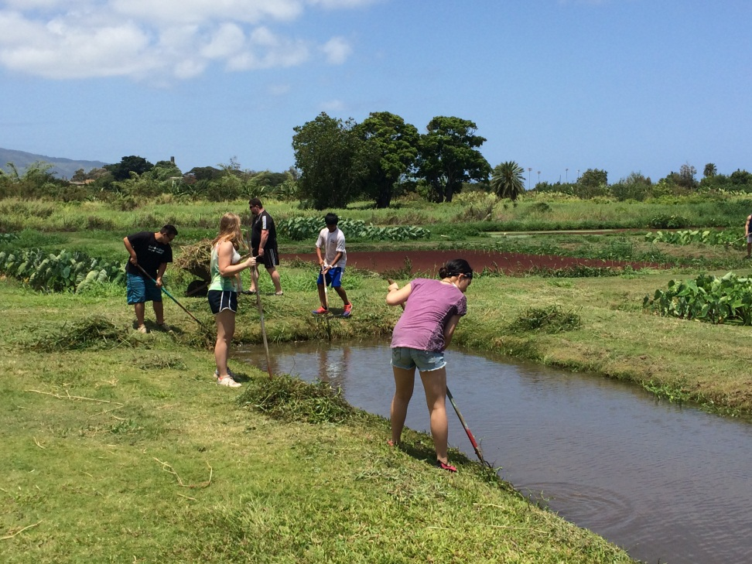
Studying, then Working in a Lo’I
Mahalo nui loa to Uncle Steve

Slide 10
New ideas to bring home…
Aloha - affection, peace, compassion and mercy, sharing the spirit of…
Mana - a form of a spiritual energy and also healing power which can exist in places, objects and persons. It is the Hawaiian belief that there is a chance to gain mana and lose mana in everything that you do. Our life-force is passed on in what we give to others, likewise, we receive others’ mana passed to us.

Slide 11
…and share with our East coast brethren
Mana’o - thoughts, ideas, knowledge, or opinions -- when making decisions together people often ask for each other's mana'o
Pono – rightousness, Goodness, uprightness, morality, moral qualities

Slide 12
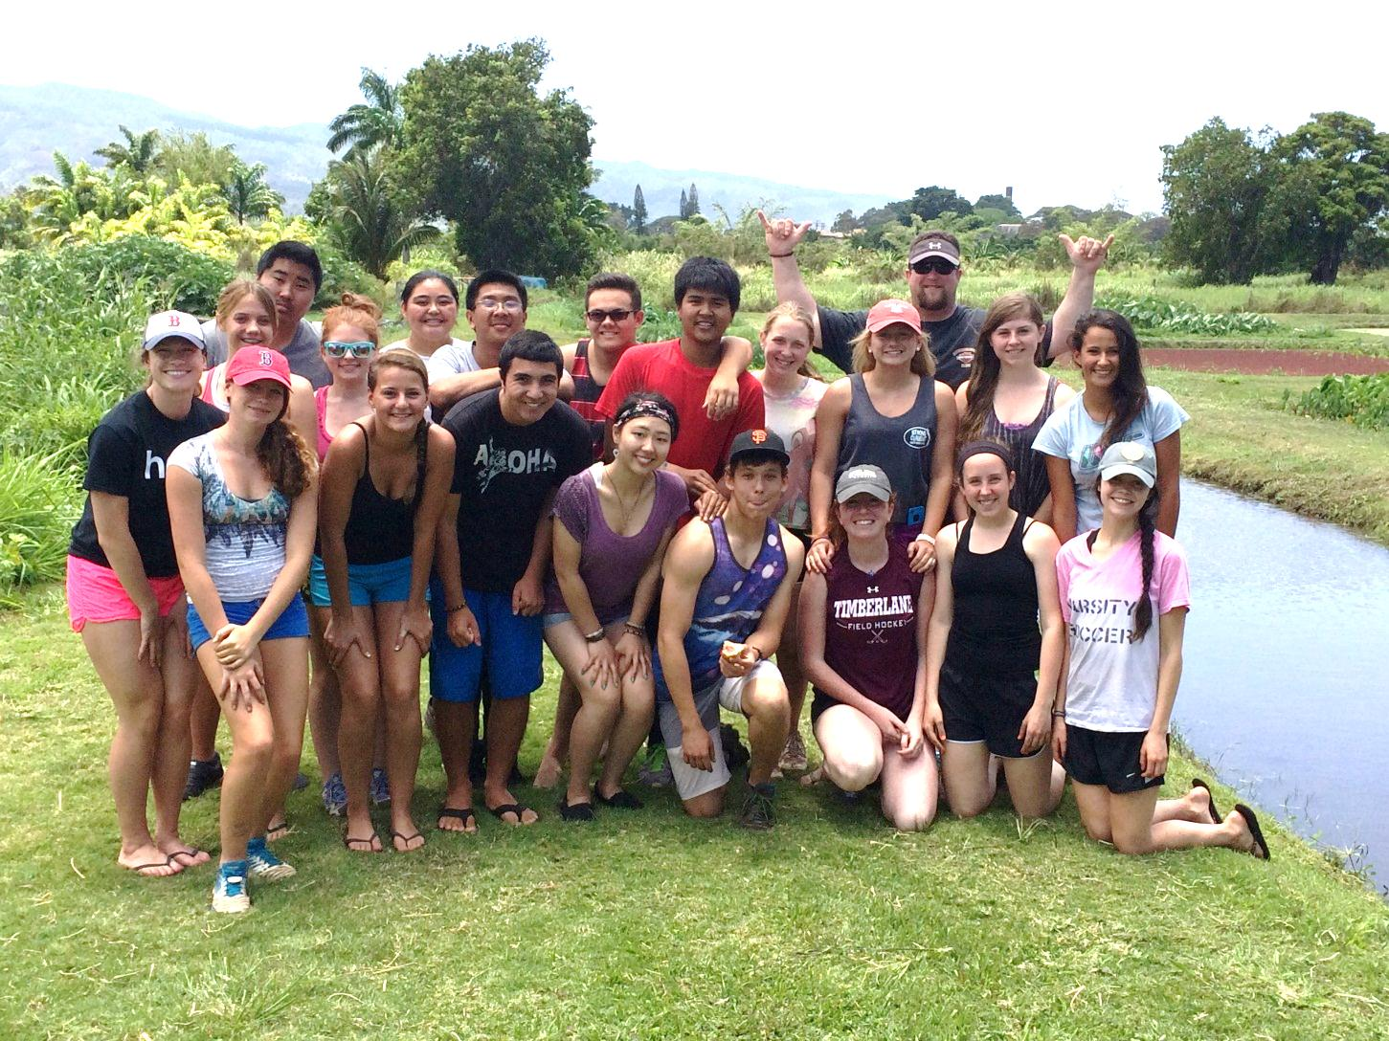
O’hana

