Slide 1
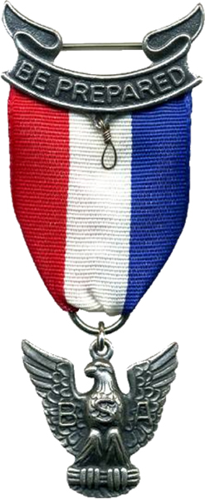
Eagle Project Results: Timberlane observatory
Nick Bealo
June 19, 2014

Slide 2
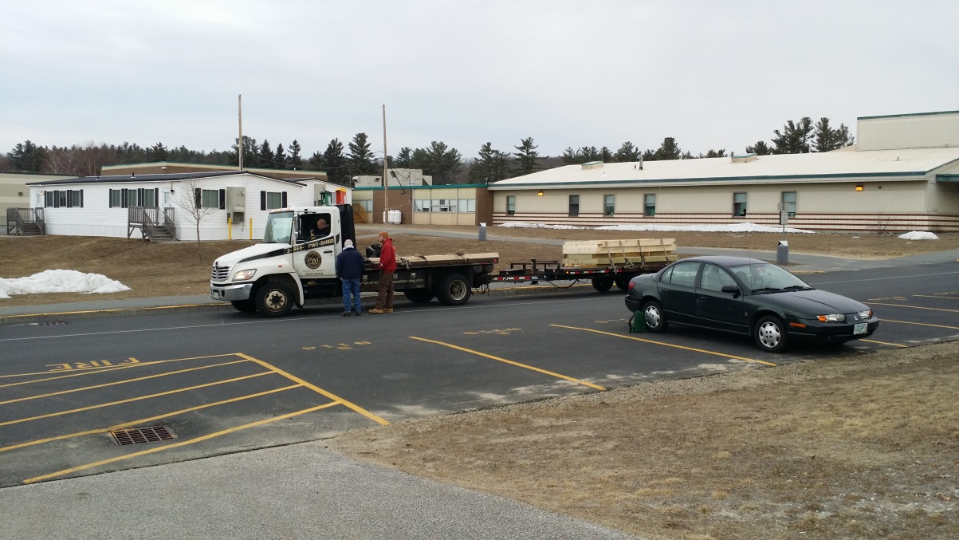
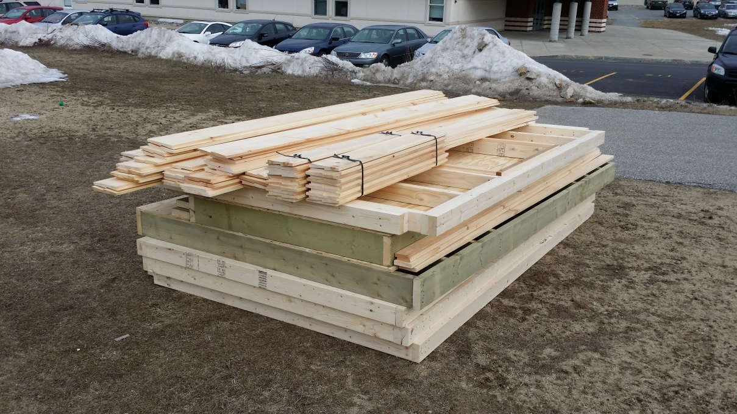
How It Started

Slide 3
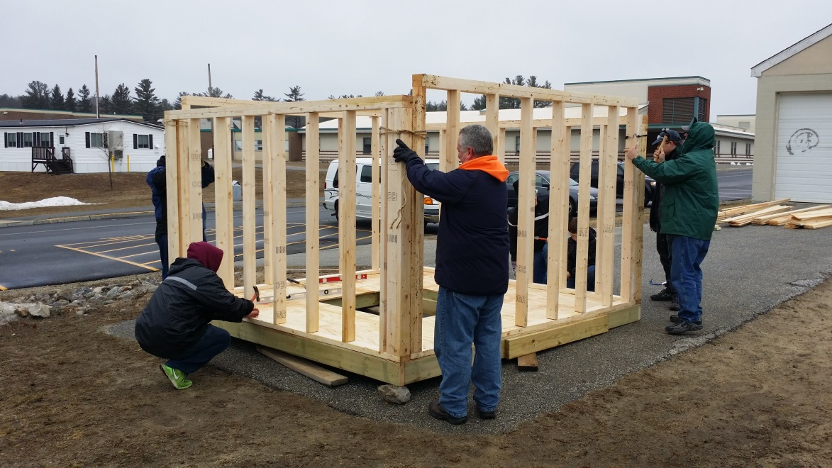
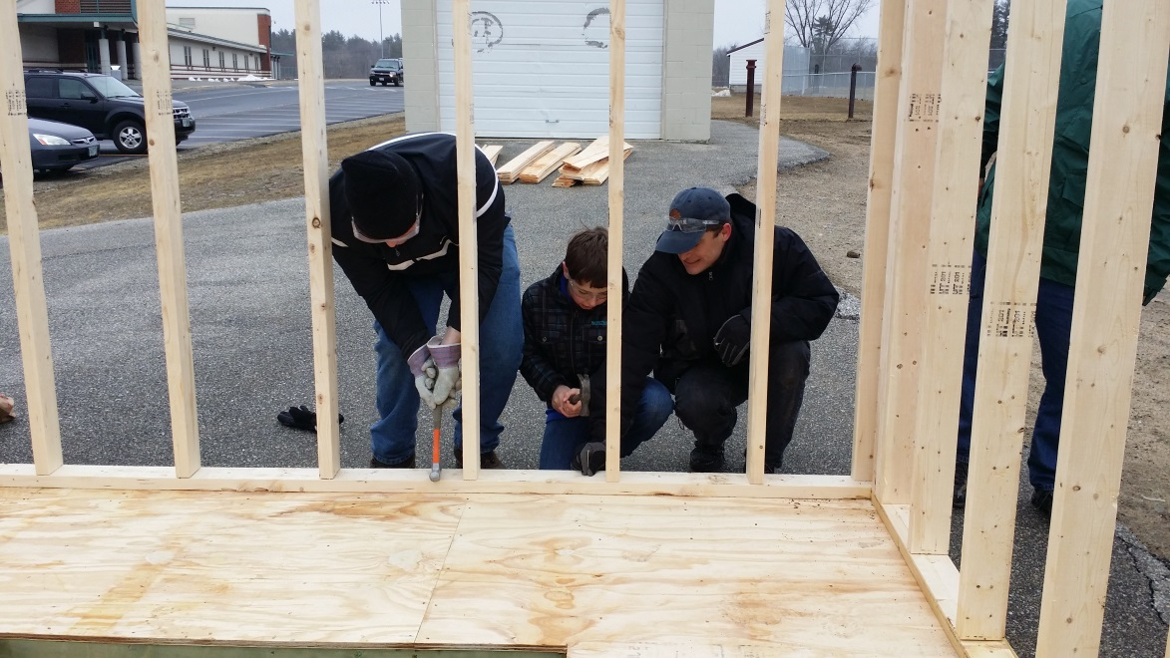
First Workparty

Slide 4
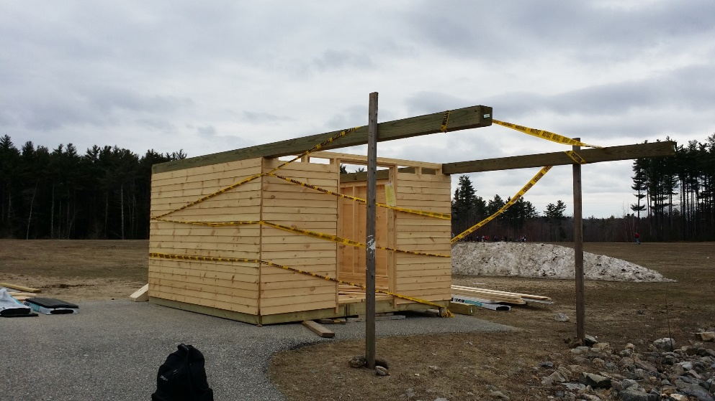
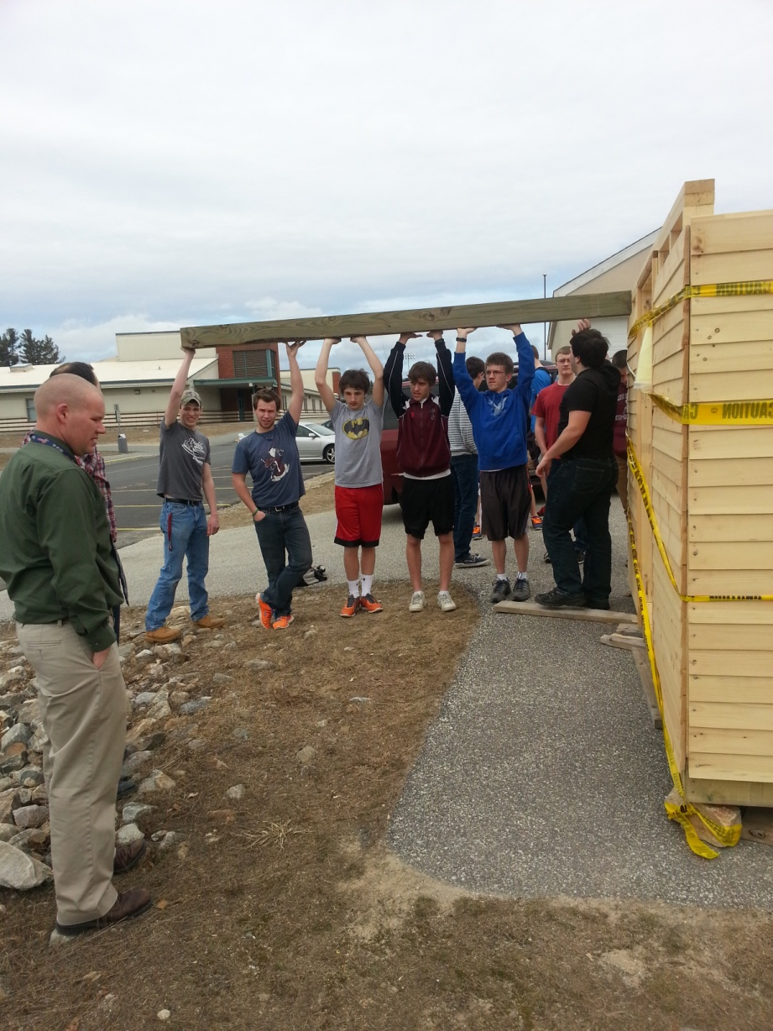
Second Workparty

Slide 5
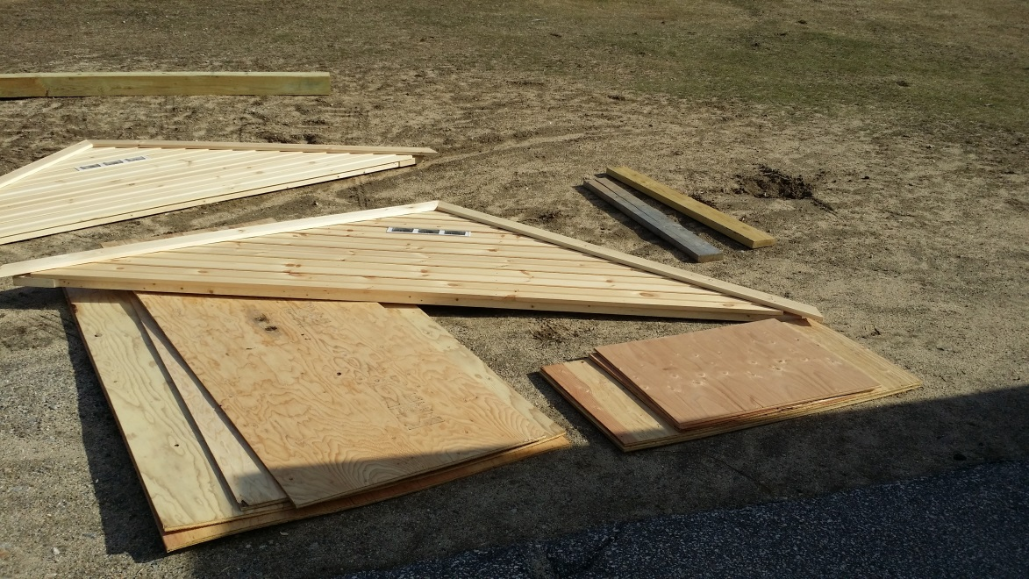
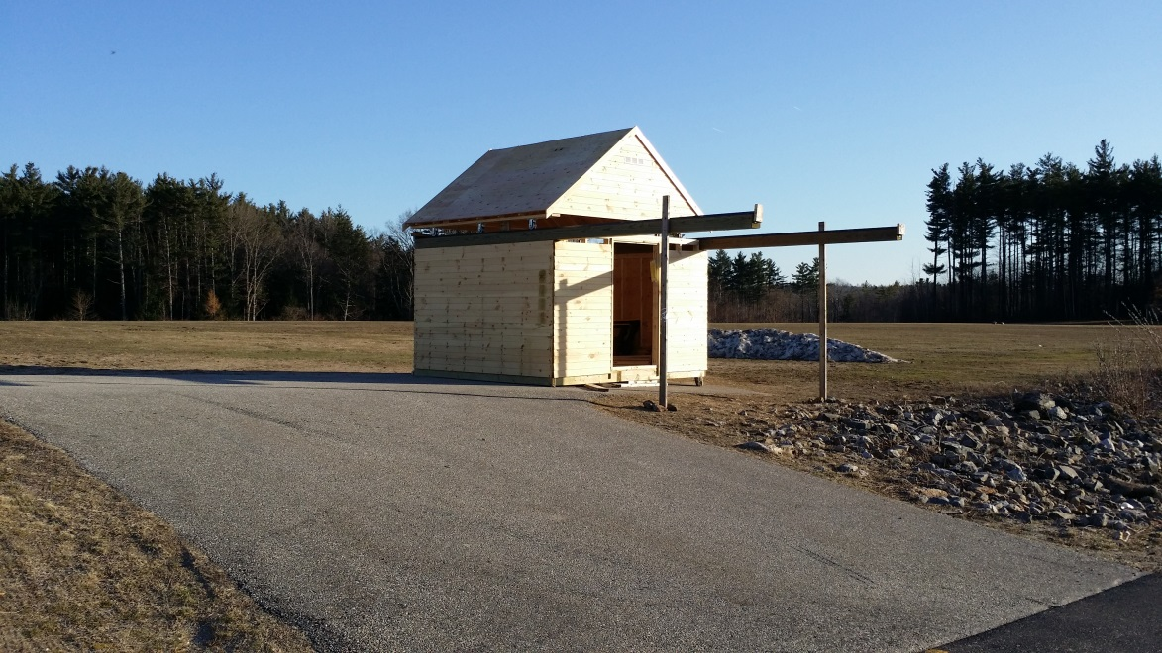
Third Workparty

Slide 6
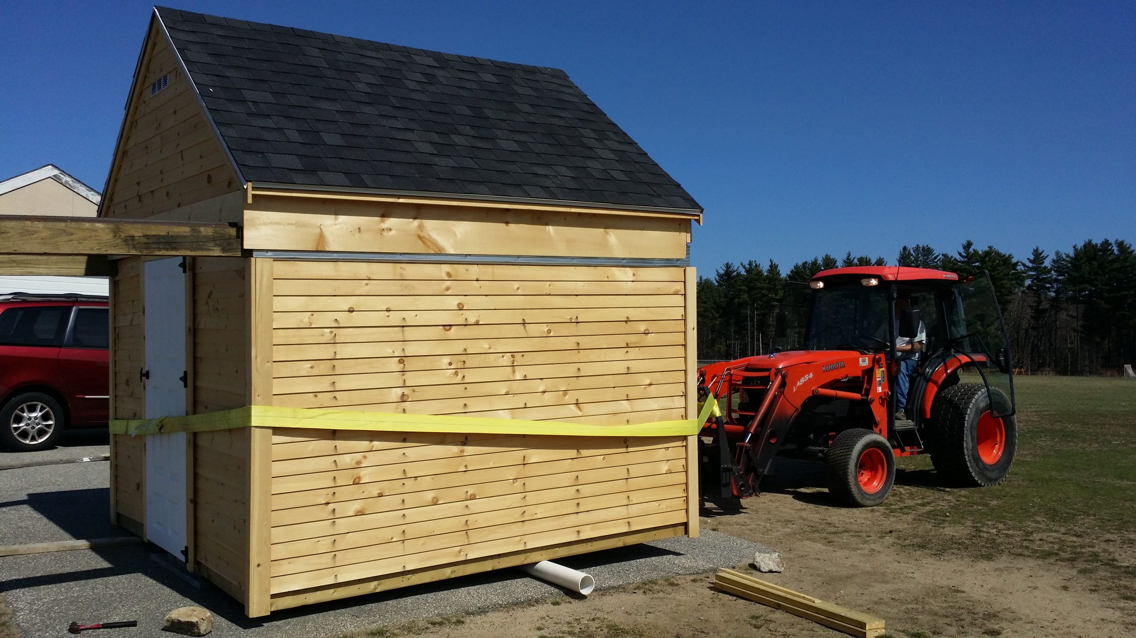
The Big Move

Slide 7
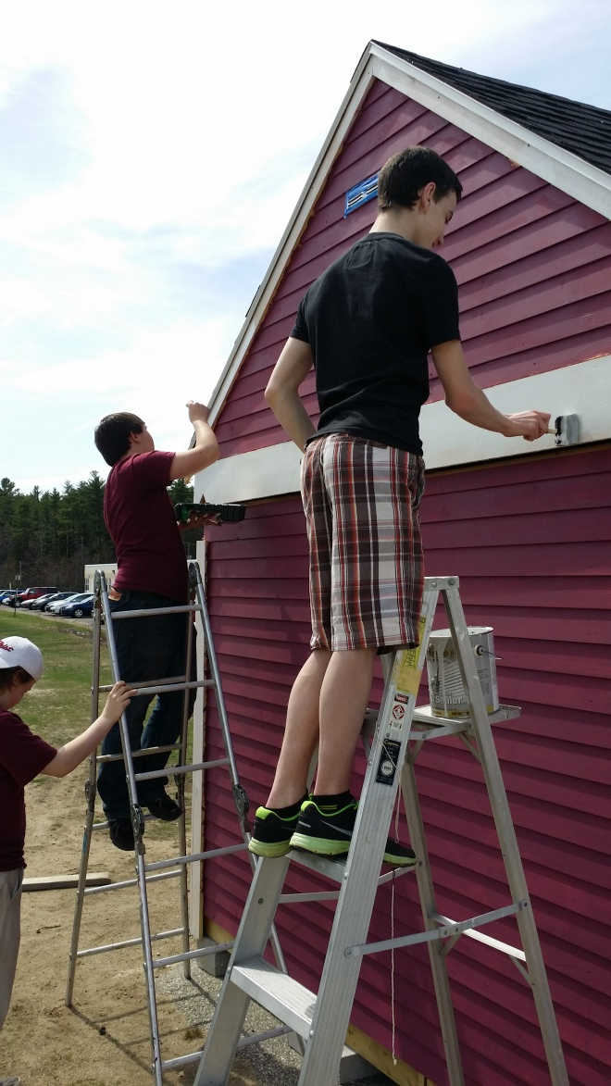
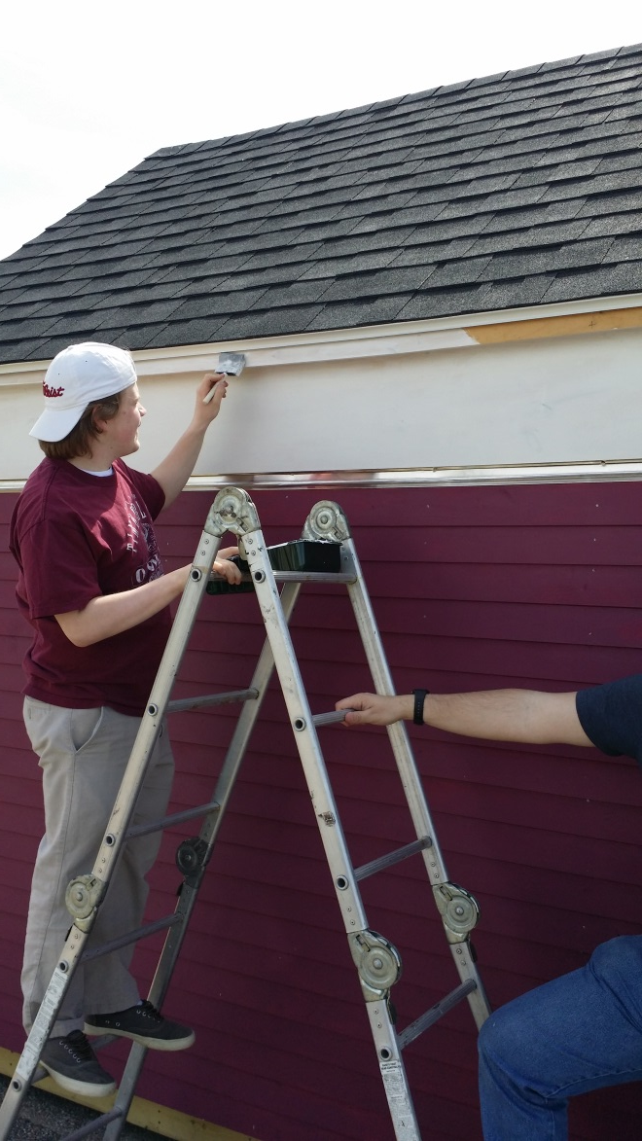
Painting

Slide 8
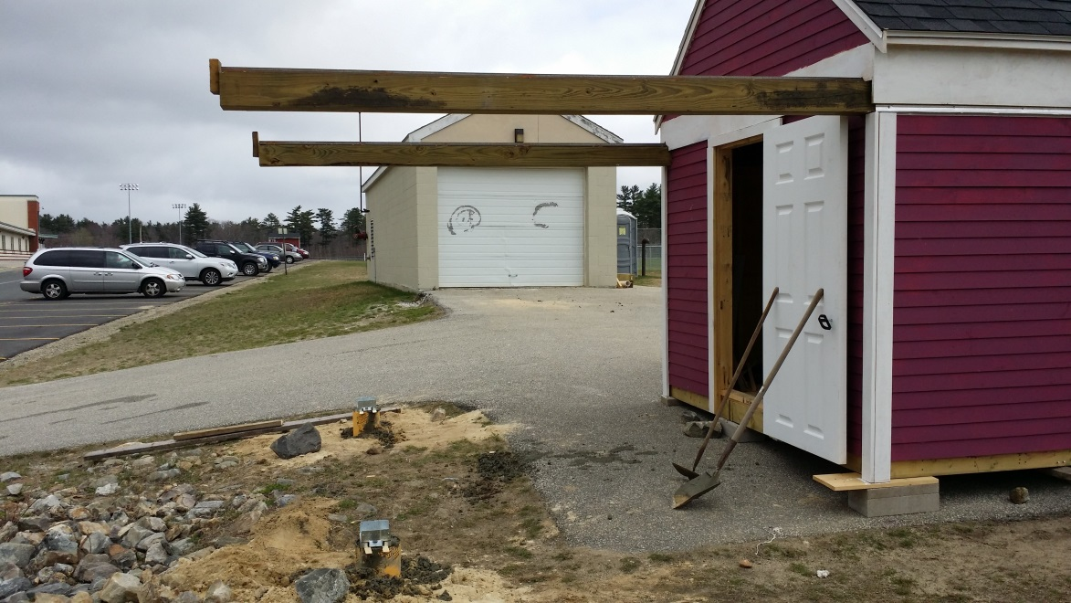
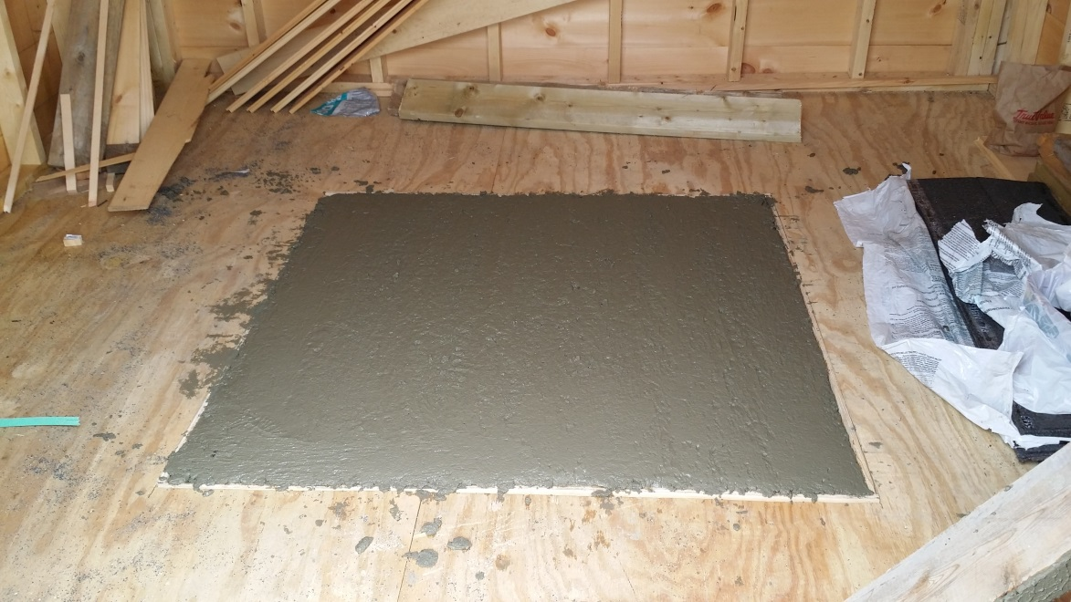
Concrete Pour

Slide 9
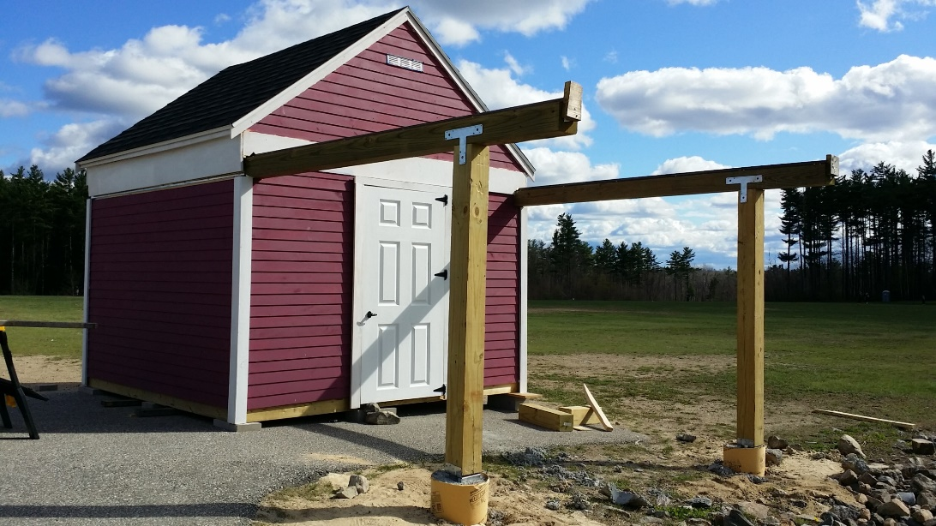
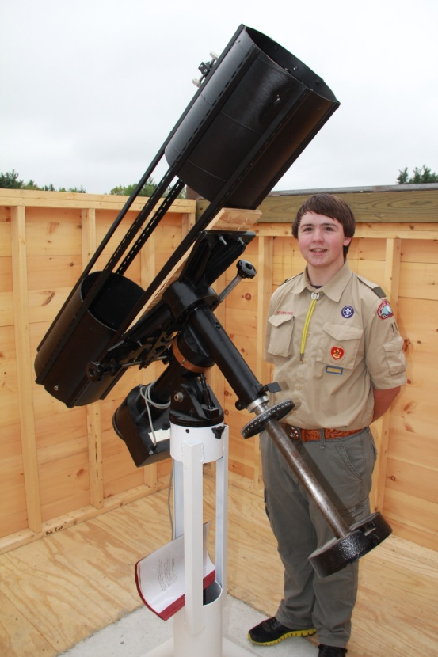
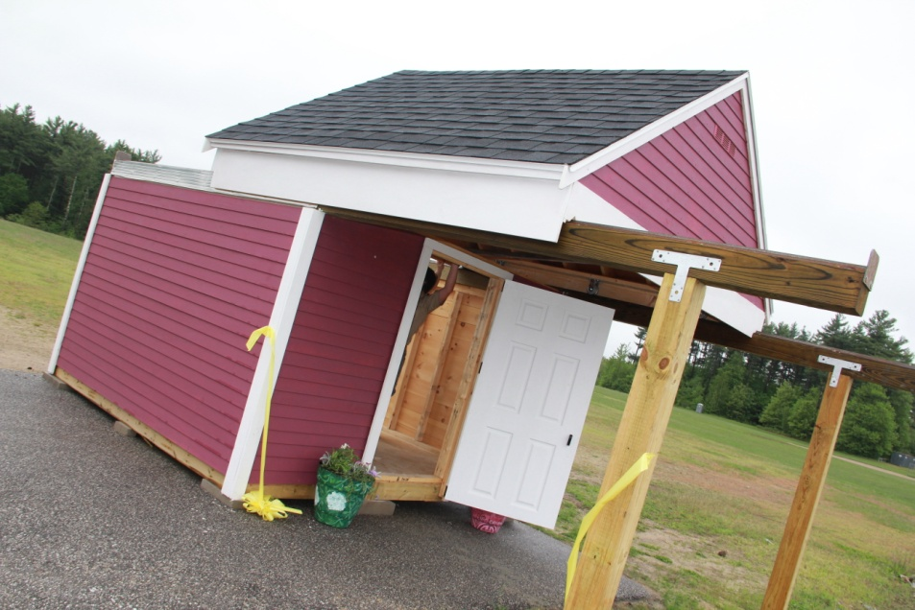
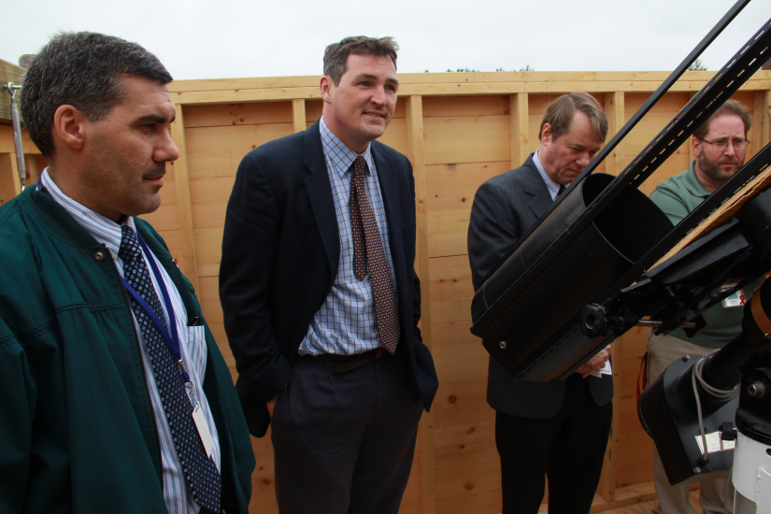
Final Product

Slide 10
Possible Uses
For-Credit Classes
  HS Physics
  HS Physical Science
  HS Space Science
  MS Science
  Elementary School Field Trips??
Adult Education Classes
  Intro to Astronomy Class
Public Outreach??
  Occasional Open Observatory Nights for students and local residents????

Slide 11
Cost
$2600 raised
  Including 3 in-district Lions Clubs, TRHS Milkmen, TRHS Teachers Fund and TRHS PTSA
Over $900 in materials and equipment donated
  Including donations from astronomy clubs in MA, NH and VT
Over 400 man hours spent
Cost to TRSD: $0

Slide 12
Final Thanks
Volunteers
  Teachers
    Mark Pedersen
    Steven Rugoletti
    Benjamin Morse
    Mark Cerniglia
  Boy Scouts
    Nick Unger
    Patrick Radford
    Devan Perelgut
    Michael Perelgut
    Avtar Dhaliwal
    Bryce Whittaker
    Nate Flyzik
    Dan Driver
    Zach Sullivan
  TRHS Community and Adults
    Matt Turner
    Jerry Dow
    Brendan Bourque
    Sam Kappler
    Tyler Brennan
    Matt Milone
    Adam Milone
    Joey Mancinelli
    Adam Milone
    Bob Couilliard
    Andrew Ahlquist
    Jim Hughes
    Mike Foster
    Riley McGun
    Madison Dicarlo
    Julia Perelgut

Slide 13
Businesses And Organizations
Timberlane Milkmen
Home Depot
Westville Supply
Post Woodworking
Plaistow Lions Club
TRHS Teachers Fund
James Holland DMD
Megastore Auto Group
TRHS PTSA
Torromeo Industries
Corey Motors
Sandown Lions Club
Amateur Telescope Makers of Boston
Springfield VT Amateur Telescope Makers
NH Astronomical Society
Atkinson Lions Club
Moynihan Lumber

