Slide 1
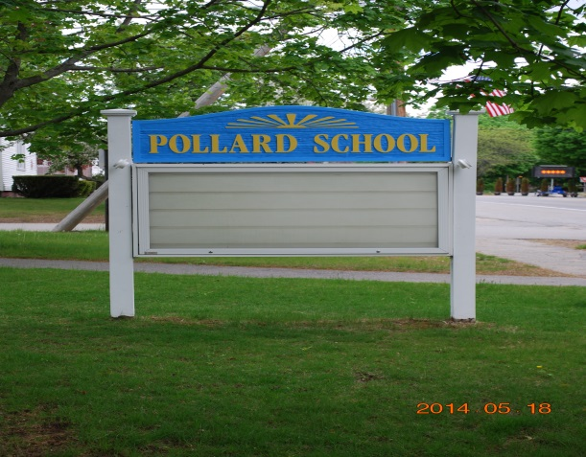
My Eagle Project
Ben Flyzik

Slide 2
My Eagle Scout Project
For my Eagle project I am going to be fixing up and restoring two baseball diamonds behind Pollard Elementary School. Both will need new home plates and new baseball clay. All dugouts will need new benches and to be cleared out. They have lots of plants and if to be used again, they will have to be removed.

Slide 3
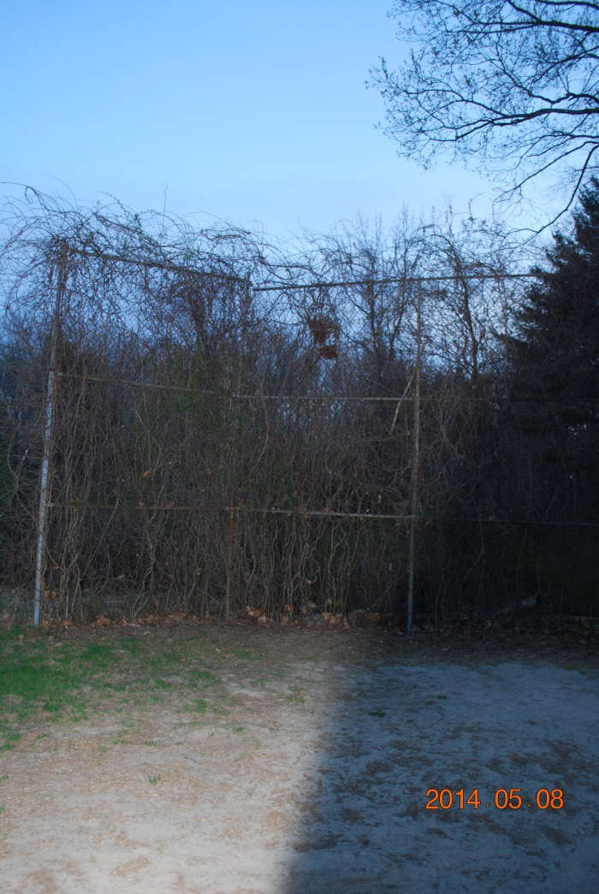
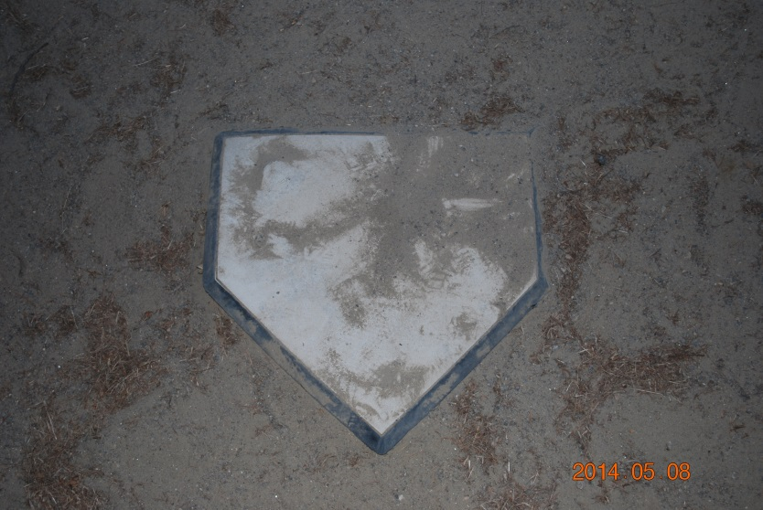
Home bases and backstop needs work.

Slide 4
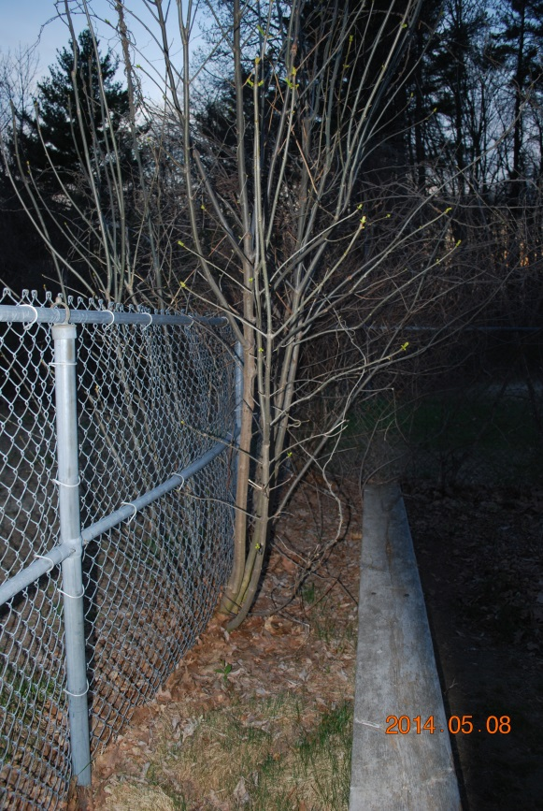
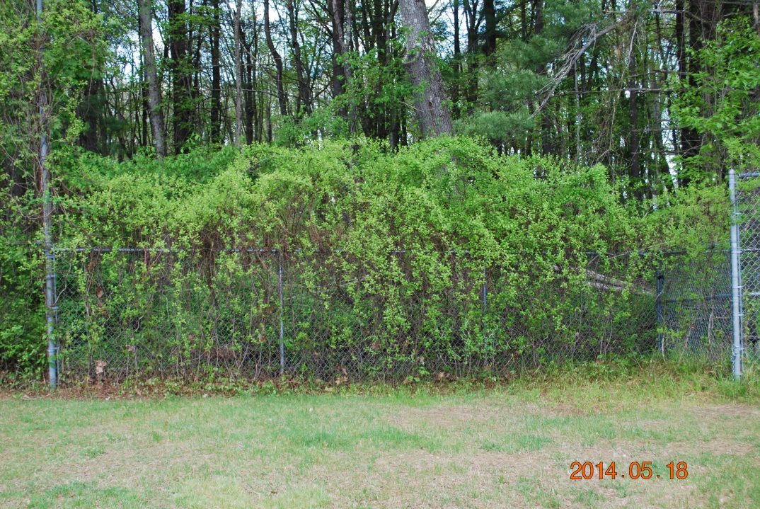
Trimming along the fences.

Slide 5
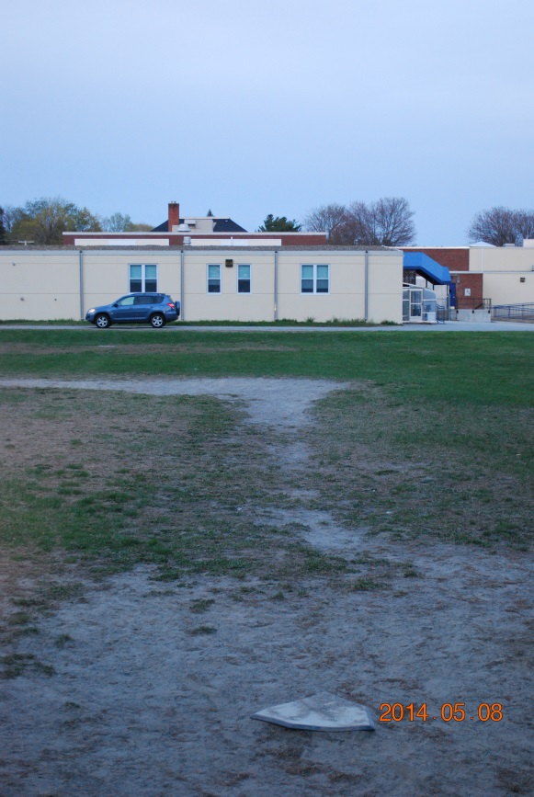
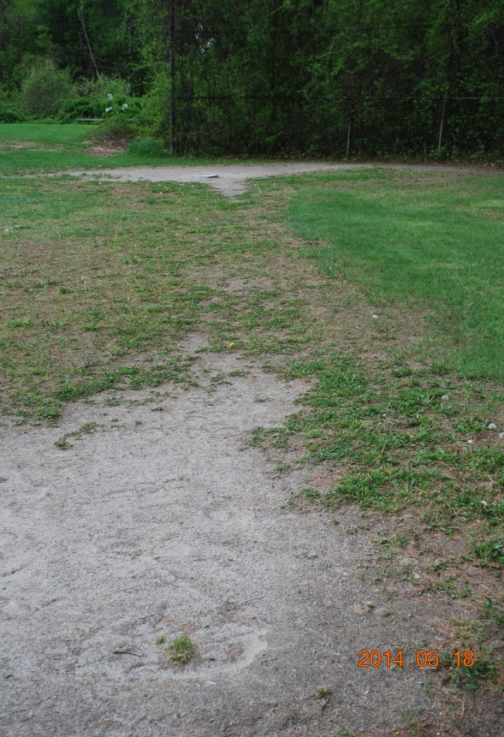
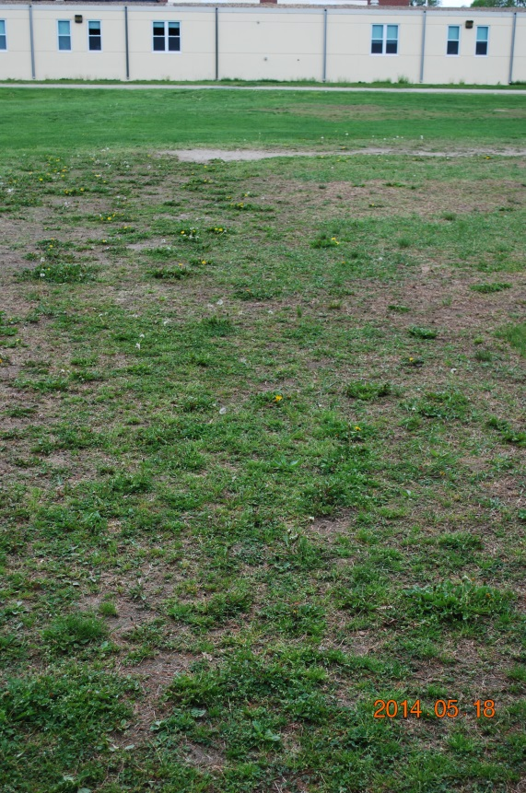
New clay for the diamond.

Slide 6
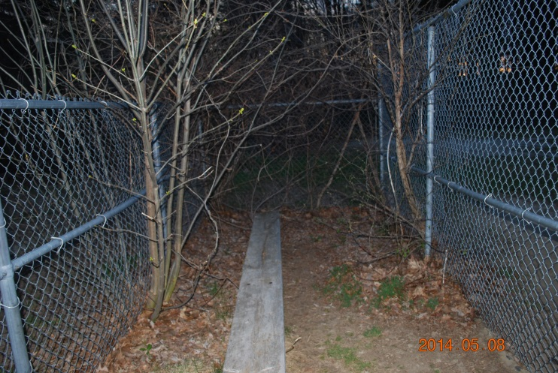
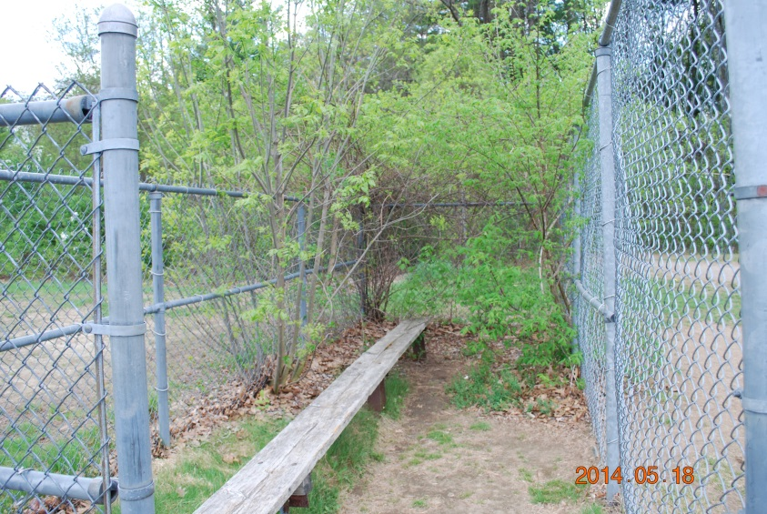
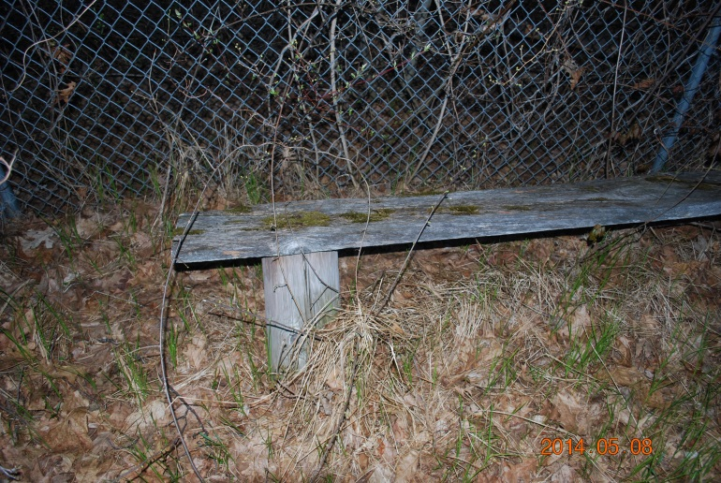
New benches.

