Slide 1

Timberlane District Action Plan
June 19, 2014
Presentation to the TRSD School Board

Slide 2

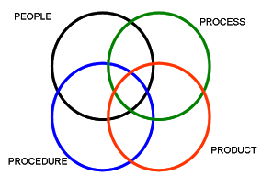
Focus on
Student Learning
and
Systems Improvement

Slide 3
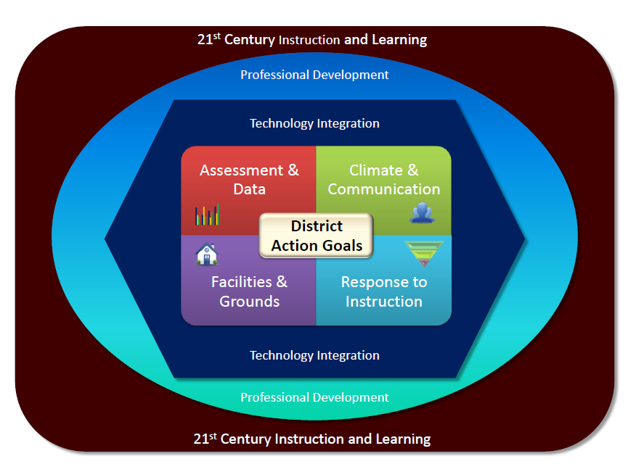

Slide 4
Timberlane District Action Plans
Started this reflective process in August 2012
Prioritized needs and divided into 4 subgroups
Developed a District Action Plan
Revised the action plan, as needed
School Action plans supported the District plan
Held Full Admin Meetings 4 times per year
Aug, Oct, January, May

Slide 5
Response to Instruction
Beth Rincon: Chair
Goal 1:
The District Framework for RTI for Literacy, Math and Behavior is written, articulated and implemented district-wide.
Progress: (ongoing)
Completed the District-wide roll out of overview of the RTI Framework
Developed the needs assessment and surveyed staff ending June 2014
In August, the administrators will look at the results by schools for additions to school action plan
Implementation plans specific to each school’s needs will be done during 2014-15

Slide 6
Response to Instruction
Goal 2
Tier II instruction is articulated and implemented in each school and measured by student progress monitoring data.
Progress: (ongoing)
Elementary chose “Fundations” as a phonemic awareness program for Tier I and Tier II strategic instruction.
Each school will need to analyze the survey and identify the Tier II interventions used for math and literacy, appropriate to their instructional program.

Slide 7
Facilities and Grounds
George Stokinger: Chair
Goal 1
Timberlane will revise the Capital Improvement Plan by Sept 2013.
Progress: (ongoing)
The scheduled School Board retreat was held on Dec 3, 2013. Revising the CIP is a School Board goal and District personnel will participate as requested.

Slide 8
Facilities and Grounds
Goal 2
Structures will be put in place to address curb appeal concerns at each school by June 2013.
Progress: (met)
Each school addressed their needs with the Director of Facilities and work orders were submitted. Security upgrades were made last year.
This is an ongoing discussion addressed each Spring, as summer project needs are examined.

Slide 9
Communication and Climate
Kathy McKechnie: Chair
Goal 1
In order to improve district-wide communications, an internal flowchart will be established to ensure the accuracy, consistency and timeliness of information to all stakeholders.
Progress: (met)
Universal template for all meeting minutes.
SharePoint established as the storage house for employee information.
Flow charts were identified
Google Drive is used as a tool for collaboration and sharing of documents.
All staff have @gapps accounts.
Google trainings and information sessions have been offered
Created a template for communication planning

Slide 10
Communication and Climate
Goal 2
In order to improve district-wide communication, a calendar system will be developed for the purpose of coordinating; annual professional development, assessment, school and district meetings, committee meetings, and school level events.
Progress: (met)
Google calendar was established as the universal district calendar.
Located on TRSD website and includes building based events.
Established a consistent format for populating the calendar.
Identified key personnel to populate the calendar.
Drafted a protocol for planning and scheduling events .
Established Outlook calendar as personal planner.
Produced an Outlook informational Screencast.

Slide 11
Assessment and Data
Deb Armfield: Chair
Goal 1
Timberlane will have a comprehensive assessment system by December 2013.
Progress: (met)
Completed an audit of all district-wide and school level assessments
Surveyed Teachers to determine what data they currently have and what data they need.
Examined research and various assessment tools
Selected STAR as the Universal Screening
Set up an implementation plan for training.
Presented it to the School Board

Slide 12
Assessment and Data
Goal 2
Timberlane will establish a data management system for district data that will display individual student growth, by 2014.
Progress: (met)
The School Net data management system was selected
NECAP data and Dibels data was entered into the system
Administrators were trained
STAR assessment data will be entered this summer
John Holland drafted an implementation plan, and started training school level data teams

Slide 13
Assessment and Data
Goal 3
A communication plan will be developed by June 2014, in order to share relevant data with staff, administrators, school board, and public.
Progress: (ongoing for 2014-15)
This will occur in collaboration with the Communication and Climate Committee upon the STAR data being entered into the SchoolNet system

Slide 14
NEXT YEAR
Assessment and Data and the RTI subcommittees will merge into one group for continued work on data-driven decision making and instructional interventions.
Facilities and Grounds will not be a separate subcommittee.
Communication and Climate will continue their action plan for another year.
In August, the Full administrative team will determine priorities for the next 2 years.

Slide 15

Weaving it all together
Curriculum
Assessment/Data
Instruction
Communication
Technology
Professional Development
Facilities

Slide 16
Questions?
Thank you for your support…

