Slide 1


Meg Miller, Outbound to Spain 2013 2014

Slide 2

Sponsor club: Hollis Brookline Rotary Club
Host Club: Sevilla Rotary Club (Spain)
Host school: IES Fernando de Herrera

Slide 3
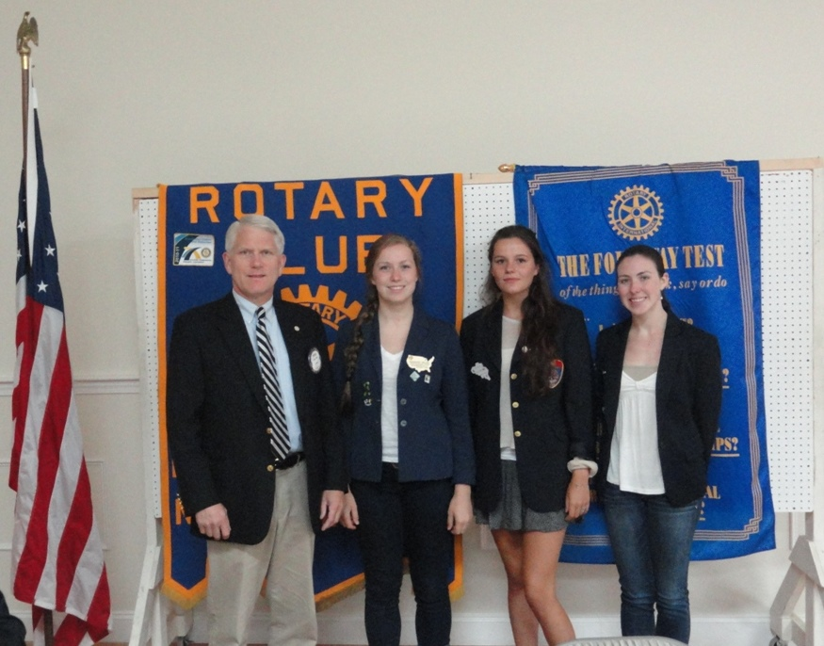

Slide 4
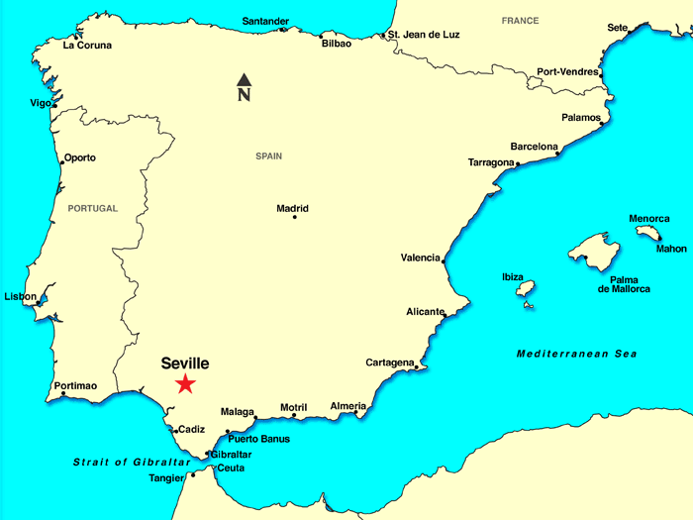

Slide 5
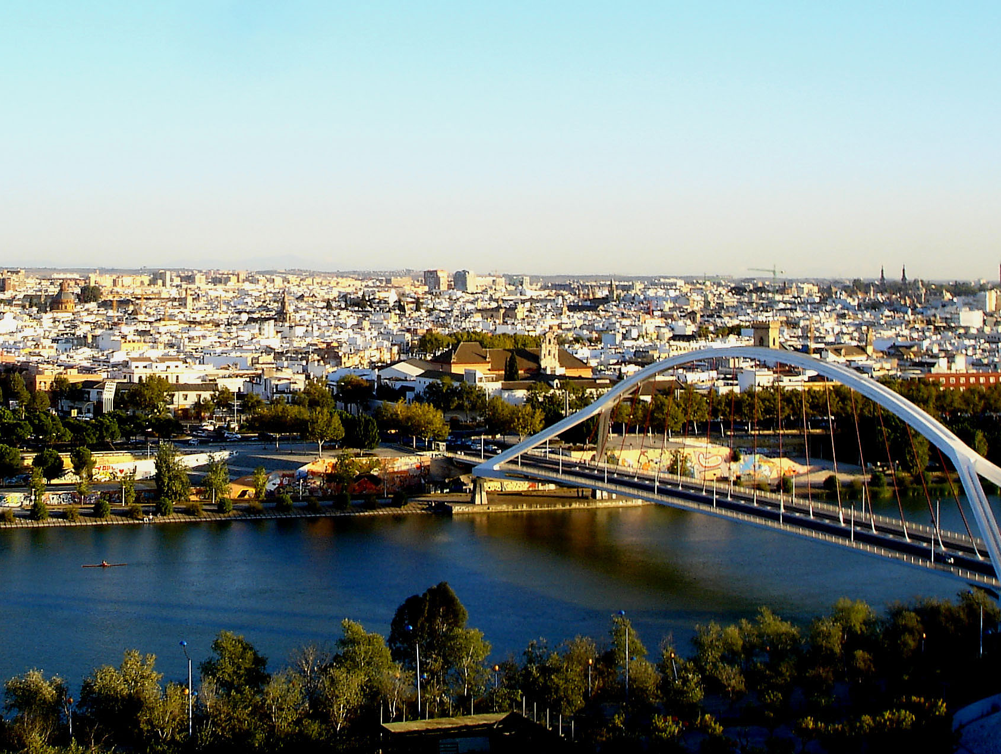

Slide 6
Bachillerato of Social Sciences:
Castilian Language and Literature 2
Foreign Language 2 (English)
History of Philosophy
History of Spain
Religion (Ethics)
Applied Math for Social Sciences 2
Economics
Geography
Integrated Project
Universal Literature

Slide 7
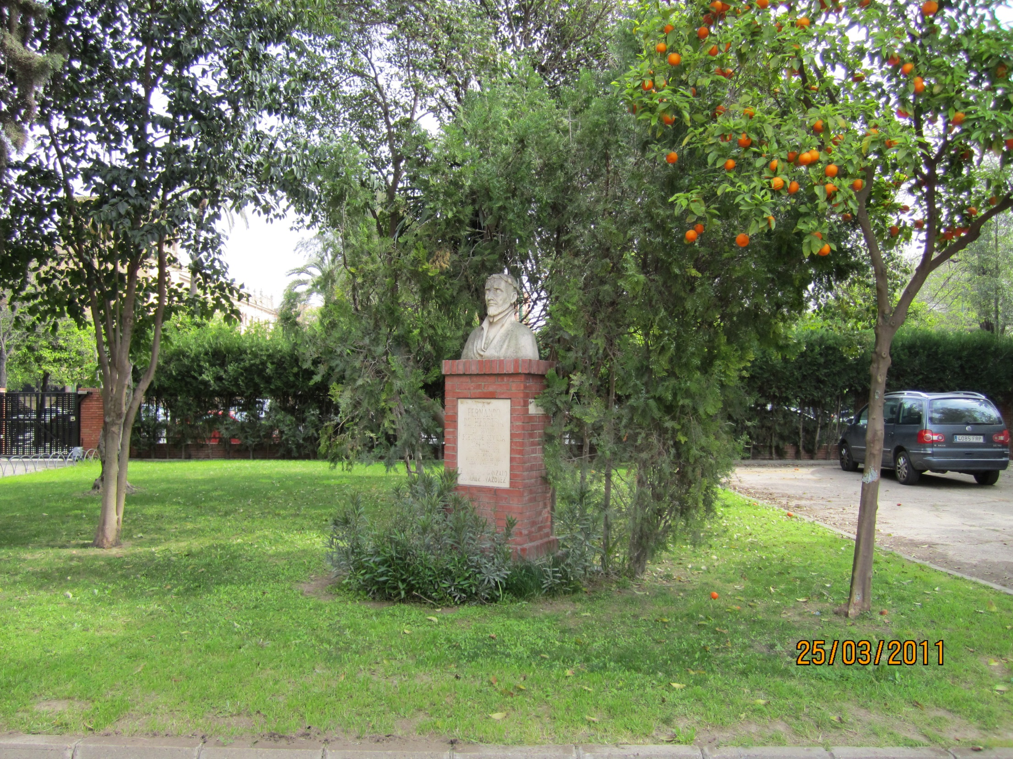
Instituto de Educación Secundaria Fernando de Herrera

Slide 8
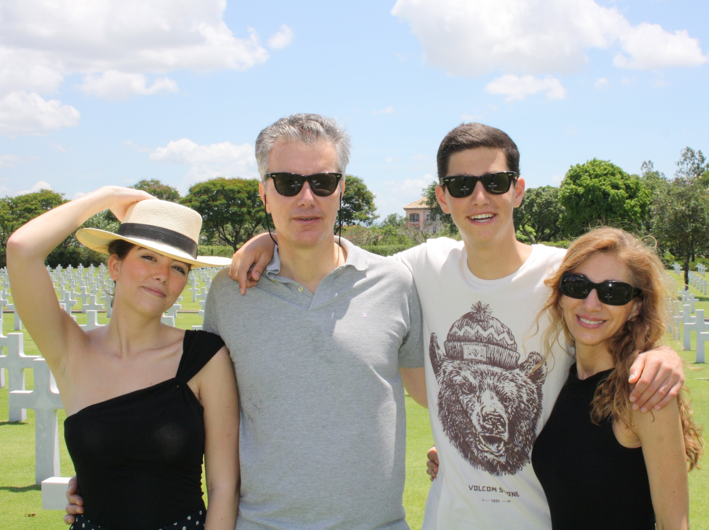

Slide 9
megnespana.blogspot.com

