Slide 1
TRHS College Fair
Recap of Day 1: Monday
September 16th
TRHS Guidance Department

Slide 2
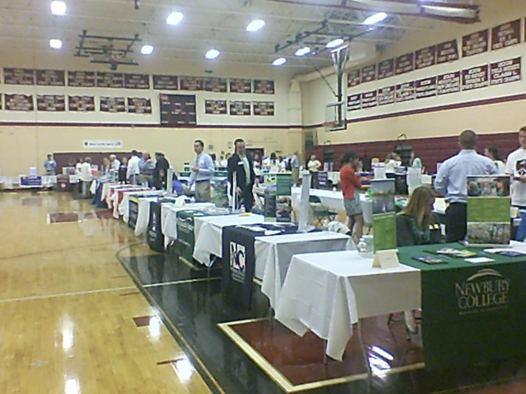
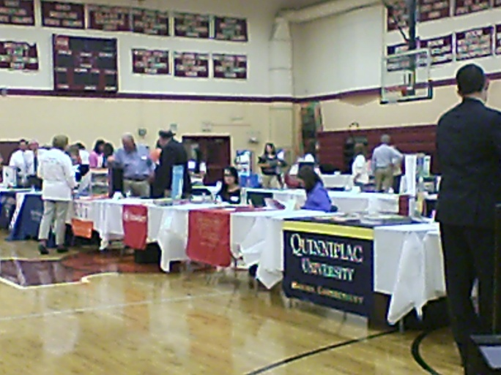
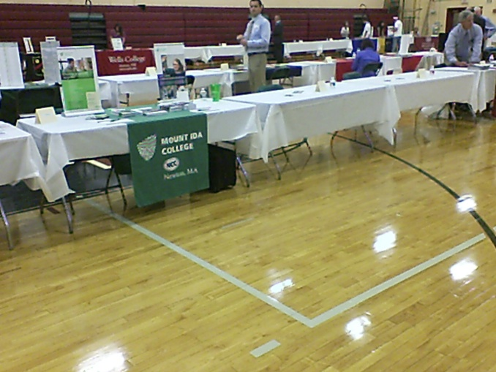
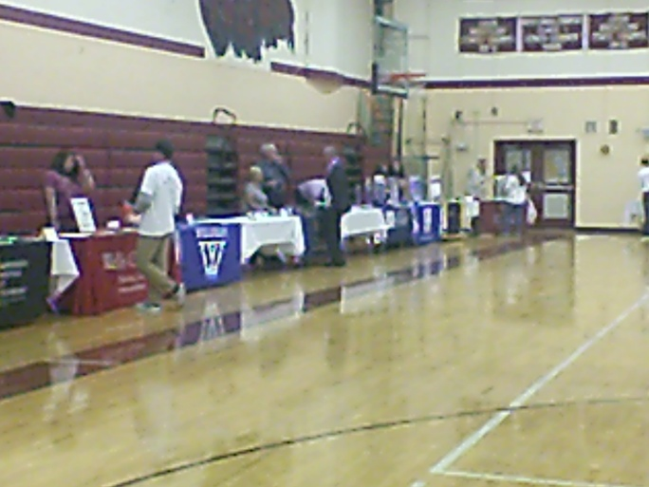
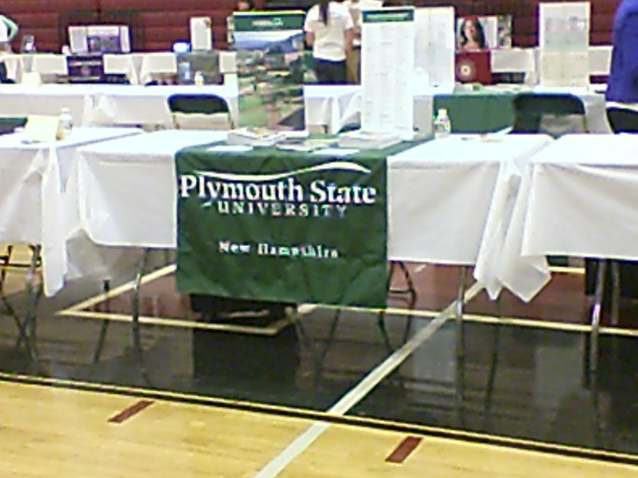
College Fair Setup in the TRHS Gym

Slide 3
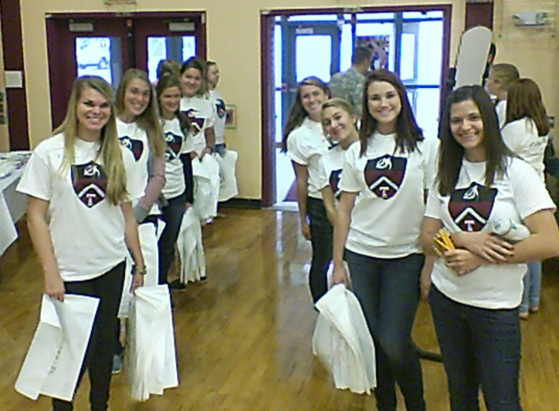
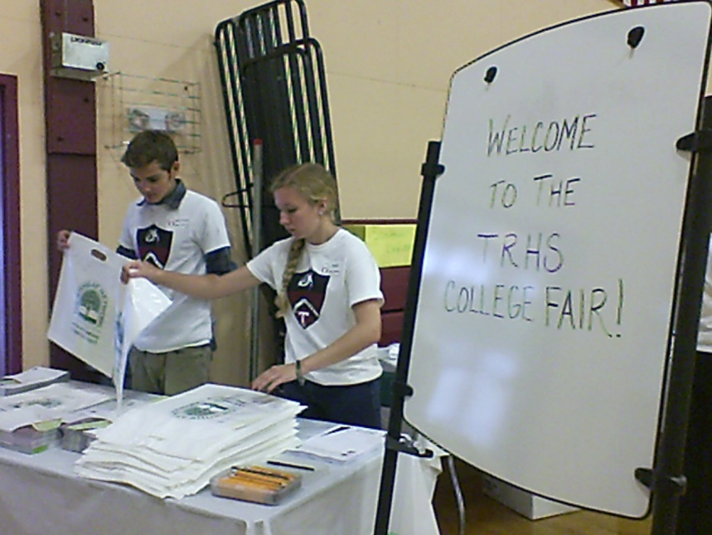
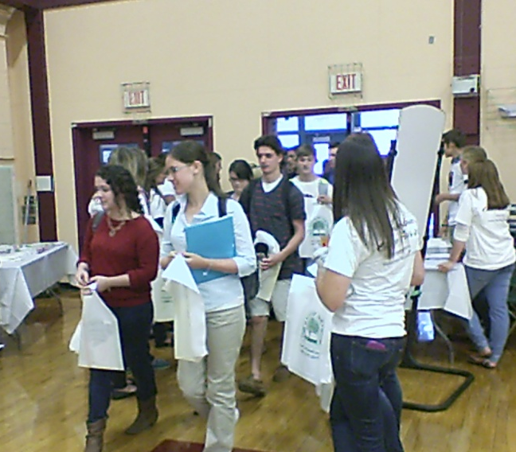
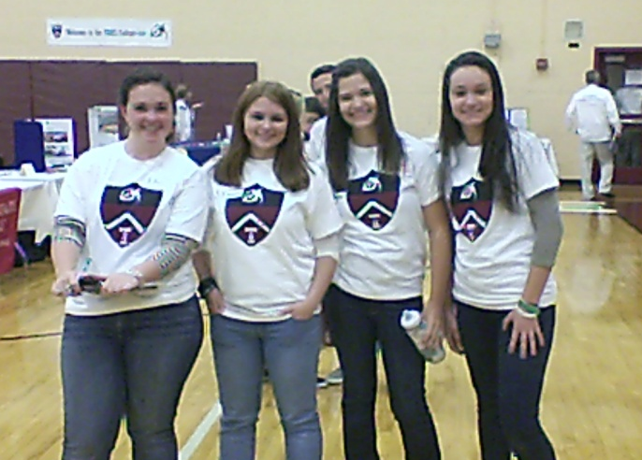
College Fair Junior & Senior Volunteers

Slide 4


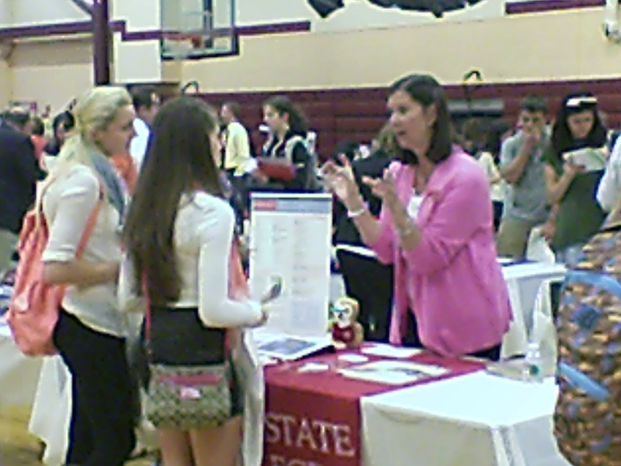
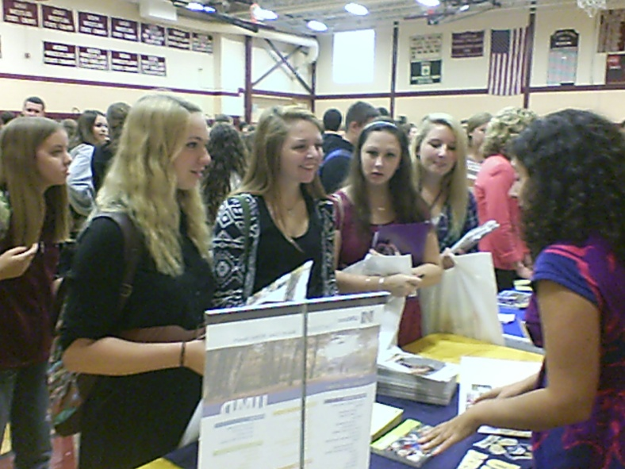
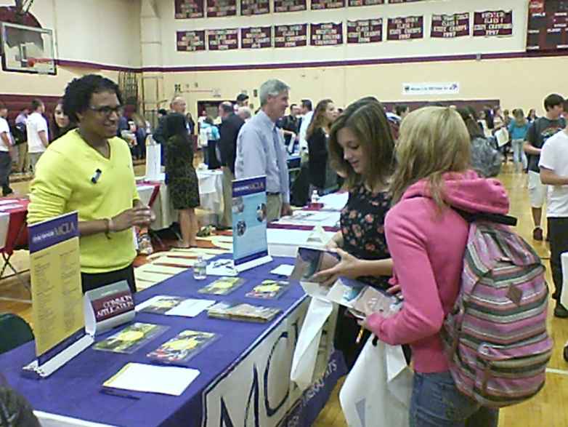
Students Speak to College Reps

Slide 5

Class of 2013
Timberlane
Post Secondary
HIGHLIGHTS
TRHS Guidance Department

Slide 6
Class of 2013
Summary of Graduated Students
2013 Graduates
4 YEAR | 53%
2 YEAR | 29%
Employment | 12%
Military | 4%
Other (Prep School, Certificate Programs & Unemployed) | 2%

Slide 7
TRHS 5 Year Summary
Year | 2 Year | 4 Year | Military | Total
2013 | 29% | 53% | 4% | 86%
2012 | 31% | 49% | 3% | 83%
2011 | 33% | 53% | 3% | 89%
2010 | 35% | 51% | 3% | 89%
2009 | 31% | 53% | 2% | 86%

Slide 8
College Application Details
The Guidance Department processed 1,200 applications in Naviance for the Class of 2013
  Application options include:
      “Early”- Early Action/Early Decision/Restrictive Early Action
      Regular Admission
      Rolling Admission
      On-Site Acceptance Days (held at TRHS with local Community Colleges).
  HIGHLIGHTS:
    Average of 5 applications per matriculated students.
    26% of applications were processed “early”
      74% of early applications resulted in acceptance.
Notes:
Review of Common App or Online Application by counselor
Processing of transcripts, school profile & letters of recommendation
Completion of counselor reports required by schools at time of application/mid year/final report.

Slide 9
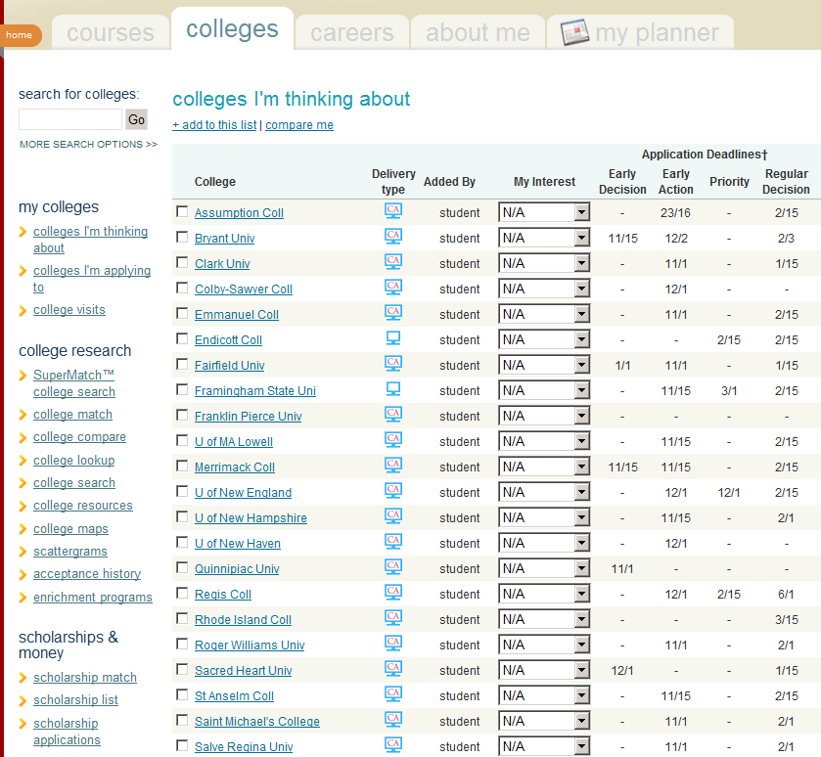
Naviance! Helpful Information!

Slide 10
Class of 2013 Accepted List
Albany College of Pharmacy
Alfred University
American International College
American University
Anna Maria College
Assumption College
Bates College
Bay State College
Becker College
Berklee College of Music
Boston College
Boston University
Brandeis University
Bridgewater State University
Brigham Young University, Idaho
Bryant University
Bunker Hill Community College
Carnegie Mellon University
Castleton State College
Champlain College
Clark University
Clark University
Clarkson University
Cleveland State University
Coastal Carolina University

Slide 11
Class of 2013 Accepted List
Coastal Carolina University
Colby-Sawyer College
University of Colorado at Boulder
Connecticut College
University of Connecticut
Continental Academie of Hair Design - Manchester Campus
Cornell University
Curry College
Dalton State College
Dean College
University of Delaware
Drexel University
East Carolina University
Eastern Nazarene College
Elmira College
Elon University
Embry-Riddle Aeronautical University - FL
Emerson College
Emmanuel College
Endicott College
Fitchburg State University
Framingham State University
Franklin Pierce University
Full Sail University
Georgetown University
Georgia Institute of Technology

Slide 12
Class of 2013 Accepted List
Gettysburg College
Granite State College
Great Bay Community College
University of Hartford
Hartwick College
Hartwick College
Hofstra University
University of Illinois
Iona College
Ithaca College
Johnson & Wales University
Keene State College
Lakes Region Community College
Lasell College
Le Cordon Bleu College of Culinary Arts
Lesley University
LIU Post
Lynchburg College
Lyndon State College
University of Maine at Farmington
Maine Maritime Academy
University of Maine
Manchester Community College
University of Maryland, Eastern Shore
Massachusetts College of Pharmacy
Massachusetts Maritime Academy

Slide 13
Class of 2013 Accepted List
University of Mass, Amherst
University of Mass, Boston
University of Mass, Dartmouth
University of Mass, Lowell
McDaniel College
Merrimack College
Michael's School of Hair Design
University of Michigan
Middlesex Community College
Montana State University
Mount Ida College
Nashua Community College
New England College
NESCOM
University of New England
University of NH at Manchester
New Hampshire Institute of Art
New Hampshire Institute of Art
University of New Hampshire
University of New Haven
New York University
Newbury College
Nichols College
University of North Carolina
Northeastern University
Northern Essex Community College

Slide 14
Class of 2013 Accepted List
Norwich University
Pennsylvania State University
Plymouth State University
Porter and Chester Institute
Providence College
Purdue University
Quinnipiac University
Quinsigamond Community College
Rensselaer Polytechnic Institute
Rhode Island College
University of Rhode Island
Rivier University
Rochester Institute of Technology
Roger Williams University
Rutgers
Saint Anselm College
Saint Joseph's College-ME
Saint Michael's College
Salem State University
Salve Regina University
Simmons College
South Carolina State University
University of Southern Maine
Southern NH University
Springfield College
St. Lawrence University

Slide 15
Class of 2013 Accepted List
SUNY, Albany
Suffolk University
SUNY College of Env. Science
Syracuse University
University of Tennessee
Thomas College
US Air Force Academy Prep
United States Army
United States Marine Corps
United States Navy Recruiter
Vermont Technical College
University of Vermont
Wagner College
Wellesley College
Wentworth Institute of Technology
West Virginia University
Western Connecticut State University
Western New England University
Wheelock College
Worcester Polytechnic Institute
Worcester State University
York County Community College

Slide 16

New Hampshire College Placements
Total: 111 Students
Colby-Sawyer College: | 2
Daniel Webster College: | 1
Franklin Pierce College: | 2
Granite State College: | 2
Hesser College: | 1
Keene State College: | 14
New England College: | 1
NH Institute of Art: | 1
NHCCS: | 29
Plymouth State University: | 12
Rivier College: | 2
SNHU: | 13
SNHU Advantange: | 1
University of New Hampshire: | 30

