Slide 1
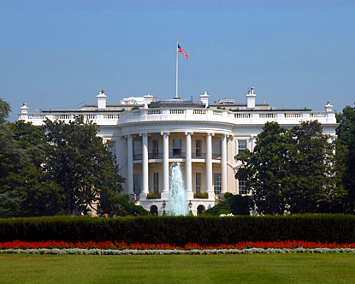
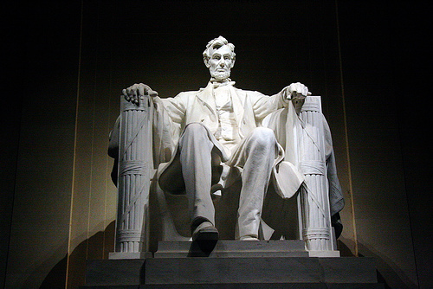
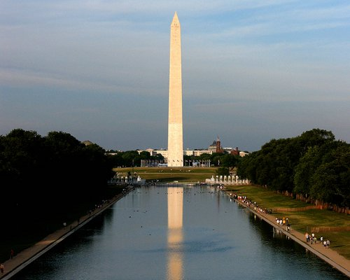
American Studies
Washington D.C. Trip
Proposed by: Meaghan Guanci,
Patty Deyermond, and Joshua Silveira
Proposed Dates: Friday, March 20-Sunday, March 22

Slide 2
Rationale
Experiential Learning
  Bring classroom content to life
Awaken sense of travel and intellectual curiosity
Packed with historical sites, informational museums
Opportunity to see the nation’s capital

Slide 3
Capital Tours
Highly recommended by colleagues
35 years experience
Experienced tour escort provided
All inclusive company- provides airfare, motor bus coaches while in D.C., breakfasts and dinners
Provides a security guard at hotel at night
Collects payments directly via online registration

Slide 4
Overview of Costs/Itinerary
Approximately $640-$700 (# of sign-ups drives price)
Depart Logan on Southwest Flight #2499 @7:00 am Friday, March 20th
Arrive @ Logan on Southwest Flight #1748 @ 11:00 pm Sunday, March 22nd
Some stops include: Lincoln Memorial, Vietnam Memorial, World War II Memorial, Holocaust Museum, Newseum, National Air and Space Museum, White House, U.S. Capitol Building

