Slide 1
Timberlane District
Action Plans
December 19, 2013
Presentation to the TRSD School Board

Slide 2

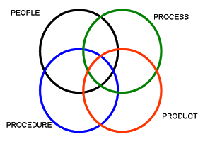
Focus on
Student Learning
and
Systems Improvement

Slide 3
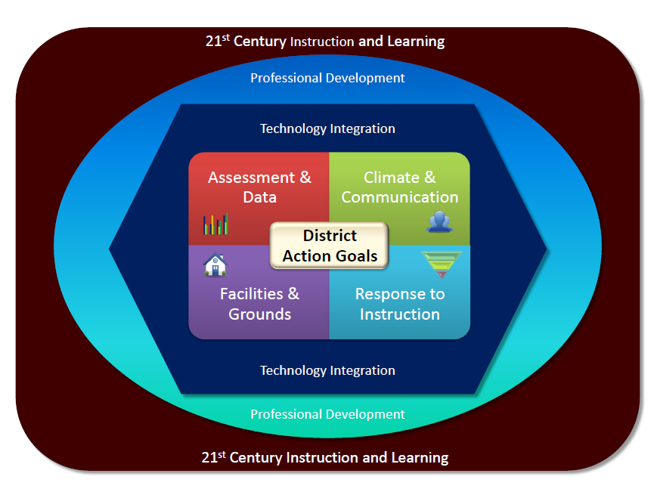

Slide 4
Timberlane District Action Plans
Started this reflective process in August 2012
Prioritized needs and divided into 4 subgroups
Developed District Actions Plans
Revised the action plans, as needed
School Action plans support the District plans
Hold Full Admin Meetings 4 times per year
Next Full meeting is January 27, 2014

Slide 5
Response to Instruction
Goal 1:
The District Framework for RTI for Literacy, Math and Behavior is written, articulated and implemented district-wide.
Progress:
Developed overview of RTI district frameworks and presented to staff
Developed needs assessment; to be distributed to staff Jan 2014

Slide 6
Response to Instruction
Goal 2
Tier II instruction is articulated and implemented in each school and measured by student progress monitoring data.
Progress:
After the completion of Goal #1, each school will define the scientific research based interventions/strategies to be used for strategic Tier 2
RTI group will work closely with the District Data and Assessment group to train staff in the appropriate progress monitoring tool(s) to be used in Tier 2
Each school will define the scientific research based enrichment/extension strategies to be used in Tier 2

Slide 7
Facilities and Grounds
Goal 1
Timberlane will revise the Capital Improvement Plan by Sept 2013.
Progress:
Board Mtg of Dec. 3, will establish CIP committee in Spring 2014
1.4 Safety – School upgrades completed in Summer 2013

Slide 8
Facilities and Grounds
Goal 2
Structures will be put in place to address curb appeal concerns at each school by June 2013.
Progress:
Grounds crew worked at Elem schools in Fall of 2013.
2015 budget funds equipment.

Slide 9
Communication and Climate
Goal 1
In order to improve district-wide communications, an internal flowchart will be established to ensure the accuracy, consistency and timeliness of information to all stakeholders.
Progress:
Universal template for all meeting minutes.
SharePoint established as the storage house for employee information.
Google Drive is being explored as a tool for collaboration and sharing of documents.
All staff have @gapps accounts.
Google trainings and information sessions have been offered
Notes:
Our work:
Examined the complexity of the Timberlane organization.
Focus on communication within the structure of group/committee work.
Examine district technology tools for communication (SharePoint; Google Drive).
Gather information on the restructuring and re-organization of the district
administration and committees.
Progress:
Universal template for all meeting minutes.
SharePoint established as the storage house for employee information.
Google Drive is being explored as a tool for collaboration and sharing of documents.
All staff have @gapps accounts.
Google trainings and information sessions have been offered.
Actions:
Inform all stakeholders of approved forms and practices.
Re-organize SharePoint for support ease and efficiency in accessing information.
Provide Google Drive trainings and examine use of Google as a district tech tool for communication.
Create and disseminate SharePoint informational Screencast.
Actions:
Inform all stakeholders of approved forms and practices.
Re-organize SharePoint for support ease and efficiency in accessing information.
Provide Google Drive trainings and examine use of Google as a district tech tool for communication.
Create and disseminate SharePoint informational Screencast.

Slide 10
Communication and Climate
Goal 2
In order to improve district-wide communication, a calendar system will be developed for the purpose of coordinating; annual professional development, assessment, school and district meetings, committee meetings, and school level events.
Progress:
Google calendar was established as the universal district calendar.
Located on TRSD website and includes building based events.
Established a consistent format for populating the calendar.
Identified key personnel to populate the calendar.
Drafted a protocol for planning and scheduling events .
Established Outlook calendar as personal planner.
Produced and Outlook informational Screencast.
Notes:
Our work:
Examine current calendar systems.
Examined the format for populating calendar.
Examined which events to post on District Wide Public Calendar of Events (DWPCE).
Examine current practices for planning and scheduling activities and events.
Progress:
Google calendar was established as the universal district calendar.
Located on TRSD website and includes building based events.
Established a consistent format for populating the calendar.
Identified key personnel to populate the calendar.
Drafted a protocol for planning and scheduling events .
Established Outlook calendar as personal planner.
Produced and Outlook informational Screencast.
Actions:
Submit protocol for planning and scheduling events to the SLT.
Disseminate Outlook informational screencast to employees.
Survey staff regarding: Access and use of district tech tools; knowledge of the organizational structure; access and use of Google calendar, degree of satisfaction of overall communication.

Slide 11
Assessment and Data
Goal 1
Timberlane will have a comprehensive assessment system by December 2013.
Progress:
A full audit of all district-wide and school level assessments currently being administered to students was completed and reviewed by the committee.
Teachers were surveyed to determine what data they currently have and what data they need. They were also asked to report on access all relevant data. These surveys were reviewed by the committee.

Slide 12
Assessment and Data
Goal 1 Continued
The committee established a common vision and prioritized the elements and components of a comprehensive assessment system for PK-grade 12
An assessment outline was developed and includes Universal Screening for all students 3 times per year with progress monitoring for students who fall below the benchmark levels.
The committee examined research and data related to current assessment tools and selected 5 for comprehensive review. These included; AIMS Web, STAR, PALS, NWEA, i-Ready

Slide 13
Assessment and Data
Goal 1 Continued
Each of these assessments supported RTI, had excellent reporting suites, and were vetted and reviewed by the National Center for Response to Intervention
The STAR Assessment was selected
The STAR Assessment was proposed to the Curriculum and Assessment Committee and met with unanimous approval.
The Star Assessment was presented to the SLT and met with unanimous approval
The STAR assessment will be presented to the School Board for approval in January.

Slide 14
Assessment and Data
Goal 2
Timberlane will establish a data management system for district data that will display individual student growth, by 2014.
Progress:
The School Net data management system was selected last year and data is currently being uploaded to the system.
The system has been introduced to administrators at all levels, and professional learning is in progress as part of the work with the district data team.
Professional learning for staff will begin on the April 25th Early Release

Slide 15
Assessment and Data
Goal 3
A communication plan will be developed by June 2014, in order to share relevant data with staff, administrators, school board, and public.
Progress:
This will occur in collaboration with the Communication and Climate Committee upon the approval and adoption of a Universal Assessment and Progress monitoring tool.

Slide 16
Questions?
Thank you for your support…

