Slide 1

German-American Partnership Program
Germany Experience
June 14th-July 12th, 2014
not just learning, but experiencing…

Slide 2
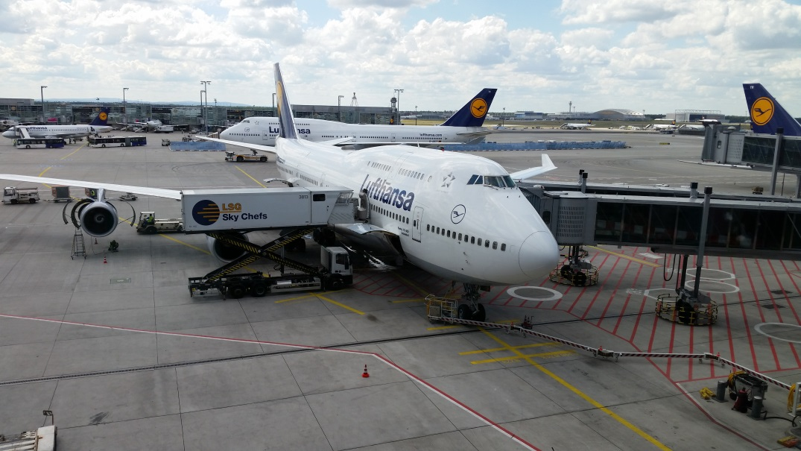
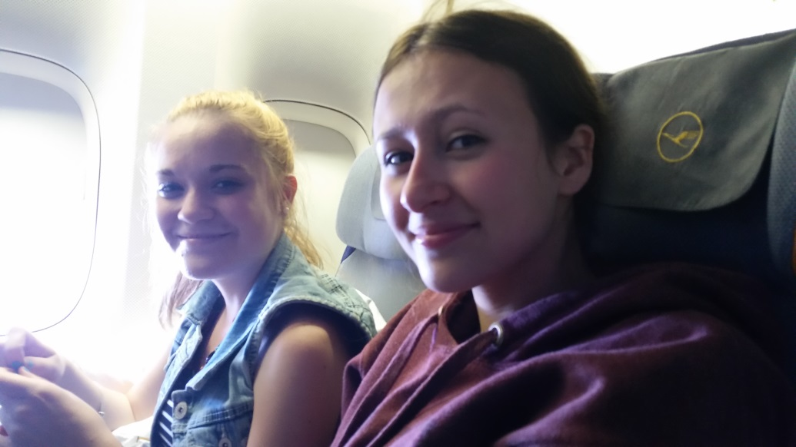
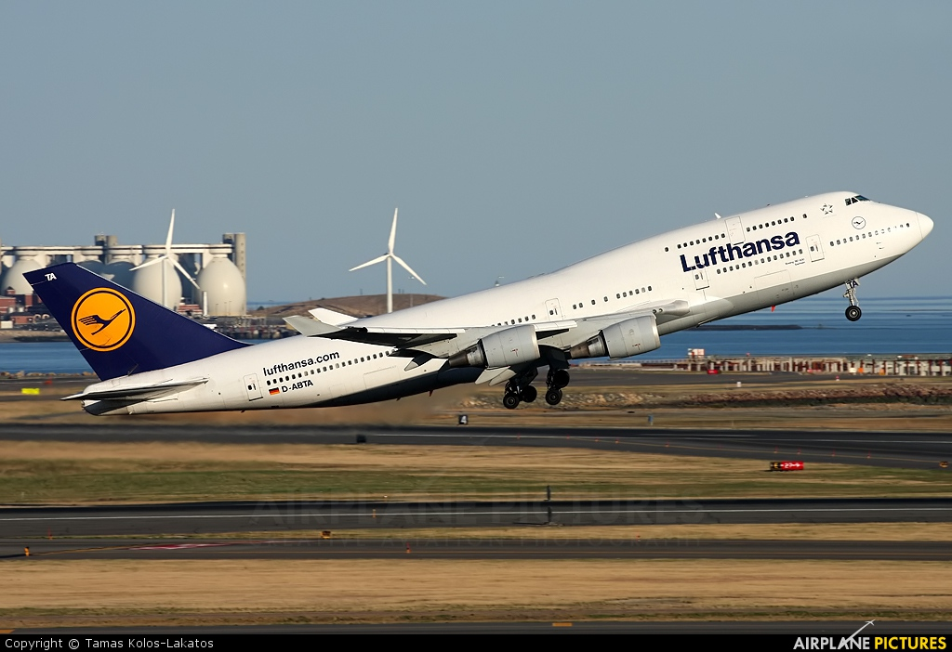
Departure from Logan, June 14th

Slide 3
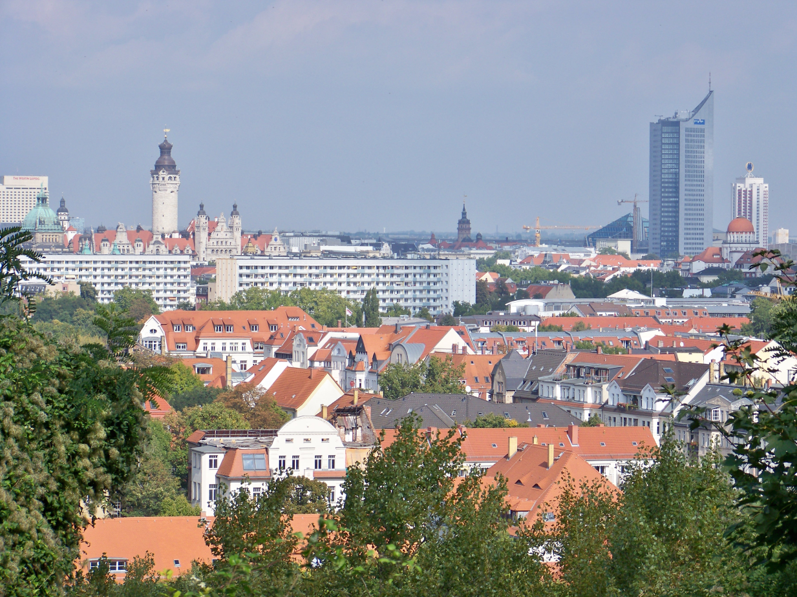
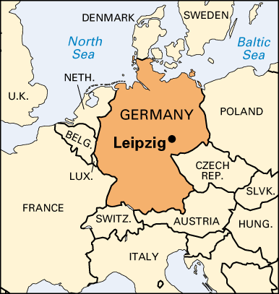
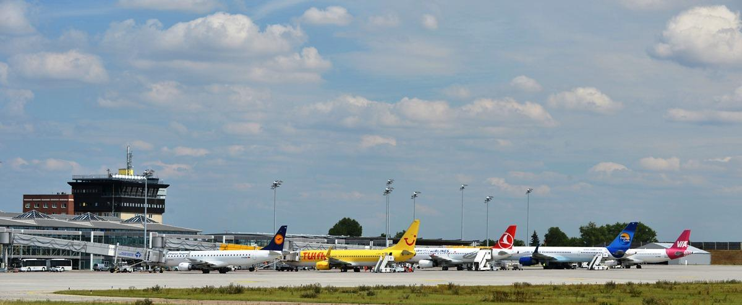
Arrival in Leipzig, Germany
June 15th

Slide 4
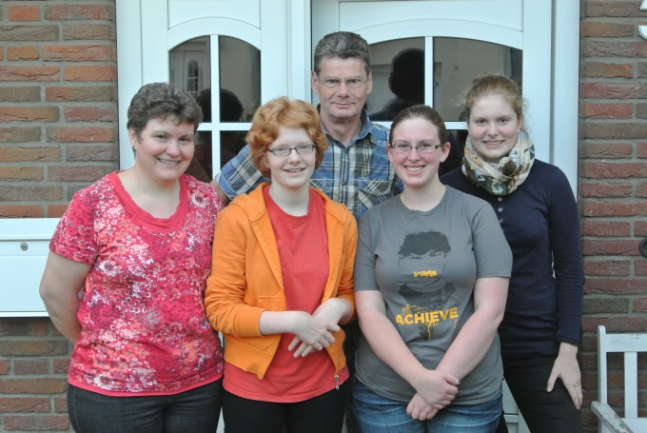
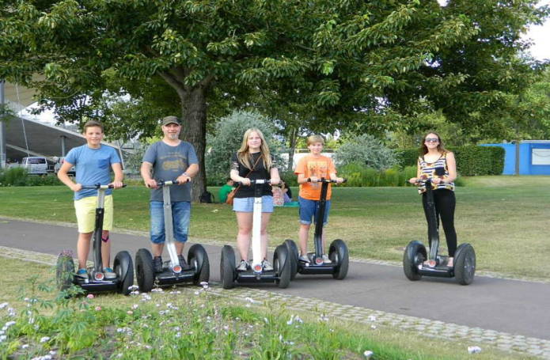
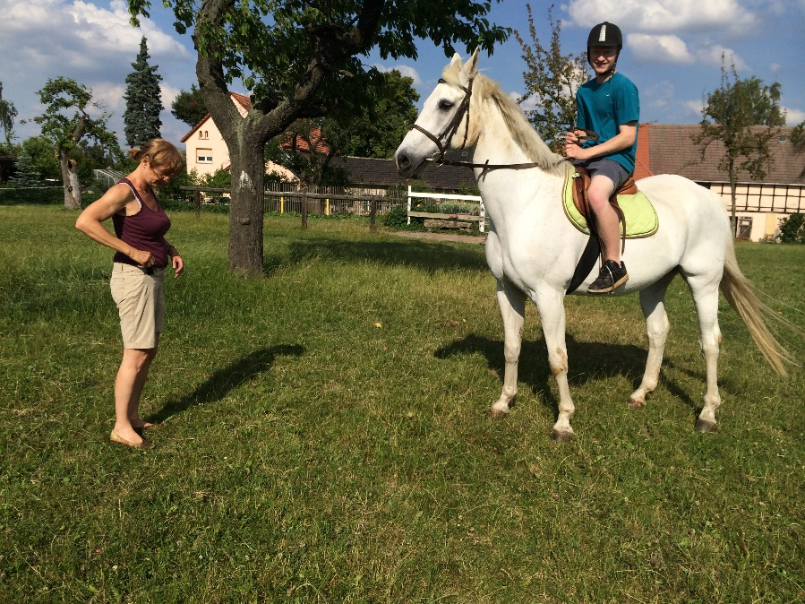
The German Family Experience…
Miranda Kryskow and her German family…
Sarah Ramirez and her German family on Segways…
Ryan Madsen gets a horseback riding lesson from his German host mom.

Slide 5
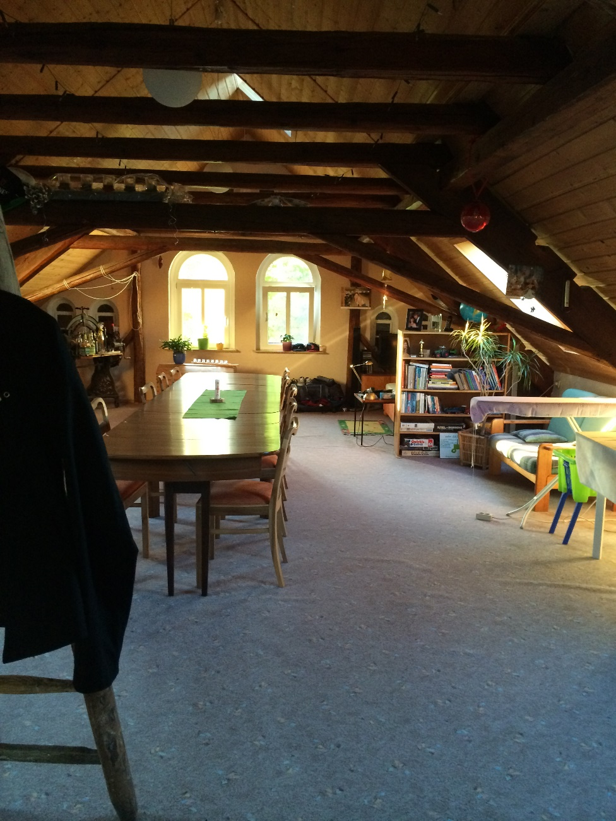
Where do I stay\sleep?

Slide 6
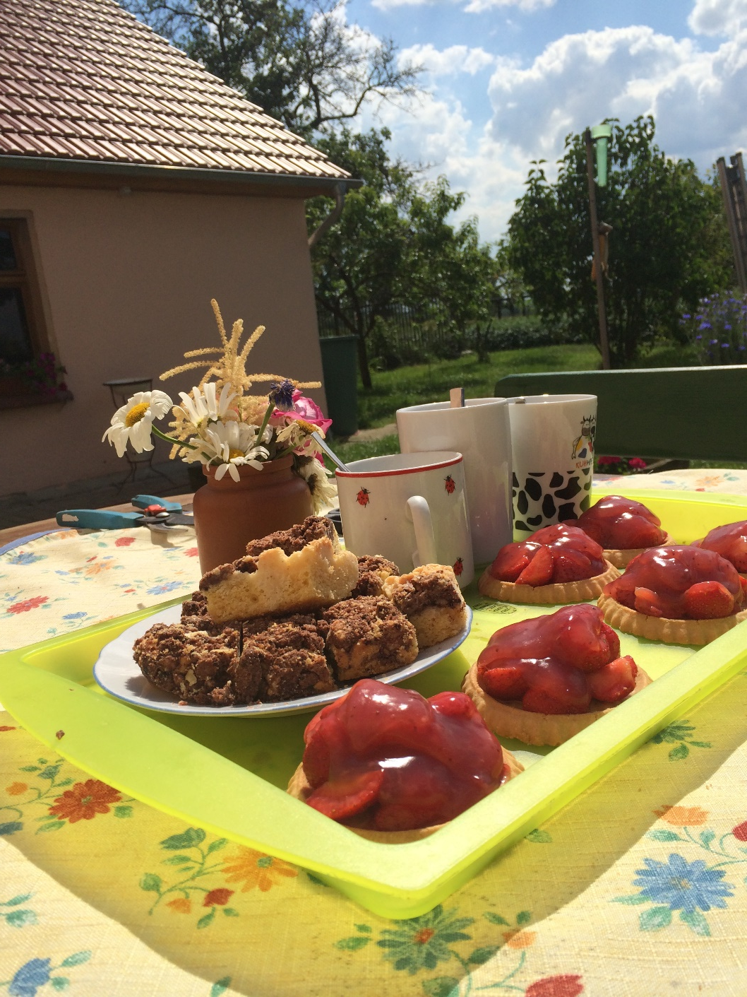
Afternoon coffee and treat time….

Slide 7
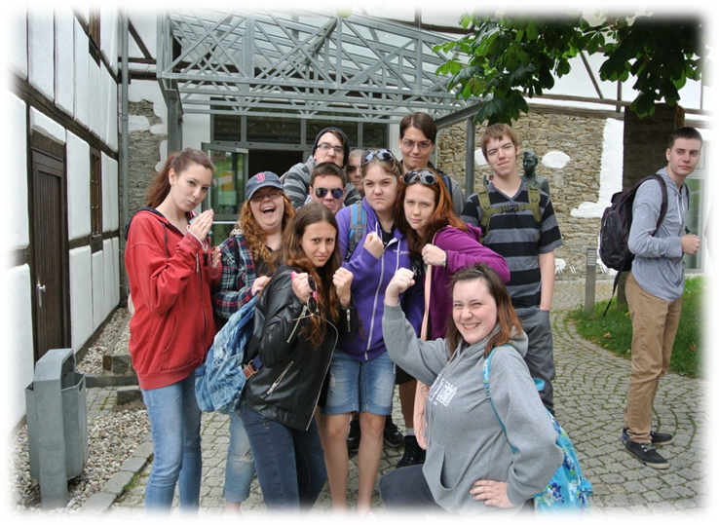
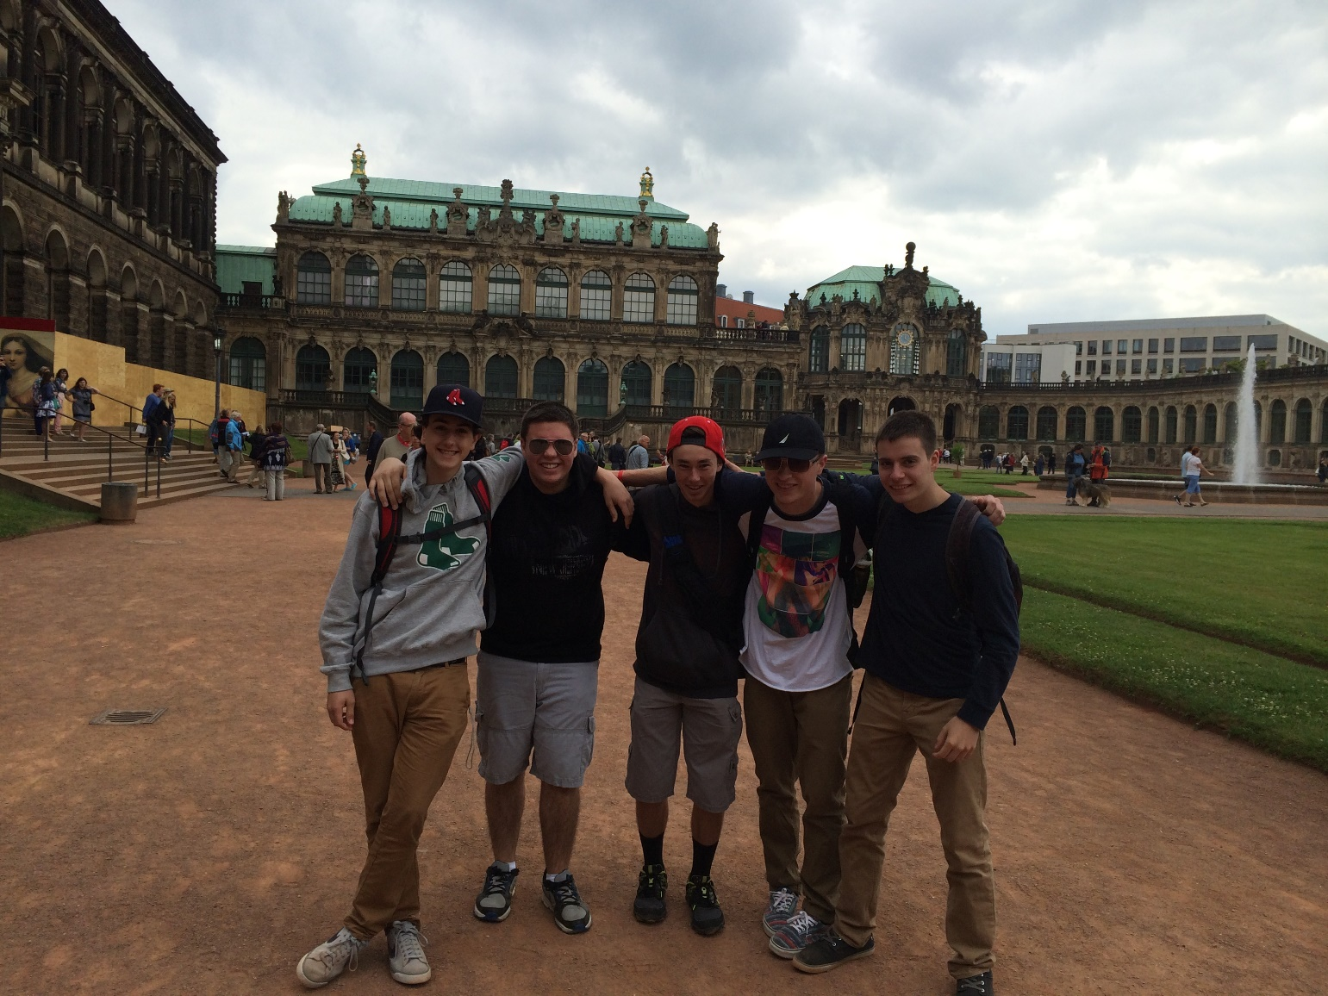
BFF and memories made to last a lifetime…

Slide 8
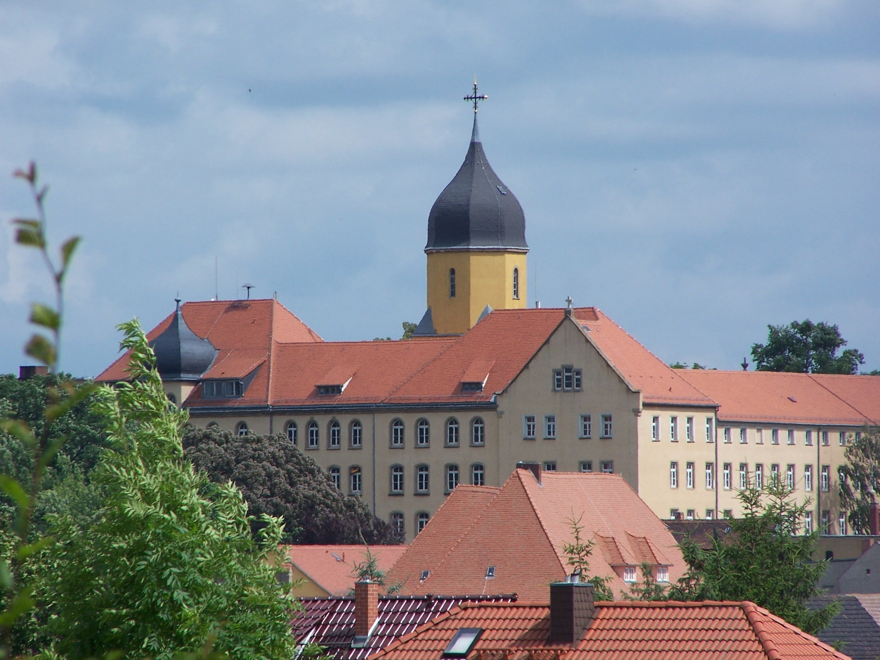
Die Christophorus Schule

Slide 9
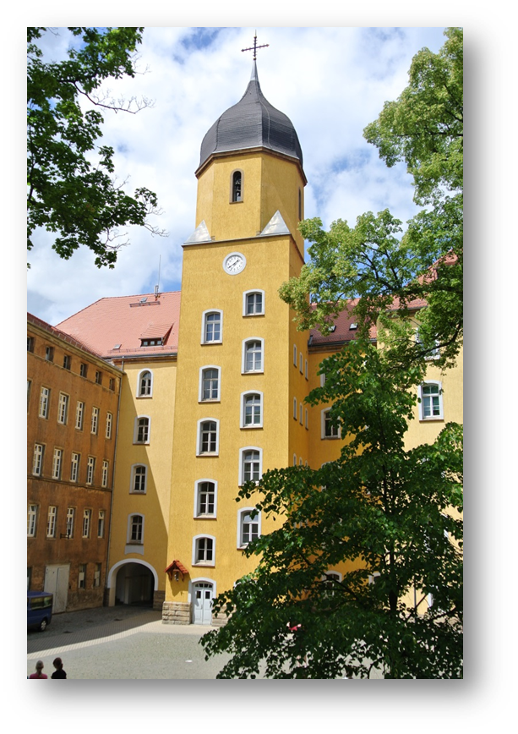
Die Christophorus Schule
540 students, grades 5-12
Day students and boarding students attend
Is a Gymnasium = a College and University
Preparatory School
Competency in 2 world languages is compulsory for graduation
* 1st language grades 5-10;
2nd language grades 7-10
* world languages taught: English, French, Russian, Chinese, Latin, and Spanish
* one must pick at least one of these to study through the 12th grade

Slide 10
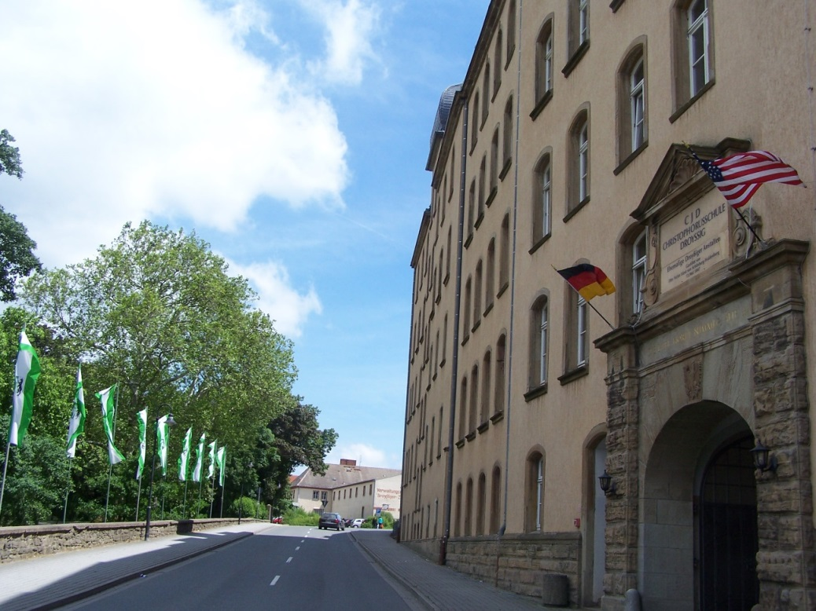
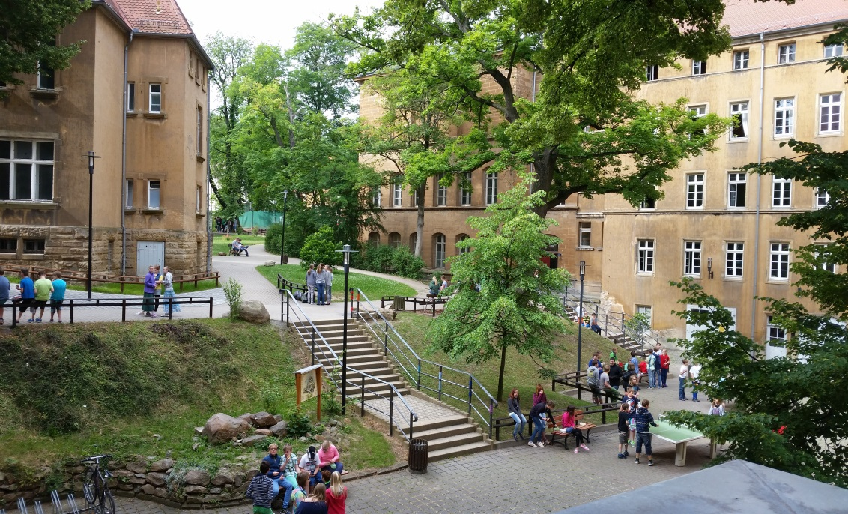
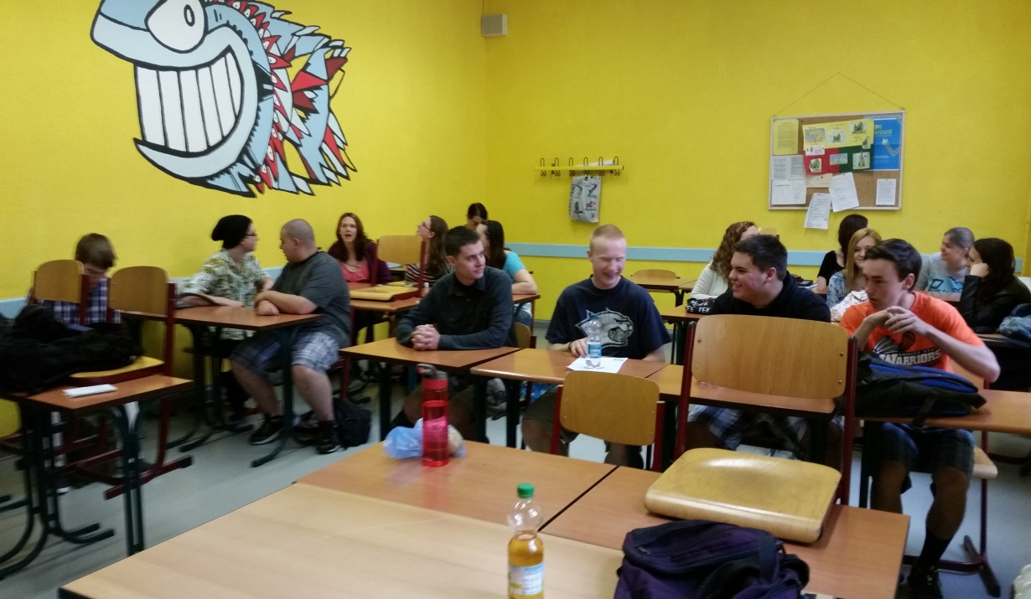
In and around the school…

Slide 11
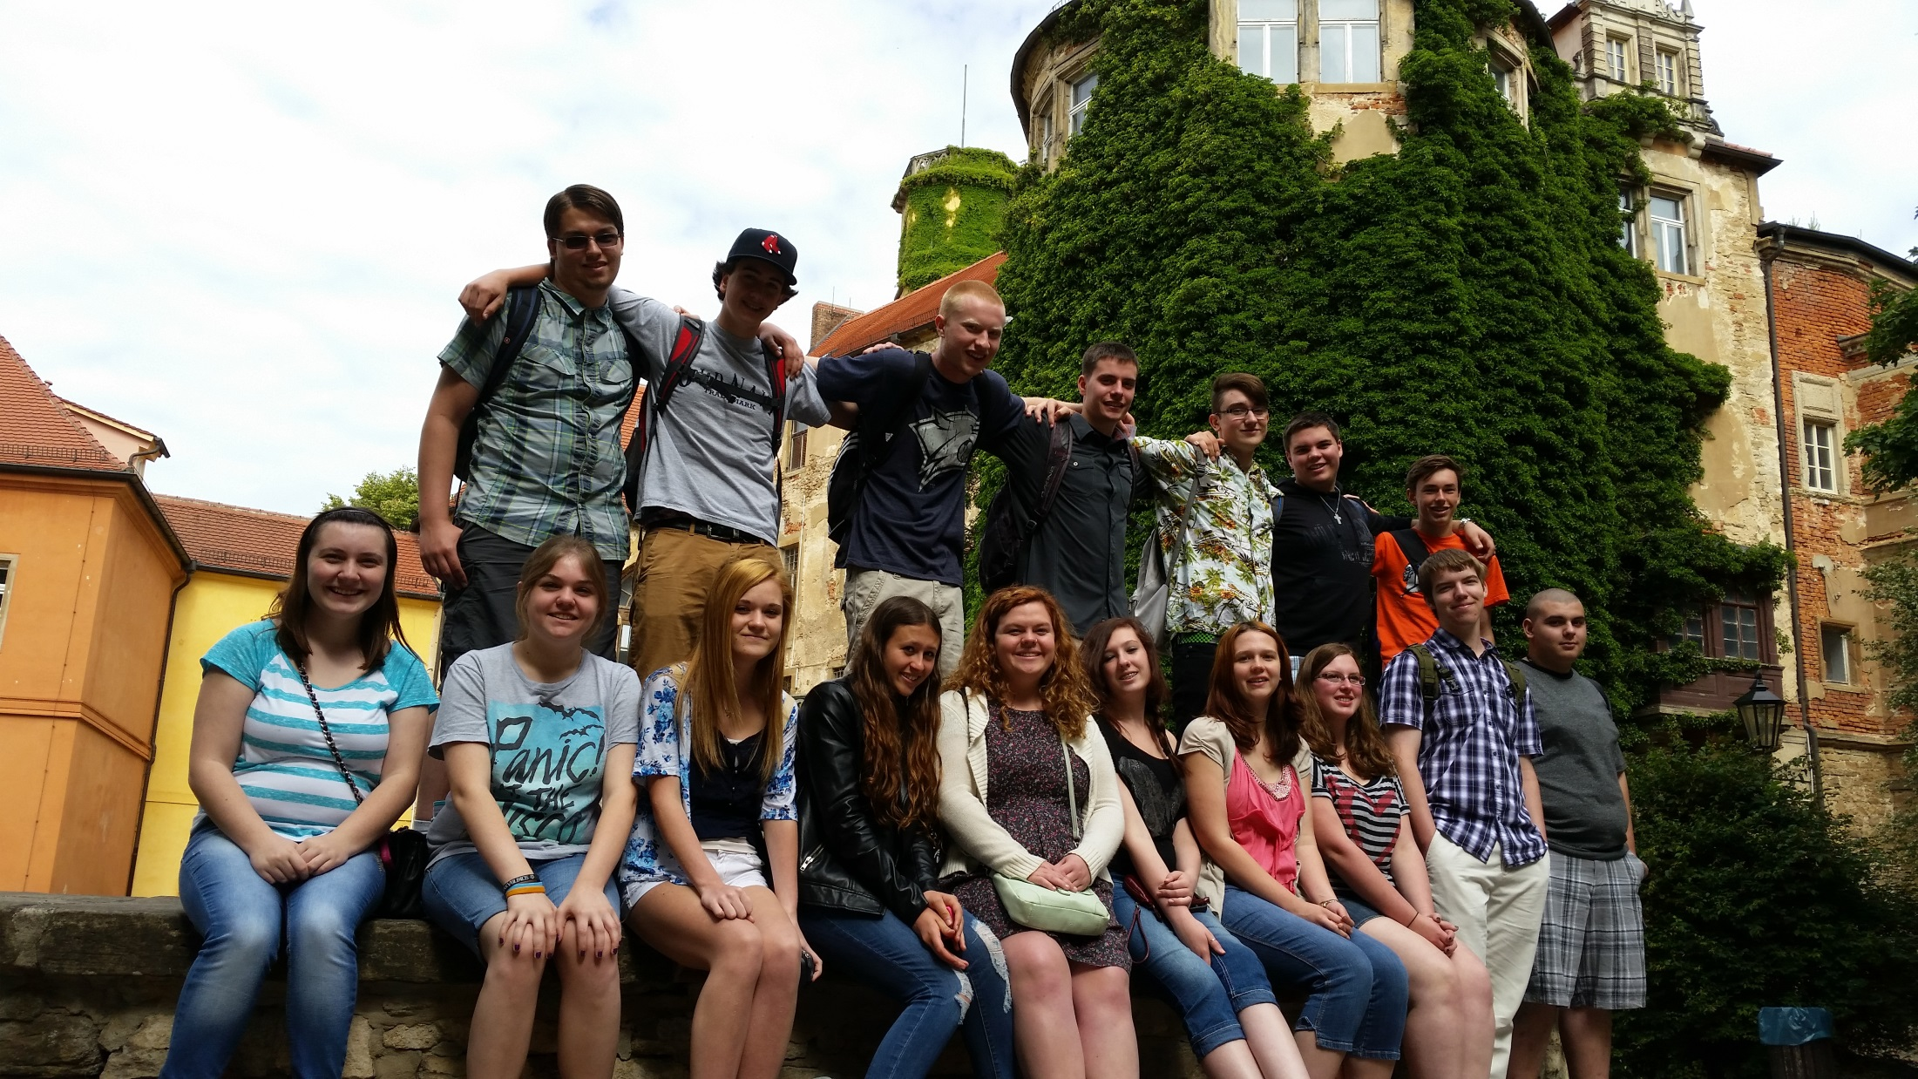

Slide 12
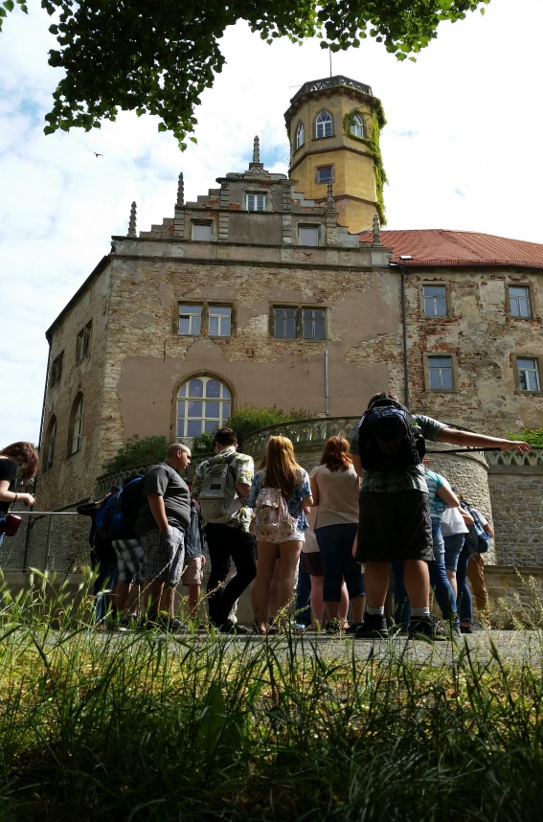
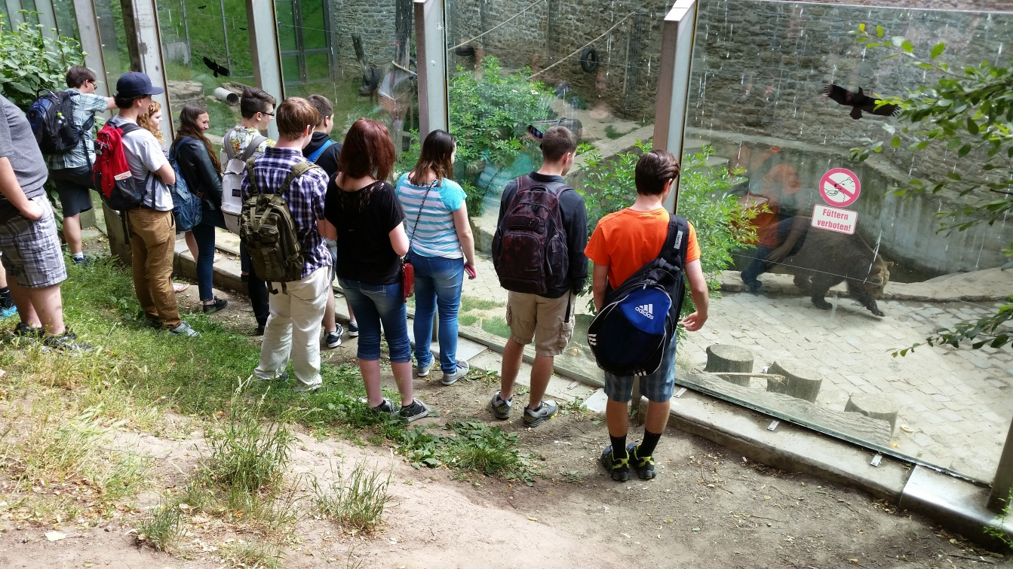
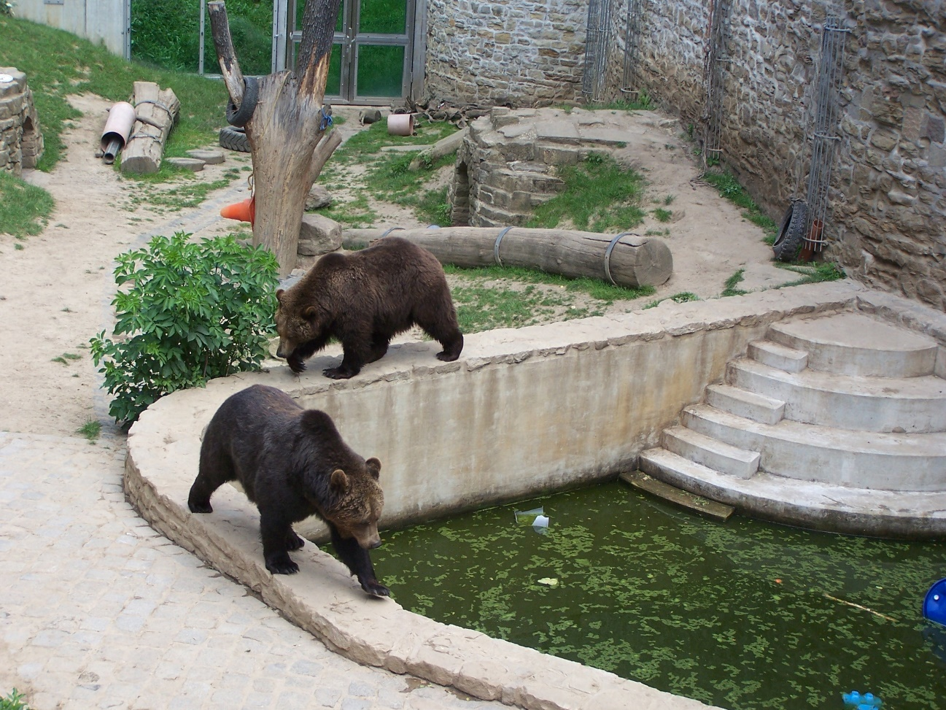
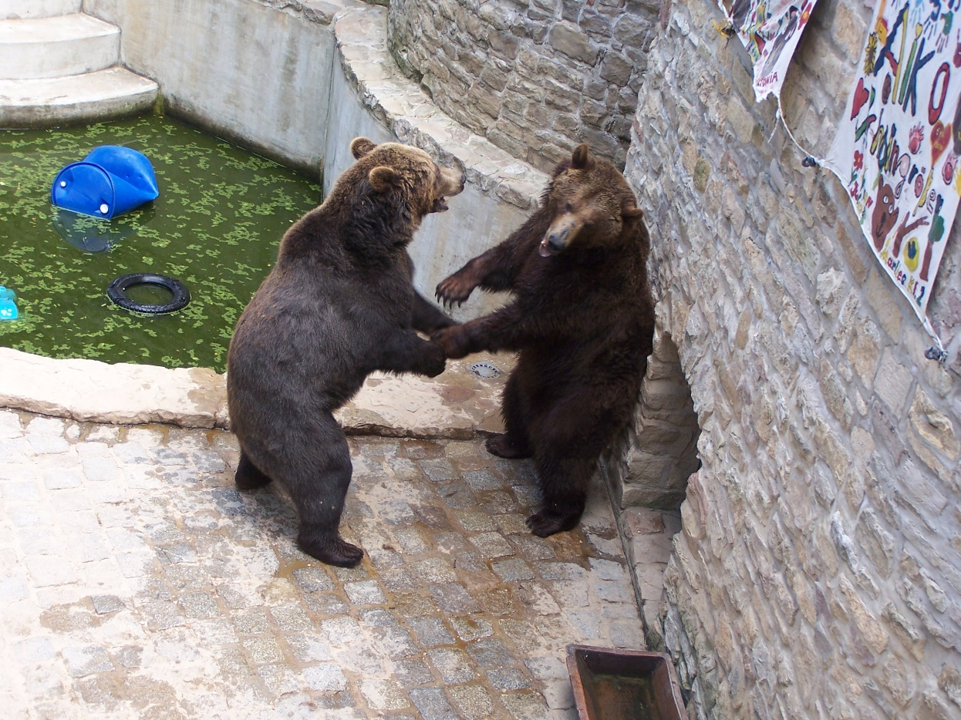
The Droyβig bears…
Toni

Slide 13
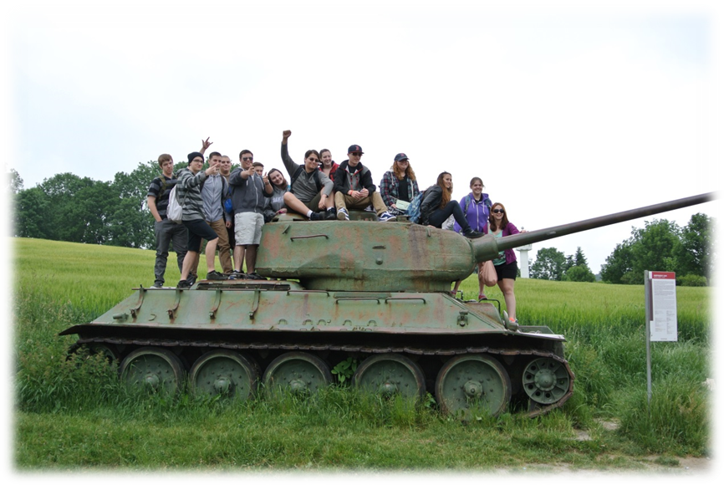
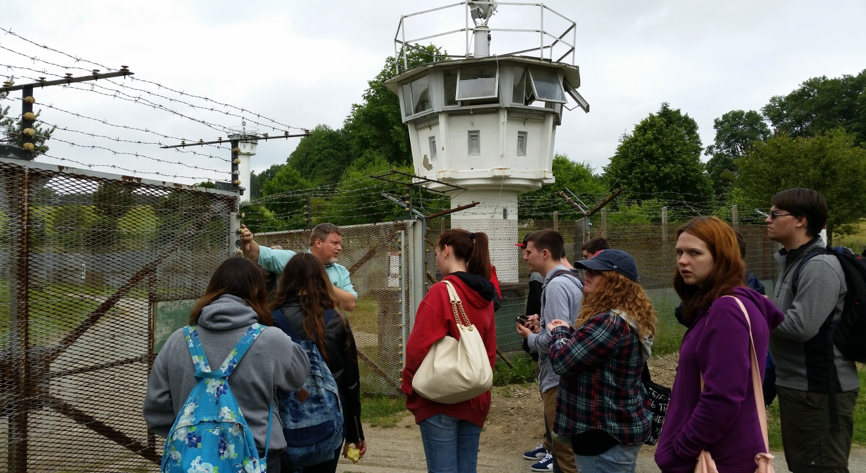
Moedlareuth “Little Berlin”

Slide 14
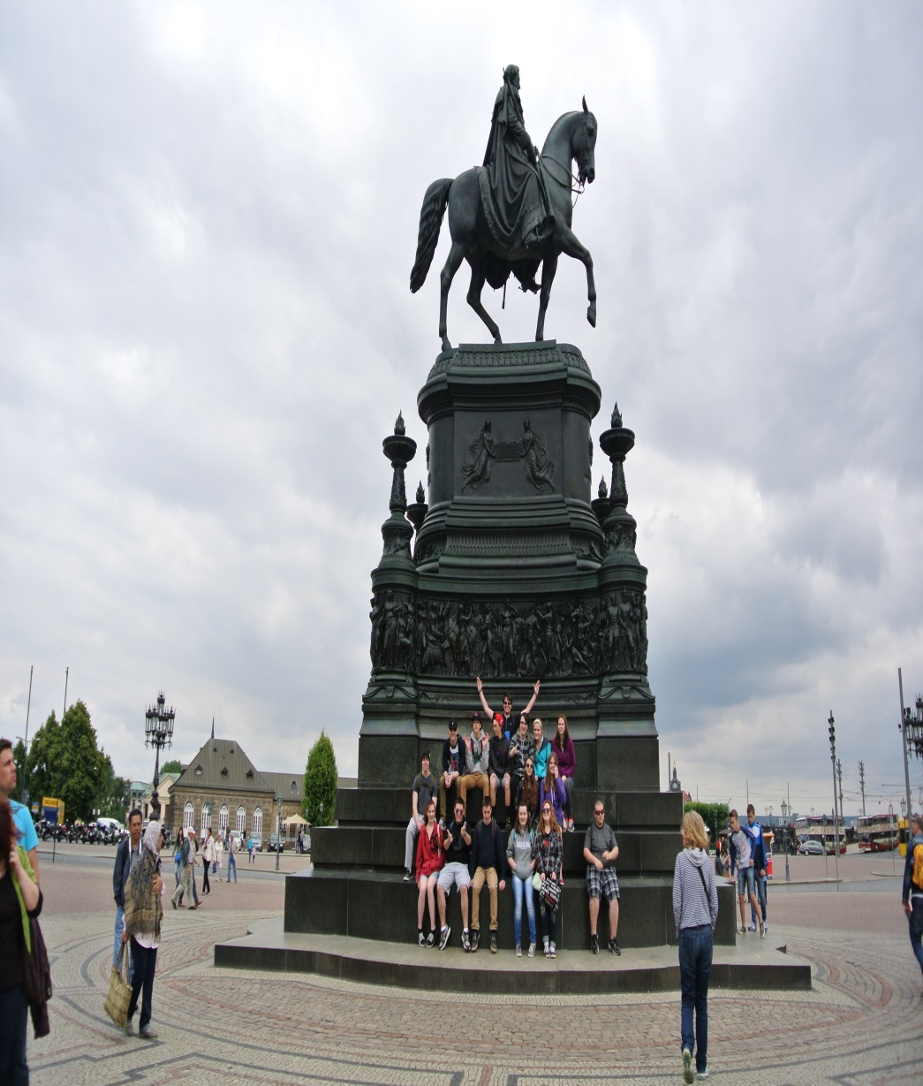
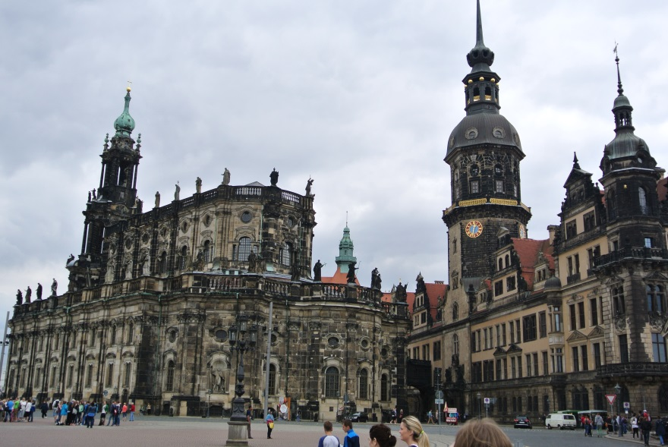
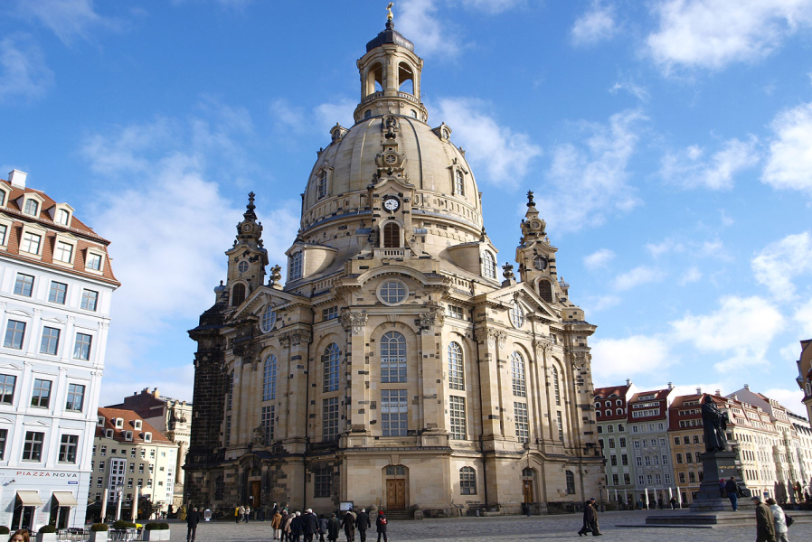
Dresden

Slide 15
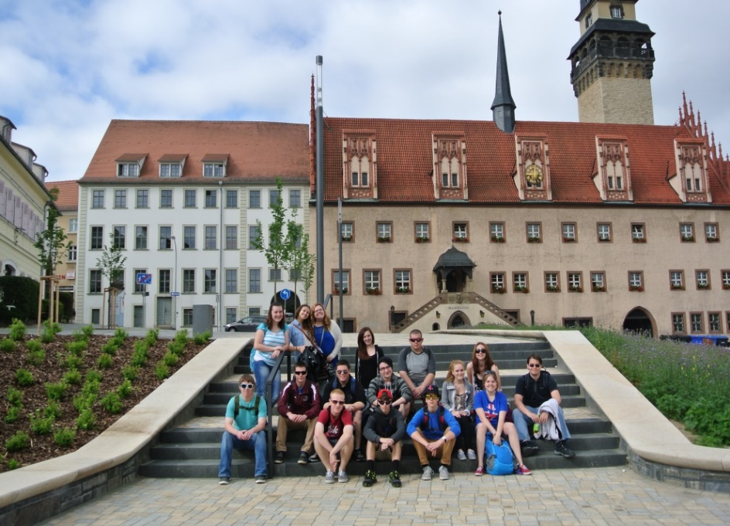
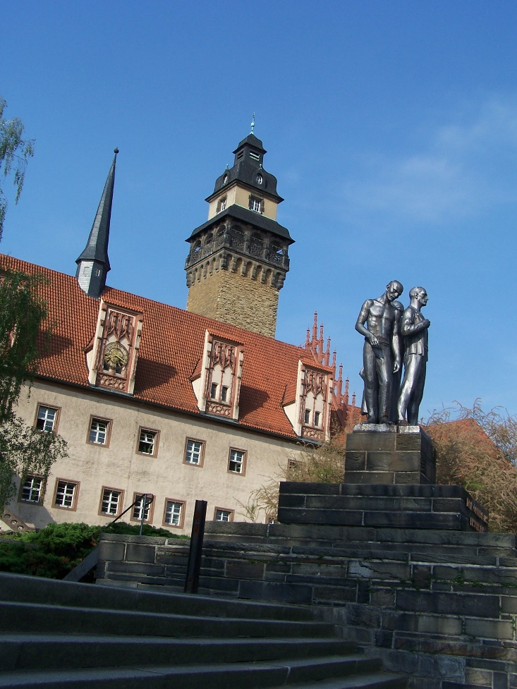
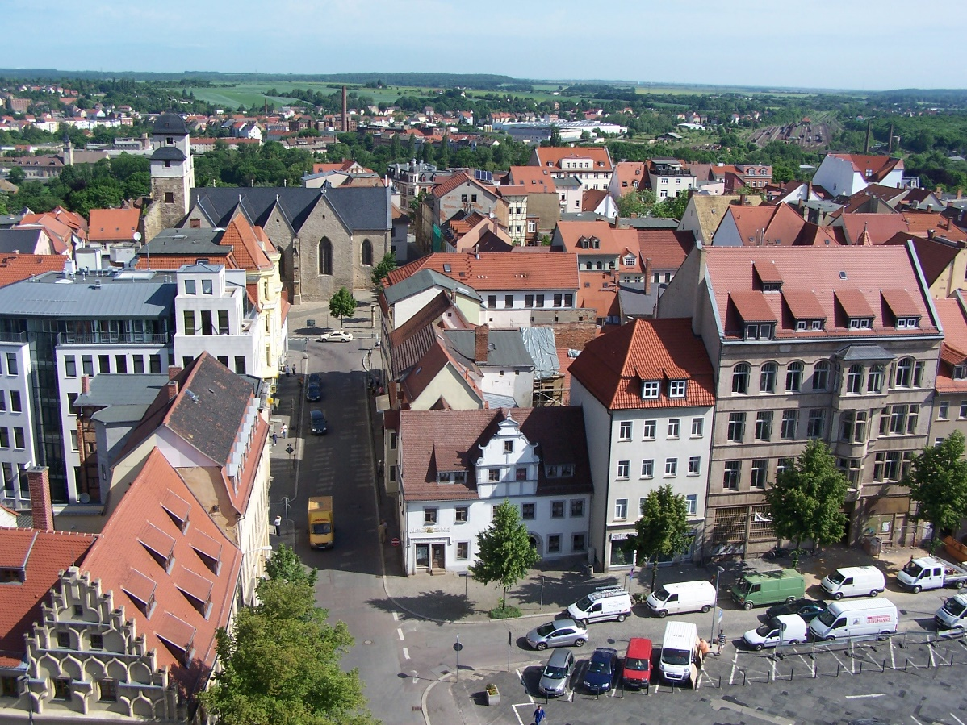
Zeitz

Slide 16
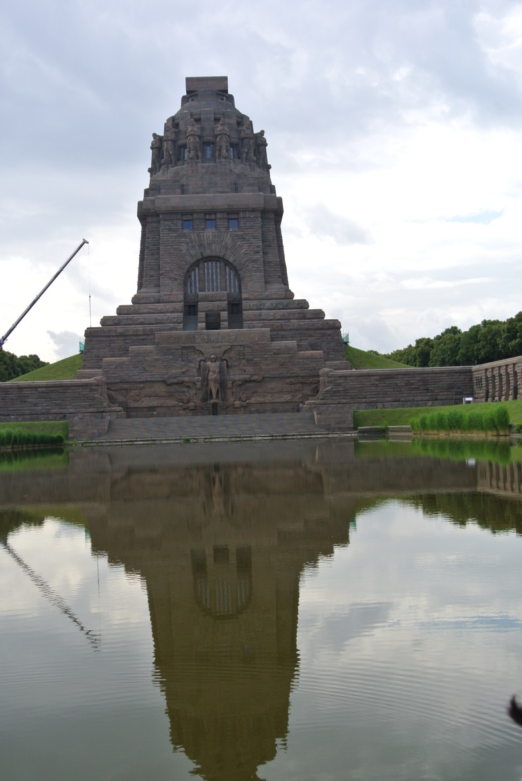
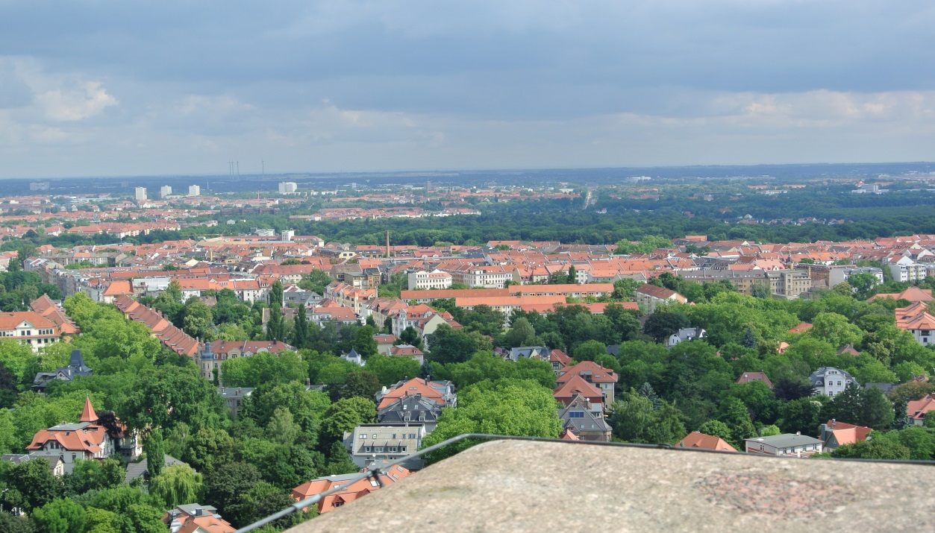
Leipzig

Slide 17
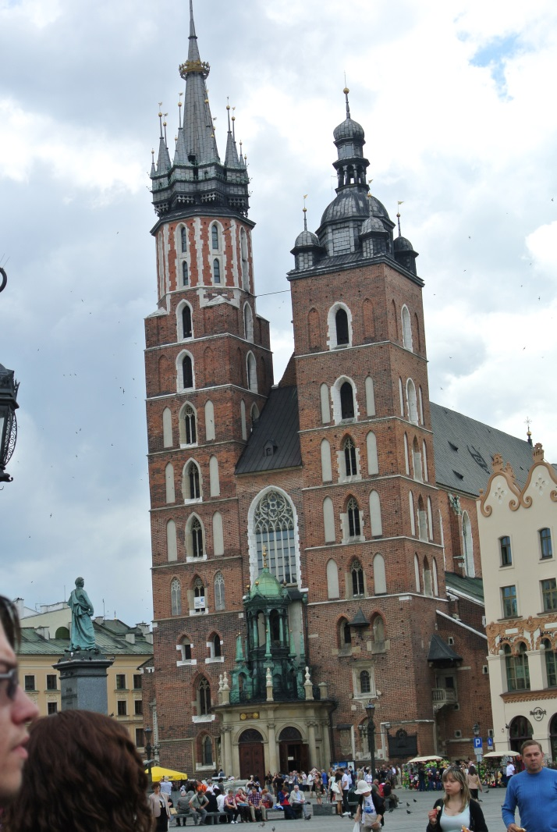
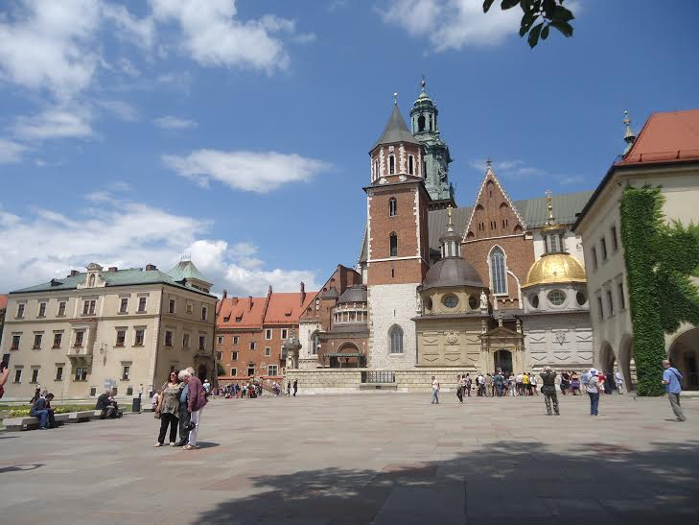
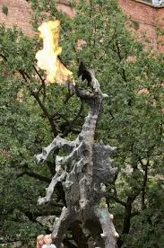
Poland
KRAKOW

Slide 18
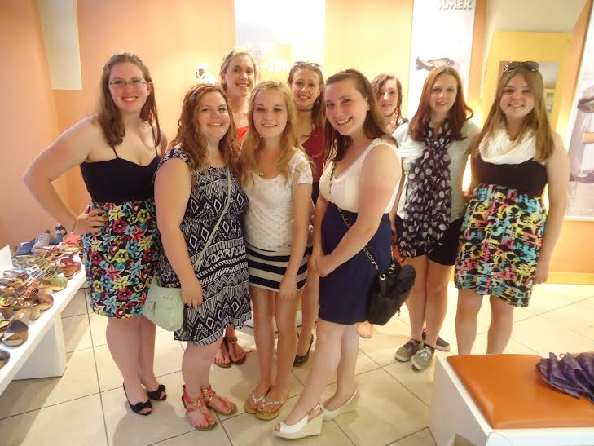
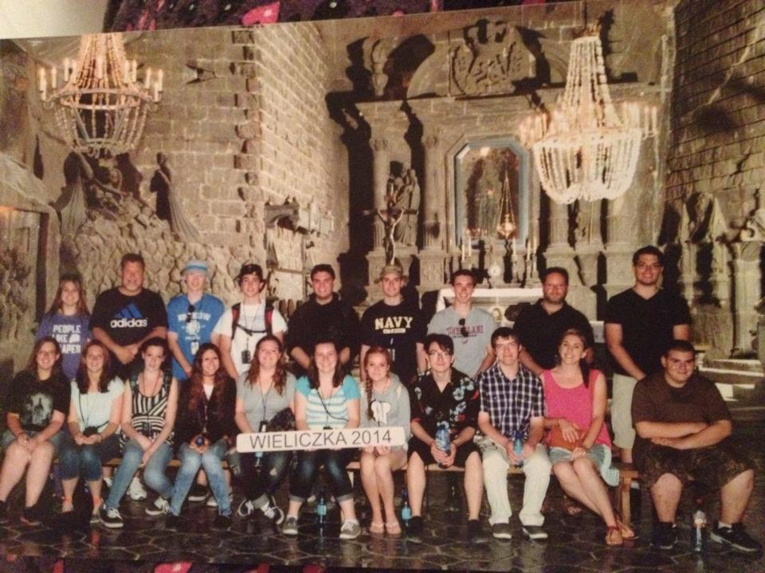
More Poland

Slide 19
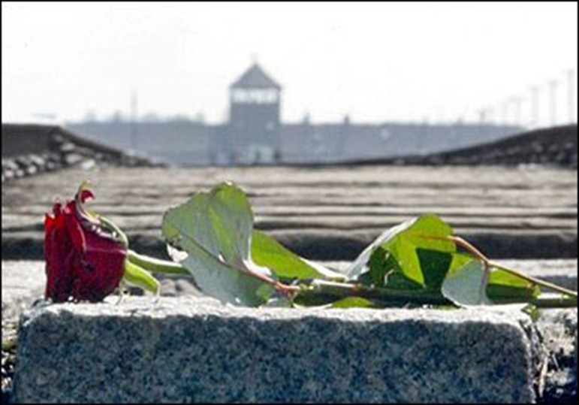
AUSCHWITZ

Slide 20
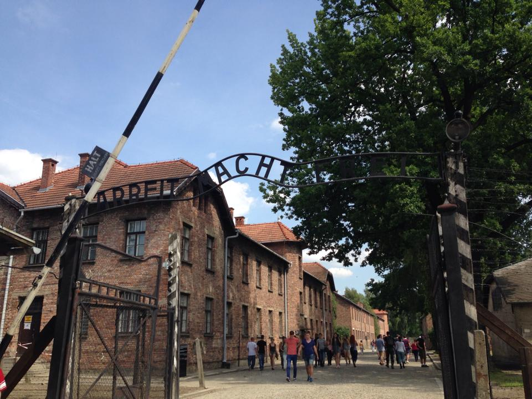
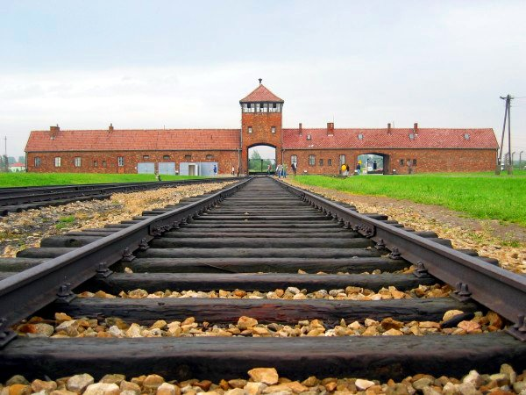
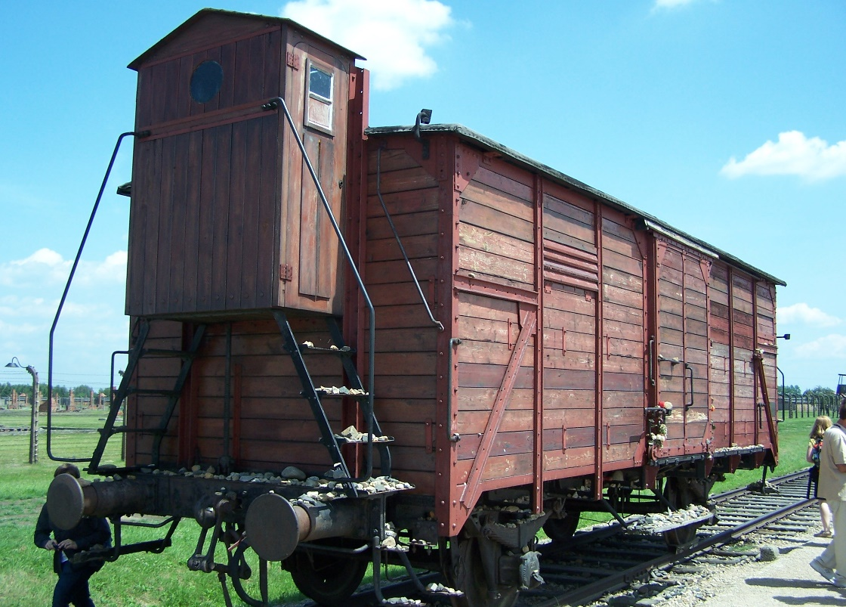
1940-45
2.2 million victims

Slide 21
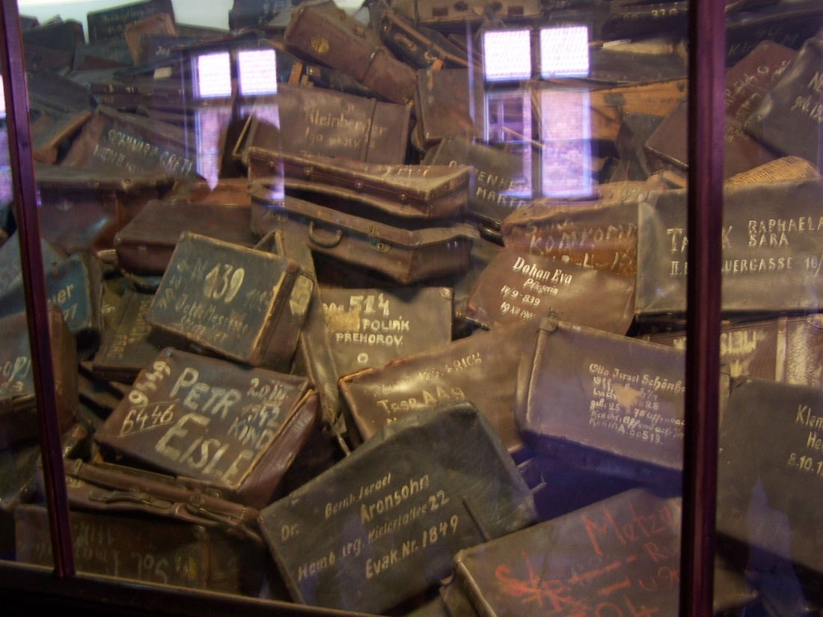
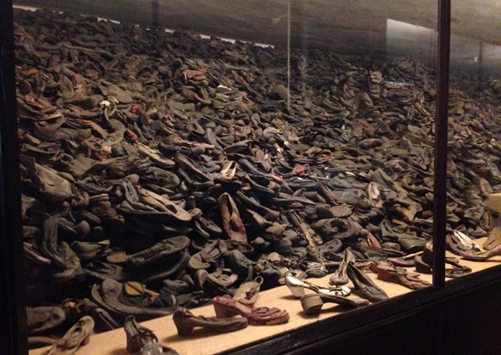

Slide 22
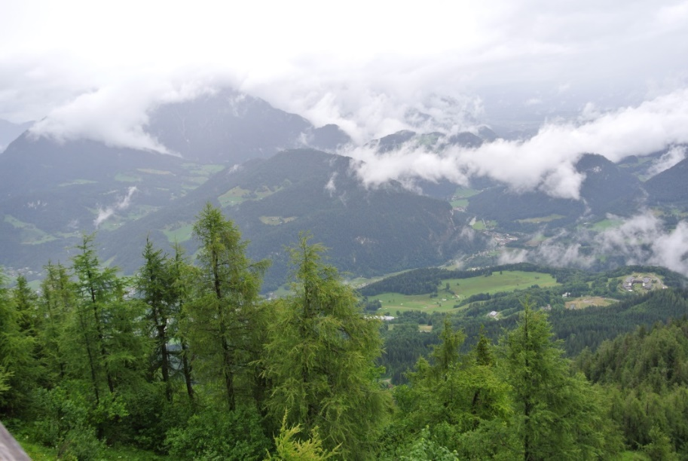
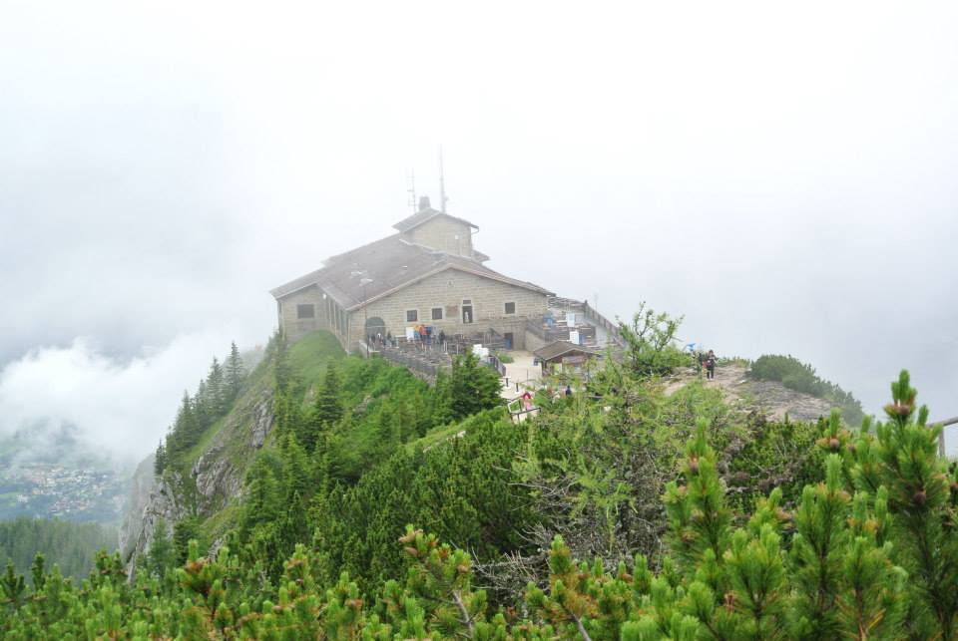
Hitler’s Tea House

Slide 23
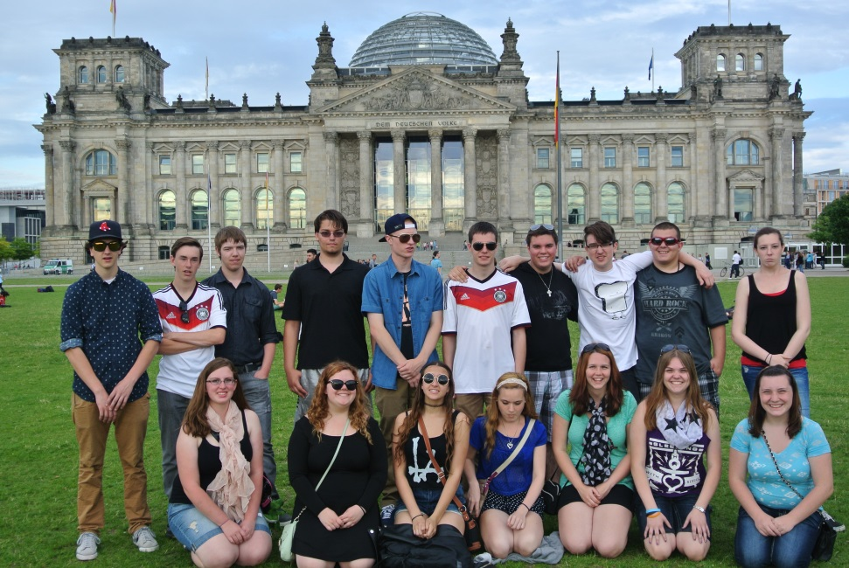
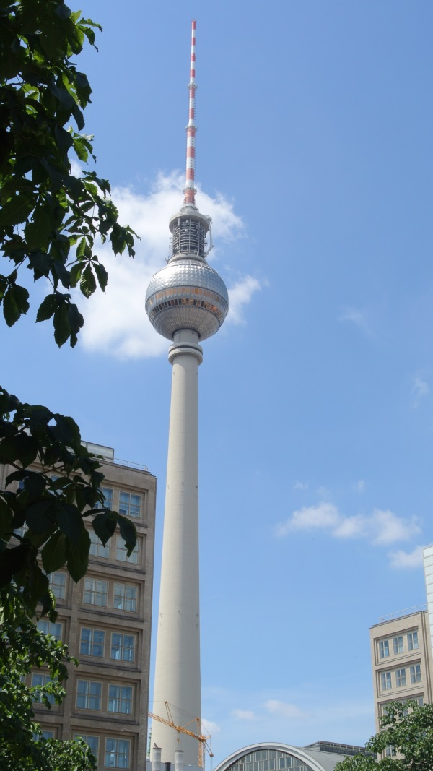
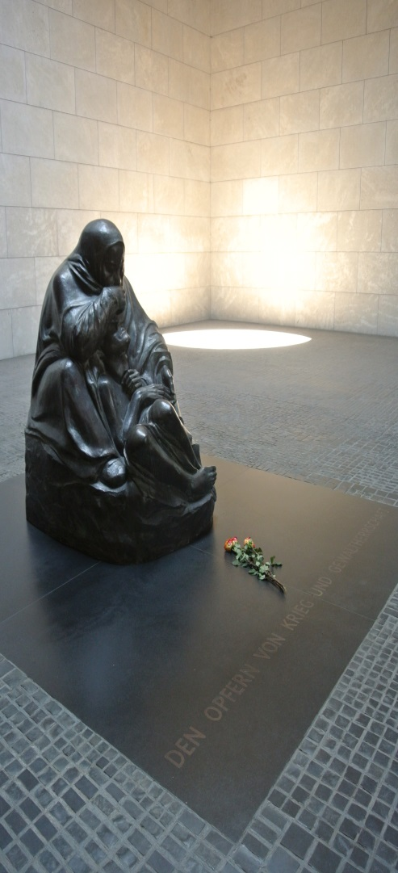
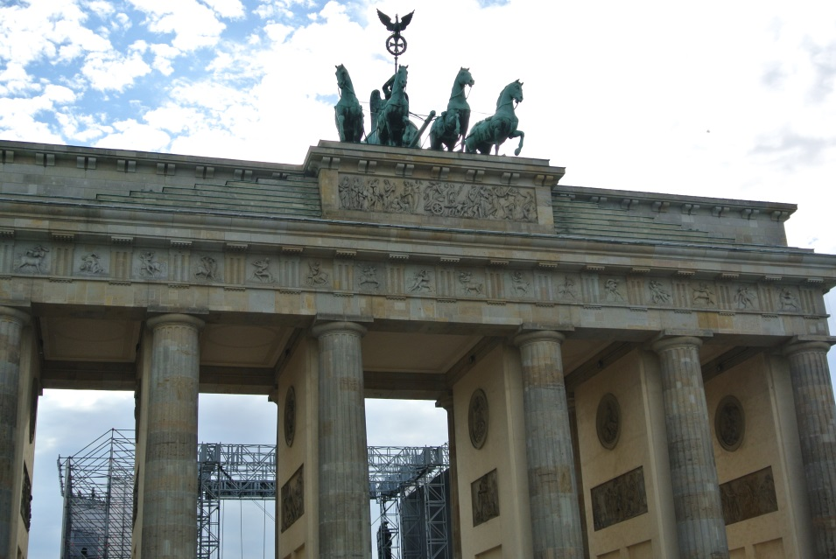
Berlin

Slide 24



Munich

Slide 25



Austria

Slide 26

The Eagle’s Nest, July 9th

Slide 27
Es war sehr gut! Danke!
Special Thanks to our great teachers who traveled with us
Herr Madsen
Mr. Rugoletti
Senora G
Students on the trip:
Tiffany Zukas
Jon Hinson
Miranda Kryskow
Cody LaMonica
Galen Morrill
Sam Kappler
Ryan Madsen
Tim McLaughlin
Bailey House
Sara Ramirez
Gina Pelechowicz
Nick Pelechowicz
Nick Ragust
Jeremy Walker
Brianna Hankel
Kayla Clegg
Stephanie Flathers

