Slide 1
Class of 2014 SAT Scores
School Board Meeting
January 2015

Slide 2
2014 Senior SAT Results :
214 Timberlane Seniors tested.
If students tested more than once,
most recent score was used.
Year | 2014 | 2013 | Difference
Critical Reading | 499 | 485 | +14
Math | 521 | 508 | +13
Writing | 495 | 483 | +12

Slide 3
SAT Summary / 3 Years Timberlane Seniors

Slide 4
2014 SAT Comparison Scores –
NE States / Public HS Scores

Slide 5
Standardized testing scores like SATs are only one variable in the admission decision process, however we can use SAT data and GPA’s of our graduates to aide us in counseling our students.
Counselors and students can review historical ‘Scattergrams’ to gain prospective of admission data of pervious Timberlane students.
Naviance - a web-based resource for students and parents that encourages and supports post high school career and college planning

Slide 6
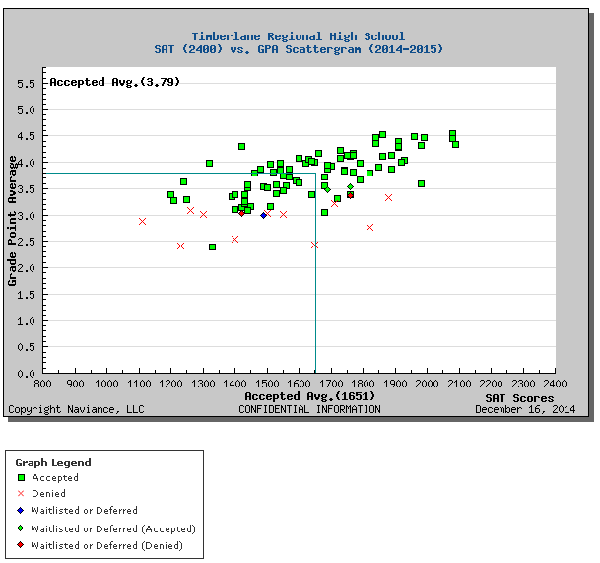
SAT and GPA Naviance Scattergram
  Displays graduated students admission status as well as GPA and SAT scores – Univ. of NH

Slide 7
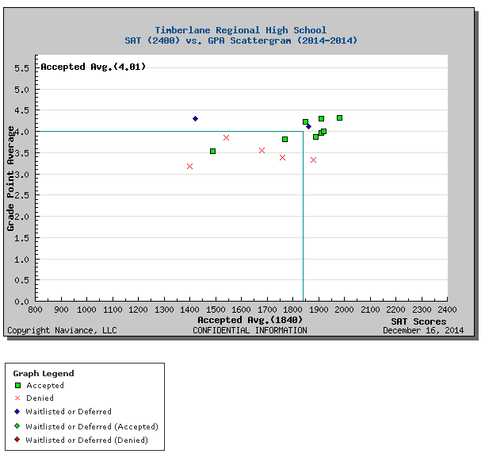
SAT and GPA Naviance Scattergram
  Displays graduated students admission status as well as GPA and SAT scores – WPI

Slide 8

Questions

