Slide 1
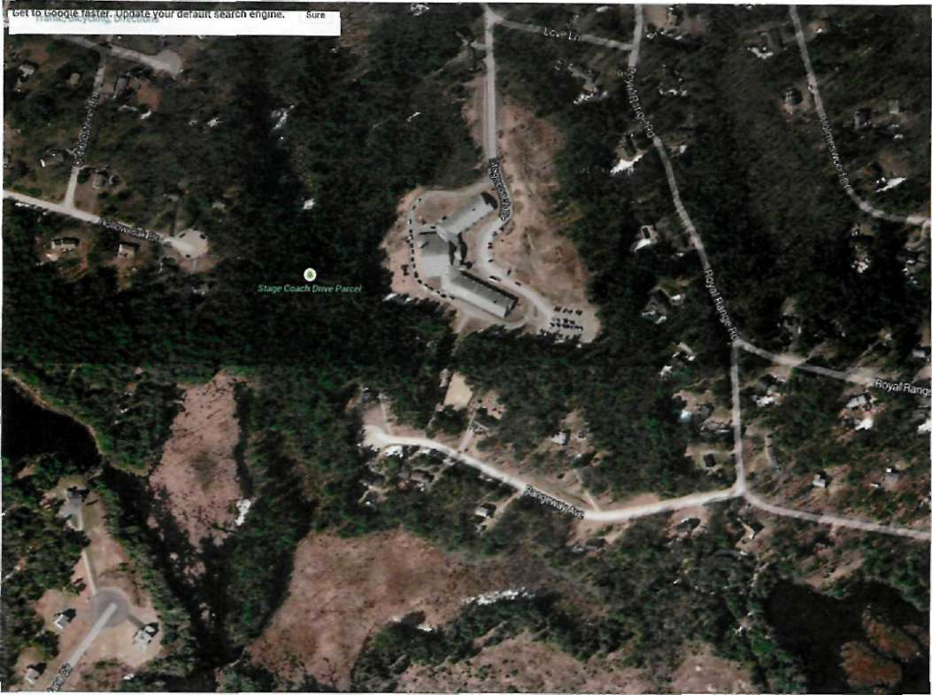
Sandown North Elementary
56,000 square feet/42 acre site

Slide 2
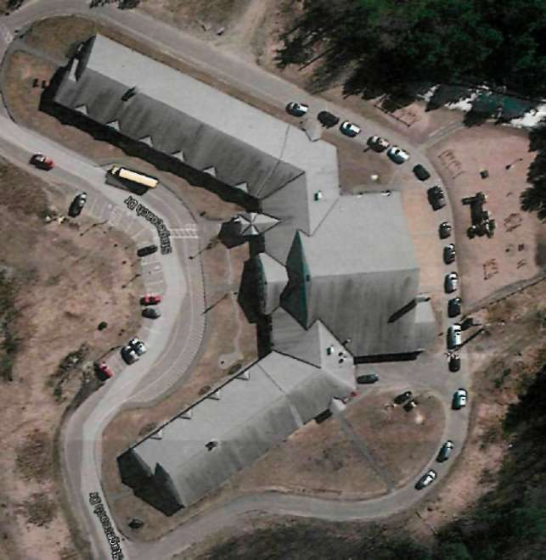
Sandown North Playground

Slide 3
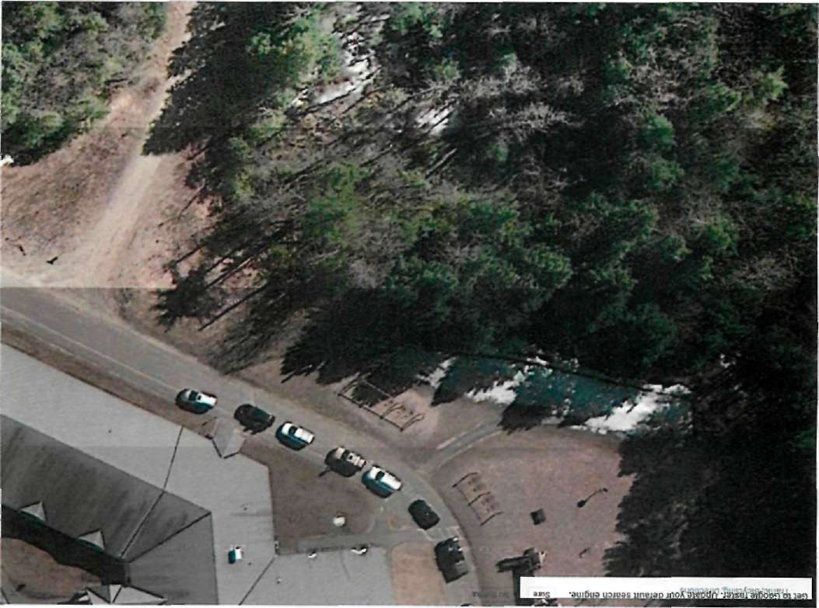
Sandown North Playground

Slide 4
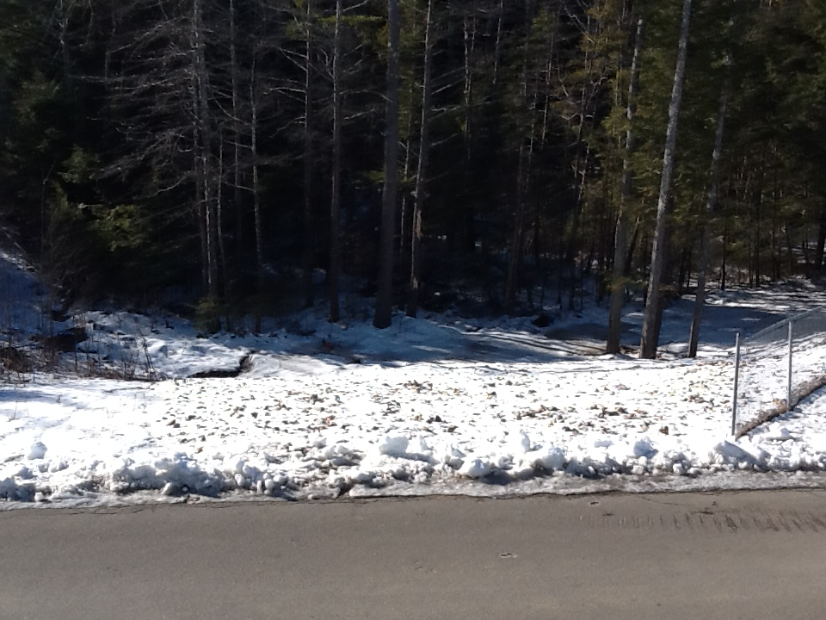

Slide 5
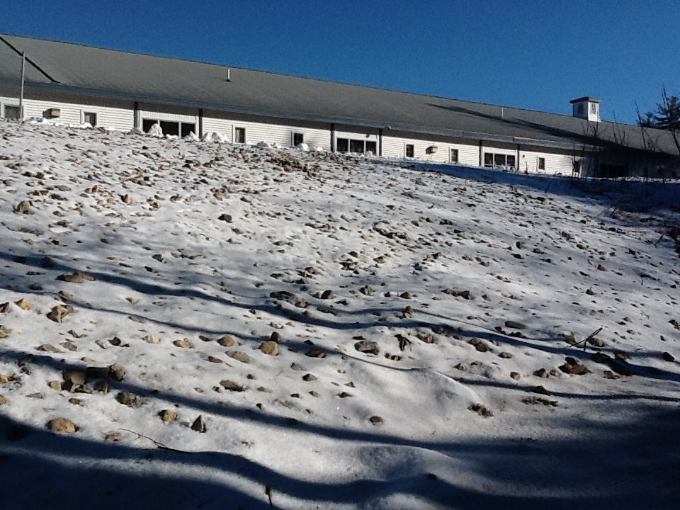

Slide 6
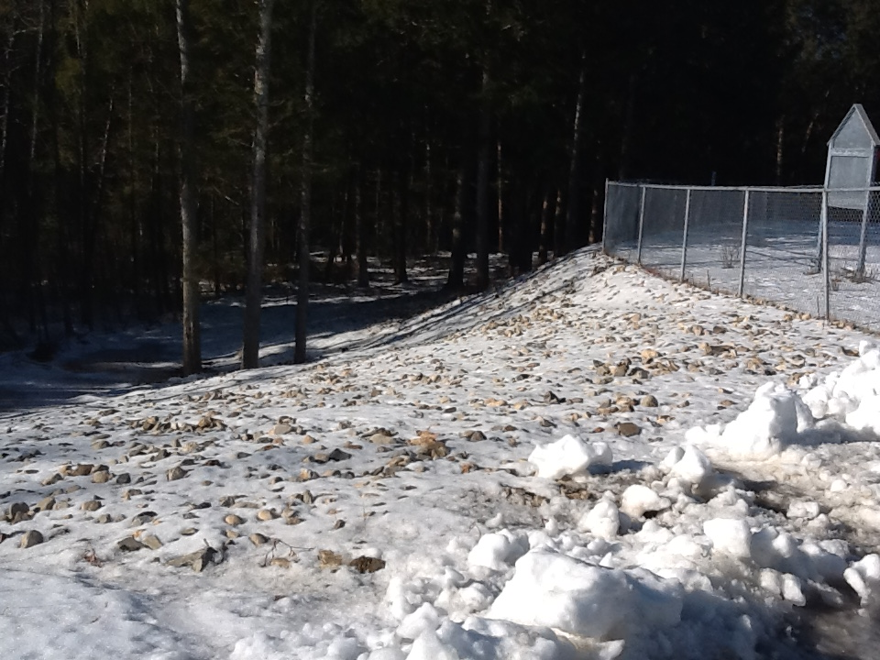

Slide 7
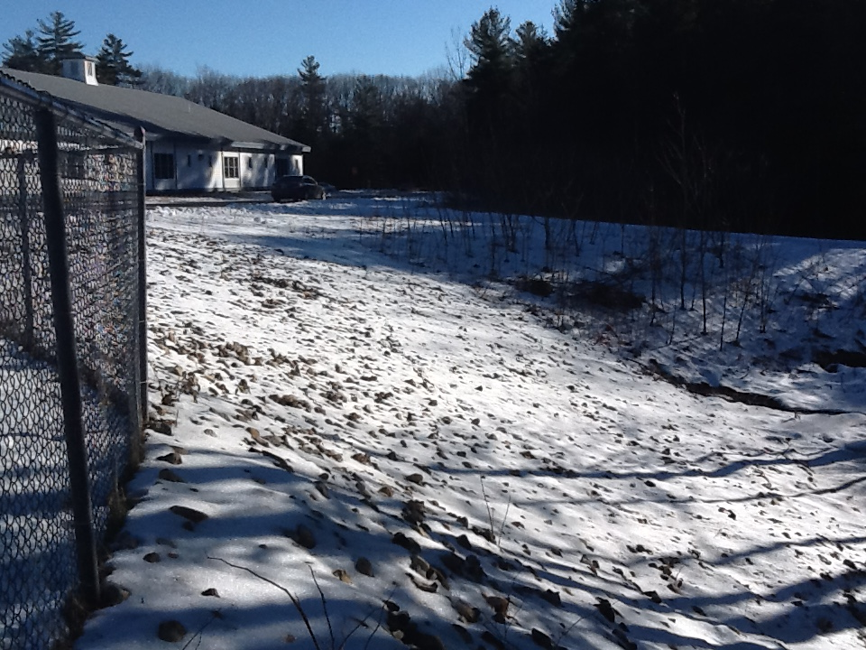

Slide 9
Sandown North Playground
Create an area approximately 60’ x 125’
Install 2 – 3 pieces of playground equipment
Equipment to be determined by PLT & PE

Slide 10
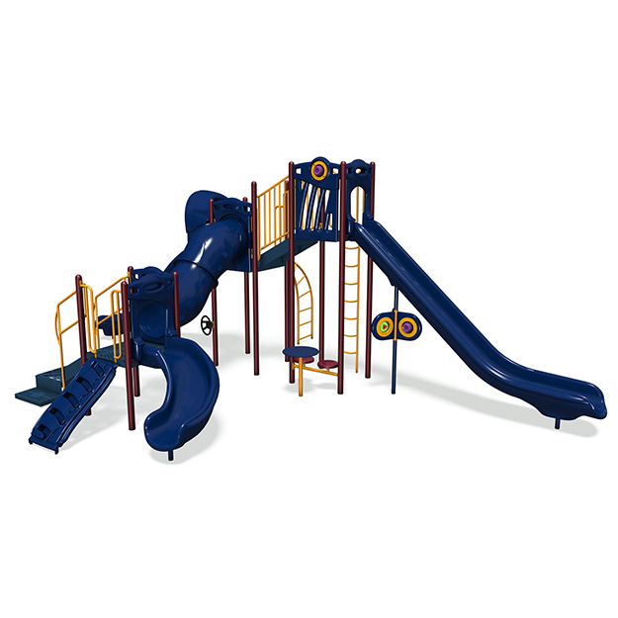
Sandown North Playground

Slide 11
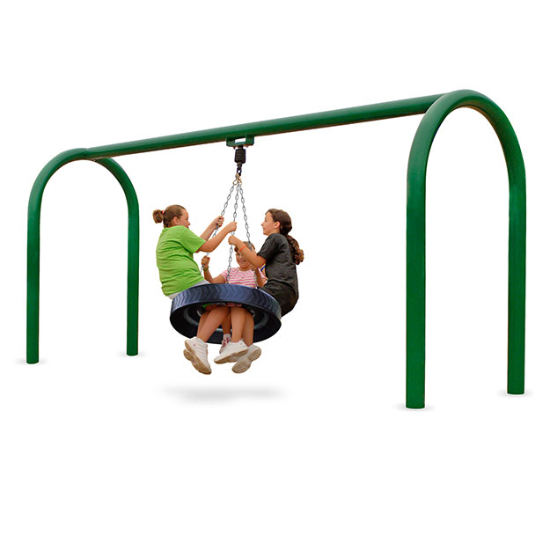
Sandown North Playground

Slide 12
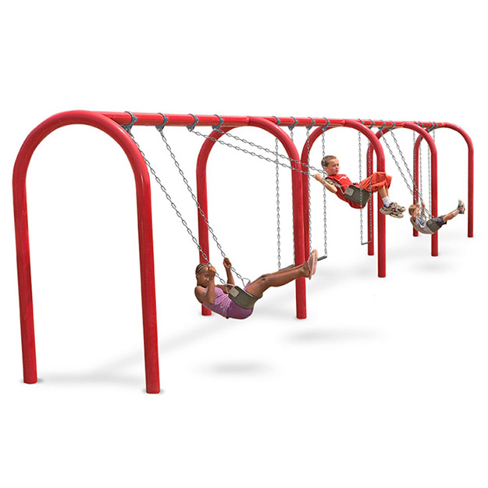
Sandown North Playground

Slide 13
Sandown North Playground Project
Site work $15,000.00
Playground Fiber $5,000.00
Fencing $8,200.00
Playground Equipment $35,000.00
Total Cost $63,200.00

