Slide 1
PROPOSED EAGLE PROJECT BY
TYLER BOOTH
Installation of Raised Garden Beds
At Timberlane Regional High School
Notes:
Introduce your self. Tyler Booth, from Troop 18 and this is my proposed Eagle Project.

Slide 2
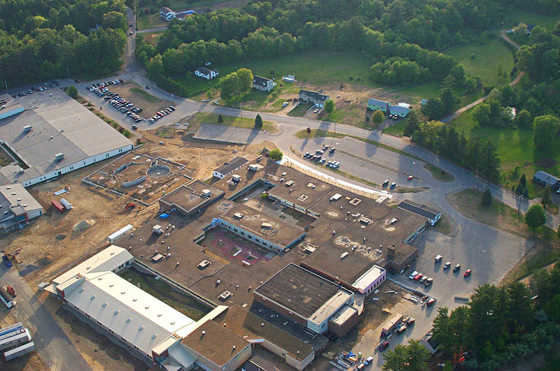
Raised Garden Beds will be located at Timberlane High School in the back Courtyard in this area Area being worked is approximately 1200 Square feet. Estimated material cost is around $1800.00.
East Wall
Notes:
The raised garden beds will be located at Timberlane Regional High School, in the back Courtyard as shown in the picture. Area to be worked is on the east side of the courtyard and the size of the area is approximately 1200 SQ. FT.
Material cost is around 1,800.00 dollars.

Slide 3
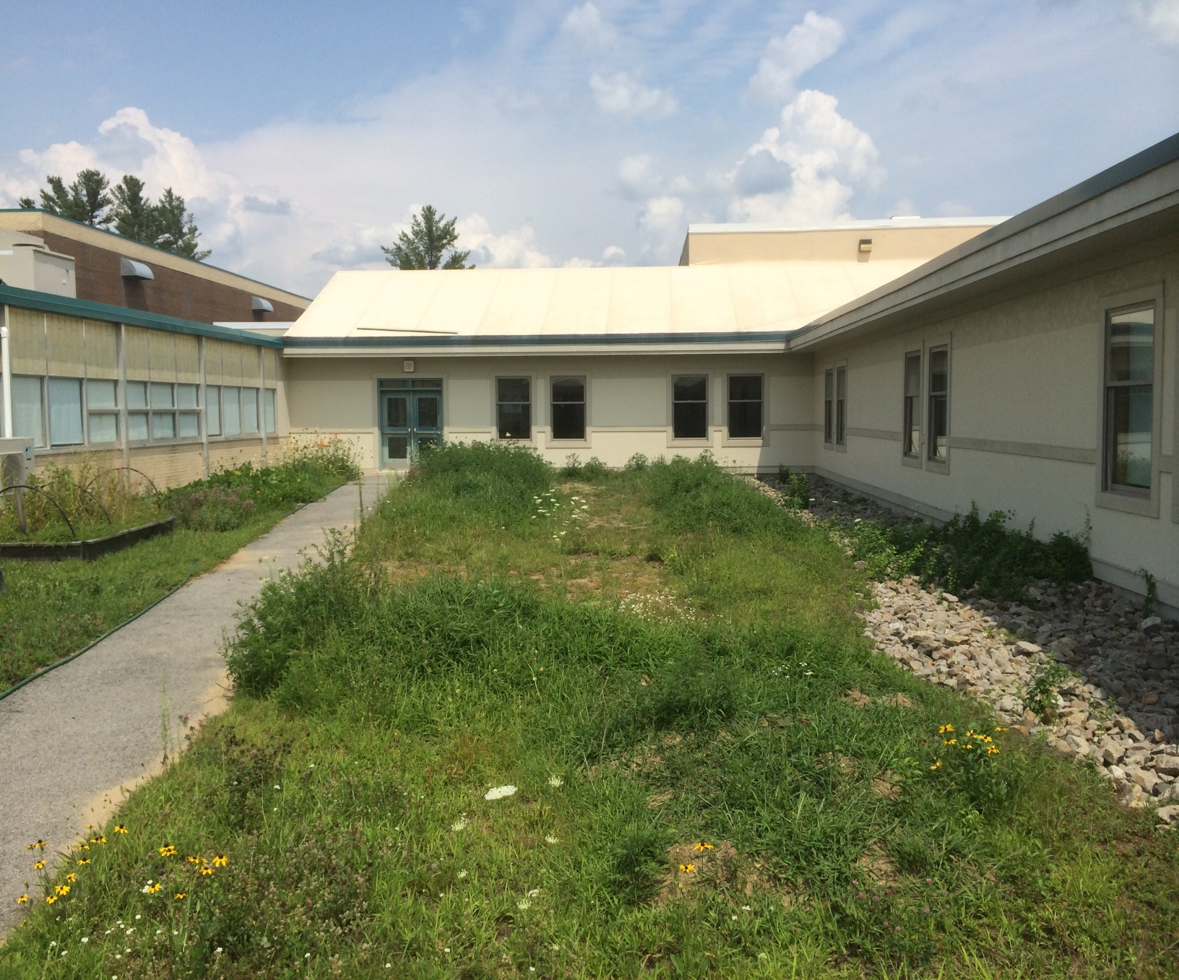
Location of the 4 Raised garden beds
Location of the elevated Garden bed
Notes:
Looking toward the east wall. This is a rough location for the 5 Raised Garden beds. The lower bed will be the elevated garden bed. This area once had a large mound that was dug up by some Hawaiian exchange students last spring and was spread around this area into smaller mounds. The soil from the mounds needs to be moved to a central location (area to the west side of the Elevated Garden Bed) to allow the ground to be leveled and the to locate where the beds will be located. The soil that is removed will need to be screened to remove large rocks and sod. This soil will then be used to fill the raised garden beds.

Slide 4
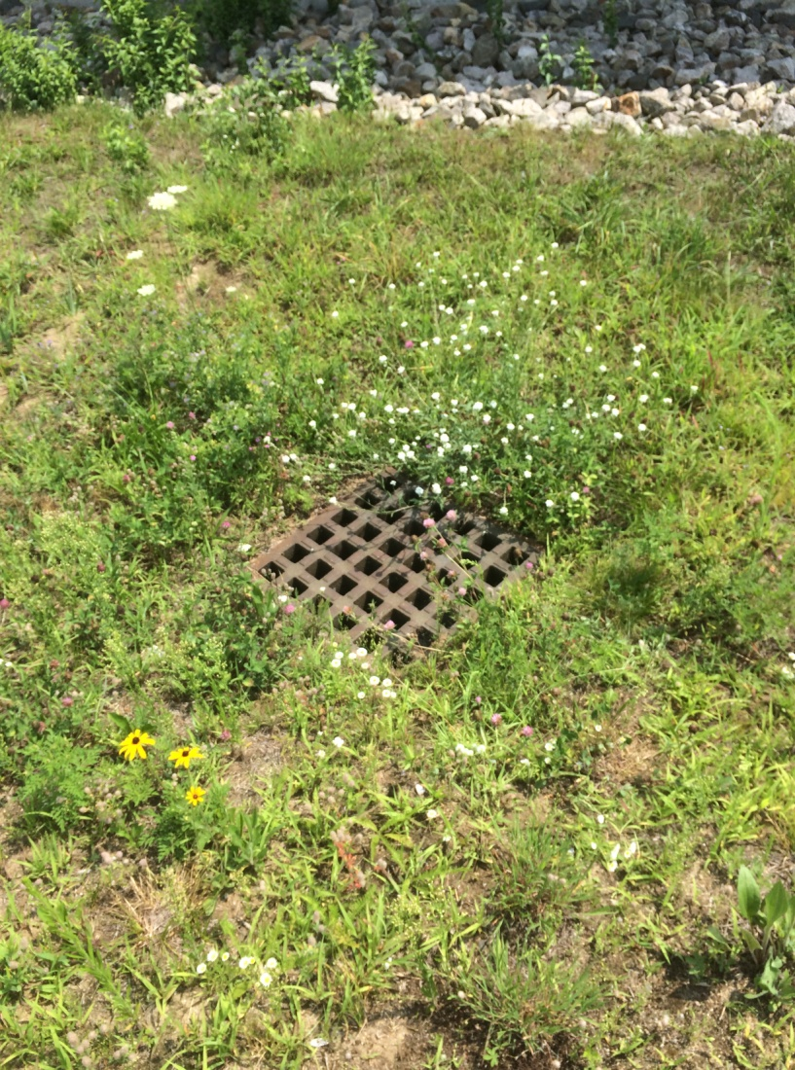
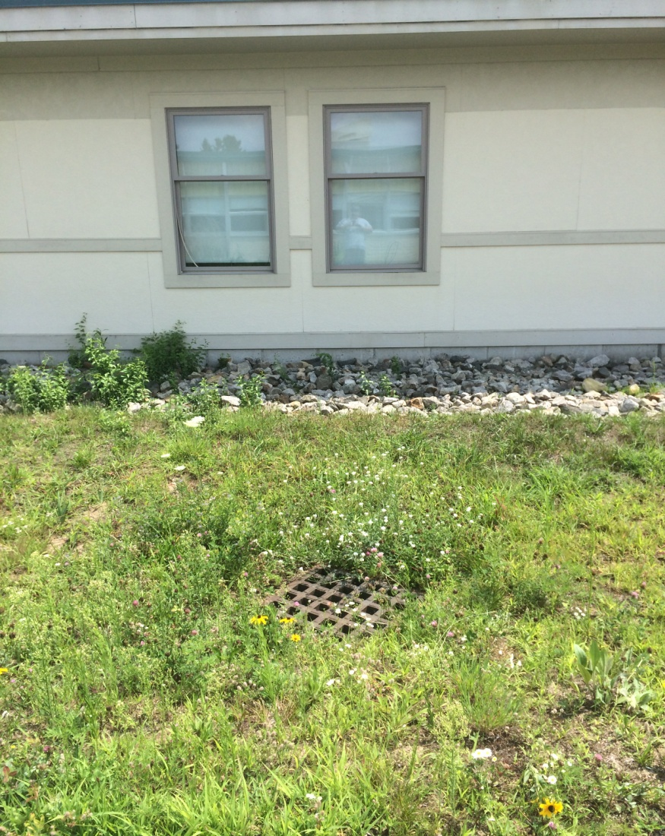
Drainage Area
Notes:
The drainage area is a few feet away from where the raised garden beds are going to be located. The plan is to remove topsoil, put down ground cloth and crushed stone from around the drain over to the rock barrier by the building, over to the side walk, approximately 4 to 6 feet to the west side of the drain and over to and around the area of rubberized mulch. This will help to facilitate better drainage. The final slid will better show the layout of the beds and how the materials will be spread out.

Slide 5
Raised Garden Bed
(4’ X 8’)
Plan View
4X4
2X4
2X4
2X4
4X4
2X4
4’
2X4
8’
4X4
4X4
2X4
2X4
2X4
4X4
2X4
2X4
2X4
4X4
10”
12”
Notes:
This is the design of the Raised Garden Bed. There will be 5 raised garden beds made, one, which will be an elevated bed to allow wheel chair access. Garden beds are going to be 4 feet by 8 feet and will be 12 inches high. They will be constructed from Red Cedar using five quarter boards, 2 by 4’s and 4 by 4’s. The stand for the elevated bed will be constructed using 4 X 6 and 6 X 6 Pressure treated lumber. Red Cedar lumber is recommended for use in this application and has a life of 30 plus years.

Slide 6

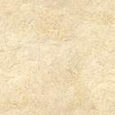

Elevated Raised Garden Bed
Notes:
This view shows the elevated bed sitting on the base with corned boards in place that will hold the garden bed to the base. Also pictured are the footings that will be filled with crush stone to help provide support so that the bed will not settle or sink into the ground.

Slide 7



Partial view of the Courtyard depicting Drain Area, Side Walk and Existing Lawn Area. Along with New Garden Beds, Crushed Rock and Rubberized Mulch Area
Existing Rock
Existing Rock
Crushed Stone
Rubberized Mulch
New Crushed Stone
Existing Rock
New Raised Bed
Drain Grate
New Crushed Stone
New Raised Bed
New Raised Elevated Bed
New Raised Bed
New Raised Bed
Rubberized Mulch
Side Walk
Door
Side Walk
Existing Raised Garden Bed
Existing Lawn Area
Existing Rock
Existing Rock
Notes:
This slide shows the layout of the 4 Raised Garden Beds along with the location of the Elevated Garden Bed, along with the area that is going to be filled with Rubberized Mulch and the area where the new Crushed Stone is to be spread. It also shows the area’s of existing rock that run between what is being developed and the exterior wall of the school, it also shows the side walk and an area of the existing lawn and raised garden bed.
This Eagle Project has been approved by the Troop Committee and has been review and approved by Mr. Hughes the Facilities Manager for the School District. If approved by the School Board then the Proposal for this Eagle Project will be submitted to the Council for acceptance. Once the project gets approved, my plan is to then seek donations from area businesses to help with the cost project and I hope to start the project late spring, early summer. Any Questions?

