Slide 1
School Funding – Articles of Agreement
To see if the Timberlane Regional School District shall replace Article #5 and Article #6 from the April 30, 1964 agreement to read as follows:
5. The operating and capital expenses of the Timberlane Regional School District payable in each fiscal year shall be apportioned at a rate so each pre-existing district pays the same local school rate of taxation based upon the equalized valuation as most currently available as determine by the State Tax Commission. All forms of aid and local school impact fees from each pre-existing district will be applied to reduce the operating and capital expense before apportionment.
6. Repealed

Slide 2
School Funding – Philosophy
We came together as one entity to form the Timberlane Regional School District in 1964 for a common goal. In a similar manner Rockingham County was formed by the various towns that compose it to support a common goal. Portsmouth and Rye pay the same county tax rate as Atkinson, Danville, Plaistow, and Sandown. That rate is derived by taking the operating budget and distributing it across all Towns based upon their equalized assessed values. There is no function, in determining that rate, of the number of patrons at the Rockingham County Jail, or the number of beds occupied at the Rockingham County Nursing Home from a participating town. It is one homogeneous entity.

Slide 3
School Funding – Articles of Agreement
Budget (MS22 & 24) | $ 67,335,682
Less Local Rev & CR (MS24) | $ 9,086,306
Total Appropriations | $ 58,249,376
Less Net Capital | $ 2,516,274
Current Expenses | $ 55,733,102
Less Town Specific (MS24 Rev) | $ 144,515
Current Expense to Apportion | $ 55,588,587

Slide 4
Capital Expenses
Capital Equipment | $ 3,620,085
Less Building Aid | $ 1,103,811
Less Capital Reserve | $ 0
Less Net Capital | $ 2,516,274

Slide 5
School Funding – State Aid
Town | EE Retained Tax | EE Grant
Atkinson | $ 2,079,827 | $ 1,221,729
Danville | $ 769,613 | $ 3,299,767
Plaistow | $ 2,079,337 | $ 2,497,900
Sandown | $ 1,266,123 | $ 4,364,892
Total | $ 6,194,900 | $ 11,384,288
Total Aid (EE Ret Tax + Grant) |  | $ 17,579,188
EE Retained Tax is $2.43 or $2.45/$1K assessed

Slide 6
School Funding – ADM (Average Daily Mean)
Town | ADM | ADM Ratio
Atkinson | 917.68 | 23.38%
Danville | 762.64 | 19.43%
Plaistow | 1188.16 | 30.27%
Sandown | 1056.26 | 26.91%
Total | 3924.74 | 100.00%

Slide 7
School Funding – Equalized Property Value (EPV)
Town | Equalized Value | EPV Ratio
Atkinson | $ 846,875,141 | 33.42%
Danville | $ 315,940,514 | 12.47%
Plaistow | $ 854,548,611 | 33.73%
Sandown | $ 516,462,705 | 20.38%
Total | $ 2,533,826,971 | 100.00%

Slide 8
School Funding – Local School Impact Fees
Town | Dollar Amount
Atkinson | $ 25,909
Danville | $ 54,703
Plaistow | $ 20,000
Sandown | $ 43,903
Total | $ 144,515

Slide 9
School Funding – New Proposal Breakdown
Operating Budget | $ 55,588,587
Capital (+) | $ 2,516,274
Total Expenses | $ 58,104,861
Total Aid (-) | $ 17,579,188
Total Impact fees (-) | $ 144,515
Total Appropriations | $ 40,381,158
Total Assessments | $ 2,533,826,971
Tax Rate/$1K | $ 15.9368

Slide 10
School Funding – New Proposed Local School Tax
Town | Amount to be raised locally * | New School Apportionment
Atkinson | $ 13,496,501 | $ 16,823,966
Danville | $ 5,035,089 | $ 9,159,172
Plaistow | $ 13,618,792 | $ 18,216,029
Sandown | $ 8,230,776 | $ 13,905,694
Total | $ 40,381,158 | $ 58,104,861
* Amount to be raised locally = EPV (Town) * $15.9368/$1K

Slide 11
School Funding – New Proposed School Tax
Town | 2013 Local School Tax Rate * | 2013 State School Tax Rate | Total School Tax | Delta
Atkinson | $ 15.94 | $ 2.456 | $ 18.39 | $ 3.53
Danville | $ 15.94 | $ 2.436 | $ 18.37 | $ (6.19)
Plaistow | $ 15.94 | $ 2.433 | $ 18.37 | $ 0.63
Sandown | $ 15.94 | $ 2.452 | $ 18.39 | $ (3.04)
* Proposed changed = $15.9368/$1K

Slide 12
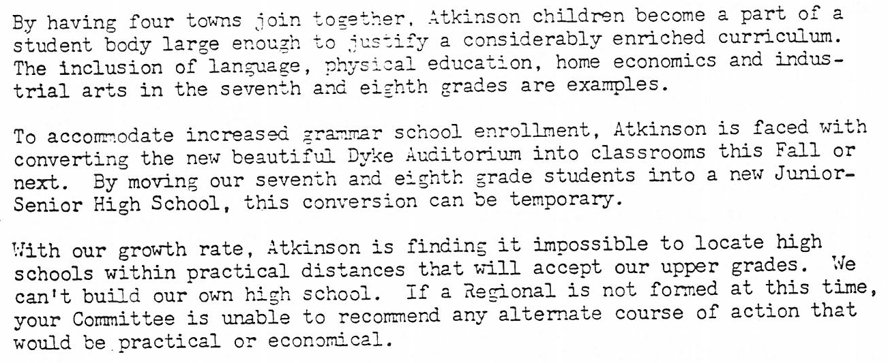
May 1964 Report to the Voters
Page I-3:
To the Voters of Atkinson:

Slide 13
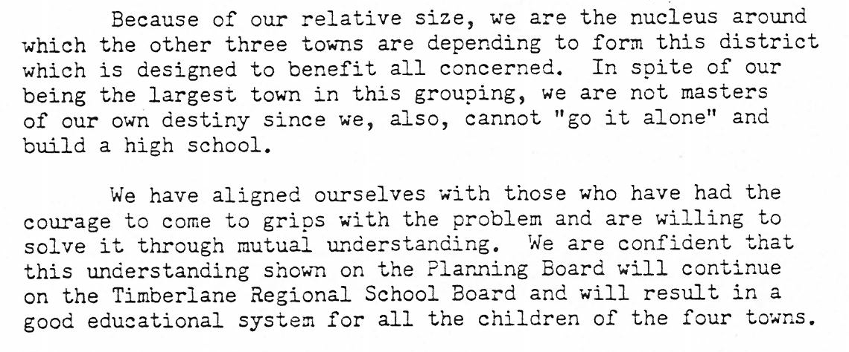
May 1964 Report to the Voters
Page I-5:
To the Voters of Plaistow:

Slide 14
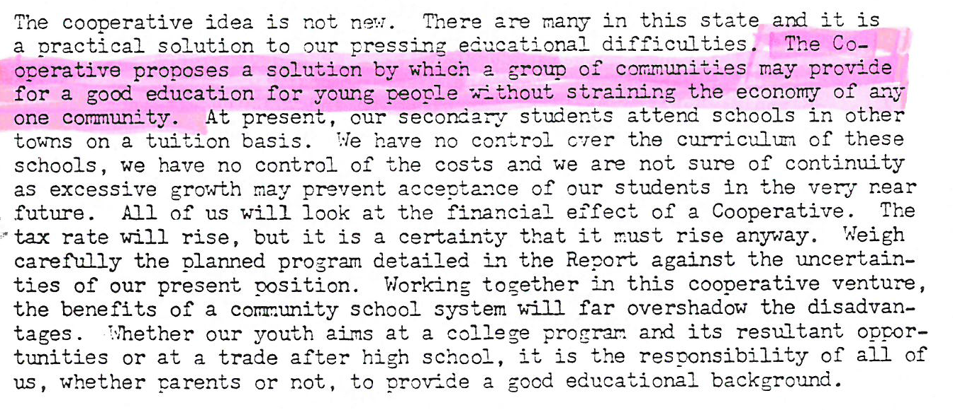
May 1964 Report to the Voters
Page I-6:
To the Voters of Sandown:

Slide 15
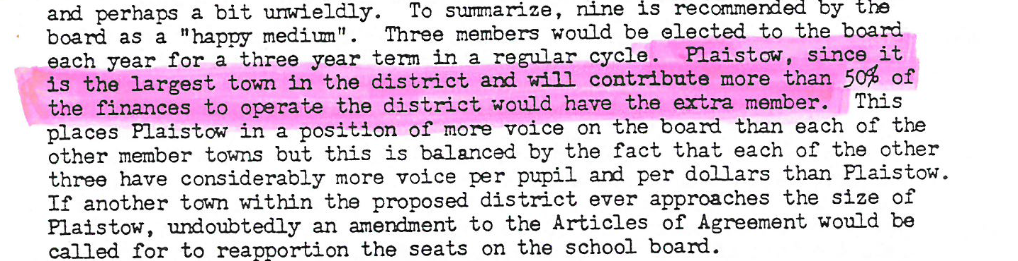
May 1964 Report to the Voters
Page II-4:
Detailed Analysis of Articles of Agreement – Article 2:
2014 – Plaistow is responsible for 33% of the budget

Slide 16
School Funding – Special Education
Town | SPED ADM | SPED Dollar Received
Atkinson | 121.36 | $ 232,509
Danville | 152.45 | $ 292,073
Plaistow | 225.71 | $ 432,429
Sandown | 236.19 | $ 452,507
State Aid for SPED is $1,915/ADM

