Slide 1
Timberlane Regional Middle School goes to
Destination Imagination Global Finals!
What have we been doing?
What have we accomplished?
What is the opportunity?
What do we need from you?

Slide 2



What we have been doing!
Since November 2014, the Three Amigos have been meeting outside of school hours to prepare for their team challenge and instant challenge competitions.
Team Challenge
Instant Challenge
Points of Interest
- Create three independent improvisational sketches.
- Research and incorporate improvisational games and street performances.
- Practice integrating randomly selected situations and settings
Team members must think under pressure by applying appropriate skills to produce a solution to an instant challenge in a period of just 5 to 8 minutes.
What does improv have to do with education?
“Not only does it hone communication and public speaking skills, it also stimulates fast thinking and engagement with ideas. On a deeper level, improv chips away at mental barriers that block creative thinking — that internal editor who crosses out every word before it appears on a page — and rewards spontaneous, intuitive responses” - Deana Criess, director of ImprovBoston’s National Touring Company
www.Gofundme.com/ThreeAmigos

Slide 3
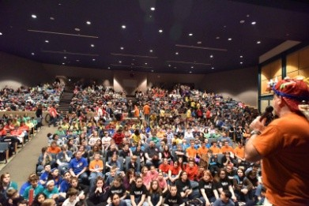
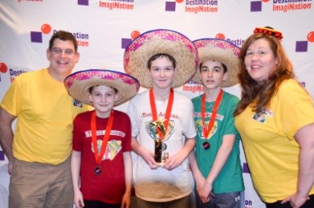
What we have accomplished!
Spirit of Discovery & Imagination Award
"This middle level team embodied the principles and essence of Destination Imagination in their approach to solving their Instant Challenge. They demonstrated that it’s not always about the points; it’s about the process."
Kingston Regional
Improv Games
Middle School Level
1st Place
State Tournament
Improv Games
Middle School Level
2nd Place
www.Gofundme.com/ThreeAmigos

Slide 4

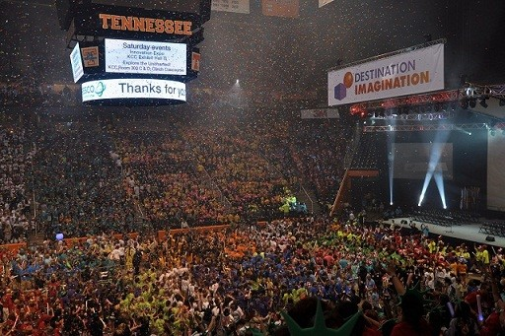
Our Opportunity
Over 1,600 teams
From 47 States
And 16 countries
World’s largest celebration of creativity!
Agenda
Opening Ceremonies
Skills Workshops
Innovation Expo
Duct Tape Ball
Passport Party
Pin Trading
Meeting people from around the world!
Competing
Closing Ceremonies
www.Gofundme.com/ThreeAmigos

Slide 5
Our Opportunity
www.Gofundme.com/ThreeAmigos
In 2013, you sponsored Danville Elementary DI team with $4,000. Thank you!
Will you do it again?
Excused Absence May 19 – 22 for Patrick
Proctor, Hayden Bean and Travis Alexander
Permission to take students on the trip
Help raising Funds!
Planned Fundraising Activities:
Tagging
Local business sponsors
Basket Raffles
Bake Sales
Benefit Concert
Expenses
Costs | PP | 3 Students | 2 Coaches | 2 Parents | Total
Entrance Fee/Room Board | $715.00 | $2,145.00 | $1,430.00 | $1,430.00 | $5,005.00
Airfare | $298.70 | $896.10 | $597.40 | $597.40 | $2,090.90
Auto Rental | $77.46 | $232.38 | $154.92 | $154.92 | $542.23
Misc (team shirts, materials, etc) | $50.00 | $150.00 | $100.00 |  | $250.00
Pins | $70.00 | $210.00 |  |  | $210.00
Grand Total | $1,211.16 | $3,633.48 | $2,282.32 | $2,182.32 | $8,098.13

