Slide 1


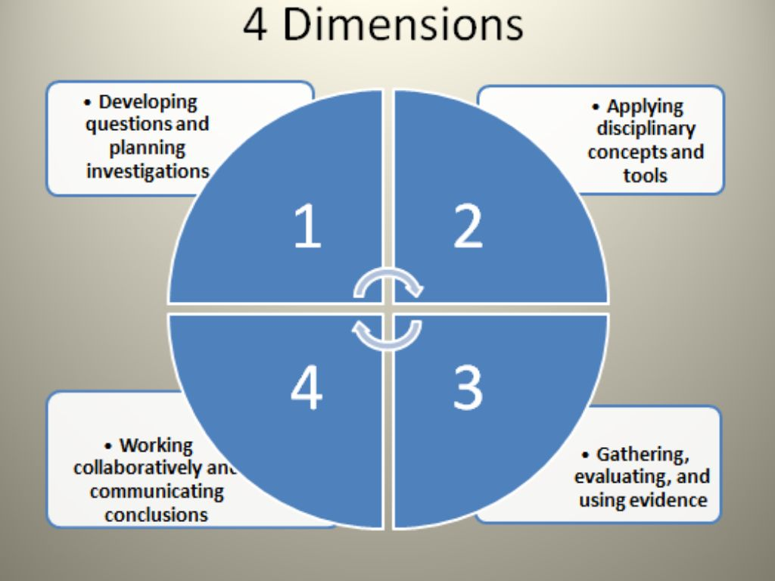
C3 Framework
CIVICS
GEOGRAPHY
ECONOMICS
HISTORY
Psychology
Sociology
Anthropology
SERVICE LEARNING
Taking Informed Action

Slide 2


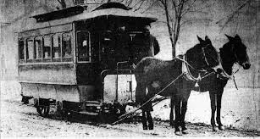
Scope and Sequence
K: Self and Others
1: Classroom and School
2: My Community
3: New Hampshire
4: United States Regions
5: North America
6: What Defines a Civilization?
7: The Roots of Democracy thru the Age of Exploration
8: Colonial America thru the Civil War
9: Freshmen Studies (Civics and Economics)
10: World History
11: Reconstruction thru Today
12: Electives

