Slide 1

Superintendent’s Advisory Committee
Sandown Elementary School Consolidation
21-May-2015

Slide 2

Committee Membership
Co-chairs:
Debra Armfield: Executive Director of Curriculum, Assessment and Profession Learning PK-12
Shawn Freligh: Sandown Resident
Members:
Erich Beyrent: Sandown Resident
Lou Broad: Teacher & TTA President
Nancy Danahy: Director of Human Resources
Lee Dube: Budget Committee Member
Jo-Ann Georgian: Principal Sandown North
Jon Goldman: Sandown Selectman
John Holland: Director of Technology
Patrice Liff: Assistant Principal/ Curriculum Coordinator - Sandown North
Sheila Lowes: Sandown Parent
Deb Lytle: Sandown Parent
Susan Rasicot: Director of Student Services
Beth Rincon: Director of Special Education
Doug Rolph: Principal - Sandown Central
Scott Strainge: Director of Alternative/Continuing Education and Enrichment
George Stokinger: Business Administrator SAU 55
Kelly Ward: School Board Member - Sandown
Dr. Roxanne Wilson: Assistant Superintendent of Schools
Mary Youngblood: Literacy Specialist - Sandown Central

Slide 3
Charge of The Committee
The Committee is charged with offering recommendations to the Superintendent to support and facilitate the effective consolidation of the two Sandown schools, with a focus on what is in the best interest of students, communities, the district, and special education programs.
It is not the charge of this Committee to make specific staff recommendations or prepare a fiscal analysis of the options. That responsibility will fall to the Superintendent.

Slide 4
Mission of the Committee
To create a blueprint for consolidating Sandown’s two elementary schools into a unified facility while providing an exceptional education for the enrichment of Sandown’s PK-5th grade students.
Inform the transition of current 4th grade Sandown Central School students to Sandown North School with minimal disruption.
Review long-term impacts and provide recommendations for future needs to the Superintendent in order to plan appropriately.
Create recommendations that consider the health, safety, education, development and success of Sandown elementary students, educators, administrators and parents, while considering the impact on all District stakeholders.
Recommend options for the utilization of the Sandown Central School facility that are fiscally responsible and meet the current and future needs of the District.

Slide 5
Timeline
24-Mar-2015: Committee is launched
  Committee met regularly over 6 weeks
  Included site walks at both Sandown schools.
19-May-2015: Final report and recommendations delivered to the Superintendent
20-May-2015: Report and recommendations are presented to the Superintendent and Leadership Team
21-May-2015: Overview of recommendations delivered to the School Board

Slide 6
Areas of focus
Classrooms and Programs
Future facilities considerations
Playgrounds and greenspace
Bus transportation
Traffic and Parking
Technology
Staff impact

Slide 7

Recommendations

Slide 8
Classroom and Programs
Relocate and consolidate the district-wide Timberlane Learning Center Preschool Program and Early Learning Environments to Sandown Central School
Relocate all Sandown North Kindergarten classes to Sandown Central School
House Grades 1-5 at Sandown North Elementary School
Create a Transition Committee to Support Consolidation

Slide 9
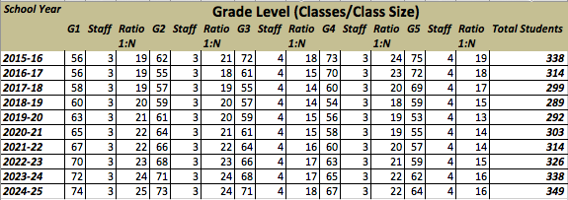
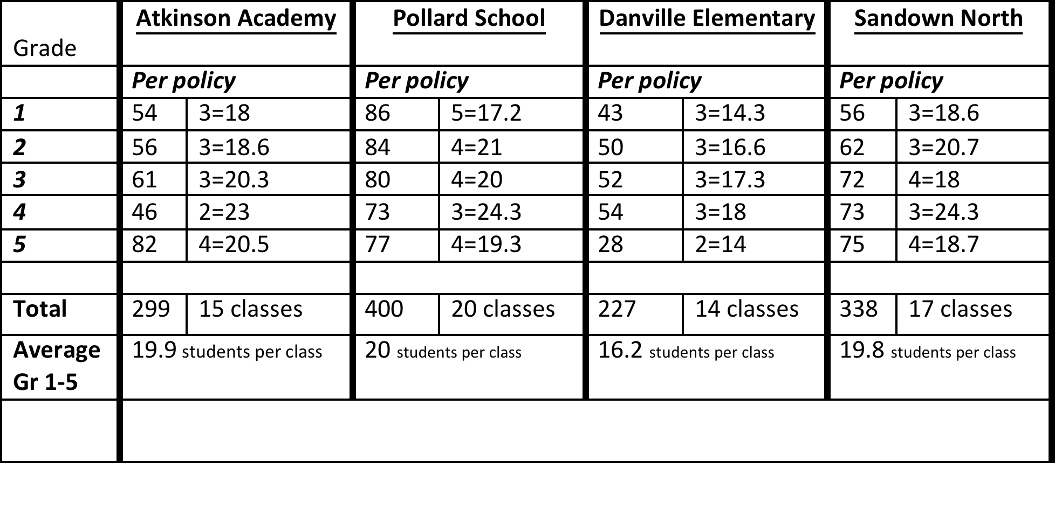
Projected Enrollments

Slide 10
Future Facilities Considerations
Evaluate Infrastructure at Sandown North/Central
Capital Improvement Committee reviews long term plans for both schools
Install a fire sprinkler system at Sandown North

Slide 11
Playground and Green Space
Construct additional playing fields at Sandown North with the location determined by Director of Facilities and Superintendent
Minimum of one acre
Install appropriate fencing around portions of the field

Slide 12
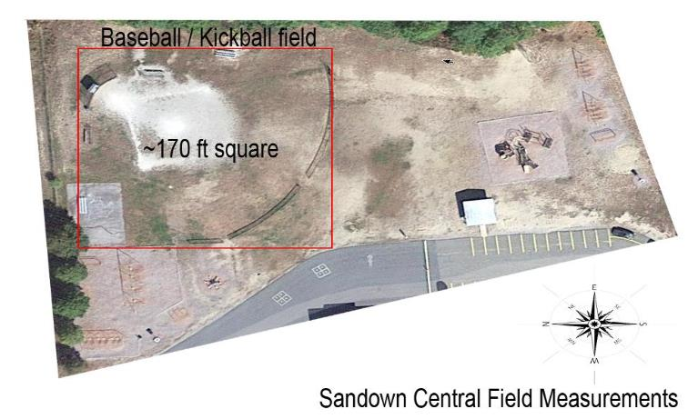
Green Space at Central

Slide 13
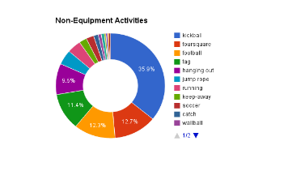
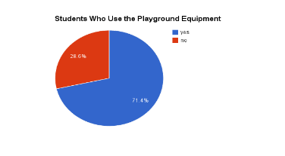
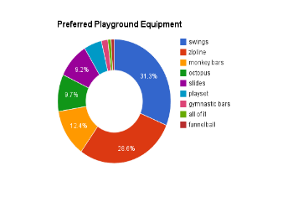
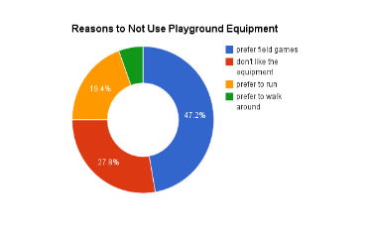
Student Survey

Slide 14
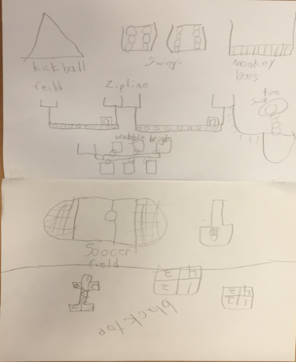
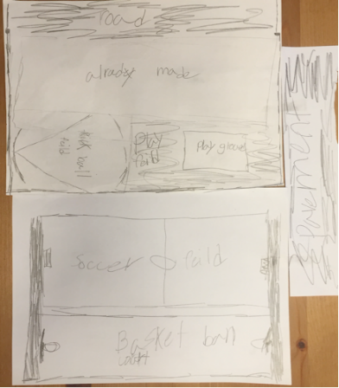
Student Green Space Involvement

Slide 15
Bus Transportation, Traffic, Parking
District Transportation Coordinator and Administration will explore most efficient routes in order to reduce travel time for students
District and Town Officials collaborate on opening emergency access road from Sandown North, for busses only
Evaluate traffic flow patterns to reduce congestion at drop-off and pick-up times

Slide 16
Professional Staff
The administration and TTA (Timberlane Teachers’ Association) should work to ensure, where possible, continuity in building representation from the TTA as well as actively encourage increase in dialog
TTA Leadership should increase interaction and assistance with building representatives to ensure smooth transition and dialog
TTA Leadership will consider a temporary special appointment of one additional representative per building to increase representation during transition
To promote respect and support of the faculty and staff at both schools, full disclosure of this plan should be given to them at the absolute earliest opportunity

Slide 17
Thank you & Questions

