Slide 1
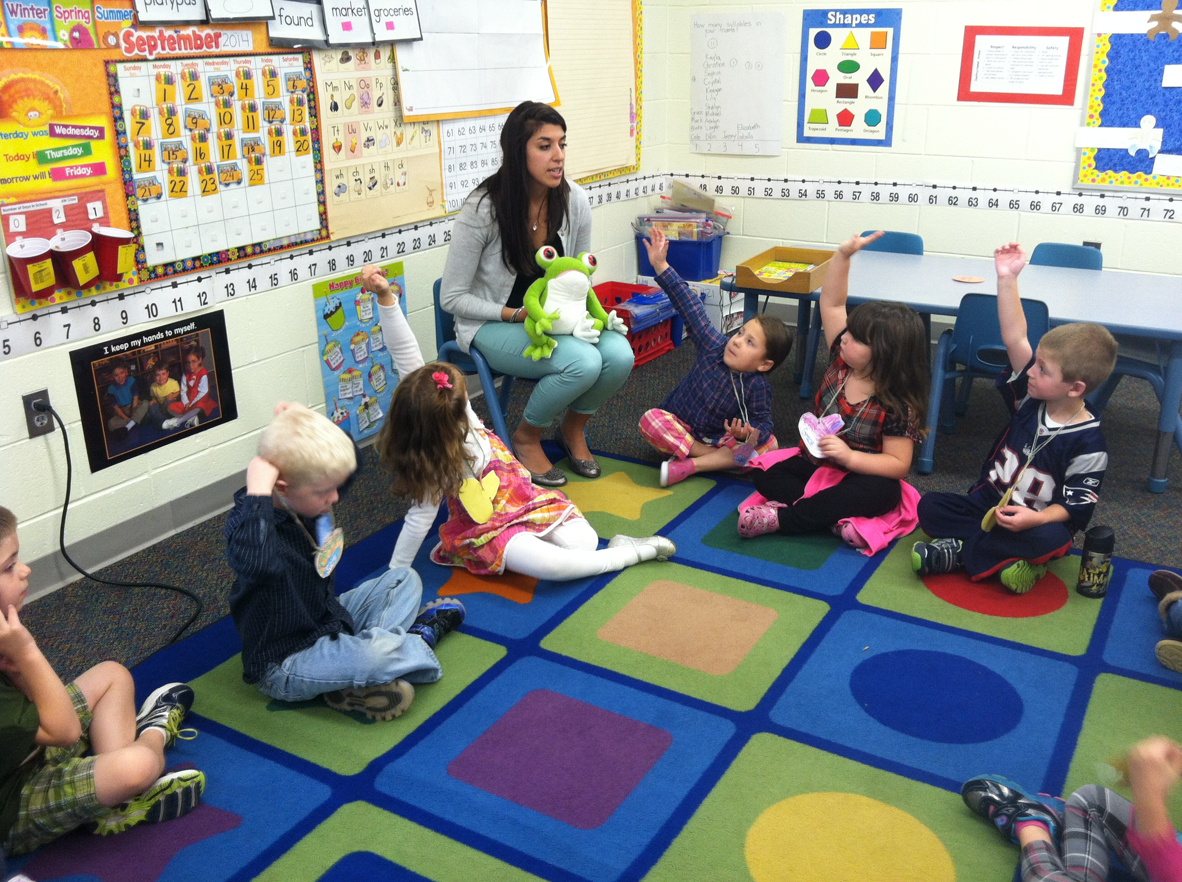
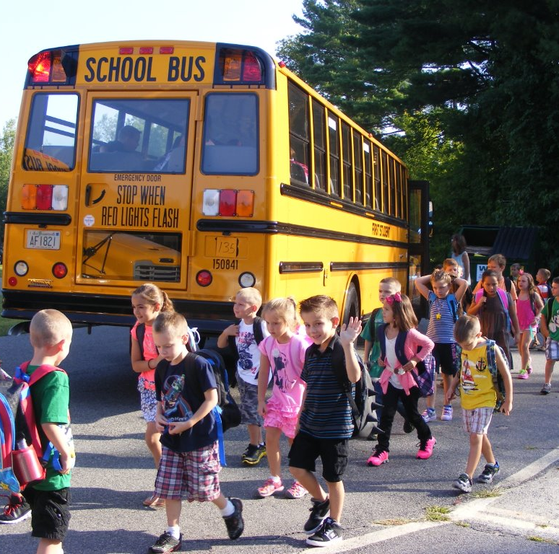
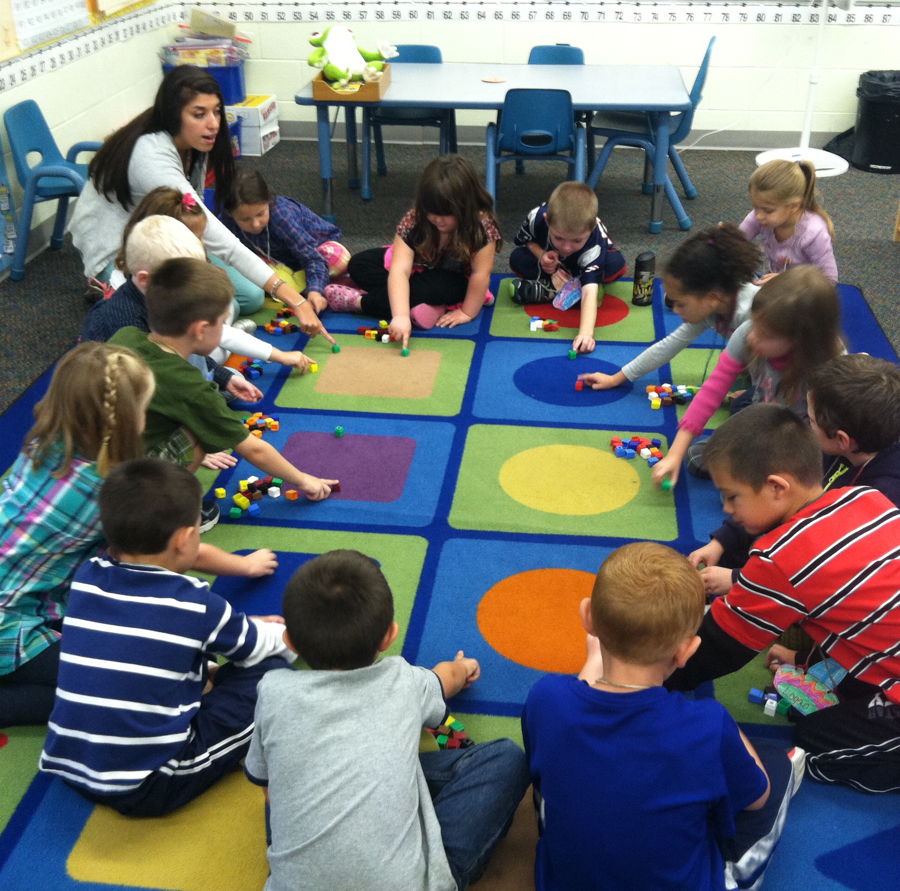
Renaissance Kindergarten & FLES
Update
2014-2015 School Year

Slide 2
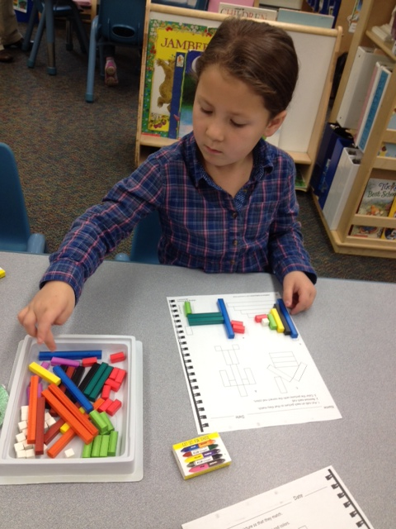
Current Enrollment
 | Full Day | Half Day |  | Total
 |  | AM | PM
Atkinson Academy | 21 | 12 | 16 | 49
Danville Elementary | 16 | 14 | 8 | 38
Pollard | 32 (2 classes) | 35 (2 classes) | 13 | 79
Sandown North | 14 | 18 | 18 | 50

Slide 3
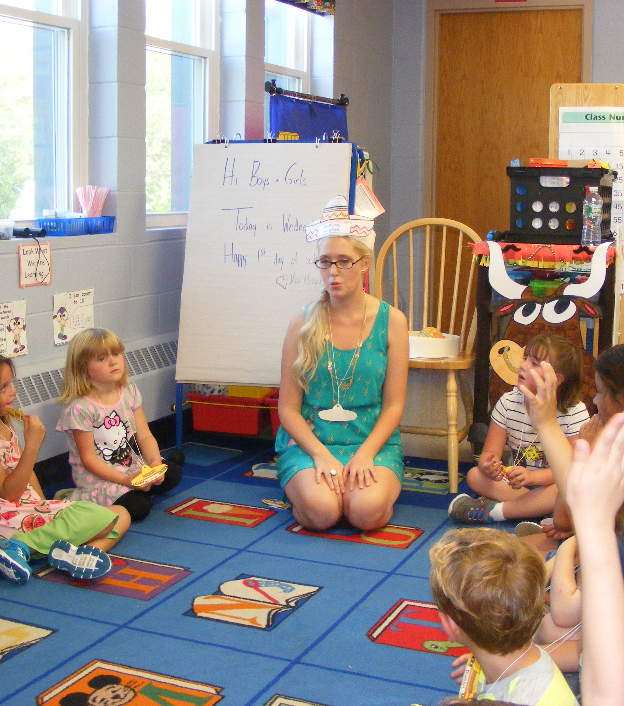
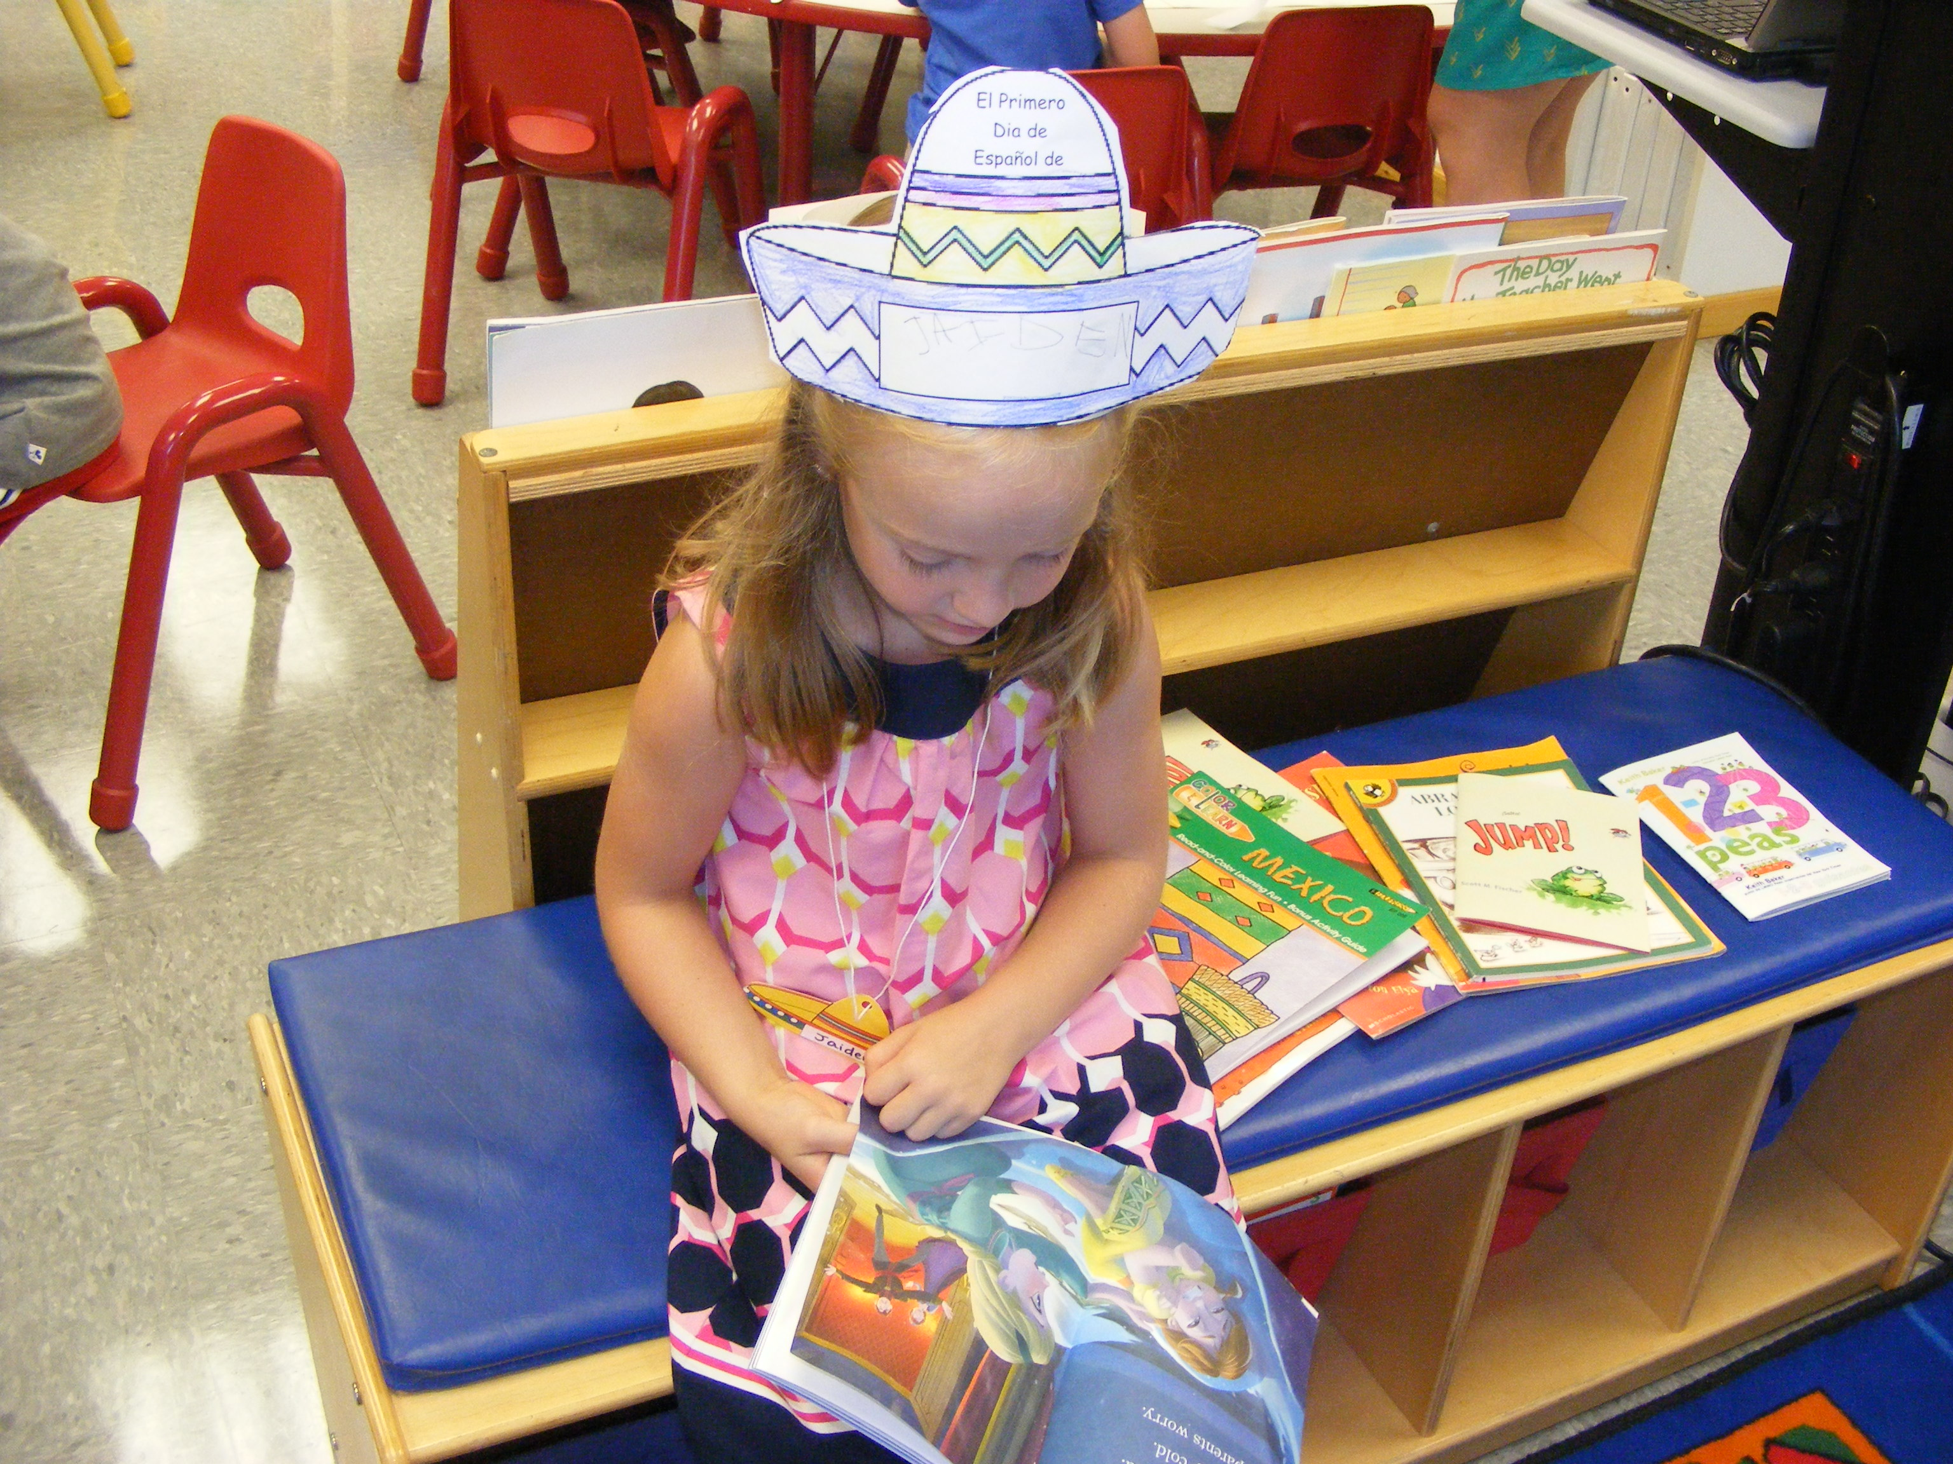
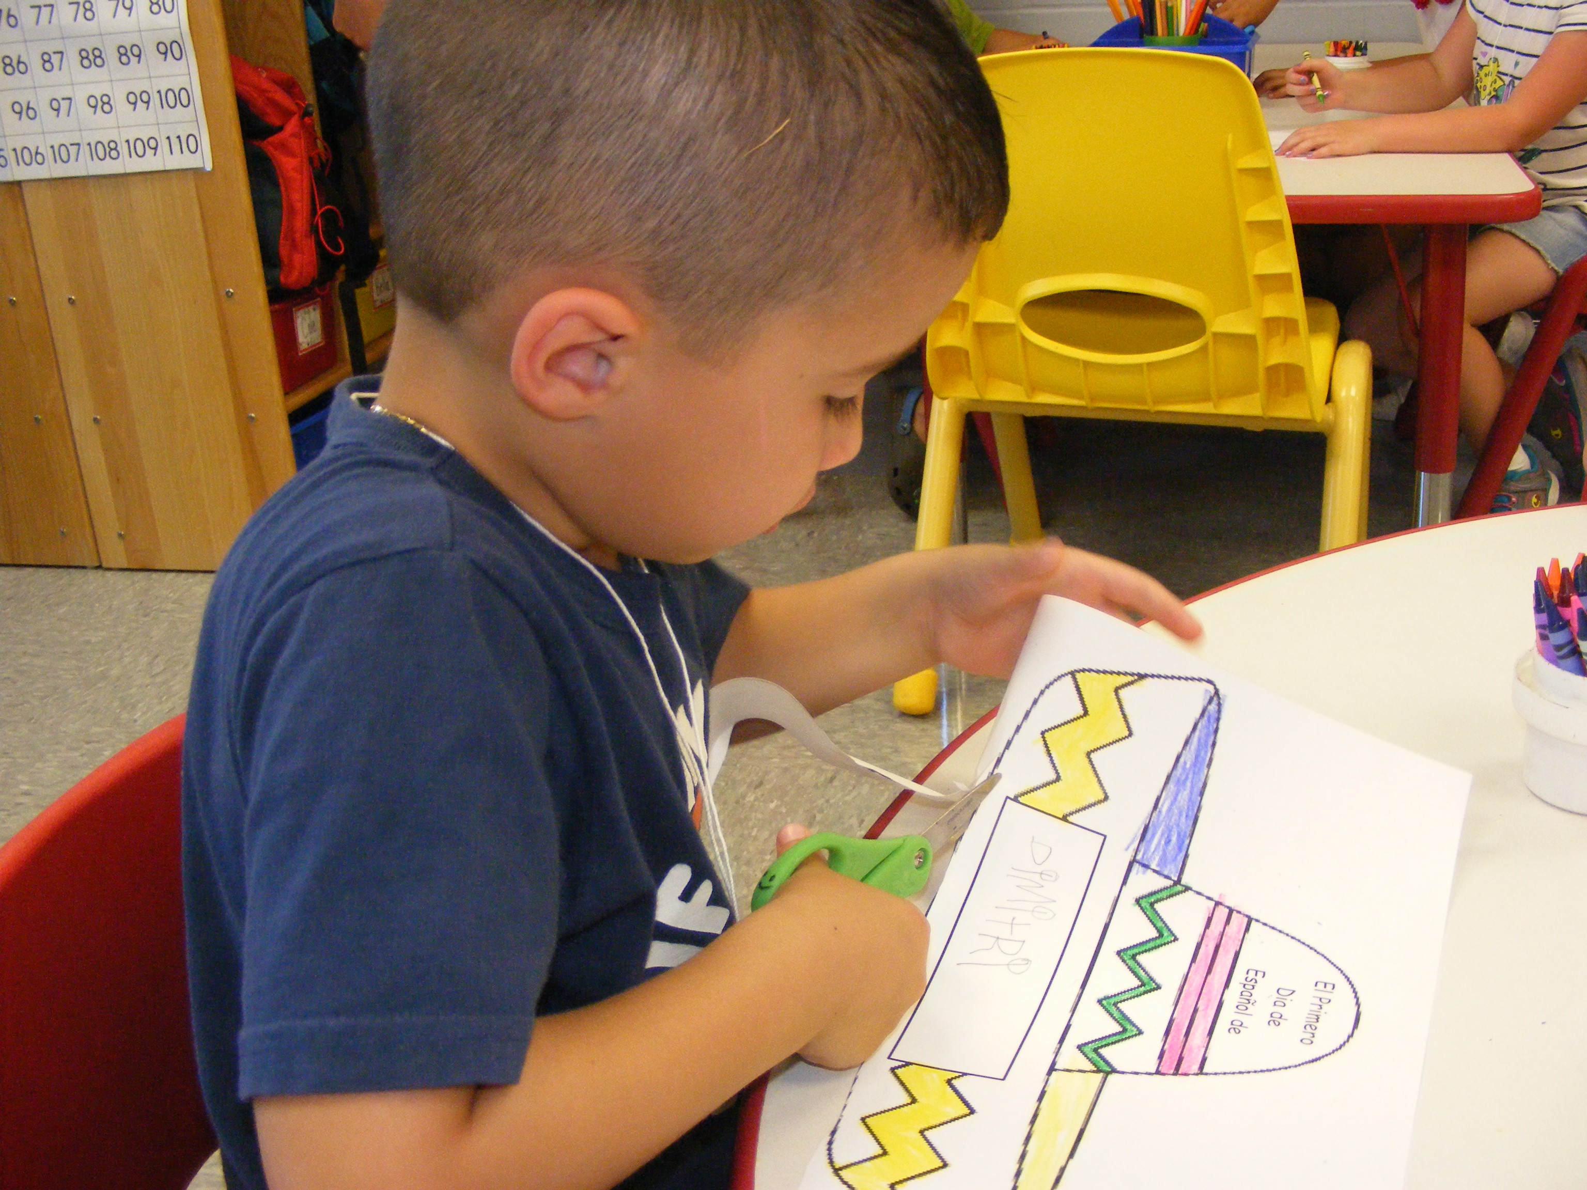
Danville Elementary and Sandown North FLES with Señora Hughes

Slide 4
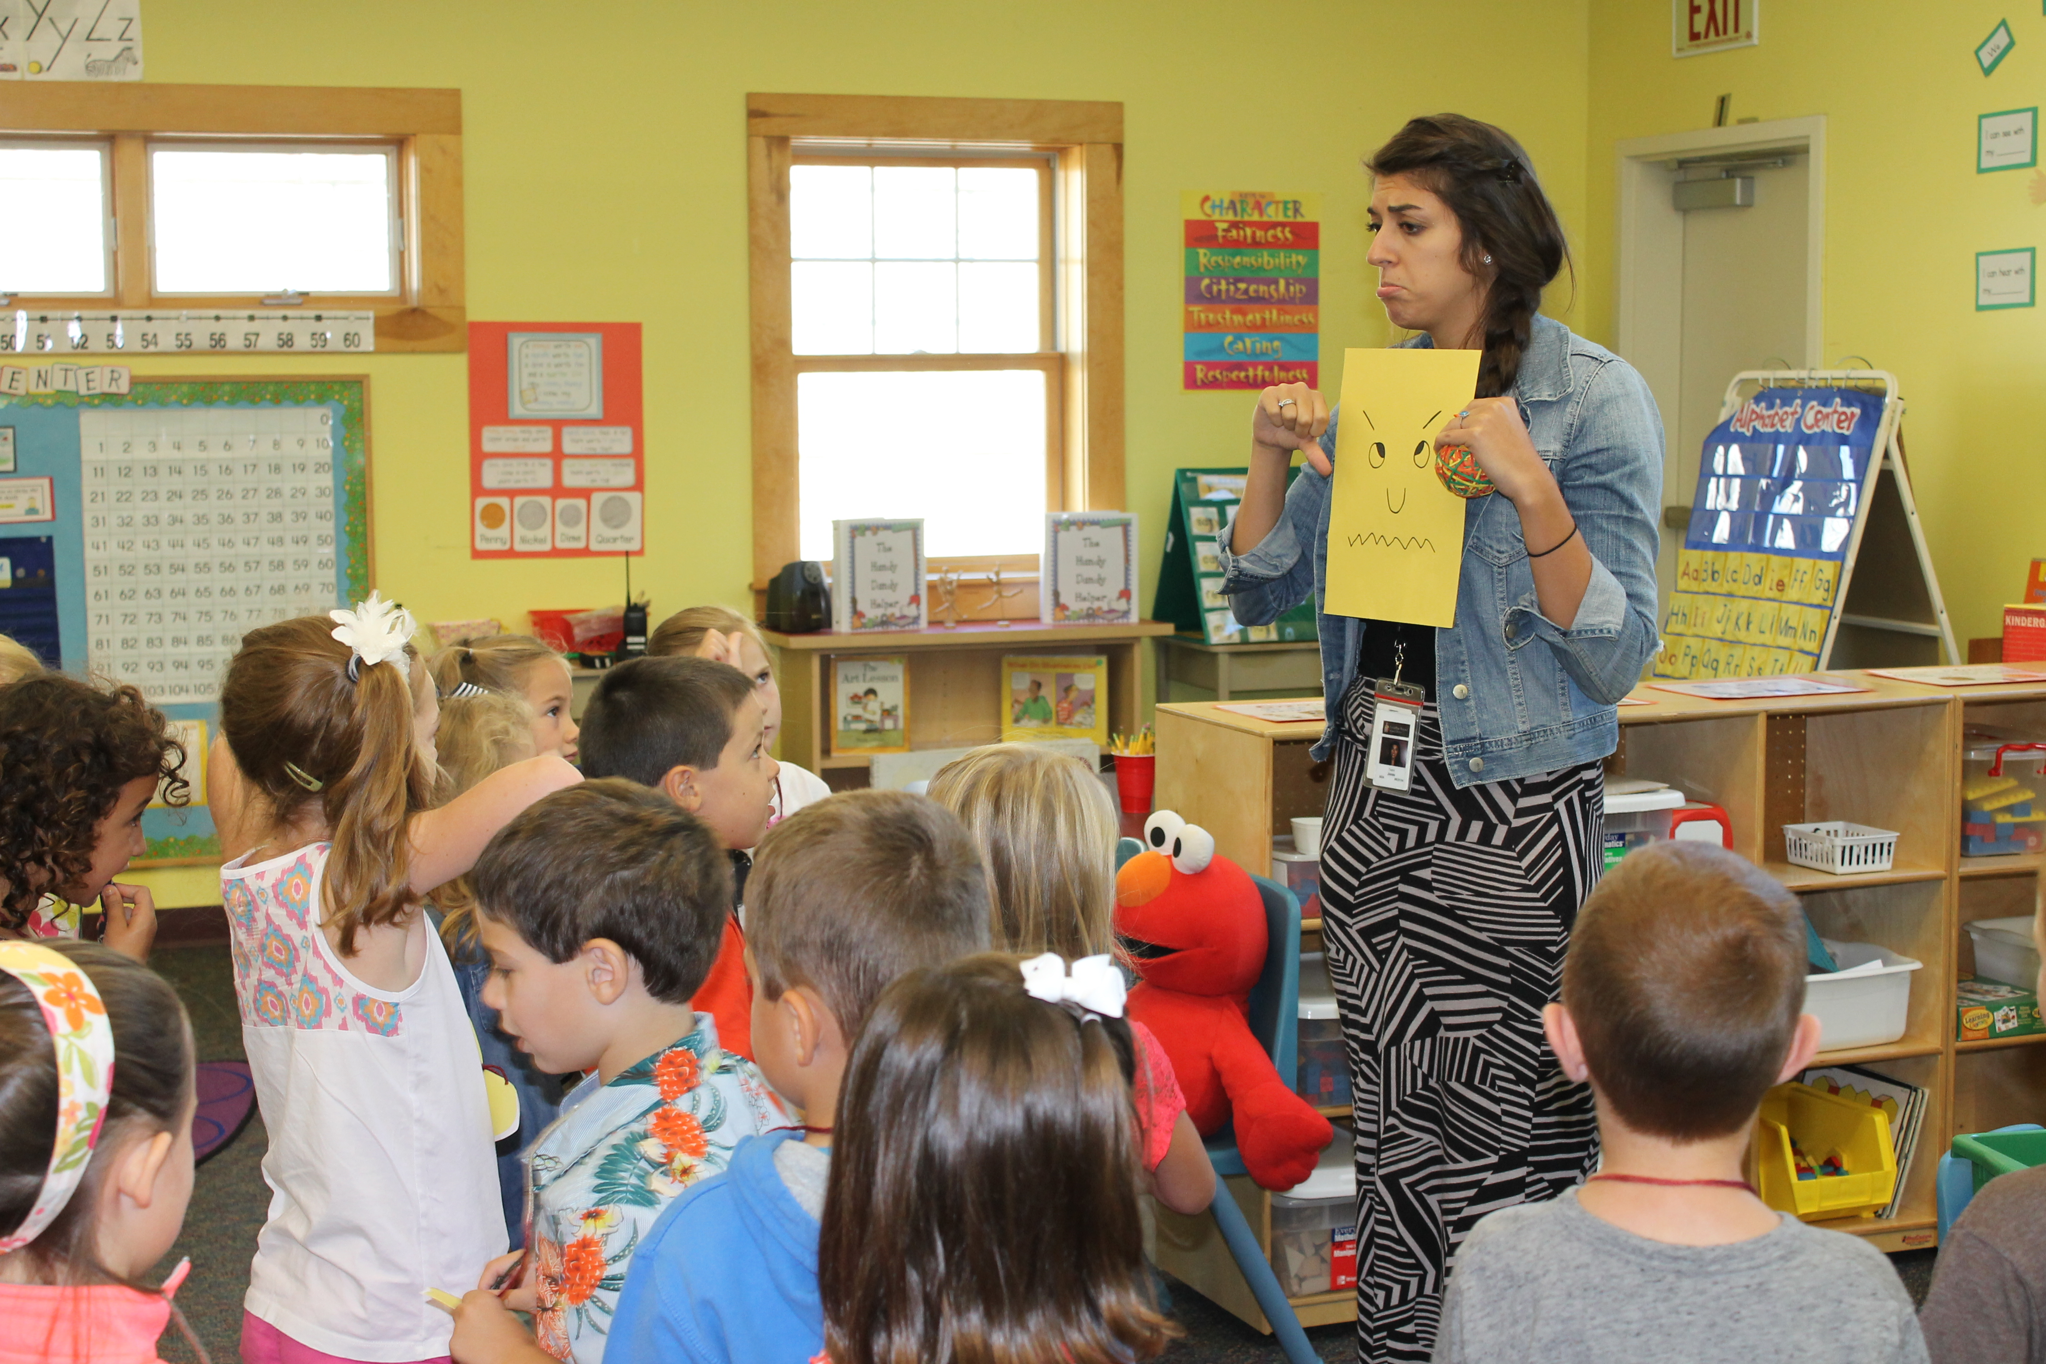
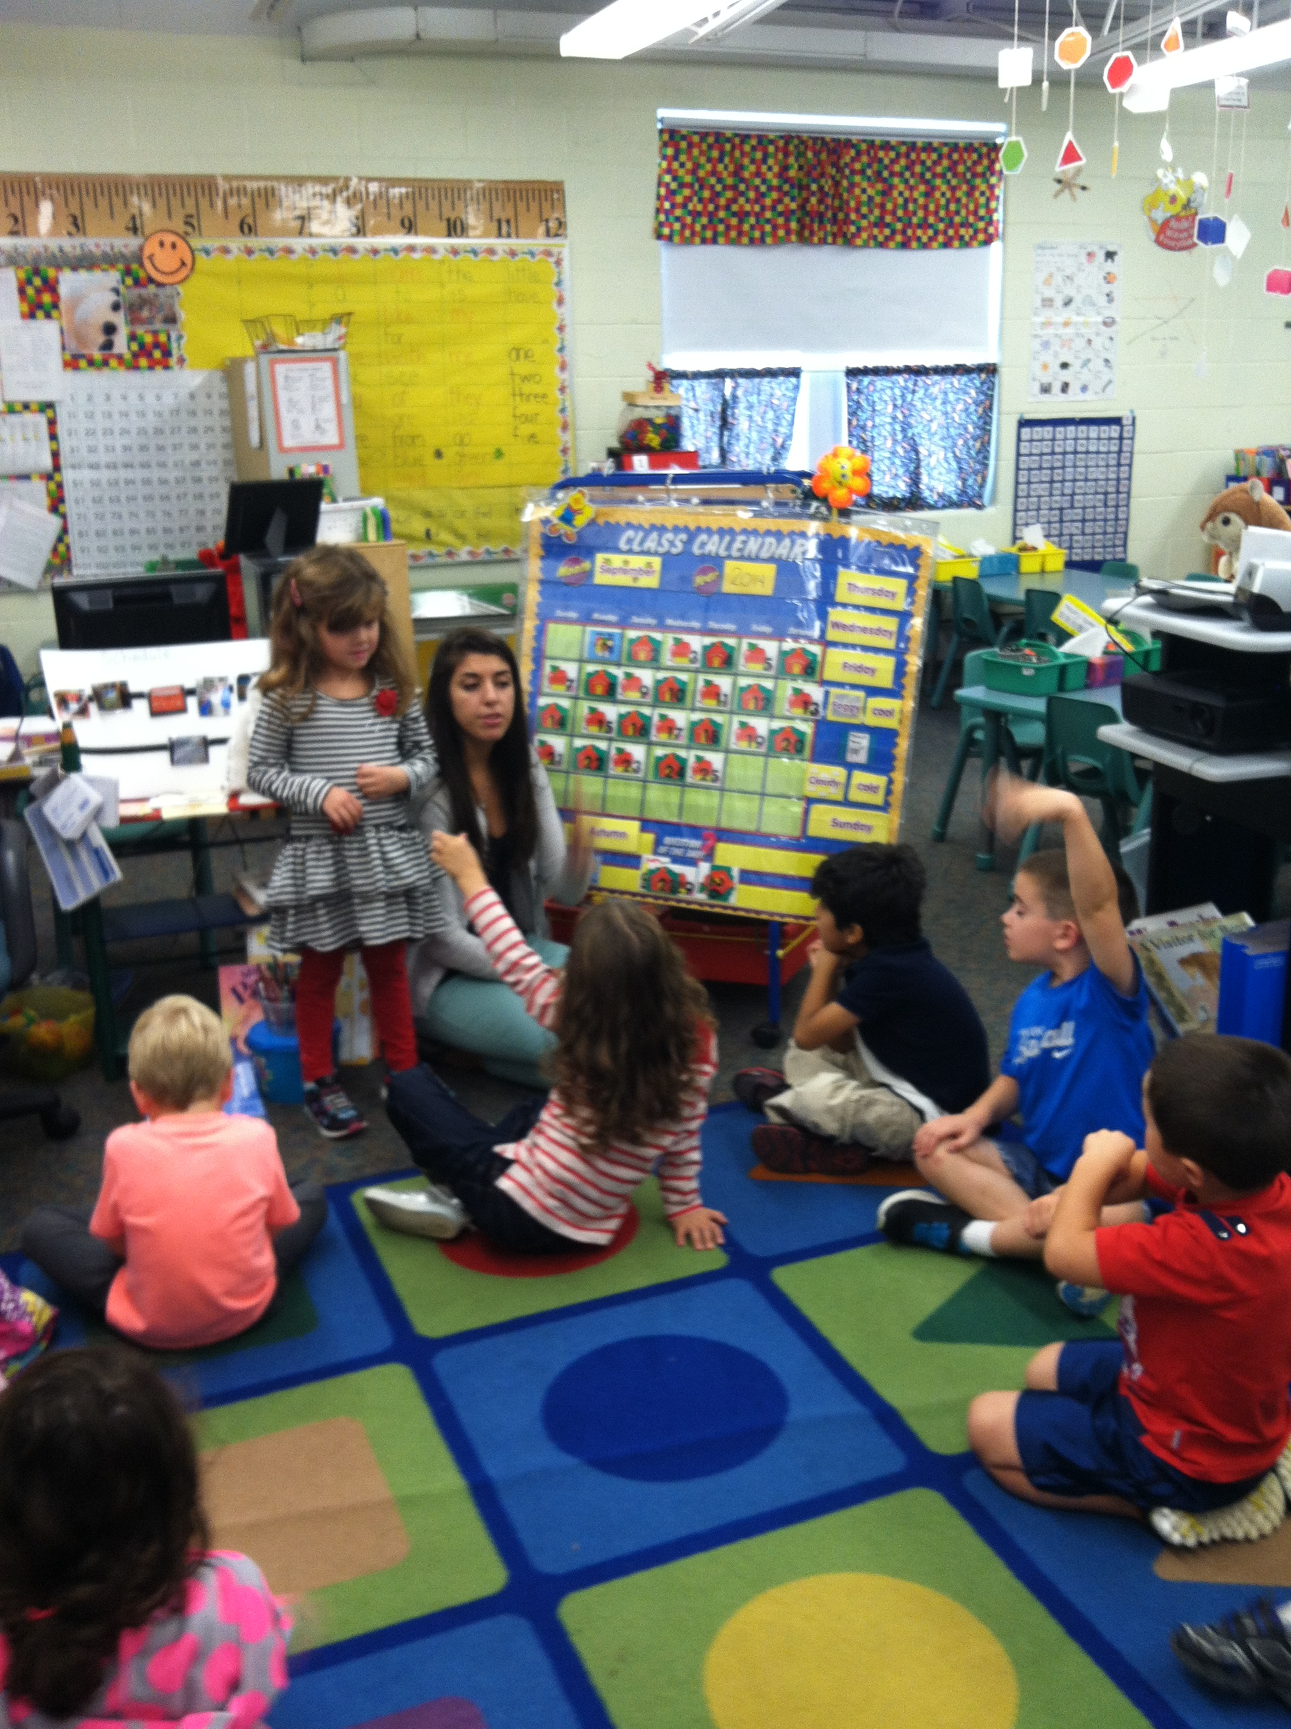
Atkinson Academy and Pollard School FLES with Señorita Jones

Slide 5
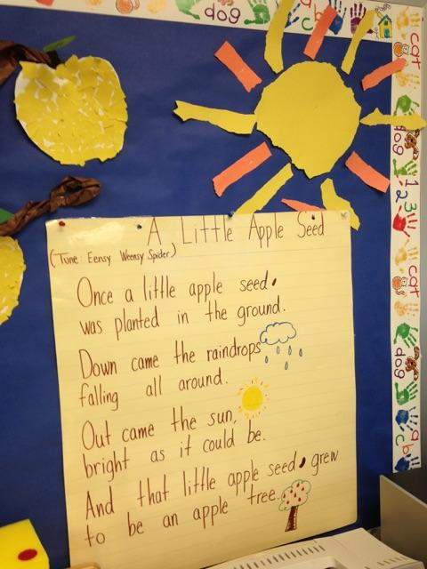
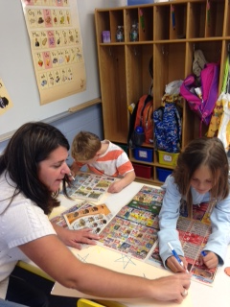
Stephanie Mezquita,
Renaissance Kindergarten Teacher,
Danville Elementary

Slide 6
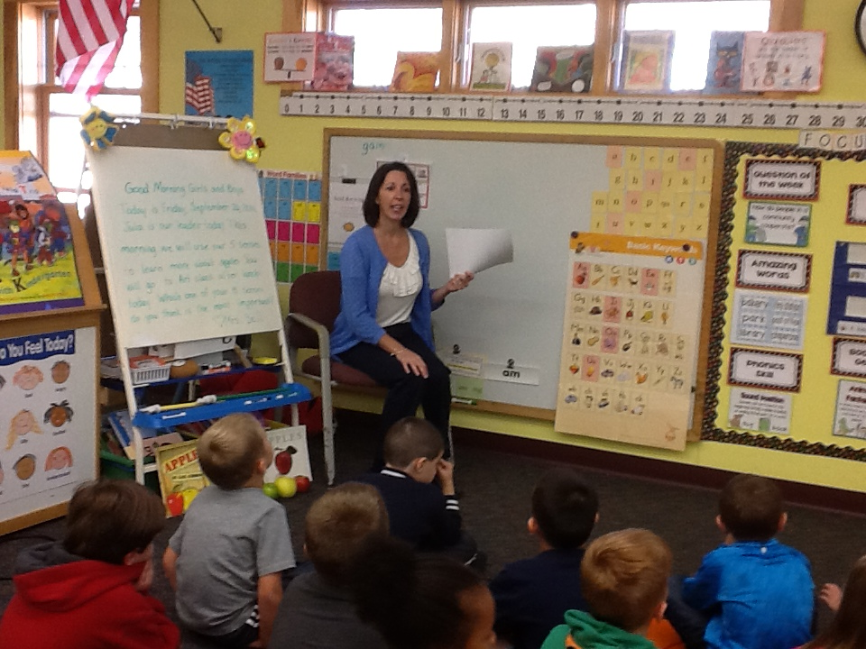
Deb Bell
Renaissance Kindergarten Teacher, Atkinson Academy

Slide 7
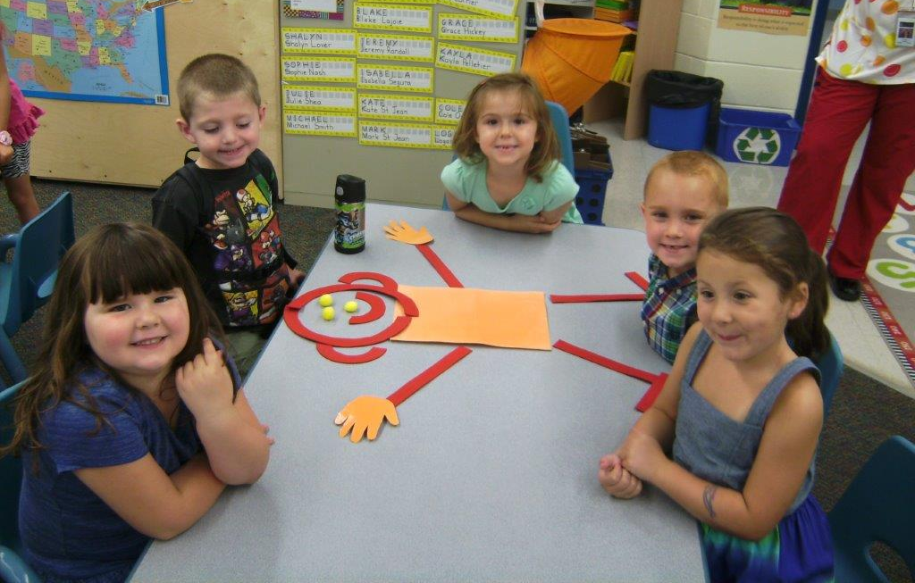
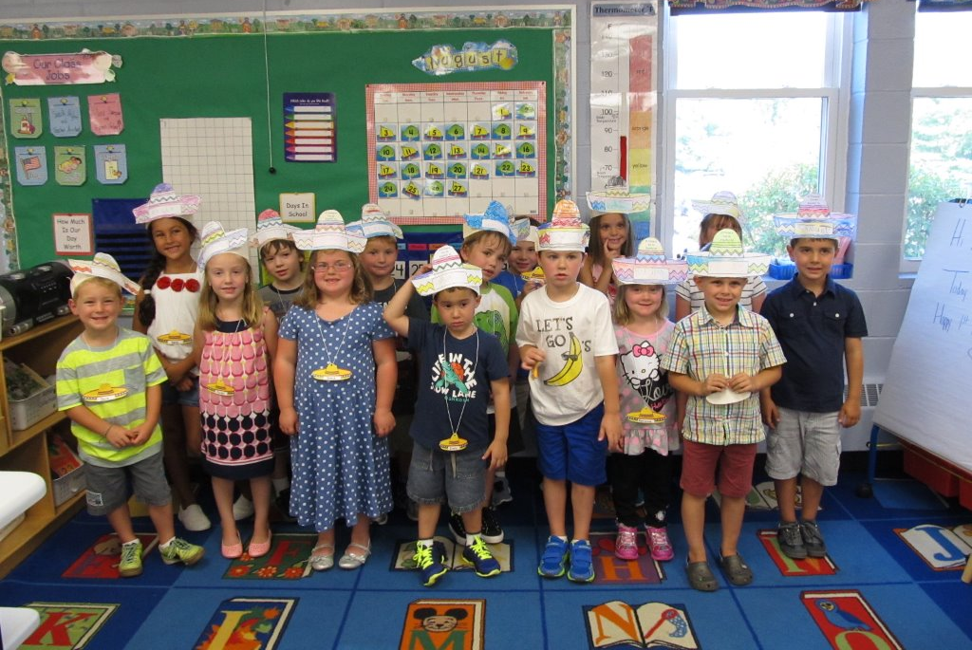
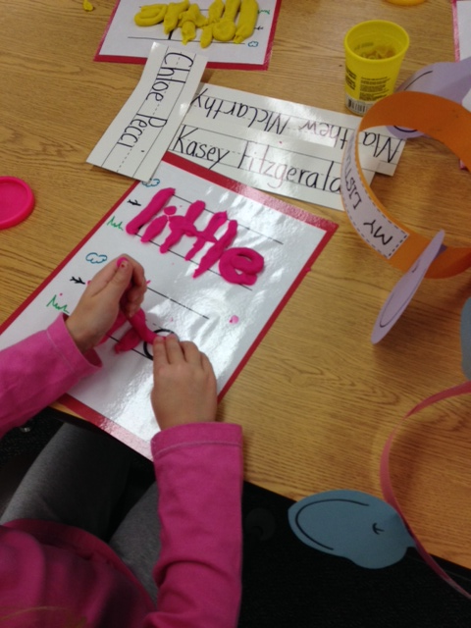
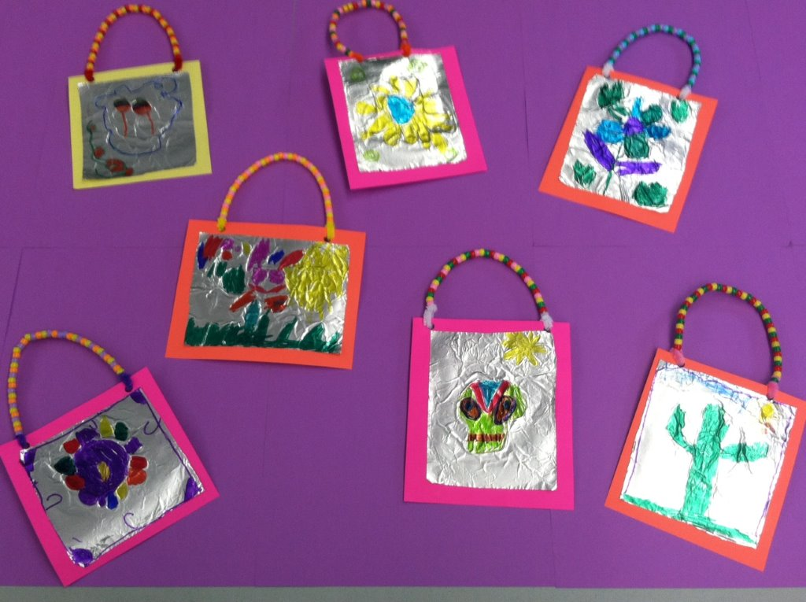
Nancy Barcelos & Kathie Dayotis… Looking Ahead

