Slide 1
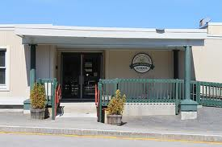
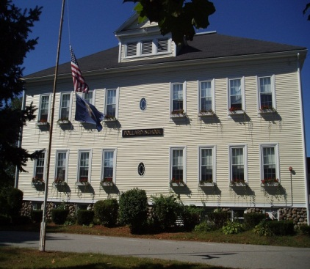
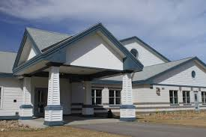
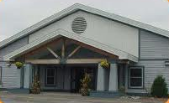
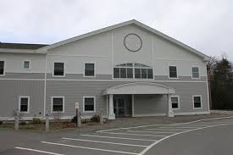
TRSD Elementary Schools’ Action Plans
October 2, 2014
2014-2015

Slide 2
Common Elementary Goal #1
STAR ASSESSMENT: TRSD Elementary Schools will implement Renaissance Learning STAR Assessments for universal screening and progress monitoring during the 2014-15 school year. These assessments will provide actionable data related to the impact of curriculum, program, and pedagogy. In addition, STAR data will be used to monitor growth, group students for instruction and to assess the effectiveness of interventions.
Notes:
The first two goals are common to all 5 elementary schools. We will have some activities specific to our own schools, however the majority of the steps will be common and include:
STAR Assessment are currently being administered to all students PreK-5
Champions and Professional staff will be trained in accessing report data and data analysis protocol
Data from STAR Assessment will be shared/discussed at PLC and grade level teachers will implement a plan using Tier times based on their class/grade level data
Progress monitor struggling students
Mid-year Assessment given to all students PreK-5
End-of-year Assessment given to all students PreK-5

Slide 3
Common Elementary Goal #2
GUIDED READING: In order to improve reading scores and increase student engagement, TRSD Elementary Schools will provide guided reading training to all classroom teachers and interventionists. Teachers will make informed instructional decisions to ensure that students are appropriately matched to engaging texts and grouped effectively according to their instructional reading levels for support.
Notes:
Literacy Specialists will receive intensive training in effective coaching practices.

Slide 4
SANDOWN NORTH ELEMENTARY School’s Action Plan Goals

Slide 5
Goal #3
By June 2015, we will have established communication norms and procedures to optimize collaboration, as measured by 80% staff participation.

Slide 6
Goal #4
By June 2015, students will partake in daily experiences that engage multiple modes of learning, as measured by classroom visits and School-wide Information Systems Data.

Slide 7
SANDOWN CENTRAL School’s Action Plan Goals

Slide 8
Goal #3
In an effort to promote a captivating learning environment, we will create stimulating units of study and lessons that are varied, creative, interactive, utilize technology, and provide relevant learning response options. Success will be measured by a 10% increase in the captivation category score of the next Tripod Survey.

Slide 9
Goal #4
Our goal is to improve student performance as measured by an increased amount of students meeting their suggested growth percentile on STAR assessments.

Slide 10
Danville Elementary School’s Action Plan Goals

Slide 11
Goal #3
The staff will work to improve school culture through the enhancement of student academic engagement, student personal responsibility for learning and behavior, and student expression of personal interests. Success will be measured by student progress and a decrease in negative behaviors as recorded through our School-Wide Intervention Systems (SWIS) data and student voice as reported through the Tripod Survey.

Slide 12
Goal #4
Staff will increase their understanding of Response to Instruction (RTI) practices by establishing universal protocols for interventions, and using research based methods, while monitoring growth. Success will be measured through formative and summative assessments, universal screenings and the progress monitoring of targeted skills.

Slide 13
ATKINSON ACADEMY’s Action Plan Goals

Slide 14
Goal #3
Atkinson Academy will have a systematic math data collection process in place by June 2015 that will provide teachers with accurate and reliable information from which instructional decisions can be made.

Slide 15
Goal #4
Atkinson Academy will maintain a systematic behavior management plan designed and implemented during the 2014-2015 school year. Student behaviors will be recorded through a School-Wide Intervention System (SWIS).

Slide 16
Pollard School’s Action Plan Goals

Slide 17
Goal #3 Literacy:
Each student’s score will increase by 5-8% and/or show mastery in the acquired skills critical to literacy development by the end of the 2014-2015 school year as measured by pre- and post-assessments, including emergent literacy checklists for pre-kindergarten and grade level word lists for kindergarten through fifth grade.
Areas of Focus of acquired skills critical to literacy development:
  PreK/K: Emergent-Letter name-alphabetic
  Grade 1: Late emergent- Within word pattern
  Grade 2: Late letter name-Early syllable and affixes
  Grade 3: Within word pattern-Syllables and affixes
  Grade 4: Within word pattern-Syllables and affixes
  Grade 5: syllables and affixes-Derivational relations
Notes:
All classroom teachers will administer a Spelling Inventory from Words their Way
Data from the inventory as well as STAR Assessment Data will be discussed at PLC
The Words Their Way Instructional philosophy will be utilized as a resource during Tier 2 instruction for struggling students’ Grades K-5
Grades K-2 will also utilize the Wilson Fundations program, a phonological/phonemic awareness, phonics and spelling program, for instruction
PreK students receive instruction utilizing the Lively Letters program focusing on phonemic awareness, visual processing, short term memory and rapid naming of visual symbols. Handwriting Without Tears issued in partnership with LL to bring early literacy skills to print making it a multisensory approach (full Circle)
Universal post-assess all students

Slide 18
Goal #4 Math:
Each student’s score will increase by 5-8% and/or show mastery in the “Critical Areas of Focus” based upon the Common Core Standards by the end of the 2014-2015 school year as measured by pre- and post-assessments.
Critical Areas of Focus:
  PreK/K: Fluency of number sense including demonstration (objects) and ability to compare whole numbers within 20.
  Grade 1: Fluency and understanding of addition facts within 20.
  Grade 2: Fluency and understanding of subtraction facts within 20.
  Grade 3: Fluency and understanding of multiplication facts up to 100.
  Grade 4: Fluency and understanding of division facts up to 100.
  Grade 5: Fluency and understanding with addition and subtraction of fractions.
Notes:
Grade level teachers reviewed last year’s Universal screener and made adjustments as needed.
Grade levels will give universal screening to identify students that currently require intervention with the focus area skills.
Data from Grade level Universal screenings and STAR Assessment will be discussed at PLC
Progress monitor struggling students

Slide 19
Any Questions?

