Slide 1
Sandown North Transition
Update and Recommendations
Team: Heidi Chaput, Liz Conte, Amy Difeo, Jan Gilman,
Terry Kellaway, Deb Lytle, Laura McLaughlin,
Lisa Paladino, Pamella Pitman, Nancy Stafford, Stan Stone
Student: Adam Noyes, Student Council President

Slide 2
Charge of the Transition Committee:
Transition
      Students
      Families
      Staff
Arrival / Dismissal
Facilities
Standard Operating Procedures

Slide 3
Sandown North School Teams
Leadership Team
Emergency Response Team
Safety Team
Universal Team

Slide 4
Transition – Sandown North Community
Open House:
  Families attended one of two 45 minute sessions and were split alphabetically.
  Dedication of 2 Eagle Scout projects
  Greeting Students on first day

Slide 5
Student Focused Activities:
SERESC Conference attended by Universal team
Universal work day before school opened
Student Council will assist with Universal procedures
MMM – 5th grade hosts
Mentorship for younger students

Slide 6
Transition Activities
Roll out of our new theme.
Rob Surette Artist in Residence

Slide 7
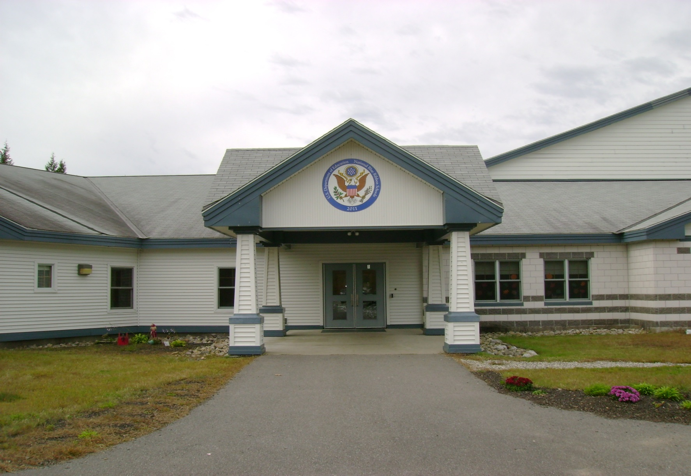
SANDOWN NORTH
ELEMENTARY SCHOOL
Notes:
Student: Our first Monday back at school we joined together for our first Monday Morning Meeting. This wasn’t a typical MMM because it was run by some of the teachers. It was cool to all gather together for this assembly. I will now show you a shortened version of what was presented to the students. We were introduced to our new school wide theme for this year.

Slide 8



Last year’s theme was:
RACE TO BE
A STAR!
SNE
Notes:
Student: Each year we have a new school theme.

Slide 9

Bonus question for our 5th graders…
What was the theme two years
ago?
Notes:
Student: A lot of the 5th graders remembered the theme from 2 years ago, plus some others from earlier years.

Slide 10

FOLLOW YOUR
YELLOW BRICK ROAD

Slide 11

This year our theme is:
PEACE
LEARN AND GROW

Slide 12


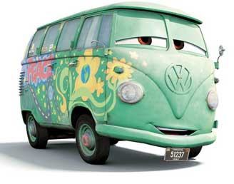
We are coming together to get our groove on to be STARs.

Slide 13
We have started off our school year
learning about our
STAR
expectations…

Slide 14

SAFE
TRUSTWORTHY
ALWAYS RESPECTFUL
RESPONSIBLE

Slide 15
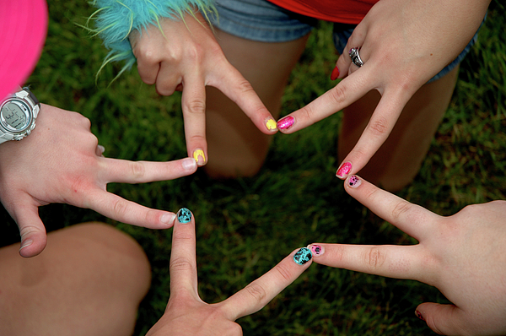
Our ambassadors will help us to learn and grow.
teachers
friends
parents

Slide 16
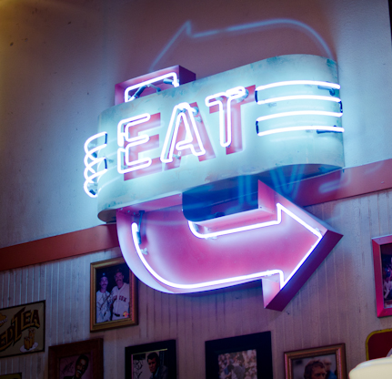
Coming soon…
the new STAR QUEST Cafe.

Slide 17
PEACE
LEARN AND GROW
Imagine all the great things we can accomplish this year as we learn and grow peacefully!

Slide 18
There’s no place like Sandown North!

Slide 19
Concerns/Successes:
Student Arrival / Dismissal
Staff and Visitor Parking
Parking lot lighting
Lunch/Recess schedule

Slide 20
Concerns/Successes:
Classrooms
  Cubbie height/hooks
  Space
Refrigerator space
Adult Bathrooms
Staff room/mailboxes

Slide 21
Green space/Playground area
4 Square has been repainted. Looking
to add additional squares
Looking at more grass area
PE teacher researched additional activities for 4th & 5th grade. Teachers asked for student input.

Slide 22
Next Steps for Transition Committee
Continue to communicate to staff & parents
Continue to meet on an as needed basis to address successes and concerns throughout the school year.

