Slide 1
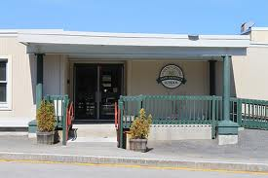
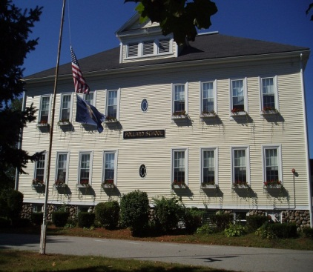
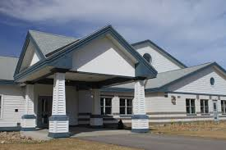
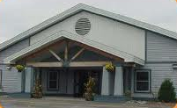
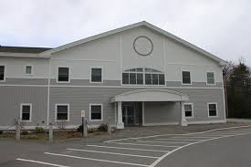
Elementary Schools’ Action Plan Review
October 1, 2015

Slide 2
Common Elementary Goal #1
STAR ASSESSMENT: TRSD Elementary Schools will implement Renaissance Learning STAR Assessments for universal screening and progress monitoring during the 2014-15 school year. These assessments will provide actionable data related to the impact of curriculum, program, and pedagogy. In addition, STAR data will be used to monitor growth, group students for instruction and to assess the effectiveness of interventions.

Slide 3
Action Steps for Goal 1
STAR Assessments were administered to all students PreK-5
Champions and Professional staff trained in accessing report data and data analysis protocol to support staff in interpreting data
Champions at each school have access to a data coach from Renaissance and they have been very Supportive to staff
Data from STAR Assessment will be shared/discussed at PLC
Progress monitor struggling students
Mid-year Assessment given to all students PreK-5 (January)
End-of-year Assessment given to all students PreK-5

Slide 4
Common Elementary Goal #2
GUIDED READING: In order to improve reading scores and increase student engagement, TRSD Elementary Schools will provide guided reading training to all classroom teachers and interventionists. Teachers will make informed instructional decisions to ensure that students are appropriately matched to engaging texts and grouped effectively according to their instructional reading levels for support.

Slide 5
Action Steps for Goal 2
Literacy Specialists received intensive training in effective coaching practices and continue to receive training to support all teachers
Teachers and administrators were provided 2 days intensive training in Guided Reading with Heinemann with follow up by literacy coaches to support teachers
Teachers provided with Literacy Text “Fountas and Pinnell Guided Reading Comprehension”
Work during early release days and PLCs

Slide 6
Elementary Level Common Goals for 2015-16 School Year
    During 2015-2016 school year, teachers will continue to refine practices and develop pedagogy to support balanced literacy instruction and the implementation of the newly adopted math program. Building-level literacy coaches, the Elementary Literacy Coordinator, and school and district administrators will provide monitoring and support through Instructional Rounds and walk-throughs.

Slide 7
Elementary Level Common Goals for 2015-16 School Year
By June 2016, the percentage of students in grades 2-5 performing at or above benchmark will increase by at least 5%, as measured by the Reading STAR assessment.
By June 2016, the percentage of students in Pre-K, Kindergarten, and grade 1 performing at or above benchmark will increase by at least 10%, as measured by the Early Literacy STAR assessment.
By June 2016 the percentage of students in grades 1-5 performing at or above benchmark will increase by at least 5%, as measured by the Math STAR assessment.

Slide 8
Atkinson Academy
Action Plan Review

Slide 9
Goal 1
Atkinson Academy will have a systematic math data collection process in place by June 2015 that will provide teachers with accurate and reliable information from which instructional decisions can be made.

Slide 10
Action Steps for Goal 1
Met
Determine what mathematical data will be collected throughout the school-year.
Identify mandatory assessment timeframe/ guidelines.
The school will determine the progress monitoring tools to be used in tier 2 for strategic groups
Grade level teams will meet in PLCs with a focus on planning math interventions and providing continuous progress monitoring for strategic groups
All mandatory data collection will be made available three times per year through the comprehensive STAR assessment system.

Slide 11
Goal 2
Atkinson Academy will maintain a systematic behavior management plan designed and implemented during the 2014-2015 school year. Student behaviors will be recorded through a School-Wide Information System (SWIS).

Slide 12
Action Steps for Goal 2
Determine members of the team.
Identify basic goals of the team.
Continue to use school mascot and themes for rollouts to model behavioral expectations.
Inform staff of common language and procedures to be used by students when accessing the hallway in school setting.
Introduce SWIS (School Wide Information System) as a means to collect data.
Major behaviors will be collected by staff to be entered into SWIS

Slide 13
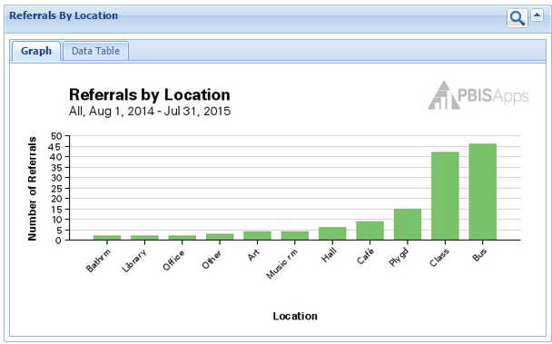
Update Goal 2: Met

Slide 14
2015-16 Action Plan Goal
By June 2016, Atkinson Academy staff will record all student minor behaviors using the School Wide Information System (SWIS) and plan and implement 3 themes/roll outs that model behavior expectations of the targeted behaviors as identified through the analysis of the SWIS data.

Slide 15
Danville Elementary Action Plan Review

Slide 16
Goal 1
The staff will work to improve school culture through the enhancement of student academic engagement, student personal responsibility for learning and behavior, and student expression of personal interests. Success will be measured by student progress and a decrease in negative behaviors as recorded through our School-Wide Information Systems (SWIS) data and student voice as reported through the Tripod Survey.

Slide 17
Action Steps for Goal 1
SWIS data was analyzed by Universal Team to look for patterns of identified behaviors
Held monthly Universal Team meetings to discuss behavioral concerns
School wide assemblies with Danville’s mascot to teach and re-teach expected behaviors
Intermediate grade level students began to confer with teachers regarding progress and goal setting
Professional Staff participated in a book study of Mindset, (C.S.Dweck, Ph.D. 2006)
Build community spirit by hosting a back to school barbecue
In Progress

Slide 18
Goal 2
Staff will increase their understanding of Response to Instruction (RTI) practices by establishing universal protocols for interventions, and using research based methods, while monitoring growth. Success will be measured through formative and summative assessments, universal screenings and the progress monitoring of targeted skills.

Slide 19
Action Steps for Goal 2
All students participated in benchmark assessments three times during the year
Students not meeting expectations were progress monitored often throughout the year using research based tools to best monitor specific needs
Champions attended on-line conference calls and training sessions with assigned data coach
Staff meetings were devoted to learning how to use various components of STAR Assessment
Through PLC, Target, and Data Team meetings, staff worked collaboratively to plan for specific targeted instruction using data collected

Slide 20
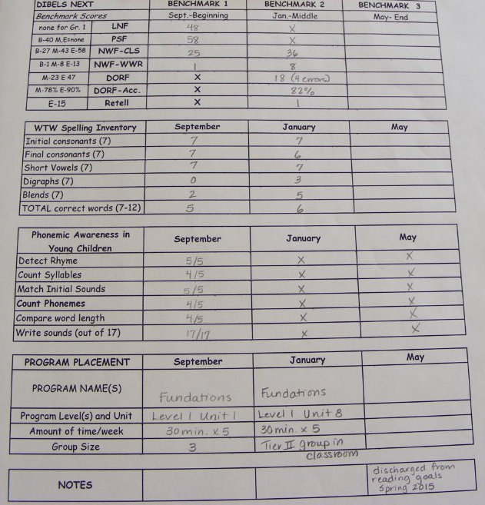
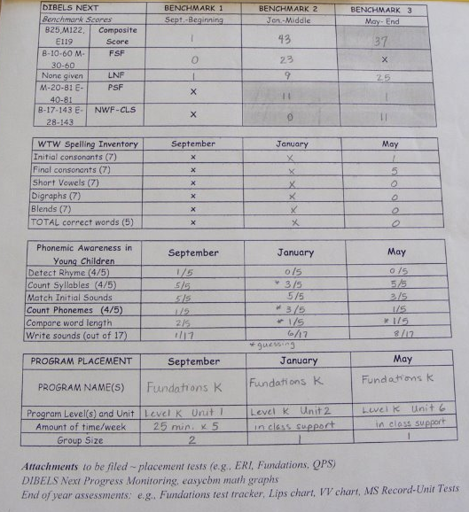
Update Goal 2: In progress

Slide 21
2015-16 Action Plan Goals
All staff will consistently implement the universal behavior system to support Danville’s core values as measured by monthly School Wide Information System (SWIS) data reports during the 2015-2016 school year.

Slide 22
Pollard School Action Plan Review

Slide 23
Goal 1
All students will increase by 5-8% and/or achieve mastery in the acquired skills critical to literacy development by the end of the 2014-2015 school year as measured by pre- and post-assessments, including emergent literacy checklists for pre-kindergarten and grade level word lists for kindergarten through fifth grade.
Areas of Focus of acquired skills critical to literacy development:
  PreK/K: Emergent-Letter name-alphabetic
  Grade 1: Late emergent- Within word pattern
  Grade 2: Late letter name-Early syllable and affixes
  Grade 3: Within word pattern-Syllables and affixes
  Grade 4: Within word pattern-Syllables and affixes
  Grade 5: syllables and affixes-Derivational relations

Slide 24
Action Steps for Goal 1
All classroom teachers administered a Spelling Inventory from Words their Way as a pre-assessment.
Data from the inventory as well as STAR Assessment Data was discussed at PLC throughout the year
The Words Their Way Instructional philosophy was utilized as a resource during W.I.N. (What I Need- Tier 2 time) instruction for struggling students’ Grades K-5
Grades K-2 also utilize the Wilson Fundations program, (A phonological/phonemic awareness, phonics and spelling program) for instruction
All students were post-assess on the Spelling Inventory

Slide 25
Update Goal 1: In Progress
Literacy:
Grade level | Mid-year Assessment % making SMART Goal | Post- Assessment% making SMART Goal | Met 5-8% from Beg of Year
Kindergarten | 91% | 100% | 
Grade 1 | 89% | 100% | 
Grade 2 | 80% | 96% | 
Grade 3 | 57% | 69%
Grade 4 | 46% | 65%
Grade 5 | 55% | 77%

Slide 26
Goal 2
All Students will achieve mastery and/or increase mastery in the “Critical Areas of Focus” based upon the Common Core Standards listed below by 5-8% by the end of the 2014-15 school year as measured by pre- and post-assessments.
Critical Areas of Focus:
  PreK/K: Fluency of number sense including demonstration & ability to compare whole #’s within 20.
  Grade 1: Fluency & understanding of addition facts.
  Grade 2: Fluency & understanding of subtraction facts within 20.
  Grade 3: Fluency & understanding of multiplication facts up to 100.
  Grade 4: Fluency & understanding of division facts.
  Grade 5: Fluency and understanding with addition and subtraction of fractions.

Slide 27
Action Steps for Goal 2
Grade level teachers modified the Universal screener they used last year (increasing # of questions and focused questions on their mastery area).
Grade levels gave universal screening to identify students that currently require intervention with the focus area skills. These students were given W.I.N. (What I Need- Tier 2 time) to focus on the mastery of the skill indicated in our goal
Data from Grade level Universal screenings and STAR Assessments were discussed at PLC
Teachers progress monitored struggling students to support their individual needs
Post assessment was given to all students to measure growth

Slide 28
Update Goal 2: In Progress
Math:
Grade level | Mid-year Assessment % making SMART Goal | Post- Assessment% making SMART Goal | Met 5-8%
Kindergarten | 94% | 98% | 
Grade 1 | 100% | 100% | 
Grade 2 | 88% | 99% | 
Grade 3 | 87% | 98% | 
Grade 4 | 81% | 99% | 
Grade 5 | 100% | 100% | 

Slide 29
2015-16 Action Plan Goal
By June 2016, Pollard School staff will plan and implement 3 roll outs targeting student behaviors needing to be decreased as identified through the analysis of our School Wide Information System (SWIS) data.

Slide 30
Sandown North
Action Plan Review

Slide 31
Goal 1
By June 2015, we will have established communication norms and procedures to optimize collaboration, as measured by 80% staff participation.

Slide 32
Action Steps for Goal 1
Adopted norms of practice
Normalized calendar invitations and reminders
Released common note taking form before it was adequately tested
Field tested a 2nd template
Considered www.remind.com for sending one-way text message alerts (parent and staff communication)

Slide 33
Update Goal 1: Met
Need to go further with efficiency of communication so use of www.remind.com being investigated

Slide 34
Goal 2
By June 2015, students will partake in daily experiences that engage multiple modes of learning, as measured by classroom visits and School-wide Information Systems Data.

Slide 35
Action Steps for Goal 2
Found in preliminary data that most instruction was visual and linguistic
Built a model for collecting and categorizing resources for staff: http://wp.timberlane.net/sn/documents/
Worked with our Renaissance coach to review data sets available through STAR
Looked at data to see students reached by current mode and those needing more targeted , differentiated support

Slide 36
Update Goal 2: In Progress
Need to:
Refine walkthrough form to focus on modes of learning
Provide professional learning that links learning style, behavior information and academic performance
Increase focus on teaching/learning styles at the Professional Learning Community level

Slide 37
2015-16 Action Plan Goals
By April of 2016, Sandown North’s student voice will be represented by educators from each grade level and across instructional specialties in each of our school’s culture and performance committees.
    Each committee will have at least one administrator, classroom teacher, instructional specialist, and unified arts specialist. Grade levels will be equally represented in all committees.

Slide 38
Sandown Central Action Plan Review

Slide 39
Goal 1
In an effort to promote a captivating learning environment, We will create stimulating units of study and lessons that are varied, creative, interactive, utilize technology, and provide relevant learning response options. Success will be measured by a 10% increase in the overall results of the next Tripod Survey.

Slide 40
Action Steps for Goal 1
Teachers provided relevant student response options to demonstrate learning.
Teachers supported students in the development and progression of collaborative interactive work.
Instruction and direction was provided with a variety of technology tools for creation and presentation.
Teachers provided choice and options within the curriculum for learning.
Created and promoted a growth mindset in students.
Teachers and staff supported students in the development of personal learning goals.

Slide 41
Update Goal 1: In Progress
Students experienced different teachers & their styles
Students presented social study facts in their own creative way. Teachers provide options as way for students to choose what they were excited about.
Guided Reading- students were able to engage in appropriate and intriguing literature. Students challenged themselves to read new literature.
Part of the Solar system unit, students selected a topic of interest regarding outer space. Students chose to do one or more of the following: A Google Presentation, a 3-D model , a creative poster, & a oral presentation. Evaluated by using a rubric & a minimum typed chrome book report with requirements.
Provided an interactive & captivating ”Sound in Focus” science assembly.
Teachers modeled a growth mind set with the students. Teachers met with students to set goals connected to their progress on STAR assessments & their school work.

Slide 42
Goal 2
Our goal is to improve student performance as measured by an increase amount of students meeting their growth percentile on STAR assessments.

Slide 43
Action Steps for Goal 2
Created a data team that assists in the data collection, management and response to data.
Developed a system to collect, share, manage and respond to data.
The leadership team supported the teachers in creating structures that encourages students to develop a “ growth mindset” .
Formative data was collected on the progress of the students.

Slide 44
Update Goal 2: Met
Leadership/data team is in place to collect & manage the school’s data.
Developed a system to collect, share, & respond to data. Utilize grade level screening reports to identify students needing interventions. STAR results & relevant data such as Dibels and Words Their Way were considered. Provided teacher training & analysis on the STAR platform at grade level PLC’s & staff mtgs.
Utilized all of STAR’s features to promote student growth in reading & math. Growth proficiency feature of STAR plotted student growth percentiles. This report promoted reflection & discussion at PLC’s as well as action & adjustments in instruction/programming, if necessary.
80% of students were proficient after winter screening assessment with a median growth per student of 83%.

Slide 45
2015-16 Action Plan Goals
During the 2015-2016 school year, teachers will develop skills for implementing positive behavioral intervention practices and instructional practices. These skills will be designed to maximize student engagement with materials, peers and adults, and to promote family involvement, resulting in a positive culture for learning, social-emotional growth and stability. Success will be demonstrated when procedures for responding to individual children are documented and all classrooms are implementing evidence-based practices with fidelity.
By June 2016, the percentage of Timberlane Learning Center 4 year old Pre- kindergarten and kindergarten students at or above benchmark, will increase by at least 10% as measured by STAR Early Literacy.
By June 2016, the number of 3 year old preschool students at or above benchmark, will increase by at least 10% as measured by the Preschool Early Literacy Indicator (PELI).

