Slide 1
Trip to Montréal, Québec
May 20th and 21st, 2016

Slide 2
Purpose
practice in a real French setting
affordable opportunity to offer a cultural immersion experience
connections with classes other than French
incidental learning experiences
personal enjoyment and enrichment as life-long learners

Slide 3
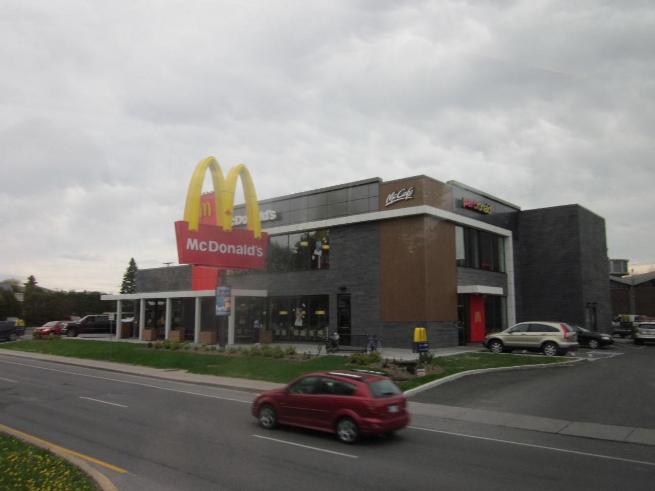
Proposed agenda Friday, May 20th
6:00 to 11:15 a.m. traveling to the province of Québec.
First stop at McDonald’s.
No French, no Food!

Slide 4
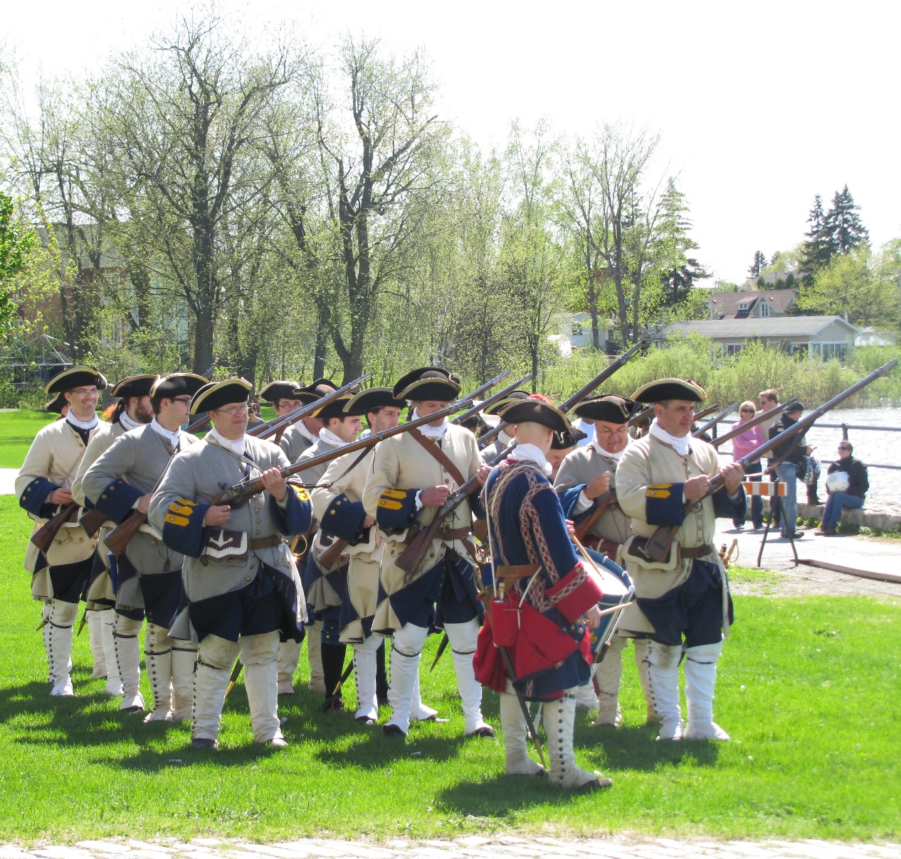
Proposed agenda Friday, May 20th
Fort Chambly.
Two activities:
Military uniforms of the Past
A French fort to Discover

Slide 5
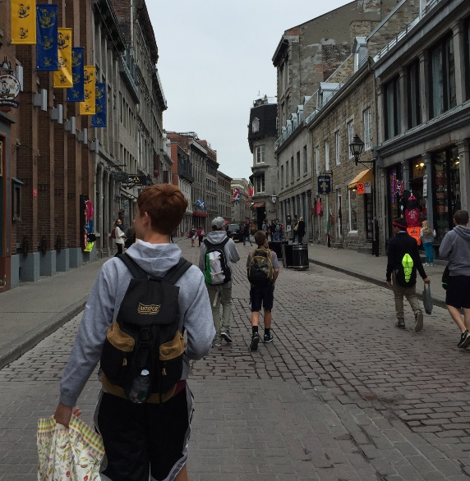
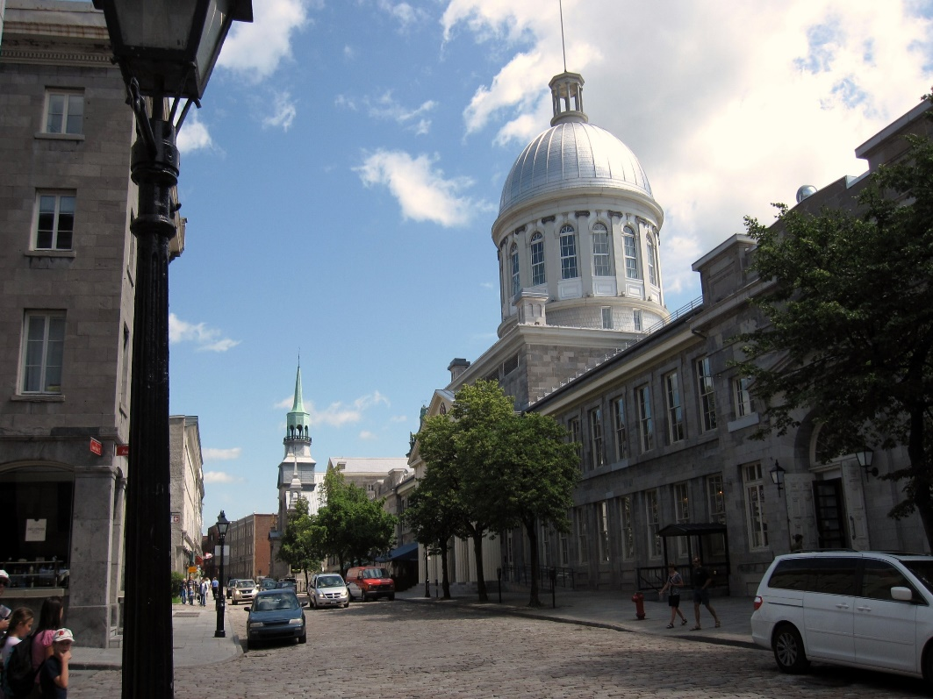
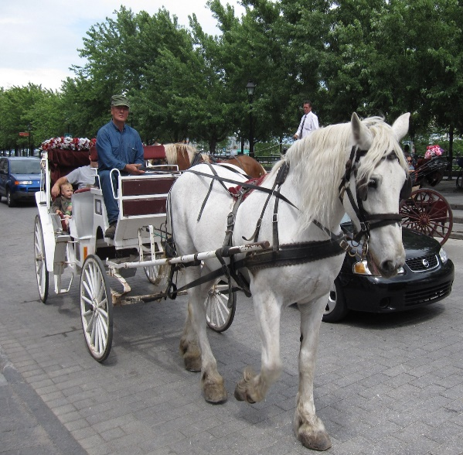
Proposed agenda Friday, May 20th
Mount Royal
Old Montréal
Check in at the Auberge for the night.

Slide 6
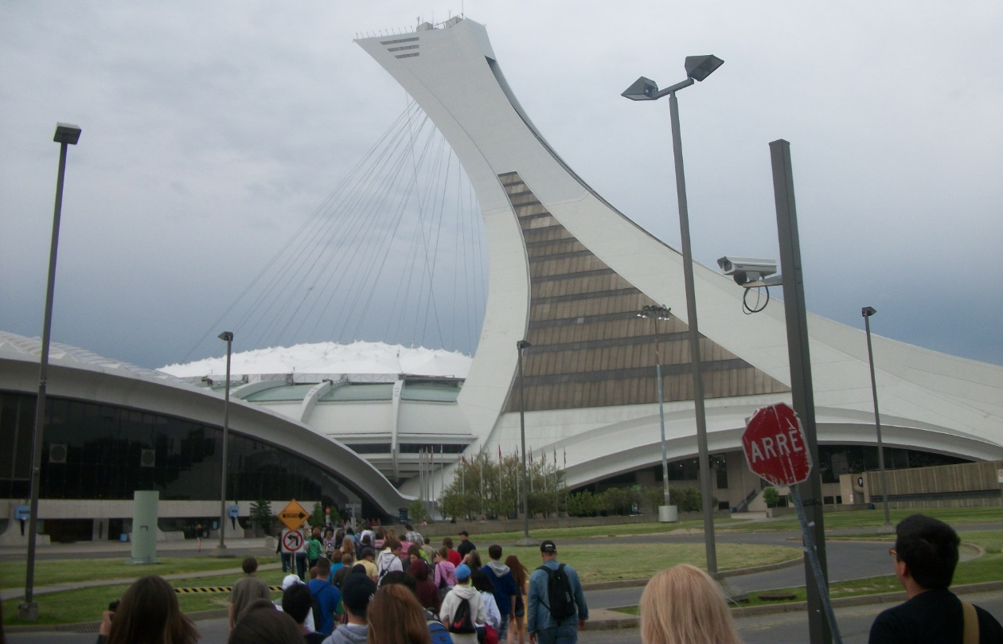
Proposed agenda Saturday, May 21st
French breakfast
Biodome and the Olympic Tower
The ecosystems:
Tropical Forest
Laurentian Maple forest &
Gulf of St. Lawrence
Labrador Coast
Sub-Antarctic Islands

Slide 7
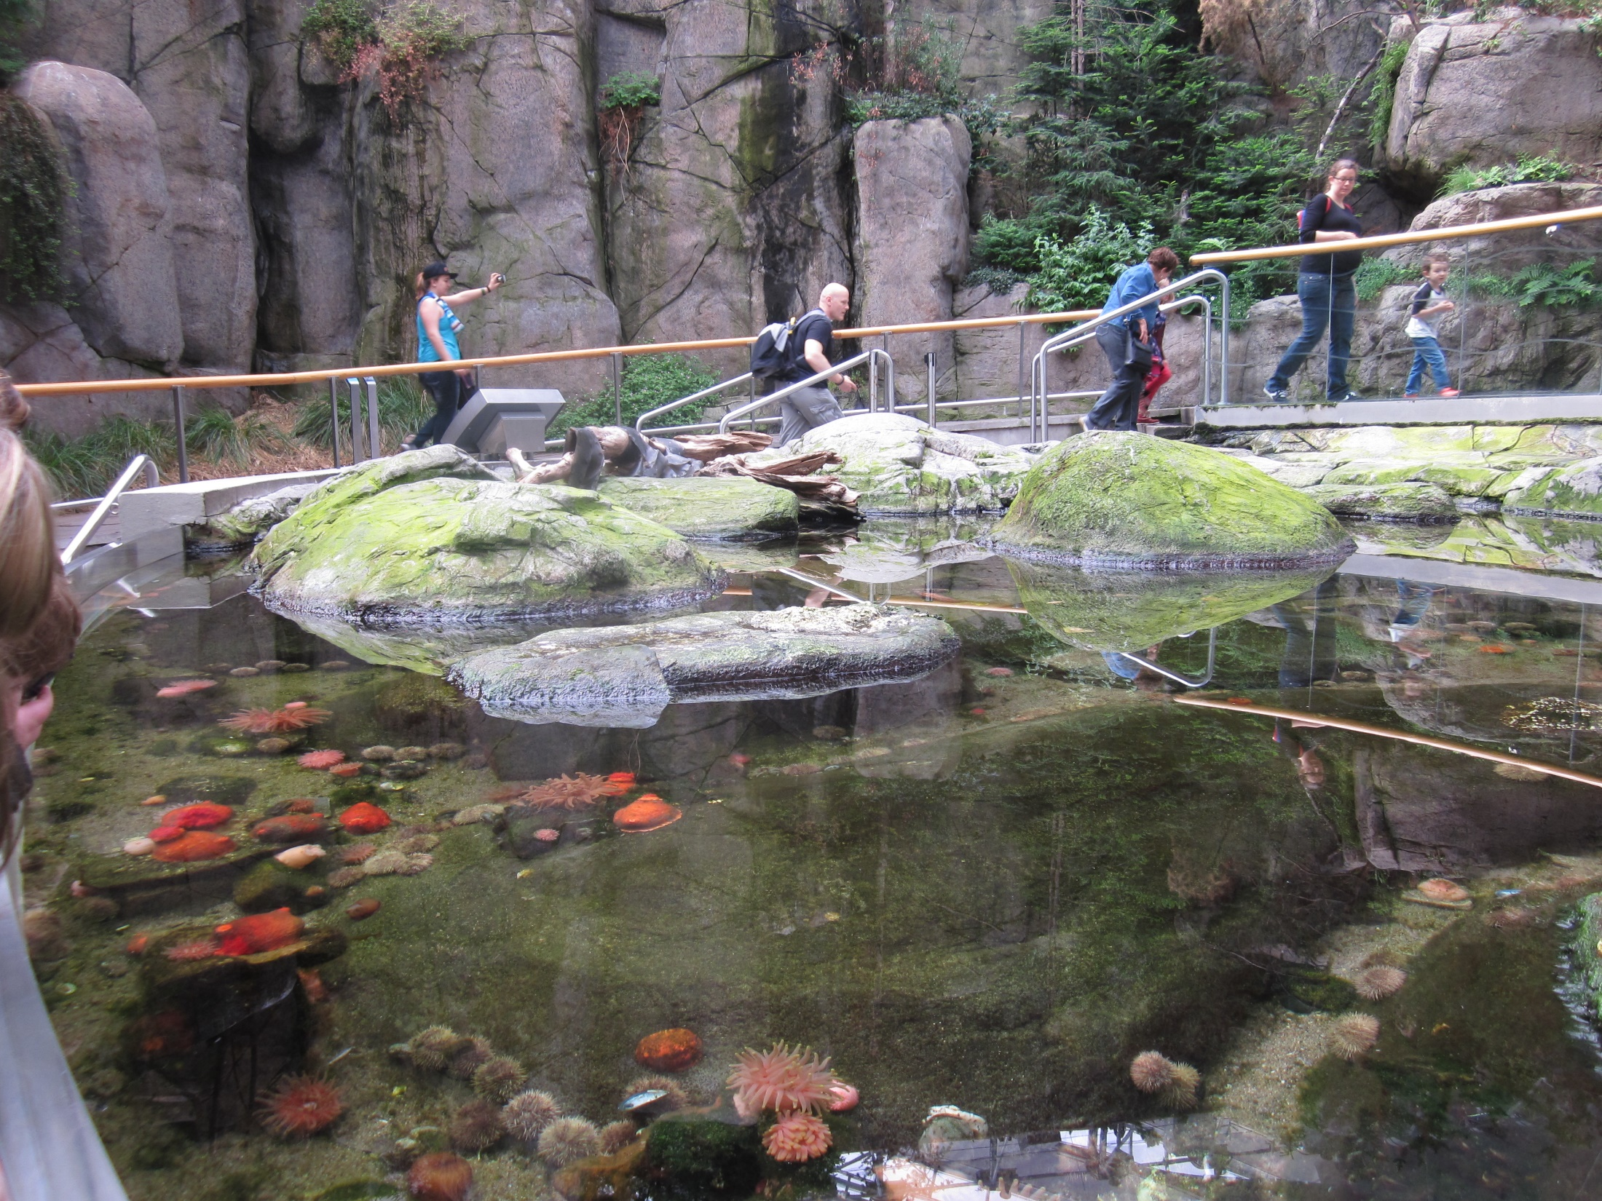

Slide 8
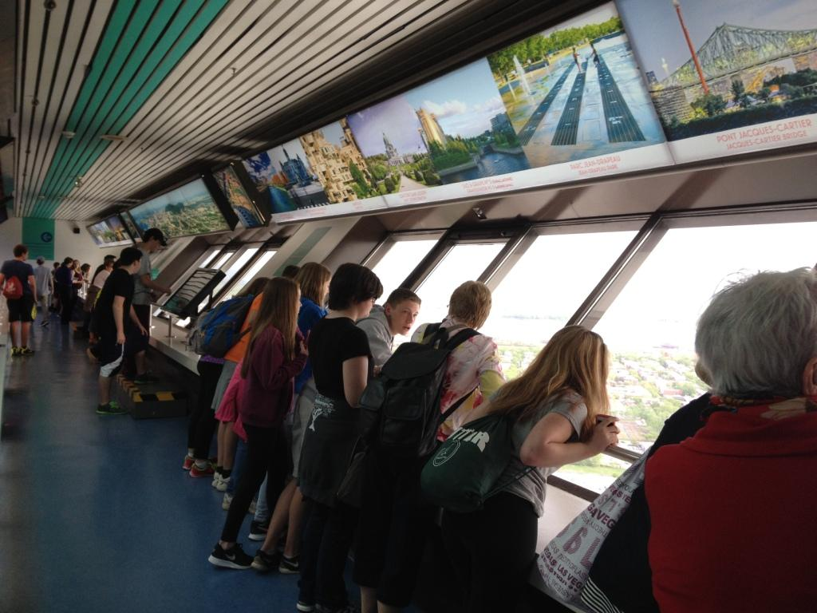
At the Olympic Tower

Slide 9
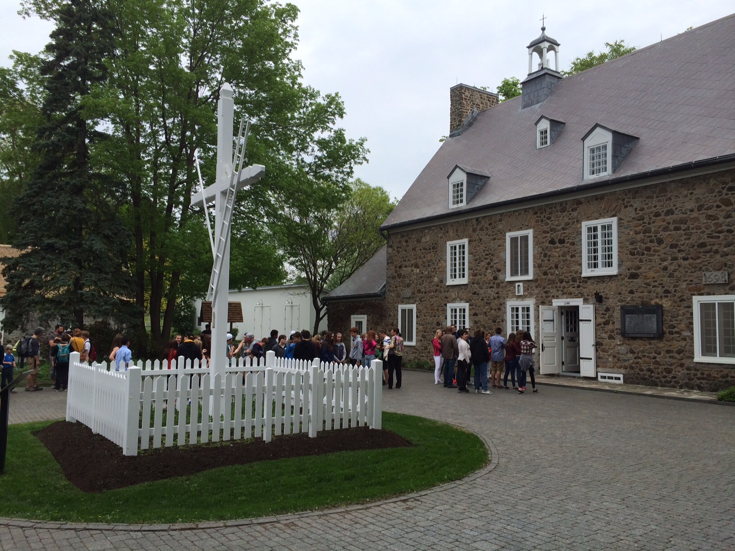
Proposed agenda Saturday, May 21st
La Maison St-Gabriel
en route for the United States.
TRMS, no later than 10:30 p.m.
Au revoir Montréal!

Slide 10
Safety/Organizational Measures prior to the trip:
Two meetings with chaperones to talk about their roles and expectations, the itinerary, distribution of money, etc.
Student medical information
Student’s parent/guardian contact info
Review of the medical forms by the nurse at TRMS
Day of the trip:
All chaperones will be provided with:
  Booklet with the pictures of all participants and cell numbers of all adults.
  Itinerary, city map and subway.
  Lists of the groups: chaperones and students; room numbers

Slide 11
Safety/Organizational Measures:
Day of the Trip
Designated staff member without an assigned group to take care of any student(s) who experience sickness/problems.
A school nurse travels with us.
Ratio of 6-8 students per chaperone.
Chaperones will take attendance throughout the day. Most of the day, we travel as a group except for the visit “Behind the scenes” at the Biodome.
Every student will have a partner that they are with at all times.
Emergency Meet-Up Spots will be designated in case of separation in Old Montréal and in the métro.

