Slide 1
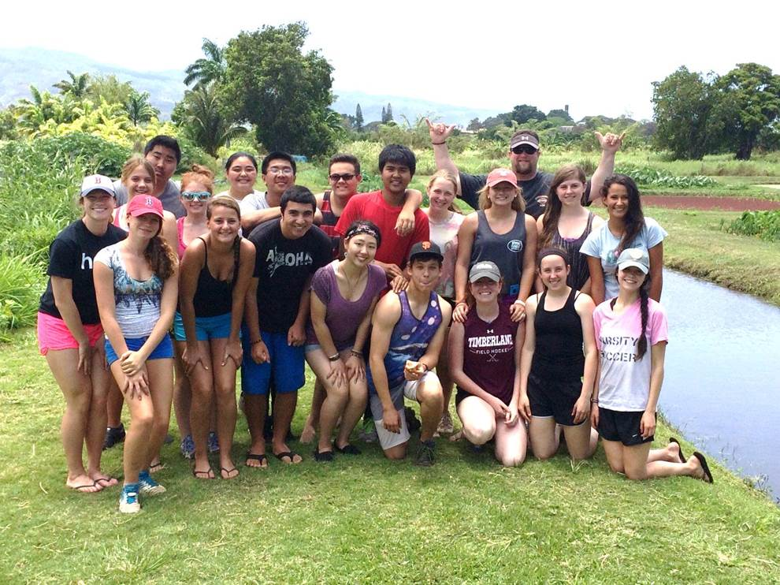
Kaulele Pueo:
Hawaiian cultural exchange
Friday April 22 – Sunday May 1
Depart from TRHS @ 4:00 am
Arrive at Boston Logan Airport for pickup

Slide 2
Purpose
Direct connection with US History/ Studies course content:
  United States enters WWII
  Statehood, 1959
Awaken a sense of exploration/travel
New perspectives, diversity
Exploring new cultures, language and ancient history

Slide 3
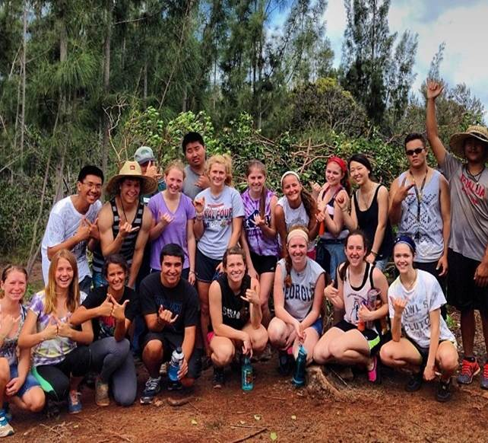
Proposed Agenda
Community Service Projects!
  Waimea Valley – the valley of the Kings – sacred burial caves of the Hawai’ian kings
      Clearing invasive species and replanting native trees
  Restoring the 88 acre Paepae He`eia Fish Pond
      Over 800 years old, partially destroyed by 100 year flood
  Work in a lo’i (Taro patch)

Slide 4
Proposed Agenda (cont’d)
Pearl Harbor (Arizona Memorial tour and museum)
Bishop Museum Tour
Dole Plantation tour
Waialua Intermediate/ High School
  Students will shadow hosts throughout the school day
Tour of North Shore – Haleiwa town, Waimea Bay, Sunset & Pipeline
Tour of East Shore/ East Side, Pali Lookout (final battle sight for unification of Hawaiian kingdom)

Slide 5
Proposed Agenda (cont’d)
Kamehameha High School
  Students will shadow hosts throughout the school day
  Tour of the Heritage Center and Chapel (On the Kamehameha Campus)
Tour `Iolani Palace (Royal Palace for the Kingdom of Hawai`i)
Possible day trip to the Big Island of Hawaii
  Volcano National Park – Kilauea, active volcano
  Rainbow falls
  Black sand beach
    Honu (Green Sea Turtle) nesting grounds

Slide 6
Safety/Organizational Measures:
Group will consist of 2 district administrators (CPR, First Aid and AED certified) with 13 students
How are we traveling on the ground? We will be traveling in two 7 passenger mini vans driven ONLY by the chaperones.
What about days where free time is scheduled? No matter the situation, students will NEVER TRAVEL ALONE either by foot or by car. There are 2 chaperones and students will be with at least one at all times!

Slide 7
Safety/Organizational Measures:
Both Chaperones have extensive experience running this trip and have collectively been to the islands over 35 times!
Chaperones will be have at all times:
  Student medical information
  Student’s parent/guardian contact info
  Group contacts
  Chaperone contacts
  NOTE: Honolulu is a major city, similar to Boston. Emergency services and Hospitals are easily accessible at all times throughout our trip. Our hotel even has a walk-in medical center!

Slide 8
Student cost
(School/ District cost = $0)
Cost of trip for students: $2,500
Includes:
            Roundtrip Air
            8 Nights Hotel
            Daily Ground Transportation to all events/tours
            Admission to 2 museums and Cultural Learning Center
What is the estimated cost for meals and admissions? A safe estimate would be $400. Although some meals will be covered by our hosts, we will be on our own for several meals.

Slide 9
Living arrangements
Where will we be staying?
Sheraton Princess Kaiulani Waikiki 120 Kaiulani Avenue
Honolulu, HI 96815
Phone: (808) 922-5811
Fax: (808) 931-4577
What are the room arrangements? All students and chaperones will be in the same hotel. Students will be 2 to a room. There will be ONLY males or ONLY females in each room. 10:00 curfew will be in effect unless events keep us out later and student’s rooms will be checked by a chaperone.

Slide 10
Chaperone Contact Information
Bill Mealey Scott Strainge
Dean of Attendance Director of Alternative and Continuing Ed
Timberlane Reg School District Timberlane Regional High School
william.mealey@timberlane.net scott.strainge@timberlane.net
603-382-6541 Ext 3902 603-382-6541 Ext 3907
Heather Roy
Assistant Principal
Timberlane Regional High School
Heather.roy@timberlane.net
603-382-6541 Ext 3904

