Slide 1
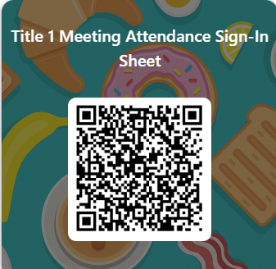
Snowden ScHool
Annual Title 1 Parent Meeting 2025-26 While you wait, please take a moment and sign in

Slide 2
2015 Every Student Succeeds Act(ESSA)
Title 1 is a component of the federal ESSA act
Title 1 provides federal funding that allows the school to provide programs, supplies, and materials for all students at Snowden.
Title 1ensures that all stakeholders are kept informed of circumstances impacting academic achievement at the school.

Slide 3
Parental Notifications and Feedback
Title 1 provides access to the following documents: These documents are the Parent’s Right to Know, The Snowden Family Engagement Plan and the Parent Compact.
Title 1 collects parent feedback throughout the year.
Visit our website to find the links to Title 1 documents and parental feedback survey*
The MSCS handbook and Student Code of Conduct are accessible here.

Slide 4
PARENT’S Right to know
I. Title I Parent’s Right to Know
All parents have the right to request the following:
A teacher’s professional qualifications, licensure, grade(s) certification, waivers
A teacher’s baccalaureate and/or graduate degree, fields of endorsement, previous teaching experience
A paraprofessional’s qualifications
An annual notice of Student Education Records Privacy and notice for disclosure of School Directory Information
An assurance that their child’s name, address and telephone listing not be released to military recruiters
Timely notice that their child has been assigned, or has been taught for four or more consecutive weeks by, a teacher who is not highly qualified

Slide 5
Family Engagement
Parental Involvement
In an effort to draw the school experience into our students’ home lives, we will encourage parents to do the following:
Serve on the site-based leadership team
Attend grade level meetings, parent meetings, parent conferences, programs and PTA meetings
Volunteer their talents / services / time to the instructional program and other school activities

Slide 6
School Compact
(Covers expectations for all stakeholders)
Parents (ex. See that my child attends school regularly and arrives on time by 8:15 AM)
Students (ex. Understand that my student issued computer is not my personal property and make efforts not to damage, lose it, or use it inappropriately. )
Teachers (ex. Encourage / inform students by providing information about student progress on assignments and major tests such as TCAP, Iready, and other common formative assessments. )
Administration (Provide a safe, supportive, effective, and positive environment that allows for positive communication among the teachers, parents, and students)

Slide 7
School Communications/Reporting student progress
There are many ways to receive school-wide communications:
Black Board
Email, Text and Phone
Social Media – Snowden Facebook & Snowden PTO Facebook
Marquee (in front of the school)
Monthly Family Calendar
Annual Parent Meetings
Grade Level Newsletters
Class Dojo
Face-to-Face Meetings
Remind
PTO Meetings and PTO Calendar
Powerschool

Slide 8
District-Wide Conferences and
Student progress Dates
Parent Teacher Conference
Middle School: September 9th, 2025, 4:00-7:00 PM
Elementary School: September 11th, 2025, 4:00-7:00 PM
Middle School: January 27th, 2026, 4:00-7:00 PM
Elementary School: January 29th, 2026, 4:00-7:00 PM
Student grades are accessible on a daily basis through the Powerschool Portal. The following dates are when the quarters end:
October 3rd , 2025
December 19th, 2025
March 13th, 2026
May 21st, 2026

Slide 9

parent Support
Snowden hosts a variety of activities throughout the year.
Data Nights will be held each semester to assist parents in understanding their child’s data.
3rd Grade Commitment meetings will be held to assist elementary parents in understanding the state laws regarding 3rd grade.

Slide 10
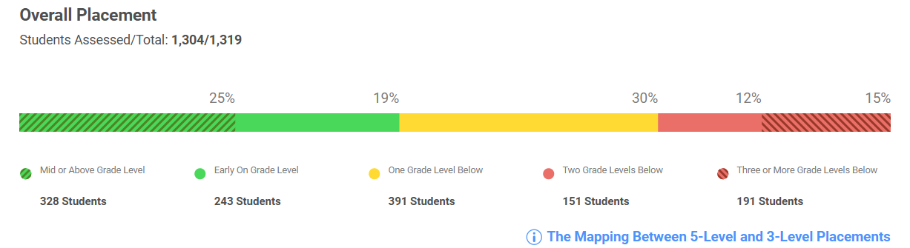
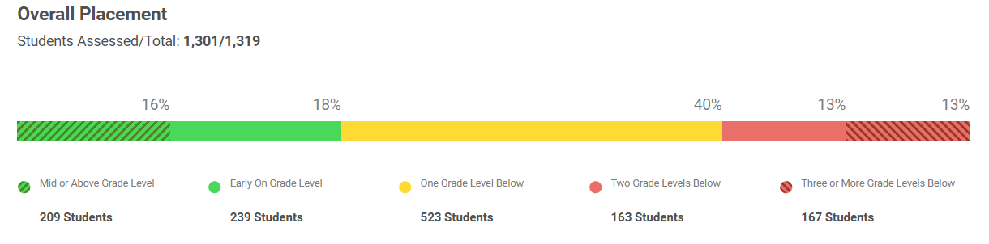
School-Wide Data 2025-26
TNReady school-level data is currently embargoed.
Iready 2025 Data is as follows:
25% of students scored mid or above grade level for ELA. 19% scored early on grade level.
16% of students scored mid or above grade level for math. 18% scored early on grade level.

Slide 11
School improvement Plan: The school develops a SIP each school year to document Title 1 activities and to account for expenditures.
Goals and the associated strategies: Reading/Language Arts Standard aligned core instruction Professional development Targeted intervention and personalized learning Early Literacy Mathematics Standard aligned core instruction Professional development Targeted intervention and personalized learning

Slide 12
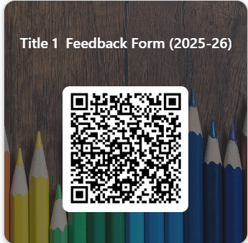
Parental Feedback
Please provide feedback to us throughout the year and reach out to us if you have questions.
Stephanye Jimerson, K-5 jimersonsl@scsk12.org
Susan D. McClanahan, 6-8
mcclanahansd@scsk12.org

